Slide 1
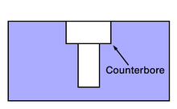
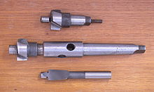
A counterbore
A counterbore (symbol: ⌴) is a cylindrical flat-bottomed hole that enlarges another coaxial hole, or the tool used to create that feature. A counterbore hole is typically used when a fastener, such as a socket head cap screw, is required to sit flush with or below the level of a workpiece's surface.

Slide 2
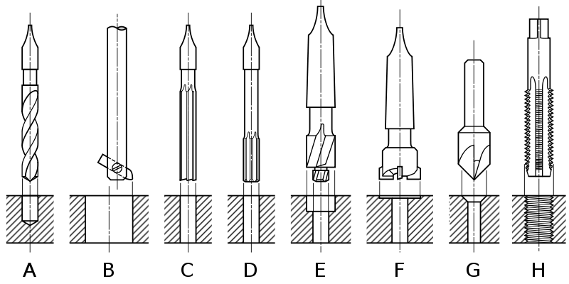
A spotface
A spotface or spot face is a machined feature in which a certain region of the workpiece (a spot) is faced, providing a smooth, flat, accurately located surface. This is especially relevant on workpieces cast or forged, where the spotface's smooth, flat, accurately located surface stands in distinction to the surrounding surface whose roughness, flatness, and location are subject to wider tolerances and thus not assured with a machining level of precision. The most common

Slide 3
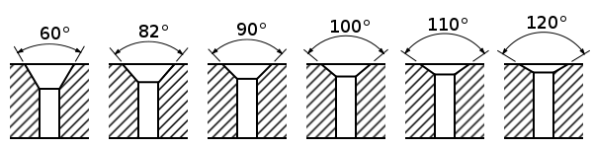
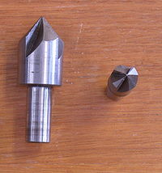
countersink
countersink (symbol: ⌵) is a conical hole cut into a manufactured object, or the cutter used to cut such a hole. A common use is to allow the head of a countersunk bolt or screw, when placed in the hole, to sit flush with or below the surface of the surrounding material (by comparison, a counterbore makes a flat-bottomed hole that might be used with a socket-head capscrew).

Slide 4
