Slide 1
9
Accounting for Receivables
Learning Objectives
1
Explain how companies recognize accounts receivable.
2
Describe how companies value accounts receivable and record their disposition.
Explain how companies recognize notes receivable.
3
Describe how companies value notes receivable, record their disposition, and present and analyze receivables.
4

Slide 2

LEARNING
OBJECTIVE
Explain how companies recognize accounts receivable.
1
Amounts due from individuals and other companies that are expected to be collected in cash.
Amounts owed by customers on account that result from the sale of goods and services.
Written promise for amounts to be received. Normally requires the collection of interest.
Nontrade receivables such as interest, loans to officers, advances to employees, and income taxes.
Accounts Receivable
Notes Receivable
Other Receivables
LO 1

Slide 3
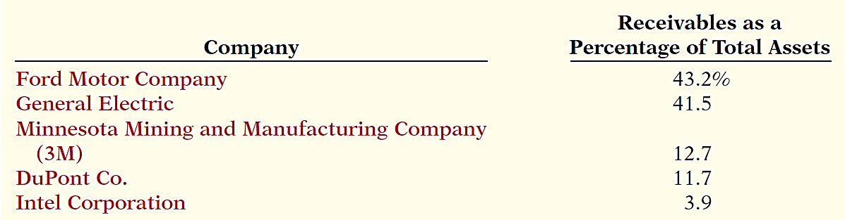
Types of Receivables
Amounts due from individuals and other companies
that are expected to be collected in cash.
Illustration 9-1
Receivables as a percentage
of assets
LO 1

Slide 4
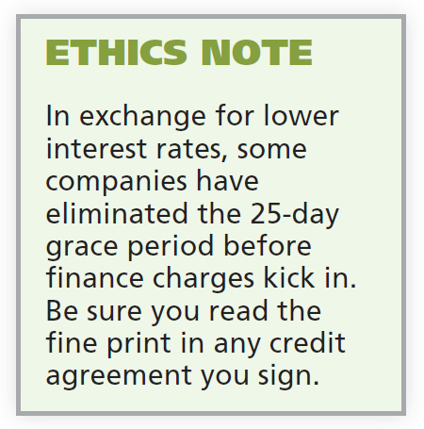
Types of Receivables
Three accounting issues:
  Recognizing accounts receivable.
  Valuing accounts receivable.
  Disposing of accounts receivable.
Recognizing Accounts Receivable
Service organization records a receivable when it performs service on account.
Merchandiser records accounts receivable at the point of sale of merchandise on account.
LO 1

Slide 5
Recognizing Accounts Receivables
Illustration: Assume that Jordache Co. on July 1, 2017, sells merchandise on account to Polo Company for $1,000 terms 2/10, n/30. Prepare the journal entry to record this transaction on the books of Jordache Co.
Jul. 1
Accounts Receivable 1,000
Sales Revenue 1,000
LO 1

Slide 6
Recognizing Accounts Receivables
Illustration: On July 5, Polo returns merchandise worth $100 to Jordache Co.
Jul. 5
Sales Returns and Allowances 100
Accounts Receivable 100
Illustration: On July 11, Jordache receives payment from
Polo Company for the balance due.
Jul. 11
Cash 882
Sales Discounts ($900 x .02) 18
Accounts Receivable 900
LO 1

Slide 7
ANATOMY OF A FRAUD
Tasanee was the accounts receivable clerk for a large non-profit foundation that provided performance and exhibition space for the performing and visual arts. Her responsibilities included activities normally assigned to an accounts receivable clerk, such as recording revenues from various sources that included donations, facility rental fees, ticket revenue, and bar receipts. However, she was also responsible for handling all cash and checks from the time they were received until the time she deposited them, as well as preparing the bank reconciliation. Tasanee took advantage of her situation by falsifying bank deposits and bank reconciliations so that she could steal cash from the bar receipts. Since nobody else logged the donations or matched the donation receipts to pledges prior to Tasanee receiving them, she was able to offset the cash that was stolen against donations that she received but didn’t record. Her crime was made easier by the fact that her boss, the company’s controller, only did a very superficial review of the bank reconciliation and thus didn’t notice that some numbers had been cut out from other documents and taped onto the bank reconciliation.
Total take: $1.5 million
THE MISSING CONTROL
Segregation of duties. The foundation should not have allowed an accounts receivable clerk, whose job was to record receivables, to also handle cash, record cash, make deposits, and especially prepare the bank reconciliation.
Independent internal verification. The controller was supposed to perform a thorough review of the bank reconciliation. Because he did not, he was terminated from his position.
LO 1

Slide 8
DO IT!
1
Recognizing Accounts Receivable
On May 1, Wilton sold merchandise on account to Bates for $50,000 terms 3/15, net 45. On May 4, Bates returns merchandise with a sales price of $2,000. On May 16, Wilton receives payment from Bates for the balance due. Prepare journal entries to record the May transactions on Wilton’s books.
May 1
Accounts Receivable—Bates 50,000
Sales Revenue 50,000
Sales Returns and Allowances 2,000
Accounts Receivable—Bates 2,000
Cash ($48,000 - $1,440) 46,560
Sales Discounts ($48,000 x .03) 1,440
Accounts Receivable—Bates 48,000
4
16
LO 1

Slide 9
LEARNING
OBJECTIVE
Describe how companies value accounts receivable and record their disposition.
2
Valuing Accounts Receivables
Alternative Terminology
You will sometimes see
Bad Debt Expense called
Uncollectible Accounts
Expense.
Current asset.
Valuation (cash realizable value).
Uncollectible Accounts Receivable
Sales on account raise the possibility of accounts not being collected.
Companies record credit losses as debits to Bad Debt Expense.
LO 2

Slide 10
Valuing Accounts Receivable
Methods of Accounting for Uncollectible Accounts
Direct Write-Off
Theoretically undesirable:
  No matching.
  Receivable not stated at cash realizable value.
  Not acceptable for financial reporting.
Allowance Method
Losses are estimated:
  Better matching.
  Receivable stated at cash realizable value.
  Required by GAAP.
LO 2

Slide 11
Valuing Accounts Receivable
How are these accounts presented on the Balance Sheet?
Allowance for Doubtful Accounts
Accounts Receivable
Beg. 500
25 Beg.
End. 500
25 End.
LO 2

Slide 12
Valuing Accounts Receivable
LO 2

Slide 13
Valuing Accounts Receivable
Alternate Presentation
LO 2

Slide 14
Valuing Accounts Receivable
Journal entry for credit sale of $100?
Accounts Receivable 100
Sales 100
Allowance for Doubtful Accounts
Accounts Receivable
Beg. 500
25 Beg.
End. 500
25 End.
LO 2

Slide 15
Valuing Accounts Receivable
Journal entry for credit sale of $100?
Accounts Receivable 100
Sales 100
Allowance for Doubtful Accounts
Accounts Receivable
Beg. 500
25 Beg.
Sale 100
End. 600
25 End.
LO 2

Slide 16
Valuing Accounts Receivable
Collected $333 on account?
Cash 333
Accounts Receivable 333
Allowance for Doubtful Accounts
Accounts Receivable
Beg. 500
25 Beg.
Sale 100
End. 600
25 End.
LO 2

Slide 17
Valuing Accounts Receivable
Collected $333 on account?
Cash 333
Accounts Receivable 333
Allowance for Doubtful Accounts
Accounts Receivable
Beg. 500
25 Beg.
Sale 100
333 Coll.
End. 267
25 End.
LO 2

Slide 18
Valuing Accounts Receivable
Adjustment of $15 for estimated bad debts?
Bad Debt Expense 15
Allowance for Doubtful Accounts 15
Allowance for Doubtful Accounts
Accounts Receivable
Beg. 500
25 Beg.
Sale 100
333 Coll.
End. 267
25 End.
LO 2

Slide 19
Valuing Accounts Receivable
Adjustment of $15 for estimated bad debts?
Bad Debt Expense 15
Allowance for Doubtful Accounts 15
Allowance for Doubtful Accounts
Accounts Receivable
Beg. 500
25 Beg.
Sale 100
333 Coll.
15 Est.
End. 267
40 End.
LO 2

Slide 20
Valuing Accounts Receivable
Write-off of uncollectible accounts for $10?
Allowance for Doubtful Accounts 10
Accounts Receivable 10
Allowance for Doubtful Accounts
Accounts Receivable
Beg. 500
25 Beg.
Sale 100
333 Coll.
15 Est.
End. 267
40 End.
LO 2

Slide 21
Valuing Accounts Receivable
Write-off of uncollectible accounts for $10?
Allowance for Doubtful Accounts 10
Accounts Receivable 10
Allowance for Doubtful Accounts
Accounts Receivable
Beg. 500
25 Beg.
Sale 100
333 Coll.
15 Est.
10 W/O
W/O 10
End. 257
30 End.
LO 2

Slide 22
Valuing Accounts Receivable
LO 2

Slide 23
Valuing Accounts Receivable
DIRECT WRITE-OFF METHOD FOR UNCOLLECTIBLE ACCOUNTS
Illustration: Assume that Warden Co. writes off M. E. Doran’s $200 balance as uncollectible on December 12. Warden’s entry is:
Bad Debt Expense 200
Accounts Receivable—M. E. Doran 200
Theoretically undesirable:
  No matching.
  Receivable not stated at cash realizable value.
  Not acceptable for financial reporting.
LO 2

Slide 24
Accounts Receivable
ALLOWANCE METHOD FOR UNCOLLECTIBLE ACCOUNTS
Companies estimate uncollectible accounts receivable.
Debit Bad Debt Expense and credit Allowance for Doubtful Accounts (a contra-asset account).
Companies debit Allowance for Doubtful Accounts and credit Accounts Receivable at the time the specific account is written off as uncollectible.
LO 2

Slide 25
ALLOWANCE METHOD
RECORDING ESTIMATED UNCOLLECTIBLES
Illustration: Hampson Furniture has credit sales of $1,200,000 in 2017, of which $200,000 remains uncollected at December 31. The credit manager estimates that $12,000 of these sales will prove uncollectible.
Dec. 31
Bad Debt Expense 12,000
Allowance for Doubtful Accounts 12,000
LO 2

Slide 26
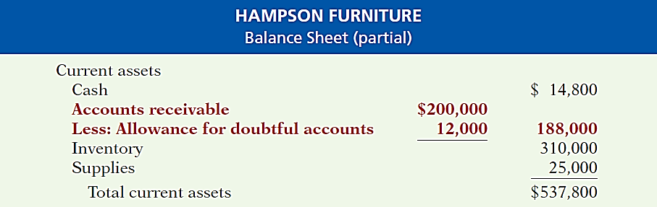
RECORDING UNCOLLECTIBLES
Illustration 9-3
Presentation of allowance
for doubtful accounts
The amount of $188,000 represents the expected cash realizable value of the accounts receivable at the statement date.
LO 2

Slide 27
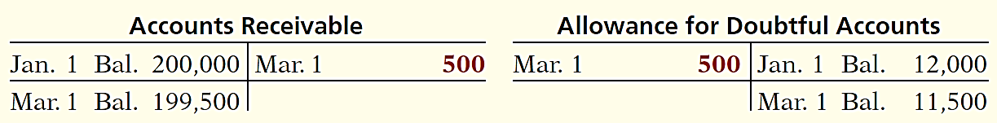
ALLOWANCE METHOD
RECORDING WRITE-OFF OF AN UNCOLLECTIBLE ACCOUNT
Illustration: The vice-president of finance of Hampson Furniture on March 1, 2018, authorizes a write-off of the $500 balance owed by R. A. Ware. The entry to record the write-off is:
Mar. 1
Allowance for Doubtful Accounts 500
Accounts Receivable—R. A. Ware 500
Illustration 9-4 General ledger balances after write-off
LO 2

Slide 28
ALLOWANCE METHOD
RECOVERY OF AN UNCOLLECTIBLE ACCOUNT
Illustration: On July 1, R. A. Ware pays the $500 amount that Hampson had written off on March 1. Hampson makes these entries:
July 1
Accounts Receivable—R. A. Ware 500
Allowance For Doubtful Accounts 500
1
Cash 500
Accounts Receivable—R. A. Ware 500
LO 2

Slide 29
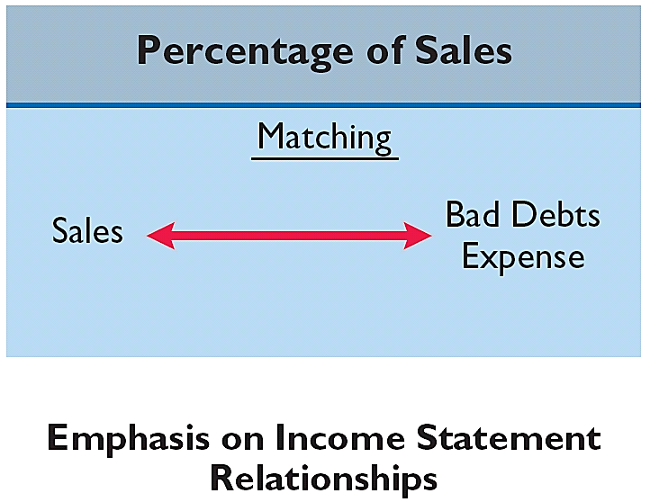
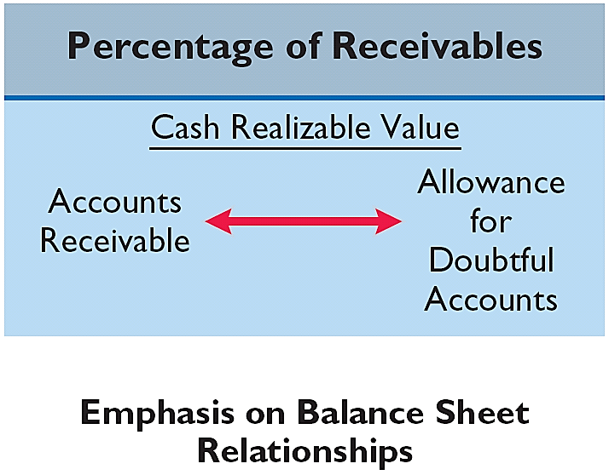
ALLOWANCE METHOD
ESTIMATING THE ALLOWANCE
Illustration 9-6
Comparison of bases for
estimating uncollectibles
LO 2

Slide 30
ALLOWANCE METHOD
ESTIMATING THE ALLOWANCE
Illustration 9-6
Comparison of bases for
estimating uncollectibles
Management estimates what percentage of credit sales will be uncollectible. This percentage is based on past experience and anticipated credit policy.
LO 2

Slide 31
ALLOWANCE METHOD
Percentage-of-Sales
Illustration: Assume that Gonzalez Company elects to use
the percentage-of-sales basis. It concludes that 1% of net credit sales will become uncollectible. If net credit sales for 2017 are $800,000, the adjusting entry is:
Dec. 31
Bad Debt Expense 8,000
*
Allowance For Doubtful Accounts 8,000
* $800,000 x 1%
LO 2

Slide 32
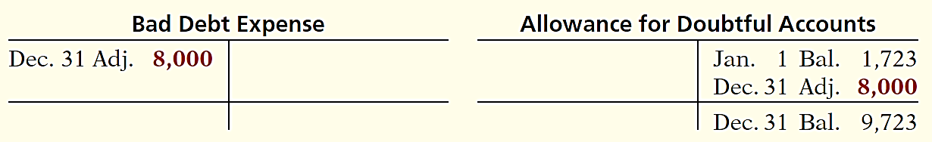
ALLOWANCE METHOD
Percentage-of-Sales
  Emphasizes matching of expenses with revenues.
  Adjusting entry to record bad debts disregards the existing balance in Allowance for Doubtful Accounts.
Illustration 9-7 Bad debt accounts after posting
LO 2

Slide 33
ALLOWANCE METHOD
ESTIMATING THE ALLOWANCE
Illustration 9-6
Comparison of bases for
estimating uncollectibles
Management establishes a percentage relationship between the amount of receivables and expected losses from uncollectible accounts.
LO 2

Slide 34
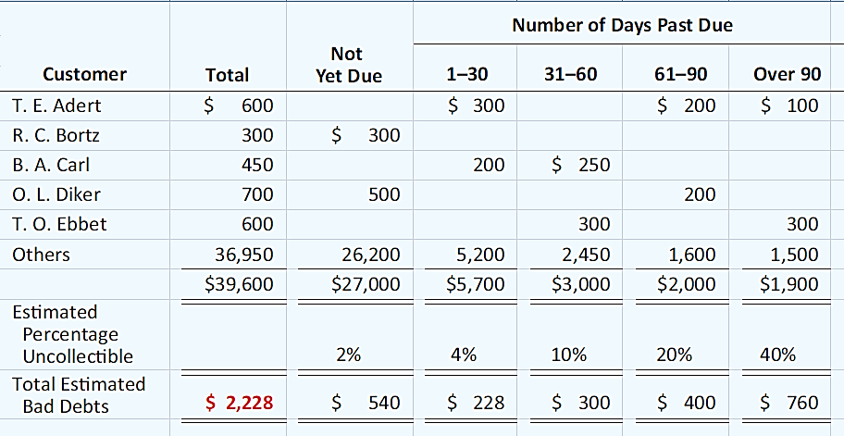
ALLOWANCE METHOD
Helpful Hint Where appropriate, companies may use only a single percentage rate.
Aging the accounts receivable - customer balances are classified by the length of time they have been unpaid.
Illustration 9-8
LO 2

Slide 35
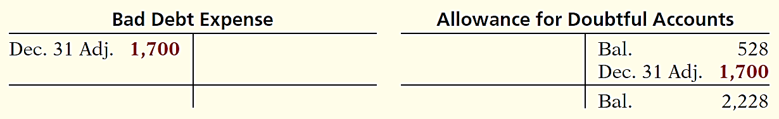
ALLOWANCE METHOD
ESTIMATING THE ALLOWANCE
Illustration: Assume the unadjusted trial balance shows Allowance for Doubtful Accounts with a credit balance of $528. Prepare the adjusting entry assuming $2,228 is the estimate of uncollectible receivables from the aging schedule.
Dec. 31
Bad Debt Expense 1,700
Allowance For Doubtful Accounts 1,700
Illustration 9-9 Bad debts accounts after posting
LO 2

Slide 36
Disposing of Accounts Receivables
Companies sell receivables for two major reasons.
  Receivables may be the only reasonable source of cash.
  Billing and collection are often time-consuming and costly.
LO 2

Slide 37
Disposing of Accounts Receivables
SALE OF RECEIVABLES
Factor
  Finance company or bank.
  Buys receivables from businesses and then collects the payments directly from the customers.
  Typically charges a commission to the company that is selling the receivables.
  Fee ranges from 1-3% of the receivables purchased.
LO 2

Slide 38
SALE OF RECEIVABLES
Illustration: Assume that Hendredon Furniture factors
$600,000 of receivables to Federal Factors. Federal Factors assesses a service charge of 2% of the amount of receivables sold. The journal entry to record the sale by Hendredon Furniture is as follows.
($600,000 x 2% = $12,000)
Cash 588,000
Service Charge Expense 12,000
Accounts Receivable 600,000
LO 2

Slide 39
Disposing of Accounts Receivables
CREDIT CARD SALES
  Recorded the same as cash sales.
  Retailer pays card issuer a fee of 2 to 6% for processing the transactions.
LO 2

Slide 40
CREDIT CARD SALES
Illustration: Anita Ferreri purchases $1,000 of compact discs for her restaurant from Karen Kerr Music Co., using her Visa First Bank Card. First Bank charges a service fee of 3%. The entry to record this transaction by Karen Kerr Music is as follows.
Cash 970
Service Charge Expense 30
Sales Revenue 1,000
LO 2

Slide 41
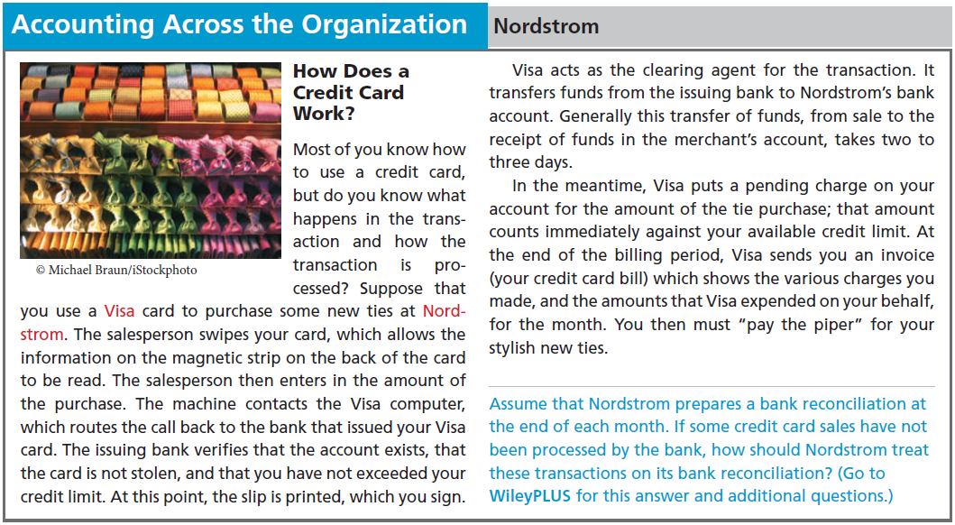
LO 2

Slide 42
DO IT!
2
Uncollectible Accounts Receivable
Brule Co. has been in business five years. The ledger at the end of the current year shows:
Accounts Receivable $30,000 Dr.
Sales Revenue $180,000 Cr.
Allowance for Doubtful Accounts $2,000 Dr.
Bad debts are estimated to be 10% of receivables. Prepare the entry to adjust Allowance for Doubtful Accounts.
Solution:
Bad Debt Expense 5,000
*
Allowance for Doubtful Accounts 5,000
* [(0.1 x $30,000) + $2,000]
LO 2

Slide 43
LEARNING
OBJECTIVE
Explain how companies recognize notes receivable.
3
Companies may grant credit in exchange for a promissory note. A promissory note is a written promise to pay a specified amount of money on demand or at a definite time.
Promissory notes may be used
  when individuals and companies lend or borrow money,
  when amount of transaction and credit period exceed normal limits, or
  in settlement of accounts receivable.
LO 3

Slide 44
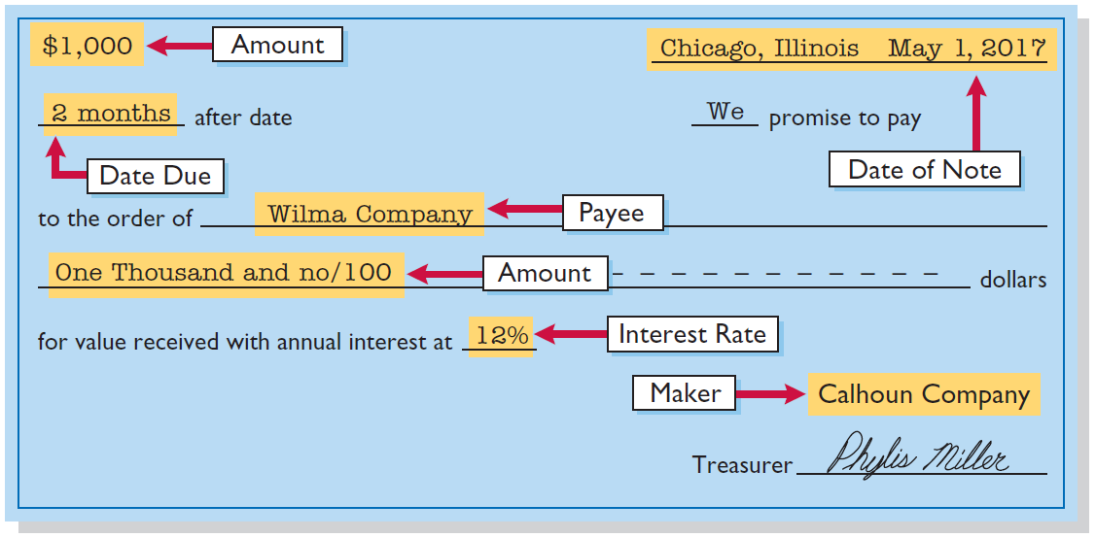
Notes Receivable
To the Payee, the promissory note is a note receivable.
To the Maker, the promissory note is a note payable.
Illustration 9-11
LO 3

Slide 45

Notes Receivable
Determining the Maturity Date
Note expressed in terms of
  Months
  Days
Computing Interest
Illustration 9-14 Formula for computing interest
LO 3

Slide 46
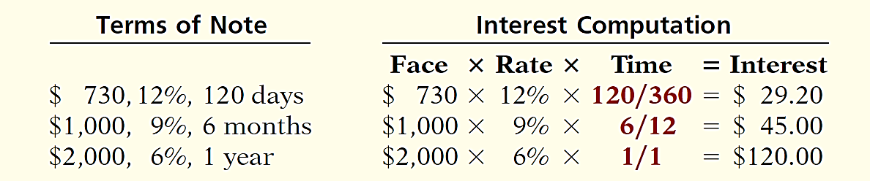
Notes Receivable
Computing Interest
When counting days, omit the date the note is issued, but include the due date.
Illustration 9-15
Helpful Hint
The interest rate specified is the annual rate.
LO 3

Slide 47
Recognizing Notes Receivable
Illustration: Calhoun Company wrote a $1,000, two-month, 12% promissory note dated May 1, to settle an open account. Prepare entry would Wilma Company makes for the receipt of the note.
May 1
Notes Receivable 1,000
Accounts Receivable 1,000
LO 3

Slide 48
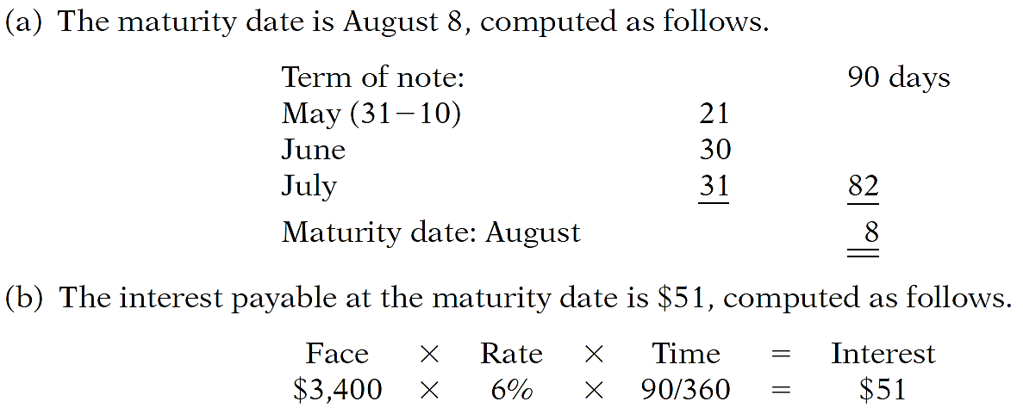
DO IT!
3
Recognizing Notes Receivable
Gambit Stores accepts from Leonard Co. a $3,400, 90-day, 6% note dated May 10 in settlement of Leonard’s overdue account. (a) What is the maturity date of the note? (b) What is the interest payable at the maturity date?
LO 3

Slide 49
LEARNING
OBJECTIVE
Describe how companies value notes receivable, record their disposition, and present and analyze receivables.
4
Valuing Notes Receivable
Report short-term notes receivable at their cash (net) realizable value.
Estimation of cash realizable value and bad debt expense are done similarly to accounts receivable.
Allowance for Doubtful Accounts is used.
LO 4

Slide 50
Notes Receivable
Disposing of Notes Receivable
Notes may be held to their maturity date.
Maker may default and payee must make an adjustment to the account.
Holder speeds up conversion to cash by selling the note receivable.
LO 4

Slide 51
Disposing of Notes Receivable
HONOR OF NOTES RECEIVABLE
Maker pays it in full at its maturity date.
DISHONOR OF NOTES RECEIVABLE
Not paid in full at maturity.
No longer negotiable.
LO 4

Slide 52
HONOR OF NOTES RECEIVABLE
Illustration: Wolder Co. lends Higley Co. $10,000 on June 1, accepting a five-month, 9% interest note. If Wolder presents the note to Higley Co. on November 1, the maturity date, Wolder’s entry to record the collection is:
Nov. 1
Cash 10,375
Notes Receivable 10,000
Interest Revenue 375
($10,000 x 9% x 5/12 = $375)
LO 4

Slide 53

ACCRUAL OF INTEREST RECEIVABLE
Illustration: Suppose instead that Wolder Co. prepares financial statements as of September 30. The adjusting entry by Wolder is for four months ending Sept. 30.
Illustration 9-16
Timeline of interest earned
Sept. 30
Interest Receivable 300
Interest Revenue 300
($10,000 x 9% x 4/12 = $300)
LO 4

Slide 54
ACCRUAL OF INTEREST RECEIVABLE
Illustration: Prepare the entry Wolder’s would make to record the honoring of the Higley note on November 1.
Nov. 1
Cash 10,375
Notes Receivable 10,000
Interest Receivable 300
Interest Revenue 75
LO 4

Slide 55
DISHONOR OF NOTES RECEIVABLE
Illustration: Assume that Higley Co. on November 1 indicates that it cannot pay at the present time. If Wolder Co. does expect eventual collection, it would make the following entry at the time the note is dishonored (assuming no previous accrual of interest).
Nov. 1
Accounts Receivable 10,375
Notes Receivable 10,000
Interest Revenue 375
LO 4

Slide 56
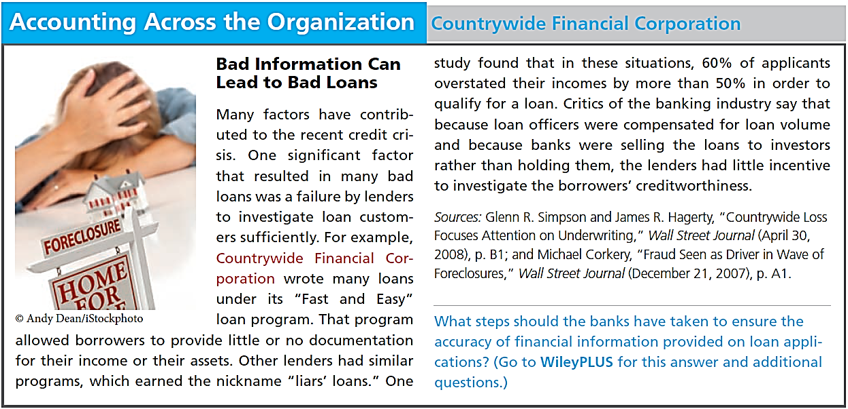
LO 4

Slide 57
Statement Presentation and Analysis
PRESENTATION
Identify in the balance sheet or in the notes each major type of receivable.
Report short-term receivables as current assets.
Report both gross amount of receivables and allowance for doubtful account.
Report bad debt expense and service charge expense as selling expenses.
Report interest revenue under “Other revenues and gains.”
B/S
I/S
LO 4

Slide 58
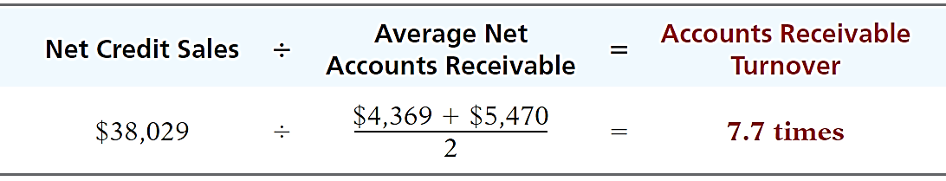
Statement Presentation and Analysis
ANALYSIS
Illustration: In 2013 Cisco Systems had net sales of $38,029 million for the year. It had a beginning accounts receivable (net) balance of $4,369 million and an ending accounts receivable (net) balance of $5,470 million. Assuming that Cisco’s sales were all on credit, its accounts receivable turnover is computed as follows.
Illustration 9-17
Accounts receivable turnover
and computation
LO 4

Slide 59

Statement Presentation and Analysis
ANALYSIS
Illustration: Variant of the accounts receivable turnover ratio is average collection period in terms of days.
Illustration 9-17
Illustration 9-18
LO 4

Slide 60
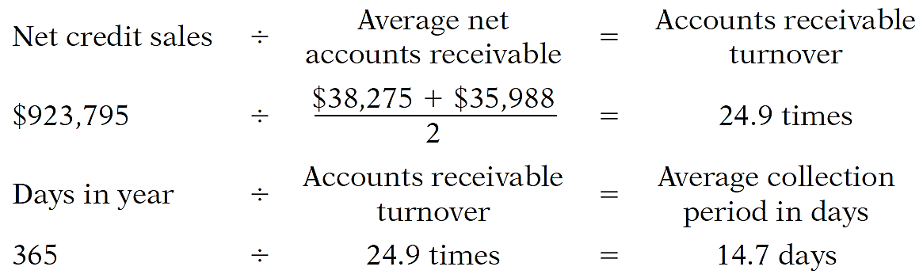
DO IT!
4
Analysis of Receivables
In 2017, Phil Mickelson Company has net credit sales of $923,795 for the year. It had a beginning accounts receivable (net) balance of $38,275 and an ending accounts receivable (net) balance of $35,988. Compute Phil Mickelson Company’s (a) accounts receivable turnover and (b) average collection period in days.
(a)
(b)
LO 4

Slide 61

A Look at IFRS
LEARNING
OBJECTIVE
Compare the accounting for receivables under GAAP and IFRS.
5
Key Points
  Similarities
  The recording of receivables, recognition of sales returns and allowances and sales discounts, and the allowance method to record bad debts are the same between GAAP and IFRS.
  Both IFRS and GAAP often use the term impairment to indicate that a receivable or a percentage of receivables may not be collected.
LO 5

Slide 62
A Look at IFRS
Key Points
  Similarities
  The FASB and IASB have worked to implement fair value measurement (the amount they currently could be sold for) for financial instruments, such as receivables. Both Boards have faced bitter opposition from various factions.
  Differences
  Although IFRS implies that receivables with different characteristics should be reported separately, there is no standard that mandates this segregation.
LO 5

Slide 63
A Look at IFRS
Key Points
  Differences
  IFRS and GAAP differ in the criteria used to determine how to record a factoring transaction. IFRS uses a combination approach focused on risks and rewards and loss of control. GAAP uses loss of control as the primary criterion. In addition, IFRS permits partial derecognition of receivables; GAAP does not.
LO 5

Slide 64
A Look at IFRS
Looking to the Future
The question of recording fair values for financial instruments will continue to be an important issue to resolve as the Boards work toward convergence. Both the IASB and the FASB have indicated that they believe that financial statements would be more transparent and understandable if companies recorded and reported all financial instruments at fair value.
LO 5

Slide 65
A Look at IFRS
IFRS Self-Test Questions
Which of the following statements is false?
Receivables include equity securities purchased by the company.
Receivables include credit card receivables.
Receivables include amounts owed by employees as a result of company loans to employees.
Receivables include amounts resulting from transactions with customers.
LO 5

Slide 66
A Look at IFRS
IFRS Self-Test Questions
Under IFRS:
the entry to record estimated uncollected accounts is the same as GAAP.
it is always acceptable to use the direct write-off method.
all financial instruments are recorded at fair value.
None of the above.
LO 5

Slide 67
Copyright
“Copyright © 2015 John Wiley & Sons, Inc. All rights reserved. Reproduction or translation of this work beyond that permitted in Section 117 of the 1976 United States Copyright Act without the express written permission of the copyright owner is unlawful. Request for further information should be addressed to the Permissions Department, John Wiley & Sons, Inc. The purchaser may make back-up copies for his/her own use only and not for distribution or resale. The Publisher assumes no responsibility for errors, omissions, or damages, caused by the use of these programs or from the use of the information contained herein.”

