Slide 1

Revision of c language
Shadi Daana

Slide 2
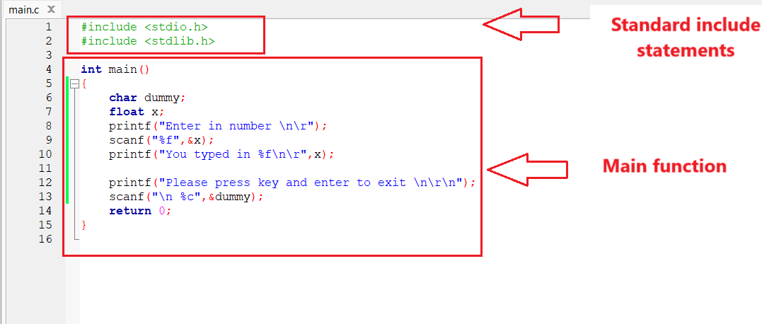
Skeleton of a C program

Slide 3
Include statements
#include <stdio.h> is called a preprocessor command.
Preprocessor commands are identified by the # at the beginning of the line.
#include tells the preprocessor to open the file stdio.h and read it into the program to be compiled with the remainder of the program.
The file name is surrounded by angle brackets (< >)or double quotes ("")
#include <stdio.h> #include <stdlib.h>
#include "myheader1.h" #include "myheader2.h"
< > Primarily used for including standard library headers or system headers
" " Used for including user-defined header files, (files created as part of your project)

Slide 4
Include statements
Here are some examples of the standard header files in C language:
#include <stdio.h>
#include <stdint.h>
#include <stdbool.h>
#include <stdlib.h>
#include <string.h>
#include <math.h>
You need to include the appropriate library for the functions you intend to use
For example: you need to include math header if you need to use sqrt or sin

Slide 5
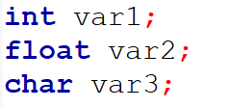
Variables in C
Variable is basically nothing but the name of a memory location that we use for storing data.
We can change the value of a variable in C or any other language, and we can also reuse it multiple times.
You need to declare variables before using them

Slide 6
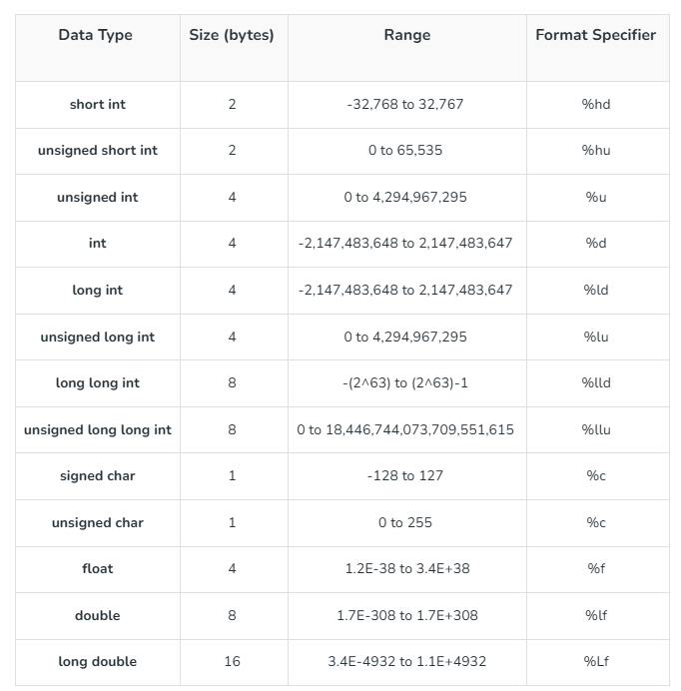
Basic Data Types
C has only a few built-in types:
char
int
float
double
Additional qualifiers are used to modify the basic types
short
long
signed
unsigned
Source: https://www.geeksforgeeks.org/data-types-in-c/

Slide 7
C Type Conversion (Type Casting)
#include <stdio.h> int main() { int num1 = 17, num2 = 5; float result; result = num1 / num2; printf("result: %f\n", result); }
#include <stdio.h> int main() { int num1 = 17, num2 = 5; float result; result =(float) num1 / num2; printf("result: %f\n", result); }
Output
Output
Result: 3.000000
Result: 3.400000

Slide 8
Const and volatile variables
The const keyword is used to declare variables whose values cannot be changed after initialization.
The volatile keyword tells the compiler that the value of the variable may change at any time, without any action by the code itself.
Variables modified by interrupt service routines (ISRs) should be volatile
const int MAX_VALUE = 100; // MAX_VALUE cannot be changed after this
volatile int flag = 0; // flag might be changed by external hardware or ISR

Slide 9
Standard IO
#include <stdio.h> int main() { int myNum; char myChar; printf("Type a number AND a character and press enter: \n"); scanf("%d %c", &myNum, &myChar); printf("Your number is: %d\n", myNum); printf("Your character is: %c\n", myChar); }
Format specifier

Slide 10
Operators in C Language
Operators | Type
++, -- | Unary Operator
+, -, *, /, % | Arithmetic Operator
<, <=, >, >=, ==, != | Rational Operator
&&, ||, ! | Logical Operator
&, |, <<, >>, ~, ^ | Bitwise Operator
=, +=, -=, *=, /=, %= | Assignment Operator
?: | Conditional Operator
Unary Operator
(one operand)
Binary Operator
(two operands)
Ternary Operator
(three operands)

Slide 11
Operators in C Language- Example
#include <stdio.h> int main() { /*Arithmetic Operators*/ int result1 = 5 + 3; // result1 is 8 /*Relational Operators*/ int result2 = (5 > 3); // result2 is 1 (true) /*Logical Operators*/ int result3 = (5 > 3) && (3 < 7); // result3 is 1 (true) /*Assignment Operators*/ int x = 5; x += 3; // x is now 8 /*Increment and Decrement Operators (Unary Operator)*/ int y = 5; y++; // y is now 6 /*Bitwise Operators:*/ int result4 = 5 & 3; // result4 is 1 /*Conditional Operator (Ternary Operator)*/ int result5 = (5 > 3) ? 1 : 0; // result5 is 1 }

Slide 12
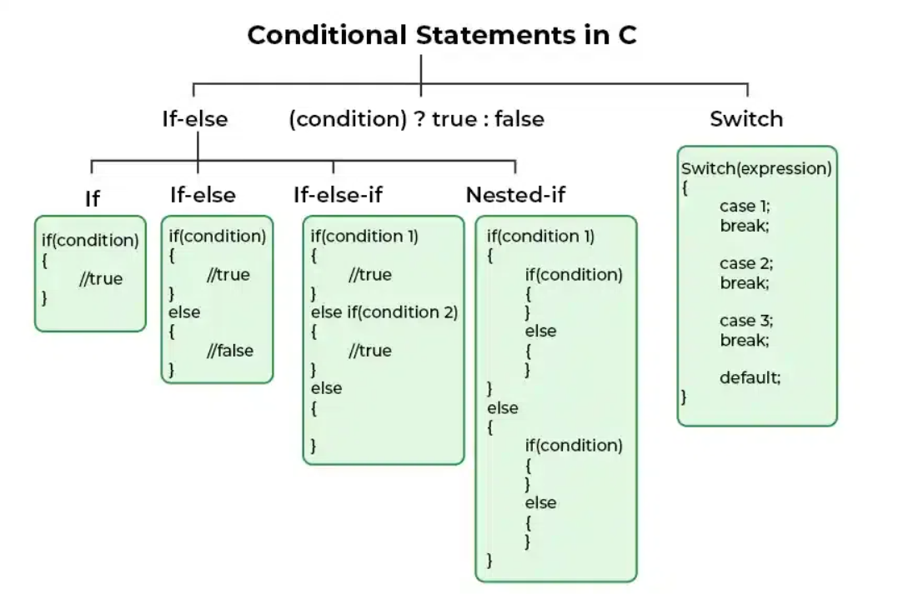
Conditional Statements
Source: https://www.geeksforgeeks.org/decision-making-c-cpp/

Slide 13
Conditional Statements- Examples
#include <stdio.h> int main() { int num; printf("Enter a number: "); scanf("%d", &num); if (num > 0) { printf("The number is positive.\n"); if (num % 2 == 0) { printf("It is also even.\n"); } else { printf("It is odd.\n"); } } else if (num < 0) { printf("The number is negative.\n"); if (num % 2 == 0) { printf("It is also even.\n"); } else { printf("It is odd.\n"); } } else { printf("The number is zero.\n"); } return 0; }
#include <stdio.h> int main() { int grade; printf("Enter your grade (1-3):\n"); printf("1. Excellent\n"); printf("2. Good\n"); printf("3. Needs Improvement\n"); printf("Enter your choice: "); scanf("%d", &grade); switch (grade) { case 1: printf("You did an excellent job!\n"); break; case 2: printf("Good work! Keep it up!\n"); break; case 3: printf("You need to improve. Don’t give up!\n"); break; default: printf("Invalid! Please enter a number between 1 and 3.\n"); break; } return 0; }

Slide 14
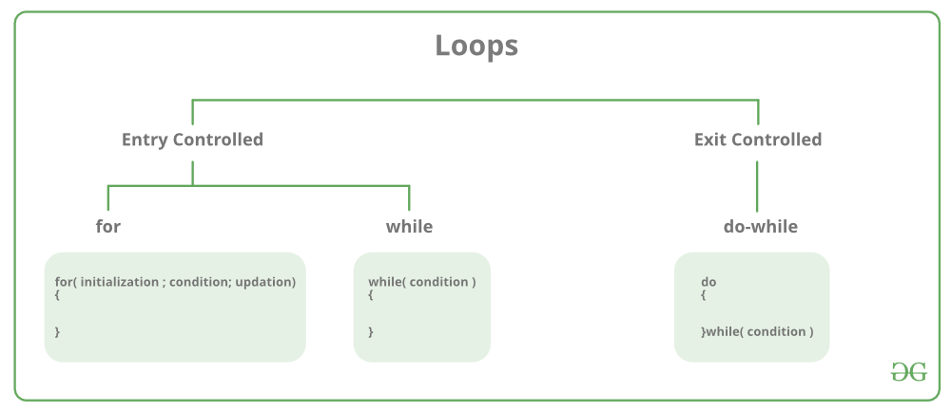
Loops in C
Source: https://www.geeksforgeeks.org/c-loops/

Slide 15
Loops in C
#include <stdio.h> int main() { int i = 1; int k = 4; while (i <= 5) { printf("while loop %d\n", i); i++; } for (int j = 0; j <= 5; j++) { printf("for loop %d\n", j); } do { printf("do-while loop %d\n", k); k++; } while (k <= 3); return 0; }
Output
while loop 1 while loop 2 while loop 3 while loop 4 while loop 5 for loop 0 for loop 1 for loop 2 for loop 3 for loop 4 for loop 5 do-while loop 4

Slide 16
Jump Statements
There are 4 types of jump statements in C language:
break: can be used to exit for, while, do-while, and switch statements
continue: causes the next iteration of a for, while, or a do while loop to be started
goto: can be used to transfer control of the program from one location to another
return: exits a function and optionally returns a value.

Slide 17
Macros
The #define directive is used to create symbolic constants
#include <stdio.h> #define PI 3.14159 int main() { float radius = 5.0; float area = PI * radius * radius; printf("Area= %.2f\n", area); return 0; }

Slide 18
Macros
Macro for Inline Functions
#include <stdio.h> #define SQUARE(x) ((x) * (x)) int main() { int number = 4; printf("%d^2 = %d\n", number, SQUARE(number)); return 0; }
#define MIN(a,b) (((a)<(b)) ? (a) : (b)) #define ABS(a) ((a)<0 ? -(a) : (a))
Some useful micro functions

Slide 19
Macros
Macro for Conditional Compilation
#include "stm32f1xx.h" // Include header for STM32F103 series #include "stm32f4xx.h" // Include header for STM32F407 series #define STM32F103 // Comment this and uncomment the next line for STM32F407 // #define STM32F407 int main() { #ifdef STM32F103 RCC->APB2ENR |= RCC_APB2ENR_IOPAEN; // Enable GPIOA clock for STM32F103 #elif defined(STM32F407) RCC->AHB1ENR |= RCC_AHB1ENR_GPIOAEN; // Enable GPIOA clock for STM32F407 #else #error "Please define STM32F103 or STM32F407." #endif return 0; }
Depending on whether STM32F103 or STM32F407 is defined, the respective clock enable command is compiled.
If neither microcontroller is defined, an error message will stop the compilation.

Slide 20
Arrays
An array is a collection of elements, all of the same data type, stored in contiguous memory locations.
Array characteristics:
Homogeneous: All elements are of the same data type.
Fixed Size: The size is determined when the array is declared and cannot be changed during runtime.
Contiguous Memory: Elements are stored in adjacent memory locations.
Indexed: Elements are accessed by their position (index) in the array
Following are proper array declarations:
extern int a[]; long rd[100]; float temperatures[1000]; char st[]={"Make a character array"}; float pressure[]={ 1.1, 2.3, 3.9, 3.7, 2.5, 1.5, 0.4};

Slide 21
Arrays
A string is an array of characters, with each character represented by an ASCII value
All strings in C are null terminated (The last character must be a zero or a null. ).
The length of the array is one greater than the length of the string.
#include <stdio.h> int main() { char st[]={"Make a character array"}; printf("%s",st); return 0; }
Format specifier for string

Slide 22
Two Dimensional Arrays
A 2D array is also known as a matrix (a table of rows and columns).
A multidimensional array is basically an array of arrays.
#include <stdio.h> int main() { int matrix[2][3] = { {21, 5, 14}, {6, 74, 86} }; int i, j; for (i = 0; i < 2; i++) { for (j = 0; j < 3; j++) { printf("%d ", matrix[i][j]); } printf("\n"); } return 0; }

Slide 23
Structures
We can use struct when we need to store similar data of multiple entities (User defined data type)
// Define a structure named Student struct Student { int id; char name[50]; float grade; };
// Define a structure named Book struct Book { int id; char title[100]; char author[50]; };
The structure declaration must be followed by a semicolon

Slide 24
Structures
#include <stdio.h> #include <string.h> // Define a structure named Student struct Student { int id; char name[50]; float grade; }; int main() { struct Student student1; student1.id = 101; strcpy(student1.name, "Ahmad"); student1.grade = 87.5; // Print the student's information printf("Student ID: %d\n", student1.id); printf("Student Name: %s\n", student1.name); printf("Student Grade: %.2f\n", student1.grade); return 0; }
Define a structure named Student
student1 is an instance of struct Student
Assign values to the fields of student1 instance
Use the dot (.) operator to access the fields of the structure

Slide 25
Structures
A structure is similar to an array, but far more general. An array must be a collection of like types, and an array is NOT a type.
A structure is a collection of one or more variables identified by a single name.
The variables can be of different types.
Structures are types in the sense that an int is a type.
Therefore, if you have properly declared a structure, you may declare another structure of the same type

Slide 26
Structures with typedef
struct Student { int id; char name[50]; float grade; }; struct Student student1; struct Student student2;
typedef struct { int id; char name[50]; float grade; } Student; Student student1; Student student2;
Without typedef, you need to use the struct keyword every time you declare an instance (variable) of that type

Slide 27
The enum
enum is short for “Enumeration"
It allows the user to create custom data types with a set of named integer constants
It simplifies and makes the program more readable.
enum enum_name { const1 = 8; const2 = 4; }
enum months {Jan =1,Feb, Mar, April, May, June, July, Aug, Sept, Oct, Nov, Dec};

Slide 28
The enum
#include <stdio.h> // Define an enum for LED states enum LEDState { OFF, ON }; int main() { enum LEDState led = ON; // Set the LED state to ON if (led == ON) { printf("The LED is ON.\n"); } else { printf("The LED is OFF.\n"); } return 0; }

Slide 29
Functions in C
The function is the heart of a C program.
In fact, any C program is merely a function named main.
A function is a block of code which only runs when it is called.
You can pass data, known as parameters or arguments, into a function
You can also return data from the function
Functions are used to perform certain actions, and they are important for reusing code: Define the code once, and use it many times.

Slide 30
Functions in C
Function Definition
Function parameters
If there is no inputs, we can use void keyword
int max(int a, int b) { int result; result=(a > b) ? a : b; return result; }
A function can return a value using the return statement
The return type specified in the function declaration must match the type of the value being returned.
If there is no return value, the return type is specified as void

Slide 31
Functions in C
#include <stdio.h> int max(int a, int b) ; int main() { int result = max(10, 5); printf("Maximum: %d\n", result); return 0; } int max(int a, int b) { int result; result=(a > b) ? a : b; return result; }
Function Declaration (Function Prototype)
Function Call
Function Definition

Slide 32
Functions in C
#include <stdio.h> int max(int a, int b) ; int main() { int result = max(10, 5); printf("Maximum: %d\n", result); return 0; } int max(int a, int b) { int result; result=(a > b) ? a : b; return result; }
Not the same
They are local variables
Variables declared inside a function have local scope, meaning they are only accessible within that function.
The scope of a function parameter is also local.
The lifetime of local variables is limited to the function's execution duration

Slide 33
Functions in C
Global variables
The variables that are declared outside of all functions
#include <stdio.h> int a, b; void add() { printf("%d", a + b); } int main() { a = 10; b = 15; add(); return 0; }
They are accessible to any function within the same file
Or accessible across multiple files by using extern keyword

Slide 34
Static Variable
A static variable declared inside a function retains (keeps) its value between function call.
It is not destroyed on function exit.
You cannot reach it from outside of the function (scope limited to the function)
void countCalls() { static int counter = 0; counter++; printf("Called %d times\n", counter); }

Slide 35
Functions Pass By Address
#include <stdio.h> // Function to double the values of an array void doubleArray(int arr[], int size) { for (int i = 0; i < size; i++) { arr[i] *= 2; // Double each element } } int main() { int numbers[] = {1, 2, 3, 4, 5}; /* Calculate size of the array*/ int size = sizeof(numbers) / sizeof(numbers[0]); doubleArray(numbers, size); printf("Doubled array: "); for (int i = 0; i < size; i++) { printf("%d ", numbers[i]); } printf("\n"); return 0; }
Does anyone notice what happened ?
Output
Doubled array: 2 4 6 8 10

Slide 36
Functions Pass By Address
#include <stdio.h> // Function to double the values of an array void doubleArray(int arr[], int size) { for (int i = 0; i < size; i++) { arr[i] *= 2; // Double each element } } int main() { int numbers[] = {1, 2, 3, 4, 5}; /* Calculate size of the array*/ int size = sizeof(numbers) / sizeof(numbers[0]); doubleArray(numbers, size); printf("Doubled array: "); for (int i = 0; i < size; i++) { printf("%d ", numbers[i]); } printf("\n"); return 0; }
The array passed and returned without using return in the function
Output
Doubled array: 2 4 6 8 10

Slide 37
Functions Pass By Address
#include <stdio.h> // Function to double the values of an array void doubleArray(int arr[], int size) { for (int i = 0; i < size; i++) { arr[i] *= 2; // Double each element } } int main() { int numbers[] = {1, 2, 3, 4, 5}; /* Calculate size of the array*/ int size = sizeof(numbers) / sizeof(numbers[0]); doubleArray(numbers, size); printf("Doubled array: "); for (int i = 0; i < size; i++) { printf("%d ", numbers[i]); } printf("\n"); return 0; }
In C, when passing an array to a function, you are actually passing an address (pointer) to the first element of the array.
This allows the function to access and modify the contents of the array directly.
Output
Doubled array: 2 4 6 8 10

Slide 38
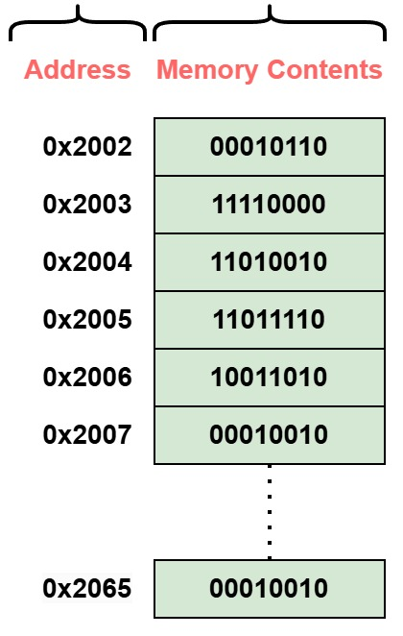
Pointers in C
Pointer is a special variable that is capable of storing an address
It points to a memory location where the first byte is stored (base address)
Ptr
X: Integer variable

Slide 39
Pointers in C
Syntax to declare pointer variables:
data_type *pointer_name;
It refers to the type of the value that the pointer will point to
char *ptr1; int *ptr2; float *ptr3;
Point to character value
Point to integer value
Point to float value
* (asterisk) symbol tells the compiler that ptr3 is a pointer to a float

Slide 40
Pointers in C
Declaring a point variable is not enough
You must initialize the pointer before use.
Uninitialized pointers can lead to undefined behavior
One way to initialize a pointer is to assign address of a variable
int x= 54; ​
x
int *ptr;
54
ptr = &x;
0x2002
ptr
Address of operator
0x2002
0x2026

Slide 41
Pointers in C
You can access the value stored at the memory location pointed to by a pointer
This is called "dereferencing "
int x= 54; ​
x
int *ptr;
54
ptr = &x;
0x2002
ptr
printf("%d", *ptr);
0x2002
Dereference operator
0x2026

Slide 42
Pointers in C
You can also change the data of a variable pointed by a pointer
int x= 54; ​ int *ptr; ptr = &x;
x
*ptr = 8;
54
printf("%d", *ptr);
8
0x2002
ptr
0x2002
In this context, * (asterisk) symbol is acting as a dereference operator.
0x2026

Slide 43
Pointers in C
⚠️ Cautions:
Directly assigning memory addresses without initialization is dangerous in most high-level programming
In embedded systems, uninitialized pointers can be used to access and manipulate registers directly
int *ptr; *ptr = 10; printf("Value: %d\n", *ptr);
*(uint32_t *)(RCC_AHB1ENR) |= (1 << 3); *(uint32_t *)(GPIOD_MODER) &= ~(1 << 31); *(uint32_t *)(GPIOD_MODER) |= (1 << 30);

Slide 44
Pointers in C
int x= 15; ​ int *ptr1= &x; Int *ptr2=NULL;
int x= 15; ​int x= 38; int *ptr1= &x; Int *ptr2= &y;
ptr2 = ptr1;
*ptr2 = 20;
*ptr2 = *ptr1;
ptr1
ptr1
15
0x2000
x
0x2000
0x2000
20
15
ptr2
ptr2
0x2000
38
15
0x2000
0x2024
0x2024
ptr2=ptr1 is not the same as *ptr2=*ptr1

Slide 45
Functions and Pointers
Pass By Reference
Pointers can be used to pass data to functions by reference, allowing functions to modify the original data
This function takes a pointer to an integer (int *ptr) as a param
#include <stdio.h> void updateValue(int *ptr) { *ptr = 42; } int main() { int x = 10; printf("Before: %d\n", x); updateValue(&x); printf("After: %d\n", x); return 0; }
changes the value at the address ptr points to, effectively modifying x in main
&x gets the address of x in main, which is passed to updateValue
Output
Before: 10 After: 42

Slide 46
Arrays and Pointers
The name of an array (e.g., arr) acts like a pointer to its first element.
Elements can be accessed using pointer arithmetic:
*(arr + i) is equivalent to arr[i]
#include <stdio.h> int main() { int arr[5]; arr*=10; printf("%d\n", arr[0]); return 0; }
int arr[3] = {10, 20, 30}; printf("%d\n", *(arr + 1)); // Output: 20

Slide 47
Arrays and Pointers
When you pass an array to a function, you’re actually passing a pointer to its first element.
#include <stdio.h> void printArray(int *arr, int size) { for (int i = 0; i < size; i++) { printf("%d ", arr[i]); } } int main() { int arr[3] = {10, 20, 30}; printArray(arr, 3); return 0; }

Slide 48
Struct and Pointers
Dot Operator (.): Accesses members of a structure directly using an instance.
Arrow Operator (->): Accesses members of a structure via a pointer to the instance.
struct Point { int x; int y; }; struct Point p; p.x = 10; // Directly accesses member x
struct Point { int x; int y; }; struct Point *ptr = &p; ptr->x = 10; // Accesses member x through a pointer

Slide 49
Strings Operations in C
Declaring and Initializing Strings
In C, strings are arrays of char terminated by a null character (\0).
Common String Functions (from <string.h>)
Strlen: Get string length
Strcpy: Copy string to another
Strcat: Concatenate strings
Strcmp: Compare two strings
Strchr: Find character in string
Strstr: Find substring within a string
char str[20] = "Hello"; char *strPtr = "Hello";

Slide 50
Strings Operations in C
#include <stdio.h> #include <string.h> int main() { char str1[20] = "Hello"; char str2[20] = "World!"; char buffer[40]; printf("Length of str1: %lu\n", strlen(str1)); strcpy(buffer, str1); printf("After strcpy, buffer: %s\n", buffer); strcat(buffer, ", "); strcat(buffer, str2); printf("After strcat, buffer: %s\n", buffer); return 0; }
Output
Length of str1: 5 After strcpy, buffer: Hello After strcat, buffer: Hello, World!

Slide 51
Memory Copy
In C, memory copying can be done using the memcpy function from the <string.h> library.
This function is used to copy a specified number of bytes from one memory location to another
Syntax:
dest: Pointer to the destination memory area where the content is to be copied.
src: Pointer to the source memory area from which the content is to be copied.
n: The number of bytes to copy.
void* memcpy(void *dest, const void *src, size_t n);

Slide 52
Memory Copy - Example
In the following example we use memcpy to copy data from one array to another:
#include <stdio.h> #include <string.h> int main() { int source[] = {1, 2, 3, 4, 5}; int destination[5]; memcpy(destination, source, sizeof(source)); return 0; }

Slide 53
Questions?

Slide 54
References
Van Sickle, T. (2001). *Programming microcontrollers in C* (2nd ed.). Newnes.
GeeksforGeeks. (n.d.). *GeeksforGeeks - A computer science portal for geeks*. Retrieved [date], from https://www.geeksforgeeks.org/
Neso Academy. (n.d.). *Data structures and algorithms*. YouTube. Retrieved [date], from https://www.youtube.com/playlist?list=PLBlnK6fEyqRggZZgYpPMUxdY1CYkZtARR

