Slide 1
Chapter 6 Demand Forecasting Equivalent to Chapter 6 in Hirschey and Bentzen
Adapted from
Managerial Economics in a Global Economy, 5th Edition by Dominick Salvatore

Slide 2
Introduction
Forecasting because of uncertainty and risk.
Macro vs. Micro forecasts
Forecasting techniques:
naïve to very sophisticated
Qualitative to quantitative
Purchased from consulting firms
Performed by the firm
Some are useful for short-term forecasts (example barometric forecasts)
Some are more useful for long-term forecasting (example: input-output method)

Slide 3
Introduction
The choice of the technique depends on:
The cost of preparing the forecast and the benefit that results from its use
The lead time in decision making
The time period of the forecast (short or long term)
The level of accuracy required
The quality and availability of the data
The level of complexity of the relationships to be forecasted

Slide 4
Qualitative Forecasts
To make short-term forecasts when no quantitative data are available.
They can be useful in supplementing quantitative forecasts
They can be invaluable in forecasting the demand for a new product to be introduced.

Slide 5
Qualitative Forecasts
Survey Techniques
Planned Plant and Equipment Spending
Expected Sales and Inventory Changes
Consumers’ Expenditure Plans
Opinion Polls
Business Executives (Delphi method)
Sales Force
Consumer Intentions

Slide 6
Qualitative Forecasts: Surveys Techniques
Rationale: Many economic decisions are made well in advance of actual expenditure
In general, the record of these surveys has been rather good in forecasting actual expenditure, except during periods of unexpected international political upheavals.
More useful in conjunction with quantitative method of forecasting.
These are not popular among consumers because of the loss of privacy, the time involved, and the pressure.

Slide 7
Qualitative Forecasts: Opinion Polls
The sales of firm depend also on the policies adopted by the firm, so why not having a more specific opinion?
Executive polls: Delphi technique
Sales force polling
Consumer Intentions polling

Slide 8


Naïve Forecasting: Time-Series Analysis The past pattern will continue unchanged in the future!
Fluctuations in the time-series data because:
Secular Trend
Long-Run Increase or Decrease in Data
Cyclical Fluctuations
Long-Run Cycles of Expansion and Contraction
Seasonal Variation
Regularly Occurring Fluctuations
Irregular or Random Influences

Slide 9
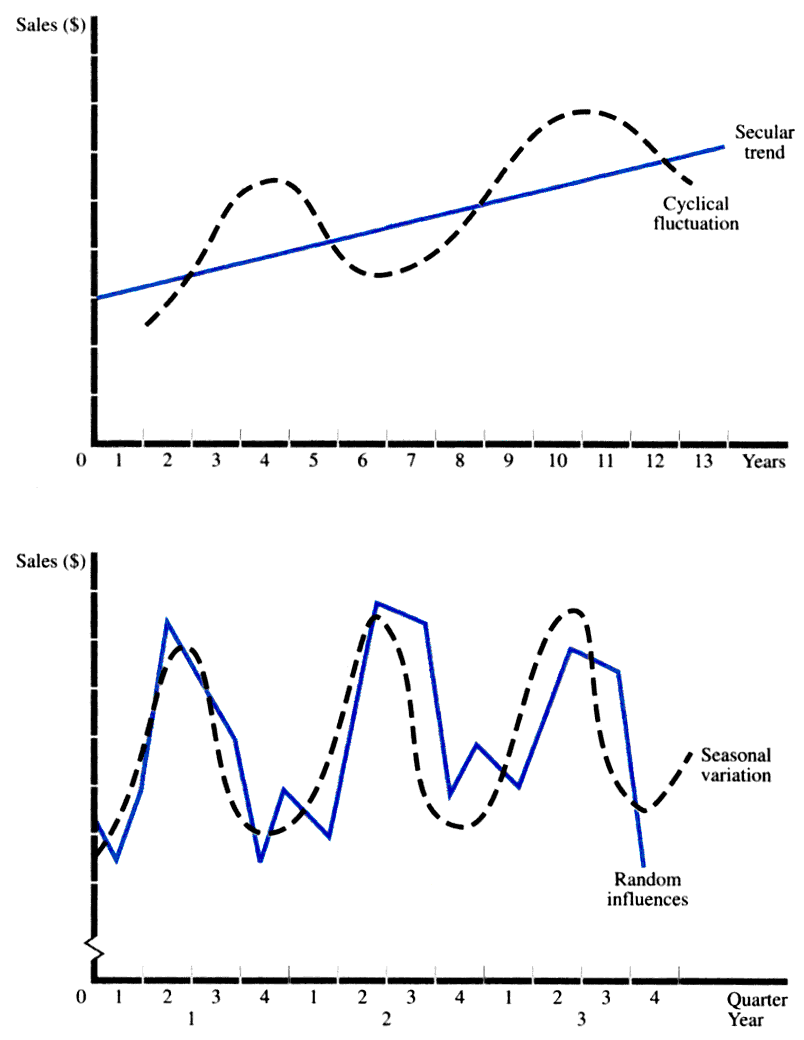



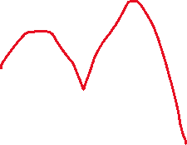



Slide 10



Trend Projection
Linear Trend: S_{t} = S₀ + b t b = absolute amount of Growth per time period
Constant Growth Rate S_{t} = S₀ (1 + g)^{t} g = Growth rate
Estimation of Growth Rate ln S_{t} = ln S₀ + t ln (1 + g)

Slide 11
Seasonal Demand for (sales of) Electricity (in millions of kilowatt-hours) in a US City, 2000-2003
Time Period | Quantity
2000.1 | 11
2000.2 | 15
2000.3 | 12
2000.4 | 14
2001.1 | 12
2001.2 | 17
2001.3 | 13
2001.4 | 16
2002.1 | 14
2002.2 | 18
2002.3 | 15
2002.4 | 17
2003.1 | 15
2003.2 | 20
2003.3 | 16
2003.4 | 19

Slide 12
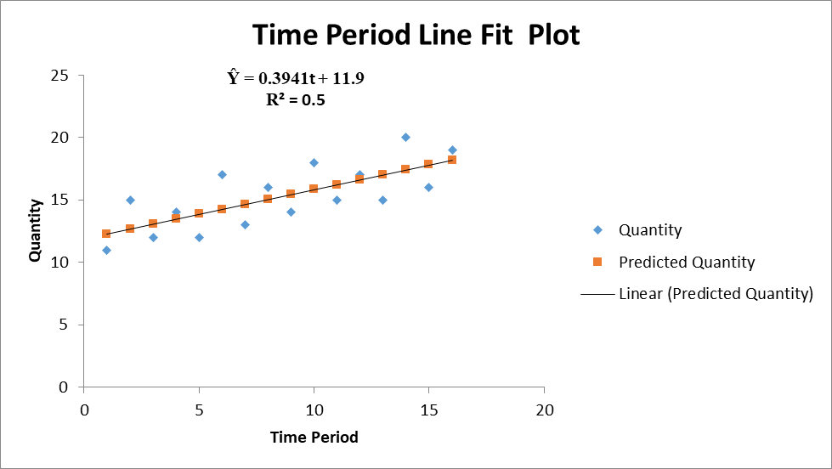
Trend Projection: Constant Absolute Amount

Slide 13
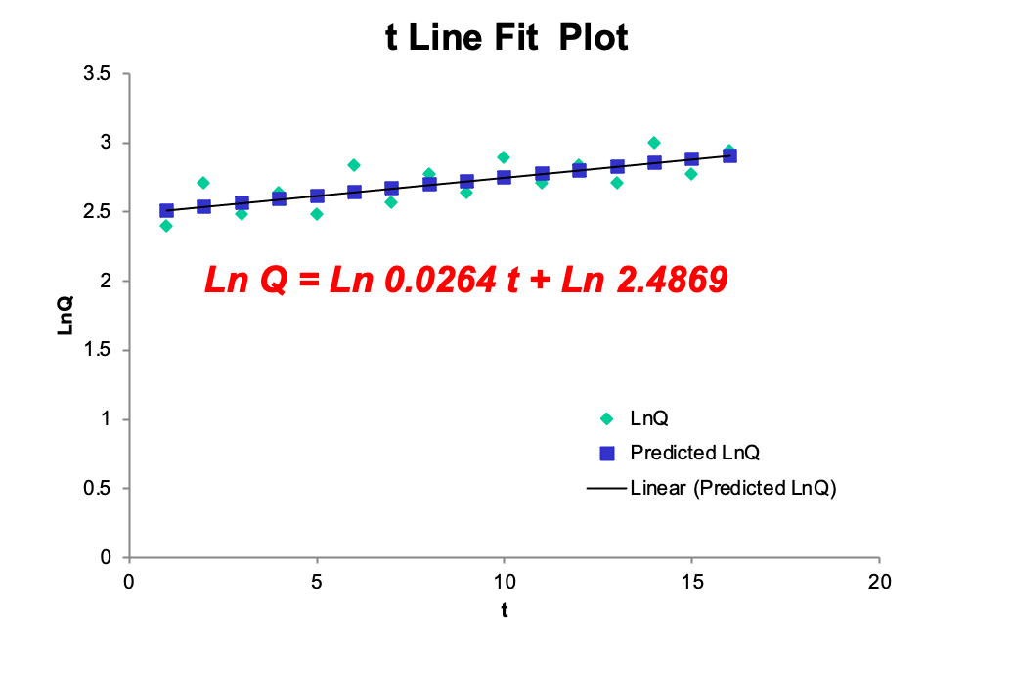
Trend Projection: Constant Growth Rate
R² = 0.54

Slide 14
Seasonal Variation
Ratio to Trend Method
Actual
Trend Forecast
Ratio =
Seasonal Adjustment
Average of Ratios for Each Seasonal Period
=
Adjusted Forecast
Trend Forecast
Seasonal Adjustment
=

Slide 15
Seasonal Variation
Ratio to Trend Method: Example Calculation for Quarter 1
Year | Actual | Trend Forecast | Ratio
2000.1 | 11 | 11.90 + (0.394)(1) = 12.29 | 0.8950
2001.1 | 12 | 11.90 + (0.394)(5) = 13.87 | 0.8652
2002.1 | 14 | 11.90 + (0.394)(9) = 15.45 | 0.9061
2003.1 | 15 | 11.90 + (0.394)(13) = 17.02 | 0.8813
Seasonal adjustment factor = 0.8869
Trend Forecast for 2004.1 = 11.90 + (0.394)(17) = 18.60
Seasonally Adjusted Forecast for 2004.1 = (18.60)(0.8869) = 16.50

Slide 16
Alternative: Dummy Variables
Base period is the last quarter (and it will be estimated by the regression as the constant term.
D₁ = 1 in the first quarter of each year, and zero in any other quarter
D₂ = 1 in the second quarter of each year, and zero in other quarters.
D₃ = 1 in the third quarter of each year and zero in other quarters.

Slide 18
Alternative: Dummy Variables
S_{t} = 12.75 – 2.375 D_{1t} + 1.75D_{2t} – 2.125D_{3t} + 0.375t
(-10.83) (8.11) (-9.94) (22.25)
R² = 0.99
S₁₇ = 12.75 -2.375 + 0.375(17) = $16.75 m in the 1st quarter/2004
S₁₈ = 12.75 + 1.75 + 0.375(18) = $21.25 m in the 2nd quarter/2004
S₁₉ = 12.75 – 2.125 + 0.375(19) = $17.75 m in the 3rd quarter/2004
S₂₀ = 12.75 + 0.375(20) = $20.25 m in the 4th quarter/2004

Slide 19
Remember
These forecasts are based on the assumption that the past trend and seasonal patterns in the data will persist during 2004.
It is difficult or impossible to consider cyclical and irregular or random forces.
Thus, time-series analysis cannot forecast turning points until they have occurred.
Time-series analysis does not examine the underlying forces that cause the observed time series to fluctuate.
It is seldom used alone but is most useful in conjunction with other forecasting methods.

Slide 20
Smoothing Techniques
Another method of naïve forecasting.
They predict values of a time-series on the basis of some average of its past values only.
They are useful when the time series exhibit little trend or seasonal variations but a great deal of irregular or random variation.
These kinds of variations are then smoothed, and future values are forecasted based on some average of past variation.

Slide 21
1) Moving Average Forecasts
Forecast is the average of data from w periods prior to the forecast data point.
The greater w is, the greater is the smoothing effect because each new observation receives less weight.
This is more useful the more erratic or random is the time-series data.

Slide 22
Moving Averages Techniques

Slide 23
2) Exponential Smoothing Forecasts
We might expect more recent observations to be more important, so why should we give equal weights to all observations?
Forecast is the weighted average of the forecast and the actual value from the prior period. W here means the weight which is between 0 and 1.

Slide 24
2) Exponential Smoothing Forecasts
 Two decisions to make:
 1) It is necessary to assign a value to the initial forecast (F_{t}) to get the analysis started. One way to do that is to let F_{t} = the mean value of the entire observed time-series data.
 2) We must decide the value of w. Therefore, we need to find the root-mean square error (RMSE) after trying different values of w.

Slide 25
Exponential Smoothing

Slide 26
Root-Mean Square Error (RMSE)
 Measures the Accuracy of a Forecasting Method.
Use the moving average that results in the smallest RSME.
This also can be applied when you compare the results of moving averages and exponential smoothing.

Slide 27
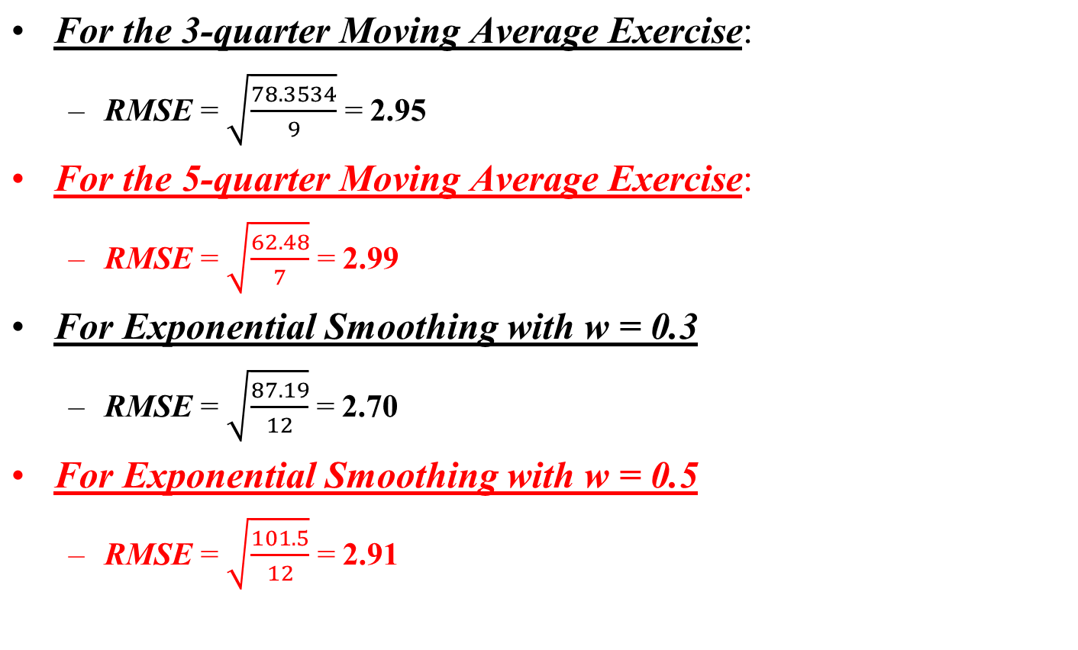
Root Mean Square Error (RMSE)

Slide 28
Barometric Methods
National Bureau of Economic Research
Department of Commerce
Leading Indicators
Lagging Indicators
Coincident Indicators
Composite Index
Diffusion Index

Slide 29
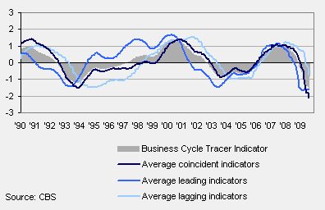
Barometric Indicators
Leading, coincident and lagging business cycle indicators

Slide 30
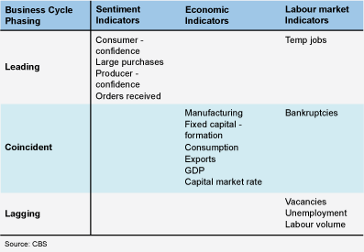
Phasing of BCT indicators

Slide 31
Barometric Methods
The use of indices (composite and diffusion) improves the accuracy of barometric forecasting.
The record of this technique is far from perfect.
Variability in lead time is another weakness.
It signals the direction of the change but it says little about the magnitude of the change.
Difficult to managers to identify leading indicators that provide accurate forecasts for their specific needs.

Slide 32
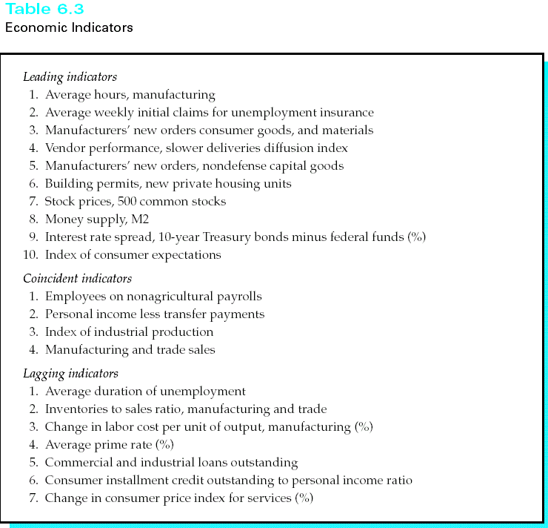
Economic Indicators

Slide 33
Economics Indicators
General rule of thumb
If, after a period of increases, the leading indicator index sustains three consecutive declines, a recession (or a slowing) will follow.
Economic indicators have predicted each recession since 1948.

Slide 34
Economic Indicators: Drawbacks
Leading indicators occasionally forecast recessions that do not occur.
A change in the index does not indicate the precise size of the decline or increase.
The data are subject to revision in the ensuing months.
The managers may find it difficult to identify leading indicators that provide accurate forecasts for their specific needs.

Slide 35
Composite Index
It consists of a weighted average of several leading indicators.
The indicators are weighted based on the predictive ability of each series.
The series that better predict would be given a greater weight.
The index is interpreted in terms of percentage changes from period to period.

Slide 36
Diffusion Index
It is calculated as the proportion of indicators that increase from one period to another.

Slide 37
Example on Composite and Diffusion Indexes
Month | Leading Indicator I | Leading Indicator II | Leading Indicator III
1 | 400 | 30 | 100
2 | 425 | 29 | 110
3 | 460 | 33 | 135
 | Diffusion Index | Composite Index
1 | - | 100.00
2 | 66.70 | 104.31
3 | 100.00 | 120.00

Slide 38
Example on Composite and Diffusion Indexes
Try to figure out how do we compose the index from the previous table! This is your job! Good luck!

