Slide 1


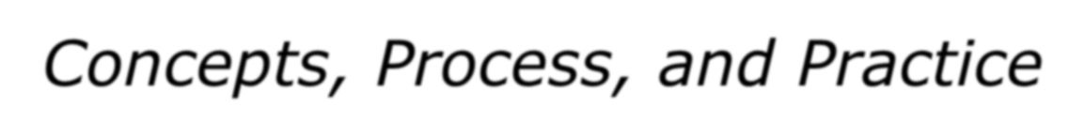


Fundamentals of Nursing
Kozier & Erb's
Concepts, Process, and Practice
TENTH EDITION
CHAPTER 47
Nutrition

Slide 2
Introduction
Nutrition
  All interactions between organism and food it consumes
Nutrients
  Organic and inorganic substances required for body function
Nutritive value
  Nutrient content of a specified amount of food

Slide 3
Essential Nutrients
Macronutrients
  Water
  Carbohydrates
  Protein
  Fats
  Minerals and vitamins required in hundreds of grams

Slide 4
Essential Nutrients
Micronutrients
  Vitamins
  Minerals
  Required in milligrams or micrograms

Slide 5
Carbohydrates
Carbon (C), hydrogen (H), oxygen (O)
  Sugars
    Monosaccharides
      Glucose: Most abundant
      Fructose
      Galactose
    Disaccharides
  Starches
    Polysaccharides
  Fiber

Slide 6
Carbohydrates
Carbohydrate digestion
  Major enzymes ptyalin (salivary amylase), pancreatic amylase, and disaccharidases
  End products are monosaccharides.
  Normally absorbed by the small intestine

Slide 7
Carbohydrates
Carbohydrate metabolism
  The body breaks carbohydrates into glucose.
    Maintains blood levels
    Provides a ready source of energy
Storage and conversion
  Used, or stored as glycogen or fat

Slide 8
Protein
Proteins (amino acids)
Protein digestion
  Digestion begins in mouth with enzyme pepsin.
  Most protein digested in the small intestine

Slide 9
Protein
Protein digestion
  Pancreas secretes the proteolytic enzymes trypsin, chymotrypsin, and carboxypeptidase.
  Glands in intestinal wall secrete aminopeptidase and dipeptidase, which break protein into amino acids.

Slide 10
Protein
Storage
  Amino acids absorbed by active transport through small intestines
    Plasma protein
    Body tissue (metabolic pool)

Slide 11
Lipids
Fatty acids
  Saturated
  Unsaturated
    Monounsaturated
    Polyunsaturated

Slide 12
Lipids
Lipids: Fats and oils
Lipid digestion
  Digestion begins in stomach, but mainly digested in small intestines.
  Digestion primarily by bile, pancreatic lipase, and enteric lipase
  End products of lipid digestion are glycerol, fatty acids, and cholesterol.
  Reassembled inside intestinal cells into triglycerides and cholesterol es_{co}t_{n}e_{tin}r_{u}s_{ed on next slide}

Slide 13
Lipids
Lipid digestion
  Small intestine and liver convert these into soluble compounds called lipoproteins (lipid + protein).
Lipid metabolism
  Conversion of fat into usable energy occurs through enzyme lipase that breaks down triglycerides in adipose cells, releasing glycerol and fatty acids into the blood.

Slide 14
Micronutrients
Vitamin
  Organic compounds that cannot be manufactured by body
  Water-soluble
    C, B complex
    Needed daily
  Fat-soluble
    A, D, E, and K
    Can be stored
Minerals
continued on next slide

Slide 15
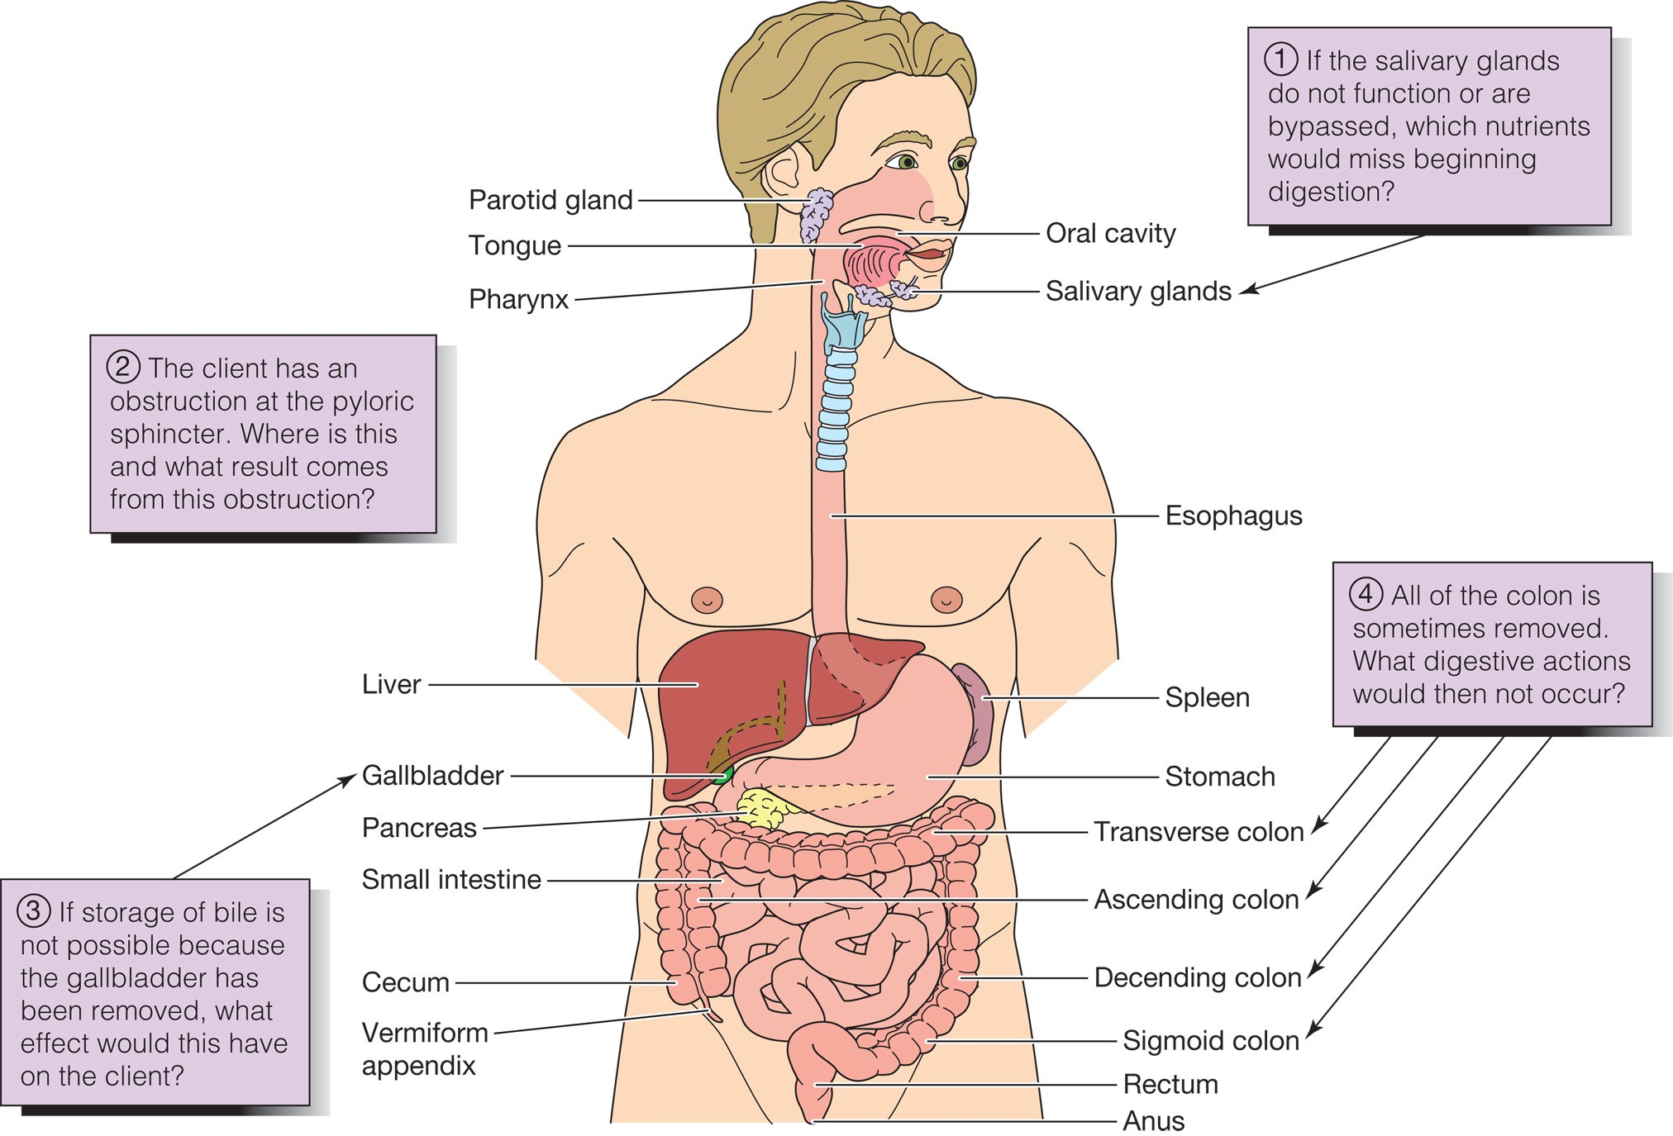
Anatomy & Physiology Review Digestive System

Slide 16
Body Weight and Body Mass Standards
Ideal Body Weight (IBW)
  Optimal weight recommended for optimal health
  Male: 106 pounds + 6 X number of inches over 5 feet tall
  Female: 100 pounds + 5 X number of inches over 5 feet tall

Slide 17
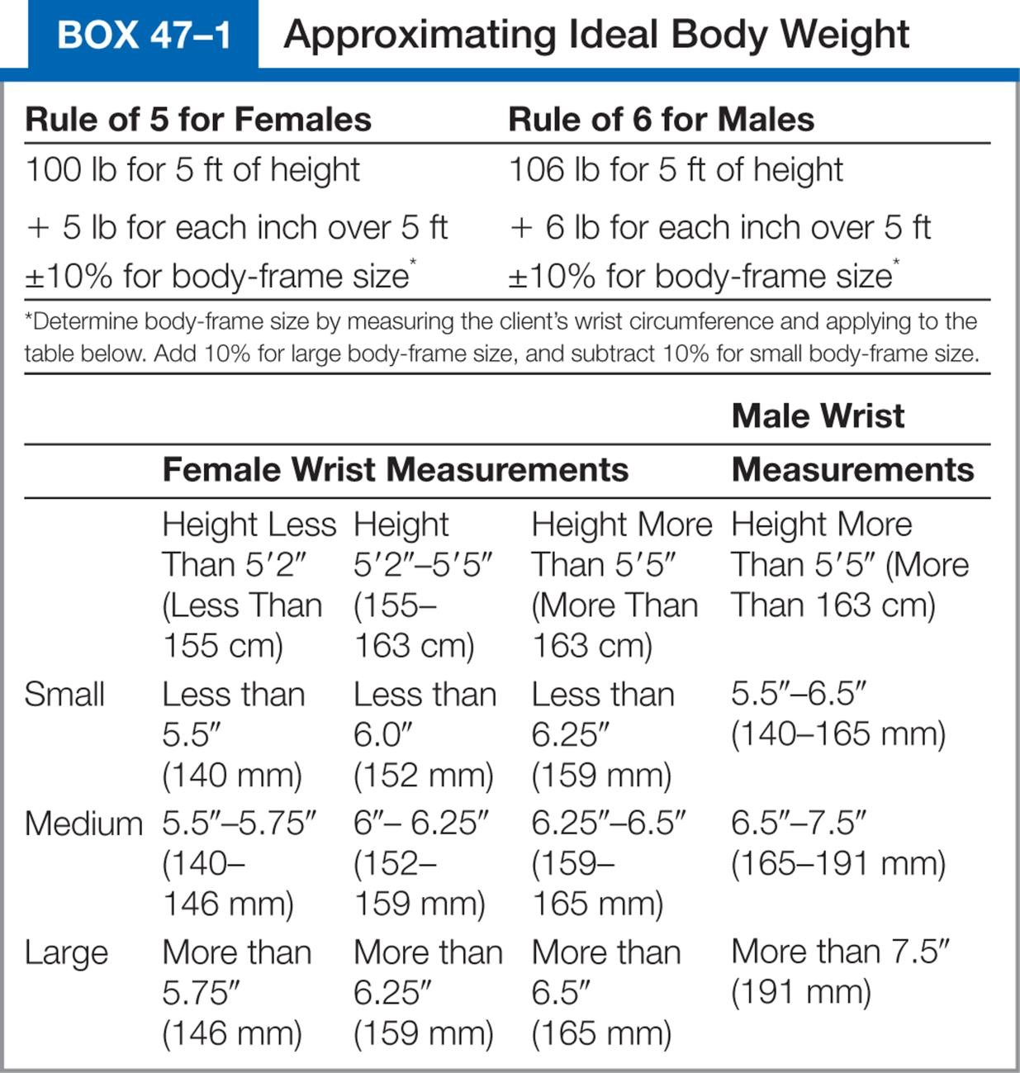
Box 47–1 Approximating Ideal Body Weight

Slide 18
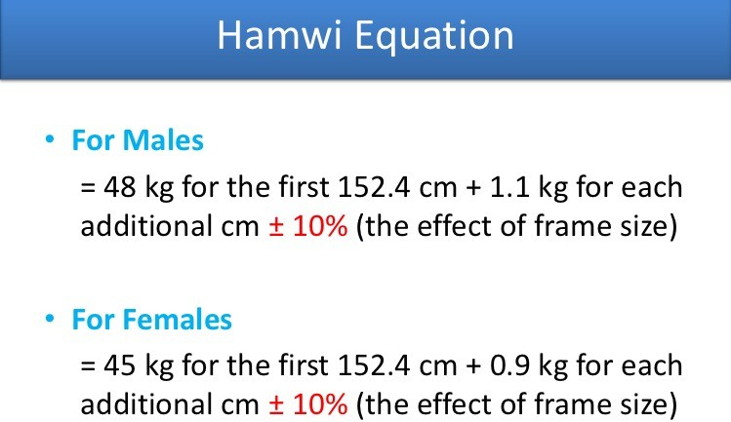

Slide 19
Body Weight and Body Mass Standards
Measuring BMI
  Take the weight in kilograms and divide by the height in meters squared.
Body Mass Index (BMI)
  Considered more reliable indicator by health professionals
BMI = Weight (kg)/Height (meters2)

Slide 20
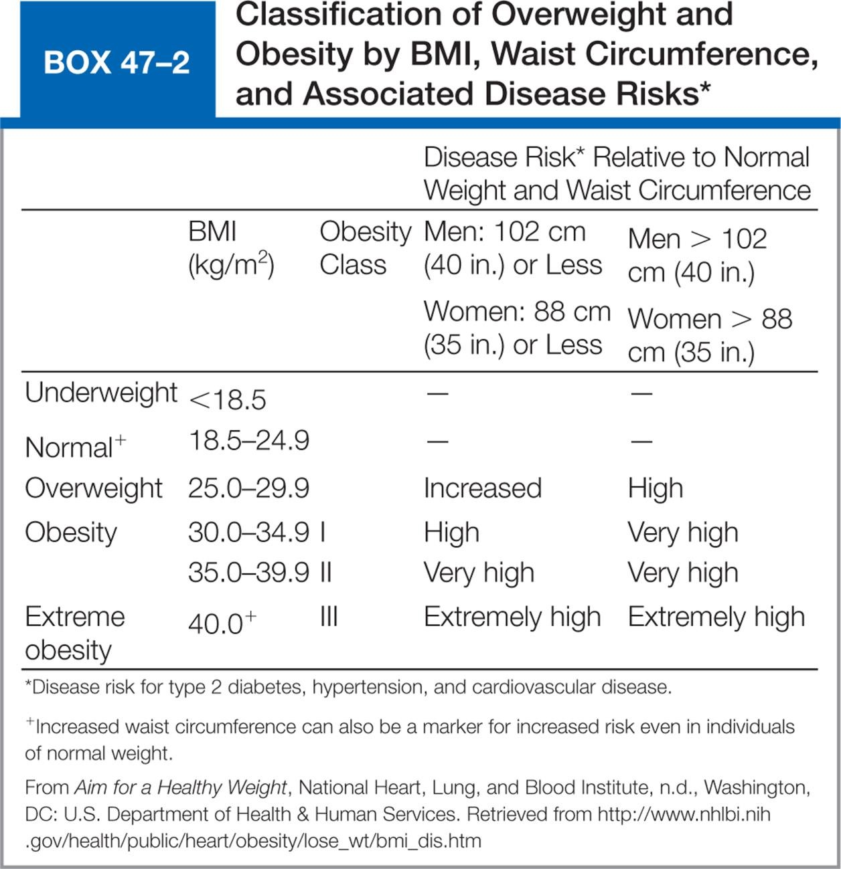
Box 47–2 Classification of Overweight and Obesity by BMI, Waist Circumference, and Associated Disease Risks*

Slide 21
Factors Affecting Nutrition
Development
  Periods of rapid growth require an increase in nutrients
Sex
Ethnicity and culture
  Traditional foods
  Do not use "good food, bad food" approach

Slide 22
Factors Affecting Nutrition
Beliefs about food
  Fads
Personal preferences
  May be related to familiarity
  Textures
Religious practices

Slide 23
Factors Affecting Nutrition
Lifestyle
  Convenience items versus preparation
  Muscular activity
Economics
  Availability of meat, fresh vegetables
Medications and therapy
  Include information in history interview
  Radiotherapy

Slide 24
Factors Affecting Nutrition
Health
  Medications
  Therapy
  Dysphagia: difficult swallowing
Alcohol consumption
Advertising
Psychological factors

Slide 25
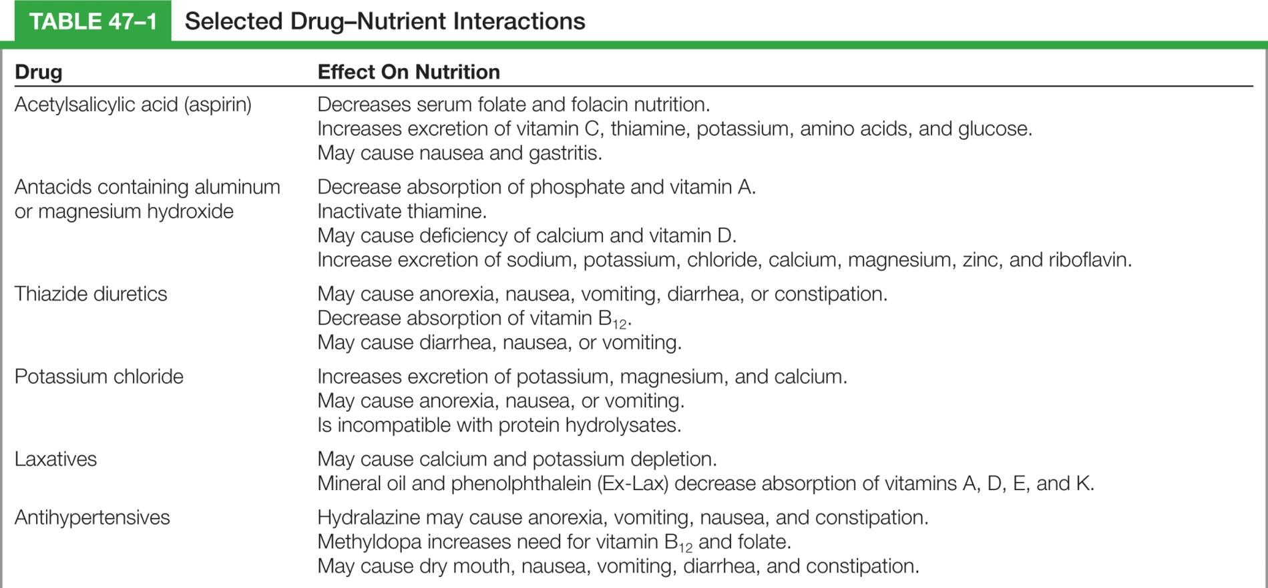
Table 47–1 Selected Drug-Nutrient Interactions
continued on next slide

Slide 26
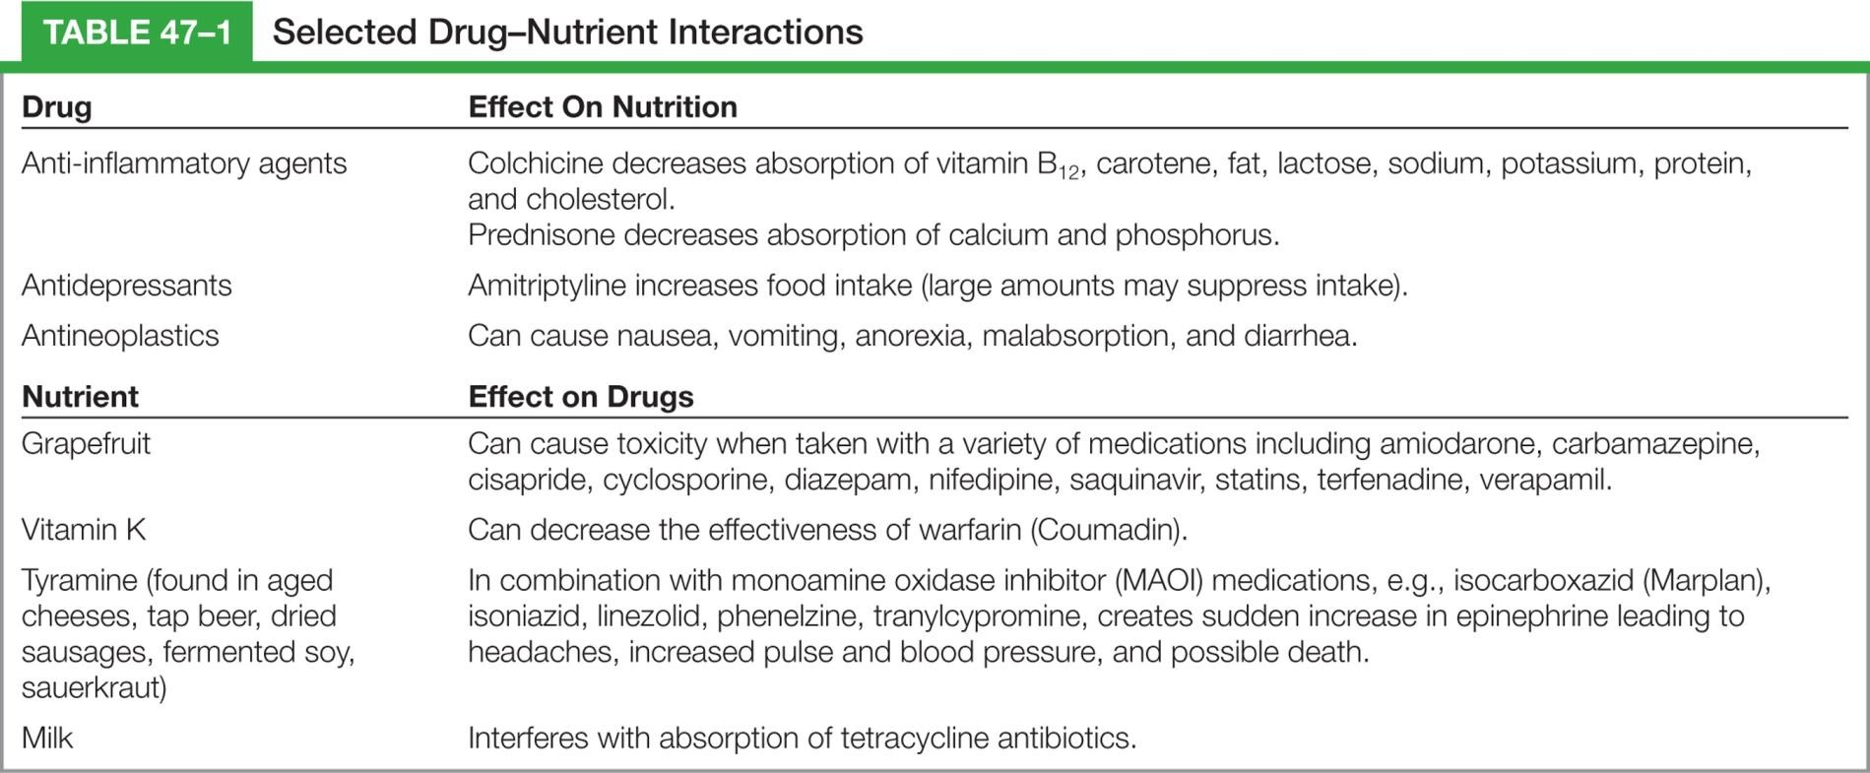
Table 47–1 (continued) Selected Drug-Nutrient Interactions

Slide 27
Nutritional Variations Throughout the Life Cycle
Neonate to 1 year
  Demand feeding
    Child fed when hungry
  Regurgitation
    Does not usually result in deficiency
  Iron deficiency anemia
    Anemia
  Bottle mouth syndrome

Slide 28
Nutritional Variations Throughout the Life Cycle
Toddlers
  Eat most foods
  Adjust to 3 meals/day
  Feed selves
  Deciduous teeth allow range of foods
Preschooler
  Adult foods
  May require snacks

Slide 29
Nutritional Variations Throughout the Life Cycle
School-age child
  Balanced diet of about 2400 Kcal
  Protein-rich food for breakfast to sustain school work
  Teach child about healthful eating
  Poor eating habits lead to obesity

Slide 30
Nutritional Variations Throughout the Life Cycle
Adolescent
  Increased need for nutrients and calories, calcium
  Teach healthy lifelong eating habits
  Risk for eating disorders
    Anorexia nervosa
    Bulimia

Slide 31
Nutritional Variations Throughout the Life Cycle
Young adult
  Continue to eat a healthy diet with special attention to protein, calcium, and limiting cholesterol and caloric intake
  Two or three liters of fluid should be included in the daily diet

Slide 32
Nutritional Variations Throughout the Life Cycle
Middle-aged adult
  Postmenopausal women need to ingest sufficient calcium and vitamin D to reduce osteoporosis.
  Antioxidants such as vitamin A, C, and E may be helpful in reducing the risk of heart disease in women.

Slide 33
Nutritional Variations Throughout the Life Cycle
Older adults
  What is needed in their nutritional intake?
  How many calories? Why is it different than other adults?
  What can be done to avoid constipation?
continued on next slide

Slide 34
Nutritional Variations Throughout the Life Cycle
Older adults
  What are the physical changes that occur with aging that may effect nutritional intake?
  What are the psychosocial factors associated with aging that may affect nutritional intake?

Slide 35
Altered Nutrition
Malnutrition
  Lack of necessary or appropriate food substances
  Overnutrition
    Overweight
    Obese
  Undernutrition

Slide 36
Altered Nutrition
Protein-calorie malnutrition (PCM)
  Depressed visceral proteins
  Visible muscle and fat wasting
Protein stores
  Somatic
    Skeletal muscle mass
  Visceral
    Plasma, hemoglobin, hormones, antibodies

Slide 37
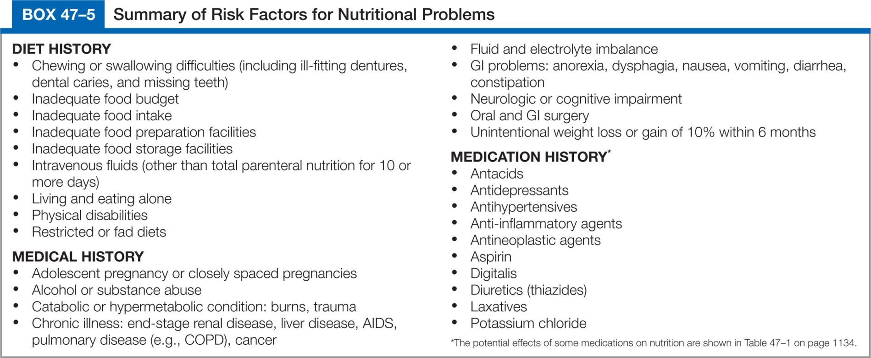
Box 47–5 Summary of Risk Factors for Nutritional Problems

Slide 38
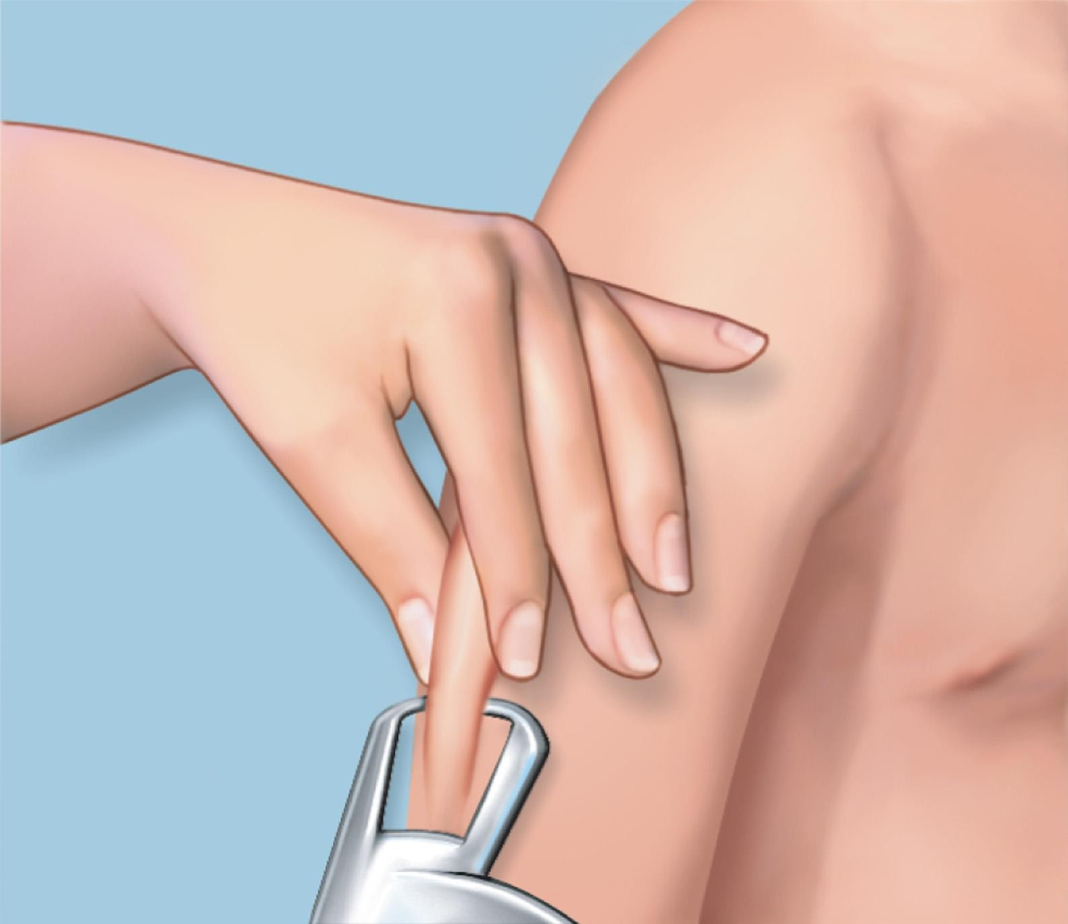
Figure 47–5 Measuring the triceps skinfold.

Slide 39

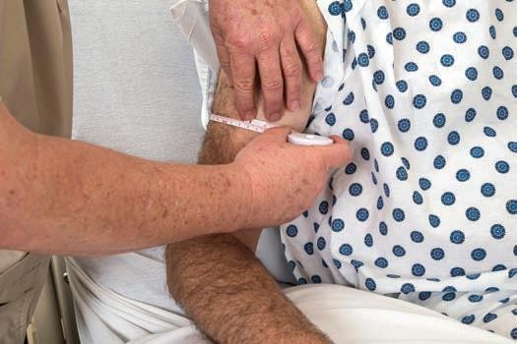
Figure 47–6 • Measuring the mid-arm circumference.

Slide 40
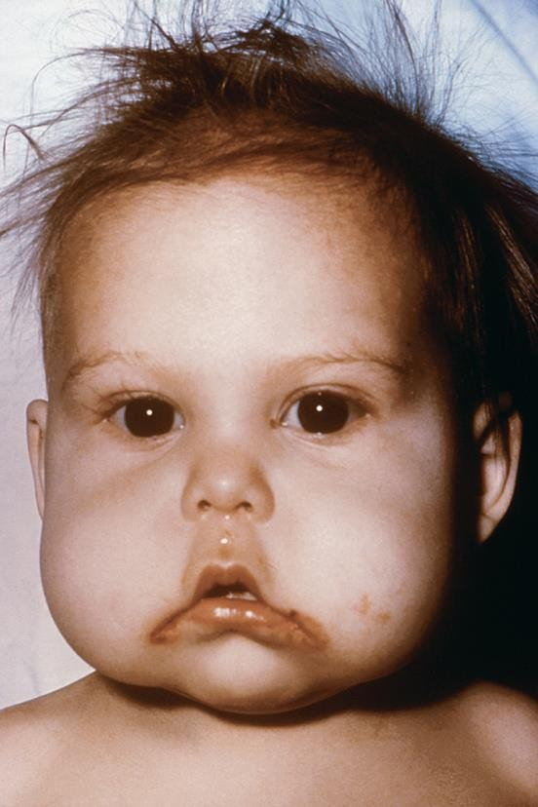
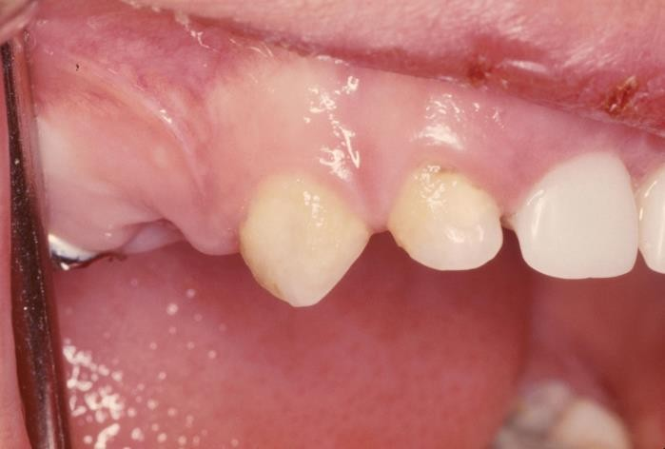
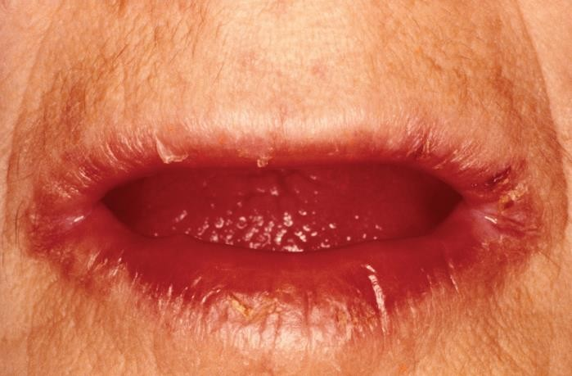
Figure 47–7 Examples of nutritional deficiencies: A, dull, sparse hair and inflammation of the corners of the mouth from protein deficiency; B, rickets from vitamin D or calcium deficiency; C, pallagra, caused by a chronic lack of niacin (vitamin B).
A from Centers for Disease Control and Prevention; B from Custom Medical Stock Photo; C from Biophoto Associates/Science Source.
B
A
C

Slide 41
Assessing
Clinical data (physical examination)
  Focus on skin, hair, nails, eyes, and mucosa
  Calculating percentage of weight loss
    Compare height, current body weight, and usual body weight
    IBW based on healthy people

Slide 42
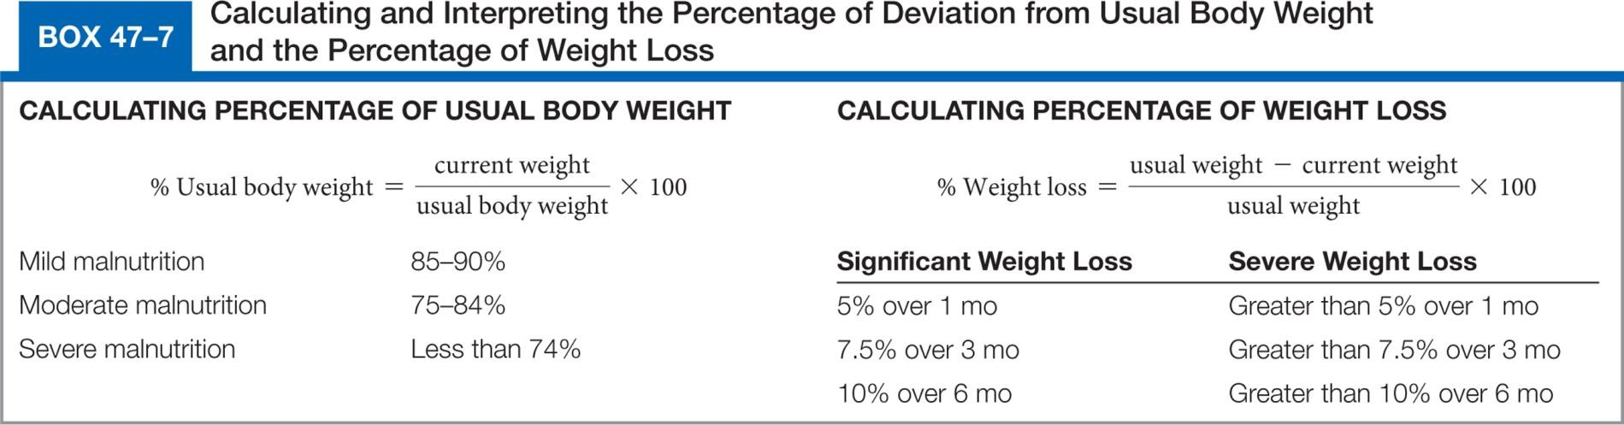
Box 47–7 Calculating and Interpreting the Percent of Deviation from Usual Body Weight and the Percent of Weight Loss

Slide 43
Assessing
Dietary data
  Eating patterns, habits
  Food preferences
  Frequency, type, and quantity of food consumed
  Social, economic, ethnic, religious factors
    Living and eating companions, etc.
continued on next slide

Slide 44
Diagnosing
Imbalanced Nutrition: More Than Body Requirements
Imbalanced Nutrition: Less Than Body Requirements
Readiness for Enhanced Nutrition
Risk for Imbalanced Nutrition: More Than Body Requirements

Slide 45
Diagnosing
Diagnostic label used as etiology
  Activity Intolerance
  Constipation
  Low Self-Esteem
  Risk for Infection

Slide 46
Planning
Maintain or restore optimal nutritional status
Promote healthy nutritional practices
Prevent complications associated with malnutrition
Decrease weight or regain specified weight

Slide 47
Planning
Planning for home care
  Provide aid with eating, purchasing food, and preparing meals
  Instruct about nutrition therapy
  Assess client and family's abilities for self-care, financial resources, and need for referrals

Slide 48
Implementing
Hospitalized client
  Provided in collaboration with the primary care provider and the dietitian
  Reinforce information presented by dietitian
  Create an atmosphere that encourages eating
  Provide and assist with eating as needed
continued on next slide

Slide 49
Implementing
Hospitalized client
  Monitor the client's appetite and food intake
  Administer enteral and parenteral feedings
  Consult with primary care provider and dietitian about nutritional problems

Slide 50
Implementing
Assisting with special diets
  Clear liquid diet
    Fluid and carbohydrates
    No adequate protein, fat, vitamins, minerals, calories
  Full liquid diet
    Liquids or foods that turn liquid at body temperature
    Clients with GI disturbances
continued on next slide
Copyright © 2016, 2012, 2008 Pearson Education, Inc. All Rights Reserved

Slide 51
Implementing
Assisting with special diets
  Soft diet
    Low residue (low-fiber)
    What's the difference between this and pureed?
  Diet as tolerated
    Advance the diet if the patient is responding as expected
continued on next slide
Copyright © 2016, 2012, 2008 Pearson Education, Inc. All Rights Reserved

Slide 52
Implementing
Stimulating the appetite
  Decrease in food intake often accompanied by decrease in fluid intake.
  Short-term decrease not a problem, but over time it leads to nutritional problems.
  Determine reason for lack of appetite, then deal with problem

Slide 53
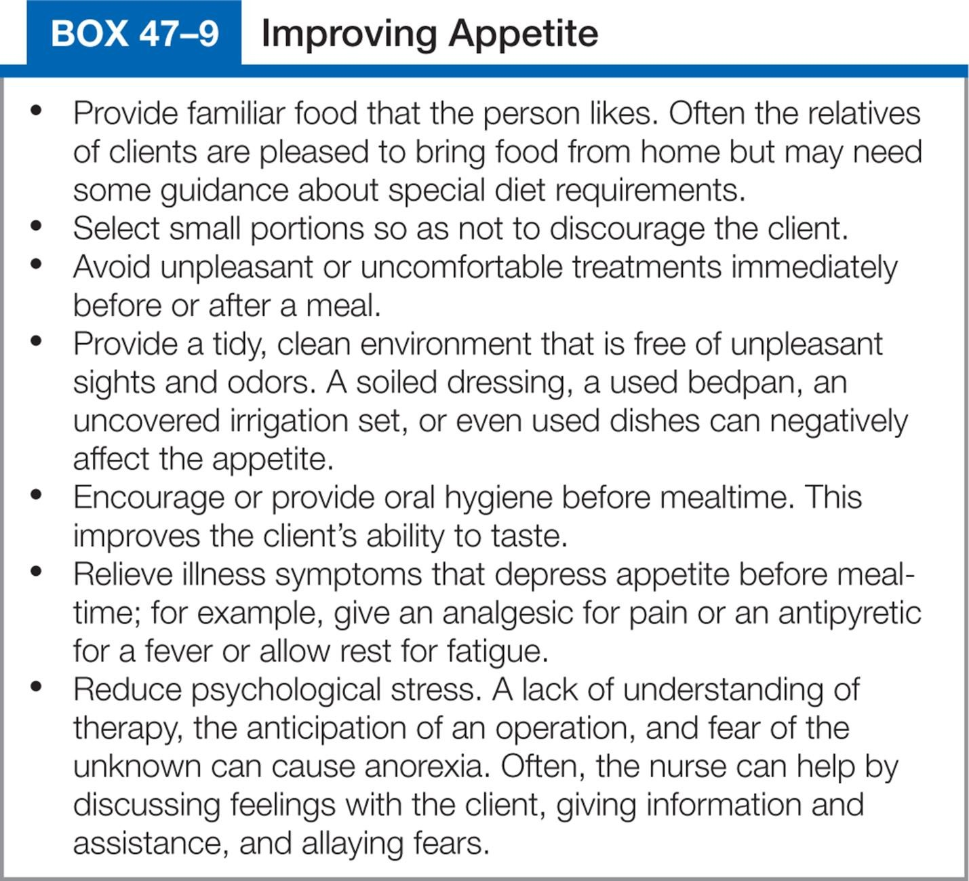
Box 47–9 Improving Appetite

Slide 54
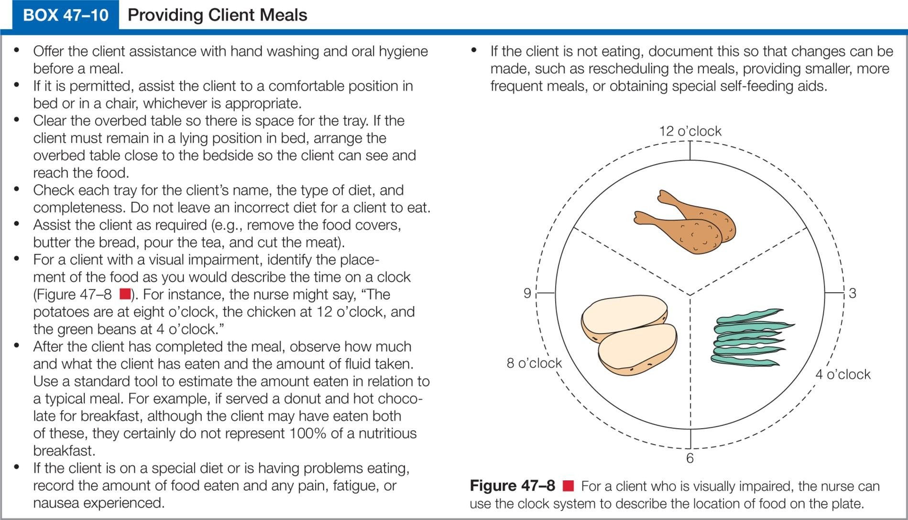
Box 47-10 Providing Client Meals

Slide 55
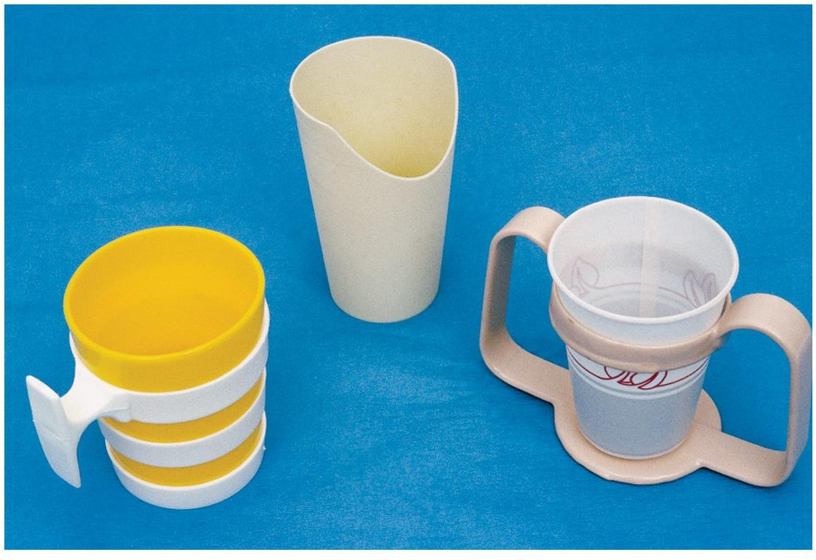
Figure 47–9 Left to right: glass holder, cup with hole for nose, two-handled cup holder.

Slide 56
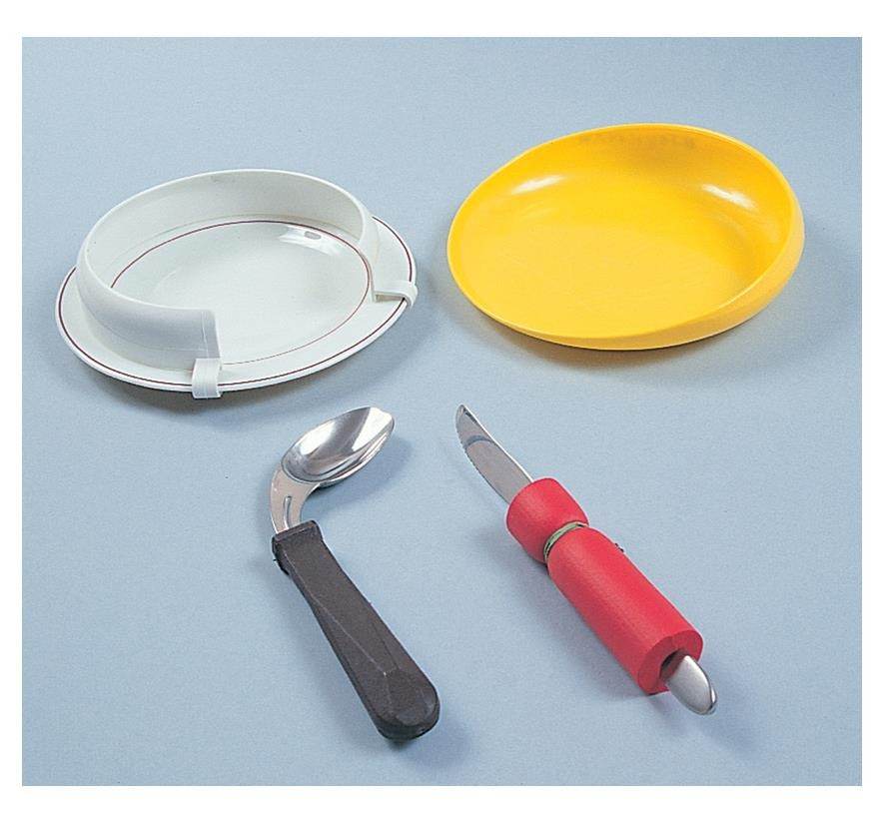
Figure 47–10 Dinner plate with guard attached and lipped plate facilitate scooping; wide-handled spoon and
knife facilitate grip.
.

Slide 57
Implementing
Enteral nutrition
  Enteral
    Through the GI system
  Enteral access devices
    Nasogastric tube
    Nasoenteric (nasointestinal) tube
    Gastrostomy and jejunostomy devices
continued on next slide

Slide 58
Implementing
Enteral nutrition
  Enteral access devices
    Percutaneous endoscopic gastrostomy (PEG)
    Percutaneous endoscopic jejunostomy (PEJ)

Slide 59
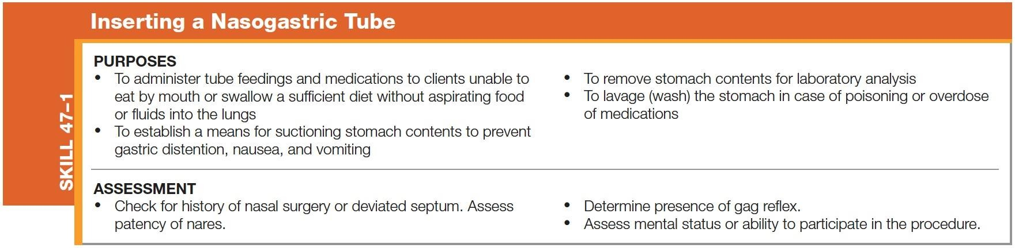
Skill 47–1 Inserting a Nasogastric tube
continued on next slide
Copyright © 2016, 2012, 2008 Pearson Education, Inc. All Rights Reserved

Slide 60
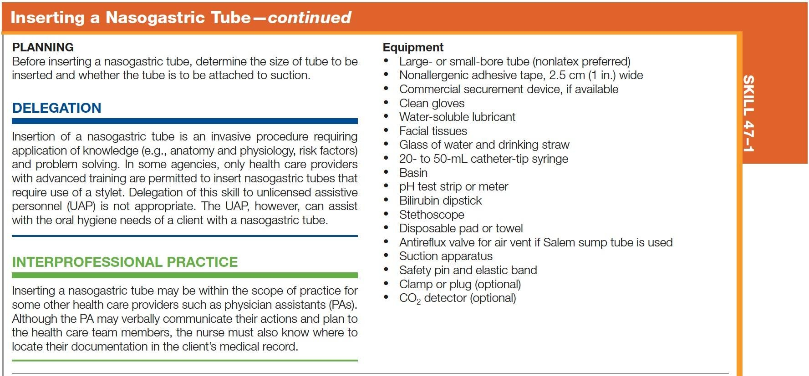
Skill 47–1 (continued) Inserting a Nasogastric tube
continued on next slide
Copyright © 2016, 2012, 2008 Pearson Education, Inc. All Rights Reserved

Slide 61
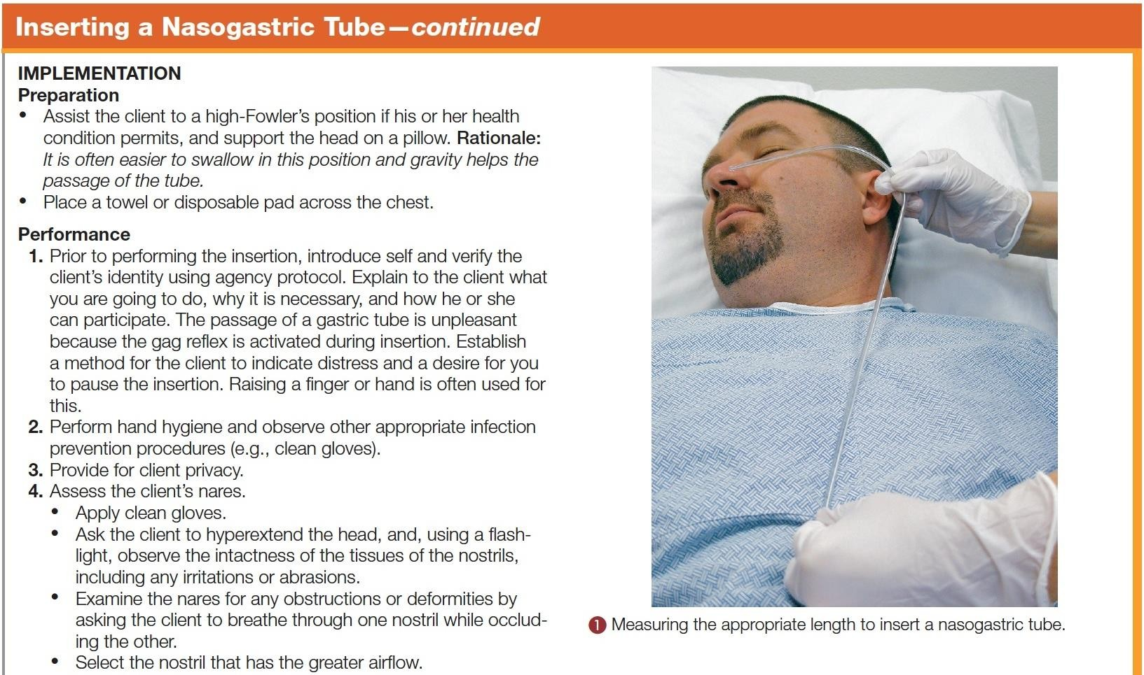
Skill 47–1 (continued) Inserting a Nasogastric tube
continued on next slide
Copyright © 2016, 2012, 2008 Pearson Education, Inc. All Rights Reserved

Slide 62
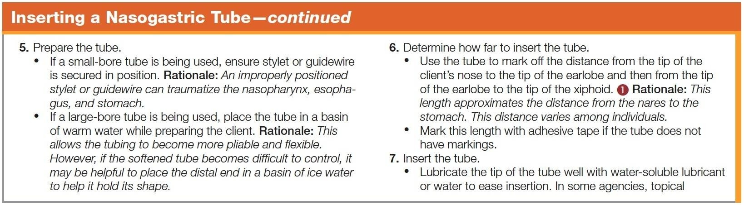
Skill 47–1 (continued) Inserting a Nasogastric tube
continued on next slide
Copyright © 2016, 2012, 2008 Pearson Education, Inc. All Rights Reserved

Slide 63
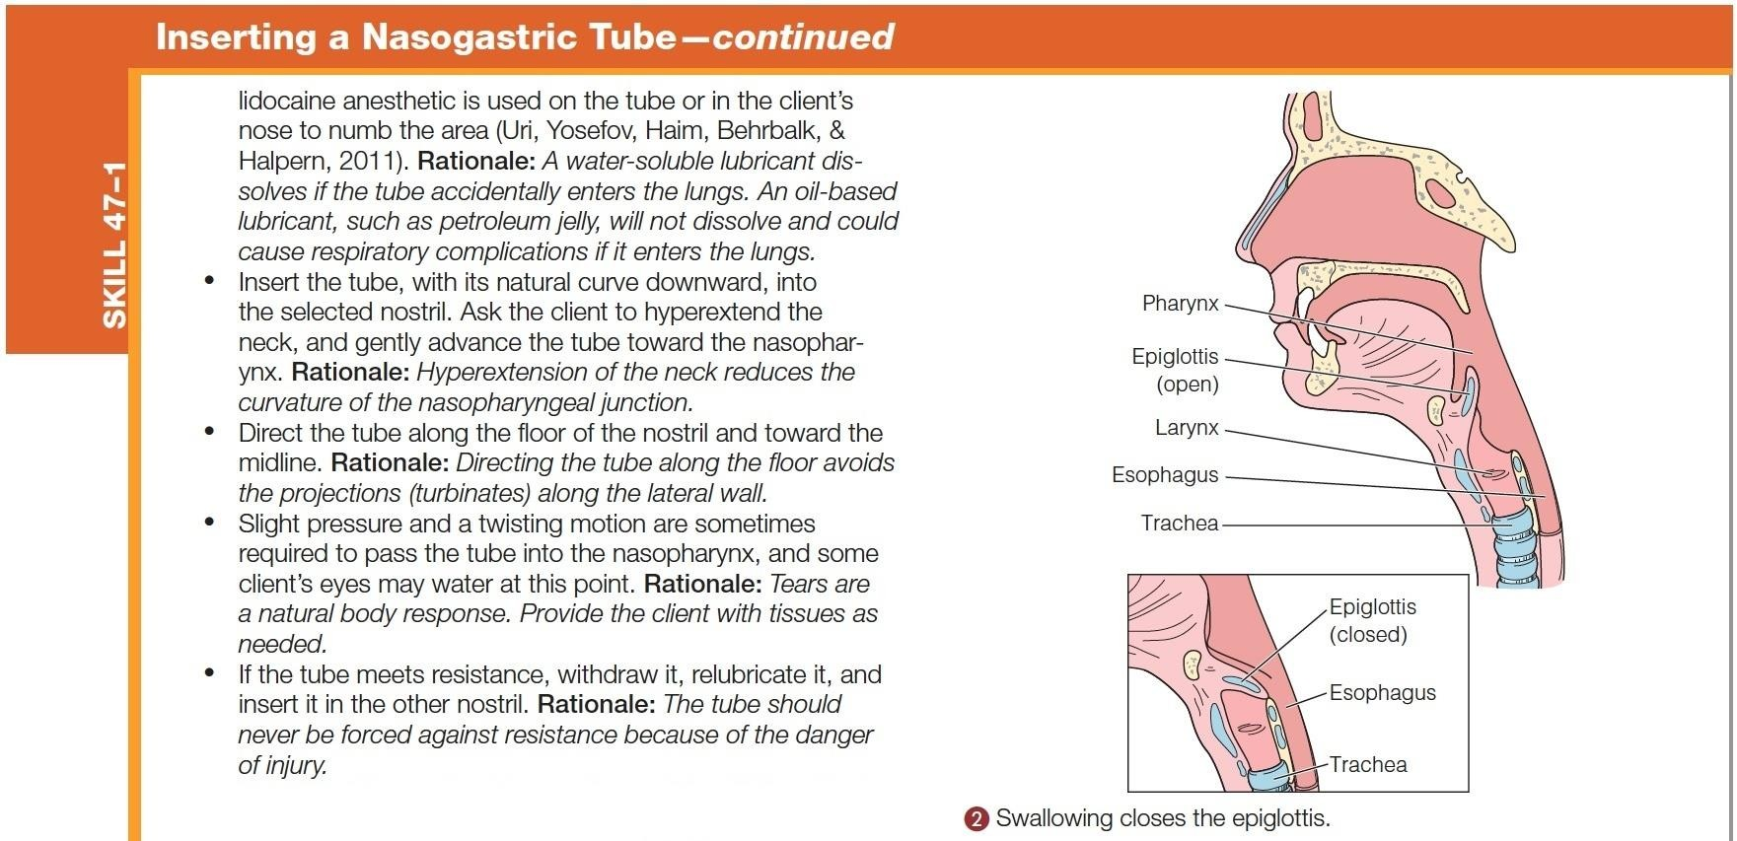
Skill 47–1 (continued) Inserting a Nasogastric tube
continued on next slide
Copyright © 2016, 2012, 2008 Pearson Education, Inc. All Rights Reserved

Slide 64
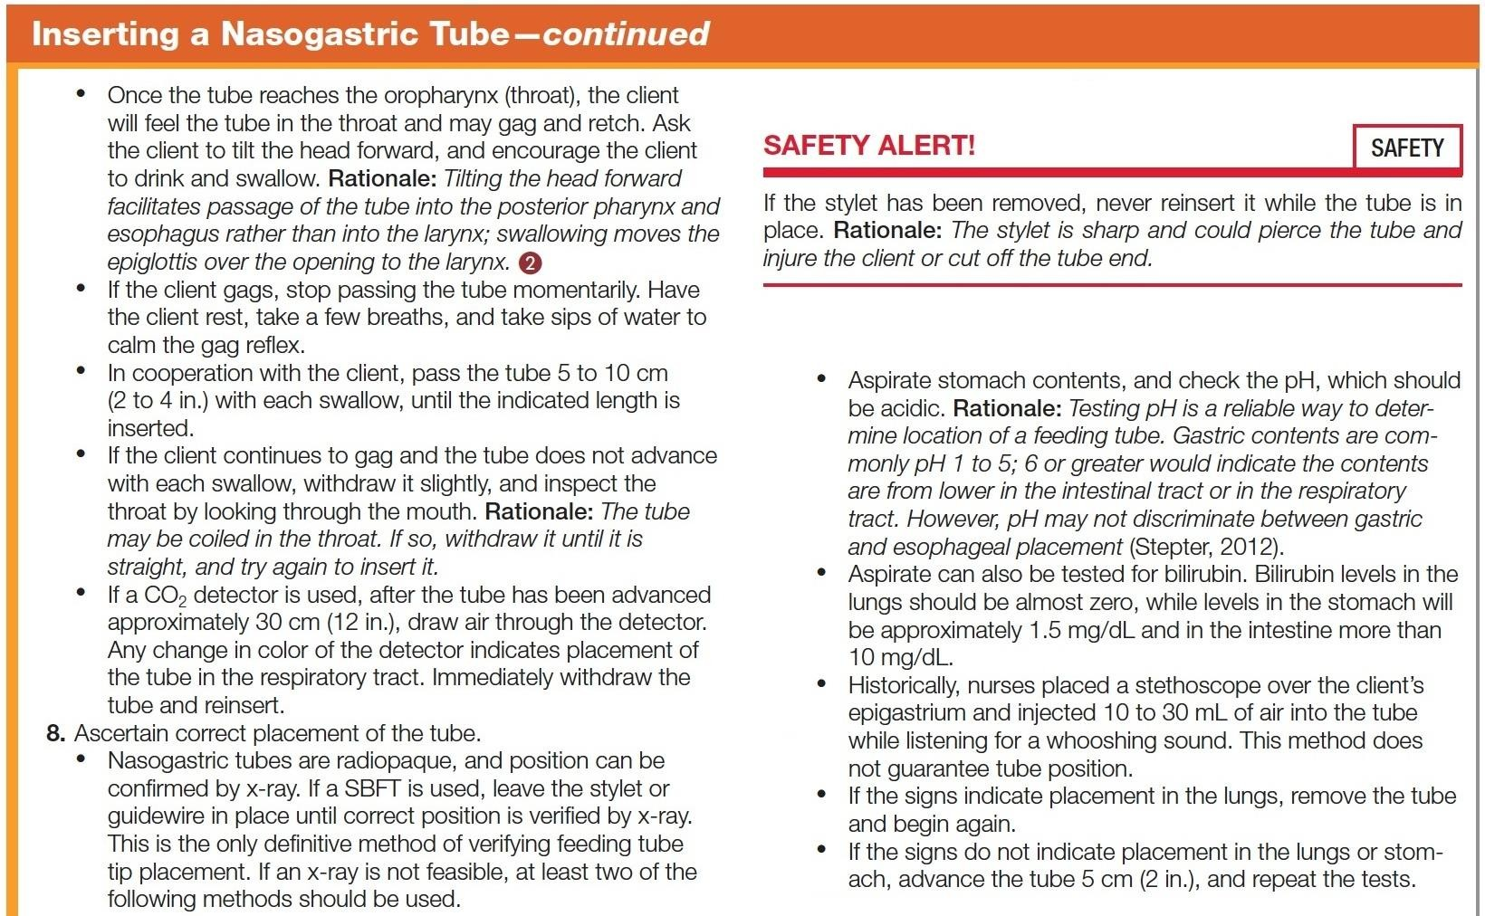
Skill 47–1 (continued) Inserting a Nasogastric tube
continued on next slide
Copyright © 2016, 2012, 2008 Pearson Education, Inc. All Rights Reserved

Slide 65
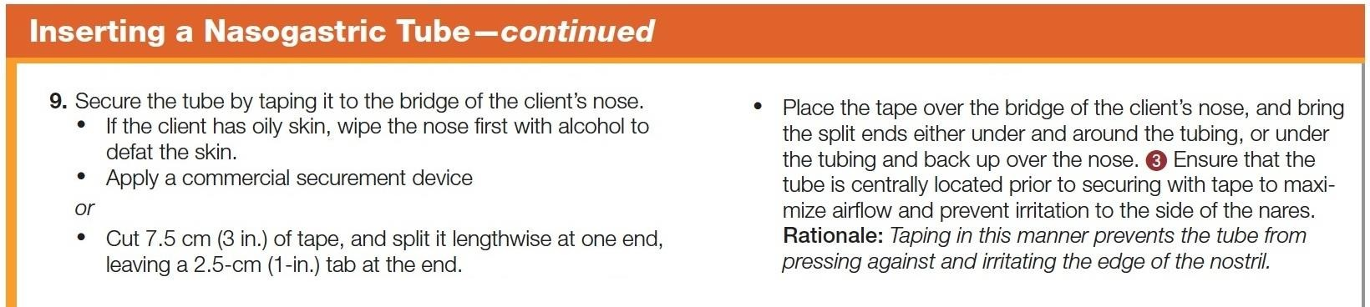
Skill 47–1 (continued) Inserting a Nasogastric tube
continued on next slide
Copyright © 2016, 2012, 2008 Pearson Education, Inc. All Rights Reserved

Slide 66
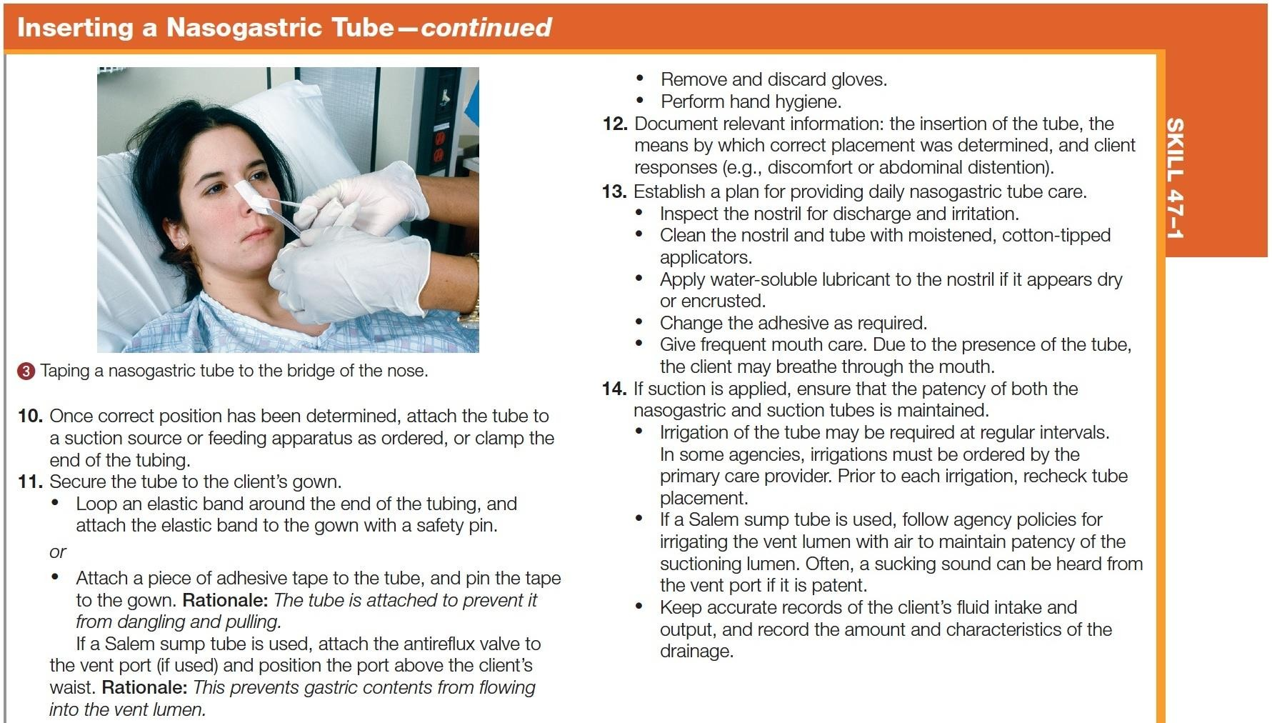
Skill 47–1 (continued) Inserting a Nasogastric tube
continued on next slide
Copyright © 2016, 2012, 2008 Pearson Education, Inc. All Rights Reserved

Slide 67
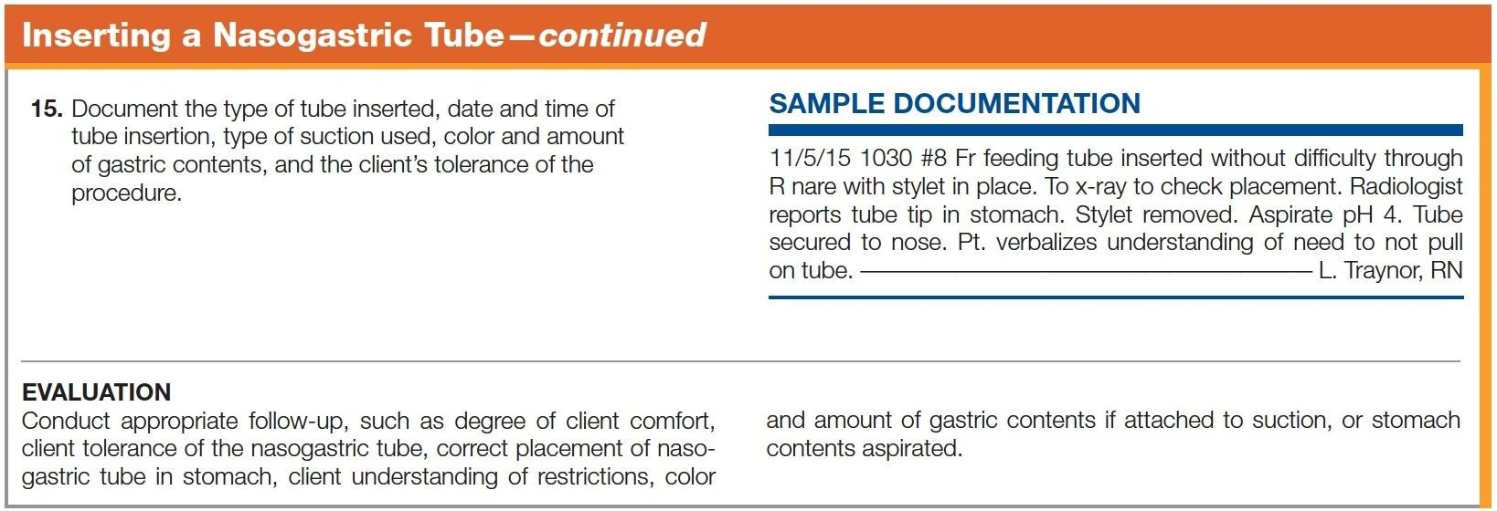
Skill 47–1 (continued) Inserting a Nasogastric tube

Slide 68
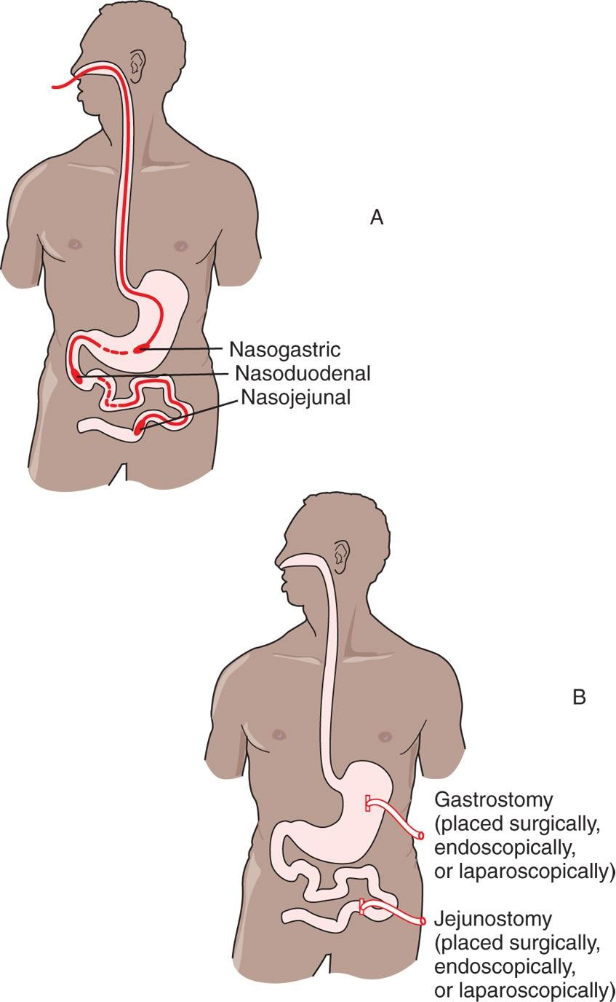
Figure 47–13 Placements for enteral access: A, for nasoenteric/nasointestinal tubes; B, for gastrostomy and
jejunostomy tubes.

Slide 69
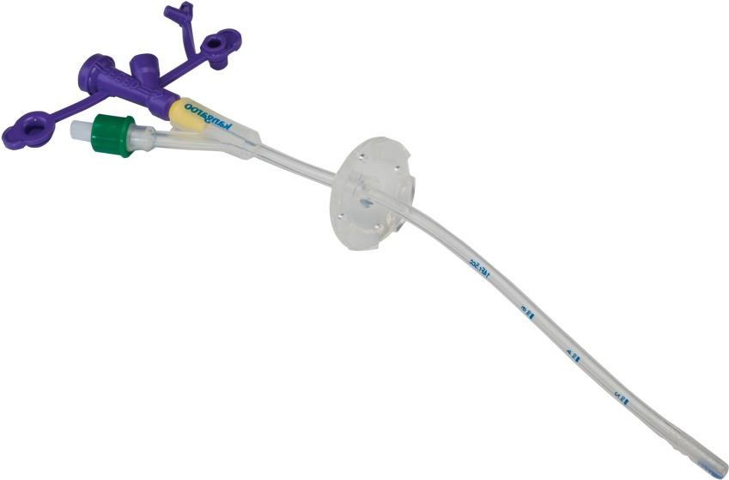
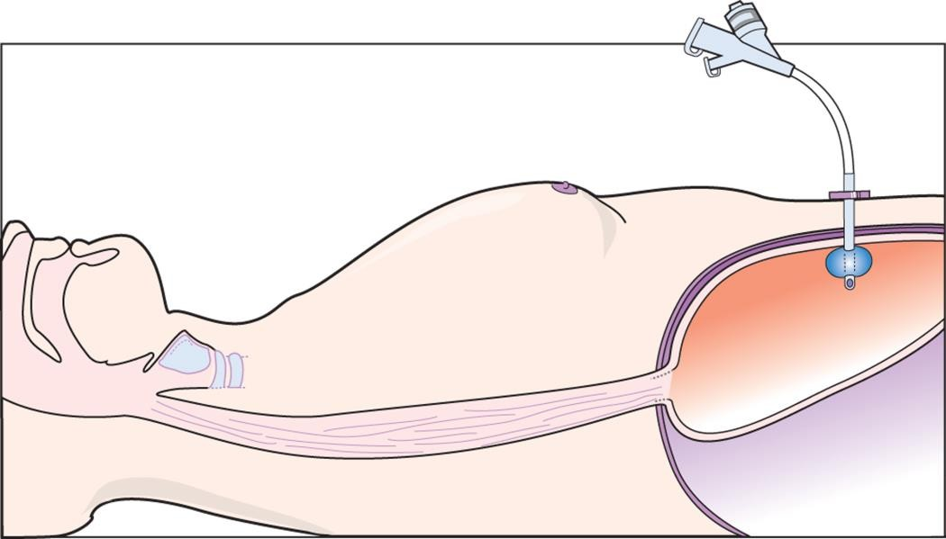
Figure 47–14 Percutaneous endoscopic gastrostomy (PEG) tube.
A, Courtesy Covidien.
A
B

Slide 70
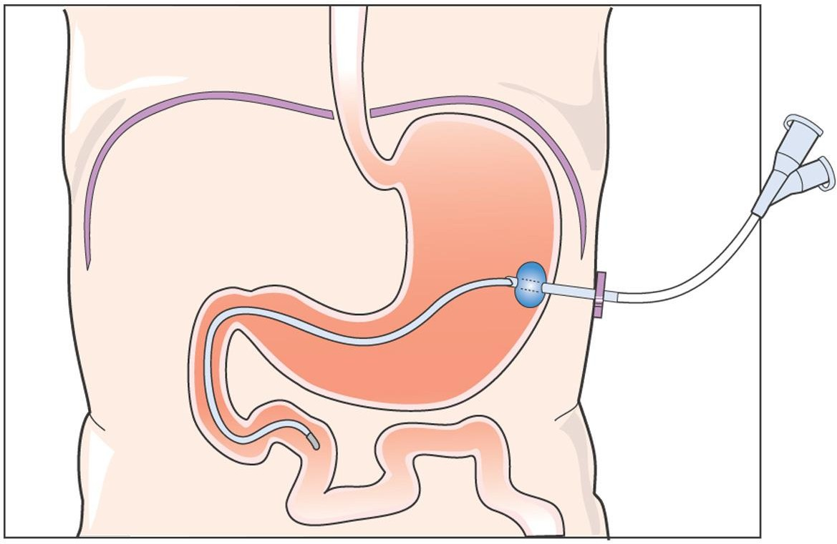
Figure 47–15 Percutaneous endoscopic jejunostomy (PEJ) tube.

Slide 71
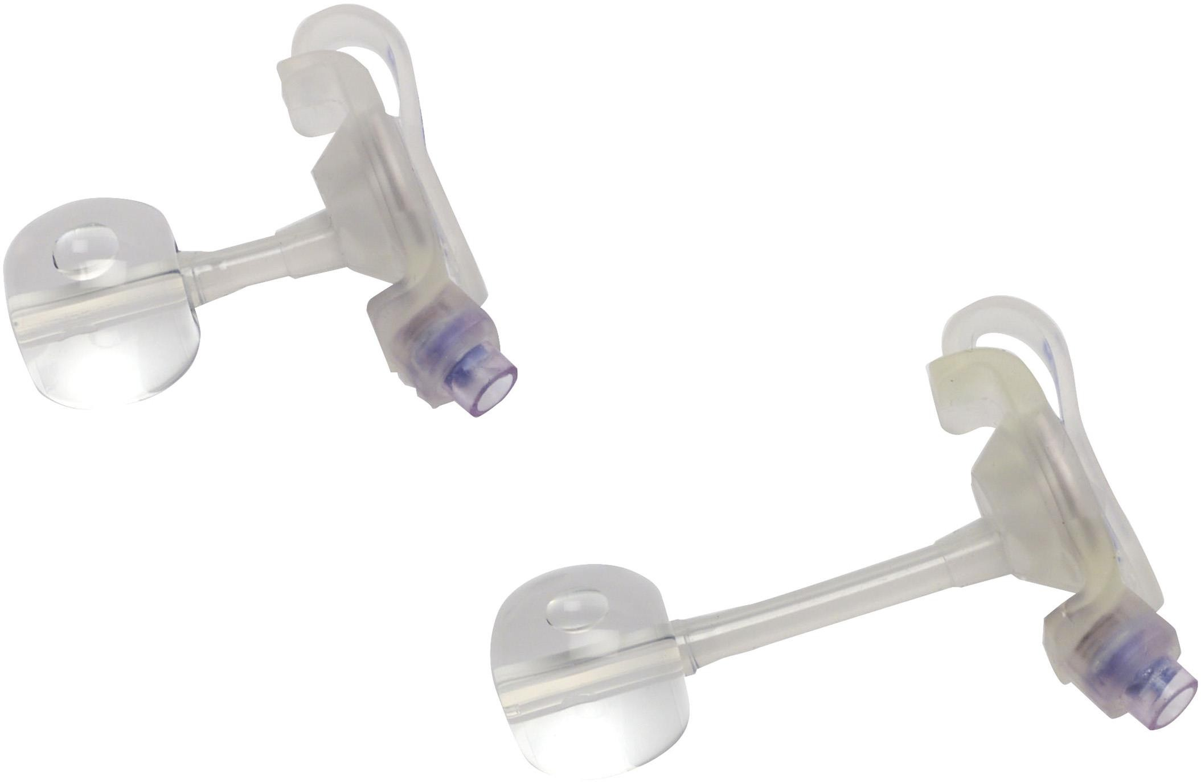
Figure 47–16 Low-profile gastrostomy feeding tube.
Courtesy Covidien.

Slide 72
Implementing
Enteral nutrition
  Testing feeding tube placement
    Initially, tube placement confirmed by radiography and tube marked with indelible ink at exit point from nose
    Length of visible tubing documented
continued on next slide
Copyright © 2016, 2012, 2008 Pearson Education, Inc. All Rights Reserved

Slide 73
Implementing
Enteral nutrition
  Testing feeding tube placement
    Verify placement before feedings, at intervals
      Aspirate GI secretions
      Measure pH of aspirated fluid
      Auscultate epigastrium while injecting 5– 20 mL of air
      Confirm length of tube insertion with insertion mark
continued on next slide
Copyright © 2016, 2012, 2008 Pearson Education, Inc. All Rights Reserved

Slide 74
Implementing
Enteral nutrition
  Enteral feedings
    Administer
      Intermittent
        300–500 mL per feeding over 30 minute period
        Usually administered room temp
continued on next slide
Copyright © 2016, 2012, 2008 Pearson Education, Inc. All Rights Reserved

Slide 75
Implementing
Enteral nutrition
  Enteral feedings
    Administer
      Continuous
        Administered over 24 h with infusion pump
        Usually administered cold
    Refeeding syndrome
      Periods of malnutrition, starvation
    Open system or closed system

Slide 76
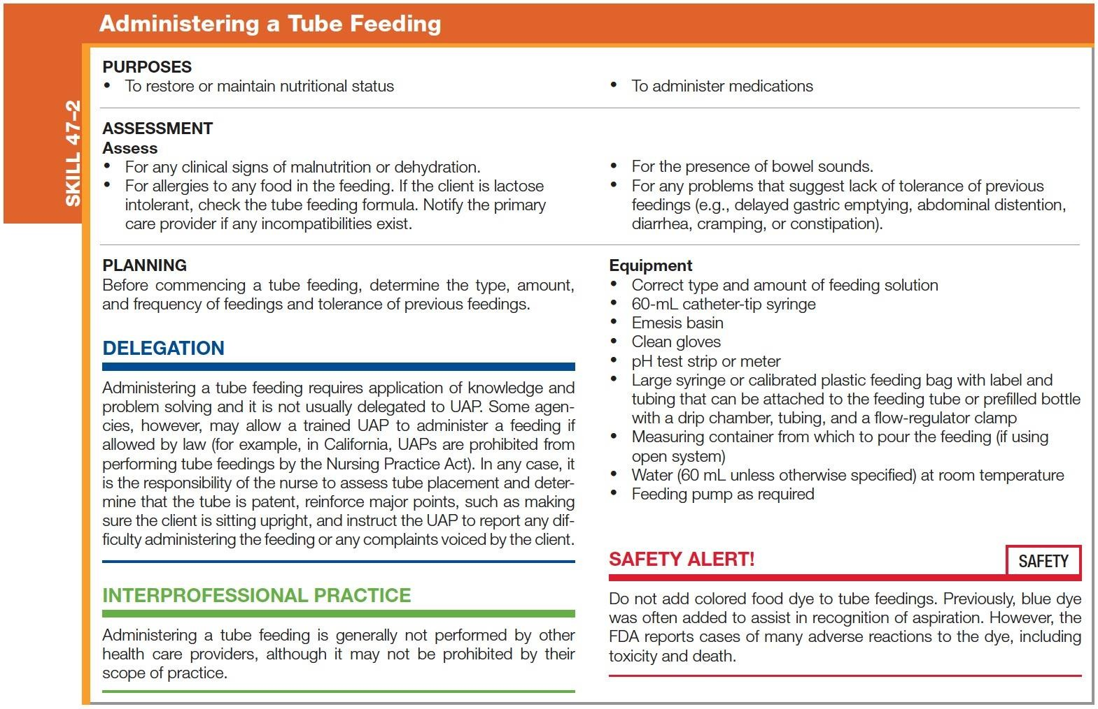
Skill 47–2 Administering a Tube Feeding
continued on next slide
Copyright © 2016, 2012, 2008 Pearson Education, Inc. All Rights Reserved

Slide 77
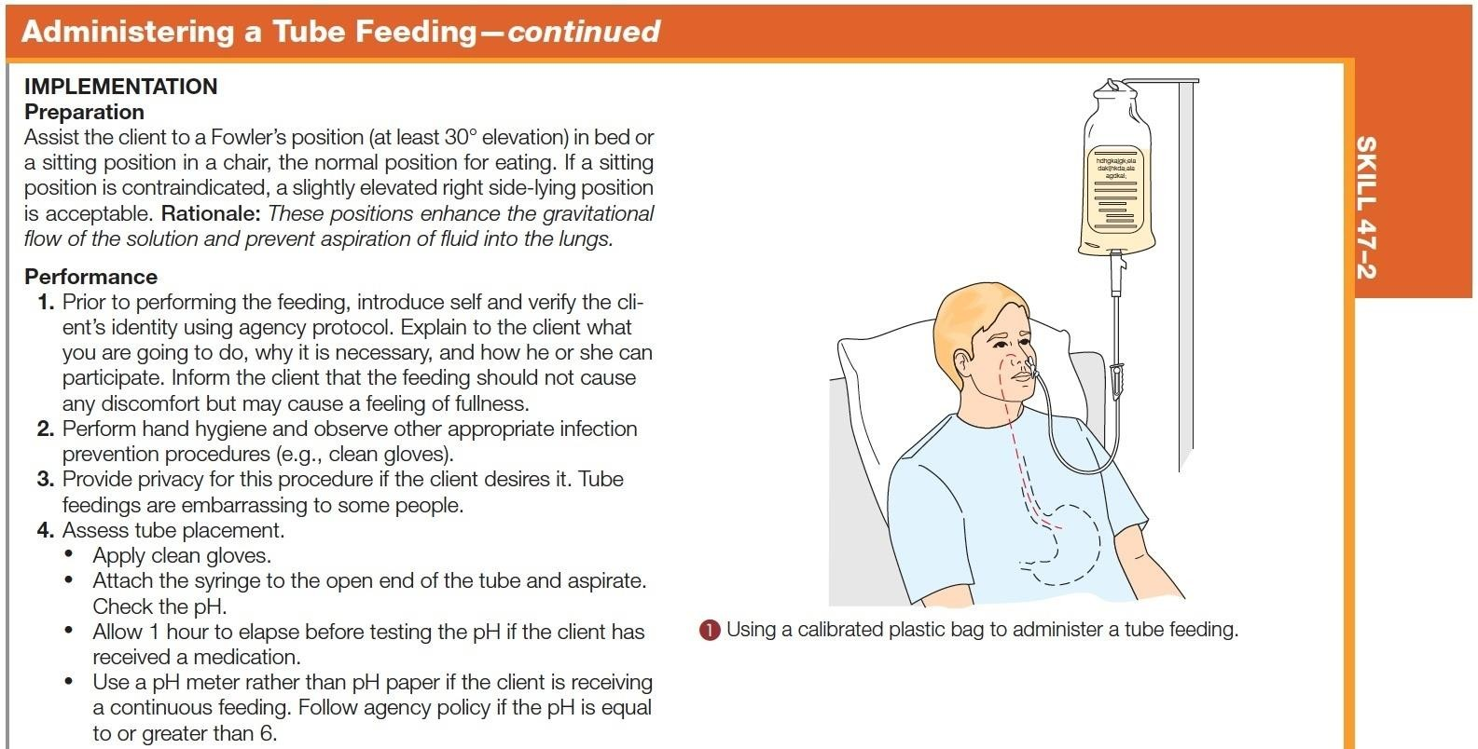
Skill 47–2 (continued) Administering a Tube Feeding
continued on next slide
Copyright © 2016, 2012, 2008 Pearson Education, Inc. All Rights Reserved

Slide 78
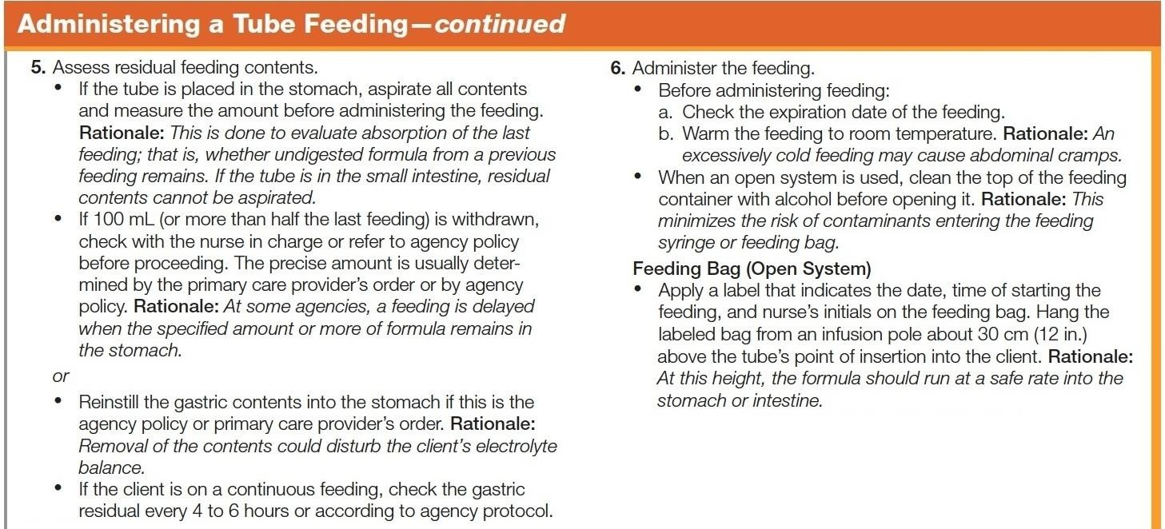
Skill 47–2 (continued) Administering a Tube Feeding
continued on next slide
Copyright © 2016, 2012, 2008 Pearson Education, Inc. All Rights Reserved

Slide 79
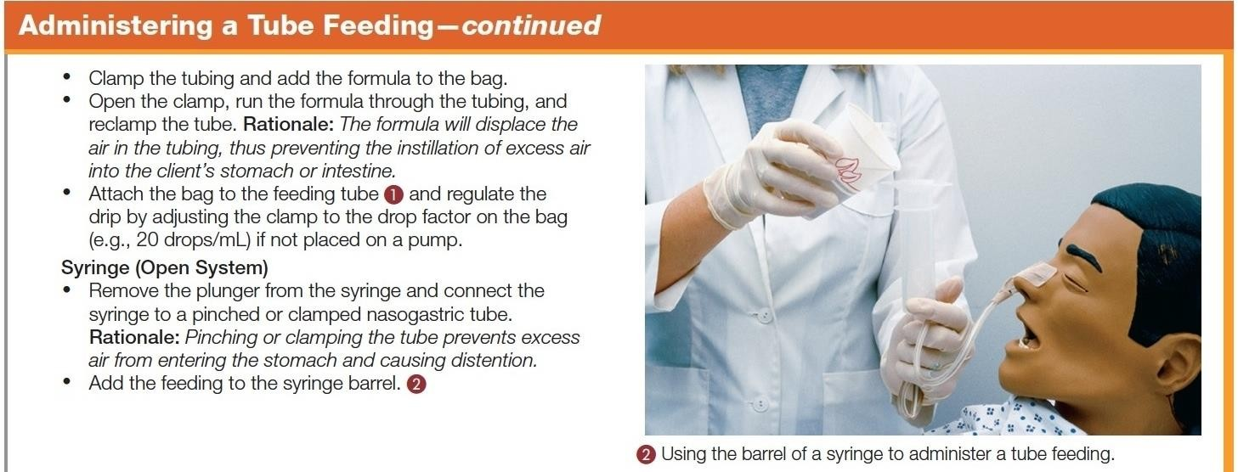
Skill 47–2 (continued) Administering a Tube Feeding
continued on next slide
Copyright © 2016, 2012, 2008 Pearson Education, Inc. All Rights Reserved

Slide 80
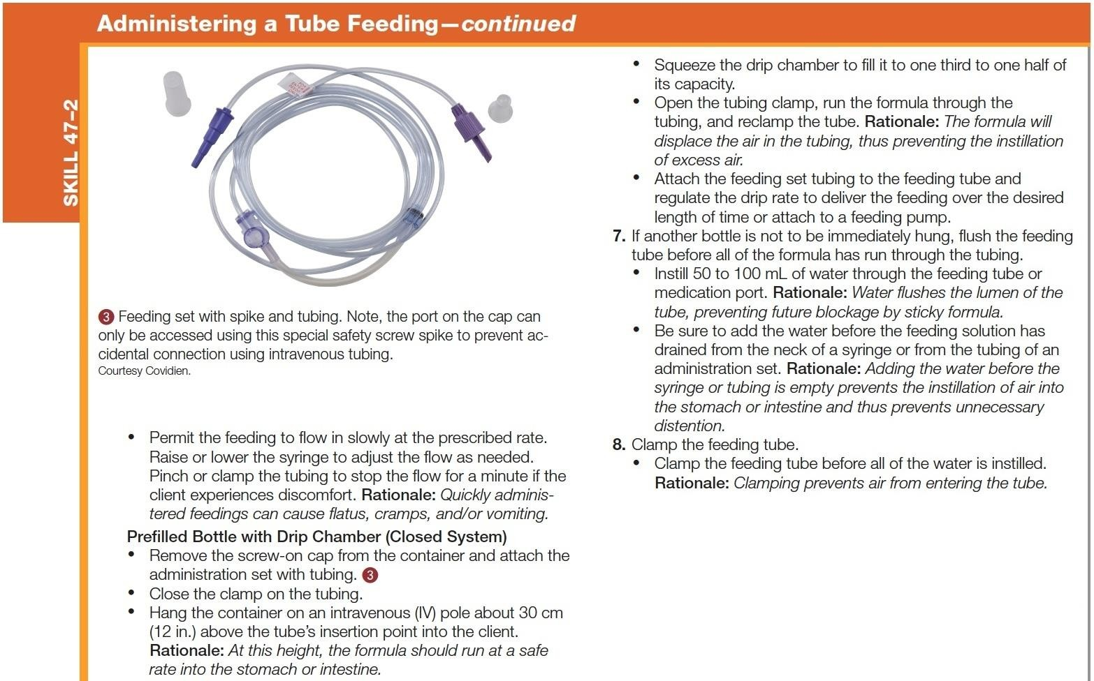
Skill 47–2 (continued) Administering a Tube Feeding
continued on next slide
Copyright © 2016, 2012, 2008 Pearson Education, Inc. All Rights Reserved

Slide 81
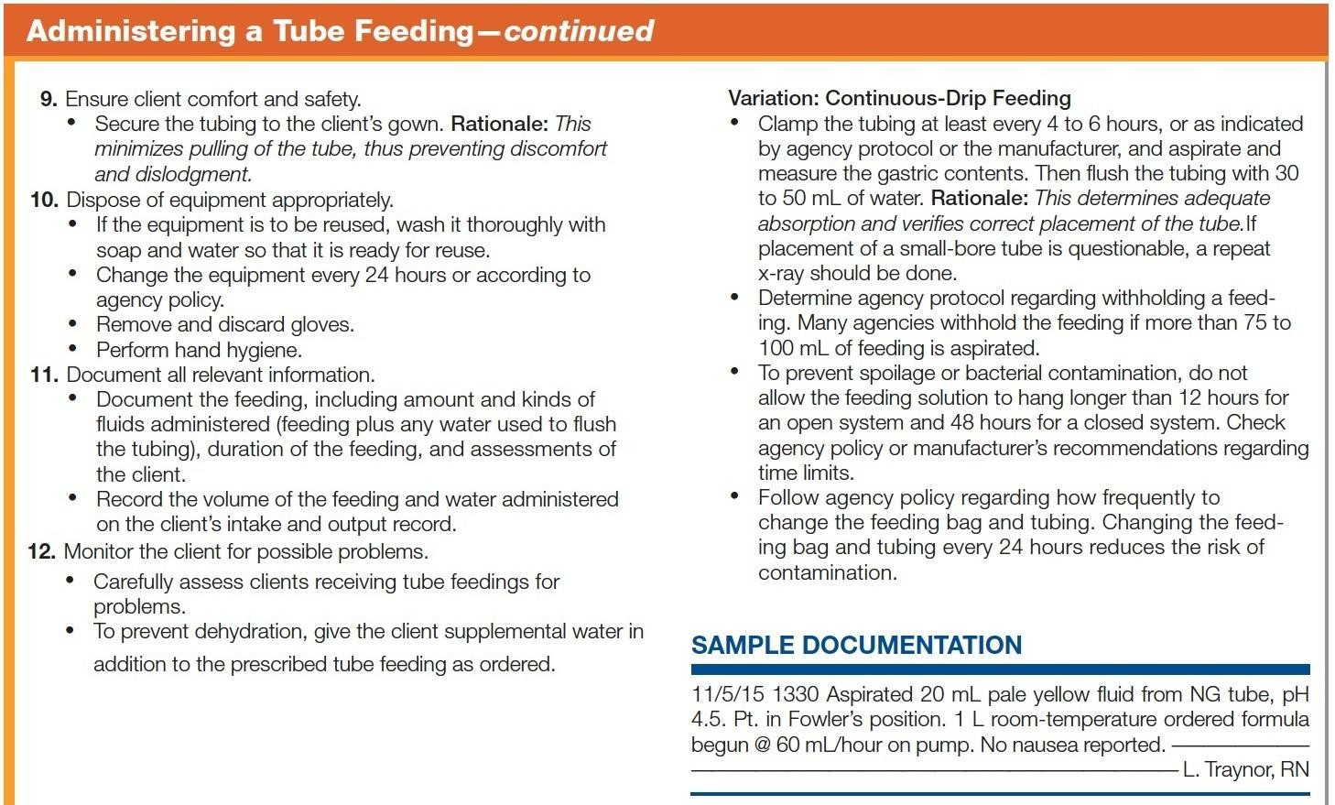
Skill 47–2 (continued) Administering a Tube Feeding

Slide 82
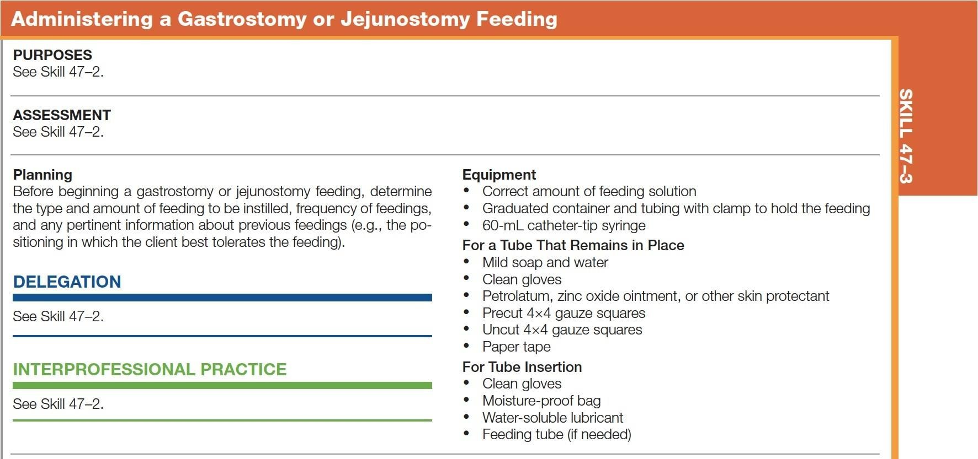
Skill 47–3 Administering a Gastrostomy or Jejunostomy Feeding
continued on next slide
Copyright © 2016, 2012, 2008 Pearson Education, Inc. All Rights Reserved

Slide 83
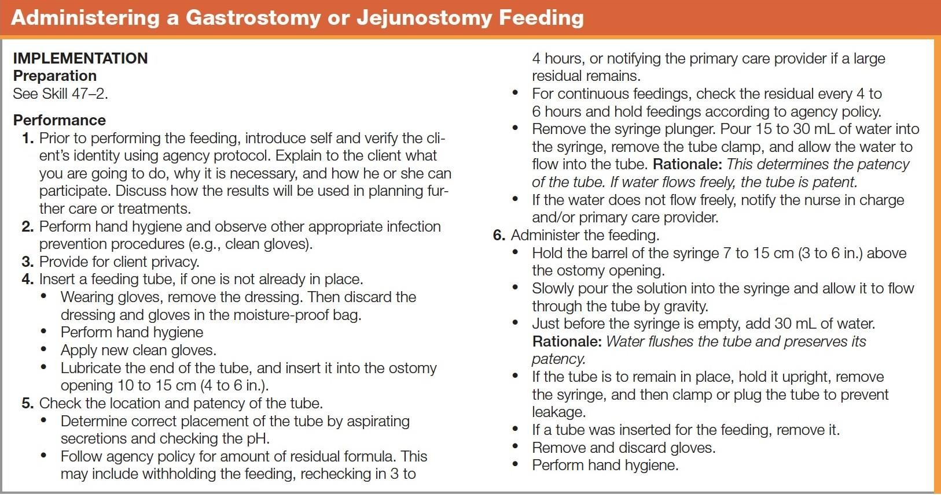
Skill 47–3 (continued) Administering a Gastrostomy or Jejunostomy Feeding
continued on next slide
Copyright © 2016, 2012, 2008 Pearson Education, Inc. All Rights Reserved

Slide 84
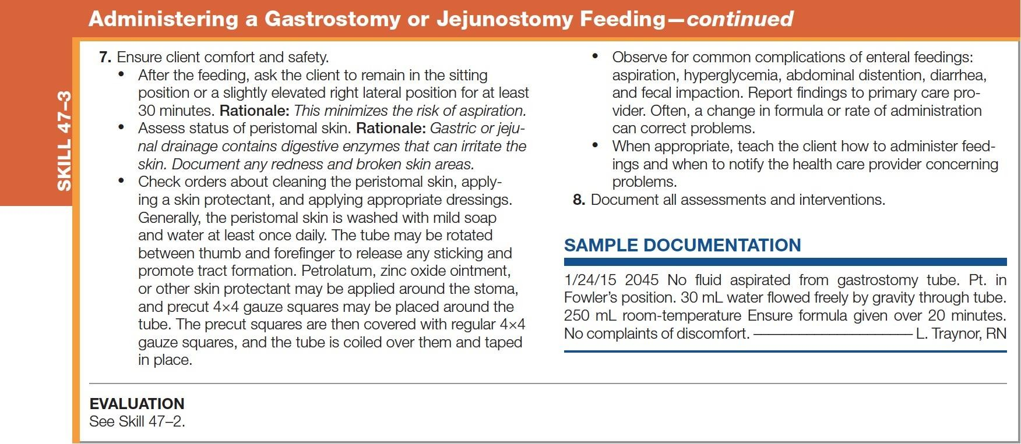
Skill 47–3 (continued) Administering a Gastrostomy or Jejunostomy Feeding

Slide 85
Implementing
Enteral nutrition
  Managing clogged feeding tubes
    Clogged tubes must be removed and reinserted; prevention is key.
    Flush with at least 30 mL water before, between, and after each medication is instilled
    Do not add meds to formula or to each other, as precipitates may form
continued on next slide

Slide 86
Implementing
Enteral nutrition
  Managing clogged feeding tubes
    First, reposition client to release kink in tubing
    If still blocked, flush and aspirate with water repeatedly

Slide 87
Implementing
Parenteral nutrition
  Total parenteral nutrition (TPN) or IV hyperalimentation
    Hypertonic; injected only into high-flow central veins
    Used in clients with severe malnutrition, severe burns, bowel disease disorders, acute renal failure, hepatic failure, metastatic cancer, and major surgeries (NPO 5 days)
continued on next slide
Copyright © 2016, 2012, 2008 Pearson Education, Inc. All Rights Reserved

Slide 88
Implementing
Parenteral nutrition
  Total parenteral nutrition (TPN) or IV hyperalimentation
    Carries risk of infection and fluid/electrolyte imbalances
    Requires surgical aseptic technique, frequent lab monitoring for TPN modification
continued on next slide
Copyright © 2016, 2012, 2008 Pearson Education, Inc. All Rights Reserved

Slide 89
Implementing
Parenteral nutrition
  Total parenteral nutrition (TPN) or IV hyperalimentation
    Infusions started gradually to prevent hyperglycemia
      Glucose levels monitored
    Discontinued gradually to prevent hyperinsulinemia and hypoglycemia
continued on next slide
Copyright © 2016, 2012, 2008 Pearson Education, Inc. All Rights Reserved

Slide 90
Implementing
Parenteral nutrition
  Peripheral parenteral nutrition (PPN)
    Less concentrated solution, can provide lipids but associated with phlebitis
    Used more to prevent than to correct nutritional imbalance
  Enteral or parenteral can be provided in home.

Slide 91
Evaluating
The goals established in the planning phase are evaluated according to specific desired outcomes.

Slide 92
Evaluating
If the outcomes are not achieved, the nurse should explore the reasons.
  Cause of problem identified? Outcomes realistic?
  Family included and supportive?
  Client's preferences considered?
  Do symptoms cause loss of appetite?
  Anything interfering with digestion or absorption?

