Slide 1
ANTIDEPRESSANTS PART 2
ISRAA MAFARJEH

Slide 2
SELECTIVE SEROTONIN REUPTAKE INHIBITORS (SSRIS)
MOA: They specifically block the reuptake of serotonin, increasing its concentrations in the synaptic cleft and its postsynaptic neuronal activity.
They are relatively safe even in overdose
Have largely replaced TCAs and MAOIs as the drugs of choice in treating depression
They take at least 2 weeks to produce significant improvement in mood
Maximum benefit may require≥12 weeks

Slide 3
SSRI DRUGS :
Fluoxetine
Citalopram
Escitalopram
Fluvoxamine
Paroxetine
Sertraline.

Slide 4
SSRI :
Therapeutic uses
Depression
Obsessive–compulsive disorder (OCD)
Panic disorder
Generalized anxiety disorder (GAD)
Posttraumatic stress disorder (PTSD)
Social anxiety disorder
Premenstrual dysphoric disorder
Bulimia nervosa (only fluoxetine is approved)

Slide 5
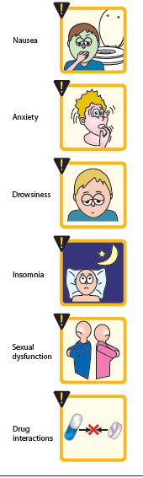
Adverse effects
Headache
Sweating
Anxiety and agitation
GI effects (nausea, vomiting, diarrhea)
Weakness and fatigue
Sexual dysfunction
Changes in weight
Sleep disturbances (insomnia and somnolence)
-Paroxetine and fluvoxamine are more sedating (may be useful in sleeping difficulty)
-Fluoxetine or sertraline are more activating SSRIs (Useful in fatigue and excessive somnolence

Slide 6
OVERDOSE :
Citalopram can cause QT prolongation
Seizures can occur in overdose
All SSRIs have the potential to cause serotonin syndrome when used in the presence of a MAOI or other highly serotonergic drug
Serotonin syndrome include the symptoms of:
Hyperthermia
Muscle rigidity
Sweating
Myoclonus
Changes in mental status and vital signs

Slide 7
DISCONTINUATION SYNDROME:
All of the SSRIs have the potential to cause a discontinuation syndrome after abrupt withdrawal
Fluoxetine has the lowest risk of causing this
Signs and symptoms of SSRI discontinuation syndrome include:
Headache
Malaise
Flu-like symptoms
Agitation and irritability
Nervousness
Changes in sleep pattern.

Slide 8
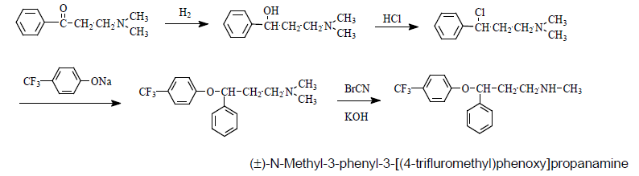
FLUOXETINE:
Synthesis: Reduction of 1-phenyl-3-(N,N-dimethylamino)propanone followed by Halogenation gives 1-phenyl-3-(N,N-dimethylamino)propyl chloride. This reacts with sodium 4-trifluoromethyl phenolate and cyanogen bromide to give fluoxetine

Slide 9
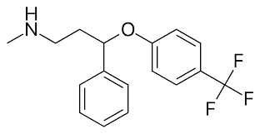
FLUOXETINE:
3-phenoxy-3-phenlpropylamine
Mono-substitution in the para position of the phenoxy group with an electron-withdrawing group results in selective inhibition of 5-HT reuptake.
Disubstitution, meta or ortho substitution and electron donating substitution cause loss of SERT selectivity.
Secondary amine enhances affinity for SERT by 10 times.
It is marketed as a racemic mixture of R- and S-fluoxetine, since the S enantiomer is 100 times more selective but R enantiomer is 8 times more potent and has longer duration of action

Slide 10
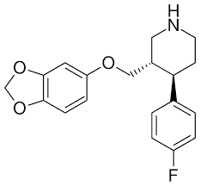
PAROXETINE :
Most potent antidepressant
Is a constrained analog of fluoxetine in which the linear phenylpropylamine group has been folded into a piperidine ring.
F atom was added at the phenyl para position, in addition to the 3,4-methylenedioxy group in the phenoxy ring
In vitro binding studies suggest that paroxetine is a more selective and potent inhibitor of 5-HT reuptake than fluoxetine

Slide 11
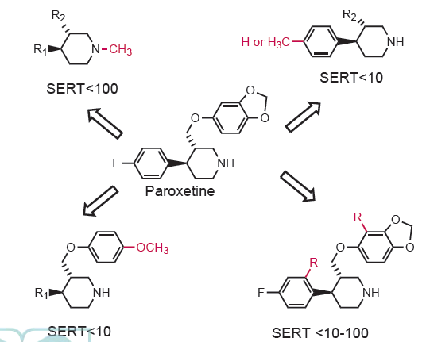

Slide 12
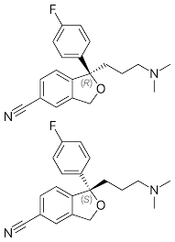
CITALOPRAM :
The addition of 5-cyano to the phthalan ring and a 4-fluoro to the
benzene ring lead to the formation of citalopram.
It is marketed as a racemic mixture of R- and S-enantiomer, but its
therapeutic activity comes from the S- enantiomer
Is the most selective 5-HT uptake inhibitor but not the most potent
Escitalopram is the S-enantiomer of citalopram that binds with high
affinity and selectivity to the human SERT

Slide 13
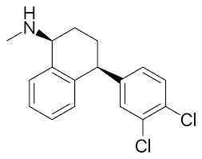
SERTRALINE :
Chlorine atoms gives sertraline its potency to inhibit 5-HT reuptake in the brain.
Sertraline contains two chiral centers and only the S,S-(+)-diastereomer is marketed. The R,R-, R,S-, and S,R diastereomers are significantly weaker as inhibitors of 5-HT reuptake.

Slide 14
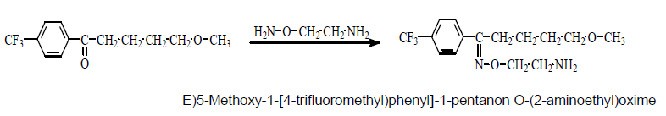
FLUVOXAMINE :
Is approved for obsessive compulsive disorder .
Synthesis: 1-(4’-Trifloromethyl)phenyl-5-methoxypentanone and O-(2-aminoethyl)hydroxylamine reaction gives Fluvoxamin.

Slide 15
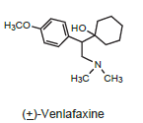
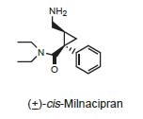
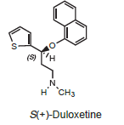
SEROTONIN/ NOREPINEPHRINE REUPTAKE INHIBITOR (SNRI)
Clinical studies suggest that compounds that increase the synaptic availability of both NE and 5-HT have greater efficacy than single-acting drugs in the treatment of major depression

Slide 16
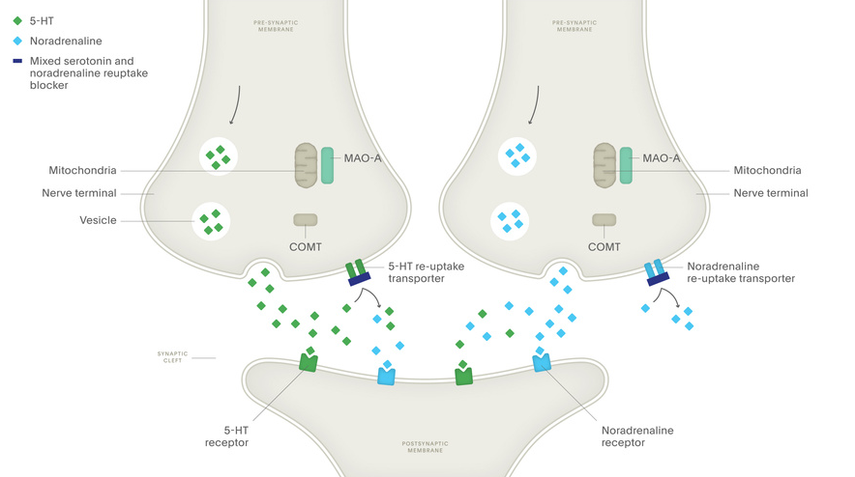
MECHANISM OF ACTION:
The selective 5-HT and noradrenaline re-uptake inhibitors (SNRIs) are thought to restore the levels of 5-HT and noradrenaline in the synaptic cleft by binding at their re-uptake transporters preventing the re-uptake and subsequent degradation of 5-HT and noradrenaline. This re-uptake blockade leads to the accumulation of monoamines in the synaptic cleft and the concentration returns to the normal range

Slide 17
USES OF SNRI:
Effective in:
Treating depression in patients where SSRI are ineffective
2) Against chronic painful symptoms, such as backache and muscle aches, against which SSRIs are relatively ineffective
3) Relieving physical symptoms of neuropathic pain such as diabetic peripheral neuropathy

Slide 18
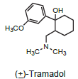
VENLAFAXINE:
Venlafaxine is a methoxyphenylethylamine antidepressant that resembles an open TCA with one of the aromatic rings replaced by a cyclohexanol ring and a dimethylaminomethyl group rather than a dimethylaminopropyl chain. It is structurally similar to the atypical opioid, tramadol.
Adverse effects:
Nausea, headache, sedation, dizziness, insomnia , sexual dysfunction & constipation.

Slide 19
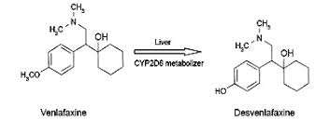
DESVENLAFAXINE:
It is the active metabolite of the parent compound venlafaxine
No significantly different clinical or adverse effects than venlafaxine.

Slide 20
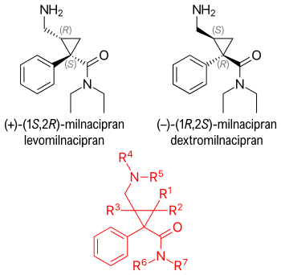
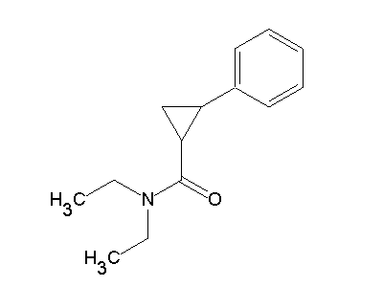
MILNACIPRAN :
Milnacipran is the cis-aminomethyl derivative of phenylcyclopropanecarboxamide
It is found as a racemic mixture, with both enantiomers exhibiting antidepressant activity.

Slide 21
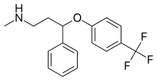
DULOXETINE:
Duloxetine has been approved for the treatment of depression and diabetic peripheral neuropathic pain.
It is another analog in the line of fluoxetine-based products, in which the phenyl and phenoxy groups of fluoxetine have been respectively replaced with the benzene isostere, thiophene, and a naphthyloxy group
In humans, duloxetine has low affinity for the other neuroreceptors, suggesting low incidence of unwanted adverse effects
Fluoxetine

Slide 22
ATYPICAL ANTIDEPRESSANTS

Slide 23
BUPROPION:
Weak dopamine and norepinephrine reuptake inhibitor
Bupropion is one of the most widely prescribed antidepressants
USES: Depression, 2nd line treatment in Smoking cessation due to it’s property to antagonize nicotine at therapeutic doses, so used to combat smoking withdrawal symptoms.
Side effects:
◦ Dry mouth ◦ Nervousness
◦ Tremor ◦ Increased risk for seizures at high doses

Slide 24
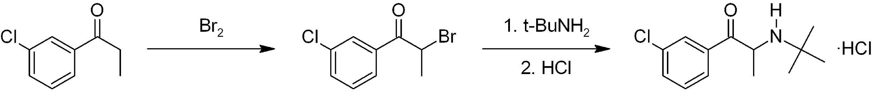
BUPROPION- SYNTHESIS
Syntesized in two chemical steps starting from 3'-chloro-propiophenone. The alpha position adjacent to the ketone is first brominated followed by nucleophilic displacement of the resulting alpha-bromoketone with t-butylamine and treated with hydrochloric acid to give bupropion as the hydrochloride salt.

Slide 25
BUPROPION - SAR
It is a trimethylated monocyclic phenylaminoketone and is structurally unrelated to the tricyclic antidepres-sants or MAO inhibitors.
Commercially available bupropion is a racemic mixture.
The strong electron withdrawing effect of the chloro substituent on the aromatic ring in bupropion is believed to be responsible for the lack of CNS stimulant
The absence of polycyclic rings and presence of more common functional groups usually found on tranquilizers contribute to the lack of marked side effects usually seen with polycyclic antidepressants .
The use of a tertiary butyl substituent as the alkyl group on the nitrogen atom was designed to diminish the N-dealkylation and hence prevent the formation of metabolites with sympathomimetic side effects.

Slide 26
MIRTAZAPINE
Enhances serotonin and norepinephrine neurotransmission by blocking presynaptic α2 receptors and 5-HT2 receptors
It is a sedative because of its potent antihistaminic activity
Side effects:
Increased appetite and weight gain
Marked sedation

Slide 27
TRAZODONE & NEFAZODONE
Weak inhibitors of serotonin reuptake
Block postsynaptic 5-HT2A receptors
With chronic use may desensitize 5-HT1A presynaptic autoreceptors increasing serotonin release
Both are sedating because of their potent H1- blocking activity
Side effects:
Orthostatic hypotension
Dizziness
Nefazodone hepatotoxicity

Slide 28
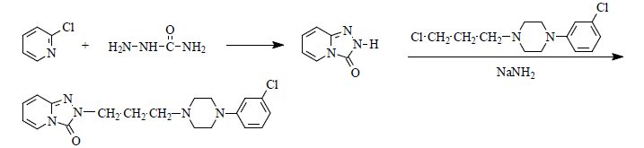
TRAZODONE:
Synthesis of Trazodone: 2-Chloropyridine reacts with semicarbazide in presence of catalytic amount of acid resulting in cyclization of triazolopyridine ring. This ring then reacts with sodium amide and 1-(3-chloropropyl)-4-(3-chlorophenyl)piperazine giving trazodone

Slide 29
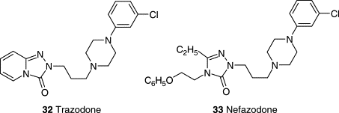
Trazodone
Nefazodone

