Slide 1
Thermal Fluid Engineering
ENMC4411
Afif Akel Hasan
Mechanical & Mechatronics Engineering Department
Birzeit University

Slide 2
Chapter 1
Thermal System Engineering
Outline
What is thermal system engineering?
Thermal System case studies
Analysis of thermal systems
Three thermal system disciplines

Slide 3
What is thermal system engineering?
TSE is concerned with how energy is utilized to accomplish certain functions in industry, transportation and at home.
  In industry thermal systems found in electric power stations, chemical process plant and in manufacturing facilities.
  In transportations, mostly all transportations are run some type of engines , cooling systems, power conversion etc.
  At home all appliances, such as ovens, refrigerators, heating and cooling systems etc
And the role energy plays in the study of human and plant life.
  In living things; respiratory system, blood circulation, temperature regulation etc.
TSE involves energy storage , transfer , and conversion of energy.

Slide 4
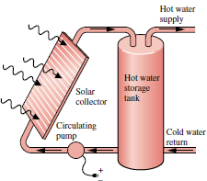
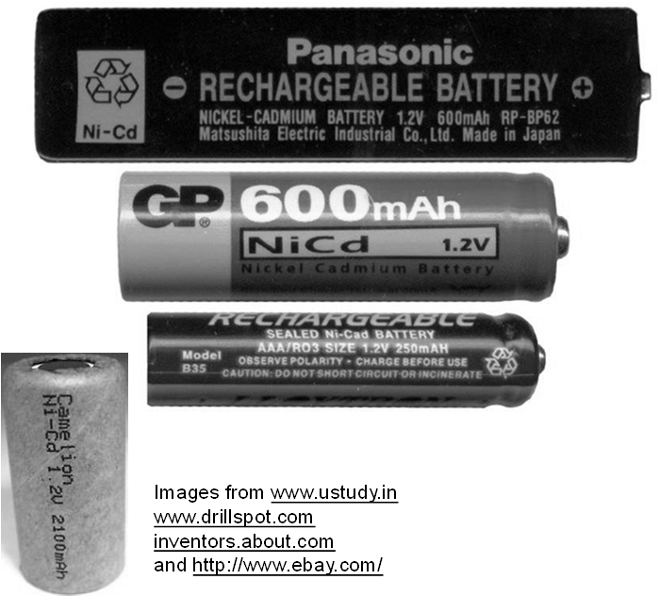
Energy storage
Energy storage such as hot water storage, battery storage, also as potential , kinetic and thermal forms.

Slide 5
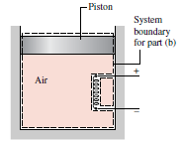
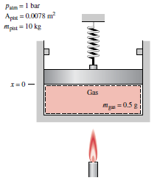
Energy transfer
Energy can be transferred between a system and its surrounding as heat or work.

Slide 6
Energy conversion
Energy can be converted from one form to another; chemical to heat by combustion, thermal to mechanical by heat engines, chemical to electrical in fuel cells or batteries.
Sunflowers as thermal system; convert solar energy to chemical by photosynthesis.
Jet engine from thermal energy to propulsion.
Electric power station from fossil fuel to thermal to mechanical and electrical energy.
Solar cell solar energy to electrical energy.
Selected applications: see figure 1.1 p2.
Cardiovascular systems: fluid flow, chemical reactions, gas exchange etc.

Slide 8
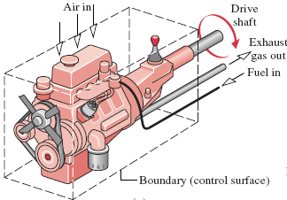
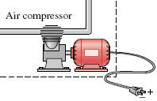
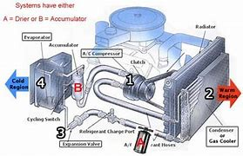
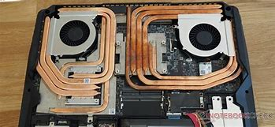
Areas of applications
Prime movers: internal-combustion engines, turbines
Fluid machinery: pumps, compressors
Power stations
Solar heating, cooling and power generation
Heating, ventilating, and air-conditioning equipment
Biomedical applications
Air and water pollution control equipment
Aerodynamics: airplanes, automobiles, buildings
Pipe flow: distribution networks, chemical plants
Cooling of electronic equipment
Manufacturing: machining, joining, laser cutting

Slide 9
Thermal System Engineering
Outline
What is thermal system engineering?
Thermal System case studies
  Domestic hot water system
  Hybrid electric car
Analysis of thermal systems
Three thermal system disciplines

Slide 10
Domestic hot water system
System consists of hot water heater or boiler (electric or fuel run). Piping mixer and faucets, and shower head.
Function of system is to provide a given flow rate at a specific temperature ( volume flow, T).
Explain; heat transfer , energy conversion and thermodynamic processes.
  Tank and pipe insulations from heat transfer.
  Mixing of hot and cold water and thermodynamics laws.
  Fluid flow and its equations, pressures valves and fittings , diameters etc.

Slide 11
Hybrid Electric Vehicle
a hybrid electric vehicle (HEV) that combines a gasoline-fueled engine with a set of batteries that power an electric motor.
The gasoline engine and the electric motor are each connected to the transmission and are capable of running the car by themselves or in combination depending on which is more effective in powering the vehicle.
• the ability to recover energy during braking and to store it in the electric batteries,
• the ability to shut off the gasoline engine when stopped in traffic and meet power
needs by the battery alone,
• special design to reduce aerodynamic drag and the use of tires that have very low
rolling resistance (friction), and
• the use of lightweight composite materials such as carbon fiber and the increased use
of lightweight metals such as aluminum and magnesium.

Slide 12
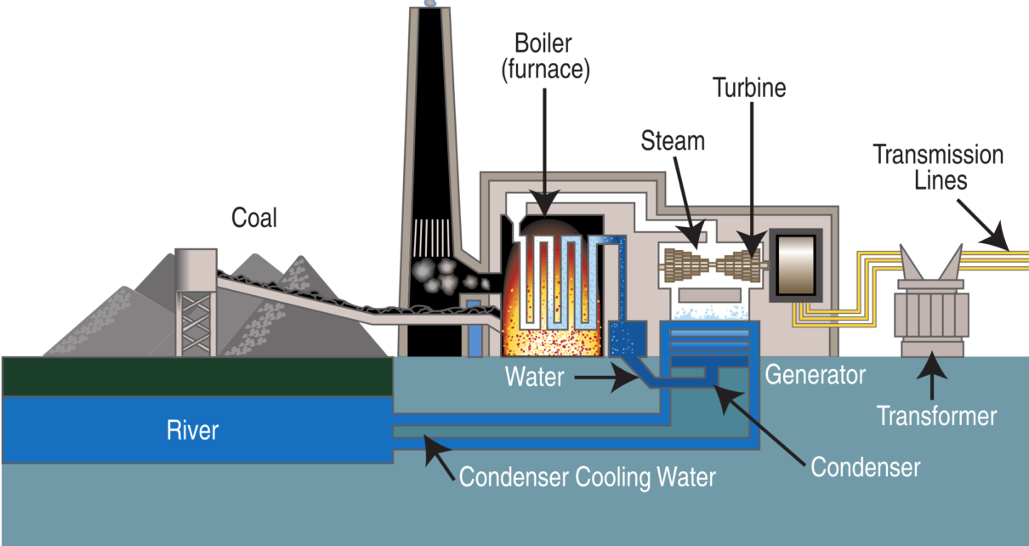
Thermal power station
Fossil fuel is combusted producing heat
Heat drives steam power plant
Turbine output drives electric generator
Explain heat transfer processes
Explain energy forms and conversion
Explain fluid mechanics applications

Slide 13
Thermal System Engineering
Outline
What is thermal system engineering?
Thermal System case studies
Analysis of thermal systems
Three thermal system disciplines

Slide 14
Engineering analysis
Engineering analysis frequently aims at developing an engineering model to obtain a simplified mathematical representation of system behavior that is sufficiently faithful to reality, even if some aspects exhibited by the actual system are not considered.
For example, idealizations often used in mechanics to simplify an analysis include the assumptions of point masses, frictionless pulleys, and rigid beams. Also reversible processes in thermodynamics.

Slide 15
Analysis of thermal systems
The first step in analysis is the identification of the system ( boundary) and how it interacts with its surroundings ( energy and material flow).
Attention then turns to the pertinent physical laws and relationships that allow system behavior to be described.
Analysis of thermal systems uses, directly or indirectly, one or more of four basic laws:
• Conservation of mass
• Conservation of energy
• Conservation of momentum
• Second law of thermodynamics
  Background knowledge of Heat Transfer, Thermodynamics, and Fluid Mechanics is so much essential.

Slide 16
Systems
System : Whatever we want to study, i.e. as a simple thing as a free body or as complex as an entire chemical refinery. A system is surrounded by a “Surrounding” and the interface being the system “Boundary”
Mass contained in a System: We may want to study a quantity of matter contained within a closed, rigid-walled tank, or we may want to consider something such as a pipeline through which natural gas flows. The shape or volume of the system being analyzed is not necessarily constant, as when a gas in a cylinder is compressed by a piston or a balloon is inflated.
System Boundary: Everything external to the system is considered to be part of the system’s surroundings. Boundary: What distinguishes the system from its surroundings.
System Interaction with its Surrounding: interactions between a system and its surroundings, which take place across the Boundary.

Slide 17
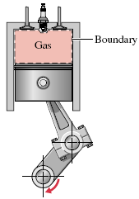
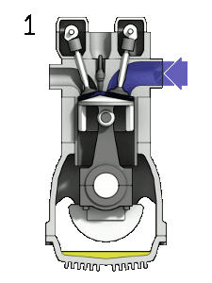
Types of Systems
A closed system – Gas in a Cylinder
Closed system: Used when studying a particular quantity of matter that does not change, and hence no transfer of mass across its boundary is permitted. Called also control mass
Control volume: A region within a prescribed boundary where mass may cross the Boundary from/to the System.
The Boundary of the Control Volume is also known as “Control Surface”.
Open system
Isolated System: A special type of closed system that does not interact in any way with its surroundings.

Slide 18
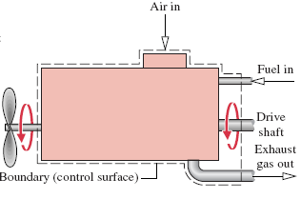
Control volume - examples
The dashed line defines a control volume that surrounds the engine. In this CV, air, fuel, and exhaust gases cross the boundary.
Control volume of the Engine.

Slide 19
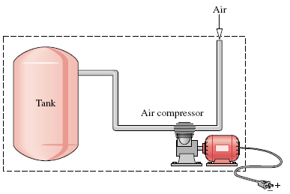
Control volume - examples
System boundary encloses the compressor, tank, and all of the piping:
This boundary might be selected if the electrical power input were known, and
The objective of the analysis were to determine how long the compressor must operate for the pressure in the tank to rise to a specified value.
Since mass crosses the boundary, the system would be a Control Volume.
A Control Volume enclosing only the compressor might be chosen if the condition of the air entering and exiting the compressor were known, and the objective were to determine the electric power input.

Slide 20
Describing System Behavior: Property, State and Process
Property: A characteristic of a system such as mass, volume, energy, pressure, temperature, etc. to which a numerical value can be assigned at a given time without knowledge of the previous behavior (history) of the system.
State: refers to the condition of a system as described by its properties. Since there are normally relations among the properties of a system, the state often can be specified by providing the values of a subset of the properties. All other properties can be determined in terms of these few.
If a system exhibits the same values of its properties at two different times, it is in the same state at these times.
Process: A transformation from one state to another. When a system undergoes a process , any of the properties of a system may change.
A system is said to be at Steady State if none of its properties changes with time.

Slide 21
Solving Problem – A Systematic Engineering Approach
Known : known values in the problem..
Find : what is to be determined?
Given Data : Draw a sketch of the system to be considered (closed or control
volume), then carefully identify the boundary.
Label the diagram with relevant information from the problem
statement.
Record all property values you are given.
Assumptions: Form a record of how you model the problem, list all simplifying
assumptions and idealizations made to reduce it to one that is
manageable. Sometimes this information also can be noted on the
sketches of the previous step.
Properties : Compile property values you anticipate will be needed for subsequent
calculations and identify the source from which they are obtained.
Analysis : Using your assumptions and idealizations, reduce the appropriate
governing equations and relationships to forms that will produce the
desired results.

Slide 22
Performing Analysis
  It is advisable to work with equations in symbol form as long as possible before substituting numerical data.
  When the equations are reduced to final forms, consider them to determine what additional data may be required. Identify the tables, charts, or property equations that provide the required values.
  When all equations and data are in hand, substitute numerical values into the equations.
  Carefully check that a consistent and appropriate set of units is being employed. Then perform the needed calculations.
  Consider whether the magnitudes of the numerical values are reasonable and the algebraic signs associated with the numerical values are correct.

Slide 23
Thermal System Engineering
Outline
What is thermal system engineering?
Thermal System case studies
Analysis of thermal systems
Three thermal system disciplines

Slide 24
Three Thermal Science Disciplines
Thermodynamics provides the foundation for analysis of thermal systems through the conservation of mass and conservation of energy principles, the second law of thermodynamics, and property relations.
Fluid mechanics and heat transfer provide additional concepts, including Empirical laws necessary to specify, for instance, material choices, component sizing, and fluid medium characteristics.

Slide 25
Fluid mechanics
Fluid mechanics is concerned with the behavior of fluids at rest or in motion.
Two fundamentals that play central roles in our discussion of fluid mechanics are
  the conservation of momentum principle and
  the mechanical energy equation.
Principles of fluid mechanics allow the study of fluids flowing inside pipes (internal flows) and over surfaces (external flows) with consideration of frictional effects and lift/drag forces.
The concept of similitude is used extensively in scaling measurements on laboratory-sized models to full-scale systems.

Slide 26
Heat transfer
Heat transfer is concerned with energy transfer as a consequence of a temperature difference.
There are three modes of heat transfer.
  Conduction refers to heat transfer through a medium across which a temperature difference exists.
  Convection refers to heat transfer between a surface and a moving or still fluid having a different temperature.
  Thermal radiation and represents the net exchange of energy between surfaces at different temperatures by electromagnetic waves independent of any intervening medium.

Slide 28
The Practice of Thermal Systems Engineering
Practical applications mostly involve the three thermal science disciplines as explained earlier in the case studies.
Thermal systems engineering is interdisciplinary in nature as also it ties to other important issues such as control, manufacturing, vibration, materials etc.
TSE has become and enabling technology for evolving fields such as nanotechnology, biotechnology, health services, bioengineering etc.

Slide 29
End of introduction

