Slide 1
BGP

Slide 2
Interior gateway protocols (IGP's)
RIP (Routing Information Protocol): Uses hop count as the routing metric.
IGRP (Interior Gateway Routing Protocol): Cisco's proprietary protocol with more advanced metrics than RIP.
OSPF (Open Shortest Path First): A link-state protocol known for fast convergence and specific topology requirements but can be difficult to filter.
It concludes that IGPs typically operate under the assumption that all participating routers trust each other.

Slide 3
Routing on the Internet has different requirements than IGPs:
Scalability: (Internet route table now 250,000 routes)
Advanced filtering: Between different organizations that don’t trust each other

Slide 4
Autonomous System
A network (group of routers) run by one organization.
Examples: ATT, Intel. Birzeit University AS20719
Each AS might include thousands of routers.
Each AS could use a different IGP routing protocol with a different metric.

Slide 5
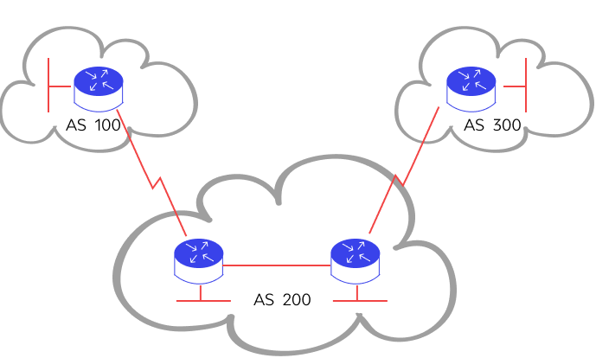

Slide 6
Problem: different AS's need to exchange routing information despite:
Different routing protocols in each AS
Different metrics in each AS
The AS's don’t trust each other
No enforced hierarchy in AS-AS connections (many loops)
250,000 routes and growing

Slide 7
Solution: a new Exterior Gateway protocol (EGP) called Border Gateway Protocol (BGP)
Optimized for scalability (# of routes) instead of convergence time
Advanced filtering
Uses AS-path list to avoid loops
Uses number of AS-hops as “universal metric”
Remember: the goal of any routing protocol is for routers to exchange routing information

Slide 8
Claim (from Cisco Networkers conference speaker): BGP is a simple protocol
Uses TCP port 179 for reliable router-router communication
Only 4 message types: open, keep-alive, update, notification
Only 6 “protocol states”
Many filtering/prioritization options, but each one is technically simple

Slide 9
BGP uses TCP port 179 for router-to-router communication
Services provided by TCP:
Retransmissions of lost data
No duplication of data
Check-summing (accurate transmission)
Note: A TCP socket is always from one router to a second router. No broadcasts or multicasts.

Slide 10
BGP Message Type 1: Open
Used to initiate a BGP session between two routers
Includes:
BGP version
Sender AS number
Hold time (Cisco default: 180 seconds)
BGP identifier (highest loopback IP address)
Optional parameters
Want to reject a BGP open? Just send a notification message!

Slide 11
BGP Message Type 2: Keep-Alive
Tell its peers that it is still alive, and let’s keep the BGP Session open.
Sent every one-third of the “hold time” (Cisco: Every 60 seconds)

Slide 12
BGP Message Type 3: Update
Network Layer Reachability Information (NLRI). That’s just a complicated way of saying:
IP prefix and length (example: 10.130.3.0/24)
Path attributes (information about each route)
Withdrawn routes (example: 172.16.5.128/25 is no longer reachable via this path)

Slide 13
BGP Message Type 4: Notification
Terminates or Rejects BGP Connection
Can include error message (“BGP version not supported”)

Slide 14
BGP Neighbor Router States
Idle: BGP process just started up or BGP error just occurred.
Connect: Initiated TCP socket to neighbor.
Active: Repeatedly attempting to connect to neighbor.
Open Sent: TCP Socket established, sent open message.
Open Confirm: Received reply open back.
Established: Received a keep-alive or update and exchanging data.

Slide 15
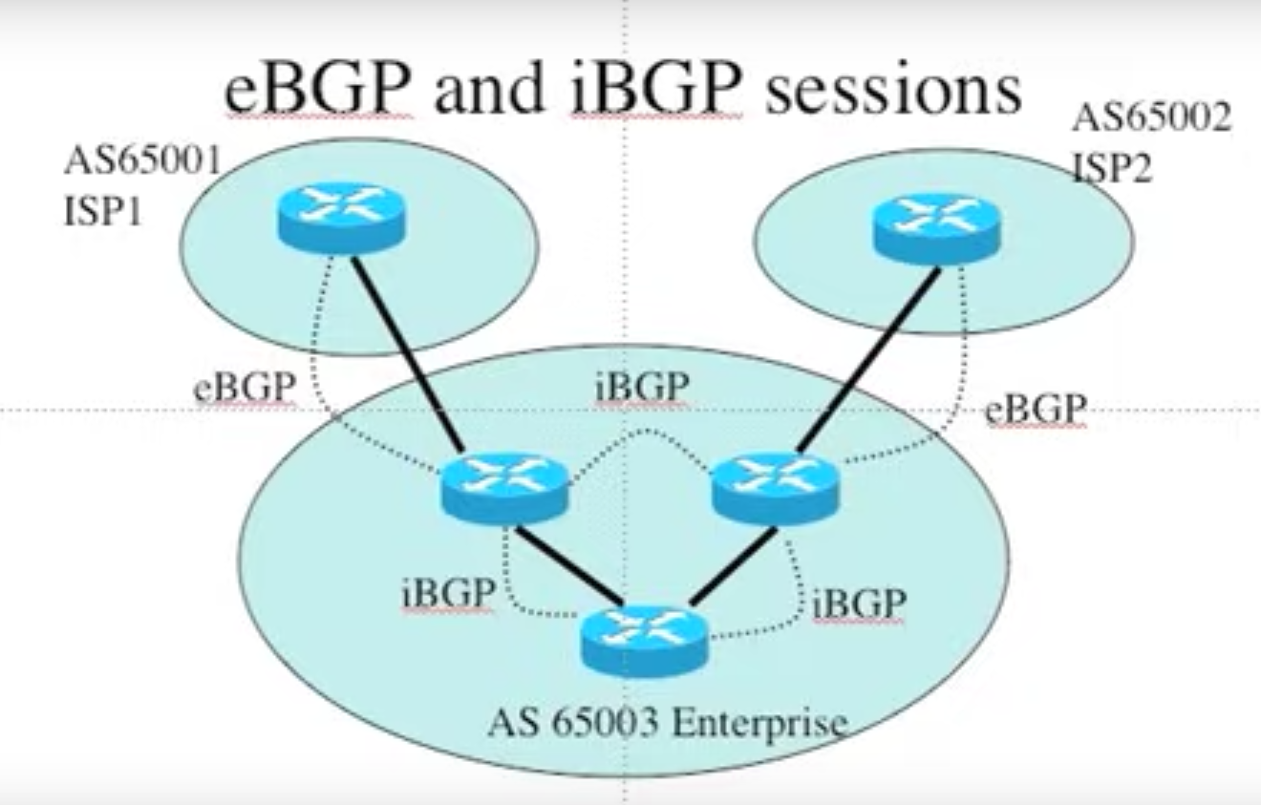

Slide 16
BGP Attribute Types
Attributes are included in BGP updates
Each NLRI (advertised route) has attributes
Well-known attributes are understood by all BGP-speaking routers
Two types of well-known attributes: mandatory and discretionary
Optional attributes may not be understood by all BGP-speaking routers
Two types of optional attributes: transitive and nontransitive

Slide 17
Well-known Mandatory Attributes
Origin:
IGP: Route originally learned from an IGP
EGP: Route originally learned from Exterior Gateway Protocol (EGP, precursor to BGP)
Incomplete: Route redistributed from another protocol. Real origin not known.
AS-PATH: List of AS's that the route has passed through. Example: (7018 3356 10)
Next-hop: IP address to forward packets to

Slide 18
Well-known Discretionary Attributes
Local Preference: a number used for route prioritization, higher is better, default is 100
Atomic Aggregate: The route was summarized

Slide 19
Optional Transitive Attributes
Optional means: not every router understands this attribute.
Transitive means: even if you don’t understand it, pass in update messages to the other routers (neighbors)
Examples:
Aggregator: Identifies the router/AS that summarized the route.
Community: Message in the update

Slide 20
Optional non-Transitive Attributes
Optional means: not every router understands this attribute.
Non-Transitive means: if you don’t understand it, don’t pass on to the other routers (neighbors)
Examples:
Multi-Exit-Discriminator (MED): Supplies a metric to allow comparison between multiple paths between the same two ASes
Originator_ID: Used by route-reflectors.
Cluster_List: Used by route-reflectors.

Slide 21
BGP Route Decision Making (Route Selection)
Weight (higher is better) (Cisco-specific)
Local pref (higher is better, 100 default)
Prefer routes originated from IGP in local AS
Prefer shortest AS_PATH attribute
Prefer better origin (IGP > EGP > incompl)
Prefer lowest MED (only between same AS)
EGBP > confed EBGP > IBGP
Prefer shortest path to eBGP next hop
Consider BGP multipath
Prefer lowest BGP router ID
Reminder:
more specific always wins
i.e “longest match”

Slide 22
BGP Route Decision Example 1
10.33.12.0 /24
Origin IGP
AS_PATH = (65236 65412 64251)
Next Hop 10.1.4.4
10.33.12.0 /24
Origin IGP
AS_PATH = (65236 65412)
Next Hop 10.1.3.3

Slide 23
BGP Route Decision Example 2
10.33.12.0 /24
Origin IGP
AS_PATH = (65236 65412)
Next Hop 10.1.4.4
10.33.12.0 /24
Origin IGP
AS_PATH = (65236 65412)
Next Hop 10.1.3.3

Slide 24
BGP Route Decision Example 3
10.33.12.0 /24
Origin IGP
AS_PATH = (65236 65412)
Next Hop 10.1.4.4
Local pref 110
10.33.12.0 /24
Origin IGP
AS_PATH = (65236 65412)
Next Hop 10.1.3.3

Slide 25
BGP Route Decision Example 3
10.33.12.0 /24
Origin IGP
AS_PATH = (65236 65412)
Next Hop 10.1.4.4
Local pref 90
10.33.12.0 /24
Origin IGP
AS_PATH = (65236 65412)
Next Hop 10.1.3.3

Slide 26
BGP Route Advertisement Rules
Only Advertise the BGP route that you prefer
If you learned the route from eBGP, Advertise to all peers (eBGP & iBGP)
If you learned the route from iBGP, advertise to eBGP peers only

Slide 27
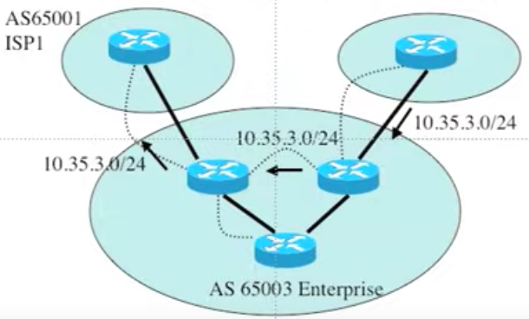
Route Advertisement Rules – broken rule

Slide 28
Required BGP Neighbors Relationship
eBGP: Configure a neighbor on each physical link between the two AS’s
iBGP: All BGP routers within an AS have to peer with every other router in full mesh

Slide 29
AS_Path Vector Update
Add to Your ASN to AS_Path Vector When the Route Leaves Your AS

