Slide 1
Consistency Altered Diets
Dana Issa Marbu’

Slide 2
Principles of Consistency Alteration
Problems related to chewing, swallowing and managing food in the month.
These problems are might be due to stroke, head or neck injury, cancer and cerebral palsy or simply aging.
Example: Aspiration of food to the lung as a result of inadequate chawing could lead to respiratory infections.
Working with a comprehensive team; swallowing therapist, doctor and dietitian.
Notes:
Cerebral palsy: is a movement disorder cause brain damage.

Slide 3
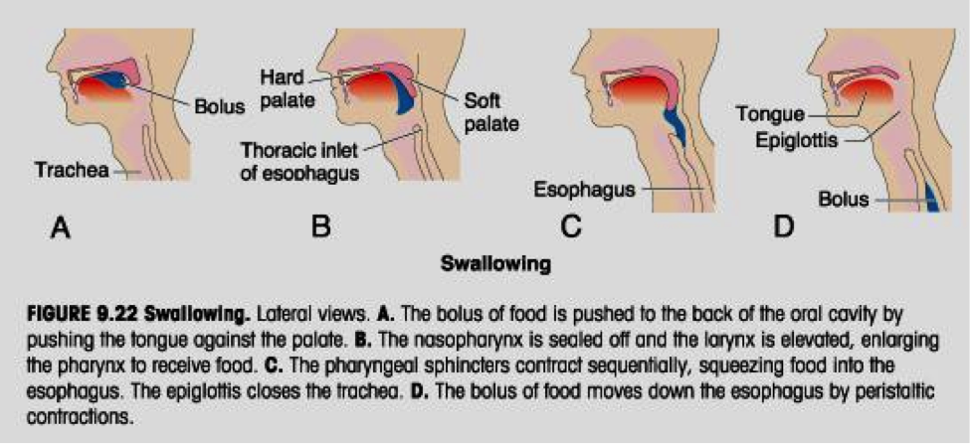
Principles of Consistency Alteration
Swallowing : is a complex action that involves coordinated movements of muscles.
Three phases of swallowing:
1- Oral phase ( mouth).
2- Pharyngeal phase (throat).
3- Esophageal phase (food tube).

Slide 4
Principles of Consistency Alteration
Dysphagia
A condition with difficulty in swallowing food or liquid. Taking more time to move the food or fluids from the mouth to the stomach (Esophageal dysphagia, Oropharyngeal).
Causes
Swallowing involves a many muscles and nervous; thus any condition that weakness or damage them could lead to dysphagia.
Complications
Malnutrition and dehydration
Weight loss
Choking

Slide 5
Principles of Consistency Alteration
1- The goals of consistency alteration are:
Consume adequate nutrients and fluids intake.
Reducing the risk of choking and aspiration.
2- It must be individualized to meet the essential needs.
3- Always monitor food and fluid intake closely, focus on nutrients dense food.
4- fluid intake is extremely important, it might be thick or liquid.
5- Nutrition supplement might needed; to ensure adequate hydration and intake.
6- Regular assessment.

Slide 6
Principles of Consistency Alteration
Mechanical Soft Diet.
Pureed Diet

Slide 7
Mechanical Soft Diet
Use: individuals who have difficulty chewing, but they are able to tolerate variety of food. Modifications in the diet need to be individualized based on patient’s needs.
Mainly used for patients with missing teeth, ill-fitting dentures, weakness or esophageal stricture.
Adequacy: the same DRIs.

Slide 8
Mechanical Soft Diet
1- The Mechanical Soft Diet is designed for easy chewing.
2- Change the consistency by cooking, grinding, chopping, mincing, or mashing.
3- The diet include food softs in texture such as cooked fruits and veggies, moist ground meat, cereal products, or dissolve crackers.
4- Most important to individualize or adjust it to the tolerance of the resident

Slide 9
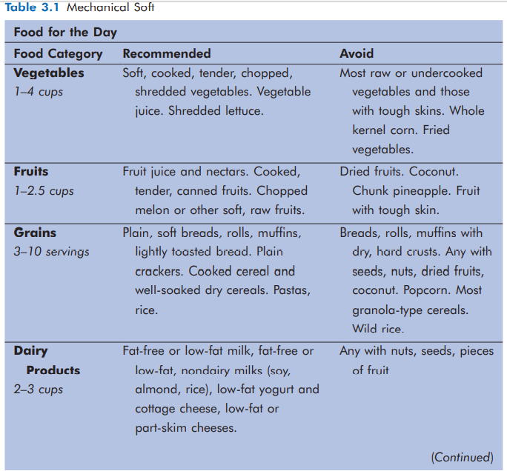
Mechanical Soft Diet

Slide 10
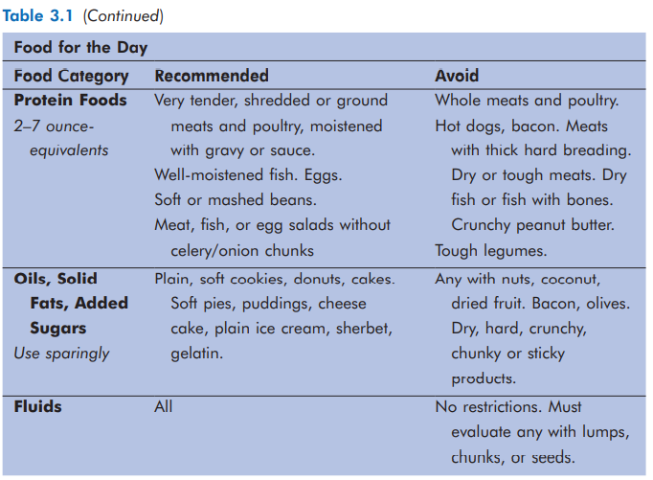
Mechanical Soft Diet

Slide 11
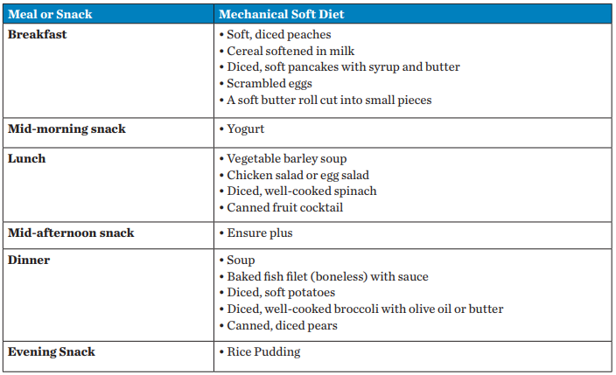
Mechanical Soft Diet
Sample menu for a mechanical soft diet.

Slide 12
Pureed Diet
Use: Designed for residents with severe chewing difficulties.
Adequacy: The suggested food plan includes foods in amounts that will provide the DRIs.
Diet principles:
1- Individuals vary in their abilities to handle different puree consistencies.
2- To improve appearance and appetite appeal, foods may be slurried (moistening foods and retaining their shape).

Slide 13
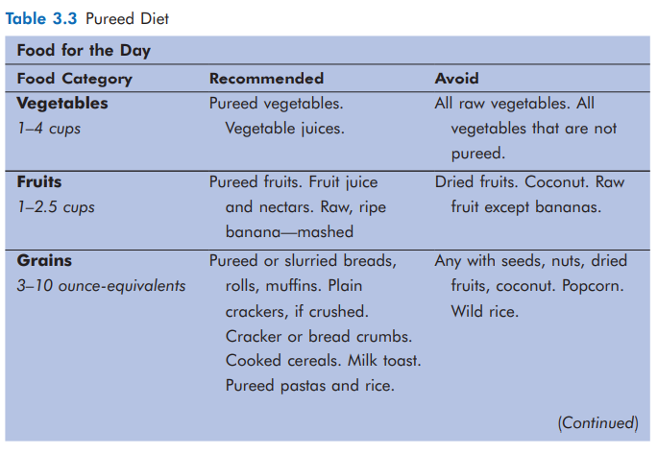
Pureed Diet

Slide 14
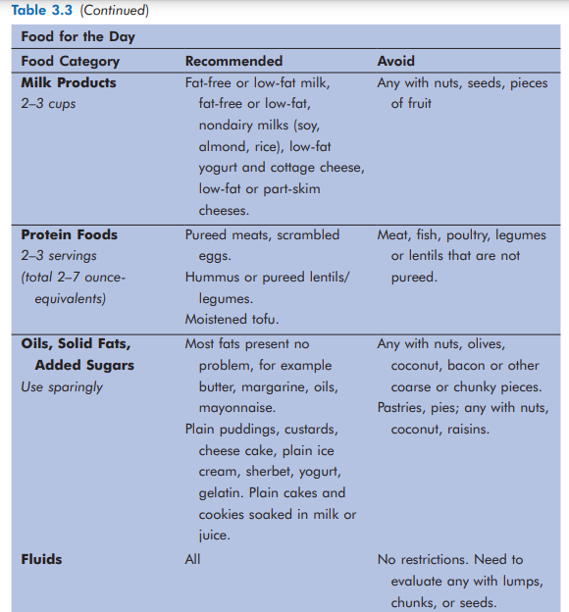
Pureed Diet

Slide 15
Assignment #2
Plan a one day mechanical and pureed diets ( separately ), following the general guidelines.
Compare between two diets; what are the differences and similarities.
This assignment should be submitted on 11th April 2022.

