Slide 1
Language development
An Introduction

Slide 2
Learning goals
- What is language?
- How does language relate to speech, hearing, and communication?
-What are the major aspects/domains of language

Slide 3
Definition of language
Language is a “complex and dynamic system of conventional symbols that is used in various modes for thought and communication (ASHA,1982).

Slide 4
Definition of language
- Language Is a System of Symbols
- The System of Language Is Conventional
- The Language System Is Dynamic
- Language Is a Tool for Human Communication

Slide 5
Language as a system of symbols 1
- Language can be considered as a code. A code is a term which refers to the translation of one type of information into another type of information; this involves the use of symbols.
- In human language, specific words represent specific concepts, items , thoughts, and so on…..
- Examples :
using the word happy to convey and describe our feelings.
using the word rose to refer to a flower.
Using the word far to describe distance.

Slide 6
Language as a system of symbols 2
- The relationship between a word and its referent (the aspect of the world to which the word refers) is arbitrary.
- For example, although English speakers recognize that happy refers to a specific feeling, any other word (e.g., sprit, nopic, or grendy) would do.

Slide 7
The System of Language Is Conventional
- Language system is conventional. That is, speakers of language abide by accepted and fixed rules. And so, adhering to specific conventions allows all members of a language community to use language with one another as a tool for expression.
- A group of people who use a common language are known as a language community.
- language communities emerge for several reasons including geographical, social and economic reasons. Give examples ?

Slide 8
The Language System Is Dynamic
- Language is in a state of activity and change, both within an individual who is acquiring language and within a community that uses a certain language.
- at the individual level the acquisition of language begins at birth, or even before birth, in utero, and is in a state of change across the lifespan. even as adults, our language skills are dynamic. as one example, we might seek to learn a second language. Examples ?
- the language a community uses is also very dynamic as demonstrated by the emergence of new vocabulary . Examples ?

Slide 9
Language Is a Tool for Communication
Communication is the process of sharing information, such as thoughts, feelings, and ideas, among two or more persons.

Slide 10
Language as a module of Human cognition
-language is a cognitive tool that helps humans to develop the “picture of the world that we use for thinking” (Bickerton, 1995).
-language is a representational tool people use for thinking and this tool permits people to communicate their thoughts to other individuals.
Language is suggested to have initially as a cultural and social evolution, rather than a biological evolution. That is, our need and interest to communicate with others gave rise to the complexity of language over time (christiansen & Kirby, 2003).

Slide 11
Language as an inner representational tool
- The human brain uses language as a representational tool to store information and to carry out many cognitive processes such as reasoning, hypothesizing, memorizing, planning, and problem solving.
- It is important to acknowledge the role of language in mathematical and scientific reasoning tasks. Let’s consider the following example :

Slide 12
Using language for thinking
“the average cost of a smart phone in the united states in 2015 is about $250. assuming the prices of consumer goods decline about 3% per year, how much, on average, would a smart phone cost in 2020?”
“my trust in you has been shattered forever by your unfaithfulness”

Slide 13
The concept of modularity 1
Modularity is a cognitive science theory about how the human mind is organized within the structures of the brain (Braisby & gellatly, 2012).
Domain specific vs domain general debate:
Domain specific : the human brain contain a set of highly specific modules-regions of the brain developed to process specific types of information such as depth perception within the visual system, or processing of acoustic input.
Domain general : is the human brain itself a generalized module in which all parts work together to carry out very general tasks like memory and reasoning, as well as domain-specific modules that execute very specific types of task

Slide 14
The concept of modularity 2
some language theorists argue that the human brain contains a large number of language-specific modules, tightly clustered and highly interconnected, each of which processes specific types of linguistic information.
researchers have long known that specific regions of the brain are associated with specific language abilities.

Slide 15
Evidence of language modularity
- Aphasia: people who sustain damage to certain areas of the left frontal lobe, such as during a stroke, often exhibit difficulty with basic grammar. these people may omit grammatical markers and speak with a “telegraphic” quality (e.g., “tommy go store now”).
- Specific Language Impairment(SLI): Children with SLI have normal hearing, cognition and neurological profiles. However, they exhibit problems in very pre-cise aspects of grammar, such as marking verb tense.
E.g.: Present tense “Walk” ---> Past tense “ Walk-ed”
- Verb marking impairment in children with SLI suggests that, perhaps, there is a particular module of the brain that processes verb structures and that this is the site of disturbance in cases of SLI.

Slide 16
Critics of language modularity
- some theorists argue that language is processed by a general neural network that operates on all aspects of language and that the hypothesized language modules lack “neurological reality” (Bickerton, 1995, p. 7)
- Evidence from research on disordered language due to developmental disability (e.g., cognitive impairment) and brain injury have failed to support the modularity concept.
- For instance, When the same module was likely damaged ( E.g., Broca’s area) , the expectation would be little variability in their impairment across affected individuals. Bickerton reviewed studies of persons with damage to a specific area of the brain purportedly linked to grammar problems, noting that these individuals showed diverse patterns of syntactic impairment.

Slide 17
HOW Does Language relate to speech, Hearing, and communication?
Speech describes the neuromuscular process by which humans turn language into a sound signal and transmit it through the air (or another medium such as a telephone line) to a receiver.
Hearing is the sensory system that allows speech to enter into and be processed by the human brain.
Communication is the process of sharing information among individuals. communication in the form of a spoken conversation between two persons involves language, hearing, and speech.

Slide 18
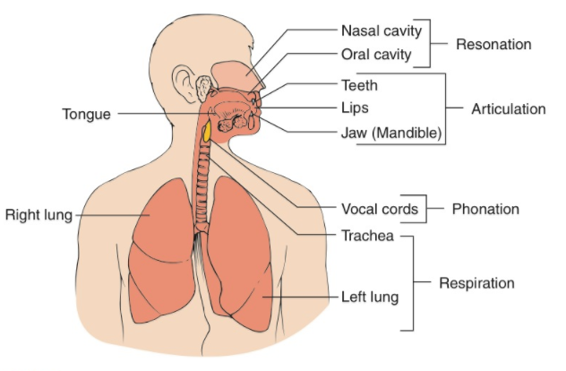
Speech 1
Speech is the voluntary neuromuscular behavior that allows humans to express language and is essential for spoken communication. It involves the precise activation of muscles in four systems: respiration, phonation , resonation , and articulation.

Slide 19
Speech 2
Model of speech production
1. perceptual target: Language code is represented by the phoneme. a phoneme is the smallest unit of sound that can signal a difference in meaning; we combine phonemes to produce syllables and words.
2. motor schema: this is a rough motor plan based on the abstract representation of the perceptual target. the rough plan organizes the phonemes into syllable chunks. The rough plan is sent forward to the major muscle groups involved with speech production.
3. speech output: the airflow, vocal fold vibration, and oral cavity movements are all finely manipulated to carry out the motor schema and to create speech.

Slide 20
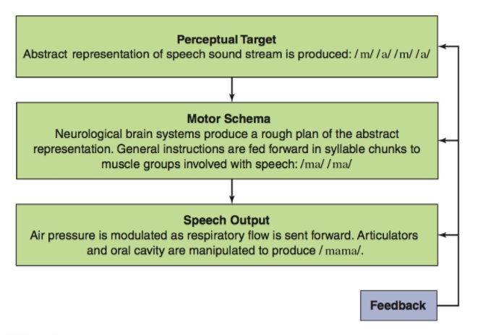
Speech 3

Slide 21
Relationship of speech to language
Does language depend on speech ?
Does speech depend on language ?
Locked-in syndrome : a case in in which an individual has completely intact language and cognitive skills, but is unable to perform any voluntary movements (i.e., has complete paralysis) with the exception of eye movement.

Slide 22
Hearing
Hearing is the perception of sound, and it includes both general auditory perception and speech perception.
Speech perception refers to how the brain processes speech and language( e.g., the word coffee). Whereas auditory perception is a more general term describing how the brain processes any type of auditory information( e.g., clap of the hands).
statistical learning : infants appear to assess statistical regularities among the sounds they hear in the speech stream around them and use these regularities to identify and learn the words of their native language. to learn new words, infants need to be able to isolate words within running speech so as to recognize that the three sounds in cup, blended together, represent the entity “cup”

Slide 23
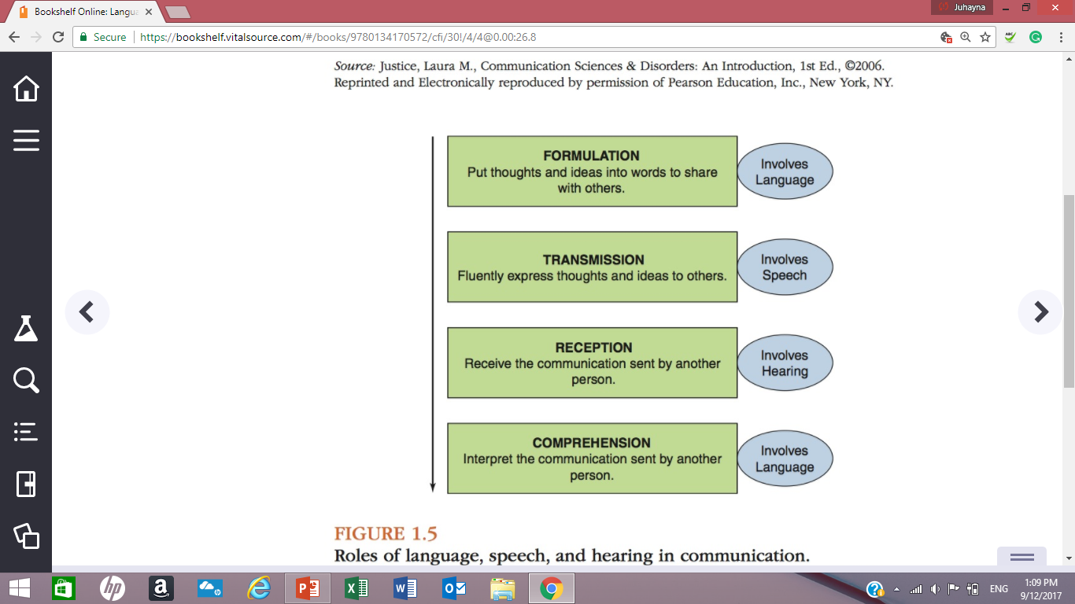
Communication 1
Communication is the process of sharing information among two or more persons, usually differentiated as the sender (speaker) and the receiver (listener).
communication involves four basic processes:
1. formulation
2. transmission
3. reception
4. comprehension

Slide 24
Types of communication
1. Symbolic communication
2. Preintentional communication
3. Intentional communication

Slide 25
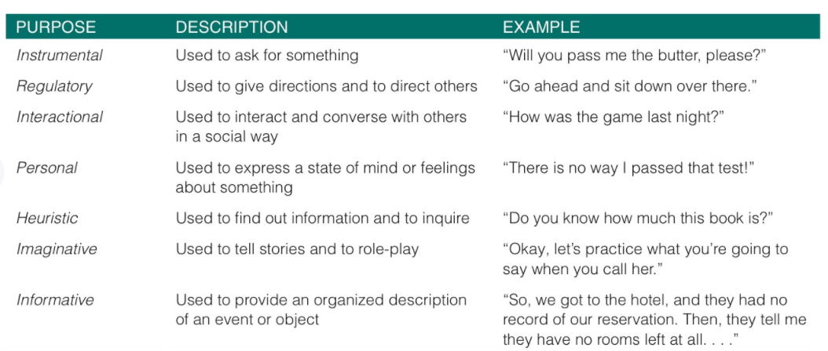
Purpose of communication

Slide 26
Main domains of language (Lahey, 1988).
Form involves sentence structure, clause and phrase usage, parts of speech, verb and noun structures, word prefixes and suffixes, and the organization of sounds into words.
Content refers to the meaning of language ;the words used and the meaning behind them. We humans convey content through our vocabulary system, or lexicon, as we select and organize words to express our ideas or to understand what other individuals are saying. Content of language can be contextualized/decontextualized.
Use is a domain focused on individual utterances to consider their intent. One possible scheme is Halliday’s seven communication intentions (see table 1.1).

Slide 27
Utterances by a 3-year-old
“I beating you up the stairs”
“ I wonned”
“ I am so fast”

Slide 28
components of Form, content, and use
1. Phonology
2. morphology
3. syntax
4. semantics
5. pragmatics

Slide 29
phonology
Phonology (form) refers to the rules of language governing the sounds that make syllables and words
Allophones are the subtle variations of phonemes that occur as a result of contextual influences on how phonemes are produced in different words.
each language has rules governing how sounds are organized in words, called Phonotactics. For instance, in english the phoneme /g/ never directly follows /s/ or /l/ at the beginning of a syllable.

Slide 30
morphology
Morphology (form) pertains to the rules of language governing the internal organization of words.
Morpheme is the smallest unit in language that carries meaning.
We can “morph” (manipulate) words in a variety of ways to change their meaning such as :
- addition prefixes to words to change their meaning (school – preschool)
- using suffixes to add grammatical information to words such as plural (cat–cats), possessive (mom–mom’s), past tense(walk–walked) and present progressive(do–doing).

Slide 31
syntax
Syntax (form) refers to the rules of language governing the internal organization of sentences.
Knowledge of the rules governing syntax enables us to:
- turn the simple statement He did it into the question Did he do it?,
- embed one simple sentence (e.g., Andre is angry) in another (e.g., Andre is not coming) to produce a complex sentence (e.g., Andre, who is angry, is not coming).

Slide 32
IS THIS SENTESNCE CORRECT ?
A well-known preposition by Noam Chomsky
“ Colorless green ideas sleep furiously “

Slide 33
semantics
Semantics (content) refers to the rules of language governing the meaning of individual words and word combinations.

Slide 34
pragmatics
Pragmatics (use) pertains to the rules governing language use for social purposes, and is a synonym for the term social communication and involve three aspects
using language for different functions or intentions (communication intentions).
organizing language for discourse, including conversation.
knowing what to say and when and how to say it (social conventions).

Slide 35
PRAGMATICS
Pragmatics (use) pertains to the rules governing language use for social purposes, and is a synonym for the term social communication.
Pragmatic rules govern linguistic, extralinguistic, and paralinguistic aspects of communication, such as word choice, turn taking, posture, gestures, facial expression, eye contact, proximity, pitch, loudness, and pauses.

Slide 36
remarkable Features OF Language
acquisition rate
universality
species specificity
semanticity
productivity

Slide 37
Acquisition rate
the years of early language acquisition are often called a critical period. This implies that that a window of opportunity exists during which language develops most rapidly and with the greatest ease. It also implies periods of time in which the environment has particularly important impacts on language growth.
One important study of the critical period, involved research on institutionalization of infants in Romania (nelson et al., 2007)
Link to the study : https://www.researchgate.net/profile/Charles_Zeanah/publication/5751943_Cognitive_Recovery_in_Socially_Deprived_Young_Children_The_Bucharest_Early_Intervention_Project/links/02bfe510158af7f532000000.pdf

Slide 38
Universality
The universality concept, as applied to language, suggests although world languages clearly vary in their syntactic organization, the cognitive infrastructure is the same for all languages. Therefore, the way in which children learn language, and the time points at which they achieve certain milestones appear to be fairly invariant among global language communities.
Can you think of a words that are shared by babies speaking a variety of languages ? Read the article below
http://theweek.com/articles/464678/why-babies-every-country-earth-say-mama

Slide 39
Species specific
Language is strictly a human capacity.
although many nonhuman species can communicate, their communication abilities tend to be relatively iconic, such that there is a transparent relationship between what is being communicated and how it is being communicated.
- A study of the communication skills of domestic dogs (Kaminksi, tempelman, call, & tomasello, 2009).
Link to the study :
https://doglab.shh.mpg.de/pdf/Kaminski_et_al_2009b_dogs_communication_iconic_signs.pdf

Slide 40
Semanticity
Human language allows people to represent events that are decontextualized, or removed from the present—to share what happened before this moment or what may happen after this moment. this concept is called semanticity or, alternatively, displacement.
one feature of human language is that is it Arabitrary.

Slide 41
productivity
Productivity describes the principle of combination—specifically, the combination of a small number of discrete units into seemingly infinite novel creations. ( limitless ability to use language )
For example, humans use a relatively small number of words and with them, can create an infinite variety of new sentences, most of which no one has ever heard.

Slide 42
Language differences
Language difference is a general term that describes the variability among language users.
A comparison of any two children of about the same age will reveal considerable differences in the form, content, and use of their language. such differences relate to the language being learned, gender and temperament, and the language-learning environment.

Slide 43
Language differences
Lamika, a 5-year-old girl, speaks a dialect of African American English. she attends a child care center in which all the other children and her teachers speak GAE.
Angela, a 3-year-old child with hearing loss, communicates by using signed exact English. she attends a special preschool for children with hearing loss, and most of her peers sign with American sign Language.
Jack, a 2-year-old child, is learning Spanish and English simultaneously. His family speaks both languages at home. in his preschool, which includes mostly monolingual Spanish-speaking children, he speaks primarily spanish but some- times uses the grammar of English.
Mimi, a 3-year-old child adopted from china at age 18 months, uses fewer vocabulary words and produces shorter sentences than other children in her child care center.

Slide 44
Dialect
Dialects are the natural variations of a language that evolve within specific cultural or geographic boundaries. these variations affect form, content, and use.

Slide 45
BILINGUalism
Although many children learn a single language (monolingualism), others acquire two or more languages (bilingualism).
Children who are raised bilingually often show language differences not seen in children who are raised monolingually, such as interchanges between the syntax and the vocabulary of the two languages they are learning. this phenomenon is called code switching.

Slide 46
bilingualism
Two types of bilingualism
simultaneous bilingualism
sequential bilingualism

Slide 47
gender
Girls usually begin talking earlier than boys do (Karmiloff & Karmiloff-smith, 2001).
Girls develop their vocabulary at a faster rate than boys do in the early years of life (rowe, raudenbush, & goldin-meadow, 2012).
Boys are more likely to have significant difficulties with language development, or language impairment; in fact, prevalence estimates show a ratio of about 2 or 3 boys to 1 girl (Dale, Price, Bishop, & Plomin, 2003).
Why such gender differences in language development occur is unclear

Slide 48
Genetic predisposition
twin studies are one method researchers use to estimate the contribution of genetics to language development, as well as the heritability of language disorders .
monozygotic (MZ) vs Dizygotic (DZ) twins
A study involving 787 pairs of twins revealed that about 16% of the variability in language ability in 4-year-old children could be attributed to heritability (Kovas et al., 2005).
Another study shows that about 49% of variability in language ability can be attributed to heritability (spinath et al., 2004). If one MZ twin has a language impairment, the other twin has about an 85% likelihood of also having the impairment.

Slide 49
Language learning enviroment
Quantity refers to the sheer amount of language a child experiences.
Quality refers to the characteristics of the language spoken in the child’s caregiving environment(the types of words, the construction of sentences, the intention of sentences ..)
Higher degrees of caregiver responsiveness during infancy and early toddlerhood are associated with accelerated rates of language development in children.

Slide 50
Language disorders
Heritable Language impairment
children with a heritable language impairment exhibit depressed language abilities, typically with no other concomitant impairment of intellect.
Because of its specificity to the functioning of language, this condition is often called specific language impairment (SLI), and it affects about 7%–10% of children (Beitchman et al., 1989; tomblin et al., 1997).

Slide 51
Language disorders
Developmental Disability Language impairment often co-occurs with certain developmental disabilities. in such cases, language impairment is considered a secondary disorder because it results secondary to a primary cause. common causes of a secondary language impairment include intellectual disability and autism spectrum disorder

