Slide 1
ENCS5321
Advanced Computer Networks
Link Layer

Slide 2
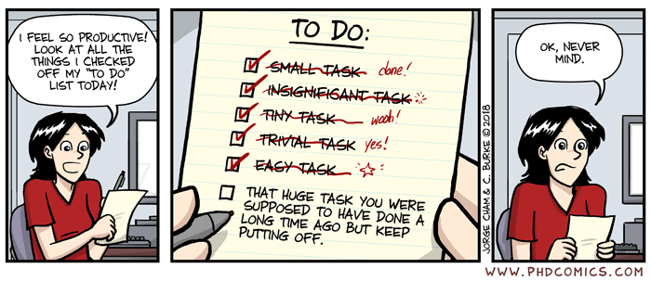
"So productive"

Slide 3
Link = Medium + Adapters

Slide 4
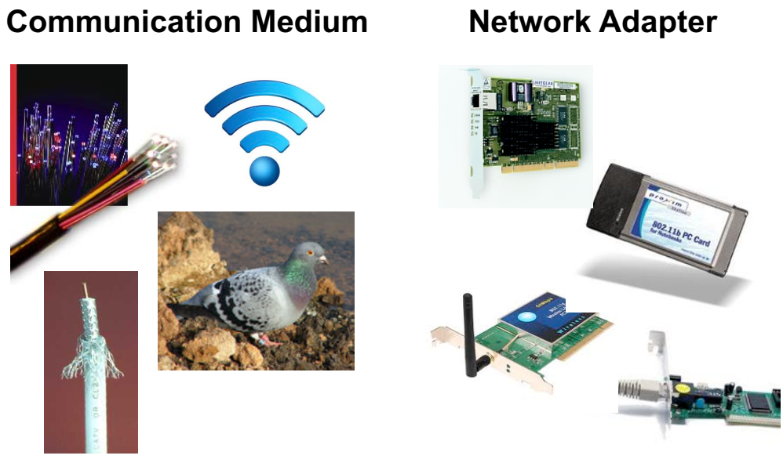
What is a Link?

Slide 5
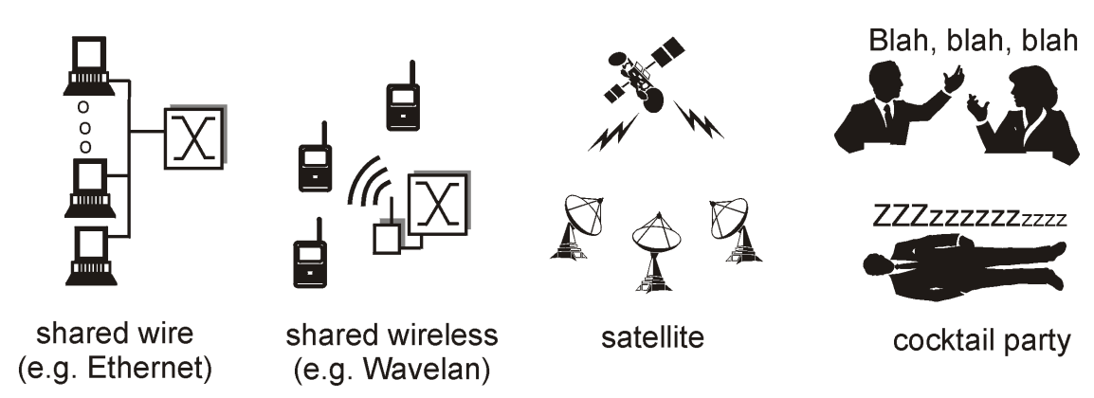
Broadcast Links: Shared Media

Slide 6
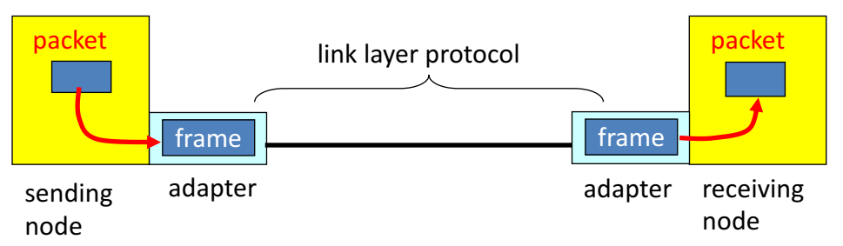
Adaptors Communicating
Sending side
  Encapsulates packet in a frame
  Adds error checking bits, flow control, etc.
Receiving side
  Looks for errors, flow control, etc.
  Extracts datagram and passes to receiving node

Slide 7
Link-Layer Services
Encoding
  Represent the 0s and 1s
Framing
  Encapsulate packet into frame, adding header/trailer
Error detection
  Receiver detecting errors with checksums
Error correction
  Receiver optionally correcting errors
Flow control
  Pacing between sending and receiving nodes

Slide 8
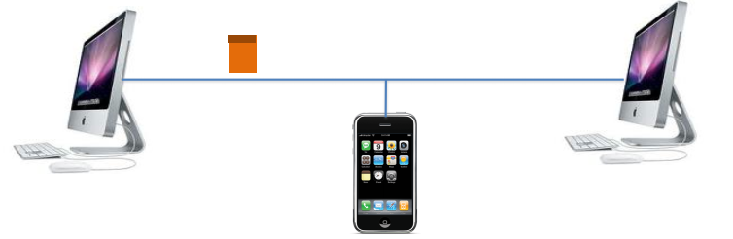
Medium Access Control Address
Identify the sending and receiving adapter
  Unique identifier for each network adapter
  Identifies the intended receiver(s) of the frame
  … and the sender who sent the frame

Slide 9
Medium Access Control Address
MAC address (e.g., 00-15-C5-49-04-A9)
  Numerical address used within a link
  Unique, hard-coded in the adapter when it is built
  Flat name space of 48 bits
Hierarchical allocation: Global uniqueness!
  Blocks: assigned to vendors (e.g., Dell) by the IEEE
  Adapters: assigned by the vendor from its block
Broadcast address (i.e., FF-FF-FF-FF-FF-FF)
  Send the frame to all adapters

Slide 10
As an Aside: Promiscuous Mode
Normal adapter: receives frames sent to
  The local MAC address
  Broadcast address FF-FF-FF-FF-FF-FF
Promiscuous mode
  Receive everything, independent of destination MAC
Useful for packet sniffing
  Network monitoring
  E.g., wireshark, tcpdump
Notes:
Tcpdump is a command line utility that allows you to capture and analyze network traffic going through your system. It is often used to help troubleshoot network issues, as well as a security tool.

Slide 11
Why Not Just Use IP Addresses?
Links can support any network protocol
  Not just for IP (e.g., IPX, Appletalk, X.25, …)
  Different addresses on different kinds of links
An adapter may move to a new location
  So, cannot simply assign a static IP address
  Instead, must reconfigure the adapter’s IP address
Must identify the adapter during bootstrap
  Need to talk to the adapter to assign it an IP address

Slide 12
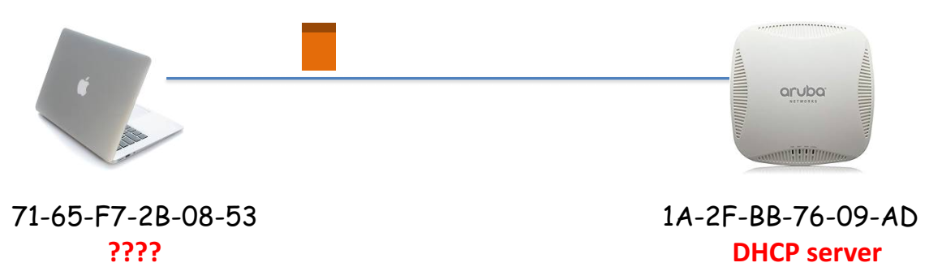
Who Am I: Acquiring an IP Address
Dynamic Host Configuration Protocol (DHCP)
  Broadcast “I need an IP address, please!”
  Response “You can have IP address 1.2.3.4.”

Slide 13
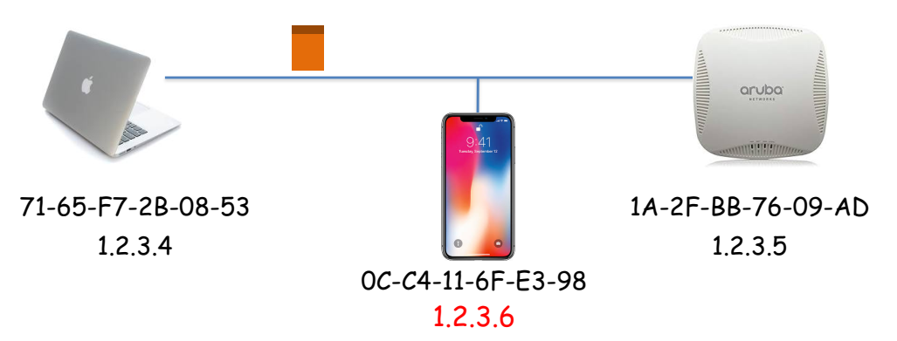
Who Are You: Discovering the Receiver
Address Resolution Protocol (ARP)
  Broadcast “who has IP address 1.2.3.6?”
  Response “0C-C4-11-6F-E3-98 has 1.2.3.6!

Slide 14
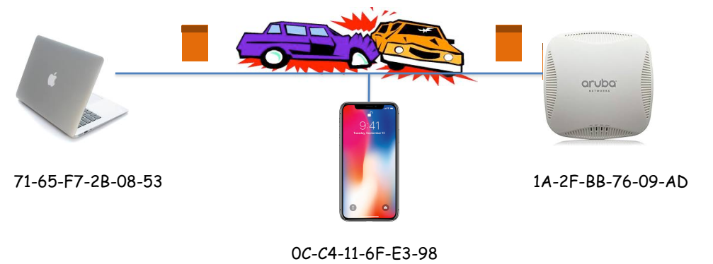
Sharing the Medium: Collisions
Single shared broadcast channel
  Avoid having multiple nodes speaking at once
  Otherwise, collisions lead to garbled data

Slide 15
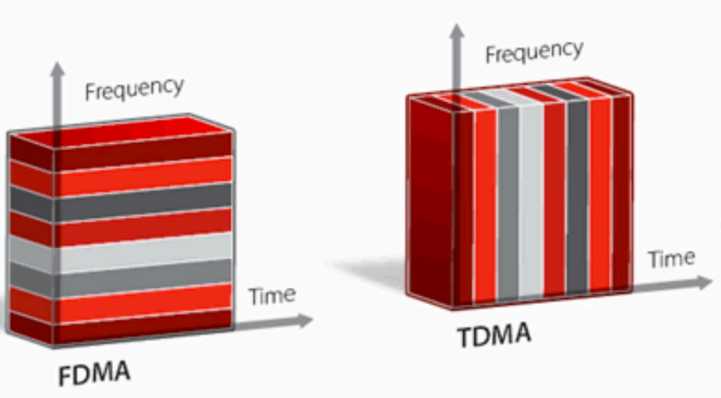
Multi-Access Protocol
Divide the channel into pieces
  in frequency vs. in time

Slide 16
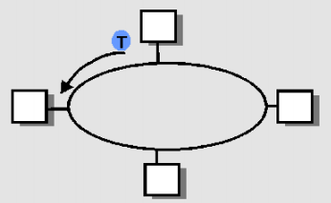
Multi-Access Protocol
Take turns
  Do not transmit w/o token
  With token, transmit for up to some max time/length
  Pass token to right
Punt
  Let collisions happen
  … and detect and recover from them

Slide 17

Like Human Conversation…
Carrier sense
  Listen before speaking
  …and don’t interrupt!
Collision detection
  Detect simultaneous talking
  … and shut up!
Random access
  Wait for a random period of time
  … before trying to talk again!

Slide 18
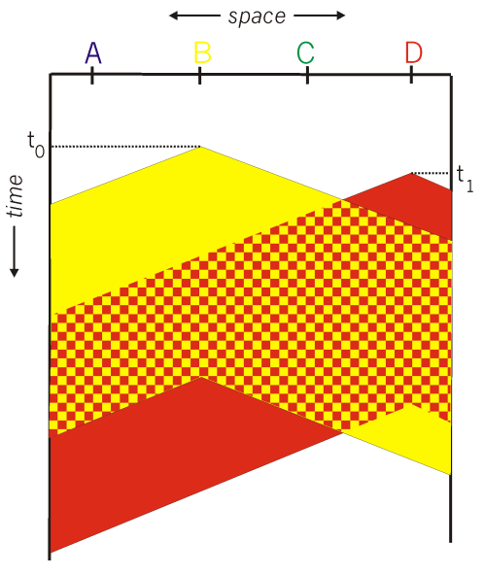
Carrier Sense Multiple Access
Listen for other senders
  Then transmit your data
Collisions can still occur
  Propagation delay
  Wasted transmission

Slide 19
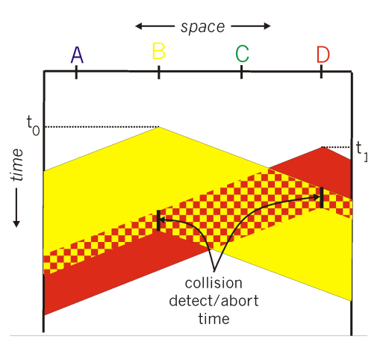
CSMA/CD Collision Detection
Detect collision
  Abort transmission
  Jam the link
Wait random time
  Transmit again
Hard in wireless
  Must receive data while transmitting

Slide 20
Comparing the Three Approaches
Channel partitioning is
  Efficient/fair at high load, inefficient at low load
  Inefficient at high load, efficient/fair at low load
“Taking turns”
  Inefficient at high load
  Efficient at all loads
  Robust to failures
Random access
  Inefficient at low load
  Efficient at all load
  Robust to failures

Slide 21
Sending packets within the local network
Ethernet and ARP

Slide 22
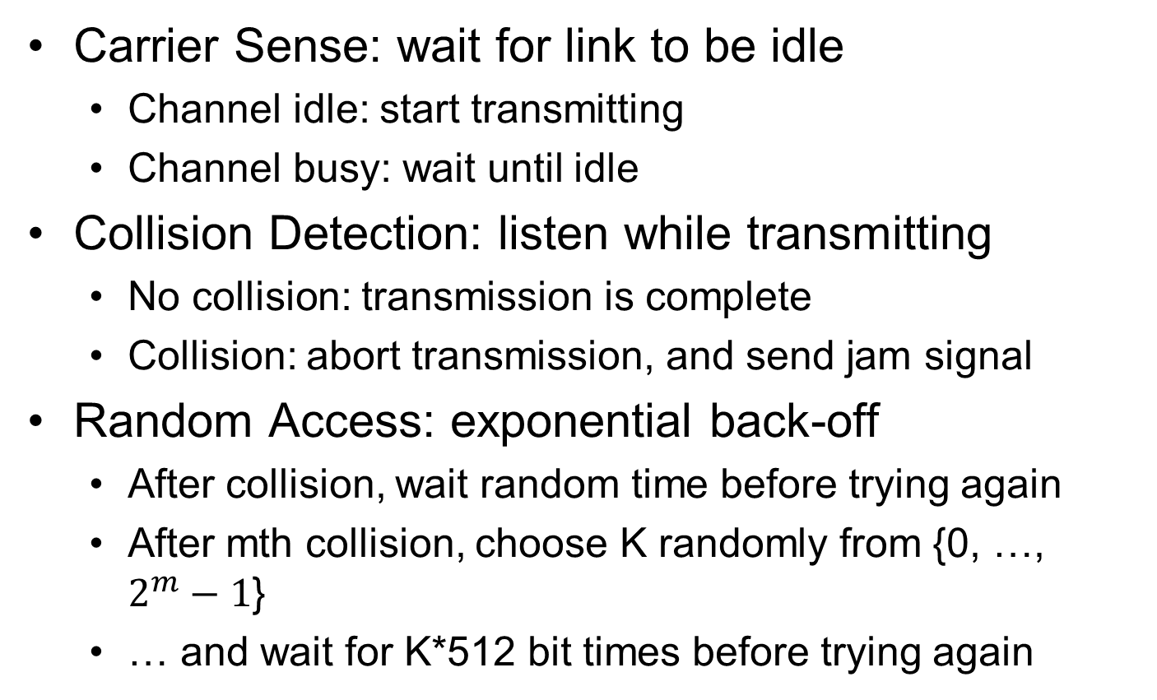
Ethernet Uses CSMA/CD
Carrier Sense: wait for link to be idle
  Channel idle: start transmitting
  Channel busy: wait until idle
Collision Detection: listen while transmitting
  No collision: transmission is complete
  Collision: abort transmission, and send jam signal
Random Access: exponential back-off
  After collision, wait random time before trying again
  After mth collision, choose K randomly from {0, …, $2^{m}−1$}
  … and wait for K*512 bit times before trying again

Slide 23
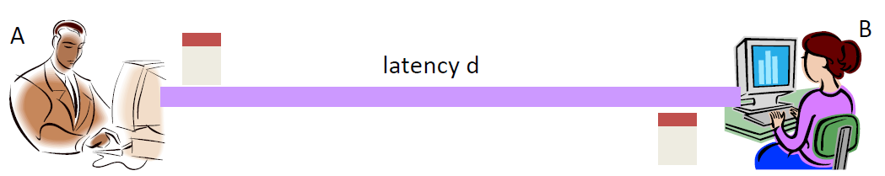
Limitations on Ethernet Length
Latency depends on physical length of link
  Time to propagate a packet from one end to other
Suppose A sends a packet at time t
  And B sees an idle line at a time just before t+d
  … so B happily starts transmitting a packet
B detects a collision, and sends jamming signal
  But A doesn’t see collision till t+2d

Slide 24
Limitations on Ethernet Length
A needs to wait for time 2d to detect collision
  So, A should keep transmitting during this period
  … and keep an eye out for a possible collision
Imposes restrictions on Ethernet
  Maximum length of the wire: 2500 meters
  Minimum length of the packet: 512 bits (64 bytes)

Slide 25
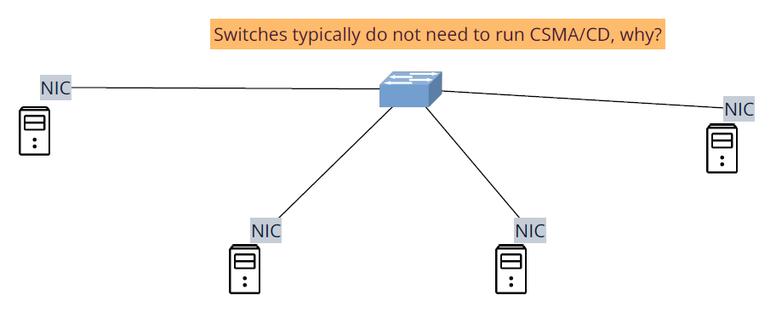
Switched Ethernet
Different Ethernet segments are interconnected with switches (that work on the link layer)
Switch: creates Ethernet segments and forwards frames between segments based on the MAC address

Slide 26
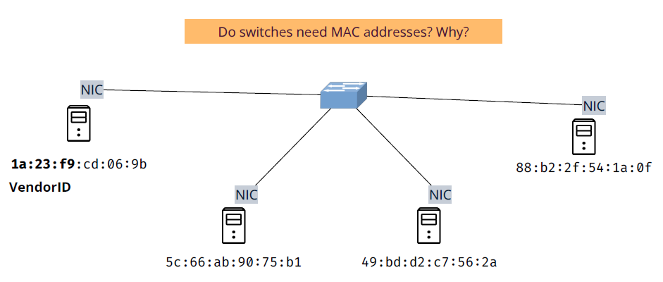
Ethernet MAC address
6-byte long, unique among all network adapters, managed by IEEE

Slide 27
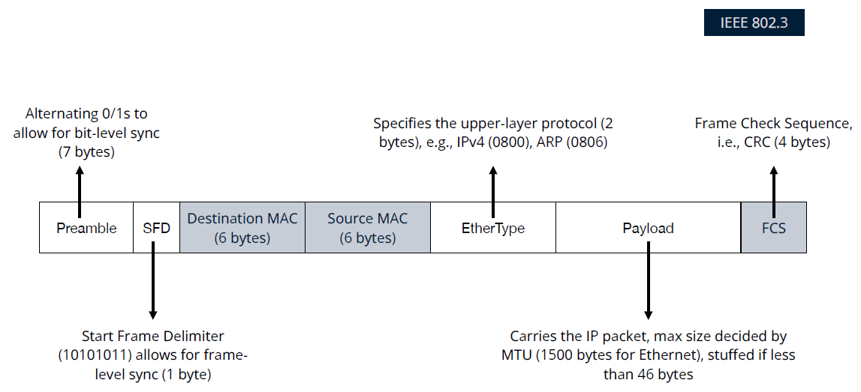
Ethernet frame structure

Slide 28
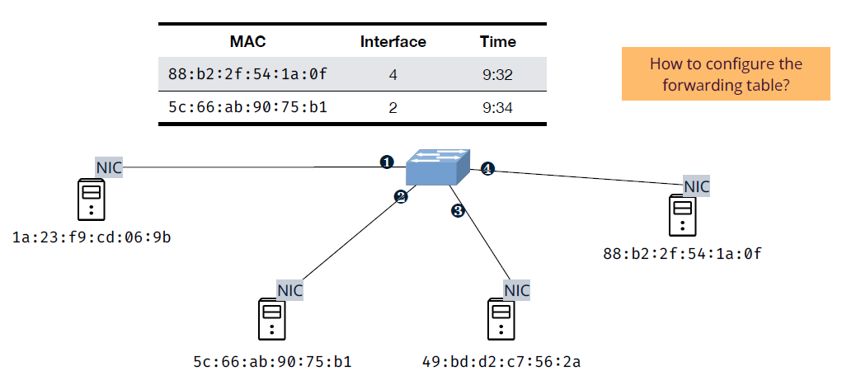
Link layer switches
Switches forward/broadcast/drop frames based on a switch table (a.k.a. forwarding table) and operate transparently to the hosts, i.e., no need for MAC addresses on them

Slide 29
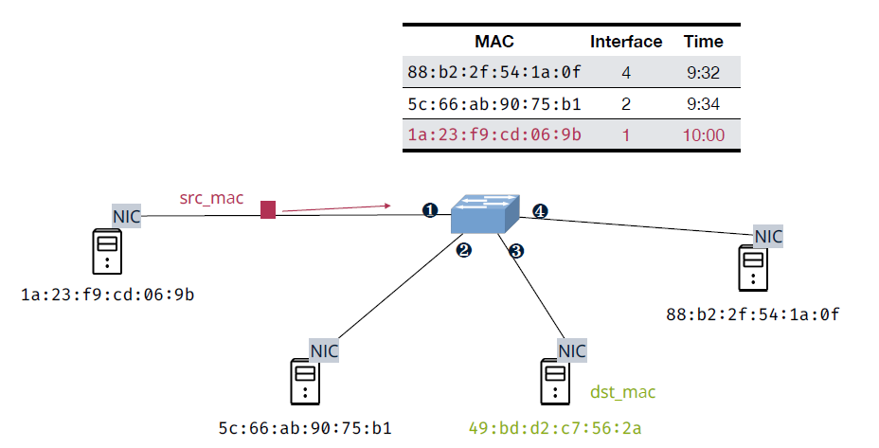
Self learning
Learn new MAC-interface mappings through incoming frames

Slide 30
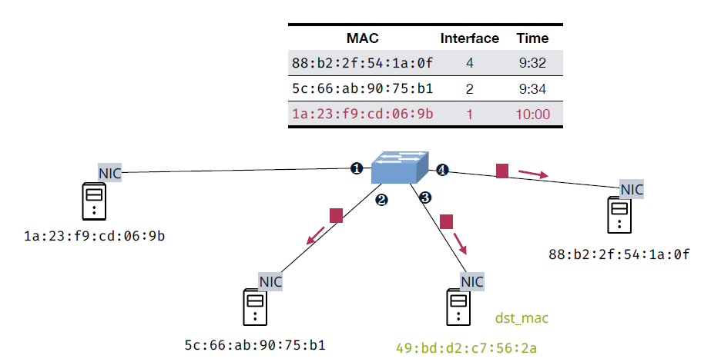
Self learning
Broadcast the new frame with unknown destination MAC on all interfaces but the one that has received the frame

Slide 31
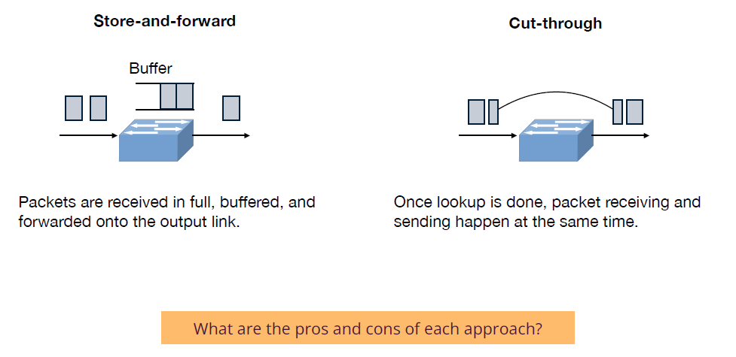
Store-and-forward vs. cut-through

Slide 32
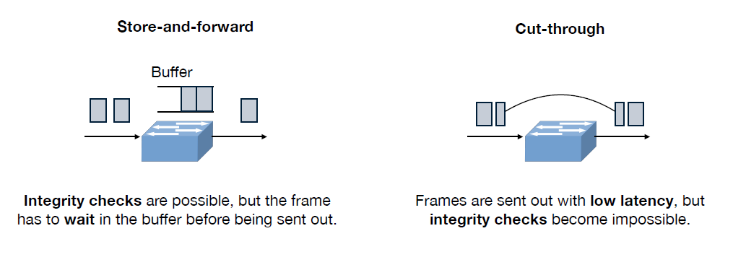
Store-and-forward vs. cut-through

Slide 33
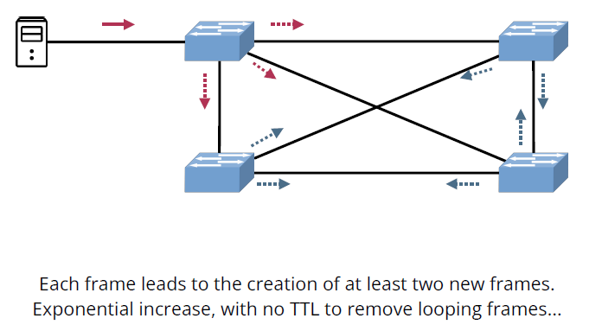
What problems do you see in Ethernet?
Problem #1: when flooding meets loops

Slide 34
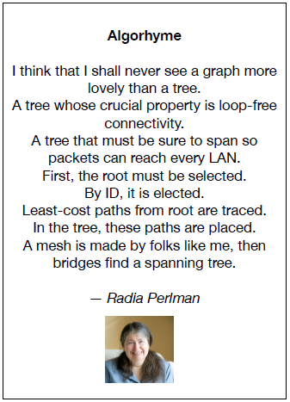
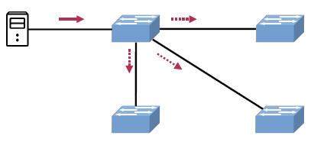
What problems do you see in Ethernet?
Redundancy without loops
Solution
  Reduce the network to one logical spanning tree
  Upon failure, automatically rebuild a spanning tree
In practice, switches run a distributed spanning tree protocol (STP)

Slide 35
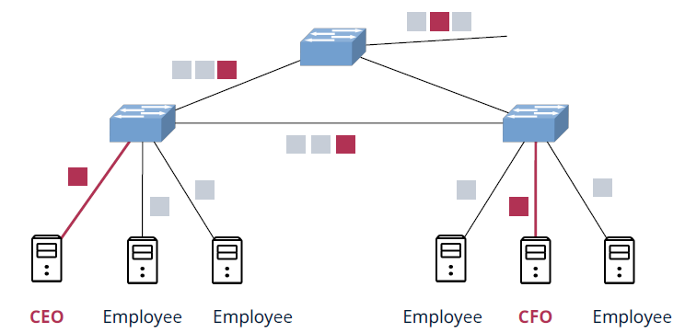
What problems do you see in Ethernet?
Problem #2: traffic isolation
  Broadcast packets cannot be localized and can cause broadcast storm in the network
  Hard user management: A user has to be connected to the a particular switch in order to isolate its traffic

Slide 36
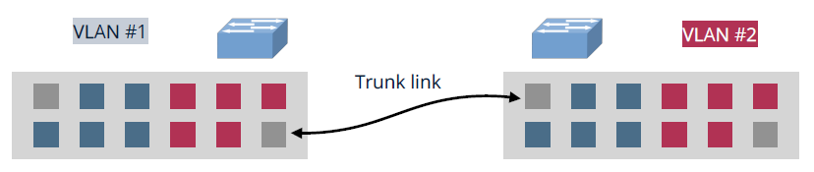
VLAN
Network manager can partition the ports into subsets and assign them to VLANs
Ports in the same VLAN form a broadcast domain, while ports on different VLANs are routed through an internal router within the switch
Switches are connected on trunk ports that belong to all VLANs
How does a receiving switch know which VLAN a frame belongs to?

Slide 37
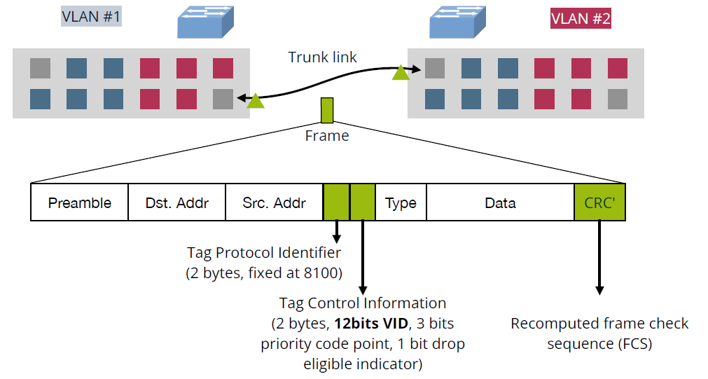
VLAN tag/IEEE 802.1Q

Slide 38
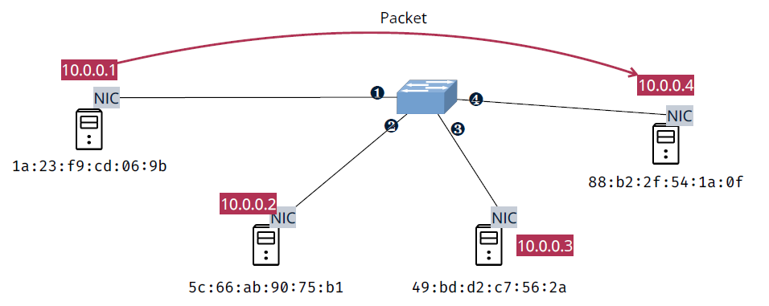
How to obtain the destination MAC address?
Assume we want to send a packet from 10.0.0.1 to 10.0.0.4 on the same subnet. The first step is to know where to forward the packet (or more precisely the frame containing the packet), i.e., obtaining the MAC address of the destination.

Slide 39
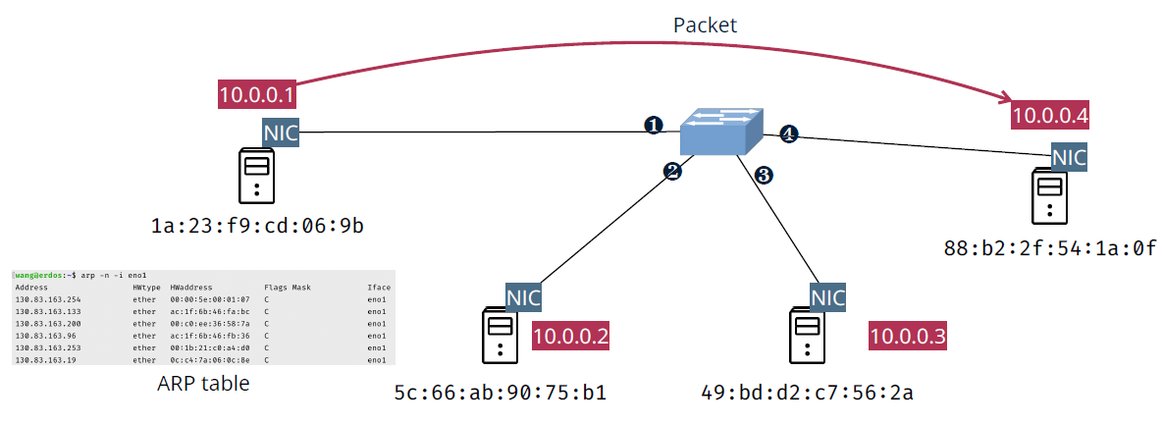
How to obtain the destination MAC address?
ARP query: Whoever has the IP address 10.0.0.4, please tell me your MAC address
ARP reply: that is me, my MAC address is 88:b2:2f:54:1a:0f
Notes:
RFC 826

Slide 40
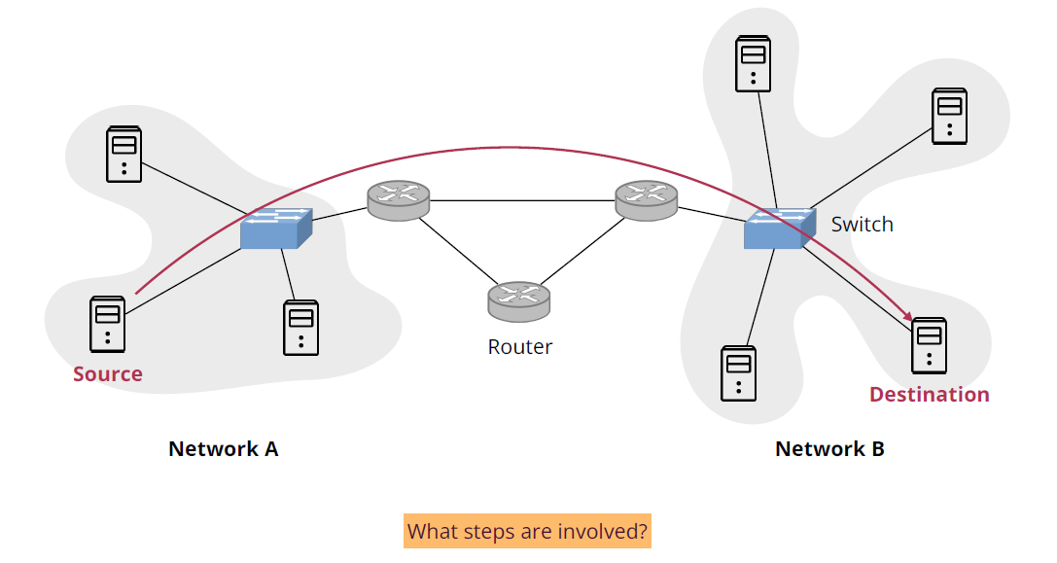
Exercise

Slide 41
internal address → external address
Network Address Translation (NAT)

Slide 42
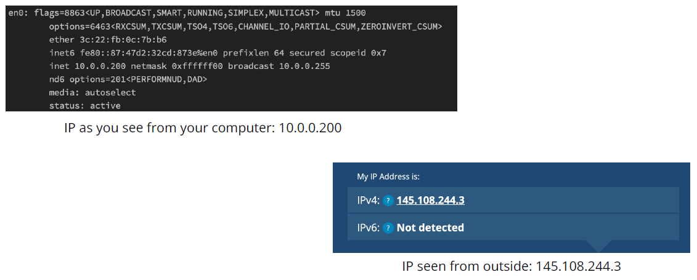
NAT example

Slide 43
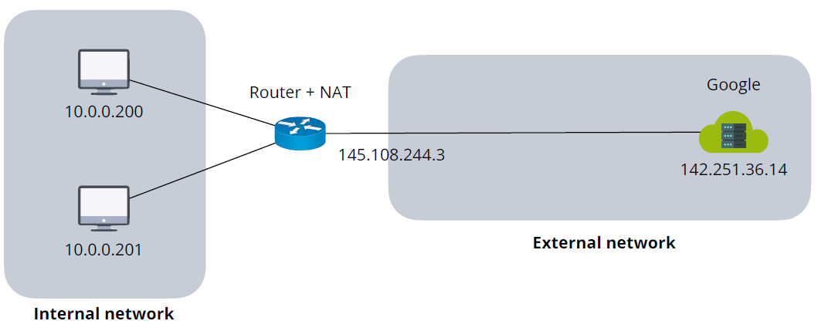
Network address translation (NAT)
A method of mapping an IP address space into another, used for masking network changes and mitigating IPv4 address exhaustion

Slide 44
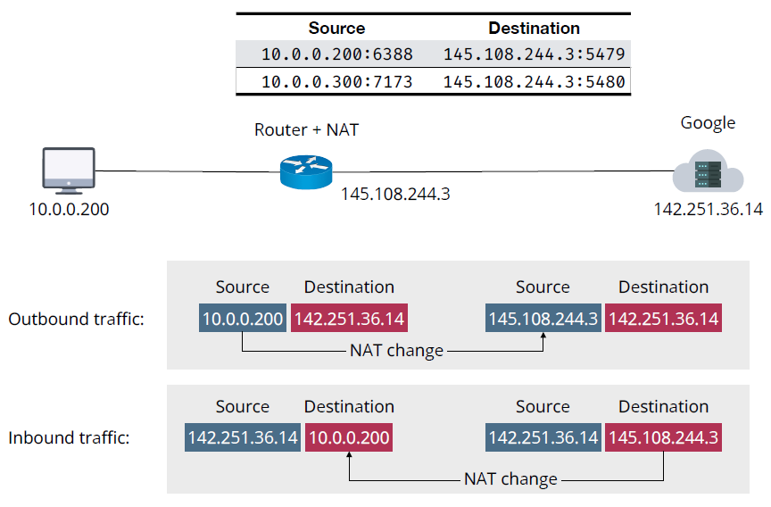
NAT example

Slide 45
NAT pros and cons
Pros
  Mitigates IPv4 address exhaustion problem: reuse IPv4 addresses in private networks
  Destination NAT for port forwarding: hiding internal servers, load balancing
Cons
  Hard to establish peer-to-peer connections
  Violates the end-to-end principle!

Slide 46
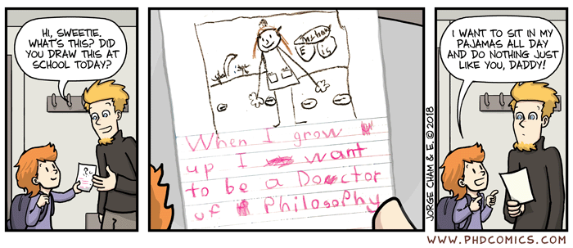
"Based on a true story"

