Slide 1


Slide 2
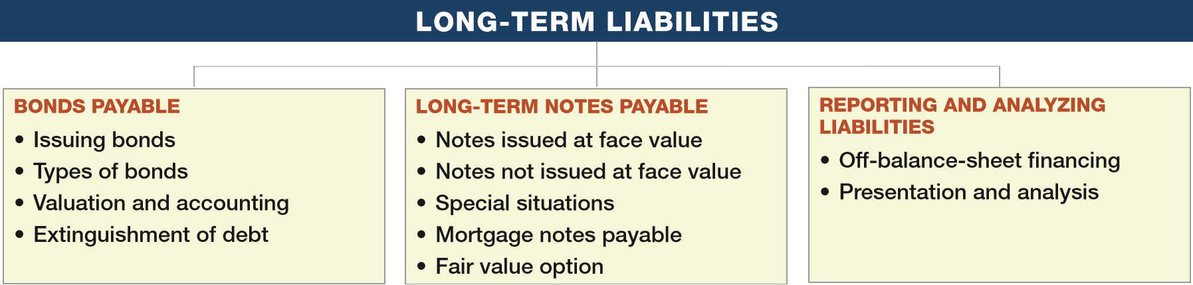
PREVIEW OF CHAPTER 14
Intermediate Accounting
16th Edition
Kieso ● Weygandt ● Warfield

Slide 3
LEARNING OBJECTIVES
14
Long-Term Liabilities
After studying this chapter, you should be able to:
Describe the nature of bonds and indicate the accounting for bond issuances.
Describe the accounting for the extinguishment of debt.
Explain the accounting for long-term notes payable.
Describe the accounting for the fair value option.
Indicate how to present and analyze long-term debt.
LO 1

Slide 4
BONDS PAYABLE
Long-term debt consists of probable future sacrifices of economic benefits arising from present obligations that are not payable within a year or the operating cycle of the company, whichever is longer.
Examples:
Bonds payable
Long-term notes payable
Mortgages payable
Pension liabilities
Lease liabilities
Long-term debt has various covenants or restrictions.
LO 1

Slide 5
BONDS PAYABLE
Issuing Bonds
Bond contract known as a bond indenture.
Represents a promise to pay:
sum of money at designated maturity date, plus
periodic interest at a specified rate on the maturity amount (face value).
Paper certificate, typically a $1,000 face value.
Interest payments usually made semiannually.
Used when the amount of capital needed is too large for one lender to supply.
LO 1

Slide 6
BONDS PAYABLE
Types of Bonds
Common types found in practice:
Secured and Unsecured (debenture) bonds.
Term, Serial, and Callable bonds.
Convertible, Commodity-Backed, Deep-Discount bonds.
Registered and Bearer (Coupon) bonds.
Income and Revenue bonds.
LO 1

Slide 7

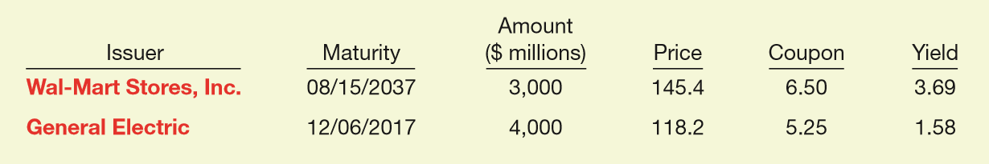
Types of Bonds
Corporate bond listing.
Company Name
Maturity date
Price as a % of par
Interest rate based on price
Face and maturity value
Interest rate paid as a % of par value
LO 1

Slide 8
Valuation and Accounting for Bonds Payable
Issuance and marketing of bonds to the public:
Usually takes weeks or months.
Issuing company must
Arrange for underwriters.
Obtain SEC approval of the bond issue, undergo audits, and issue a prospectus.
Have bond certificates printed.
LO 1

Slide 9
Valuation and Accounting for Bonds
Selling price of a bond issue is set by the
supply and demand of buyers and sellers,
relative risk,
market conditions, and
state of the economy.
Investment community values a bond at the present value of its expected future cash flows, which consist of (1) interest and (2) principal.
LO 1

Slide 10
Valuation and Accounting for Bonds
Interest Rate
Stated, coupon, or nominal rate = Rate written in the terms of the bond indenture.
Bond issuer sets this rate.
Stated as a percentage of bond face value (par).
Market rate or effective yield = Rate that provides an acceptable return commensurate with the issuer’s risk.
Rate of interest actually earned by the bondholders.
LO 1

Slide 11
Valuation and Accounting for Bonds
How do you calculate the amount of interest that is actually paid to the bondholder each period?
How do you calculate the amount of interest that is actually recorded as interest expense by the issuer of the bonds?
(Stated Rate x Face Value of the Bond)
(Market Rate x Carrying Value of the Bond)
LO 1

Slide 12
Valuation and Accounting for Bonds
Assume Stated Rate of 8%
Market Interest
Bonds Sold At
6%
Premium
8%
Par Value
10%
Discount
LO 1

Slide 13
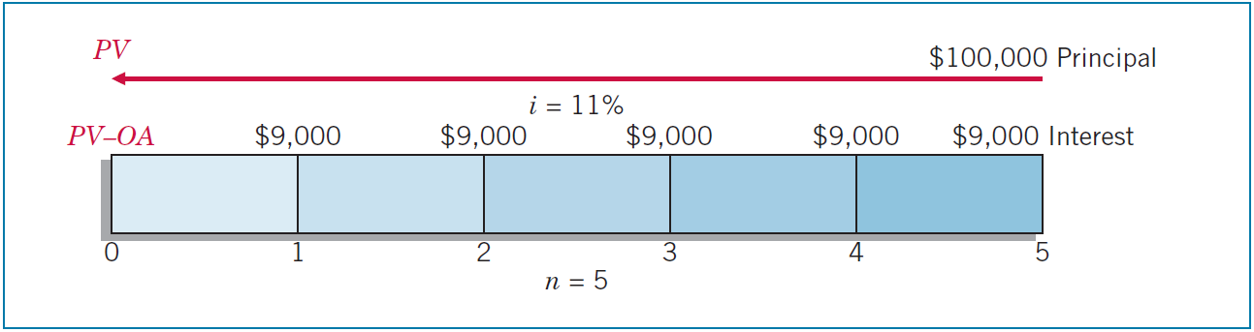
Valuation and Accounting for Bonds
Illustration: ServiceMaster Company issues $100,000 in bonds, due in five years with 9 percent interest payable annually at year-end. At the time of issue, the market rate for such bonds is 11 percent.
ILLUSTRATION 14-1
Time Diagram for Bond Cash Flows
LO 1

Slide 14
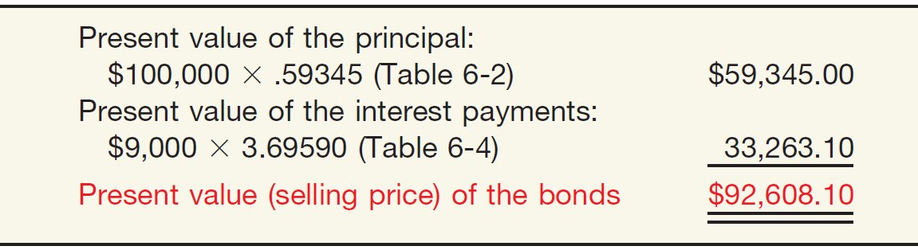

Valuation and Accounting for Bonds
ILLUSTRATION 14-1
ILLUSTRATION 14-2
Present Value Computation of Bond Selling at a Discount
LO 1

Slide 15
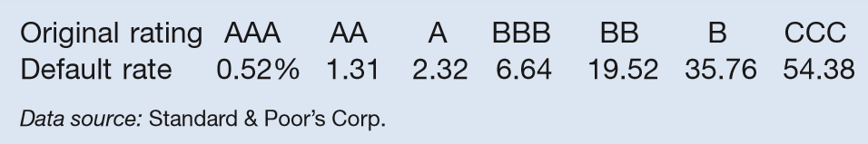
WHAT DO THE NUMBERS MEAN? HOW’S MY RATING?
WHAT’S YOUR PRINCIPLE
Two major publication companies, Moody’s Investors Service and Standard & Poor’s Corporation, issue quality ratings on every public debt issue. The table to the right summarizes the ratings issued by Standard & Poor’s, along with historical default rates on bonds with different ratings.
As expected, bonds receiving the highest quality rating of AAA have the lowest historical default rates. Bonds rated below BBB, which are considered below investment grade (“junk bonds”), experience default rates ranging from 20 to 50 percent. Debt ratings reﬂect credit quality. The market closely monitors these ratings when determining the required yield and pricing of bonds at issuance and in periods after issuance, especially if a bond’s rating is upgraded or downgraded. Unfortunately, the median rating of companies assessed by Standard & Poor’s has recently fallen from A to BBB.
(continued)
LO 1

Slide 16
WHAT DO THE NUMBERS MEAN? HOW’S MY RATING?
WHAT’S YOUR PRINCIPLE
The BBB rating is the lowest possible “investment grade” or, to put it another way, is just one notch above “junk” bond status. It should be noted that investors who seek triple-A debt are running out of options. Standard & Poor’s recently gave its top rating to just three U.S. industrial companies: ExxonMobil, Johnson & Johnson, and Microsoft. Indeed, the overall decline in ratings can be explained in part by the growing issuance of CCC-rated debt in a variety of industry sectors, as shown in the chart to the right. Years of low interest rates have encouraged some of the riskiest corporate borrowers to tap yield-hungry investors to ﬁnance their growth, spurring issuance of debt that comes with triple-C credit ratings. For investors willing to shoulder the burden of those extra risks in exchange for heftier returns, CCC-rated bonds have been alluring.
LO 1

Slide 17
Bonds Issued at Par on Interest Date
Illustration: Buchanan Company issues at par 10-year term bonds with a par value of $800,000, dated January 1, 2017, and bearing interest at an annual rate of 10 percent payable semiannually on January 1 and July 1, it records the following entry.
Journal entry on date of issue, Jan. 1, 2017.
Cash 800,000
Bonds Payable 800,000
LO 1

Slide 18
Bonds Issued at Par on Interest Date
Journal entry to record first semiannual interest payment on July 1, 2017.
Interest Expense 40,000
Cash 40,000
($800,000 x .10 x ½)
Journal entry to accrue interest expense at Dec. 31, 2017.
Interest Expense 40,000
Interest Payable 40,000
LO 1

Slide 19
Bonds Issued at Discount on Interest Date
Illustration: If Buchanan Company issues $800,000 of bonds on January 1, 2017, at 97, and bearing interest at an annual rate of 10 percent payable semiannually on January 1 and July 1, it records the issuance as follows.
Cash ($800,000 x .97) 776,000
Discount on Bonds Payable 24,000
Bonds Payable 800,000
Note: Assuming the use of the straight-line method, $1,200 of the discount is amortized to interest expense each period for 20 periods ($24,000 ÷ 20).
LO 1

Slide 20
Bonds Issued at Discount on Interest Date
Illustration: Buchanan records the first semiannual interest payment and the bond discount on July 1, 2017, as follows.
Interest Expense 41,200
Discount on Bonds Payable 1,200
Cash 40,000
At Dec. 31, 2017, Buchanan makes the following adjusting entry.
Interest Expense 41,200
Discount on Bonds Payable 1,200
Interest Payable 40,000
LO 1

Slide 21
Bonds Issued at Premium on Interest Date
Illustration: If Buchanan Company issues $800,000 of bonds on January 1, 2017, at 103, and bearing interest at an annual rate of 10 percent payable semiannually on January 1 and July 1, it records the issuance as follows.
Cash ($800,000 x 1.03) 824,000
Premium on Bonds Payable 24,000
Bonds Payable 800,000
Note: With the bond premium of $24,000, Buchanan amortizes $1,200 to interest expense each period for 20 periods ($24,000 ÷ 20).
LO 1

Slide 22
Bonds Issued at Premium on Interest Date
Illustration: Buchanan records the first semiannual interest payment and the bond premium on July 1, 2017, as follows.
Interest Expense 38,800
Premium on Bonds Payable 1,200
Cash 40,000
At Dec. 31, 2017, Buchanan makes the following adjusting entry.
Interest Expense 38,800
Premium on Bonds Payable 1,200
Interest Payable 40,000
LO 1

Slide 23
Bonds Issued Between Interest Dates
When companies issue bonds on other than the interest payment dates,
Buyers will pay the seller the interest accrued from the last interest payment date to the date of issue.
On the next semiannual interest payment date, purchasers will receive the full six months’ interest payment.
LO 1

Slide 24
Bonds Issued Between Interest Dates
Illustration: On March 1, 2017, Taft Corporation issues 10-year bonds, dated January 1, 2017, with a par value of $800,000. These bonds have an annual interest rate of 6 percent, payable semiannually on January 1 and July 1. Taft records the bond issuance at par plus accrued interest as follows.
Cash 808,000
Bonds Payable 800,000
Interest Expense ($800,000 x .06 x 2/12) 8,000
LO 1

Slide 25
Bonds Issued Between Interest Dates
On July 1, 2017, four months after the date of purchase, Taft pays the purchaser six months’ interest and makes the following entry.
Interest Expense 24,000
Cash 24,000
LO 1

Slide 26
Bonds Issued Between Interest Dates
If, however, Taft issued the 6 percent bonds at 102, its March 1 entry would be:
Cash 824,000
Bonds Payable 800,000
Premium on Bonds Payable ($800,000 x .02) 16,000
Interest Expense 8,000
*
* [($800,000 x 1.02) + ($800,000 x .06 x 2/12)]
LO 1

Slide 27
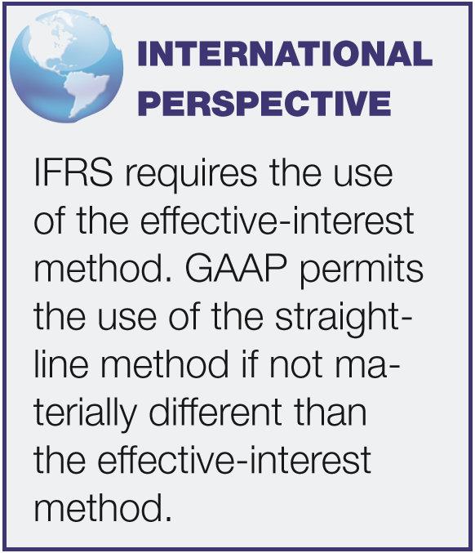
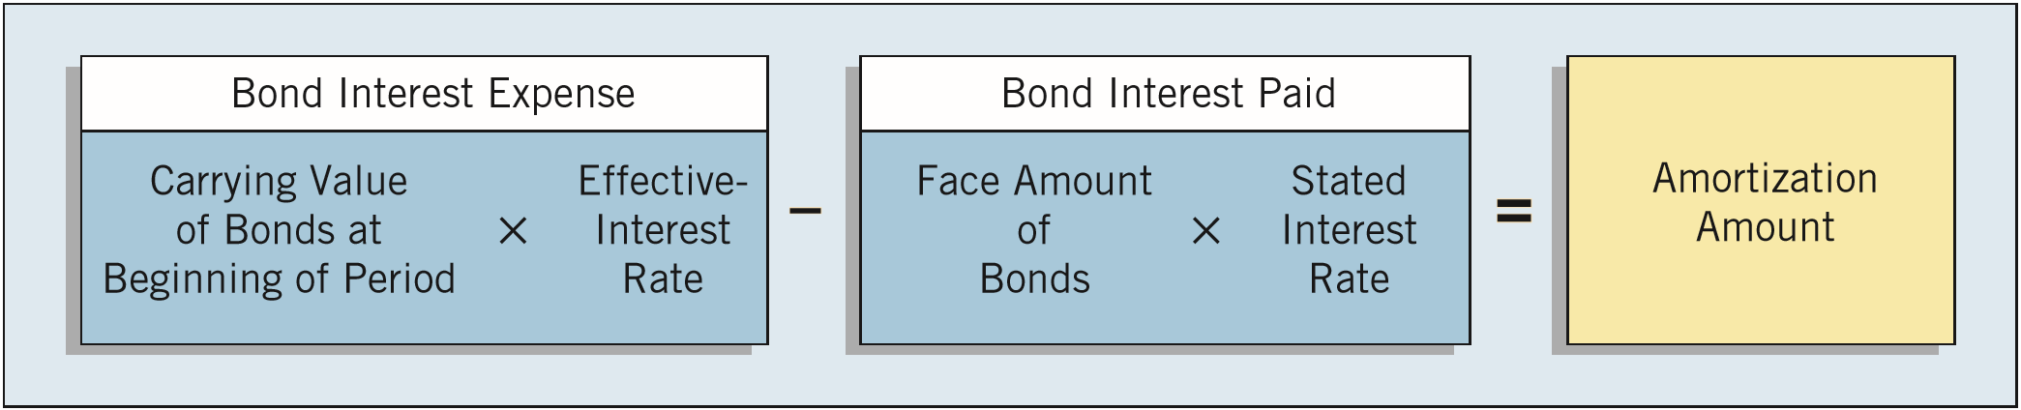
Accounting for Bonds
Effective-Interest Method
Produces a periodic interest expense equal to a constant percentage of the carrying value of the bonds.
ILLUSTRATION 14-4
Bond Discount and Premium Amortization Computation
LO 1

Slide 28
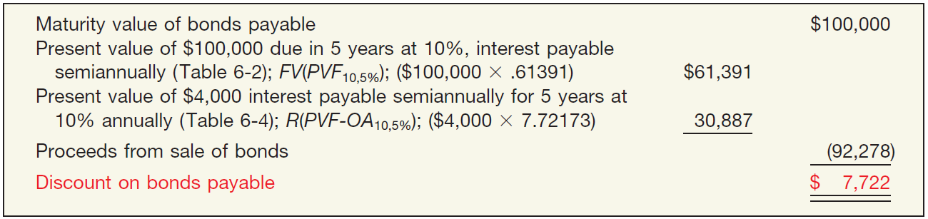
Effective-Interest Method
Bonds Issued at a Discount
Illustration: Evermaster Corporation issued $100,000 of 8% term bonds on January 1, 2017, due on January 1, 2022, with interest payable each July 1 and January 1. Investors require an effective-interest rate of 10%. Calculate the bond proceeds.
ILLUSTRATION 14-5
Computation of Discount on Bonds Payable
LO 1

Slide 29
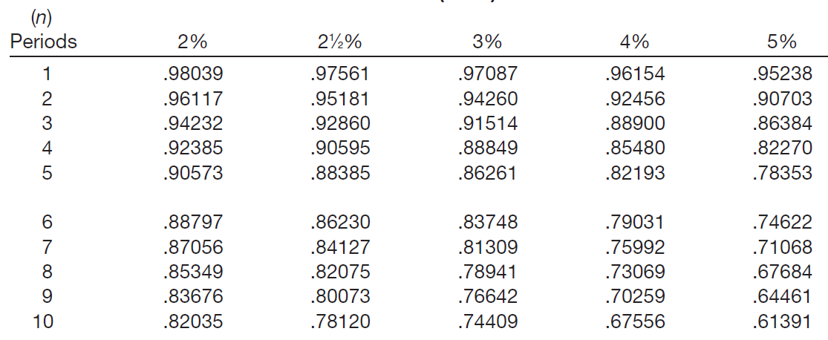
Effective-Interest Method
TABLE 6-2 PRESENT VALUE OF 1 (PRESENT VALUE OF A SINGLE SUM)
$100,000
x .61391
= $61,391
Face Value
Factor
Present Value
LO 1

Slide 30
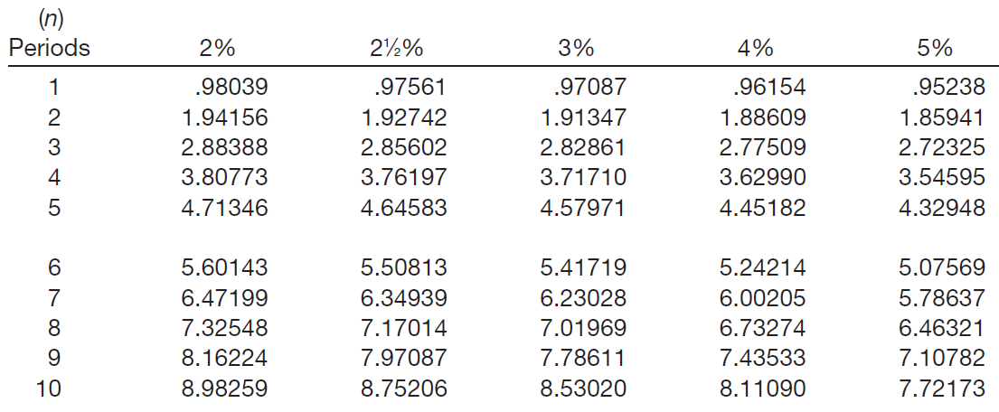
Effective-Interest Method
TABLE 6-4 PRESENT VALUE OF AN ORDINARY ANNUITY OF 1
$4,000
x 7.72173
= $30,887
Semiannual Payment
Factor
Present Value
LO 1

Slide 31
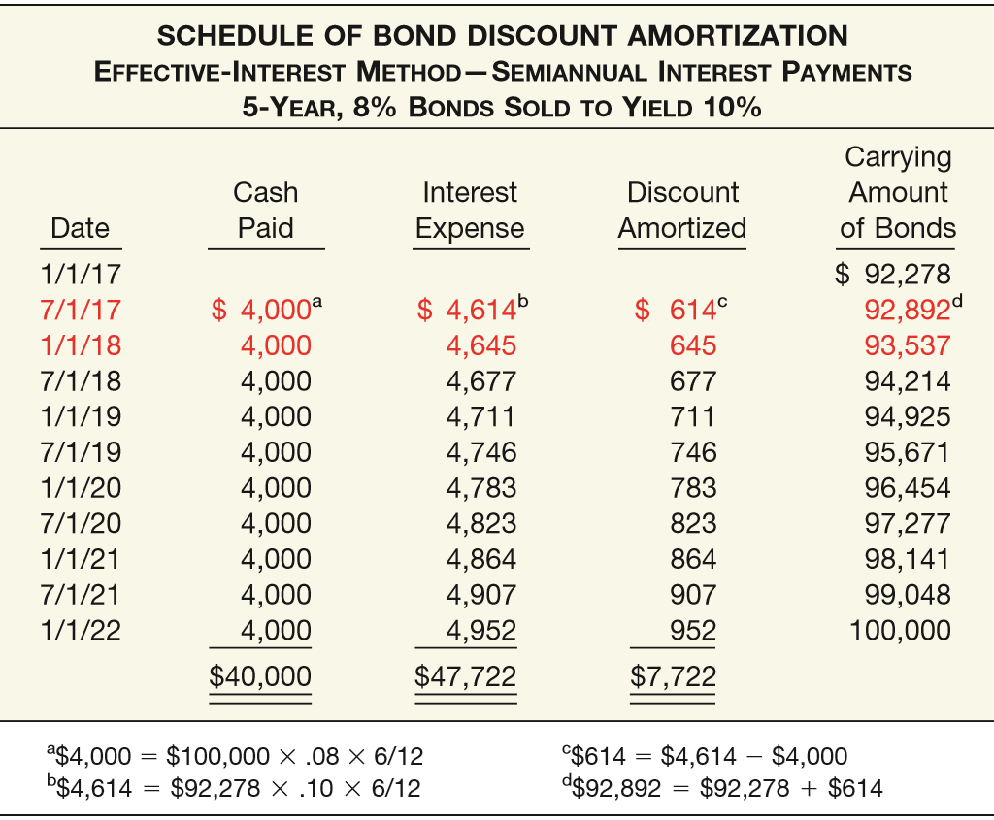
ILLUSTRATION 14-6
LO 1

Slide 32
ILLUSTRATION 14-6
Journal entry on date of issue, Jan. 1, 2017.
Cash 92,278
Discount on Bonds Payable 7,722
Bonds Payable 100,000
LO 1

Slide 33
ILLUSTRATION 14-6
Journal entry to record first payment and amortization of the discount on July 1, 2017.
Interest Expense 4,614
Discount on Bonds Payable 614
Cash 4,000
LO 1

Slide 34
ILLUSTRATION 14-6
Journal entry to record accrued interest and amortization of the discount on Dec. 31, 2017.
Interest Expense 4,645
Interest Payable 4,000
Discount on Bonds Payable 645
LO 1

Slide 35
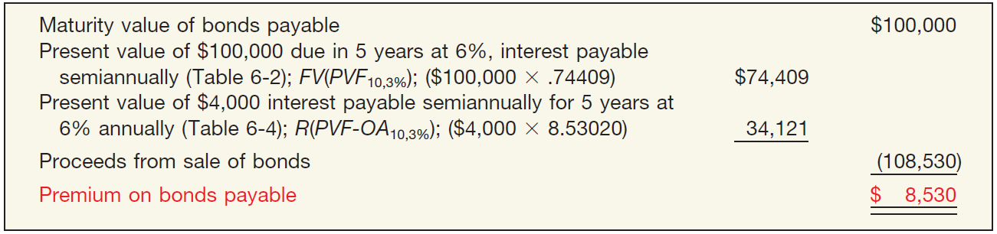
Effective-Interest Method
Bonds Issued at a Premium
Illustration: Evermaster Corporation issued $100,000 of 8% term bonds on January 1, 2017, due on January 1, 2022, with interest payable each July 1 and January 1. Investors require an effective-interest rate of 6%. Calculate the bond proceeds.
ILLUSTRATION 14-7
Computation of Premium on Bonds Payable
LO 1

Slide 36
Effective-Interest Method
TABLE 6-2 PRESENT VALUE OF 1 (PRESENT VALUE OF A SINGLE SUM)
$100,000
x .74409
= $74,409
Face Value
Factor
Present Value
LO 1

Slide 37
Effective-Interest Method
TABLE 6-4 PRESENT VALUE OF AN ORDINARY ANNUITY OF 1
$4,000
x 8.53020
= $34,121
Semiannual Payment
Factor
Present Value
LO 1

Slide 38
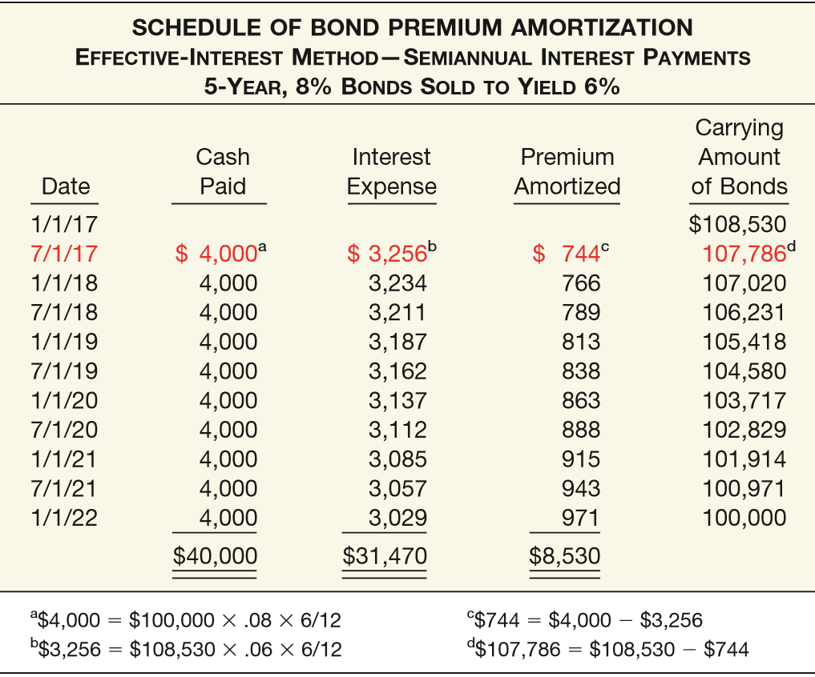
ILLUSTRATION 14-8
LO 1

Slide 39
ILLUSTRATION 14-8
Journal entry on date of issue, Jan. 1, 2017.
Cash 108,530
Premium on Bonds Payable 8,530
Bonds Payable 100,000
LO 1

Slide 40
ILLUSTRATION 14-8
Journal entry to record first payment and amortization
of the premium on July 1, 2017.
Interest Expense 3,256
Premium on Bonds Payable 744
Cash 4,000
LO 1

Slide 41
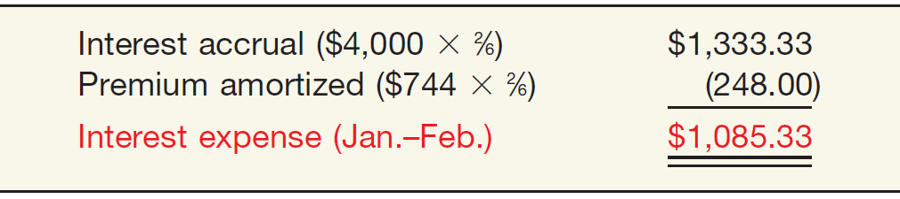
Effective-Interest Method
Accrued Interest
What happens if Evermaster prepares financial statements at the end of February 2017? In this case, the company prorates the premium by the appropriate number of months to arrive at the proper interest expense, as follows.
ILLUSTRATION 14-9
Computation of Interest Expense
LO 1

Slide 42
Effective-Interest Method
Accrued Interest
ILLUSTRATION 14-9
Evermaster records this accrual as follows.
Interest Expense 1,085.33
Premium on Bonds Payable 248.00
Interest Payable 1,333.33
LO 1

Slide 43
Effective-Interest Method
Classification of Discount and Premium
Companies report bond discounts and bond premiums as a direct deduction from or addition to the face amount of the bond.
LO 1

Slide 44
LEARNING OBJECTIVES
14
Long-Term Liabilities
After studying this chapter, you should be able to:
Describe the nature of bonds and indicate the accounting for bond issuances.
Describe the accounting for the extinguishment of debt.
Explain the accounting for long-term notes payable.
Describe the accounting for the fair value option.
Indicate how to present and analyze long-term debt.
LO 2

Slide 45
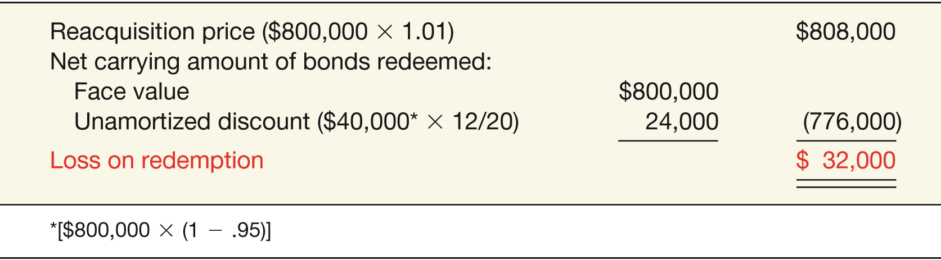
Extinguishment of Debt
Illustration: On January 1, 2010, General Bell Corp. issued at 95 bonds with a par value of $800,000, due in 20 years. Eight years after the issue date, General Bell calls the entire issue at 101 and cancels it. At that time, the unamortized discount balance is $24,000. General Bell computes the loss on redemption as follows.
ILLUSTRATION 14-11
Computation of Loss on Redemption of Bonds
LO 2

Slide 46
Extinguishment of Debt
General Bell records the reacquisition and cancellation of the bonds as follows:
Bonds Payable 800,000
Loss on Redemption of Bonds 32,000
Discount on Bonds Payable 24,000
Cash 808,000
LO 2

Slide 47
WHAT DO THE NUMBERS MEAN? YOUR DEBT IS KILLING MY EQUITY
WHAT’S YOUR PRINCIPLE
Traditionally, investors in the equity and bond markets operate in their own separate worlds. However, in recent volatile markets, even quiet murmurs in the bond market have been ampliﬁed into movements (usually negative) in share prices. At one extreme, these gyrations heralded the demise of a company well before the investors could sniff out the problem.
The swift decline of Enron in late 2001 provided the ultimate lesson: A company with no credit is no company at all. As one analyst remarked, “You can no longer have an opinion on a company’s shares without having an appreciation for its credit rating.” Indeed, other energy companies also felt the effect of Enron’s troubles as lenders tightened or closed down the credit supply and raised interest rates on already-high levels of debt. The result? Stock prices took a hit.
Other industries are not immune from the negative shareholder effects of credit problems. For example, analysts at TheStreet.com compiled a list of companies with a focus on debt levels. Companies like Copel CIA (an energy distribution company) were rewarded with improved stock ratings, based on their manageable debt levels.
Or consider the case of Apple, which recently issued a whopping $6.5 billion of debt while its stock continued to perform well. The reason? Apple is reporting
(continued)
LO 2

Slide 48
WHAT DO THE NUMBERS MEAN? YOUR DEBT IS KILLING MY EQUITY
WHAT’S YOUR PRINCIPLE
strong proﬁtability and good cash ﬂows, so there is little concern that it cannot meet its debt obligations. In contrast, other companies with high debt levels and low ability to cover interest costs were not viewed very favorably. Among them are Herbalife and Goodyear Tire and Rubber, the latter of which reported debt levels several times greater than its equity.
Goodyear is a classic example of how swift and crippling a heavy debt-load can be. Not too long ago, Goodyear had a good credit rating and was paying a good dividend. But, with mounting operating losses, Goodyear’s debt became a huge burden, its debt rating fell to junk status, the company cut its dividend, and its stock price dropped 80 percent. Only recently has Goodyear been able to dig out of its debt ditch. This was yet another example of stock prices taking a hit due to concerns about credit quality. Thus, even if your investment tastes are in equity, keep an eye on the liabilities.
Sources: Adapted from Steven Vames, “Credit Quality, Stock Investing Seem to Go Hand in Hand,” Wall Street Journal (April 1, 2002), p. R4; Herb Greenberg, “The Hidden Dangers of Debt,” Fortune (July 21, 2003), p. 153; Christine Richard, “Holders of Corporate Bonds Seek Protection from Risk,” Wall Street Journal (December 17–18, 2005), p. B4; and S. Nielson, “Ackman Says Herbalife’s Debt Levels Are Cause for Concern,” http://finance.yahoo.com/news (December 29, 2014).
LO 2

Slide 49
LEARNING OBJECTIVES
14
Long-Term Liabilities
After studying this chapter, you should be able to:
Describe the nature of bonds and indicate the accounting for bond issuances.
Describe the accounting for the extinguishment of debt.
Explain the accounting for long-term notes payable.
Describe the accounting for the fair value option.
Indicate how to present and analyze long-term debt.
LO 3

Slide 50
LONG-TERM NOTES PAYABLE
Accounting for notes and bonds is quite similar.
A note is valued at the present value of its future interest and principal cash flows.
Company amortizes any discount or premium over the life of the note.
LO 3

Slide 51
Notes Issued at Face Value
Illustration: Scandinavian Imports issues a $10,000, three-year note, at face value to Bigelow Corp. The stated rate and the effective rate were both 10 percent. Scandinavian would record the issuance of the note as follows.
Cash 10,000
Notes Payable 10,000
Scandinavian Imports would recognize the interest incurred each year as follows.
Interest Expense 1,000
Cash 1,000
($10,000 x 10% = $1,000)
LO 3

Slide 52
Notes Not Issued at Face Value
Zero-Interest-Bearing Notes
Issuing company records the difference between the face amount and the present value (cash received) as
a discount and
amortizes that amount to interest expense over the life of the note.
LO 3

Slide 53
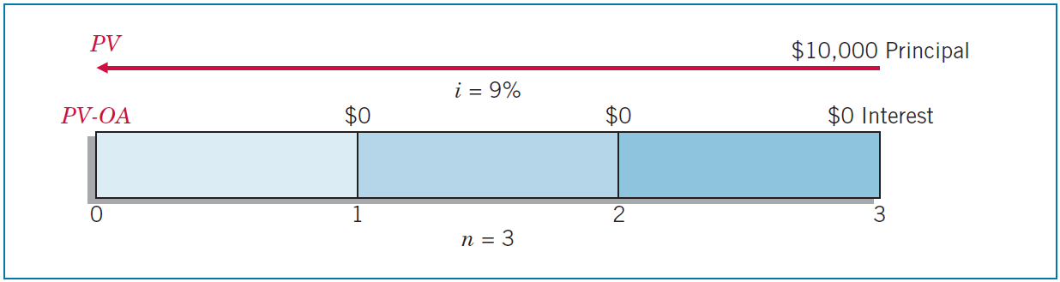
Zero-Interest-Bearing Notes
Illustration: Turtle Cove Company issued the three-year, $10,000, zero-interest-bearing note to Jeremiah Company. The implicit rate that equated the total cash to be paid ($10,000 at maturity) to the present value of the future cash flows ($7,721.80 cash proceeds at date of issuance) was 9 percent.
ILLUSTRATION 14-12
Time Diagram for Zero-Interest-Bearing Note
LO 3

Slide 54
Zero-Interest-Bearing Notes
Illustration: Turtle Cove Company issued the three-year, $10,000, zero-interest-bearing note to Jeremiah Company. The implicit rate that equated the total cash to be paid ($10,000 at maturity) to the present value of the future cash flows ($7,721.80 cash proceeds at date of issuance) was 9 percent. Turtle Cove records issuance of the note as follows.
Cash 7,721.80
Discount on Notes Payable 2,278.20
Notes Payable 10,000.00
LO 3

Slide 55
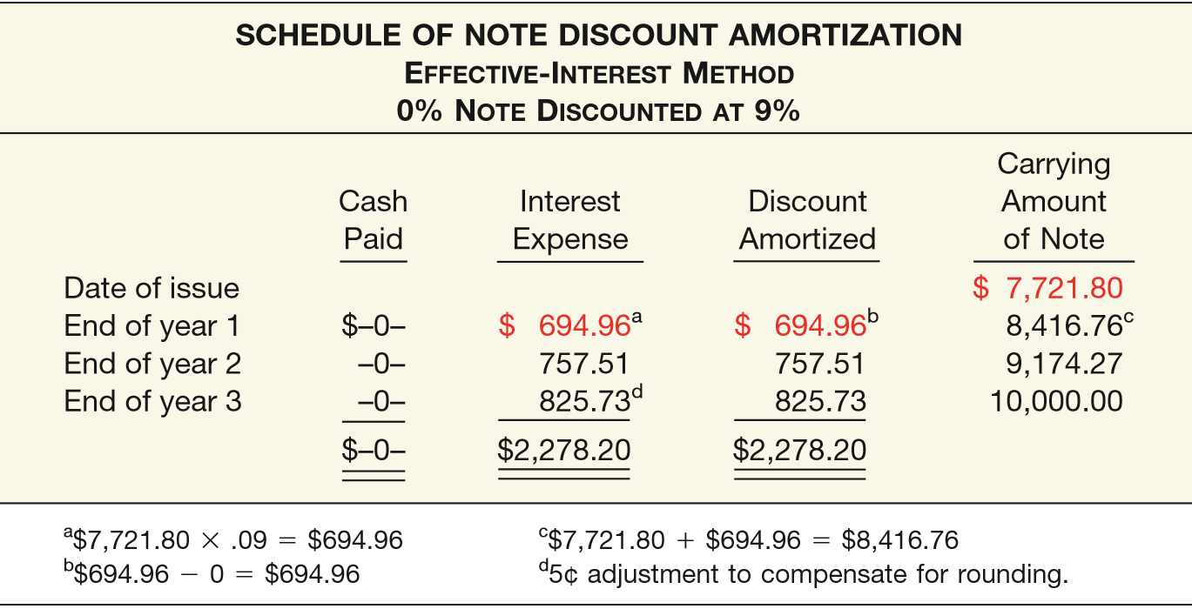
ILLUSTRATION 14-13
Schedule of Note Discount Amortization
Turtle Cove records interest expense at the end of the first year as follows.
Interest Expense 694.96
Discount on Notes Payable 694.96
LO 3

Slide 56
Interest-Bearing Notes
Illustration: Marie Co. issued for cash a $10,000, three-year note bearing interest at 10 percent to Morgan Corp. The market rate of interest is 12 percent and the stated rate is 10%. The present value of the note is calculated to be $9,520. Marie Co. records the issuance of the note as follows.
Cash 9,520
Discount on Notes Payable 480
Notes Payable 10,000
LO 3

Slide 57
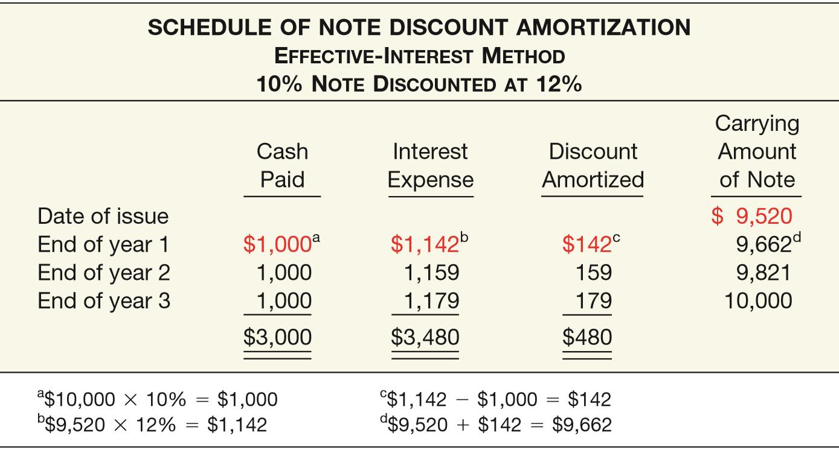
ILLUSTRATION 14-14
Schedule of Note Discount Amortization
Prepare the entry required at the end of the first year.
Interest Expense 1,142
Discount on Notes Payable 142
Cash 1,000
LO 3

Slide 58
Special Notes Payable Situations
Notes Issued for Property, Goods, or Services
When exchanging the debt instrument for property, goods, or services in a bargained transaction, the stated interest rate is presumed to be fair unless:
No interest rate is stated, or
The stated interest rate is unreasonable, or
The face amount is materially different from the current cash price for the same or similar items or from the current fair value of the debt instrument.
LO 3

Slide 59
Special Notes Payable Situations
Choice of Interest Rates
If a company cannot determine the fair value of the property, goods, services, or other rights, and if the note has no ready market, company must approximate an applicable interest rate.
Choice of rate is affected by:
Prevailing rates for similar instruments.
Factors such as restrictive covenants, collateral, payment schedule, and the existing prime interest rate.
LO 3

Slide 60
Special Notes Payable Situations
Illustration: On December 31, 2017, Wunderlich Company issued a promissory note to Brown Interiors Company for architectural services. The note has a face value of $550,000, a due date of December 31, 2022, and bears a stated interest rate of 2 percent, payable at the end of each year. Wunderlich cannot readily determine the fair value of the architectural services, nor is the note readily marketable. On the basis of Wunderlich’s credit rating, the absence of collateral, the prime interest rate at that date, and the prevailing interest on Wunderlich’s other outstanding debt, the company imputes an 8 percent interest rate as appropriate in this circumstance.
LO 3

Slide 61
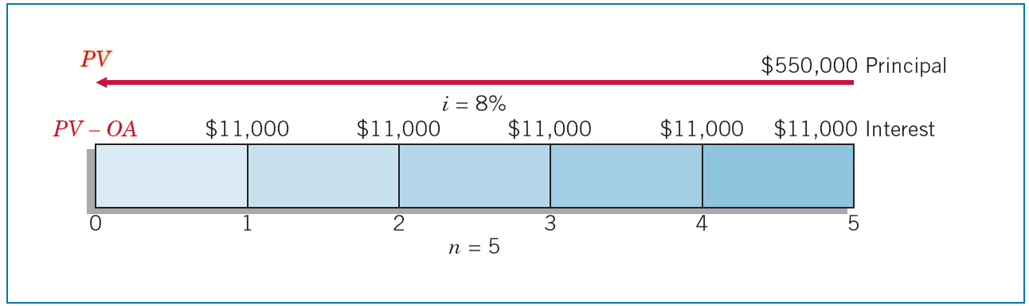
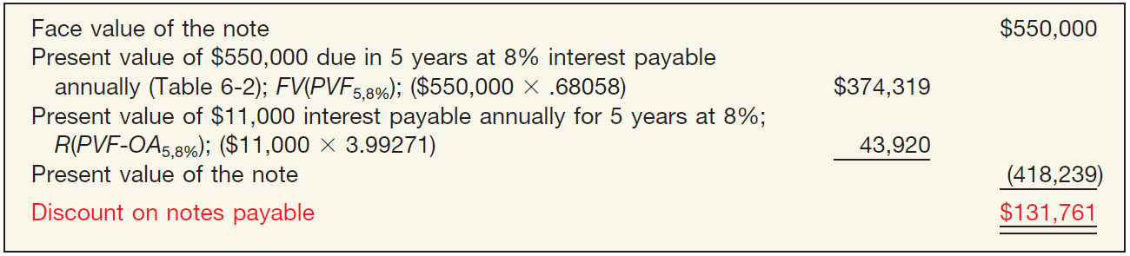
Special Notes Payable Situations
ILLUSTRATION 14-16
Time Diagram for Interest-Bearing Note
ILLUSTRATION 14-17
Computation of Imputed Fair Value and Note Discount
LO 3

Slide 62
Special Notes Payable Situations
Wunderlich records issuance of the note on Dec. 31, 2017, in payment for the architectural services as follows.
Building (or Construction in Process) 418,239
Discount on Notes Payable 131,761
Notes Payable 550,000
LO 3

Slide 63
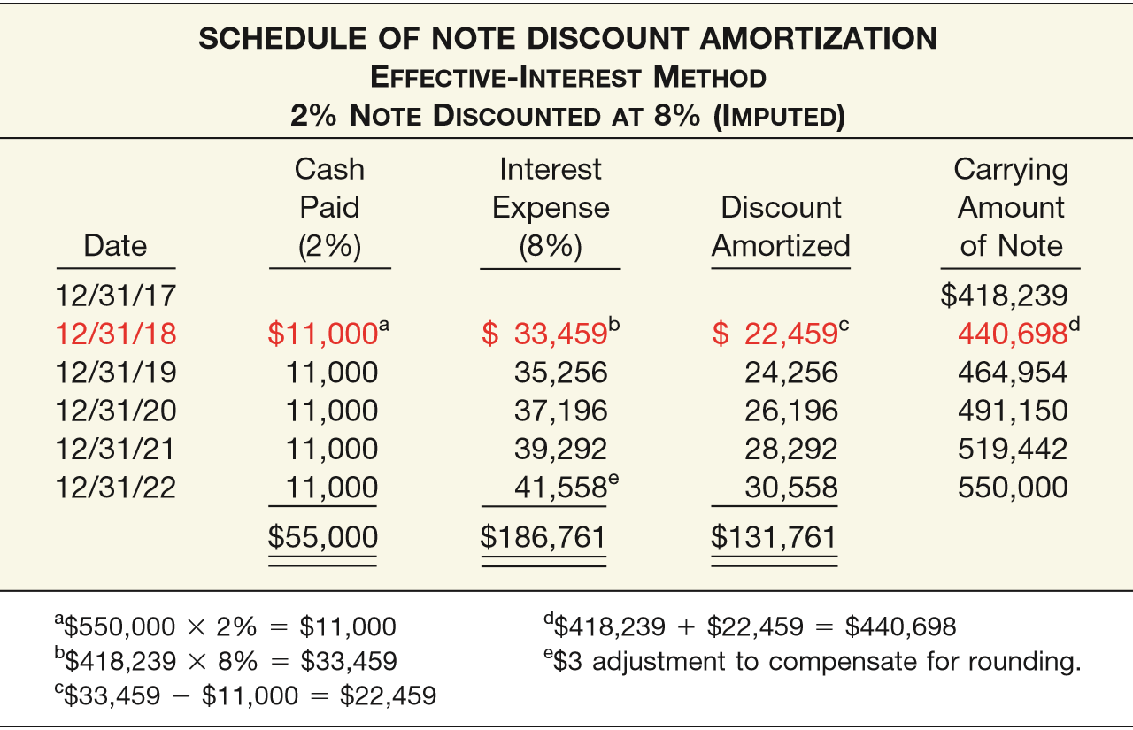
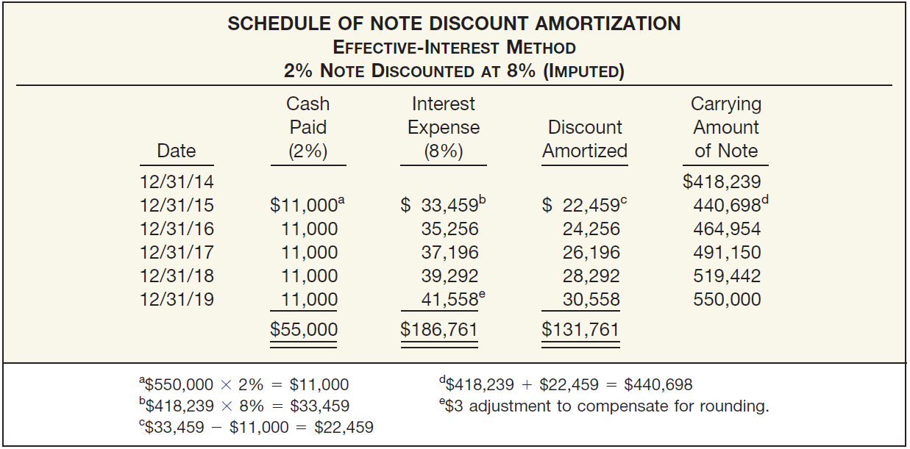
ILLUSTRATION 14-18
Payment of first year’s interest and amortization of the discount.
Interest Expense 33,459
Discount on Notes Payable 22,459
Cash 11,000
LO 3

Slide 64
Mortgage Notes Payable
A promissory note secured by a document called a mortgage that pledges title to property as security for the loan.
Most common form of long-term notes payable.
Payable in full at maturity or in installments.
Fixed-rate mortgage.
Variable-rate mortgages.
LO 3

Slide 65
LEARNING OBJECTIVES
14
Long-Term Liabilities
After studying this chapter, you should be able to:
Describe the nature of bonds and indicate the accounting for bond issuances.
Describe the accounting for the extinguishment of debt.
Explain the accounting for long-term notes payable.
Describe the accounting for the fair value option.
Indicate how to present and analyze long-term debt.
LO 4

Slide 66
LONG-TERM NOTES PAYABLE
Fair Value Option
Companies have the option to record fair value in their accounts for most financial assets and liabilities, including bonds and notes payable.
The FASB believes that fair value measurement for financial instruments, including financial liabilities, provides more relevant and understandable information than amortized cost.
LO 4

Slide 67
Fair Value Option
Fair Value Measurement
Non-current liabilities are recorded at fair value, with unrealized holding gains or losses reported as part of net income.
Illustrations: Edmonds Company has issued $500,000 of 6 percent bonds at face value on May 1, 2017. Edmonds chooses the fair value option for these bonds. At December 31, 2017, the value of the bonds is now $480,000 because interest rates in the market have increased to 8 percent.
Bonds Payable 20,000
Unrealized Holding Gain or Loss—Income 20,000
LO 4

Slide 68
WHAT DO THE NUMBERS MEAN? FAIR VALUE FUN HOUSE
WHAT’S YOUR PRINCIPLE
The move to change the accounting for ﬁnancial liabilities under the fair value option began in 2011, when Citigroup’s third-quarter earnings rose 68 percent from a year earlier, partly due to an accounting adjustment. The accounting adjustment was a $1.9 billion gain related to a change in the valuation of its debt obligations. A similar situation resulted in the third quarter of 2011 for JPMorgan. Its results were enhanced by decreasing the value of its debt, also by $1.9 billion.
Some wondered how these banks’ net incomes increased even though their credit ratings declined. This result seems counterintuitive—how does a company that is actually doing worse have its income increase? Well, at that time, fair value adjustments for liabilities under the fair value option were recorded in income, rather than in OCI. As one expert noted, “At its worse, bank accounting can seem like the mirrors in a fun house. Reality is reﬂected, but the distortions can be large.”
So what to do? Three different viewpoints were suggested. One view was that changes in the value of the liability should not be reported in income until the liability is extinguished. Those who supported this position believe that the
(continued)
LO 4

Slide 69
WHAT DO THE NUMBERS MEAN? FAIR VALUE FUN HOUSE
WHAT’S YOUR PRINCIPLE
information related to reporting value changes in the liability in income (or comprehensive income) was misleading and not useful to ﬁnancial statement users. Others argued that reporting the unrealized gains and losses related to changes in the fair value of the liability through net income was appropriate given many ﬁnancial assets could also be reported at fair value. A third group agreed with the fair value approach but indicated that if the change in value was a result of a change in credit risk the unrealized gain or loss should be reported as other comprehensive income.
As indicated in our discussion related to the accounting for the fair value option related to ﬁnancial liabilities, the FASB now requires that the unrealized gains and losses related to changes in a company’s own credit risk be reported in other comprehensive income. This approach has the beneﬁt of reducing the volatility in net income for preparers. In addition, GAAP and IFRS are now converged with respect to the accounting for liability changes arising from credit risk.
Sources: Floyd Norris, “Distortions in Baffling Financial Statements,” The New York Times (November 10, 2011); and Marie Leone, “The Fair Value Deadbeat Debate Returns,” CFO.com (June 25, 2009).
LO 4

Slide 70
LEARNING OBJECTIVES
14
Long-Term Liabilities
After studying this chapter, you should be able to:
Describe the nature of bonds and indicate the accounting for bond issuances.
Describe the accounting for the extinguishment of debt.
Explain the accounting for long-term notes payable.
Describe the accounting for the fair value option.
Indicate how to present and analyze long-term debt.
LO 5

Slide 71
REPORTING AND ANALYZING LIABILITIES
Off-Balance-Sheet Financing
Off-balance-sheet financing is an attempt to borrow monies in such a way to prevent recording the obligations.
Different Forms
Non-Consolidated Subsidiary
Special-Purpose Entity (SPE)
Operating Leases
LO 5

Slide 72
Off-Balance-Sheet Financing
Rationale
Removing debt enhances the quality of the balance sheet and permits credit to be obtained more readily and at less cost.
Loan covenants often limit the amount of debt a company may have. These types of commitments might not be considered in computing the debt limitation.
Some argue that the asset side of the balance sheet is severely understated.
LO 5

Slide 73
WHAT DO THE NUMBERS MEAN? OBILIGATED
WHAT’S YOUR PRINCIPLE
The off-balance-sheet world is slowly but surely becoming more on-balance-sheet. New interpretations on guarantees (discussed in Chapter 13) and variable-interest entities (discussed in Appendix 17B) are doing their part to increase the amount of debt reported on corporate balance sheets.
In addition, the SEC has rules that require companies to disclose off-balance-sheet arrangements and contractual obligations that currently have, or are reasonably likely to have, a material future effect on the companies’ ﬁnancial condition. Companies now must include a tabular disclosure (following a prescribed format) in the management discussion and analysis section of the annual report.
Presented next is Best Buy Co.’s tabular disclosure of its contractual obligations.
(continued)
LO 5
LO 5

Slide 74
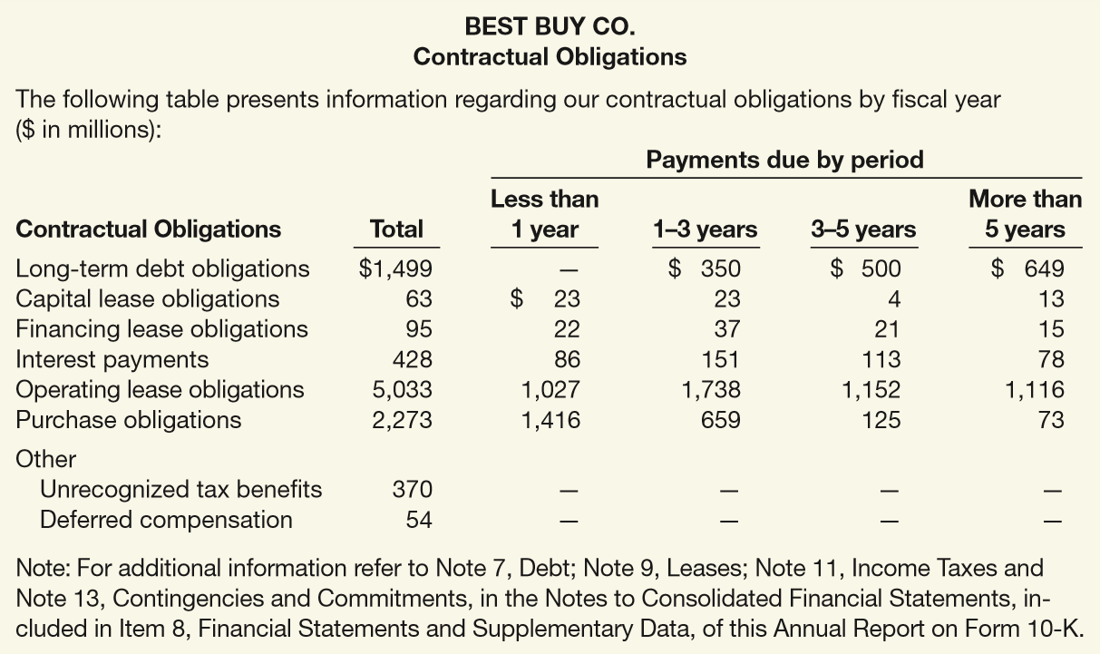
WHAT DO THE NUMBERS MEAN? OBILIGATED
WHAT’S YOUR PRINCIPLE
Enron’s abuse of off-balance-sheet ﬁnancing to hide debt was shocking and inappropriate. One silver lining in the Enron debacle, however, is that the standard-setting bodies in the accounting profession are now providing increased guidance on companies’ reporting of contractual obligations. We
believe the
SEC rule, which
requires
companies to
report their
obligations over
a period of time,
will be extremely
useful to the
investment
community.
LO 5

Slide 75
Presentation of Long-Term Debt
Note disclosures generally indicate the nature of the liabilities, maturity dates, interest rates, call provisions, conversion privileges, restrictions imposed by the creditors, and assets designated or pledged as security.
Fair value of the debt should be disclosed.
Must disclose future payments for sinking fund requirements and maturity amounts of long-term debt during each of the next five years.
LO 5

Slide 76
Analysis of Long-Term Debt
Two ratios that provide information about debt-paying ability and long-run solvency are:
1.
Debt to assets ratio
Total liabilities
=
Total assets
The higher the percentage of liabilities to total assets, the greater the risk that the company may be unable to meet its maturing obligations.
LO 5

Slide 77
Analysis of Long-Term Debt
Two ratios that provide information about debt-paying ability and long-run solvency are:
Income before income taxes and interest expense
2.
Times interest earned
=
Interest expense
Indicates the company’s ability to meet interest payments as they come due.
LO 5

Slide 78
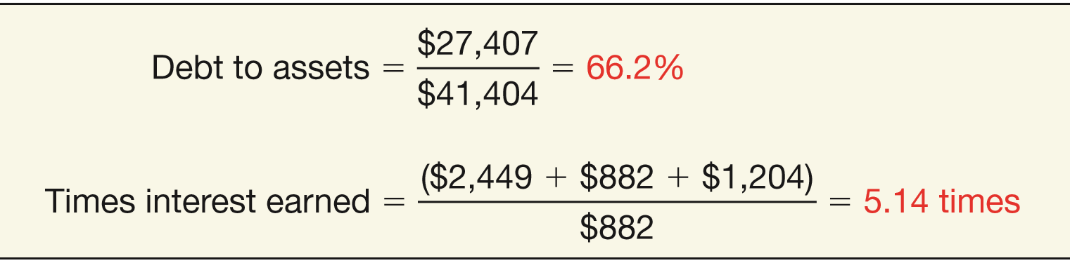

Analysis of Long-Term Debt
Illustration: Target has total liabilities of $27,407 million, total assets of $41,404 million, interest expense of $882 million, income taxes of $1,204 million, and income from continuing operations of $2,449 million. We compute Target’s debt to total assets and times interest earned ratios as follows.
ILLUSTRATION 14-22
Computation of Long-Term Debt Ratios for Target
LO 5

Slide 79
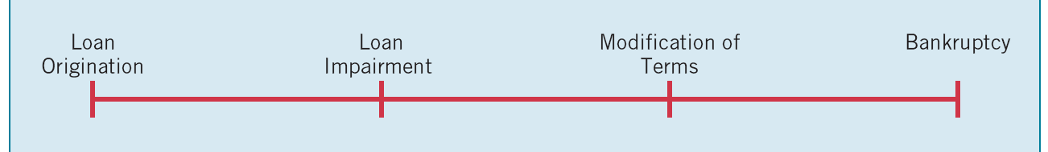
APPENDIX 14A
TROUBLED-DEBT RESTRUCTURING
Troubled-debt restructuring occurs when a creditor “for economic or legal reasons related to the debtor’s financial difficulties grants a concession to the debtor that it would not otherwise consider.”
ILLUSTRATION 14A-1
Usual Progression in Troubled-Debt Situations
Involves one of two basic types of transactions:
Settlement of debt at less than its carrying amount.
Continuation of debt with a modification of terms.
LO 6 Describe the accounting for a debt restructuring.

Slide 80
APPENDIX 14A
TROUBLED-DEBT RESTRUCTURINGS
SETTLEMENT OF DEBT
Can involve either a
transfer of noncash assets (real estate, receivables, or other assets) or
the issuance of the debtor’s stock.
Creditor should account for the noncash assets or equity interest received at their fair value.
LO 6

Slide 81
APPENDIX 14A
TROUBLED-DEBT RESTRUCTURINGS
Illustration (Transfer of Assets): American City Bank loaned $20,000,000 to Union Mortgage Company. Union Mortgage cannot meet its loan obligations. American City Bank agrees to accept from Union Mortgage real estate with a fair value of $16,000,000 in full settlement of the $20,000,000 loan obligation. The real estate has a carrying value of $21,000,000 on the books of Union Mortgage. American City Bank (creditor) records this transaction as follows.
Land 16,000,000
Allowance for Doubtful Accounts 4,000,000
Note Receivable (from Union Mortgage) 20,000,000
LO 6

Slide 82
APPENDIX 14A
TROUBLED-DEBT RESTRUCTURINGS
Illustration (Transfer of Assets): The bank records the real estate at fair value. Further, it makes a charge to the Allowance for Doubtful Accounts to reflect the bad debt write-off. Union Mortgage (debtor) records this transaction as follows.
Note Payable (to American City Bank) 20,000,000
Loss on Disposal of Land 5,000,000
Land 21,000,000
Gain on Restructuring of Debt 4,000,000
LO 6

Slide 83
APPENDIX 14A
TROUBLED-DEBT RESTRUCTURINGS
Illustration (Granting an Equity Interest): American City Bank agrees to accept from Union Mortgage 320,000 shares of common stock ($10 par) that has a fair value of $16,000,000, in full settlement of the $20,000,000 loan obligation. American City Bank (creditor) records this transaction as follows.
Equity Investment 16,000,000
Allowance for Doubtful Accounts 4,000,000
Note Receivable (from Union Mortgage) 20,000,000
LO 6

Slide 84
APPENDIX 14A
TROUBLED-DEBT RESTRUCTURINGS
Illustration (Granting an Equity Interest): It records the stock as an investment at the fair value at the date of restructure. Union Mortgage (debtor) records this transaction as follows.
Note Payable (to American City Bank) 20,000,000
Common Stock 3,200,000
Paid-in Capital in Excess of Par-Common 12,800,000
Gain on Restructuring of Debt 4,000,000
LO 6

Slide 85
APPENDIX 14A
TROUBLED-DEBT RESTRUCTURINGS
MODIFICATION OF TERMS
A debtor’s serious short-run cash flow problems will lead it to request one or a combination of the following modifications:
Reduction of the stated interest rate.
Extension of the maturity date of the face amount of the debt.
Reduction of the face amount of the debt.
Reduction or deferral of any accrued interest.
LO 6

Slide 86
APPENDIX 14A
TROUBLED-DEBT RESTRUCTURINGS
Illustration (Example 1—No Gain for Debtor): On December 31, 2016, Morgan National Bank enters into a debt restructuring agreement with Resorts Development Company, which is experiencing financial difficulties. The bank restructures a $10,500,000 loan receivable issued at par (interest paid to date) by:
Reducing the principal obligation from $10,500,000 to $9,000,000;
Extending the maturity date from December 31, 2016, to December 31, 2020; and
Reducing the interest rate from 12% to 8%.
LO 6

Slide 87
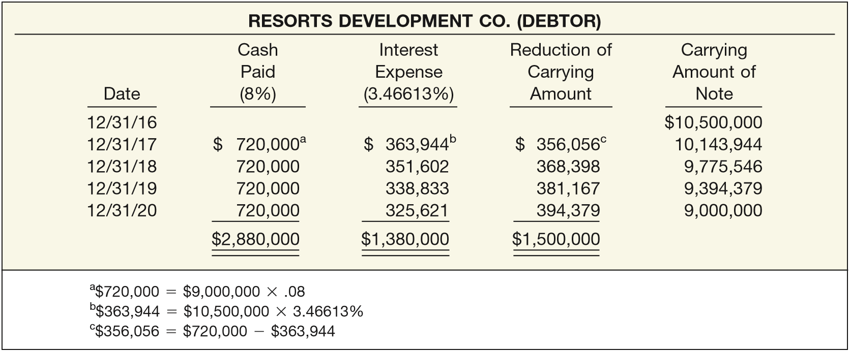
APPENDIX 14A
TROUBLED-DEBT RESTRUCTURINGS
ILLUSTRATION 14A-2
Schedule Showing Reduction of Carrying Amount of Note
Dec. 31, 2017
Notes Payable 356,056
Interest Expense 363,944
Cash 720,000
LO 6

Slide 88
APPENDIX 14A
TROUBLED-DEBT RESTRUCTURINGS
ILLUSTRATION 14A-2
Schedule Showing Reduction of Carrying Amount of Note
Dec. 31, 2020
Notes Payable 9,000,000
Cash 9,000,000
LO 6

Slide 89
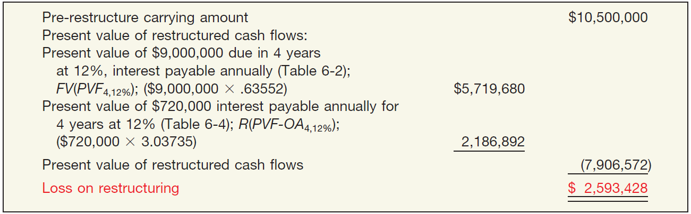
APPENDIX 14A
TROUBLED-DEBT RESTRUCTURINGS
Creditor Calculations Morgan National Bank (creditor)
ILLUSTRATION 14A-3
Computation of Loss to Creditor on Restructuring
Morgan National Bank records bad debt expense as follows:
Bad Debt Expense 2,593,428
Allowance for Doubtful Accounts 2,593,428
LO 6

Slide 90
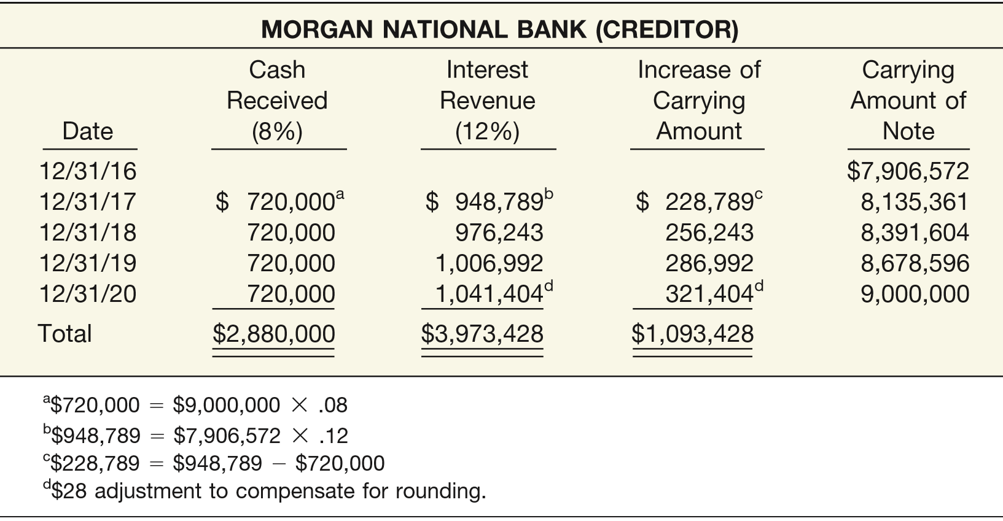
APPENDIX 14A
TROUBLED-DEBT RESTRUCTURINGS
ILLUSTRATION 14A-4
Schedule of Interest and Amortization after Debt Restructuring
Creditor Calculations
Morgan reports interest revenue based on the historical effective rate.
Dec. 31, 2017
Cash 720,000
Allowance for Doubtful Accounts 228,789
Interest Revenue 948,789
LO 6

Slide 91
APPENDIX 14A
TROUBLED-DEBT RESTRUCTURINGS
Creditor Calculations
The creditor makes a similar entry (except for different amounts debited to Allowance for Doubtful Accounts and credited to Interest Revenue) each year until maturity. At maturity, the company makes the following entry.
Dec. 31, 2020
Cash 9,000,000
Allowance for Doubtful Accounts 1,500,000
Notes Receivable 10,500,000
LO 6

Slide 92
APPENDIX 14A
TROUBLED-DEBT RESTRUCTURINGS
Illustration (Example 2—Gain for Debtor): Assume the facts in the previous example except that Morgan National Bank reduces the principal to $7,000,000 (and extends the maturity date to December 31, 2020, and reduces the interest from 12% to 8%). The total future cash flow is now $9,240,000 ($7,000,000 of principal plus $2,240,000 of interest), which is $1,260,000 ($10,500,000 - $9,240,000) less than the pre-restructure carrying amount of $10,500,000. Under these circumstances, Resorts Development (debtor) reduces the carrying amount of its payable $1,260,000 and records a gain of $1,260,000. On the other hand, Morgan National Bank (creditor) debits its Bad Debt Expense for $4,350,444.
LO 6

Slide 93
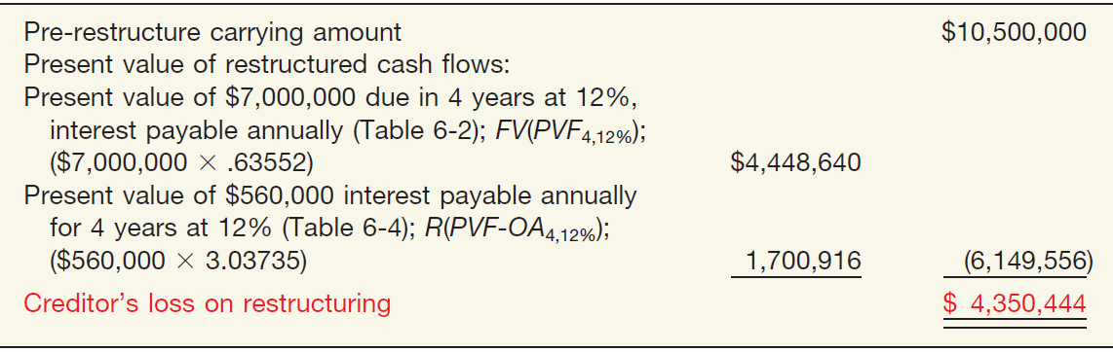
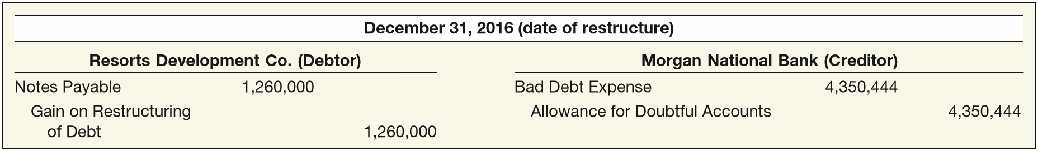
APPENDIX 14A
TROUBLED-DEBT RESTRUCTURINGS
Illustration (Example 2—Gain for Debtor): Morgan (creditor) debits its Bad Debt Expense for $4,350,444.
ILLUSTRATION 14A-5
Computation of Loss to Creditor on Restructuring
ILLUSTRATION 14A-6
Debtor and Creditor Entries to Record Gain and Loss on Note
LO 6

Slide 94
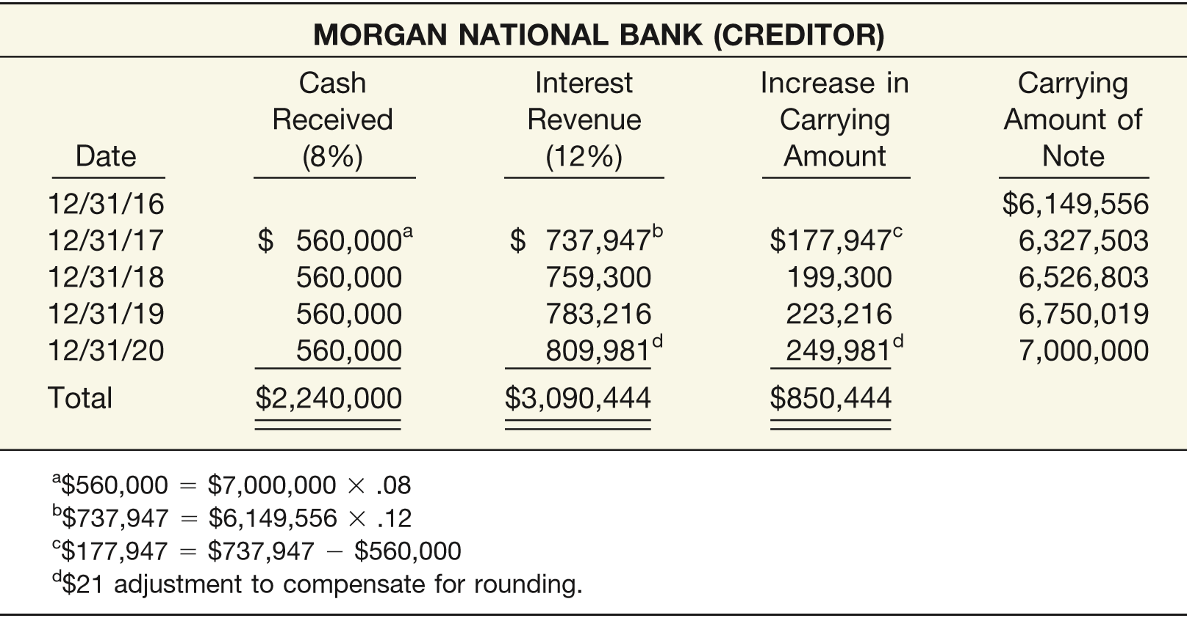
APPENDIX 14A
TROUBLED-DEBT RESTRUCTURINGS
Illustration (Example 2—Gain for Debtor): Morgan National reports interest revenue the same as the previous example—
ILLUSTRATION 14A-7
Schedule of Interest and Amortization after Debt Restructuring
LO 6

Slide 95
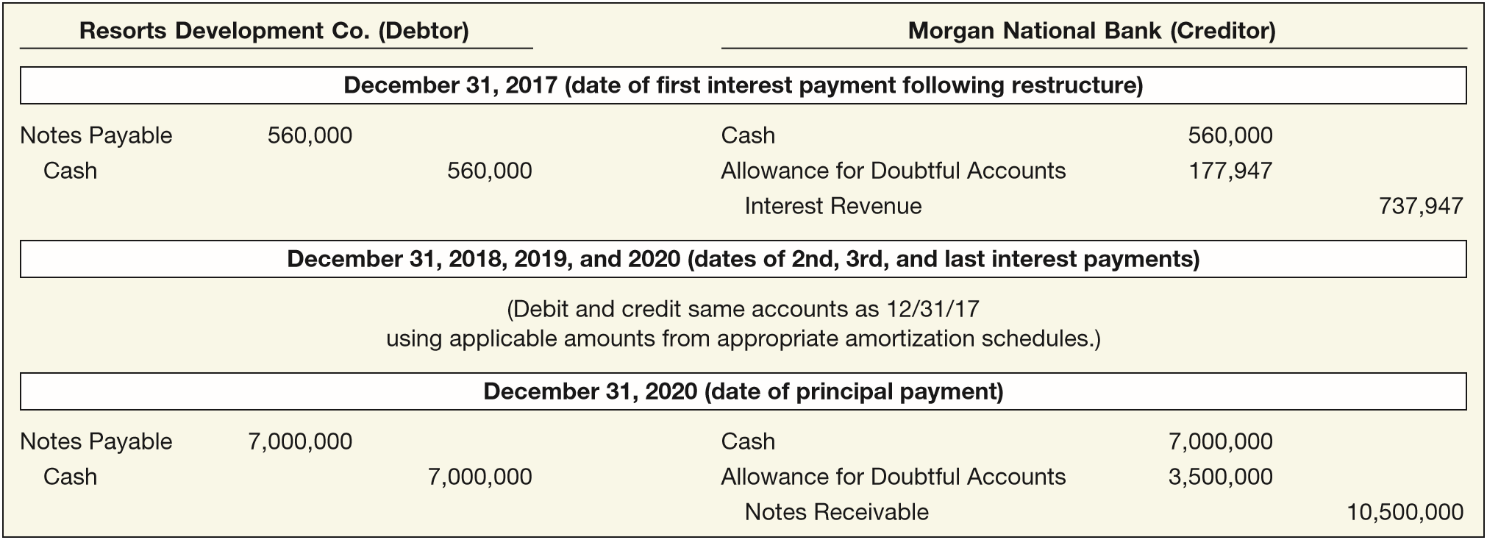
APPENDIX 14A
TROUBLED-DEBT RESTRUCTURINGS
Illustration (Example 2—Gain for Debtor): Accounting for periodic interest payments and final principal payment.
ILLUSTRATION 14A-8
Debtor and Creditor Entries to Record Periodic Interest and Final Principal Payments
LO 6

Slide 96

RELEVANT FACTS - Similarities
As indicated in our earlier discussions, GAAP and IFRS have similar liability definitions, and liabilities are classified as current and non-current.
Much of the accounting for bonds and long-term notes is the same for GAAP and IFRS.
Under GAAP and IFRS, bond issue costs are netted against the carrying amount of the bonds.
LO 7 Compare the accounting for long-term liabilities under GAAP and IFRS.

Slide 97
RELEVANT FACTS - Differences
Under GAAP, companies are permitted to use the straight-line method of amortization for bond discount or premium, provided that the amount recorded is not materially different than that resulting from effective-interest amortization. However, the effective-interest method is preferred and is generally used. Under IFRS, companies must use the effective-interest method.
Under IFRS, companies do not use premium or discount accounts but instead show the bond at its net amount.
LO 7

Slide 98
RELEVANT FACTS - Differences
GAAP uses the term troubled-debt restructurings and has developed specific guidelines related to that category of loans. IFRS generally assumes that all restructurings will be accounted for as extinguishments of debt.
IFRS requires a liability and related expense or cost be recognized when a contract is onerous. Under GAAP, losses on onerous contracts are generally not recognized under GAAP unless addressed by an industry- or transaction-specific requirements.
LO 7

Slide 99
ON THE HORIZON
The FASB and IASB are currently involved in two projects, each of which has implications for the accounting for liabilities. One project is investigating approaches to differentiate between debt and equity instruments. The other project, the elements phase of the conceptual framework project, will evaluate the definitions of the fundamental building blocks of accounting. The results of these projects could change the classification of many debt and equity securities.
LO 7

Slide 100
IFRS SELF-TEST QUESTION
Under IFRS, bond issuance costs, including the printing costs and legal fees associated with the issuance, should be:
expensed in the period when the debt is issued.
recorded as a reduction in the carrying value of bonds payable.
accumulated in a deferred charges account and amortized over the life of the bonds.
reported as an expense in the period the bonds mature or are retired.
LO 7

Slide 101
IFRS SELF-TEST QUESTION
Which of the following is stated correctly?
Current liabilities follow non-current liabilities on the statement of financial position under GAAP but non-current liabilities follow current liabilities under IFRS.
IFRS does not treat debt modifications as extinguishments of debt.
Bond issuance costs are recorded as a reduction of the carrying value of the debt under GAAP but are recorded as an asset and amortized to expense over the term of the debt under IFRS.
Under GAAP, bonds payable is recorded at the face amount and any premium or discount is recorded in a separate account. Under IFRS, bonds payable is recorded at the carrying value so no separate premium or discount accounts are used.
LO 7

Slide 102
IFRS SELF-TEST QUESTION
All of the following are differences between IFRS and GAAP in accounting for liabilities except:
When a bond is issued at a discount, GAAP records the discount in a separate contra-liability account. IFRS records the bond net of the discount.
Under IFRS, bond issuance costs reduces the carrying value of the debt. Under GAAP, these costs are recorded as an asset and amortized to expense over the terms of the bond.
GAAP, but not IFRS, uses the term “troubled debt restructurings.”
GAAP, but not IFRS, uses the term “provisions” for contingent liabilities which are accrued.
LO 7

Slide 103
COPYRIGHT
“Copyright © 2016 John Wiley & Sons, Inc. All rights reserved. Reproduction or translation of this work beyond that permitted in Section 117 of the 1976 United States Copyright Act without the express written permission of the copyright owner is unlawful. Request for further information should be addressed to the Permissions Department, John Wiley & Sons, Inc. The purchaser may make back-up copies for his/her own use only and not for distribution or resale. The Publisher assumes no responsibility for errors, omissions, or damages, caused by the use of these programs or from the use of the information contained herein.”

