Slide 1
Water and Electrolytes

Slide 2
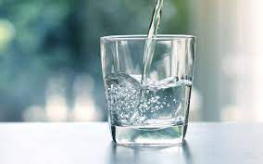
water
Beverage of choice
Water is an essential nutrient, more important to life than any of the others
you can survive only a few days w/o water

Slide 3
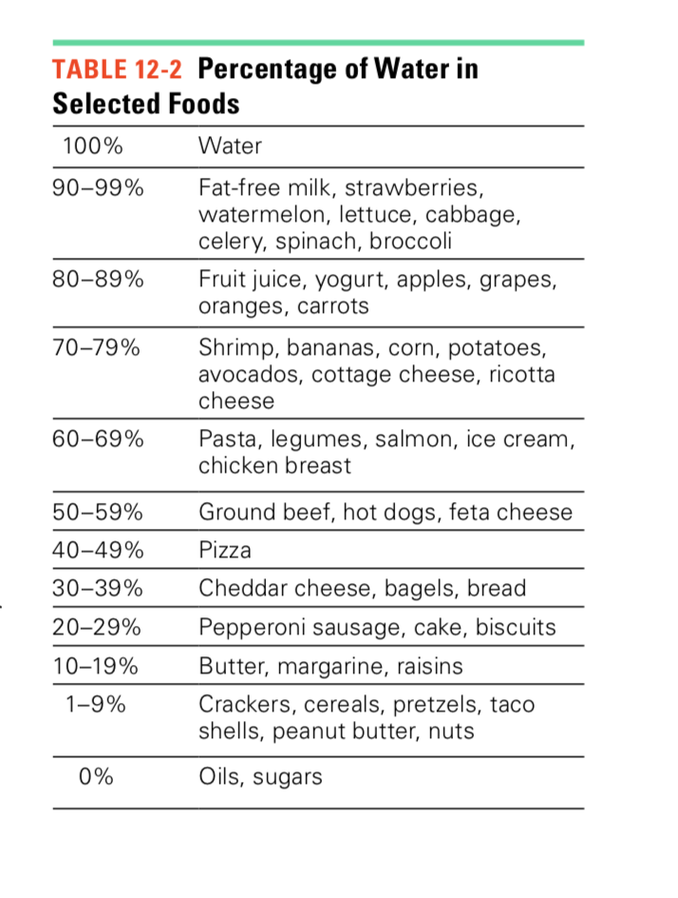
Water is found in
ALL FOODS
Fluids: water, tea, coffee, milk, juices
Food: especially fruits and vegetables which are rich sources of water.

Slide 4

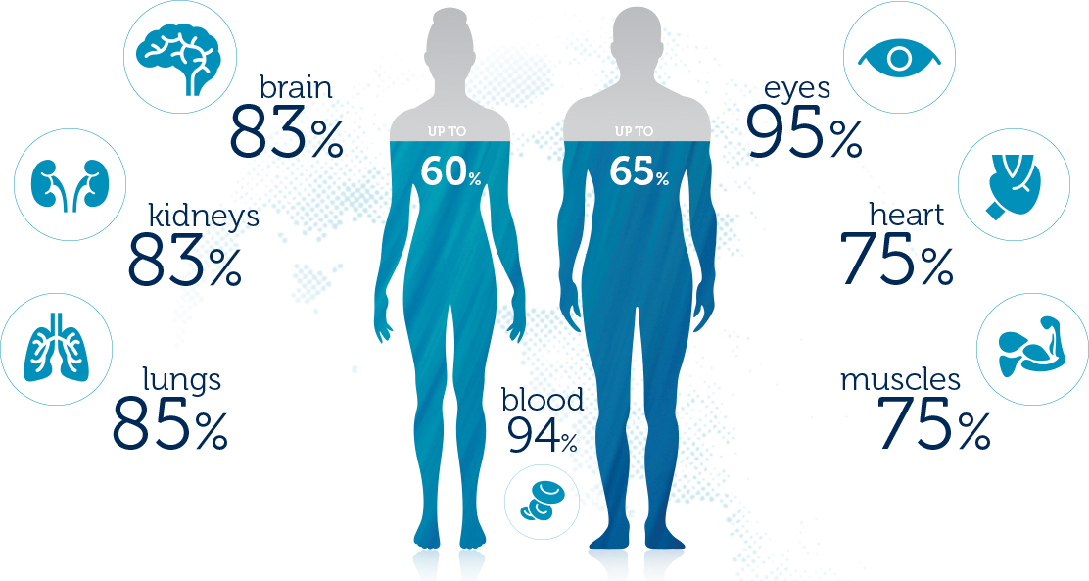
Adult persons contain about 35–45 L of water, which makes up approximately 60% of the body weight
The body maintains an appropriate balance and distribution of fluids
Water makes up about 75 percent of the weight of lean tissue
The proportion of water is generally smaller in females, obese people, and the elderly????
Notes:
because of their smaller proportion of lean tissue.

Slide 5
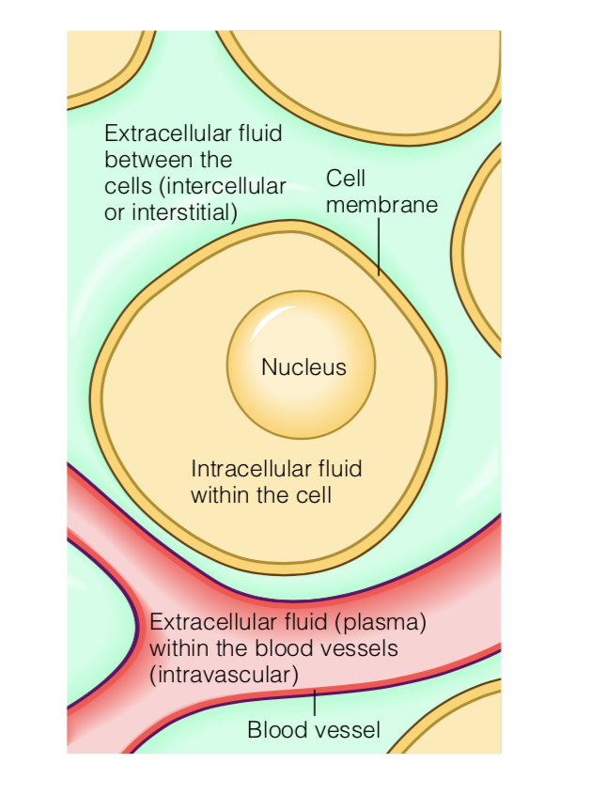
2/3 of body water is located inside cells as the Intracellular fluid (ICF)
Extracellular fluid (ECF) is distributed in various body compartments, such as blood vessels body cavities, and between cells in organs and tissues
1/3 of body water
ECF
that surrounds each cell is called interstitial fluid
ECF the blood vessels is called intravascular fluid

Slide 6
Functions
Carries nutrients and waste products throughout the body
Maintains the structure of large molecules such as proteins and glycogen
Participates in metabolic reactions
Serves as the solvent for minerals, vitamins, amino acids, glucose, and many other small molecules so that they can participate in metabolic activities
Acts as a lubricant and cushion around joints and inside the eyes, the spinal cord, and, in pregnancy, the amniotic sac surrounding the fetus in the womb
Aids in the regulation of normal body temperature, as the evaporation of sweat from the skin removes excess heat from the body
Maintains blood volume
Maintaining water balance between intake and output is vital to perform function

Slide 7
Water crosses cell membranes easily and rapidly through aquaporin (AQP) 1 channels to balance the concentrations of osmotically active substances inside and outside cells
The concentration of materials (osmoles) dissolved in the ICF and ECF compartments differ
Maintaining a balance of a bout two-thirds of the body fluids inside the cells and one-third outside is vital to the life of the cells
If too much water were to enter the cells, cell might rupture
If too much water were to leave, they would collapse

Slide 8
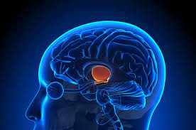
Hypothalamus
Thirst and satiety influence water intake
When water intake is inadequate, the blood becomes concentrated (having lost water but not the dissolved substances within it), the mouth becomes dry, and the hypothalamus initiates drinking behavior
When water intake is excessive, the stomach expands and stretch receptors send signals to stop drinking.
Receptors in the heart as blood volume increases
Thirst is the first sign of dehydration
Dehydration develops with either inadequate water intake or excessive water losses

Slide 9
obligatory water excretion is a minimum of about 500 milliliters (about 2 cups) of water each day. Above this amount, excretion adjusts to balance intake. If a person drinks more water, the kidneys excrete more urine, and the urine becomes more dilute
Water is lost from the lungs as vapor and from the skin as sweat; some is also lost in feces

Slide 10
Blood Plasma
The liquid component of blood
95% water
5% proteins, minerals, waste products, clotting factors, hormones, and immunoglobins.
Without plasma, blood cells would have no medium to travel on as they move through the body

Slide 11
Blood plasma and interstitial fluid (fluid between cells) have solutes dissolved in them, these solutes are electrolytes mainly:
Sodium ion (Na⁺) - cation
Chloride ion (Cl⁻) – anion
Components of salt = NaCl
ICF contains mainly potassium ions
ECF mainly sodium
Cells are somewhat permeable, so sodium will leave ECF and enter cells, and potassium will leave ICF and leak out of cells
Cells use a large part of the energy from their metabolism to pump out sodium that diffuses in and to recover potassium that leaks out

Slide 12
The major electrolytes in body fluids (both intracellular and extracellular) are:
Sodium (Na⁺)
Potassium (K⁺)
Chloride (Cl⁻)
Calcium (Ca²⁺)
Magnesium (Mg²⁺)
Bicarbonate (HCO₃⁻)
Phosphate (PO₄²⁻)
Sulfate (SO₄²⁻)

Slide 13
Electrolyte Distribution in Body Fluids
ICF
Contains mainly
K⁺
Phosphate (PO₄²⁻)
+ some other electrolytes.
Na⁺
Mg²⁺
Ca²⁺
HCOᴣˉ
ECF
Contains mainly NaCl
Na⁺
Clˉ
+ some other electrolytes
K⁺
Organic phosphate ˉ
Mg²⁺
Ca²⁺
HCOᴣˉ
Cell membranes are permeable to: N⁺, K⁺, H2O

Slide 14
Regulation of water balance
Changes in ECF sodium concentration result primarily from changes in total body water and water concentration
Water moves in and out between ECF and ICF to maintain Osmolar balance (water follows electrolytes and electrolytes attract water)
ICF volume will increase as the ECF sodium concentration decreases and vice versa
Loss of water makes body fluids more concentrated
Cells shrink as they lose water
Special cells in the hypothalamus at the base of the brain respond to shrinking of cells in two ways
stimulating thirst
Stimulating the release of antidiuretic hormone (ADH, also called vasopressin) into blood
ADH allows kidneys to reabsorb water from urine
Urine production decreases
Notes:
osmotic balance ensures that optimal concentrations of electrolytes and non-electrolytes are maintained in cells, body tissues, and in interstitial fluid. Solutes or water move across a semi-permeable membrane, causing solutions on either side of it to equalize in concentration.

Slide 15
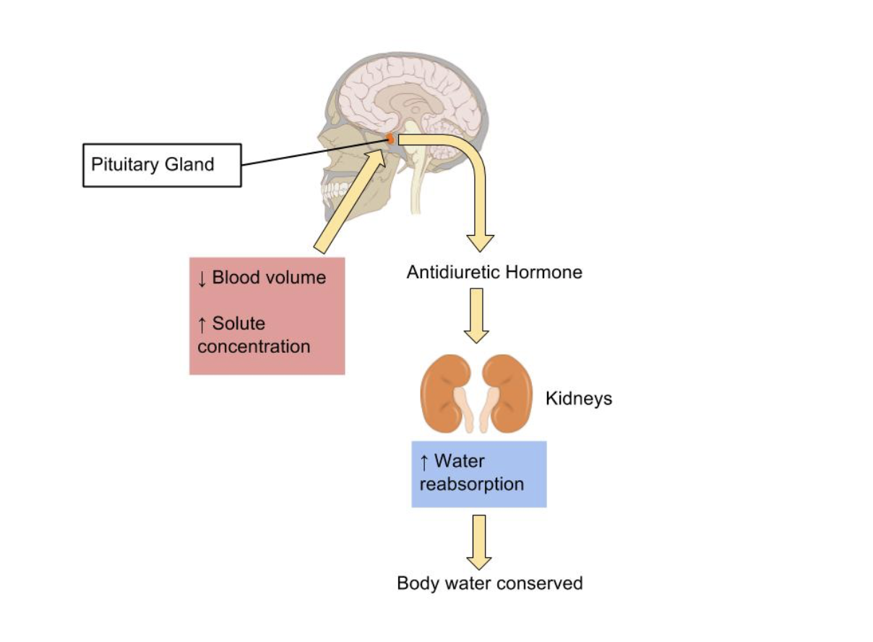
If too much water
Cell swells
Thirst stimulus switches off
ADH release stops
When Na+ concentration
http://pressbooks-dev.oer.hawaii.edu/humannutrition/chapter/regulation-of-water-balance/

Slide 16
Water Out
Urine ≈ 0.6 L (with maximum concentration the kidney can make)
Feces ≈ 0.1 L
Sweat ≈ 0.1 L (can be much higher in hot weather to cool down body temperature)
Insensible water loss which includes both through skin (≈ 0.4 L) + through lungs (breathing (≈ 0.5 L) at sea level;
Loss through lungs is only water (no sodium loss)
Loss through breathing can be much higher during exercise, in high altitudes and in dry weather
Total ≈ 1.7 L
Water In
Solid food usually provides ≈ 1.0 L
Metabolic water provides ≈ 0.4 L
Total ≈ 1.4 L
Beverages (bare minimum) ≈ 0.3 L
Total ≈ 1.7 L (to be in balance)
At least 1 L of water and other beverages are needed every day
Recommendation of fluid intake depends on kcal requirements
ml fluid/kcal
Notes:
mL fluid/kcal (minimum)

Slide 17
When does water requirement increase?
Different solutes are lost depending on why fluid is lost. If fluid is lost by vomiting or diarrhea, sodium is lost
Hormonal imbalances can also affect electrolyte excretion
Water requirement ↑ When water output ↑
Occurs in situation such as
Diarrhea, fever and vomiting (higher water loss) (loss of water and salt)
Exercise and high altitude (increased ↑ ventilation, need at least 2 L), loss of water only no sodium loss)
High temperature (more ↑ sweat for cooling). (Sweat is salty)
Diabetes:

Slide 18
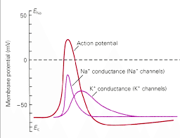
Sodium
The major minerals help to maintain the body’s fluid balance as described earlier, sodium, chloride, and potassium are most noted for that role
Common salt is sodium chloride (NaCl)
The ECF sodium concentration is at ~140 mmol/L
Involved in membrane potentials of most cells and the action potentials underlying the transmission of nerve impulses and the contraction of muscles.

Slide 19
sodium
Sodium is readily absorbed by the intestinal tract and travels freely in the blood until it reaches the kidneys, which filter all the sodium out of the blood. Then, with great precision, the kidneys return to the blood the exact amount of sodium the body needs.
When blood sodium rises, as when a person eats salted foods, thirst signals the person to drink until the appropriate sodium-to-water concentration is restored. Then the kidneys excrete both the excess water and the excess sodium together
HOWEVER
In kidneys malfunction
The body will keep more Na⁺ in body fluids (will be in positive Na+ balance)
And retain water
Edema results. (accumulation of fluid in the interstitium (Interstitial fluid)(ECF), which are located beneath the skin or in one or more cavities of the body)

Slide 20
sodium
Diets rarely lack sodium
INAKE
Natural foods: : fruits ,vegetables, meat, fish, and eggs (10%)
Processed foods contain far more sodium: bread, cheese ,salted butter and processed meats ( up to 75%)
Added salt ( 15%)
OUTPUT
Feces
Sweat
Urine

Slide 21
Na⁺ Deficiency
Deficiency of sodium does not simply result from deficient intake
Blood sodium may drop with vomiting, diarrhea, or heavy sweating, and in these cases, both sodium and water must be replenished. Under normal conditions of sweating due to physical activity, salt losses can easily be replaced later in the day with ordinary foods

Slide 22
Potassium
predominant cation
Mainly in ICF
Involved in membrane potentials of most cells and the action potentials underlying the transmission of nerve impulses and the contraction of muscles.

Slide 23
Potassium balance
Intake Diet
Present in natural an processed foods
Whole flour ,meats, and fish
Vegetables
Fruits
Eggs and dairy
Output
Feces
Urine

