Slide 1
Delegation
Maram Jaghama

Slide 2
Definition
Delegation can be defined simply as getting work done through others or as directing the performance of one or more people to accomplish organizational goals.

Slide 3
There are many good reasons for delegating:
- Sometimes, managers must delegate routine tasks so they are free to handle problems that are more complex or require a higher level of expertise.
-Managers may delegate work if someone else is better prepared or has greater expertise or knowledge about how to solve a problem.
-Delegation can also be used to provide learning or “stretching” opportunities for subordinates.
-Subordinates who are not delegated enough responsibility may become bored, nonproductive, and ineffective.
- Thus, in delegating, the leader-manager contributes to employees’ personal and professional development.

Slide 4
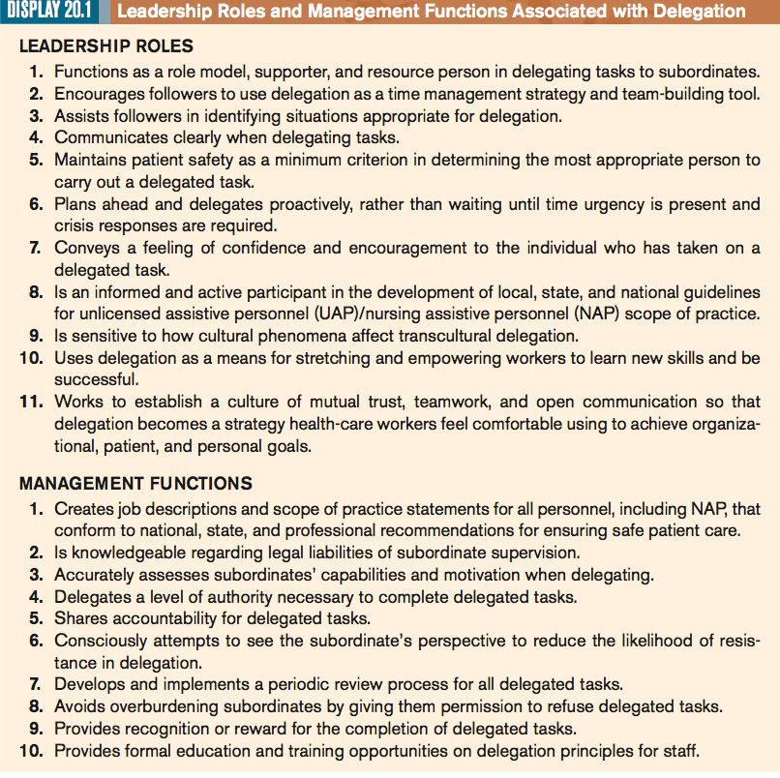

Slide 5
Delegating Effectively
Delegation is not easy. It requires you to trust somebody else to perform a task that you believe to be important.
It also takes effort: you have to explain how you do a particular task, train somebody else to do it, and then monitor that person.
The following strategies will increase the likelihood of successful and effective delegation:

Slide 6
Strategies for Successful and effective Delegation
Plan ahead.
Identify necessary skill and education levels to complete the delegated task.
Select capable personnel.
Communicate goals clearly.
Empower the delegate.
Set deadlines and monitor progress.
Monitor the role and provide guidance.
Evaluate performance.
Reward accomplishment.

Slide 7
Responsibility is shared when a task is delegated.
The right to delegate and the ability to provide formal rewards for successful completion of delegated tasks are a reflection of the legitimate authority inherent in the management role.

Slide 8
COMMON DELEGATION ERRORS
Delegation is not intuitive for most people; instead, it is a critical leadership skill that must be learned.
Frequent mistakes made by managers in delegating include
-under delegating
-over delegating
-improper delegating

Slide 9
Under delegating
Some managers under delegate because:
A manager has false assumption that delegation may be interpreted as a lack of ability on his or her part to do the job correctly or completely. -Delegation does not need to limit the individual’s control, prestige, and power; rather, delegation can extend their influence and capability by increasing what can be accomplished.
Lack of trust in the subordinates: the manager believes that the task needs experience and he/she can do the job better and faster than anybody else.
Time spend in training another to do the job can be repaid 10 folds in the future in addition to increase productivity
Fear that subordinates will resent having work delegated to them
Managers they lack experience in the job or in the delegation itself
Other managers refuse to delegate because they have an excessive need to control or be perfect. The leader-manager who accepts nothing less than perfection limits the opportunities available for subordinate growth and often wastes time redoing delegated tasks.
In addition, some individuals under delegate because they fail to anticipate the help they will need. In an ideal situation, the best time to delegate is before you become overwhelmed.

Slide 10
Over delegation
Some managers over delegate because:
Some managers over delegate because they are poor managers of time, spending most of it just trying to get organized.
Others over delegate because they feel insecure in their ability to perform a task.
Managers also must be careful not to over delegate to exceptionally competent employees, because they may become overworked and tired, which can decrease their productivity.

Slide 11
Improper delegation
Delegating at the wrong time
Delegating to the wrong person
Delegating for a wrong reason
delegating tasks and responsibilities that are beyond the capability of the person to whom they are being delegated or that should be done by someone with greater expertise, training, or authority.
Delegating decision making without providing adequate information.

Slide 12
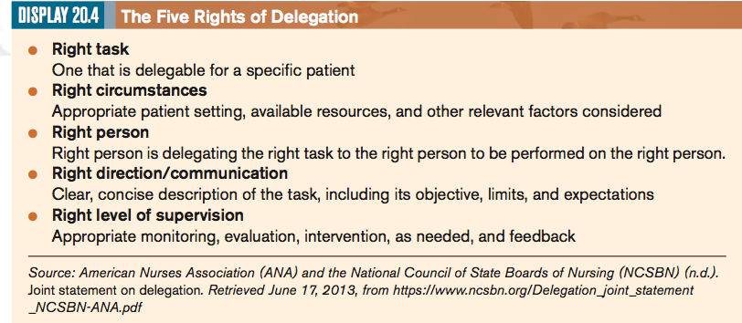

Slide 13
Delegation as a Function of Professional nursing
RNs at all levels are increasingly being expected to make assignments for and supervise the work of different levels of employees.
To increase the likelihood that the increased delegation required in today’s restructured health- care organizations does not result in an unsafe work environment, organizations should have :
(a) a clearly defined structure where RNs are recognized as leaders of the health-care team.
(b) job descriptions clearly define the roles and responsibilities of all
(c) educational programs are developed to help personnel learn roles and responsibilities of each other’s roles.
(d) adequate programs are developed to foster leadership and delegation.

Slide 14
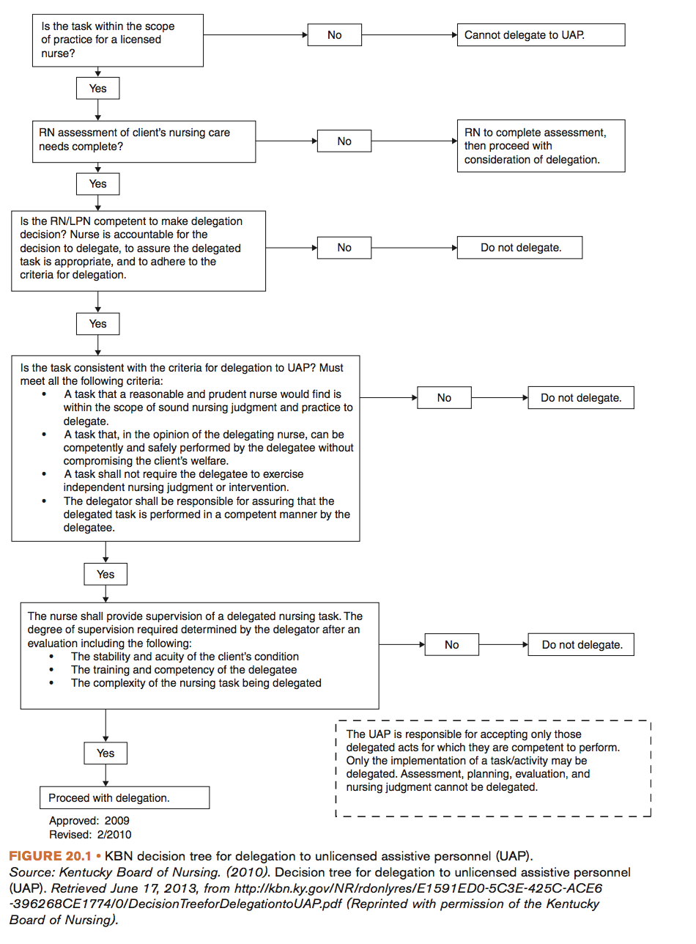
Delegating to Unlicensed Assistive Personnel

Slide 15
Subordinate Resistance to Delegation
Resistance is a common response by subordinates to delegation.
One of the most common causes of subordinate resistance to, or refusal of, delegated tasks is the failure of the delegator to see the subordinate’s perspective.
Some subordinates resist delegation simply because they believe that they are incapable of completing the delegated task.
Another cause of subordinate resistance to delegation is an inherent resistance to authority. Some subordinates simply need to “test the water” and determine what the consequences are of not completing delegated tasks. In this case, the delegator must be calm but assertive about his or her expectations and provide explicit work guidelines.
Finally, resistance to delegation may be occurring because tasks are over delegated in terms of specificity. All subordinates need to believe that there is some room for creativity and independent thinking in delegated tasks. Failure to allow for this human need results in disinterested subordinates who fail to internalize responsibility and accountability for the delegated task.

Slide 16
Benefits of delegation
Subordinates gain self esteem.
Increase subordinates job satisfaction from the responsibility and authority given to them
Foster the cooperative working relationship between managers and staff.
The organization moves a step closer toward achieving its goals
Increase productivity
More free time for the managers to accomplish tasks.

Slide 17
Steps to successful delegation
Understanding the principles of delegation:
- Ability to communicate clearly
- capacity to see the value that delegation has in developing others.
- building trust and self-esteem
- recognizing that different personalities and capabilities exist.
Acknowledging the following
-right person
-right task
-right circumstances
-right direction and communication
-right supervision and evaluation.

Slide 18
A simple delegation rule is the SMARTER.
Delegated tasks must be:-
Specific
Measurable
Agreed
Realistic
Time bound
Ethical
Recorded

Slide 19
Any questions?

