Slide 1
Building blocks of language

Slide 2
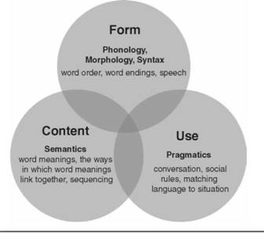
Language components
Phonological development
Morphological development
Syntactic development
Semantic development
Pragmatic development

Slide 3
What is Phonological DEvELOPmEnt?
phonological representations
Phonemes
Minimal pairs: words that differ by only one phoneme E.g., CAT/BAT
Children develop an internal representation of each phoneme in their native language (having it not neceessarily mean they can produce it).
Phonotactic rules
/l/ + /h/ is an illegal combination of sounds in English,

Slide 4
Phonological Building Blocks
using cues to segment streams of speech
developing a phonemic inventory
becoming phonologically aware

Slide 5
Cues to Segment Streams of Speech
Early in development, infants can use specific cues within the speech stream to parse it into smaller units (e.g., words) and to separate simultaneously occurring speech streams.
Infants use prosodic cues. That is, infants draw on their familiarity with word and syllable stress patterns, or the rhythm of language, to break the speech stream.E.g., “little boy”
Infants also use phonotactic cues as they become sensitive to the probability that certain sounds will occur both in general and in specific positions of syllables and words.
E.g., /gz/ cannot start a word. However, it can occur at word final position (dogs, eggs)

Slide 6
Phonemic Inventory
Phonological knowledge: internal representations of the phonemes composing a language
Phonological production :expression of these phonemes to produce syllables and words.
Develop 3-4 years
vowels develops before consonants
Several factors influence the timing of phoneme development : phonemes frequency, the number of words child use that contain phoneme, articulatory complexity to produce phoneme
Early consonants vs late consonants

Slide 7
Phonological Awareness
Phonological awareness is an individual’s ability to attend to the phonological units of speech through implicit or explicit analysis.
Tasks to evaluate phonological awareness
Syllable counting
Rhyme detection
Initial sound identification
Initial sound elision
Phoneme counting
Phonological awareness provides an important bridge between language development and reading achievement

Slide 8
influences on Phonological Development
Native Language: Speech sounds that are phonemic in one language may not be phonemic in another. E.g., /p/ in Arabic. Also the timing (same phonemes) of phoneme acquisition differs between languages because of functional load (the importance of a phoneme in the phonemic inventory of the language)
Linguistic Experience: *lower-income homes vs higher-income home
*ear infections

Slide 9
What iS mOrPhOLOgicaL DEvELOPmEnt?
Recall :
Morphology
Morpheme

Slide 10
morphological Building Blocks
Grammatical Morphemes : E.g., the /s/ in walks
Derivational morphemes : E.g., the prefix “pre” in preschool

Slide 11
Grammatical Morphemes
Children first grammatical morpheme is the present progressive –ing.
Bound morphemes e.g., suffixes & prefixes: pre,post
Free morphemes e.g., his, that
Grammatical morphology enables the child to move from speaking with a “telegraphic quality” (e.g., “Baby no eat”), to a more adultlike quality (“the baby’s not eating”).

Slide 12
Grammatical Morphemes
When researchers study children’s grammatical morphology, they often exam- ine obligatory contexts of use, and determine whether the child has omitted or included the obligatory morpheme (75%).
Example : The /s/ in “Two babies” is obligatory to indicate the plural.

Slide 13
Derivational Morphemes
Add derivational morphemes to root words to create derived words. the corpus of words derived from a common root word (e.g., friend, friendless, friendliness, bestfriend).
Derivational Morphemes e.g: suffixes & prefixes

Slide 14
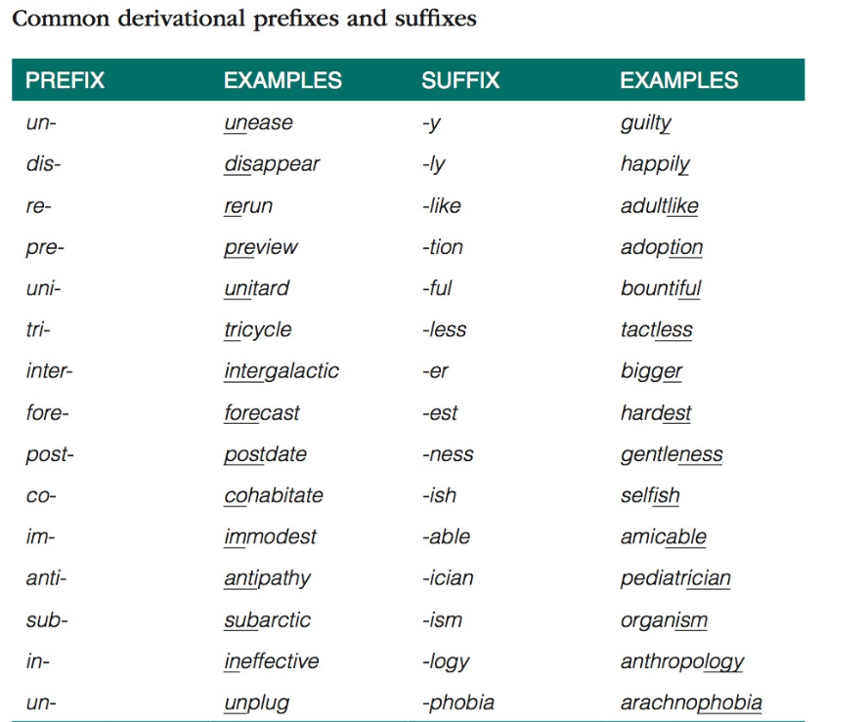

Slide 15
influences on morphological Development
Second language acquisition: They may never master grammatical morphology of second language. example : Chinese speakers who learn English as a second language find the plural marker difficult to master because plurality is not inflected morphologically in the Chinese language.
Dialect :“tom’s aunt” vs “tom aunt
Language impairment: SLI (verb tense making)

Slide 16
What iS Syntactic DEvELOPmEnt?
Syntactic development is children’s internalization of the rules of language that govern how words are organized into sentences.

Slide 17
Syntactic Building Blocks
(a) an increase in utterance length
(b) use of different sentence modalities
(c) the development of complex syntax.

Slide 18
an increase in utterance length
Most children show a gradual increase in utterance length from ages 1 to 6 years, and these increases reflect the children’s ability to chain morphemes together to produce an infinite variety of sentences.
mean length of utterance (MLU)— is a simple proxy for estimating the syntactic complexity of children’s utterances.
To calculate an MLU for a child, one makes a transcript of utterances the child speaks , calculates the number of morphemes per each utterance, and divides this by the total number of utterances.

Slide 19
Sentence Modalities
Children become increasingly skilled at producing different sentence types that vary not only in their pragmatic intent, but also in their syntactic organization.
These include :
Declaratives
Negatives
Interrogatives

Slide 20
Declaratives
These are statements of different complexity levels
1. Subject + verb: I bake.
2. Subject + verb + Object: I bake bread.
3. Subject + verb + complement: I feel good.
4. Subject + verb + adverbial phrase: I feel good today.
5. Subject + verb + indirect object + Direct object: She gave Tommy the hammer.
6. Subject + verb + Direct object + indirect object: She gave the hammer to Tommy.

Slide 21
Negatives
Negative sentences express negation and rely on such words as no, not, can’t, don’t, and won’t.
“no, i not going!”
“i don’t want to!”
“i’m not eating that!”
“Don’t do that!”
Their development occurs in a predictbale manner

Slide 22
Negatives milestones
stage 1 placed at the beginning of the sentence: “no eat that.”
stage 2 the negative word moves inside the sentence next to the main verb: “I not eat that” and “you no do that.”
stage 3 by age 4 years use the auxiliary forms of verbs that approximate adultlike negation :“you can’t do that” and “i don’t want to go.”
stage 4 passive sentences containing the modal verb won’t: “She won’t be getting a prize”
stage 5 negative sentences that involve probability estimates:“i’m not sure if she’ll get the prize”

Slide 23
Interrogatives
Interrogative sentences involve the act of questioning. children become amazingly sophisticated at organizing sentences to obtain information from other people:
“Why is that light green?”
“What happened?”
“Who did it?”
“Where are you going?”
“is it snowing?”
“he’s sad; isn’t he?”

Slide 24
Interrogatives
Two major question types:
wh- questions: early ones include what, where, and why and later emerging ones include who, whose, when, which, and how.
yes–no questions
it is most important to recognize that children acquire and implement a set of complex syntactic rules to form questions without having anyone teach them how to do so.

Slide 25
Complex Syntax: Linking Phrases and Clauses
A phrase is a cluster of words organized around a head.
Types of phrases include
noun phrases (the tall, angry boy)
prepositional phrases (in the bucket),
adjectival phrases (very happy)
and verb phrases (was saddened)
children develop skills in phrasal coordination, which allows them to connect phrases. E.g., I’m putting on my coat and my hat.

Slide 26
Complex Syntax: Linking Phrases and Clauses
A clause is a syntactic structure containing a verb or a verb phrase.
For instance, the sentence, I’ll go and you stay contains two independent clauses (I’ll go; you stay) conjoined with the coordinating conjunction and.

Slide 27
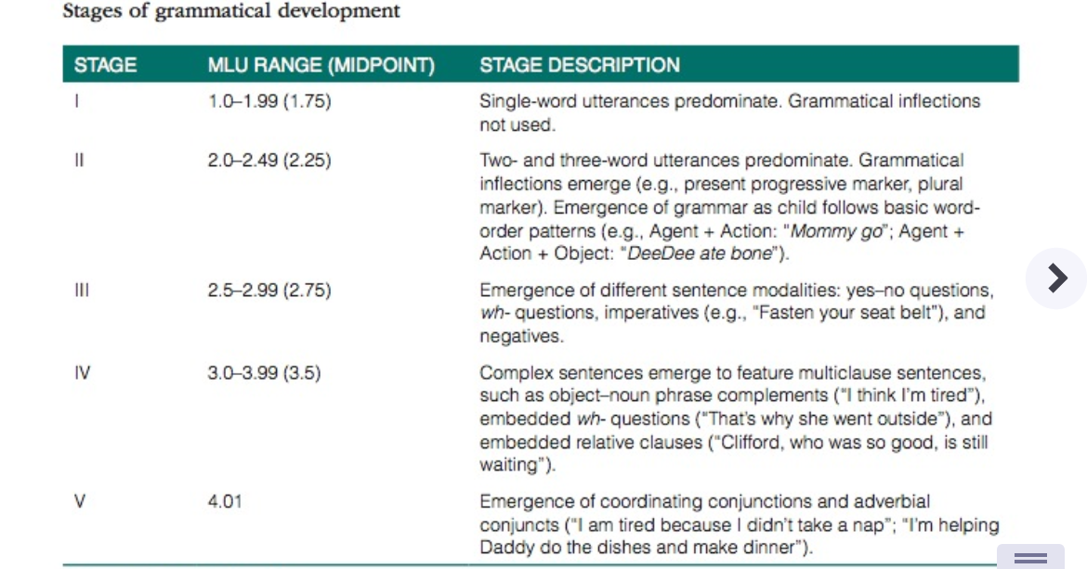

Slide 28
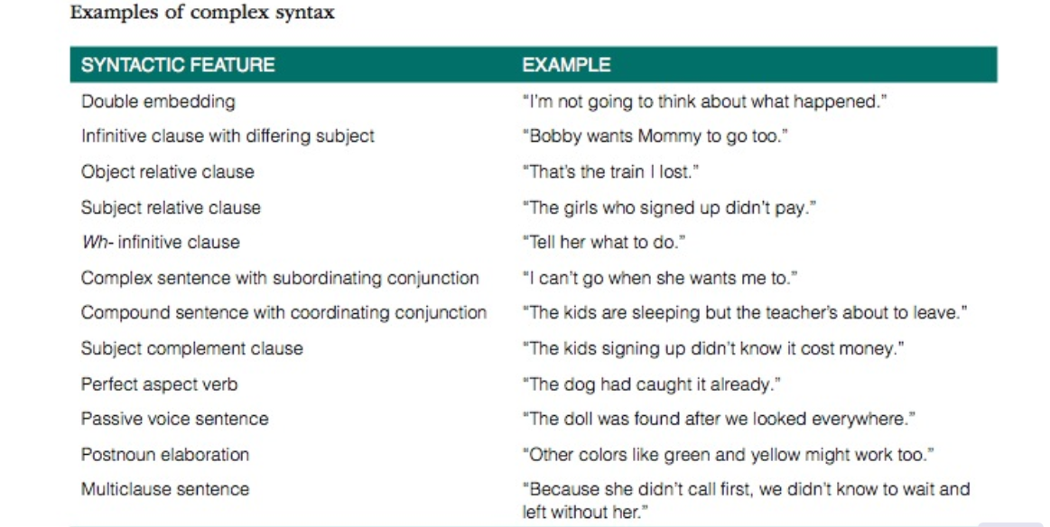

Slide 29
influences on Syntactic Development ?
1- Gender
2-child directed speech (CDS): caregiver& parents
exposed to short simple sentence vs exposed to long complex sentence
3- socioeconomic status (SES)
4- language impairment ( SLI) , secondary language impairment , and acquired language disorders

Slide 30
What is Semantic Development?
Semantic development: which refers to an individual’s learning and storage of the meanings of words.

Slide 31
Semantic Building Block
(a) acquiring a mental lexicon
(b) learning new words rapidly
(c) organizing the mental lexicon in an efficient semantic network.

Slide 32
acquiring a mental lexicon
A person’s mental lexicon is the volume of words he or she understands(receptive lexicon) and uses( expressive lexicon).
This volume increases remarkably quickly during the first several years of life—from only several words at age 12 months, to 300 words at age 24 months, to 60,000 words by early adulthood
Gain 860 words every year for children between 1-7 years, approximately 2 words per day.
One long-standing belief in the field of child language acquisition is that children undergo a vocabulary spurt, or word spurt, that begins near the end of the second year and continues for several years.
the term spurt implies that children transition from a slow stage of development to a rapid stage of development, with an inflection point differentiating the stages (this inflection point implies that there is a sudden burst in lexical growth at a given point

Slide 33
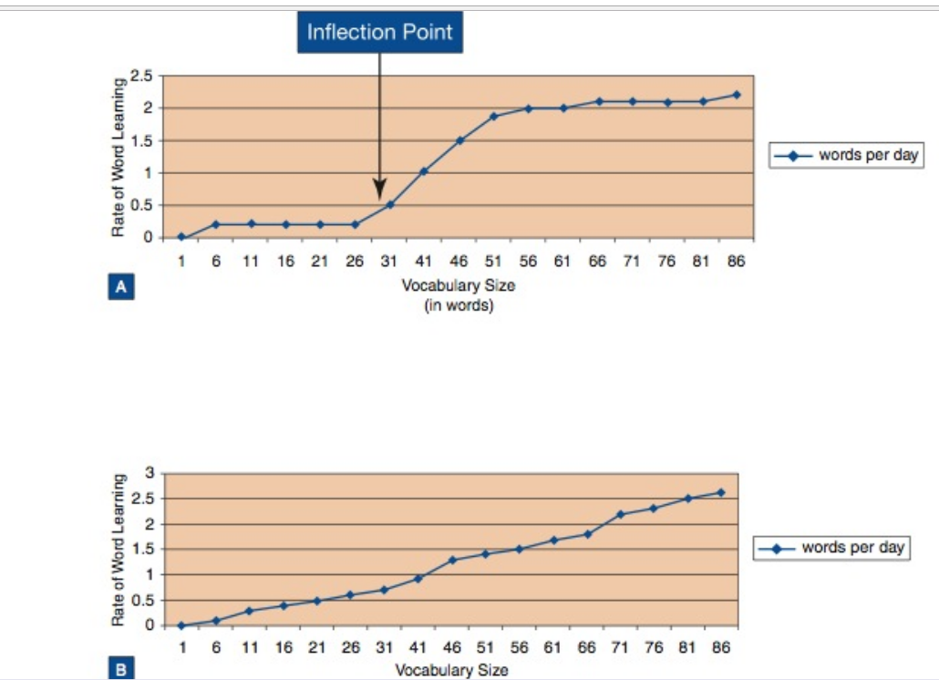
Vocabulary spurt

Slide 34
Semantic toxonomoy
A semantic taxonomy differentiates words on the basis of their semantic roles.
One classic semantic taxonomy differentiates children’s lexical items into five categories (ingram, 1989):
1. Specific nominals refer to a specific object (e.g., Daddy, Fluffy)
2. General nominals refer to all members of a category (e.g., those, cats)
3. Action words describe specific actions (e.g., up), social-action games (e.g., peekaboo), and action inhibitors (e.g., no)
4. Modifiers describe properties and qualities (e.g., big, mine)
5. Personal–social words describe affective states and relationships (e.g., yes,
bye-bye)

Slide 35
New words
There are factors that influence the speed with which a child develops an adultlike understanding of a word.
1. Concept represented by the word: concrete words are easier than abstract words. children often do not acquire words that describe beliefs and mental states—such as think and know—until age 3 or 4 years.
2. Phonological form of the word : First, Children use onomatopoeic words( (ماء=بو to refer to objects. Second, children learn words containing common sound sequences more readily than words containing rare sound sequences (Storkel, 2003).

Slide 36
influences on SEMantic Development ?
1- Gender
2- language impairment
3- language exposure

Slide 37
What is pragmitic Development?
pragmatic development: which refers to the rules govern how language is used as a social tool
Different purposes
- using conversations
- Circumstances and goals of the participants

Slide 38
PRAGMATIC Building Block
(a) communication functions (intention)
(b) conversational skills:
Schema( building blocks), Macrostructural schema of a conversation :
1- Initiation and establishment of topic
2- Navigation of a series of contingent turns that maintain or shift topic
3-Resolution and closure
(c) sensitivity to extralinguistic cues (posture, gesture, facial expression, eye contact, proximity, pitch, loudness, and pausing).

Slide 39
influences on pragmatic Development ?
1- temperament (behavioral style: attention, interactive)
2- social and cultural context (talking to parent vs friends, academic vs informal)

