Slide 1
Children & Adolescents
BOOK: Chapter 12

Slide 2
Introduction
Good health is fundamental to the growth, development, and well-being of all children and adolescents and ultimately helps to protect them from chronic diseases as adults.
Yet, the status of this group today reflects inadequate health: New challenges--> motor vehicle accidents; violence due to suicide, homicide, and abuse; substance abuse; exposure to environmental pollutants
An alarming increase in the prevalence of overweight and obese children and adolescents.
Children are generally categorized as ages 1–11 years
Adolescents are generally categorized as ages 12–19 years.
Notes:
Widespread immunization, improved sanitation, public education on nutrition and health, and the discovery of antibiotics have dramatically reduced the rates of child morbidity and mortality due to infectious diseases

Slide 3
What are children & adolescents eating?
What affects these behaviors?
Concerns around the problem of childhood obesity
  Other nutrition-related problem
Nutrition programs that target children and teenagers and the challenges of operating and improving the child nutrition programs
  Building healthful school environments

Slide 4
Health objectives
Health and Nutrition objectives for children and adolescents
Priority areas:
  physical activity and fitness, nutrition, and dental health
Examples of past success:
Decrease in prevalence of growth retardation among low-income children
The percent of elementary and secondary schools offering low-fat choices for breakfast and lunch increased
No progress in reducing obesity or childhood diabetes or iron deficiency anemia

Slide 5
The following steps are recommended
Since most post pubertal children regain any lost weight within a year, promote the initiation of behavioral therapy for overweight children before the onset of puberty
Educate children and their families about the health benefits of being physically active and weight reduction
Encourage schools to find health-promoting ways to offset potential revenues lost from vending machine sales in the event that such machines are banned.
scheduled periods for physical education during the school day can boost students’ academic achievement.
Develop and implement strategies to increase physical activity among children with disabilities ( the use of social media can be effective here)
Implement strategies to make healthful food choices available, identifiable, and affordable to all people

Slide 6
What Are Children and Adolescents Eating?
Children’s eating habits have changed over the past two decades.
Healthy Eating Index (HEI) used as an indicator of diet quality.
overall picture of the types of foods people choose to eat and demonstrates compliance with specific dietary recommendations
The HEI measures various component representing aspects of a healthful diet
The HEI uses scores 0-100 to evaluate a set of foods.

Slide 7
HEI scores are expressed as percentages of recommended dietary intake levels. A score corresponding to 100 percent indicates that the recommendation was met or exceeded on average. A score below 100 percent indicates that average intake does not meet the recommendations for that component.
Adequacy components represent the food groups, subgroups, and dietary elements that are encouraged. For these components, higher scores reflect higher intakes, because higher intakes are desirable.
Moderation components represent the food groups and dietary elements for which there are recommended limits to consumption. For moderation components, higher scores reflect lower intakes, because lower intakes are more desirable.

Slide 8
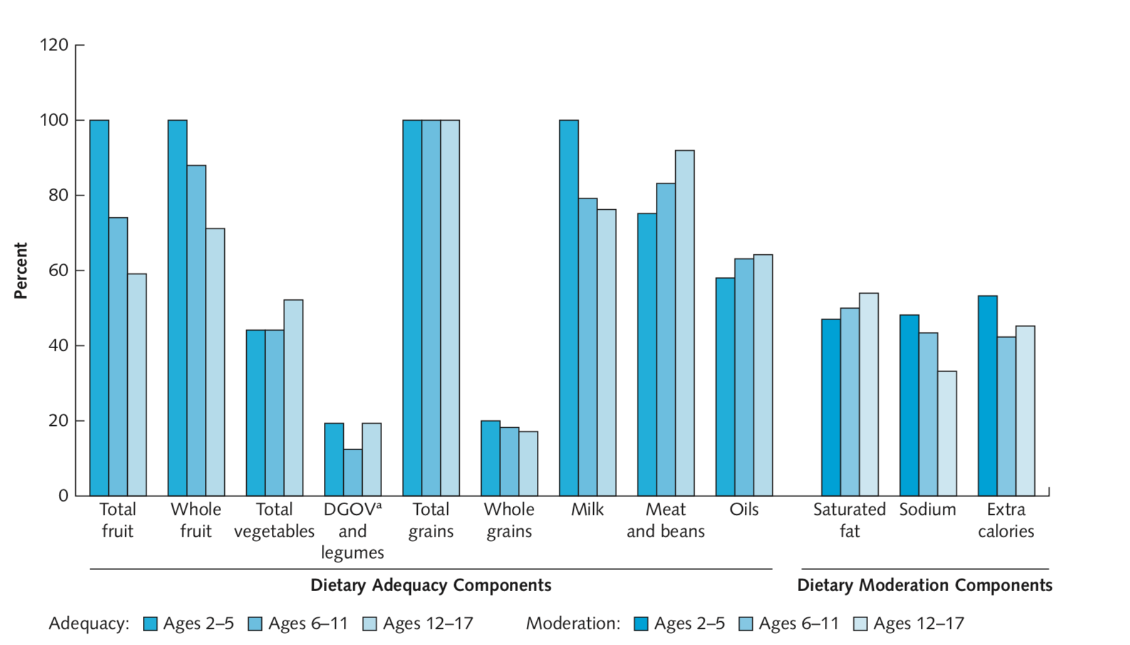
HEI-2005

Slide 9
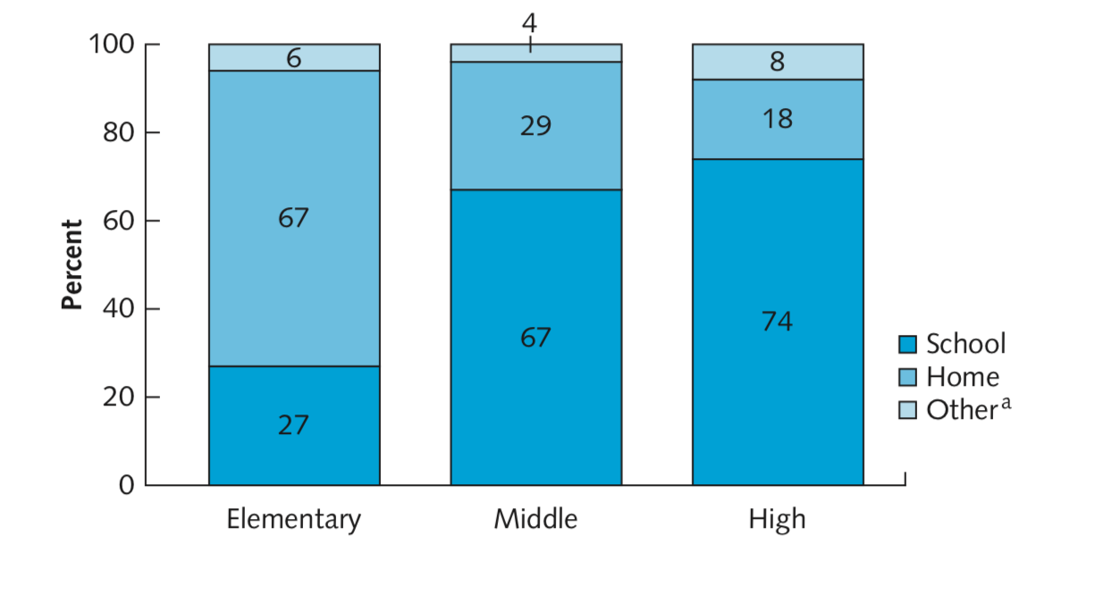
Nutrients of concern
Less than 15% of teenage girls ( ages 12-17%) met their rec’d intake of magnesium and calcium
Only 50% met their needs for iron
Survey data showed that beverage choices for all ages changed from whole milk to lower-fat milk, soft drinks, and fruit and fruit-flavored drinks
soft drinks add from 19 teaspoons of sugar for females aged 6 to 8 years, to 36 teaspoons, or three-fourths of a cup of sugar, for males aged 14 to 18 years.

Slide 10
Iron deficiency
Generally, the prevalence of iron deficiency is higher among children living at or below the poverty threshold than among other children.
Adolescents have special iron needs:
◦ In boys, the requirements increases to 11 mg, which reflects the expanding blood volume and rise in hemoglobin concentration that accompany sexual maturation.
◦ In girls, the total daily iron loss increases due to menstruation

Slide 11
What affects these behaviors?
Lifestyle
Convenience and peer pressure strongly influence food choices. These influencers include: outlets where foods are prepared and served quickly, wanting to sleep longer in the morning, socializing with friends while eating (friends help to define acceptable behavior for the peer group, including eating patterns and habits).
Media and Advertising
In a media-saturated world, children and adolescents are the target of intense and specialized marketing efforts. They often influence their parents’ decisions on where the family dines, what types of foods are eaten at home, and what brands are purchased. 70% of the food marketing directed toward children under age 12 include: breakfast cereal, snack foods, and restaurant foods. The industry targets adolescents ages 12–17 with the promotion of carbonated beverages, noncarbonated beverages, and restaurant foods.
Marketing through media.
Notes:
Marketing through media that is popular with teens, such as branded apps for mobile devices with interactive features such as ordering and discount offers and postings to social media (e.g., Facebook, Twitter) increased.

Slide 12

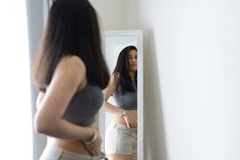
Television watching while consuming high kcal snacks
Mass media, especially television and magazines, also influence how adolescent girls and boys view their bodes by showing unrealistic body ideals.
Between 50 and 75 percent of adolescent girls are dissatisfied with their weight and body image

Slide 13
Childhood Obesity Concerns
The health consequences related to excess weight can begin early in life, especially with respect to cardiovascular disease. Nearly 60 percent of overweight children have been shown to have at least one cardiovascular risk factor, compared to 10 percent of those with a BMI less than the 85th percentile.
hypertension may occur 9 times more frequently in those who were overweight)
Underweight 5 BMI-for-age < 5th percentile
Healthy Weight 5 BMI-for-age ≥ 5th percentile to < 85th percentile
Overweight 5 BMI-for-age ≥ 85th percentile to < 95th percentile
Obese 5 BMI-for-age ≥ 95th percentile
Diagnosis of DM type 2 rapidly increasing in children and teens.

Slide 14
Social stigmatization and low self-esteem
Overweight children become targets of early discrimination (Children ages 6–10 associate obesity with negative characteristics such as laziness and sloppiness)
A negative self-image often persists into adulthood and may have a long-term impact.

Slide 15
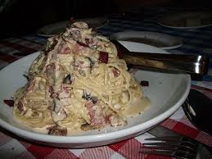
Effects of Portion Size
Numerous studies have demonstrated that people’s energy intake increases when they are offered larger portions. This is explained by various mechanisms:
The appropriateness mechanism. A food portion sets a norm and guides the amount consumed. Consequently, the portion size (rather than hunger or satiety) directs food consumption.
The ‘unit bias’ mechanism. This model suggest people see one serving (e.g. one sandwich, one can of food, one biscuit) as appropriate to consume at once, irrespective of its size

Slide 16
Effects of Portion Size
The ‘previous experience/expectation’ mechanism. Previous experiences may steer portion-size selection. For example, previous experience of the ‘degree of fullness produced by a food’ impacts on the portion size selected and consumed at a later point in time.
The ‘visual cue’ mechanism. The portion-size effect might be partly explained by visual cues. For example, similar portion sizes of food appear larger served on a small plate than on a large plate, and this steers individuals to judge portions differently.

Slide 17
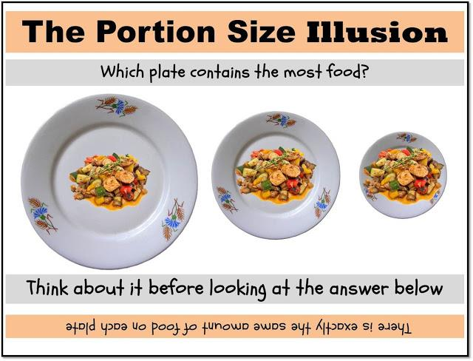

Slide 18
Portion size
Provide information
Labelling: Different types of labelling showed no or at most a very small effect
Naming and framing: Consumers respond to naming, independently of the actual size. Large sounding names (e.g. ‘double’) led to a decrease in intake
Enable choice
Example: Provide a smaller portion alongside the larger one. Introducing a smaller sized hot meal in the worksite cafeteria alongside the larger sized meal led 10% of consumers to choose the smaller
Restrict choice: Limit sugar-sweetened beverages sold in restaurants to a maximum of 473 ml predicts a modest reduction in calories especially among young adults and children who are overweight

Slide 19
Building healthful school environments
Provide age-appropriate nutrition and health education
Ensure that meals offered through school meet healthy standards.
All foods and beverages available on school campuses and at school events should contribute toward eating patterns.
Provide food options that are low in solid fat, calories, and added sugars.
Prohibit access to vending machines that compete with healthy school meals.
Provide adequate time for students to eat school meals.

Slide 20
Nutrition Education Strategies for Preadolescent Girls
Despite the high prevalence of unhealthful dieting behaviors, disordered eating, and body dissatisfaction among youth, few primary prevention programs— programs that prevent problems
children and adolescents can learn at school + at other community outreach about the dangers of unsafe weight-loss methods and about safe ways to maintain a healthful weight.

Slide 21

Free to be me program
Girl Scout badge program
Six 90-minute sessions that were presented during consecutive biweekly Girl Scout meetings.
activities on body development, the media’s impact on body image and self-esteem, and combating negative images.
critically analyzed media messages and looked for alternative positive messages. After analyzing media messages, the girls were encouraged to write letters to the media about positive body image
Free to Be Me” badge
three-hour training session taught troop leaders to teach the program. Each troop leader received a detailed handbook, along with materials and supplies. A registered dietitian served as project coordinator and worked closely with troop leaders.

