Slide 1
Chapter 16
Kinetics: Rates and Mechanisms
of Chemical Reactions
Copyright ©The McGraw-Hill Companies, Inc. Permission required for reproduction or display.
Notes:
‹#›

Slide 2
Kinetics: Rates and Mechanisms of Chemical Reactions
16.1 Factors That Influence Reaction Rates
16.2 Expressing the Reaction Rate
16.3 The Rate Law and Its Components
16.4 Integrated Rate Laws: Concentration Changes over Time
16.5 The Effect of Temperature on Reaction Rate
16.6 Explaining the Effects of Concentration and Temperature
16.7 Reaction Mechanisms: Steps in the Overall Reaction
16.8 Catalysis: Speeding Up a Chemical Reaction
Notes:
‹#›

Slide 3
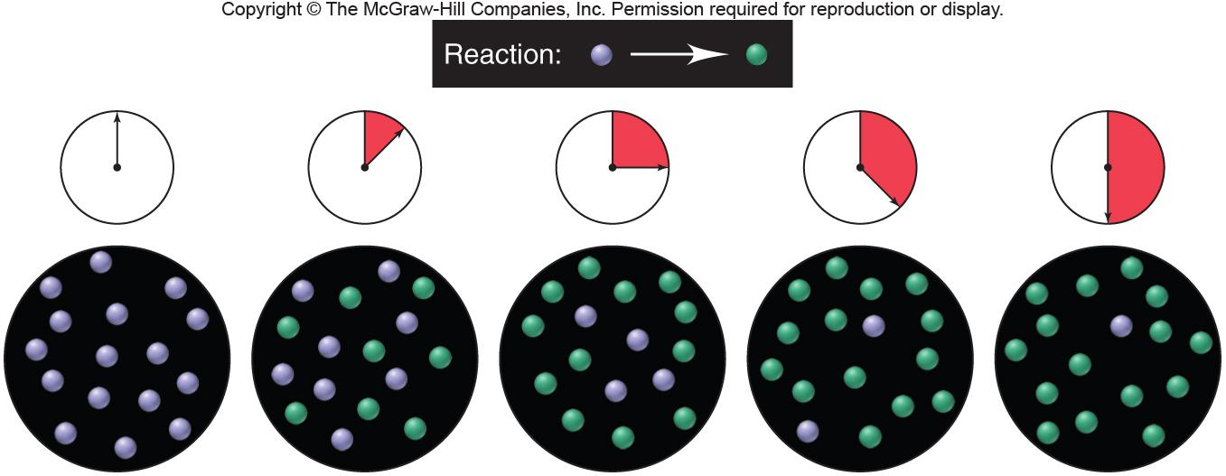
Figure 16.1
Reaction rate: the central focus of chemical kinetics.
Notes:
‹#›

Slide 4
Factors That Influence Reaction Rate
Under a specific set of conditions, every reaction has its own
characteristic rate, which depends upon the chemical nature of
the reactants.
Four factors can be controlled during the reaction:
Concentration - molecules must collide to react
Physical state - molecules must mix to collide
Temperature - molecules must collide with enough energy to react
The use of a catalyst
Notes:
‹#›

Slide 5
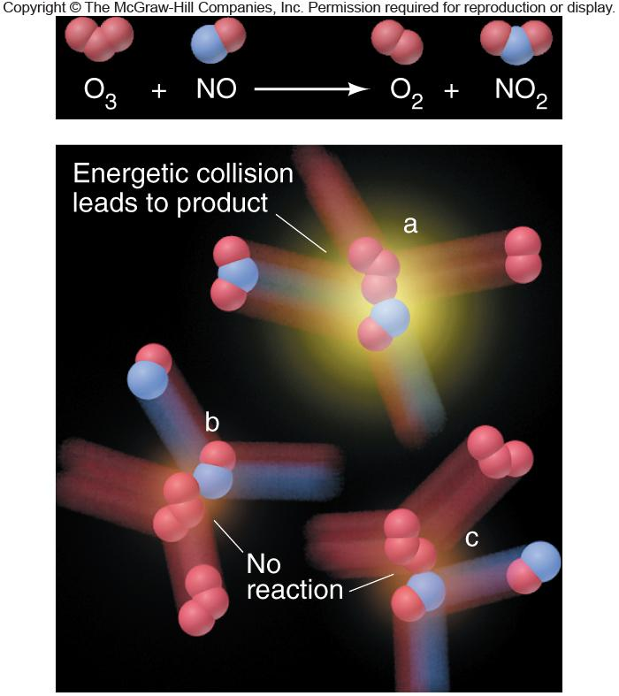
Figure 16.2
Collision energy and reaction rate.
Notes:
‹#›

Slide 6
Expressing the Reaction Rate
Reaction rate - changes in the concentrations of reactants or
products per unit of time.
Reactant concentrations decrease while product concentrations
increase.
General reaction,
A B
change in concentration of A
conc A₂ - conc A₁
Rate of reaction = -
= -
change in time
t₂ - t₁
Δ (conc A)
-
Δt
Notes:
‹#›

Slide 7
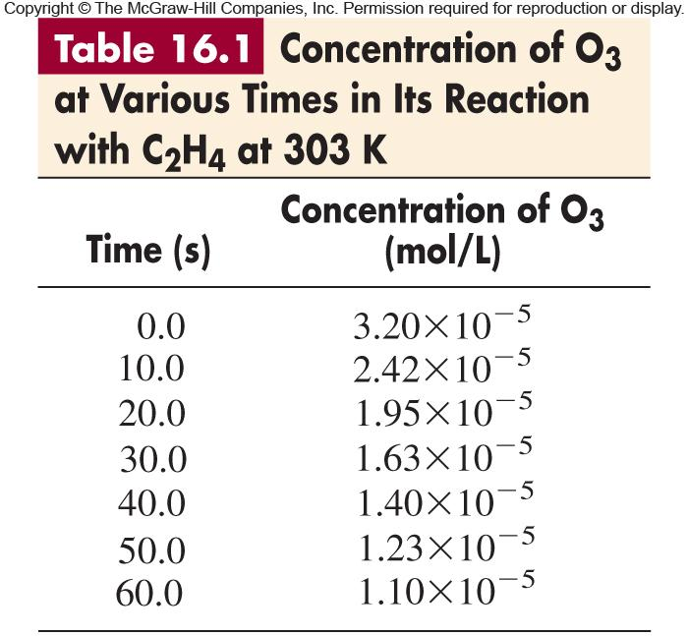
Notes:
‹#›

Slide 8
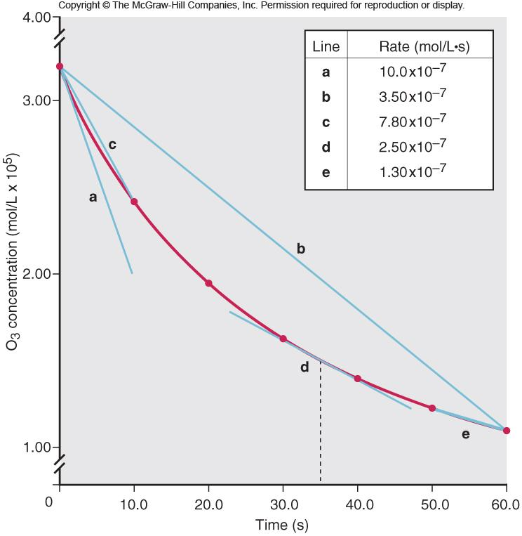
Figure 16.3
The concentration of O₃ vs. time during its reaction with C₂H₄.
rate =
Δ [C₂H₄]
-
=
Δt
Δ [O₃]
-
Δt
Notes:
‹#›

Slide 9
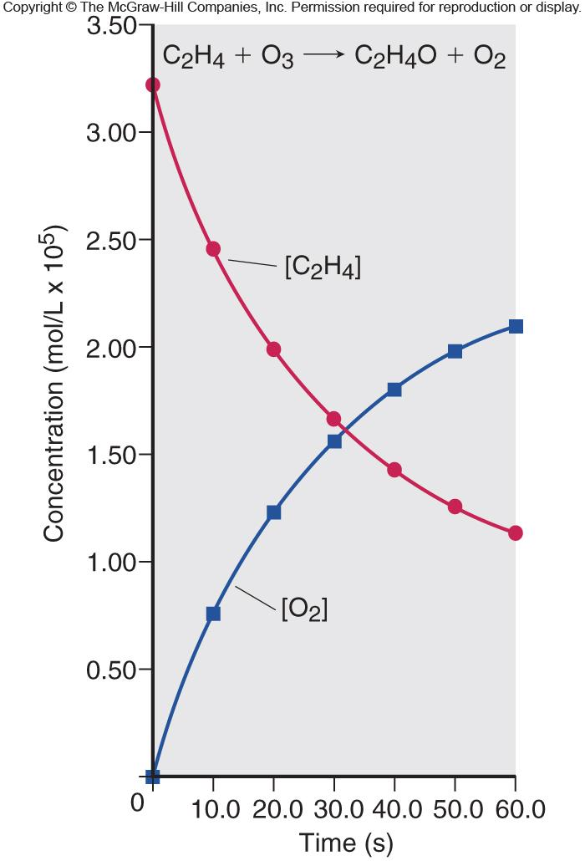
Figure 16.4
Plots of [C₂H₄] and [O₂] vs. time.
Notes:
‹#›

Slide 10
In general, for the reaction,
aA + bB cC + dD
1
Δ[A]
1
Δ[B]
1
Δ[C]
1
Δ[D]
Rate =
-
= -
= +
= +
a
Δt
b
Δt
c
Δt
d
Δt
The numerical value of the rate depends upon the substance that
serves as the reference. The changes in concentration of the other reaction components are relative to their coefficients in the balanced chemical equation.
Notes:
‹#›

Slide 11
Sample Problem 16.1
Expressing Rate in Terms of Changes in Concentration with Time
PROBLEM:
Because it has a nonpolluting product (water vapor), hydrogen gas is used for fuel aboard the space shuttle and in prototype cars with Earth-bound engines:
2H₂(g) + O₂(g) 2H₂O(g)
(a) Express the rate in terms of changes in [H₂], [O₂], and [H₂O] with time.
(b) When [O₂] is decreasing at 0.23 mol/L•s, at what rate is [H₂O] increasing?
PLAN:
Choose [O₂] as a point of reference since its coefficient is 1. For every molecule of O₂ which disappears, 2 molecules of H₂ disappear and 2 molecules of H₂O appear, so [O₂] is disappearing at half the rate of change of H₂ and H₂O.
SOLUTION:
1
Δ[H₂]
Δ[O₂]
1
Δ[H₂O]
(a)
rate =
-
= -
= +
2
Δt
Δt
2
Δt
Δ[O₂]
1
Δ[H₂O]
Δ[H₂O]
(b)
-
= -
0.23 mol/L•s
= +
; = 0.46 mol/L•s
Δt
2
Δt
Δt
Notes:
‹#›

Slide 12
Sample Problem 16.2
Determining Reaction Order from Rate Laws
PROBLEM:
For each of the following reactions, use the given rate law to determine the reaction order with respect to each reactant and the overall order:
(a) 2NO(g) + O₂(g) 2NO₂(g); rate = k[NO]²[O₂]
(b) CH₃CHO(g) CH₄(g) + CO(g); rate = k[CH₃CHO]^{3/2}
(c) H₂O₂(aq) + 3I⁻(aq) + 2H⁺(aq) I₃⁻(aq) + 2H₂O(l); rate = k[H₂O₂][I⁻]
PLAN:
Look at the rate law and not the coefficients of the chemical reaction.
SOLUTION:
(a) The reaction is 2nd order in NO, 1st order in O₂, and 3rd order overall.
3
3
(b) The reaction is order in CH₃CHO and order overall.
2
2
(c) The reaction is 1st order in H₂O₂, 1st order in I⁻, zero order in H⁺, and 2nd order overall.
Notes:
‹#›

Slide 13
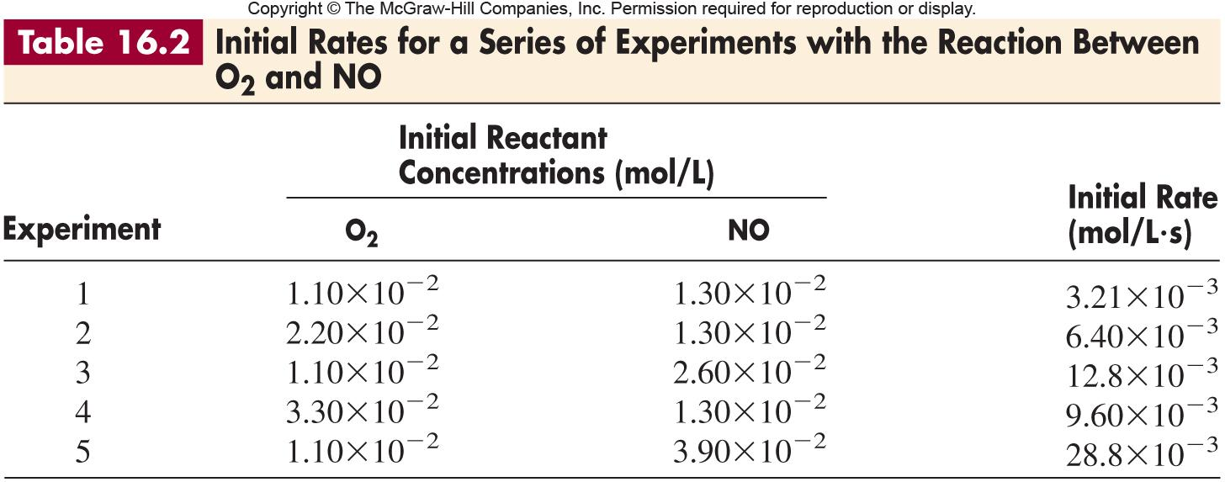
Notes:
‹#›

Slide 14
Determining Reaction Orders
Using initial rates -
Run a series of experiments, each of which starts with a different set of reactant concentrations, and from each obtain an initial rate.
See Table 16.2 for data on the reaction
O₂(g) + 2NO(g) 2NO₂(g)
rate = k [O₂]^{m}[NO]^{n}
Compare 2 experiments in which the concentration of one reactant varies and the concentration of the other reactant(s) remains constant.
rate₂
k [O₂]₂^{m}[NO]₂^{n}
[O₂]₂^{m}
[O₂]₂
m
=
=
=
rate₁
k [O₂]₁^{m}[NO]₁^{n}
[O₂]₁^{m}
[O₂]₁
6.40 x 10⁻³ mol/L•s
2.20 x 10⁻² mol/L
m
=
;
2 = 2^{m}
m = 1
3.21 x 10⁻³ mol/L•s
1.10 x 10⁻² mol/L
Do similar calculations for the other reactant(s).
Notes:
‹#›

Slide 15
Sample Problem 16.3
Determining Reaction Orders from Initial Rate Data
PROBLEM:
Many gaseous reactions occur in a car engine and exhaust systems. One of these is
rate = k[NO₂]^{m}[CO]^{n}
Use the following data to determine the individual and overall reaction orders:
Experiment
Initial Rate (mol/L•s)
Initial [NO₂] (mol/L)
Initial [CO] (mol/L)
1
0.0050
0.10
0.10
2
0.080
0.40
0.10
3
0.0050
0.10
0.20
PLAN:
Solve for the order with respect to each reactant using the general rate law using the method described previously.
SOLUTION:
rate = k [NO₂]^{m}[CO]^{n}
First, choose two experiments in which [CO] remains constant and the [NO₂] varies.
Notes:
‹#›

Slide 16
Sample Problem 16.3
Determining Reaction Order from Initial Rate Data
continued
rate 2
k [NO₂]^{m}₂[CO]^{n}₂
[NO₂] ₂
m
=
=
The reaction is 2nd order in NO₂.
rate 1
k [NO₂]^{m}₁ [CO]^{n}₁
[NO₂] ₁
0.080
0.40
m
=
16 = 4.0^{m} and m = 2.0
0.0050
0.10
rate 3
k [NO₂]²₃[CO]^{n}₃
[CO] ₃
n
=
The reaction is zero order in CO.
=
rate 1
k [NO₂]²₁ [CO]^{n}₁
[CO] ₁
0.0050
0.20
n
=
1 = 2.0^{n} and n = 0
0.0050
0.10
rate = k [NO₂]²[CO]⁰ = k [NO₂]²
The reaction is second order overall.
Notes:
‹#›

Slide 17
Integrated Rate Laws
Δ[A]
rate = -
= k [A]
First-order rate equation
Δt
[A]₀
ln
= kt
ln [A]₀ - ln [A]_{t} = kt
[A]_{t}
Δ[A]
rate = -
= k [A]²
Second-order rate equation
Δt
1
1
1
1
-
= kt
= kt
+
[A]_{t}
[A]₀
[A]_{t}
[A]₀
Δ[A]
rate = -
= k [A]⁰
Zero-order rate equation
Δt
[A]_{t} - [A]₀ = - kt
Notes:
‹#›

Slide 18
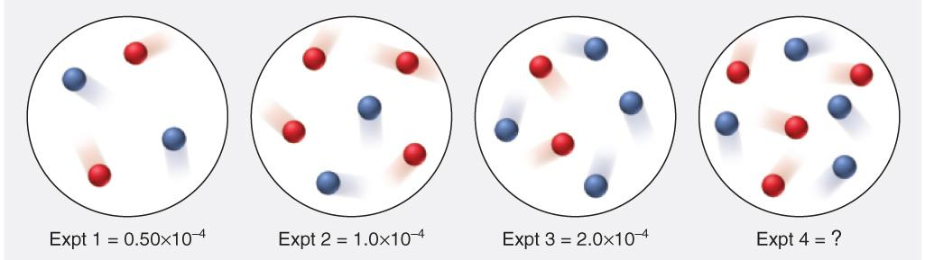
Sample Problem 16.4
Determining Reaction Orders from a Series of Molecular Scenes
PROBLEM:
At a particular temperature, two gases, A (red) and B (blue), react to form products. The following molecular scenes represent four experiments run at the same volume, labeled 1 through 4 with their initial rates (in mol/L•s):
What is the reaction order with respect to A?
With respect to B? The overall order?
(b) Write the rate law for the reaction.
(c) Predict the initial rate of experiment 4.

Slide 19
Sample Problem 16.4
Determining Reaction Orders from a Series of Molecular Scenes
continued
PLAN:
Determine the change in each reactant by counting the number of spheres and see how the change affected the rate.
(b) Use the orders from (a) to write the rate law.
(c) Use the results from Expts 1 and 3 and the rate law from part (b) to determine initial rate of Expt 4.
Notes:
‹#›

Slide 20
Sample Problem 16.4
Determining Reaction Orders from a Series of Molecular Scenes
continued
SOLUTION:
From Expts 1 and 2, A doubles while B is constant and the rate also doubles. The reaction is first order with respect to A. From Expts 1 and 3 B doubles, A is constant and the rate quadruples. The reaction is second order with respect to B. The overall order is (1 + 2), 3rd order.
Rate = k[A][B]²
Comparing Expts 3 and 4 we see that A doubles. Comparing Expts 2 and 4 A is constant and B doubles, so the rate should quadruple.
Rate 4 = 4.0 x 10⁻⁴ mol/L•s

Slide 21
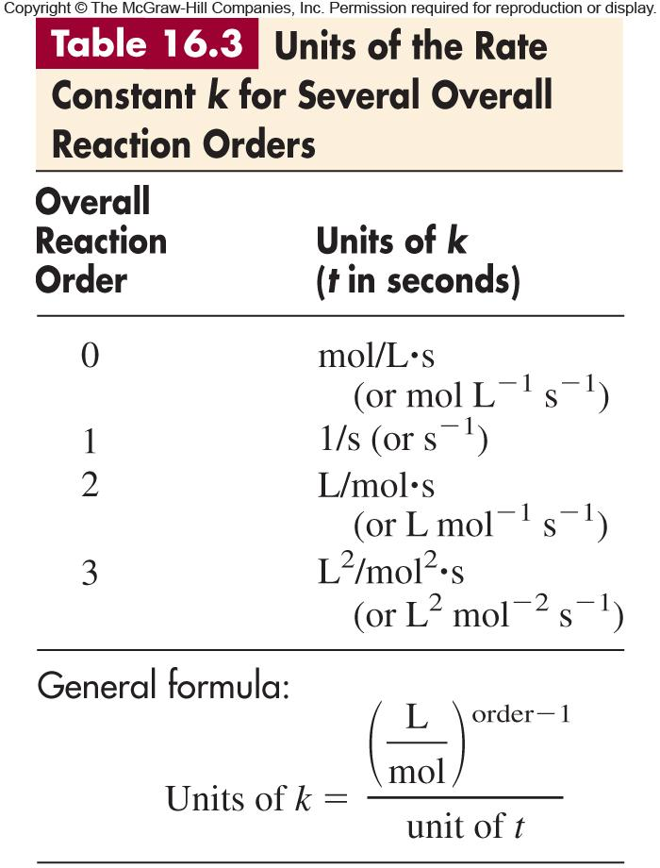
Notes:
‹#›

Slide 22
Sample Problem 16.5
Determining the Reactant Concentration at a Given Time
PROBLEM:
At 1000ºC, cyclobutane (C₄H₈) decomposes in a first-order reaction, with the very high rate constant of 87 s⁻¹, to two molecules of ethylene (C₂H₄).
(a) If the initial C₄H₈ concentration is 2.00 M, what is the concentration after 0.010 s?
(b) What fraction of C₄H₈ has decomposed in this time?
PLAN:
Find the [C₄H₈] at time, t, using the integrated rate law for a 1st order reaction. Once that value is found, divide the amount decomposed by the initial concentration.
SOLUTION:
[C₄H₈]₀
2.00
ln
= kt
; ln
= (87 s⁻¹)(0.010 s)
(a)
[C₄H₈]_{t}
[C₄H₈]
[C₄H₈] = 0.83 mol/L
(b)
[C₄H₈]₀ - [C₄H₈]_{t}
2.00 M - 0.83 M
=
= 0.58
[C₄H₈]₀
2.00 M
Notes:
‹#›

Slide 23
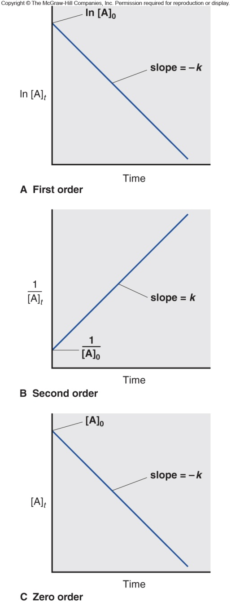
Figure 16.5
Integrated rate laws and reaction orders.
ln[A]_{t} = -kt + ln[A]₀
1/[A]_{t} = kt + 1/[A]₀
[A]_{t} = -kt + [A]₀
Notes:
‹#›

Slide 24
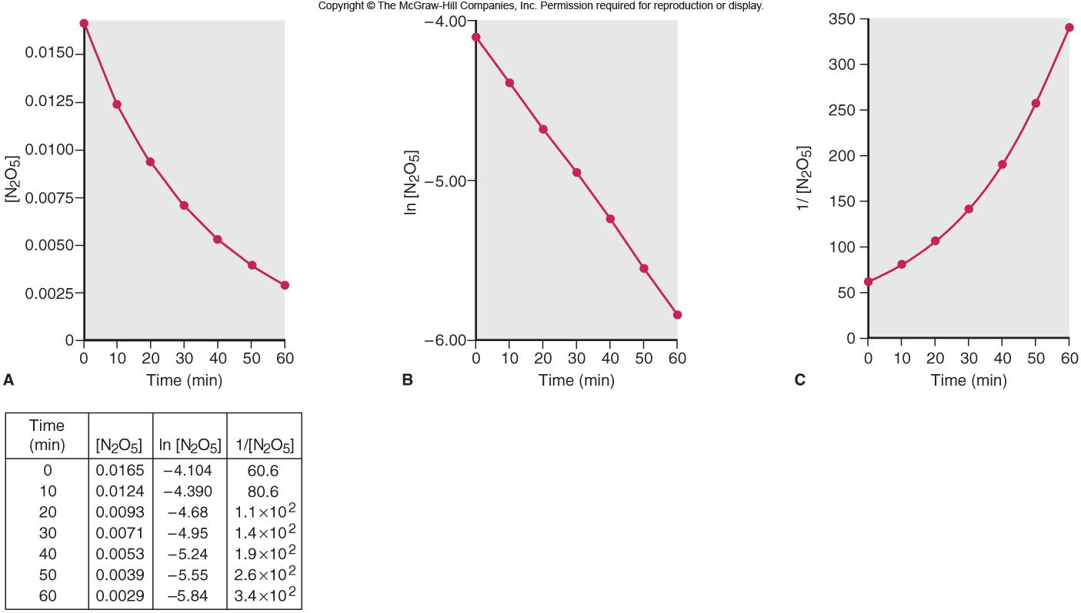
Figure 16.6
Graphical determination of the reaction order for the decomposition of N₂O₅.
Notes:
‹#›

Slide 25
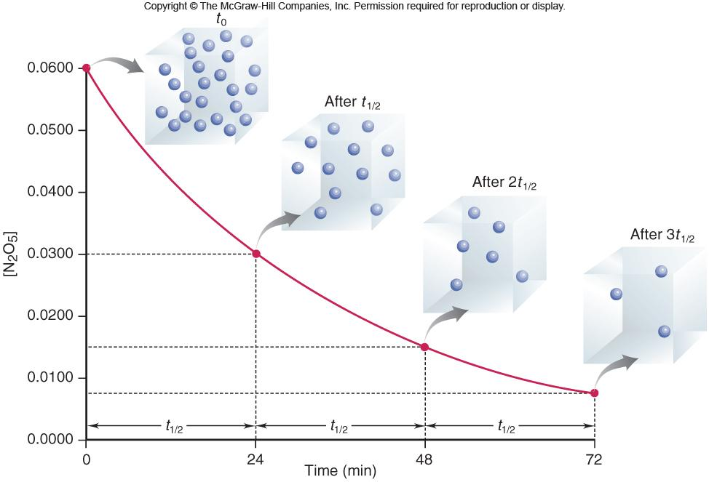
Figure 16.7
A plot of [N₂O₅] vs. time for three half-lives.
for a first-order process
ln 2
0.693
t_{1/2} =
=
k
k
Notes:
‹#›

Slide 26
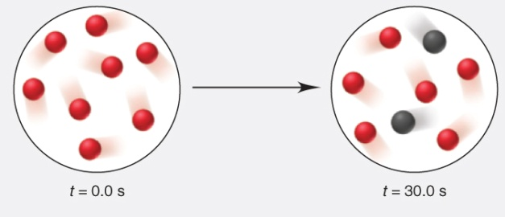
Sample Problem 16.6
Using Molecular Scenes to Determine Half-Life
PROBLEM:
Compound A (red) converts to compound B (black) in a first-order process. The following scenes represent the reaction mixture at the start of the reaction (at 0.0 s) and after 30.0 s:
Find the half-life, t_{1/2}, of the reaction.
Calculate the rate constant, k.
Draw a scene that represents the reaction mixture after 2.00 min.
PLAN:
Half-life is constant for first-order reaction. The time it takes for half of the red spheres to become black is the half-life.
We substitute the value of t_{1/2} from part (a) into Equation 16.7 and solve for k.
Knowing the half-life, one can calculate how many red and black spheres would be in the mixture at 2.00 min.
Notes:
‹#›

Slide 27
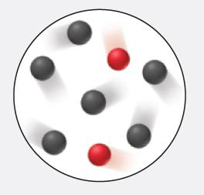
Sample Problem 16.6
Using Molecular Scenes to Determine Half-Life
continued
SOLUTION:
(a)
At t = 0.0 s, there are 8 A (red) molecules and no B (black). At t = 30.0 s, there are 6 A and 2 B molecules present, so ¼ of A has reacted. Therefore, t_{1/2} = (2 x 30.0 s) = 60.0 s
(b)
For first-order reaction, t_{1/2} = 0.693/k
k = 0.693/t_{1/2} = 0.693/60.0 s = 1.16 x 10⁻² s⁻¹
(c)
The time given, t = 120. s, is two half-lives. There should be ½(1/2) molecules of A (red) left.

Slide 28
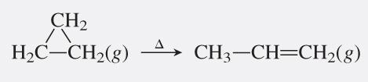
Sample Problem 16.7
Determining the Half-Life of a First-Order Reaction
PROBLEM:
Cyclopropane is the smallest cyclic hydrocarbon. Because its 60º bond angles reduce orbital overlap, its bonds are weak. As a result, it is thermally unstable and rearranges to propene at 1000ºC via the following first-order reaction:
The rate constant is 9.2 s⁻¹, (a) What is the half-life of the reaction? (b) How long does it take for the concentration of cyclopropane to reach one-quarter of the initial value?
0.693
PLAN:
Use the half-life equation, t_{1/2} =
, to find the half-life.
k
One-quarter of the initial value means two half-lives have passed.
SOLUTION:
0.693
(a)
t_{1/2} = = 0.075 s
(b)
2 t_{1/2} = 2(0.075 s) = 0.15 s
9.2 s⁻¹
Notes:
‹#›

Slide 29
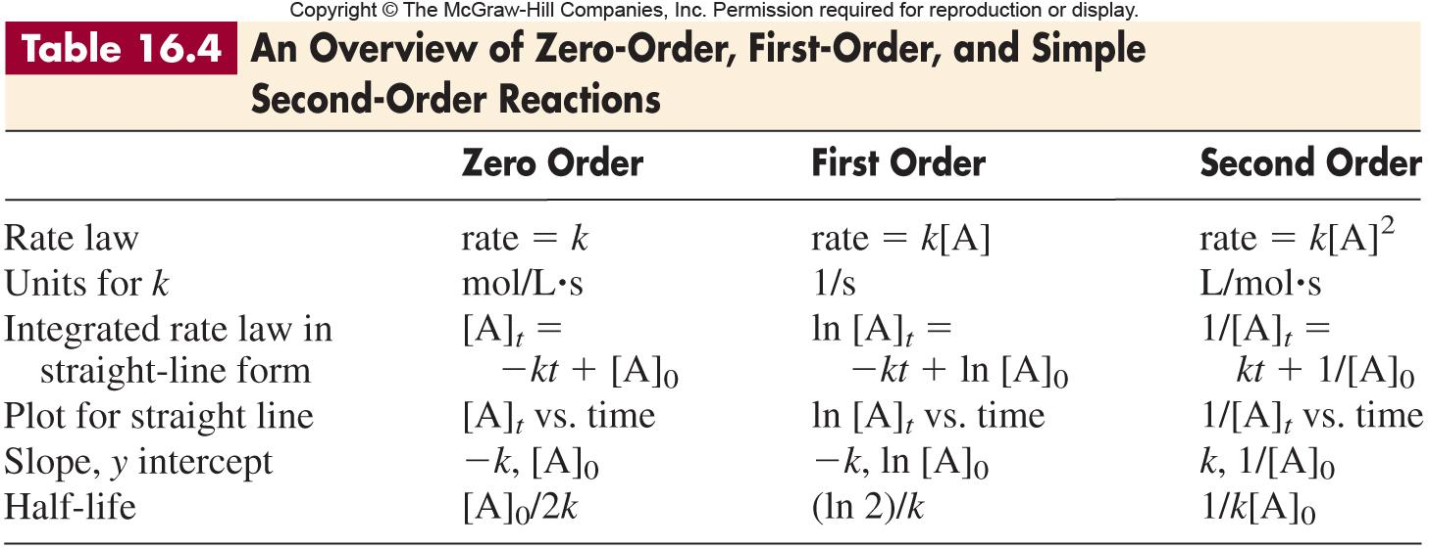
Notes:
‹#›

Slide 30
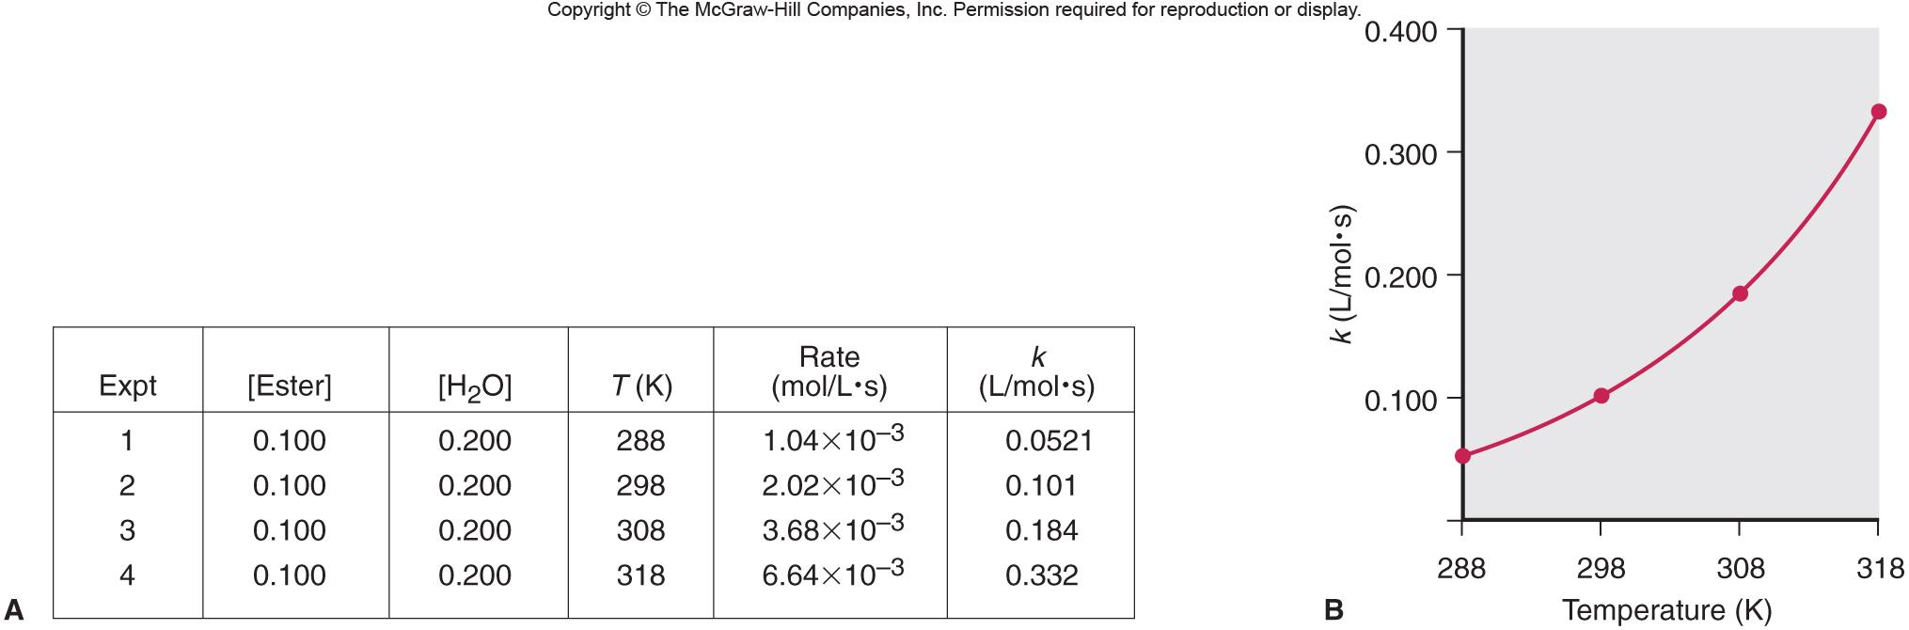
Figure 16.8
Dependence of the rate constant on temperature.
Notes:
‹#›

Slide 31
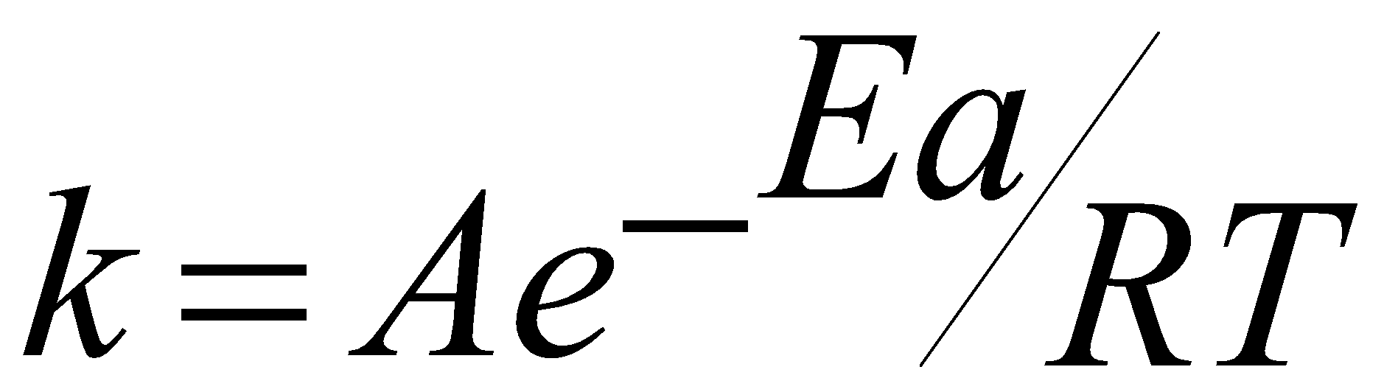
The Effect of Temperature on Reaction Rate
The Arrhenius Equation
where k is the kinetic rate constant at T
E_{a} is the activation energy
R is the universal gas constant
T is the Kelvin temperature
ln k = ln A - E_{a}/RT
A is the collision frequency factor
k₂
E_{a}
1
1
ln
=
-
-
k₁
R
T₂
T₁
Notes:
‹#›

Slide 32
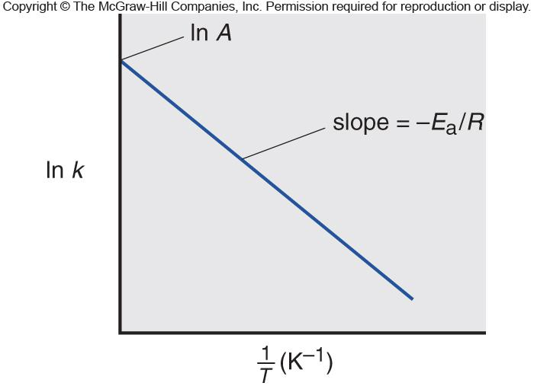
Figure 16.9
Graphical determination of the activation energy.
ln k = -E_{a}/R (1/T) + ln A
Notes:
‹#›

Slide 33
Sample Problem 16.8
Determining the Energy of Activation
PROBLEM:
The decomposition of hydrogen iodide,
2HI(g) H₂(g) + I₂(g)
has rate constants of 9.51 x 10⁻⁹ L/mol•s at 500. K and 1.10 x 10⁻⁵ L/mol•s at 600. K. Find E_{a}.
PLAN:
Use the modification of the Arrhenius equation to find E_{a}.
SOLUTION:
-1
k₂
E_{a}
1
1
k₂
1
1
ln
=
–
–
E_{a} = – R
(ln )
–
k₁
R
T₂
T₁
k₁
T₂
T₁
1.10x10⁻⁵ L/mol∙s
1
1
-1
E_{a} = –(8.314 J/mol∙K)
ln
–
9.51x10⁻⁹ L/mol∙s
600 K
500 K
E_{a} = 1.76 x 10⁵ J/mol = 176 kJ/mol
Notes:
‹#›

Slide 34
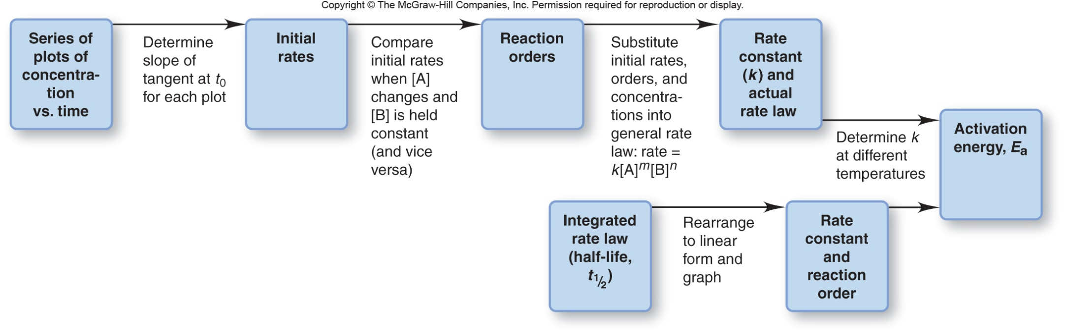
Figure 16.10
Information sequence to determine the kinetic parameters of a reaction.
Notes:
‹#›

Slide 35
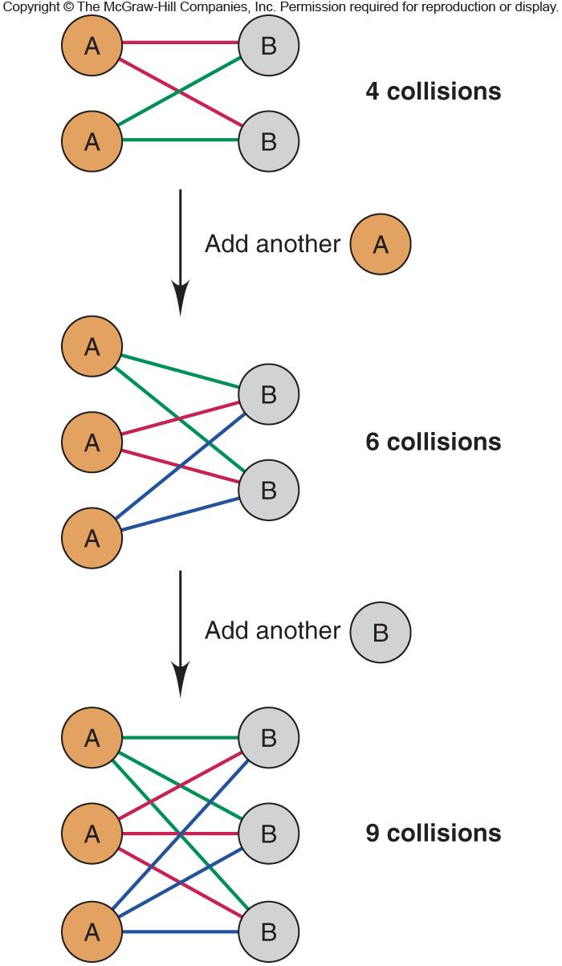
Figure 16.11
The dependence of number of possible collisions on the product of reactant concentrations.
Notes:
‹#›

Slide 36
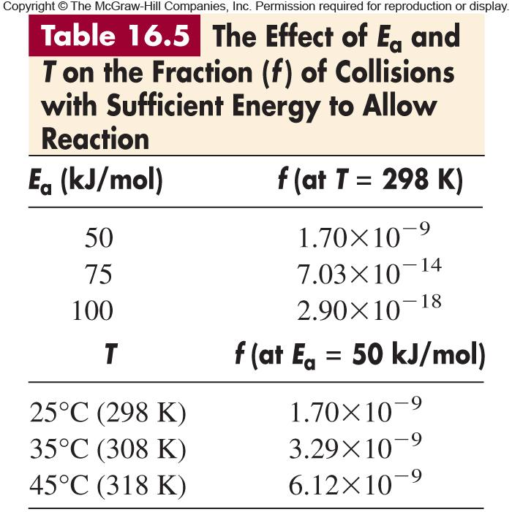
Notes:
‹#›

Slide 37
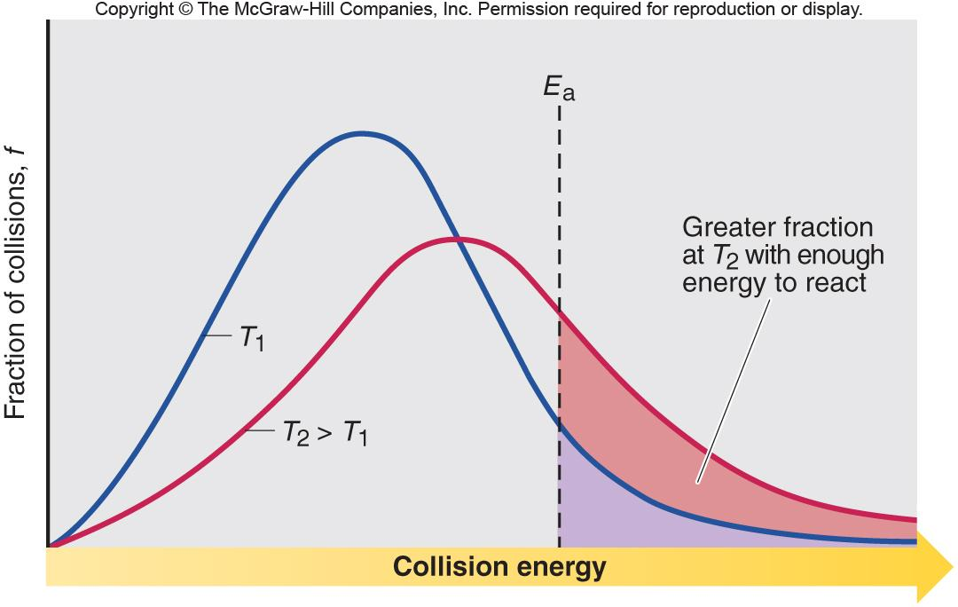
Figure 16.12
The effect of temperature on the distribution of collision energies.
Notes:
‹#›

Slide 38
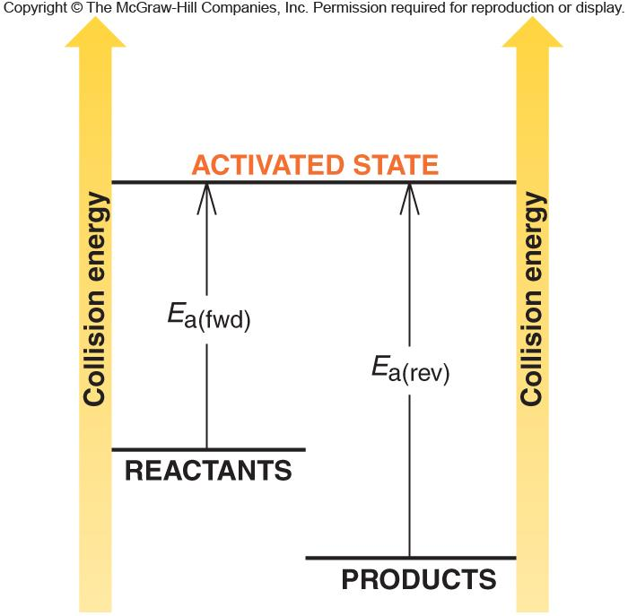
Figure 16.13
Energy-level diagram for a reaction.
The forward reaction is exothermic because the reactants have more energy than the products.
Notes:
‹#›

Slide 39
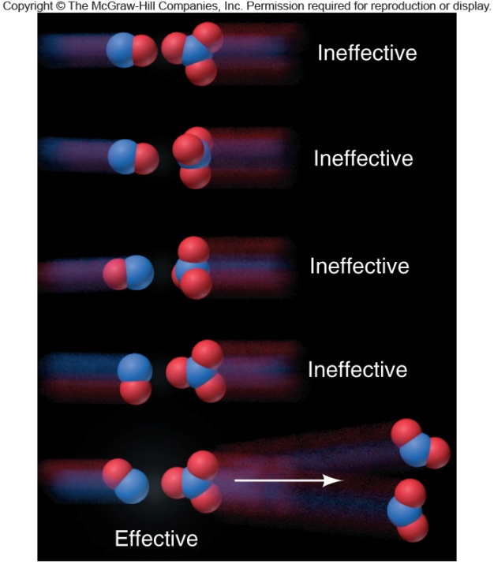
Figure 16.14
The importance of molecular orientation to an effective collision.
NO + NO₃ 2 NO₂
A is the frequency factor
Z is the collision frequency
p is the orientation probability factor
A = pZ where
Notes:
‹#›

Slide 40
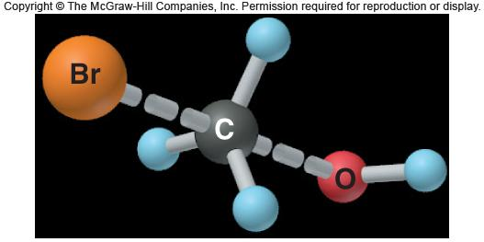
Figure 16.15
Nature of the transition state in the reaction between CH₃Br and OH⁻.
CH₃Br + OH⁻ CH₃OH + Br ⁻
transition state or activated complex
Notes:
‹#›

Slide 41
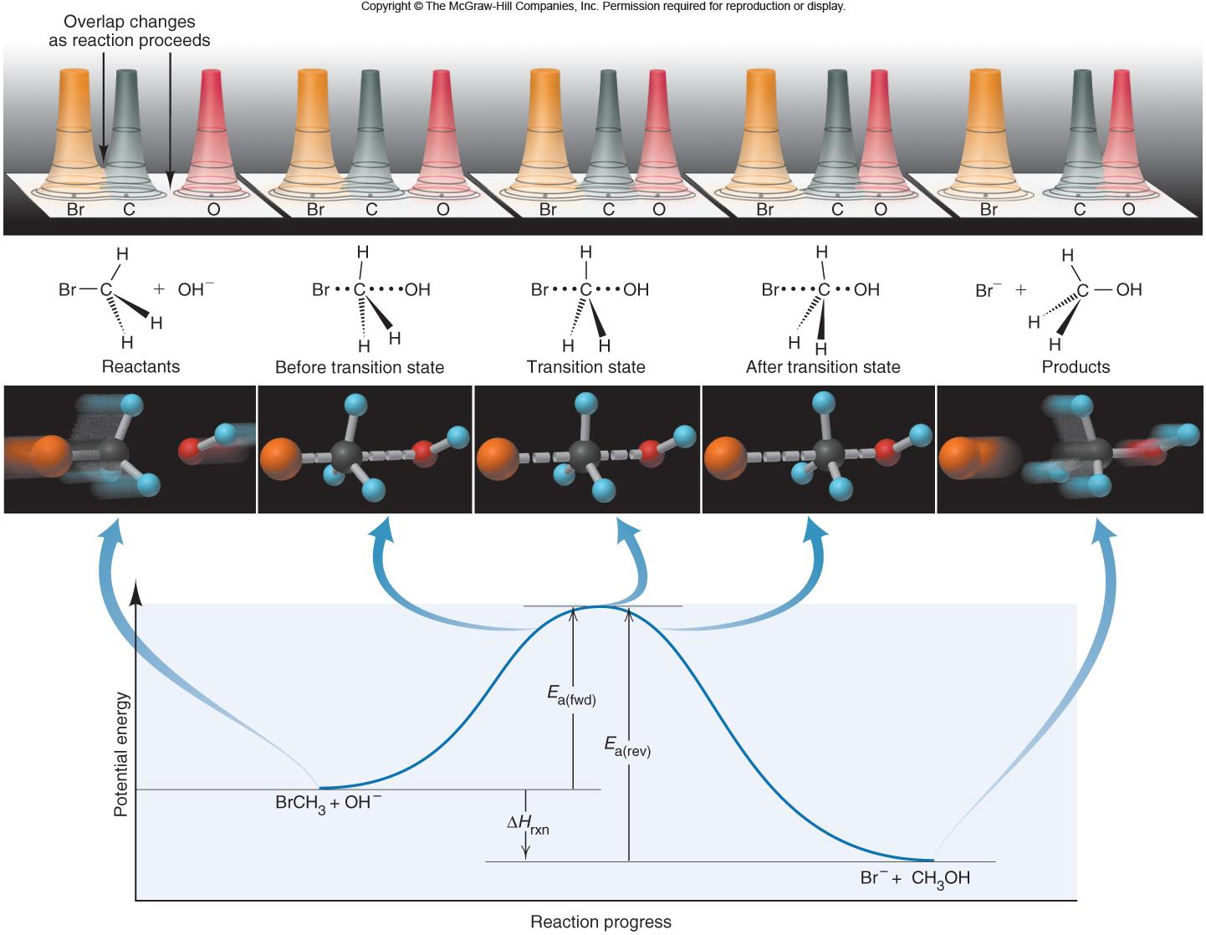
Figure 16.16
Reaction energy diagram for the reaction of CH₃Br and OH⁻.
Notes:
‹#›

Slide 42
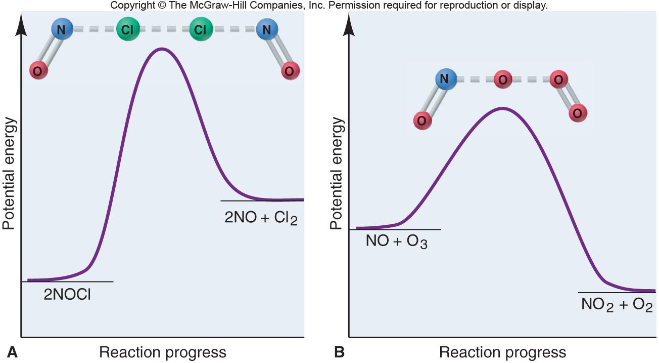
Figure 16.17
Reaction energy diagrams and possible transition states for two reactions.
Notes:
‹#›

Slide 43
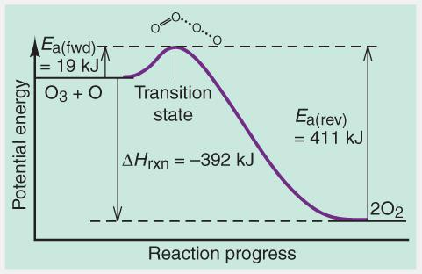
Sample Problem 16.9
Drawing Reaction Energy Diagrams and Transition States
PROBLEM:
A key reaction in the upper atmosphere is
O₃(g) + O(g) 2O₂(g)
The E_{a(fwd)} is 19 kJ, and the ΔH_{rxn} for the reaction is -392 kJ. Draw a reaction energy diagram for this reaction, postulate a transition state, and calculate E_{a(rev)}.
PLAN:
Consider the relationships among the reactants, products, and transition state. The reactants are at a higher energy level than the products and the transition state is slightly higher than the reactants.
SOLUTION:
Notes:
‹#›

Slide 44
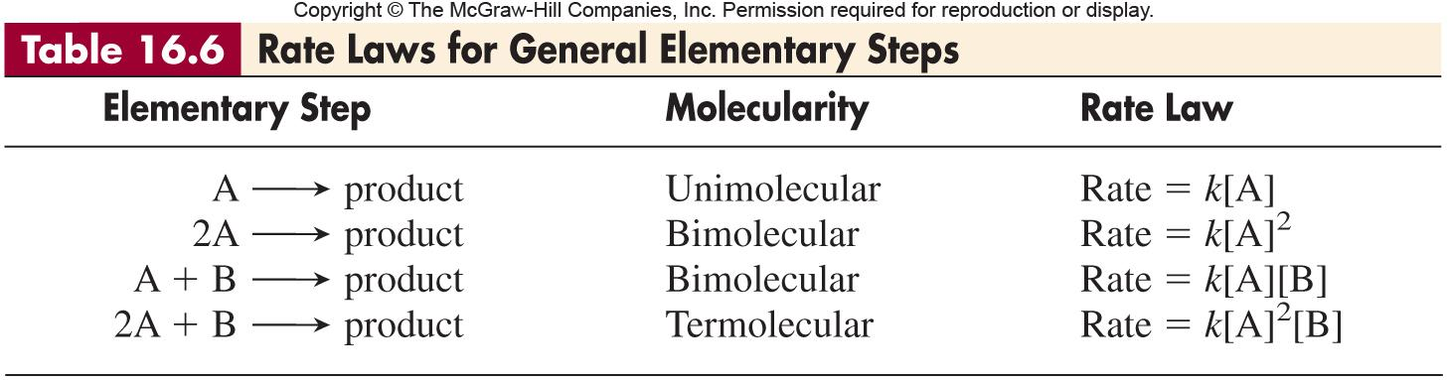
REACTION MECHANISMS
Notes:
‹#›

Slide 45
Sample Problem 16.10
Determining Molecularity and Rate Laws for Elementary Steps
PROBLEM:
The following two reactions are proposed as elementary steps in the mechanism of an overall reaction:
(1)
NO₂Cl(g)
NO₂(g) + Cl (g)
(2)
NO₂Cl(g) + Cl (g)
NO₂(g) + Cl₂(g)
(a) Write the overall balanced equation.
(b) Determine the molecularity of each step.
(c) Write the rate law for each step.
PLAN:
(a) The overall equation is the sum of the steps.
(b) The molecularity is the sum of the reactant particles in the step.
SOLUTION:
(b)
Step (1) is unimolecular.
(a)
(1)
NO₂Cl(g)
NO₂(g) + Cl (g)
Step (2) is bimolecular.
(2)
NO₂Cl(g) + Cl (g)
NO₂(g) + Cl₂(g)
(c)
Rate₁ = k₁ [NO₂Cl]
Rate₂ = k₂ [NO₂Cl][Cl]
2NO₂Cl(g)
2NO₂(g) + Cl₂(g)
Notes:
‹#›

Slide 46
The Rate-Determining Step of a Reaction Mechanism
The overall rate of a reaction is related to the rate of the slowest step, which is the rate-determining step.
Correlating the Mechanism with the Rate Law
The elementary steps must add up to the overall balanced equation.
The elementary steps must be physically reasonable.
The mechanism must correlate with the rate law.
Notes:
‹#›

Slide 47
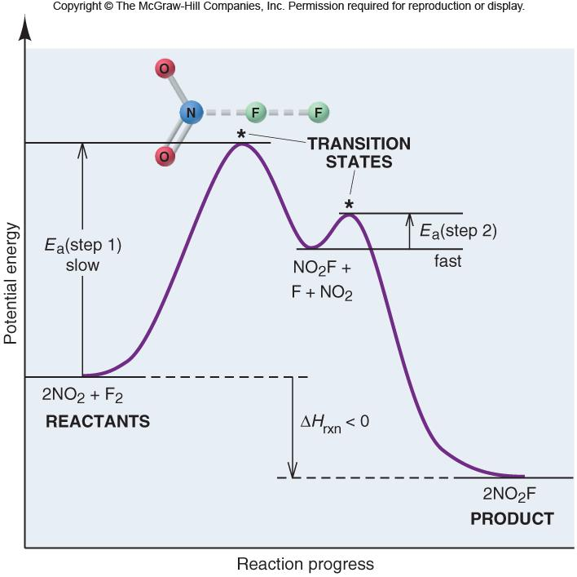
Figure 16.18
Reaction energy diagram for the two-step reaction of NO₂ and F₂.
Notes:
‹#›

Slide 48
CATALYSTS
Each catalyst has its own specific way of functioning.
In general, a catalyst lowers the energy of activation.
Lowering the E_{a} increases the rate constant, k, and
thereby increases the rate of the reaction.
A catalyst increases the rate of the forward and
reverse reactions.
A catalyzed reaction yields the products more quickly,
but does not yield more product than the uncatalyzed
reaction.
A catalyst lowers E_{a} by providing a different mechanism,
for the reaction through a new, lower energy pathway.
Notes:
‹#›

Slide 49
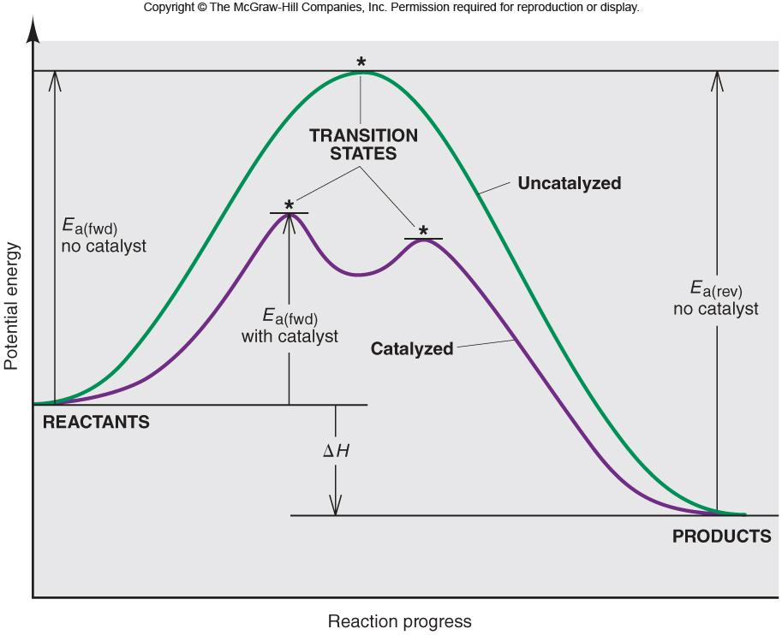
Figure 16.19
Reaction energy diagram for a catalyzed and an uncatalyzed process.
Notes:
‹#›

Slide 50
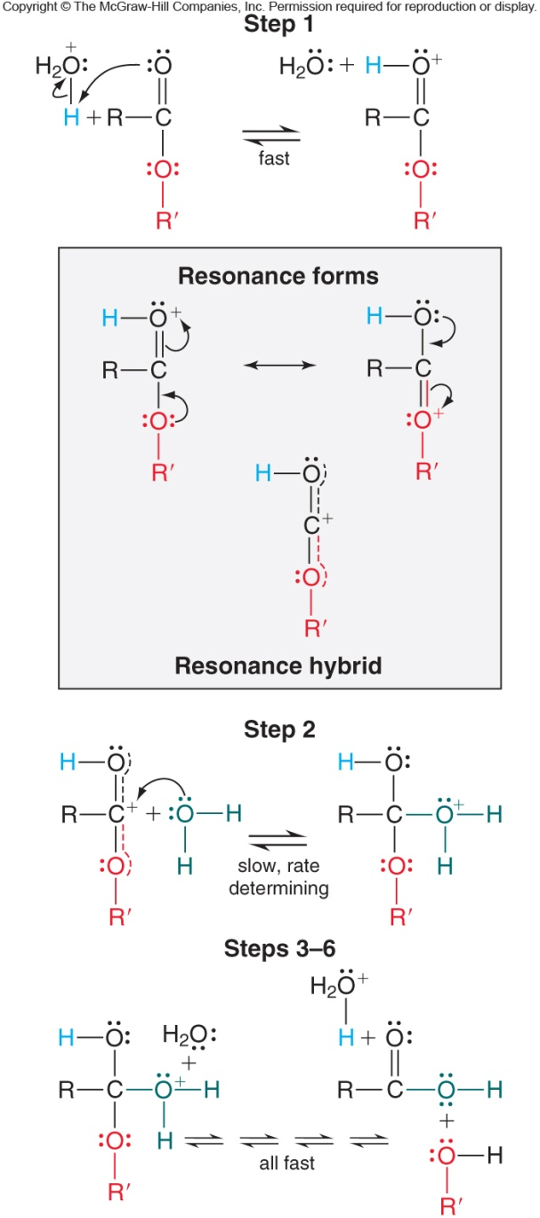
Figure 16.20
Mechanism for the catalyzed hydrolysis of an organic ester.
Notes:
‹#›

Slide 51
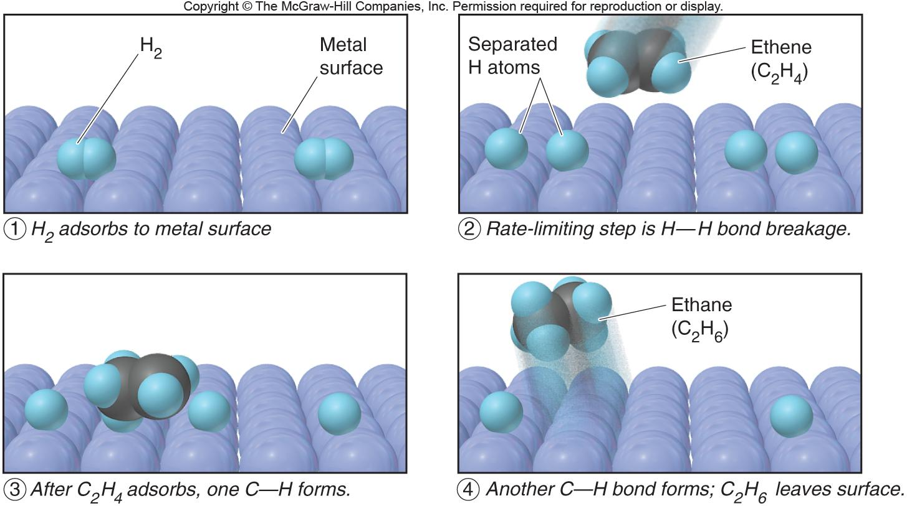
Figure 16.21
The metal-catalyzed hydrogenation of ethylene.
Notes:
‹#›

