Slide 1
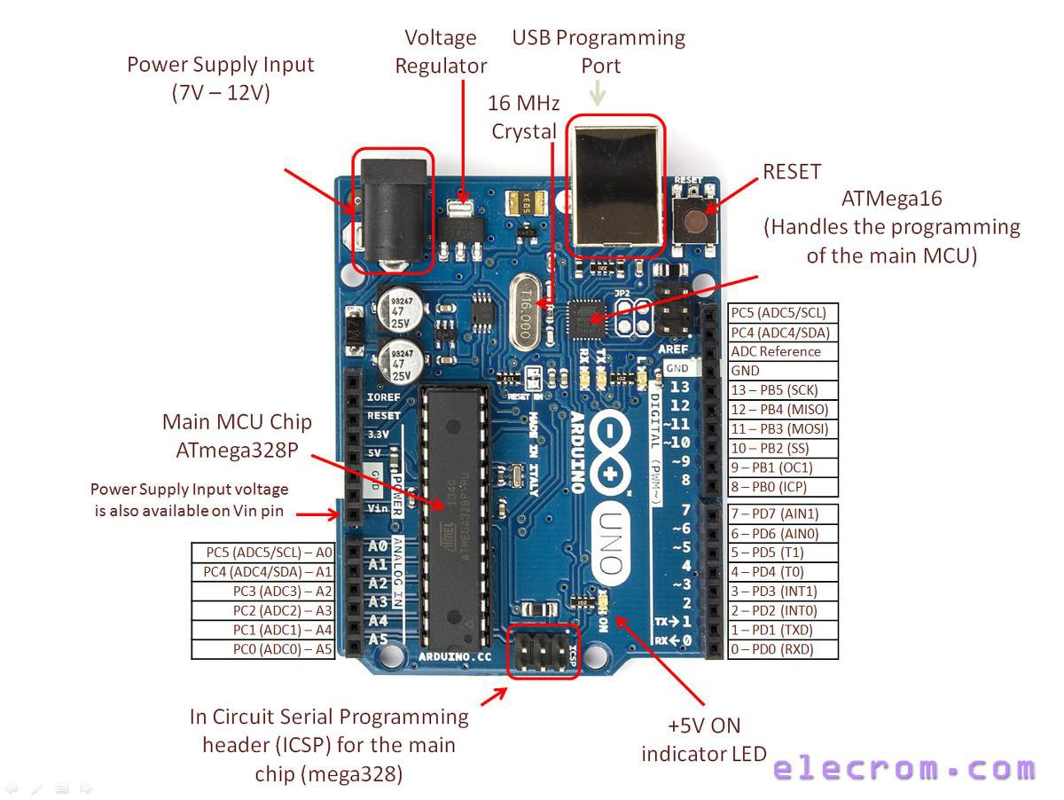
Digital Input/Output
LCD Interfacing
Timers
Interrupts
Distance Measurement
ARDUINO Module
http://www.datasheet39.com/PDF/1057332/ATmega328P-datasheet.html

Slide 2



Arduino
Digital Input/Output

Slide 3
LED connected at pin 13

Slide 4
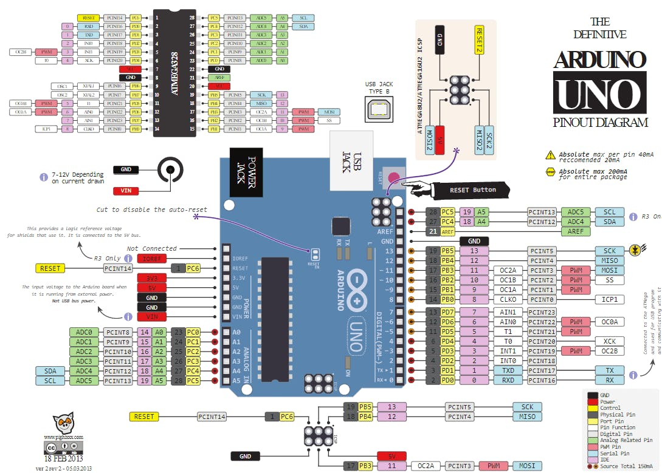

Slide 5
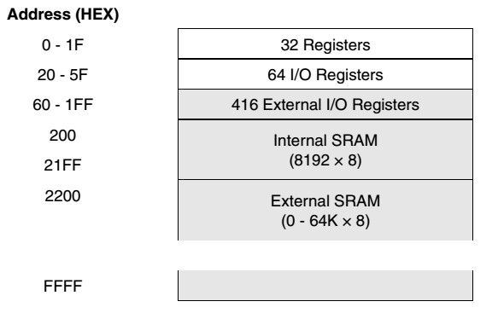
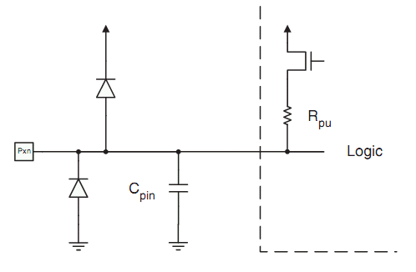
Input / Output
Input/Output ports:
  ATmega 328P (UNO): PORT B, C, D
  ATmega 2560 (MEGA): PORT A, B, C, D, E, F, G, H, J, K, L
PORTA... PORTE can be accessed by dedicated I/O instructions in, out
PORTF … PORTL can be accessed only by ld, st – extended I/O space
Each bit of each port can be configured as either input or output, using the register DDRx
The port can be written using register PORTx
The state of the input port’s pins can be read from PINx
Each pin has static electricity protection diodes
Each pin has a “pull up” resistor that can be activated or deactivated by logic (program)
https://web.stanford.edu/class/archive/engr/engr40m.1178/slides/arduino.pdf

Slide 6
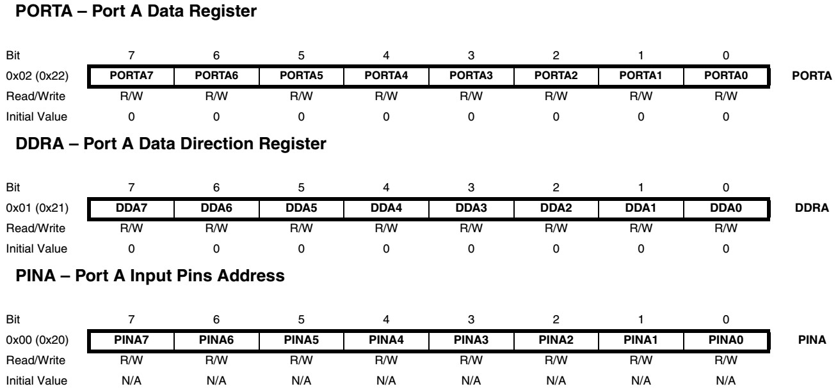
Input / Output ports
Three I/O memory address locations are allocated for each port x (A… L):
Data Register – PORTx,
Data Direction Register – DDRx
Port Input Pins – PINx
Example (PORTA):
Notation: PORTxn = pin n of PORTx (ex: PORTB3 - bit no. 3 in Port B).

Slide 7
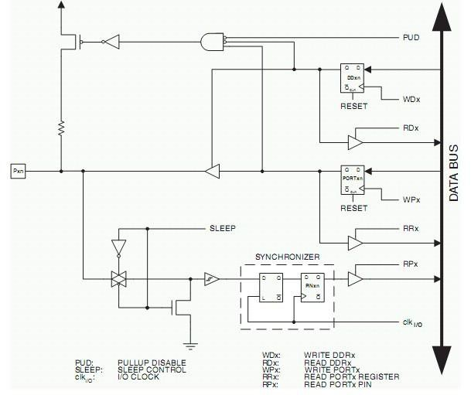
An I/O pin
Internal structure of one I/O pin (one bit of an I/O port)
Direction control
Output data
Input data

Slide 8

An I/O pin
Output configuration
‘1’
Direction bit = 1
Data written on PORTx are sent to the external pin

Slide 9



An I/O pin
Input configuration
‘0’
Direction bit = 0
A ‘1’ written to PORTx activates the pull up resistor
The data on the external pin can be read as PINx

Slide 10
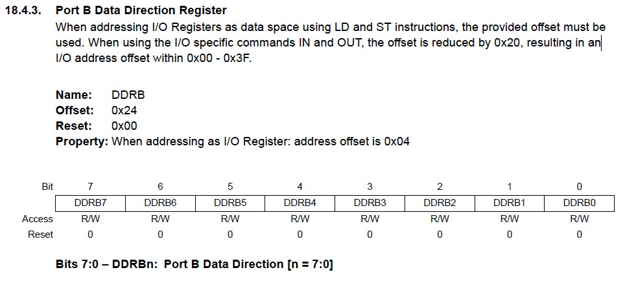

Slide 11
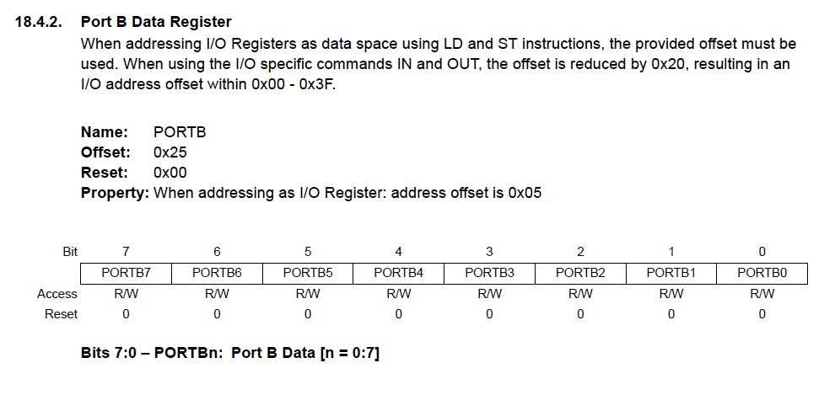

Slide 12
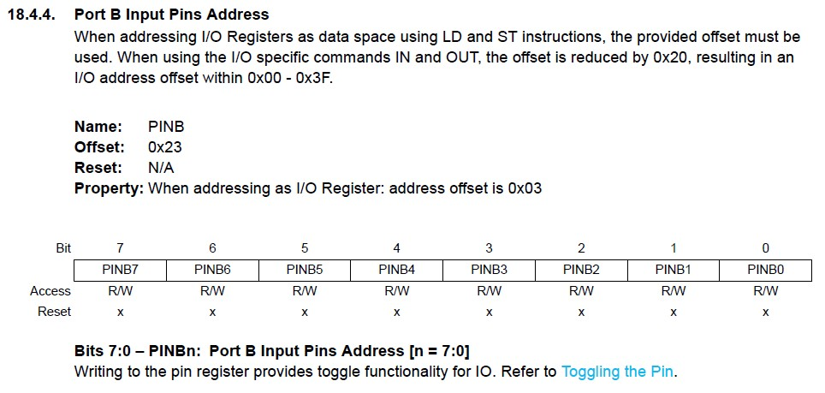
10

Slide 13
pinMode
pinMode(pin, mode)
pin: the number of the pin whose mode you wish to set
mode: INPUT, OUTPUT, or INPUT_PULLUP.
https://www.instructables.com/Beginning-Arduino-Ports-Pins-and-Programming/
‹#›

Slide 14
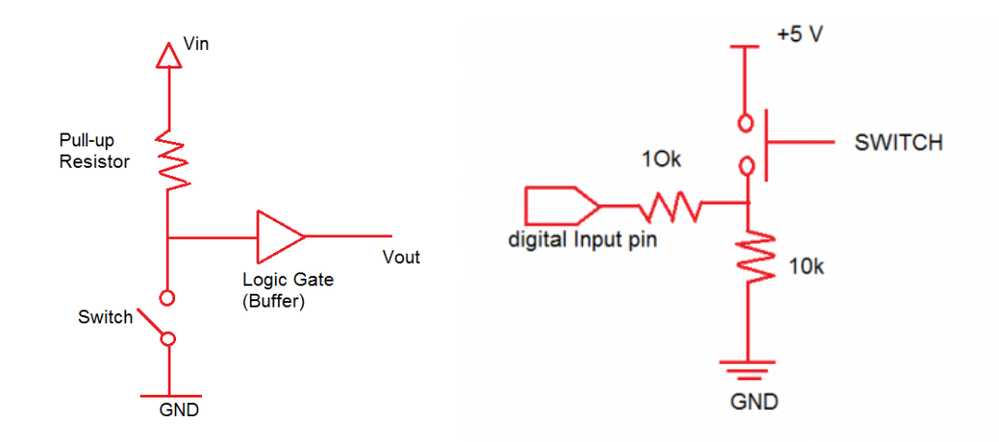
External pull-up and pull-down resistors

Slide 15
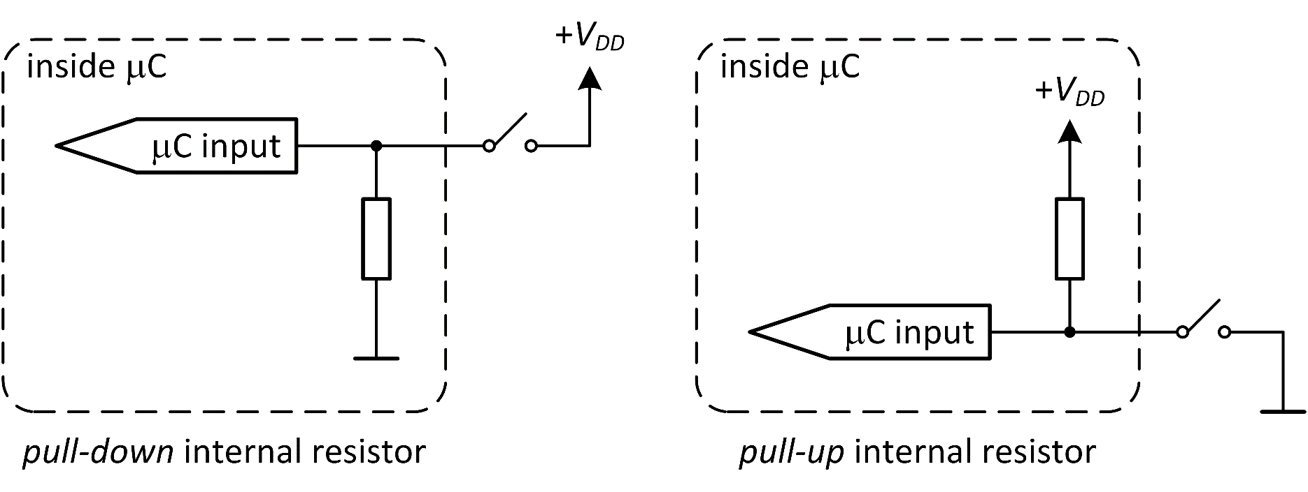
Internal pull-up and pull-down resistors
Note: in Arduino we have just built-in pull-up resistor.
pinMode(buttonPin, INPUT_PULLUP);

Slide 16
void setup() { Serial.begin(9600); pinMode(2, INPUT_PULLUP);
pinMode(13, OUTPUT);
}
void loop() {
int sensorVal = digitalRead(2); Serial.println(sensorVal);
if (sensorVal == HIGH) { digitalWrite(13, LOW);
} else {
digitalWrite(13, HIGH);
}
}
‹#›

Slide 17
Example
void setup() {
DDRB=0xFF; //ALL pins are output
}
void loop() {
PORTB=0xFF; // all pins are ON delay(1000);
PORTB=0x00; //all pins are OFF
delay(1000);
}
‹#›

Slide 18
Explain the following code?
byte x;
PORTB = (1<<PB7)|(1<<PB6)|(1<<PB1)|(1<<PB0); DDRB = (1<<DDB3)|(1<<DDB2)|(1<<DDB1)|(1<<DDB0); x= PINB;
PORTB = (1<<PB7)|(1<<PB6)|(1<<PB1)|(1<<PB0);
1<<PB7: This shifts the binary digit 1, seven positions to the left. It effectively sets the 8th bit (PB7) to 1 and leaves the rest as 0. (1<<PB7) = 0b10000000.;
1<<PB6: This shifts the binary digit 1, six positions to the left. It sets the 7th bit (PB6) to 1 and leaves the rest as 0. (1<<PB6) = 0b01000000;
The | operator is a bitwise OR operation. When you use it between these expressions, it combines them. So, the overall effect is that bits PB7, PB6, PB1, and PB0 in the PORTB register are set to 1.
PORTB = (1<<PB7)|(1<<PB6)|(1<<PB1)|(1<<PB0);
0b11000011;
‹#›

Slide 19
Masking Summery
Operator | 1 | 0
AND & | Leave unchanged | Set to 0
OR | | Set to 1 | Leave unchanged
XOR ˄ | Toggle | Leave unchanged
Example:
PORTD &= 0b11011111; // set PD5 low, leave others unchanged
PORTD |= 0b00100000; // set PD5 high, leave others unchanged
PORTD ^= 0b00100000; // toggle PD5, leave others unchanged
To Do:
Build a circuit with 4 LEDs connected for port D
Write a code using Masking such that:
-One LED is always ON
-One LED is always OFF
-One LED blinks every 0.5 Hz
-One LED blinks every 1 Hz
Notes:
To Do:

Slide 20
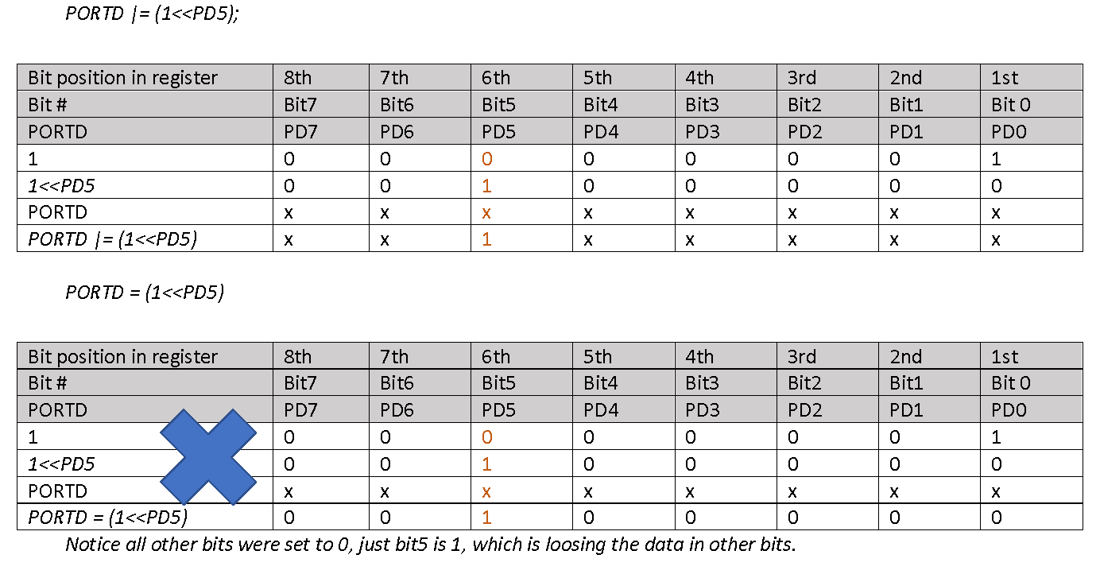

Slide 21
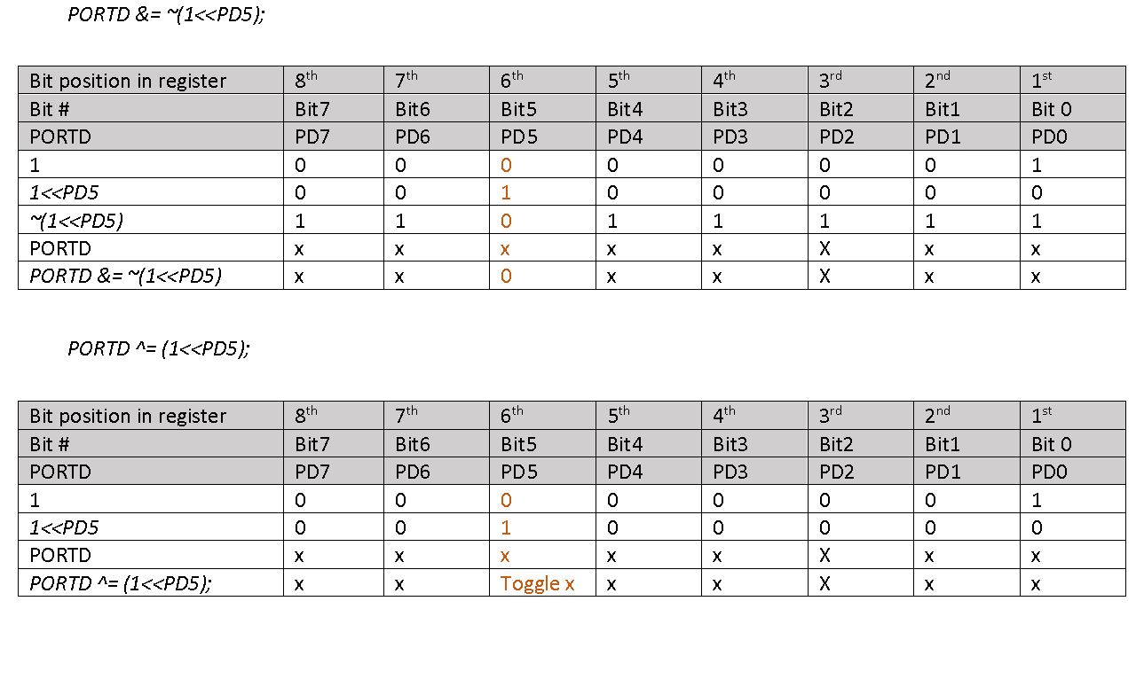

Slide 22
PORTB = (1<<PB2)|(1<<PB5); //Put Port B bit 2 and 5 HIGH and set other bits 0
DDRD = (1<<PD5)|(1<<PD6)|(1<<PD7);
// put PortD bit 5, 6 and 7 HIGH as output
PORTB |= (1<<PB5); //Put Port B bit 5 HIGH while leaving other bits unchanged
PORTD |= (1<<PD5);
// Put PortD bit 5 ( HIGH while leaving other bits unchanged
PORTD &= ~(1<<PD5);
// Put PortD bit 5 LOW while leaving other bits unchanged
PORTD = PORTD & ~(1<<PD6) & ~(1<<PD7);
// Put PortD bit 6 and 7 LOW while leaving other bits unchanged
Bitwise XOR (^)
PORTD ^= (1<<PD6);
// Toggle PortD bit 6 while leaving other bits unchanged
PORTD = PORTD ^ (1<<PD5) ^ (1<<PD6) ^ (1<<PD7);
//Toggle PortD bit 5, 6 and 7 while leaving other bits unchanged

Slide 23
Liquid Crystal Display (LCD)

Slide 24
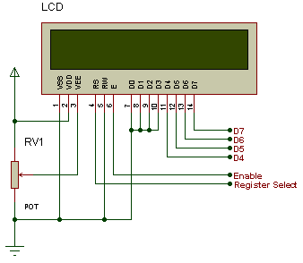
LCD in 4-bit mode,

Slide 25
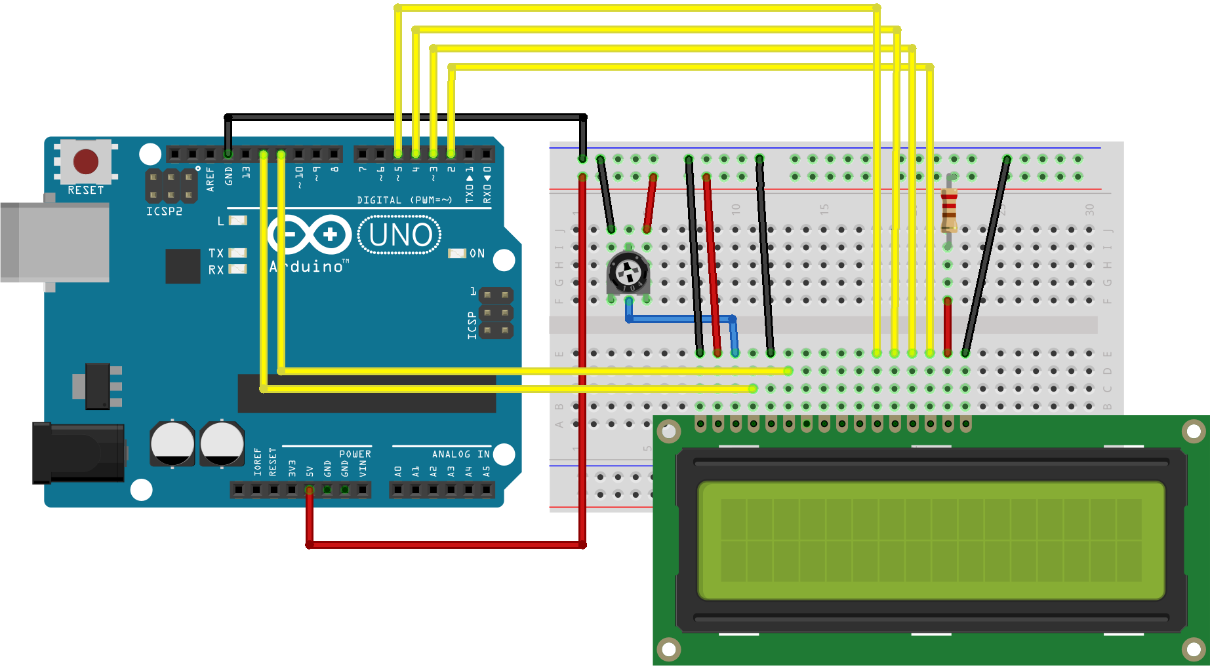

Slide 26
EN Line
The EN line is called "Enable." This control line is used to tell the LCD that you are sending it data. To send data to the LCD, your program should make sure this line is low (0) and then set the other two control lines and/or put data on the data bus. When the other lines are completely ready, bring EN high
(1) and wait for the minimum amount of time required by the LCD datasheet (this varies from LCD to LCD), and end by bringing it low
(0) again.

Slide 27
RS Line
The RS line is the "Register Select" line. When RS is low (0), the data is to be treated as a command or special instruction (such as clear screen, position cursor on a particular cell, etc.). When RS is high (1), the data being sent is text data which should be displayed on the screen. For example, to display the letter "T" on the screen you would set RS high.

Slide 28
RW Line
The RW line is the "Read/Write" control line. When RW is low (0), the information on the data bus is being written to the LCD. When RW is high (1), the program is effectively querying (or reading) the LCD. Only one instruction ("Get LCD status") is a read command. All others are write commands. So RW will almost always be low.

Slide 29
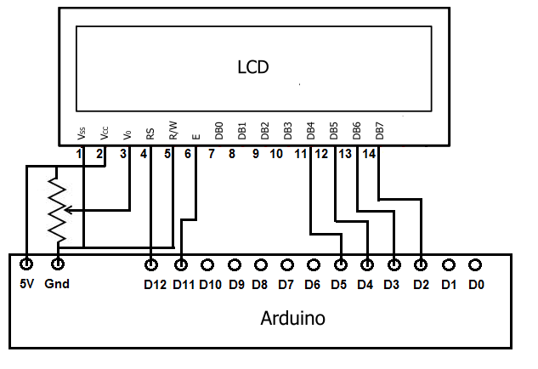
Connections

Slide 30
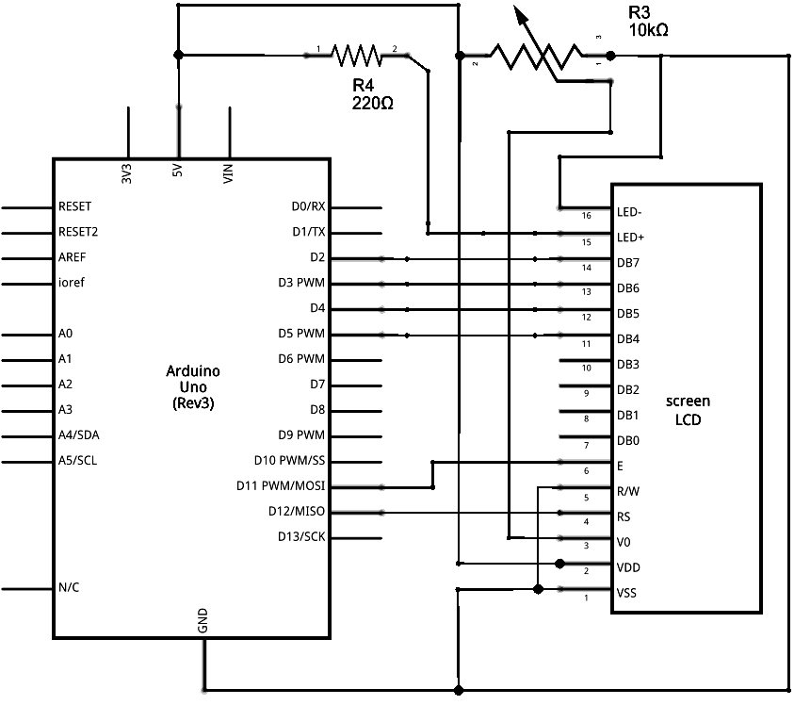
https://www.arduino.cc/en/Tutorial/LibraryExamples/LiquidCrystalDisplay

Slide 31
Example
#include <LiquidCrystal.h>
const int rs = 12, en = 11, d4 = 5, d5 = 4, d6 = 3, d7 = 2; LiquidCrystal lcd(rs, en, d4, d5, d6, d7);
void setup() {
// set up the LCD's number of columns and rows: lcd.begin(16, 2);
// Print a message to the LCD. lcd.print("ENCS438:2018"); }
void loop() {
// set the cursor to column 0, line 1
// (note: line 1 is the second row, since counting begins with 0): lcd.setCursor(0, 1);
// print the number of seconds since reset: lcd.print(millis() / 1000);
}

Slide 32
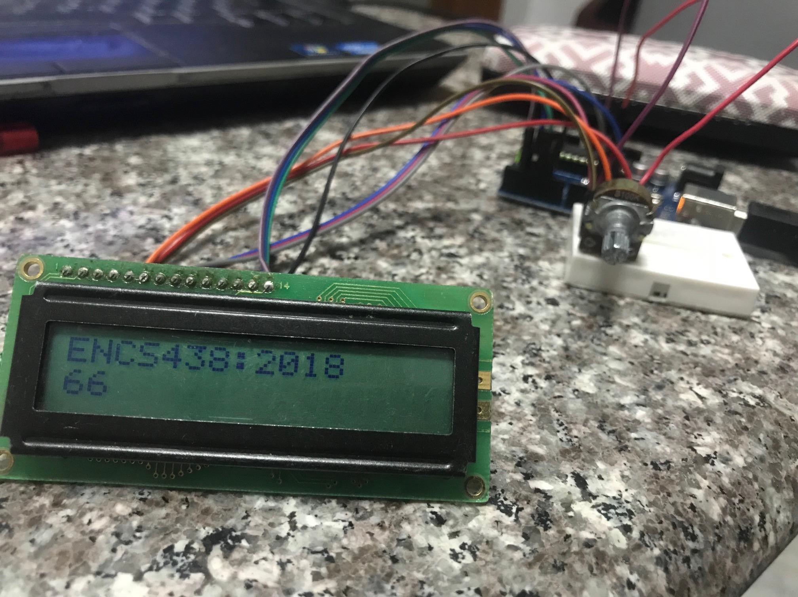
y .
\ % ; .\
\
- : ,

Slide 33
Timers and Software Interrupts

Slide 34
Timing events with Arduino
Delay functions
delay(unsigned long ms) - Pauses the program for the amount of time
(in miliseconds) specified as parameter.
delayMicroseconds(unsigned int us) – Pauses the program for the amount of time (in microseconds) specified as parameter
Example1: http://arduino.cc/en/Reference/Delay
int ledPin = 13; void setup()
{
pinMode(ledPin, OUTPUT);
}
// LED connected to digital pin 13
// sets the digital pin as output
void loop()
{
digitalWrite(ledPin, HIGH); delay(500); digitalWrite(ledPin, LOW); delay(500);
}
// sets the LED on
// waits for half second
// sets the LED off
// waits for half second

Slide 35
Timing events with Arduino
Delay functions
delay(unsigned long ms) - Pauses the program for the amount of time
(in miliseconds) specified as parameter.
http://arduino.cc/en/Reference/Delay
The use of delay() in a sketch has significant drawbacks:
•No other reading of sensors, mathematical calculations, or pin manipulation can go on during the delay function ⇒ brings most other activity to a halt.
•For alternative approaches to controlling timing see the millis() function
•Avoid the use of delay() for timing of events longer than 10's of milliseconds unless the Arduino sketch is very simple.
Certain things do go on while the delay() function is controlling the ATmega chip however, because the delay function does not disable interrupts:
•Serial communication that appears at the RX pin is recorded
•PWM (analogWrite) values and pin states are maintained,
•interrupts will work as they should.

Slide 36
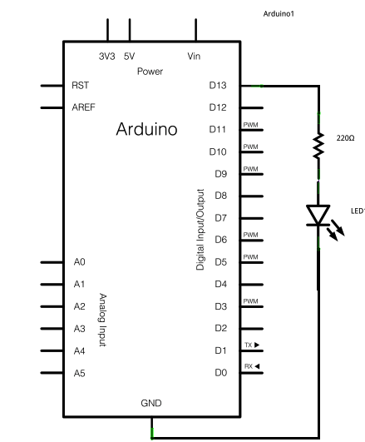
Timing events with Arduino
Time reading functions
unsigned long millis() – returns the no. of milliseconds since the Arduino board began running the current program. This number will overflow (go back to zero), after approximately 50 days.
unsigned long micros() – returns the no. of microseconds since the Arduino board began running the current program. This number will overflow (go back to zero), after approximately 70 minutes. On 16 MHz Arduino boards (e.g. Uno, Mega), this function has a resolution of 4 us (i.e. the value returned is always a multiple of 4 us).
Example 2: http://arduino.cc/en/Tutorial/BlinkWithoutDelay - How to blink the LED without using delay().
Keeps track of the last time the Arduino turned the LED on or off.
Each time through loop(), it checks if a long enough interval has passed.
If it has, it toggles the LED on or off.
Other code can run at the same time without being interrupted by the LED code !
Arduino UNO/MEGA have an on the board LED
attached to pin 13, so no hardware is needed for this example !

Slide 37
Timing events with Arduino
Example 2: Blink without Delay - http://arduino.cc/en/Tutorial/BlinkWithoutDelay
// constants won't change. Used here to set pin numbers:
const int ledPin = 13; // the number of the LED pin
: int ledState = LOW; long previousMillis = 0;
// ledState used to set the LED (2 bytes: http://arduino.cc/en/Reference/Int)
// will store last time LED was updated (4 bytes: http://arduino.cc/en/Reference/Long)
long interval = 1000;
// interval at which to blink (milliseconds)
void setup() { pinMode(ledPin, OUTPUT);
}
// set the digital pin as output:
void loop() // here is where you'd put code that needs to be running all the time.
{
unsigned long currentMillis = millis(); // current time
// check if it's time to blink the LED: (current_time – last_time) > the interval at which you want to blink the LED
if(currentMillis - previousMillis > interval)
{
previousMillis = currentMillis; // save the last time you blinked the LED
if (ledState == LOW) ledState = HIGH;
else
ledState = LOW;
// toggle LED status
// set the LED with the ledState of the variable:
digitalWrite(ledPin, ledState);
}
}

Slide 38
Timing events with Arduino
Example 3: Arduino Multitasking – 2 LEDs, each switched every 1s with a 0.5s
delay between (http://www.baldengineer.com/blog/2011/01/06/millis-tutorial/)
long sequenceDelay = 500; long flashDelay = 1000;
// seed / offset for the 2-nd LED toggle (defazaj temporal !!!)
// LED Flash period
boolean LED13state = false; boolean LED12state = false; long waitUntil13 = 0;
long waitUntil12 = sequenceDelay; void setup() {
pinMode(13, OUTPUT); pinMode(12, OUTPUT);
}
void loop() {
digitalWrite(13, LED13state); digitalWrite(12, LED12state);
// LEDs on pin 13 and 12 (initially both OFF)
// First LED lit-on immediately
// 2-nd LED with a 0.5 sec delay (offset added to the absolute time)
// each iteration of loop() will set the IO pins,
// check the time for the 1-st LED
// if time elapsed toggle the status of the 1-st LED
// next toggle time = current time + 1000 ms
if (millis() >= waitUntil13) { LED13state = !(LED13state); waitUntil13 += flashDelay;
}
// keep in mind, waitUntil12 was already seeded with a value of 500 ms
if (millis() >= waitUntil12) { LED12state = !(LED12state); waitUntil12 += flashDelay;
// check the time for the 2-nd LED
// if time elapsed toggle the status of the 2-nd LED
}

Slide 39
Timing events with Arduino
TIMER library for synchronization and timing
http://playground.arduino.cc/Code/Timer
Metods:
•int every(long period, callback): runs function ‘callback’ at regular time intervals (period [ms])
•int every(long period, callback, int repeatCount): runs function ‘callback’ at regular time intervals (‘period’ [ms]) for a limited no of times: ‘repeatCount’
•int after(long duration, callback): runs function ‘callback’ after a time interval (‘duration’ [ms])
•int oscillate(int pin, long period, int startingValue): signal generation – changes the status of ‘pin’ after each ‘period’ [ms]. Initial pin state in ‘startingValue’ (HIGH or LOW).
•int oscillate(int pin, long period, int startingValue, int repeatCount): changes the status of ‘pin’ after each ‘period’ [ms] for a no. of ‘repeatCount’ times.
•int pulse(int pin, long period, int startingValue): changes the status of ‘pin’ once, after ‘period’ [ms]. Initial pin state in ‘startingValue’ (HIGH or LOW).
•int stop(int id): All the functions above are returning an ‘id’ for the programmed
event. Use this function to stop the event (id). Max events / timer = 10.
•int update(): must be called in the main loop to update the status of the Timer object !

Slide 40
Timing events with Arduino
Example 4: generating a long pulse without blocking the system
http://www.doctormonk.com/2012/01/arduino-timer-library.html
// Classic approach (delay)
// Timer based approach
void setup()
{
pinMode(13, OUTPUT); digitalWrite(pin, HIGH); delay(10 * 60 * 1000); digitalWrite(pin, LOW);
}
#include "Timer.h"
Timer t;
// declare the Timer object
int pin = 13;
void setup()
{
pinMode(pin, OUTPUT);
// 10 minutes pulse, initial value HIGH t.pulse(pin, 10 * 60 * 1000, HIGH);}
void loop()
{
}
void loop()
{
t.update(); // update timer object
// the update function call duration is us
The disadvantage of the delay approach is that nothing else can go on while the 'delay'
is happening. You cannot update a display, or check for key presses for example.
// insert other processing here: i.e display,
// sensor input, actuators control etc.
}

Slide 41
Timing events with Arduino
Example 5: Usage of 2 timer events - One to flash a LED (oscillating signal) and another that reads analog input A0 and displays the result in the Serial Monitor. http://www.doctormonk.com/2012/01/arduino-timer-library.html
#include "Timer.h"
Timer t;
int pin = 13;
// declare the Timer object
// LED pin (flash event)
void setup()
{
Serial.begin(9600); pinMode(pin, OUTPUT); t.oscillate(pin, 100, LOW); t.every(1000, takeReading);
}
// init. serial communication
// configure pin
// init. oscillating signal (100 ms)
// at every 1000 ms call function takeReading()
void loop()
{
t.update();
}
// update timer object – compulsory for timer functioning
void takeReading()
{
Serial.println(analogRead(0));
// function called every 1000 ms (1 Hz)
// send on the serial link the value red from the analogue pin 0
// analogRead(pin) - returns a digital value (0 to 1023) obtained by converting
// the input voltage (0 .. 5V) using the ADC
}

Slide 42
Timing events with Arduino
Example 6: stopping an event
Write to the serial monitor every 2 seconds(tickEvent), flash the LED(ledEvent) fast and after 8 seconds(afterEvent), stops the LED flashing fast, and flash it 10 times slowly. http://www.doctormonk.com/2012/01/arduino-timer-library.html
#include "Timer.h"
Timer t;
int tickEvent, ledEvent, afterEvent, ledEventNew;
// events IDs
void setup()
{
Serial.begin(9600);
tickEvent = t.every(2000, doSomething); Serial.print("2 second tick started id="); Serial.println(tickEvent);
// init serial comm.
// call doSomething every 2 sec.
// write the ID(tickEvent) on serial interface
pinMode(13, OUTPUT);
ledEvent = t.oscillate(13, 50, HIGH); Serial.print("LED event started id="); Serial.println(ledEvent);
// start ledEvent (LED flashing) - 20 Hz toggle
// write the ID(ledEvent) on serial interface
afterEvent = t.after(8000, doAfter); Serial.print("After event started id="); Serial.println(afterEvent);
// schedule doAfter execution, after 10 sec.
// write the ID(ledEvent) on serial interface
}

Slide 43
Timing events with Arduino
Example 6: stopping an event - continued
Write to the serial monitor every 2 seconds(tickEvent), flash the LED(ledEvent) and after 8 seconds(afterEvent), stop the LED flashing fast, and flash it 10 times slowly. http://www.doctormonk.com/2012/01/arduino-timer-library.html
void loop()
{
t.update();
}
// update timer object – compulsory
void doSomething()
{
Serial.print("2 second tick: millis()="); Serial.println(millis());
}
// Called every 2 sec.
// send current time [ms]
// on the serial interface
void doAfter()
{
Serial.println("stop the led event"); t.stop(ledEvent);
ledEventNew = t.oscillate(13, 500, HIGH, 5); Serial.print(“New LED event started id="); Serial.println(ledEventNew);
}
// called after 10 sec. / once
// Stops the initial 20 Hz oscillation of the LED
// Starts a new oscillation (2 Hz toggle / 5 times)
// write the ID(ledEventNew) on serial interface

Slide 44
Signal generation
Variable frequency and fixed duty cycle (50%): tone() function
tone(pin, frequency) – generates a signal with ‘frequency’ on ‘pin’
tone(pin, frequency, duration) – generates a signal with ‘frequency’ on ‘pin’ in a limited time period: ‘duration’ [ms]
noTone(pin) stops the signal generation on ‘pin’.
Only one pin at a time can generate a signal using tone function. To generate a tone signal on another pin you should stop any active tone: noTone(activePin)
For some Arduino boards, the tone function/generation can alter PWM signal
generation !
No output pin setup is required.

Slide 45
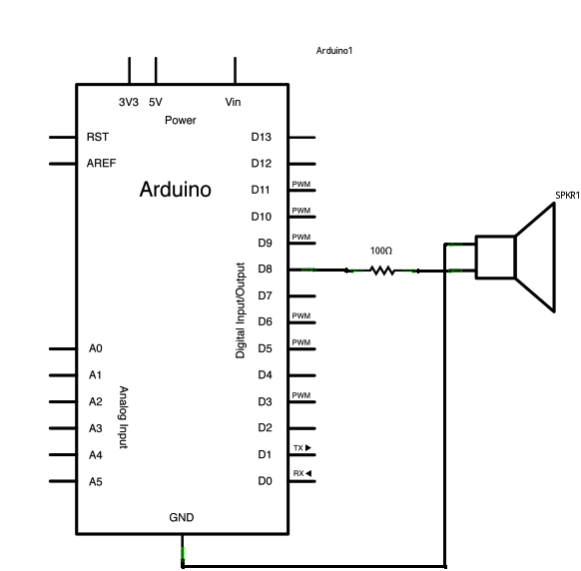
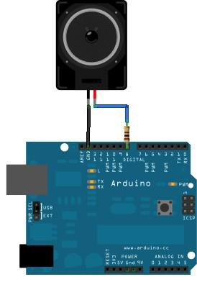
Signal generation
Example 8: Play a Melody using the tone() function
http://arduino.cc/en/Tutorial/Tone

Slide 46
Play a sound
void setup() {
// put your setup code here, to run once:
}
void loop() {
// put your main code here, to run repeatedly: tone(11,500);
}
14

Slide 47
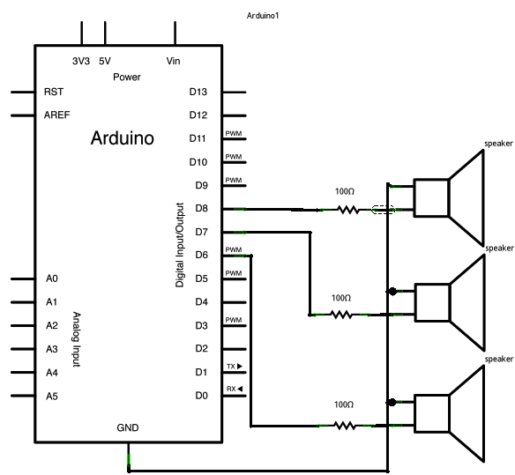
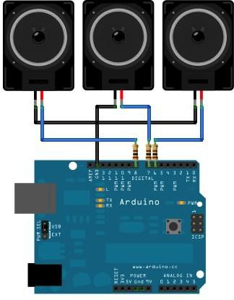
Signal generation
Example 9: Playing tones on Multiple outputs using the tone() function
http://arduino.cc/en/Tutorial/Tone4

Slide 48
Signal generation
Example 9: Playing tones on Multiple outputs using the tone() function
http://arduino.cc/en/Tutorial/Tone4
Only one pin at a time can generate a signal using tone function. Ton is generated / cycled over the 3 different pins in a sequential order !!!
void setup() { } void loop() {
noTone(8); tone(6, 440, 200);
delay(200);
// turn off tone function for pin 8
// play a note on pin 6 for 200 ms
noTone(6);
tone(7, 494, 500);
delay(500);
// turn off tone function for pin 6
// play a note on pin 7 for 500 ms
noTone(7); tone(8, 523, 300);
delay(300);
// turn off tone function for pin 7
// play a note on pin 8 for 500 ms
}

Slide 49
Motion Detection and Hardware Interrupts

Slide 50
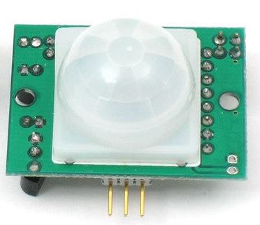
Motion Detection: PIR sensors
Output (applied to output signal pin):
Digital pulse high (3V) when triggered (motion detected) digital low when idle (no motion detected).
"Passive Infrared", "Pyroelectric", or "IR
motion" sensors.

Slide 51
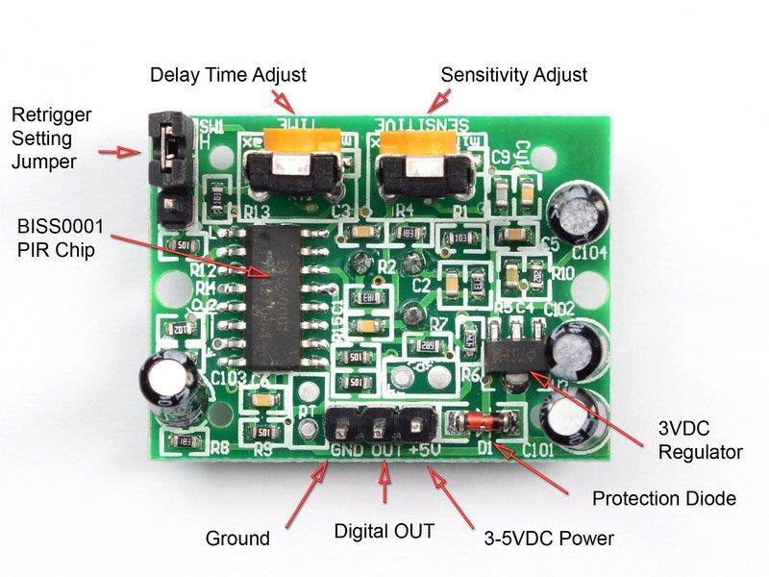
The signal duration and distance can be adjusted by the yellow potentiometer.

Slide 52
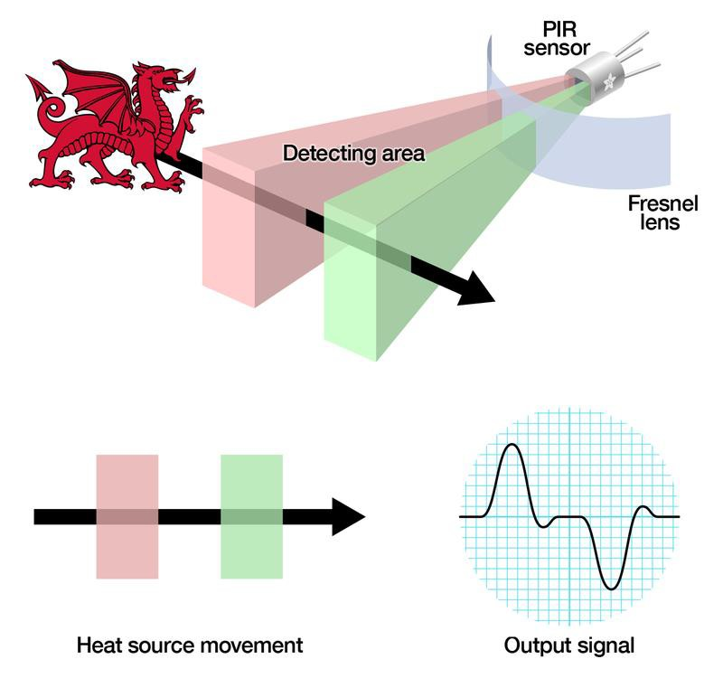
How do PIRs Work?

Slide 53
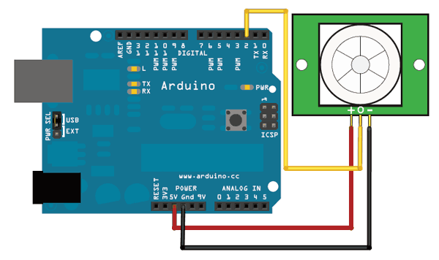
Example

Slide 54
Example
void motion()
{
Serial.println("motion"); data=digitalRead(2); Serial.print("Sensor Data="); Serial.println(data);
}
byte data=0;
void setup() {
pinMode (2,INPUT);
pinMode (13,OUTPUT); Serial.begin(9600);
}
void loop() { Serial.println("main loop"); motion();
delay(1000);
}

Slide 55
Example
void motion()
{
Serial.println("motion"); data=digitalRead(2); Serial.print("Sensor Data="); Serial.println(data);
}
void led()
{
Serial.println("led"); digitalWrite(13,HIGH); delay(10000); digitalWrite(13,LOW); delay(10000);
}
What happens now?
byte data=0;
void setup() {
pinMode (2,INPUT);
pinMode (13,OUTPUT); Serial.begin(9600);
}
void loop() { Serial.println("main loop");
led();
motion();
}

Slide 56
what is Interruption?
the Arduino code is sequential, running in series meaning that till one instruction is not over, we can’t execute the next interruption. For example, if we run 3 functions (1, 2 and 3) and we read some inputs from some buttons.
Between the functions we read the state of two pins connected to some push buttons. Since the Arduino code is sequential, is obvious that function 2 won’t run till function 1 is not over, and function 3 won’t run till function 1 and 2 are over. Even more, if we press the push button while function 1 is still running, we won’t detect that the button was pressed, because the digital read won’t run till function 1 and 2 are done. So how could we change a variable used in function 3 for example, while we are still running function 1. For that we use interruptions.
When an interruption is triggered, this will pause the code in that exact moment and take it to the interruption vector. Here we run the code of the interruption, which could be anything, and when this is over, we get back to the code and keep going from that same exact moment

Slide 57
User Program
Interrupt Handler
1
2
i
i + 1
Interrupt
occurs here
M
Figure 3.8
Transfer of Control via Interrupts

Slide 58
Hardware Interrupts
Pin#2 🡪 INT0 Pin#3🡪INT1
attachInterrupt(digitalPinToInterrupt(pin), ISR, mode);
Example: attachInterrupt(digitalPinToInterrupt(2),motion,CH ANGE);
MODE:
LOW to trigger the interrupt whenever the pin is low,
CHANGE to trigger the interrupt whenever the pin changes value RISING to trigger when the pin goes from low to high,
FALLING for when the pin goes from high to low
9

Slide 60
Interrupt Service Routines (ISR)
Use the ISR to call when the interrupt occurs; this function must take no parameters and return nothing. This function is sometimes referred to as an interrupt service routine.
You should declare as volatile any variables that
you modify within the attached function
10

Slide 61
LED connected
at pin 13
‹#›

Slide 62
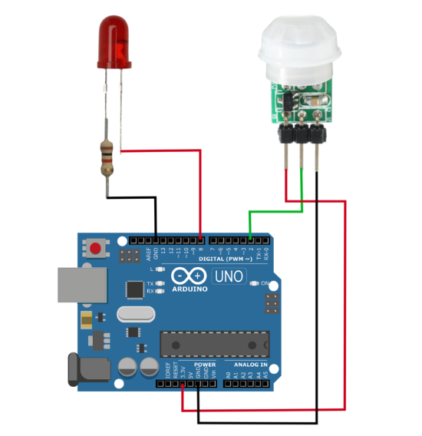
https://makersportal.com/blog/2019/5/27/arduino-interrupts-with-pir-motion-detector
const byte led_pin = 8;
const byte interrupt_pin = 2;
volatile byte state = LOW;
void setup() {
Serial.begin(9600);
pinMode(led_pin,OUTPUT);
attachInterrupt(digitalPinToInterrupt(interrupt_pin),interrupt_routine,RISING);
}
void loop() {
if (state==HIGH){
digitalWrite(led_pin,HIGH);
delay(500);
}
if (state==HIGH) {
Serial.println("low");
state = LOW;
digitalWrite(led_pin,LOW);
}
}
void interrupt_routine(){
state = HIGH;
Serial.println("interrupt");
}

Slide 63
#include <LowPower.h>
const byte led_pin = 8;
const byte interrupt_pin = 2;
volatile byte state = LOW;
void setup() {
Serial.begin(9600);
pinMode(led_pin,OUTPUT);
}
void loop() {
// the interrupt must be attached each loop
attachInterrupt(digitalPinToInterrupt(interrupt_pin),interrupt_routine,RISING);
LowPower.powerDown(SLEEP_FOREVER,ADC_OFF,BOD_OFF); // sleep until interrupt
detachInterrupt(digitalPinToInterrupt(interrupt_pin)); // remove interrupt
// the usual wake routine that turns on the LED
if (state==HIGH){
digitalWrite(led_pin,HIGH);
delay(500);
}
if (state==HIGH){
state = LOW;
digitalWrite(led_pin,LOW);
}
}
void interrupt_routine(){
state = HIGH;
}

Slide 64
With Interrupt
void motion()
{
Serial.println("motion"); data=digitalRead(2); Serial.print("Sensor Data="); Serial.println(data);
}
void led()
{
Serial.println("led"); digitalWrite(13,HIGH); delay(10000); digitalWrite(13,LOW); delay(10000);
}
volatile byte data=0;
void setup() {
pinMode (2,INPUT);
pinMode (13,OUTPUT); Serial.begin(9600); attachInterrupt(digitalPinToInterru
pt (2), motion, CHANGE);
}
void loop() { Serial.println("main loop");
led();
// motion();
}
‹#›

Slide 65
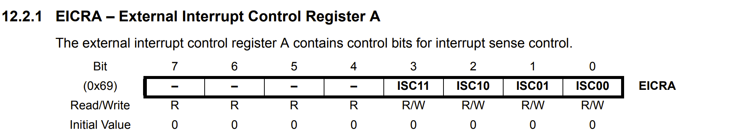
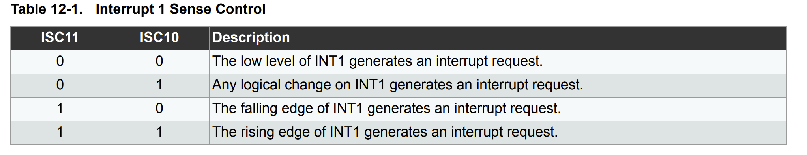
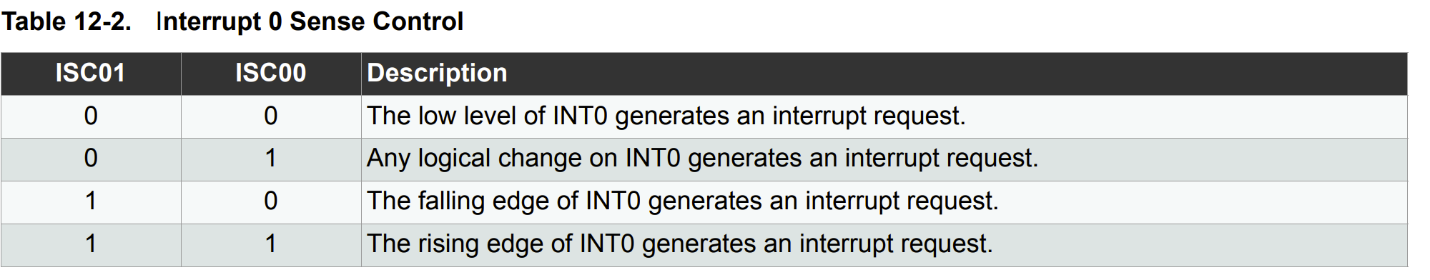
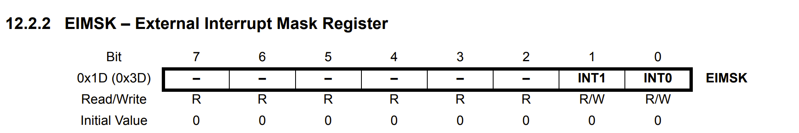
Register Description in ATmega328p

Slide 66
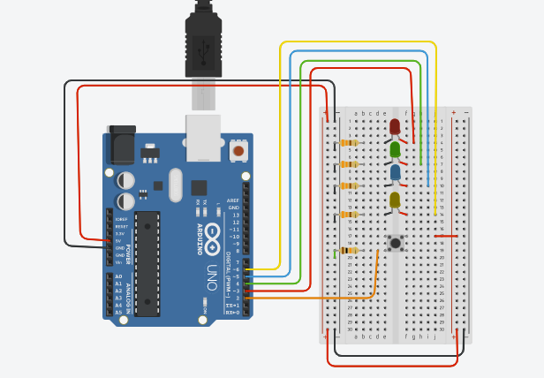
External Interrupts Using Registers
ISR(INT0_vect){ // interrupt vector for INT0 (pin 2)
// this code only runs when external interrupt 0 is triggered
if (PIND & 0b00000100 ){ // check if PD2 is high
PORTD |= 0b01000000; // set PD6 high if PD2 is high
} else {
PORTD &= 0b10111111; // else, set PD6 low
}
}
int main(void)
{
DDRD = 0b01111000; // set pins 3, 4, 5, and 6 as outputs
// other pins in port D as inputs
EICRA |= 0b00000001; // set external interrupt 0 (pin 2) to "any logical change"
// see datasheet page 89, section 17.2.1
EIMSK |= 0b00000001; // enable external interrupt 0 (pin 2)
// see datasheet page 90, section 17.2.2
sei(); // enable global interrupts
}

Slide 67
while(1)
{
PORTD |= 0b00001000; // set PD3 high, leave others unchanged
delay(1000); // Wait for 1000 millisecond(s)
PORTD &= 0b11110111; // set PD3 low, leave others unchanged
PORTD |= 0b00010000; // set PD4 high, leave others unchanged
delay(1000); // Wait for 1000 millisecond(s)
PORTD &= 0b11101111; // set PD4 low, leave others unchanged
PORTD |= 0b00100000; // set PD5 high, leave others unchanged
delay(1000); // Wait for 1000 millisecond(s)
PORTD &= 0b11011111; // set PD5 low, leave others unchanged
}

Slide 68
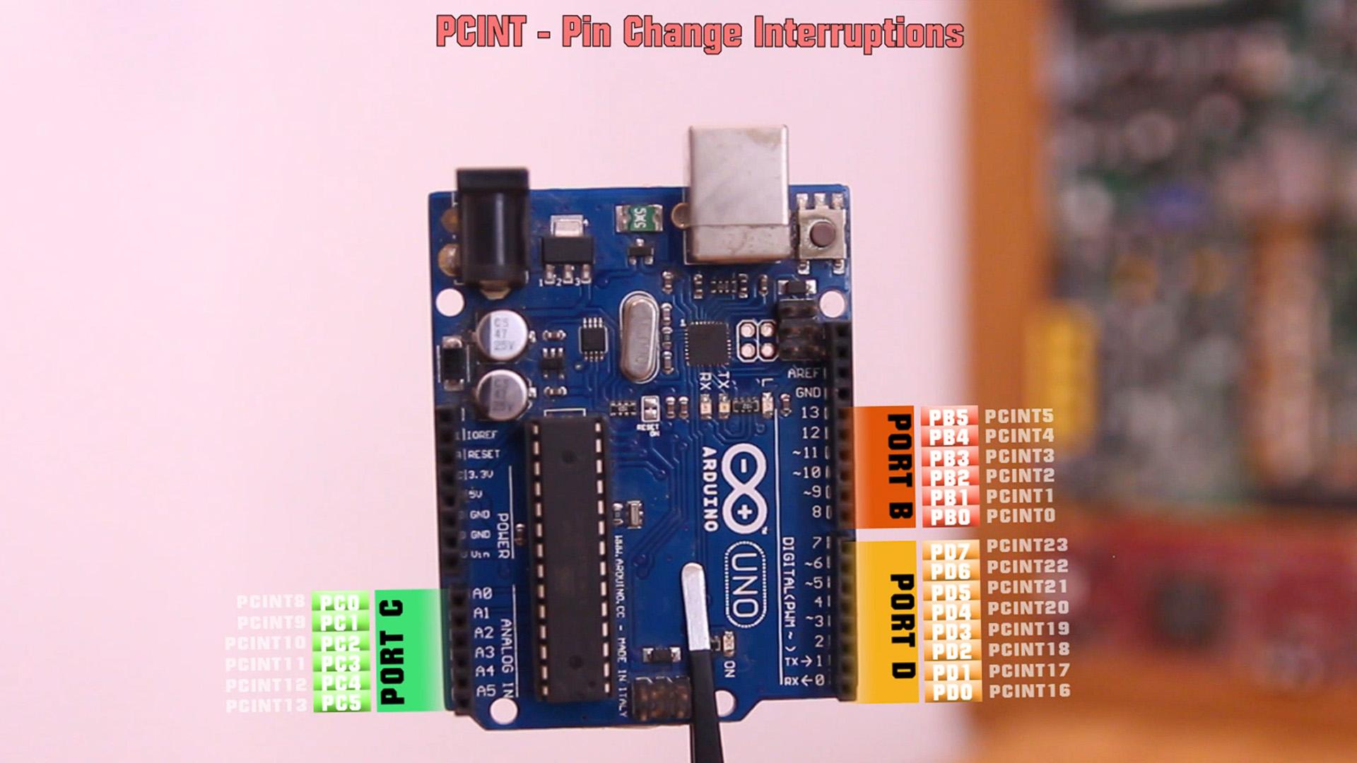
PIN CHANGE INTERRUPTIONS

Slide 69
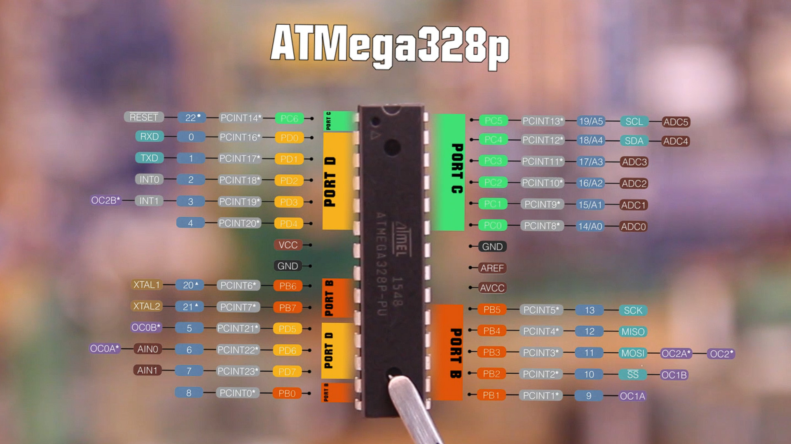

Slide 70
The interruption
Hardware interruptions are very limited, for example on the Arduino UNO, only pins 2 and 3 could trigger a hardware interruption. On the other hand, the PCINT interruptions don’t act over just one pin, but over a group of pins better known as a port.
When an interruption is triggered, this will pause the code in that exact moment and take it to the interruption vector. Here we run the code of the interruption, which could be anything, and when this is over, we get back to the code and keep going from that same exact moment. With PCINT, if activated, each time an INPUT changes its value, from HIGH to LOW or from LOW to HIGH, an interruption will be triggered.
UNLIKE INT interrupts allow you to configure the CHANGE, FALLING, RISING, LOW, and HIGH trigger, PCINT interrupts only distinguish CHANGE events.

Slide 71
Enable/Disable PCINT
PCISR Register
(Pin Change Interrupt Control Register)
Bit 7 | Bit 6 | Bit 5 | Bit 4 | Bit 3 | Bit 2 | Bit 1 | Bit 0
 |  |  |  |  | PCIE2 | PCIE1 | PCIE0
Here we have 3 bits, which control the activation or deactivation of the PCINTs for each group of pins. We use the first 3 bits of this register where bit 0 is for PCIE0, bit 1 is for PCIE1 and bit 2 is for PCIE2.
PCIE0 controls the group of pins for PCINT0 to PCINT7---Port B
PCIE1 controls the group of pins for PCINT8 to PCINT14-- Port C
PCIE2 controls the group of pins for PCINT16 to PCINT23---Port D
void setup() {
PCICR |= B00000100; //Bit2 = 1 -> "PCIE2" enabeled (PCINT16 to PCINT23) } void loop() {
//your code here... }

Slide 72
Enable OR Disable For a pin
setting a PCINT bit to a 1, it means that pin will trigger interruption
PCMSK0
BIT | Bit 7 | Bit 6 | Bit 5 | Bit 4 | Bit 3 | Bit 2 | Bit 1 | Bit 0
PCINT | PCINT7 | PCINT6 | PCINT5 | PCINT4 | PCINT3 | PCINT2 | PCINT1 | PCINT0
Arduino Pin | Cristal2 | Cristal1 | D13 | D12 | D11 | D10 | D9 | D8
PCMSK1
BIT | Bit 7 | Bit 6 | Bit 5 | Bit 4 | Bit 3 | Bit 2 | Bit 1 | Bit 0
PCINT | - | PCINT14 | PCINT13 | PCINT12 | PCINT11 | PCINT10 | PCINT9 | PCINT8
Arduino Pin | - | Reset | A5 | A4 | A3 | A2 | A1 | A0
PCMSK2
BIT | Bit 7 | Bit 6 | Bit 5 | Bit 4 | Bit 3 | Bit 2 | Bit 1 | Bit 0
PCINT | PCINT23 | PCINT22 | PCINT21 | PCINT20 | PCINT19 | PCINT18 | PCINT17 | PCINT16
Arduino Pin | D7 | D6 | D5 | D4 | D3 | D2 | D1

Slide 73
void setup() {
PCICR |= B00000100; //Bit2 = 1 -> "PCIE2" enabled (PCINT16 to PCINT23)
PCMSK2 |= B00100000; //Bit5 = 1 -> "PCINT21" enabled -> D5 will trigger interrupt }
void loop()
{
//your code here... }

Slide 74
Clear the interruption flag
PCIFR (Pin Change Interrupt Flag Register) register
BIT | Bit 7 | Bit 6 | Bit 5 | Bit 4 | Bit 3 | Bit 2 | Bit 1 | Bit 0
PCINT | - | - | - | - | - | PCIF2 | PCIF1 | PCIF0
Arduino PORT | - | - | - | - | - | PORT B | PORT C | PORT D
The bits of this register are activated each time a change occurs in a pin of the group. To reset this flag, we have to put a '1' in the corresponding register. The flags are automatically reset when the associated ISR is triggered. So, for example if D5 triggers an interruption, the flag for PCIF2 will turn 0 because pin D5 is from PCMSK2.

Slide 75
Define the ISR (Interrupt Service Routine)
• ISR (PCINT0_vect) for pin group D8 to D13
• ISR (PCINT1_vect) for pin group A0 to A5
• ISR (PCINT2_vect) for pin group D0 to D7
ISR (PCINT2_vect)
{
// For PCINT of pins D0 a D7
}

Slide 76
D5 will trigger interrupt
void setup()
{
PCICR |= B00000100; //Bit2 = 1 -> "PCIE2" enabled (PCINT16 to PCINT23)
PCMSK2 |= B00100000; //Bit5 = 1 -> "PCINT21" enabled -> D5 will trigger interrupt }
void loop()
{ //your code here... }
ISR (PCINT2_vect) { // For PCINT of pins D0 a D7 }

Slide 77
2 PCINT from same port……
bool D4_state = LOW;
bool D5_state = LOW;
void setup() {
PCICR |= B00000100; //Bit2 = 1 -> "PCIE2" enabled (PCINT16 to PCINT23)
PCMSK2 |= B00110000; //D4 and D5 will trigger interrupt
}
void loop() {
//your code here...
}
ISR (PCINT2_vect)
{
if(digitalRead(4) && D4_state){
D4_state = HIGH; //Pin D4 triggered the ISR
}
else if(digitalRead(4) && !D4_state){
D4_state = LOW;
}
if(digitalRead(5) && D5_state){
D5_state = HIGH; //Pin D5 triggered the ISR
}
else if(digitalRead(5) && !D5_state){
D5_state = LOW;
}
}
To detect that we must store the previous value using a global variable and compare that each time.

Slide 78
Have in mind (millis & micros)
during the execution of an interrupt, Arduino does not update the value of the millis and micros function. As a consequence, the delay function does not work, because it bases its operation on the millis function.
Have in mind (2 PCINT from same port)
When we are inside an interruption, the rest of interruptions are on pause. That means if one pins triggers an interruption and in just a few moments a different pin triggers another interruption while we are still running the first interruption routine, the second interruption won’t trigger.

Slide 79
Interrupts are incredibly important for performing quick tasks where constant monitoring of digital pins may be unnecessary. Interrupts are also essential for saving power and minimizing the role of the microcontroller. Interrupts can be found in home automation applications, especially in motion detection, as introduced (with passive infrared detectors). A low power library was also introduced for minimizing the power consumed between trips of the PIR sensor - this helps to minimize the role of the Arduino chip and allow the sensor to determine when the Arduino board is active, ultimately saving 70% on power consumption.

Slide 80
More Details on Timers
22

Slide 81
Timers
Timer0:
Timer0 is a 8bit timer.
It is used in delay() 2, millis() 2 and micros() 2.
Timer1:
Timer1 is a 16bit timer.
Timer2:
Timer2 is a 8bit timer like timer0.
Timer3, Timer4, Timer5:
Timer 3,4,5 are only available on Arduino Mega boards. These timers are all 16bit timers.
17

Slide 82
Timers-cont.
Options: usage of a dedicated library (i.e. Timer1) or configure directly the AVR timer/counter registers
Timer1 library: http://playground.arduino.cc/Code/Timer1
  Functions for the 16 bit Timer 1 (recommended for Arduino UNO.
  For Arduino Mega, only OCR1A, OCR1B1 are supported by the library and is recommended to use Timer3 library (with the same functions) http://playground.arduino.cc/uploads/Code/TimerThree.zip.
Most important methods of Timer class:
initialize(period) – initialize the timer with ‘period’ [us]. Period is the time interval in
which the timer performs a complete counting cycle.
setPeriod(period) – modifies the period of an already initialized timer.
pwm(pin, duty) – generates a PWM signal on ‘pin’ with the duty cycle value 0 ..
1023 For ‘pin’ only values at which the Timer/counter outputs are physically connected are allowed: Timer 1 connected at 9 and 10, Timer 3 connected at 2, 3 and 5 for Arduino Mega.
attachInterrupt(function, period) – attaches an ISR ‘function’ to be called every time when the timer finishes a cycle (OVFi) or at time intervals specified by the optional parameter ‘period’ (COMPi).
detachInterrupt() – de-attaches the ISR
disablePwm(pin) – deactivates the PWM generation on the specified pin
read() – returns the time interval passed from the last saturation of the counter

Slide 83
Timers-cont.
Example 10 - set a timer of length 1000000 microseconds (or 1 sec - or 1Hz
=> the LED will blink 1 times per second)
(https://code.google.com/p/arduino-timerone/downloads/list)
#include <TimerOne.h>
void setup()
{
pinMode(13, OUTPUT); Timer1.initialize(1000000);
// Initialize the digital pin as an output
// set a timer (period=1 sec / 1Hz
Timer1.attachInterrupt( timerIsr ); // attach the service routine here
}
void loop(){
// Main code loop
// TODO: Put your regular (non-ISR) logic here
}
/// --------------------------
/// Custom ISR Timer Routine
/// --------------------------
void timerIsr(){
digitalWrite( 13, digitalRead( 13 ) ^ 1 ); // Toggle LED
}

Slide 84
Motion Detection with Timer Interrupt
#include <TimerOne.h> volatile byte data=0; void setup() {
pinMode (2,INPUT); pinMode (13,OUTPUT); Serial.begin(9600); Timer1.initialize(1000000);
Timer1.attachInterrupt(motion);
}
void loop() {
// put your main code here, to run repeatedly:
// Serial.println("main loop"); led();
// motion();
}
void motion()
{
Serial.println("motion"); data=digitalRead(2); Serial.print("Sensor Data="); Serial.println(data);
}
void led()
{
Serial.println("led"); digitalWrite(13,HIGH); delay(10000); digitalWrite(13,LOW); delay(10000);
}
20

Slide 85
Timers-cont.
Example 11 - Sets up PWM output on pin 9 with a 50% duty cycle, and attaches an interrupt that toggles digital pin 10 every half second.
#include "TimerOne.h“
void setup()
{
pinMode(10, OUTPUT); Timer1.initialize(500000); Timer1.pwm(9, 512);
// initialize timer1, and set a 1/2 second period
// setup PWM on pin 9, 50% duty cycle
Timer1.attachInterrupt(callback); // attaches callback() as a timer overflow interrupt (TOFI)
}
void callback()
{
digitalWrite(10, digitalRead(10) ^ 1);
}
void loop()
{
// your program here...
}

Slide 86
int led = 13; // the pin that the LED is atteched to
int sensor = 2; // the pin that the sensor is atteched to
int state = LOW; // by default, no motion detected
int val = 0; // variable to store the sensor status (value)
void setup() {
pinMode(led, OUTPUT); // initalize LED as an output
pinMode(sensor, INPUT); // initialize sensor as an input
Serial.begin(9600); // initialize serial
}
void loop(){
val = digitalRead(sensor); // read sensor value
if (val == HIGH) { // check if the sensor is HIGH
digitalWrite(led, HIGH); // turn LED ON
delay(100); // delay 100 milliseconds
if (state == LOW) {
Serial.println("Motion detected!");
state = HIGH; // update variable state to HIGH
}
}
else {
digitalWrite(led, LOW); // turn LED OFF
delay(200); // delay 200 milliseconds
if (state == HIGH){
Serial.println("Motion stopped!");
state = LOW; // update variable state to LOW
}
}
}

Slide 87
Timers
AVR timers
8 bit timers/counters
16 bit timers/counters
Characteristics
Input clock prescaler
Read / write counter status
Waveform generator using a comparator (register)
  Frequency tuning, PWM generator (pulse width modulation)
Generation of interrupts at regular time intervals
Triggered by external events (capture)

Slide 88
Timers
Atmega 328P
1x 8 bit Timer0 with PWM, 1x 8 bit Timer2 PWM and Async. Operation, 1x 16 bitTimer1 with PWM
8 bit Timers specific features
•2 Independent Output Compare Units
•3 Independent Interrupt Sources (TOVx, OCFxA, and OCFxB)
Atmega 2560
1x 8 bit Timer0 with PWM, 1x 8 bit Timer2 PWM and Async. Operation, 4x 16 bitTimer(1,3,4,5) with PWM
16 bit timers specific features
•3 independent Output Compare Units
•4 independent interrupt sources
(TOVx, OCFxA, OCFxB, OCFxC, ICFx,
1 Input Capture Unit
External Event Counter

Slide 89
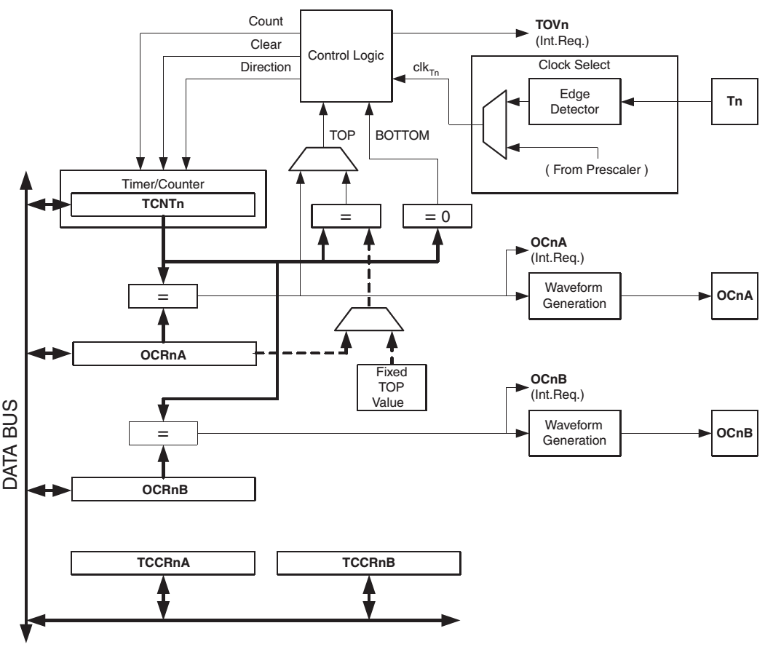
Structure of 8 bit timers
Control
External clocking
Counting
Internal clocking
Clock source selection
Comparator
Waveform generator
Output Compare Registers
Timer Counter Control Registers

Slide 90
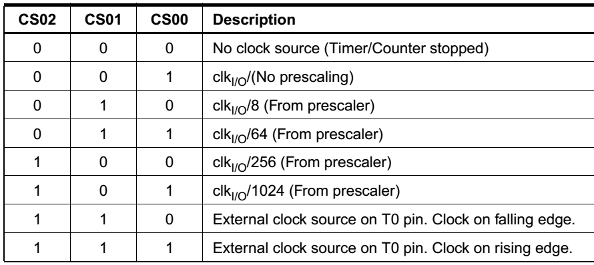
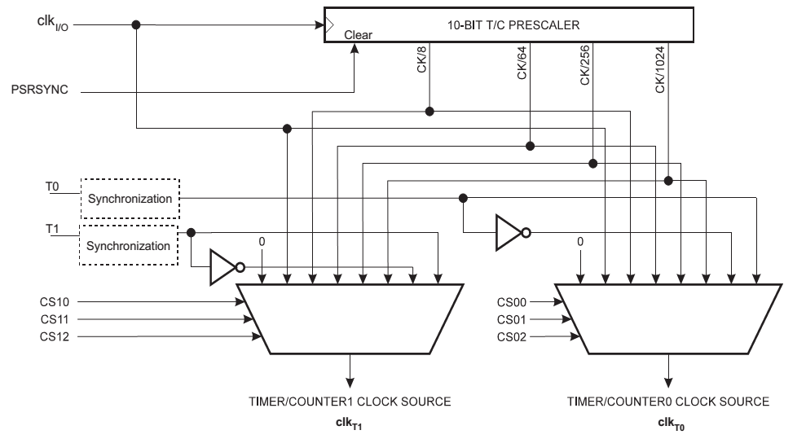
Clock signal selection
Bits CS02 .. CS00 are controlling the clk_{TOS} division at the counter’s input
Tuning of the count speed (frequency)

Slide 91
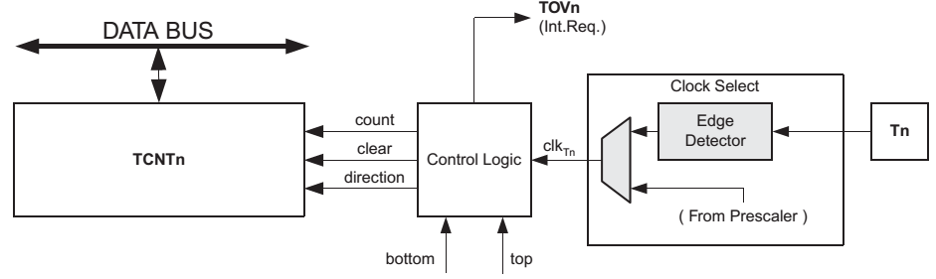
Counter unit
count Increment or decrement TCNT0 by 1.
direction Selects between increment and decrement.
clear Clear TCNT0 (set all bits to zero).
clk_{T0} Timer/Counter clock.
top Signals that TCNT0 has reached maximum value (0xFF).
bottom Signalis that TCNT0 has reached minimum value (zero).
The Timer/Counter Overflow Flag (TOV0) is set according to the mode of operation selected by the WGM02:0 bits. TOV0 can be used for generating a CPU interrupt.

Slide 92
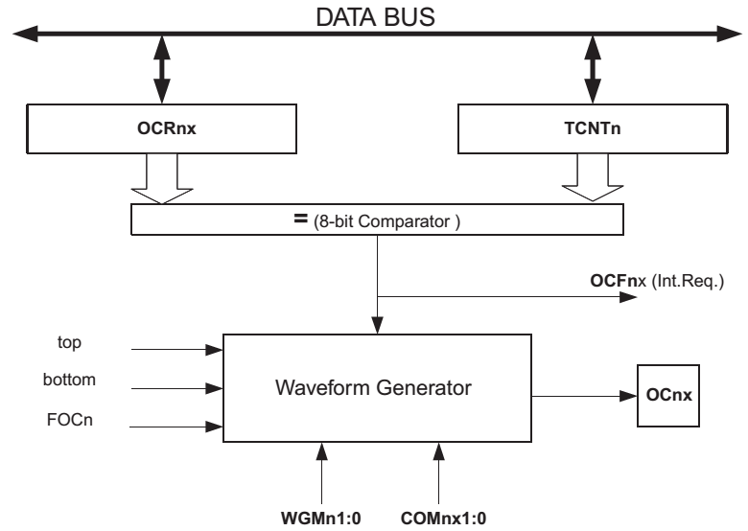
Comparison unit
Comparison between the count register (TCNT0) and the output compare register (OCR0) ⇒ used to generate different types of waveforms
Output compare flag – at equal, interrupt request is generated
Output compare bit – here the waveform will be generated

Slide 93
Timers can be configured using registers
TCCRx - Timer/Counter Control Register. The prescaler can be configured here.
TCNTx - Timer/Counter Register. The actual timer value is stored here.
OCRx - Output Compare Register
TIMSKx - Timer/Counter Interrupt Mask Register.
To enable/disable timer interrupts.
29

Slide 94
Using Timer1 to run events
30

Slide 95
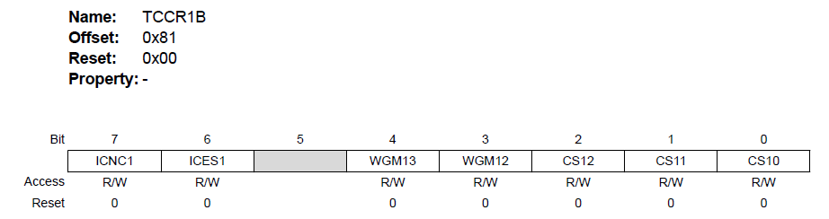
TC1 Control Register B
TCCRx - Timer/Counter Control Register. The prescaler can be configured here.
Clock Select 1 [n = 0..2]
Waveform Generation Mode
31

Slide 96
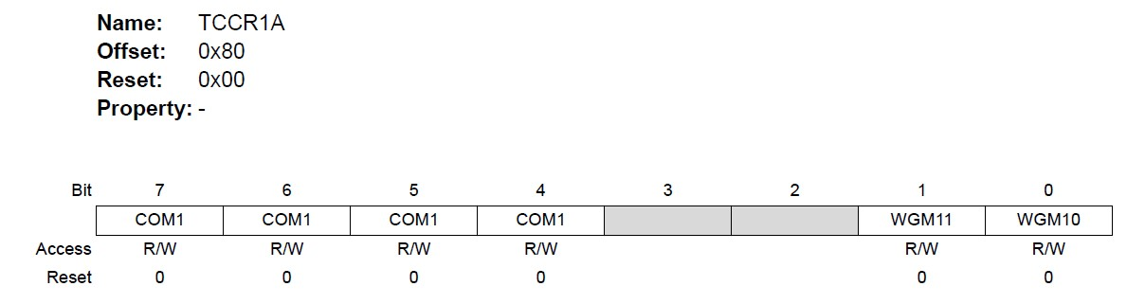
TC1 Control Register A
Waveform Generation Mode
32

Slide 97
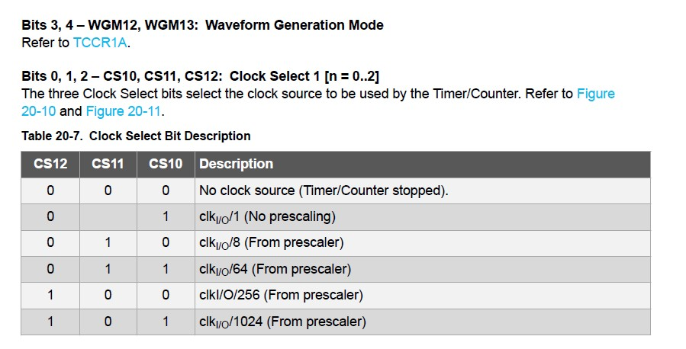
Prescaler
33

Slide 98
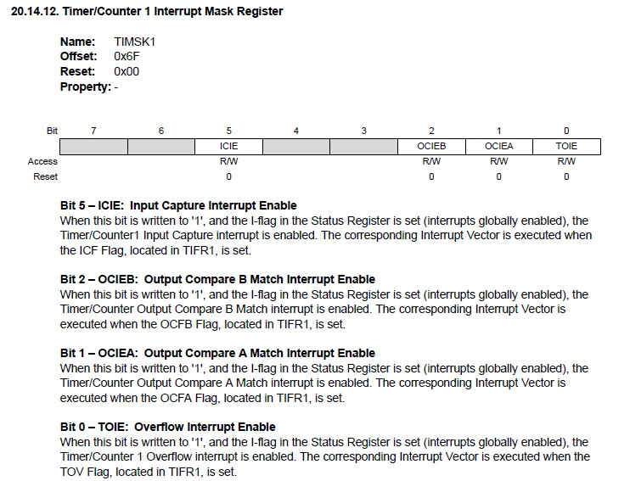
Compare match Timer
Overflow Timer
34

Slide 99
Modes
Normal
Simple counting (incrementing): 0 … 0xFFFF
When the counter overruns (0xFFFF), a timer overflow interrupt is generated and TOV flag is set then the counting is restarted from 0x00
CTC – Clear Timer on Compare Match
When the counter value (TCNT) reaches the OCR value, the counter is cleared to 0
35

Slide 100
Timer Overflow:
Timer overflow means the timer has reached is limit value. When a timer overflow interrupt occurs, the timer overflow bit TOVx will be set in the interrupt flag register TIFRx. When the timer overflow interrupt enable bit TOIEx in the interrupt mask register TIMSKx is set, the timer overflow interrupt service routine ISR(TIMERx_OVF_vect) will be called.
36

Slide 101
Clear Timer on Compare Match (CTC)
Mode
In Clear Timer on Compare or CTC mode (WGM1[2:0]=0x2), the OCR1A Register is used to manipulate the counter resolution: the counter is cleared to ZERO when the counter value (TCNT1) matches the OCR1A. The OCR1A defines the top value for the counter, hence also its resolution. This mode allows greater control of the compare match output frequency.
37

Slide 102
Output Compare Match:
When a output compare match interrupt occurs, the OCFxy flag will be set in the interrupt flag register TIFRx . When the output compare interrupt enable bit OCIExy in the interrupt mask register TIMSKx is set, the output compare match interrupt service ISR(TIMERx_COMPy_vect) routine will be called.
38

Slide 103
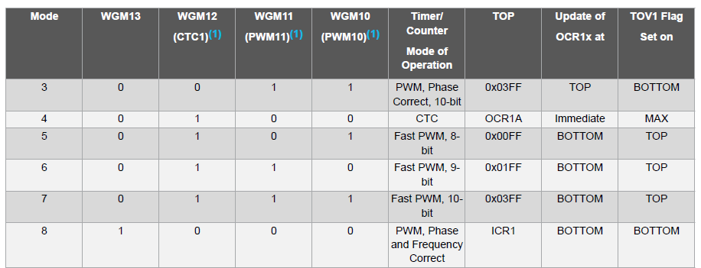
39

Slide 104
Example
Use clear timer on compare match mode to toggle a led with a frequency 0.5 Hz
https://circuitdigest.com/microcontroller-projects/arduino-timer-tutorial
40

Slide 105
#define ledPin 13 void setup(){
pinMode(ledPin, OUTPUT);
// initialize timer1
noInterrupts(); TCCR1A = 0;
TCCR1B = 0;
TCNT1 = 0;
OCR1A = 31250;
// disable all interrupts
// compare match register
TCCR1B |= (1 << WGM12); // CTC mode
TCCR1B |= (1 << CS12)|(1 << CS10); // 1024 prescaler
TIMSK1 |= (1 << OCIE1A); // enable timer compare interrupt
interrupts(); // enable all interrupts
}
ISR(TIMER1_COMPA_vect) // timer compare interrupt service routine
{
digitalWrite(ledPin, digitalRead(ledPin) ^ 1);
}
void loop()
{// your program here…}
// toggle LED pin
41

Slide 106
Example
Use timer overflow interrupt to toggle a led with a frequency 4 Hz
42

Slide 107
#define ledPin 13
void setup(){
pinMode(ledPin, OUTPUT);
// initialize timer1
noInterrupts(); TCCR1A = 0;
TCCR1B = 0;
TCNT1 = 49911;
// disable all interrupts
// preload timer 65536-16MHz/256/4Hz
TCCR1B |= (1 << CS12); TIMSK1 |= (1 << TOIE1);
// 256 prescaler
// enable timer overflow interrupt
interrupts();
// enable all interrupts
} ISR(TIMER1_OVF_vect)
{
TCNT1 = 49911;
// interrupt service routine
// preload timer
digitalWrite(ledPin, digitalRead(ledPin) ^ 1);
}
void loop(){
// your program here...
43

Slide 108
PWM with Timer ISR
Using this same code but without resetting the OCR register when we reach the value, we can create PWM signals.
This is the same process the analogWrite is using. But in this case we could use any other pin, not just the PWM pins of the Arduino.

Slide 109
bool A_STATE = true;
bool B_STATE = true;
void setup() {
pinMode(2,OUTPUT);
pinMode(3,OUTPUT);
pinMode(A0, INPUT);
pinMode(A1, INPUT);
//Timer 1 (interrupt each 50ms)
TCCR1A = 0; // Reset entire TCCR1A to 0
TCCR1B = 0; // Reset entire TCCR1B to 0
TCCR1B |= B00000100; //Set CS12 to 1 so we get prescalar 256
TIMSK1 |= B00000110; //Set OCIE1A and OCIE1B to 1 -> compare match A and B
}
void loop() {
OCR1A =map(analogRead(A0,0,1024,1000,5000);
OCR1B = map(analogRead(A1,0,1024,1000,5000);
}
ISR(TIMER1_COMPA_vect){ A_STATE = !A_STATE; //Invert LED state digitalWrite(2,A_STATE); //Write new state to the LED on pin D5
}
ISR(TIMER1_COMPB_vect){ B_STATE = !B_STATE; //Invert LED state digitalWrite(3,B_STATE); //Write new state to the LED on pin D5
}
when each of the OCRA or OCRB is reached, we invert the pulse. By changing the OCR value, we change the pulse width.

Slide 110
WatchDog Timer
The watchdog timer watches over the operation of the system.
The watchdog timer operates independent of the CPU, peripheral subsystems, and even the clock of the MCU. To keep the watchdog happy you must feed it a wdr
(watchdog reset) assembly instruction before a predefined
timeout period expires.
"A watchdog timer (WDT) is a hardware timer that automatically generates a system reset if the main program neglects to periodically service it. It is often used to automatically reset an embedded device that hangs because of a software or hardware fault."
https://create.arduino.cc/projecthub/rafitc/what-is-watchdog-timer-fffe20
44

Slide 111
Watchdog timer
A timing device such that it is set for a preset time interval and an event must occur during that interval else the device will generate the timeout signal on failure to get that event in the watched time interval.
Timeout may result in processor start a service routine or start from beginning
Functional Example
Assume that we anticipate that a set of tasks must finish in 100 ms interval.
The watchdog timer is reseted by the program instruction in case the tasks finish within 100 ms interval.
In case task does not finish (WDT_reset() is not called by the program instruction), watchdog timer generates program reset after 100 ms because there is failure of finishing the task in anticipated interval.
Watchdog timer application
Watchdog Timer can be used for Power Saving in Battery operated Remote sensing applications.
It used to prevent controller hang issues.

Slide 112
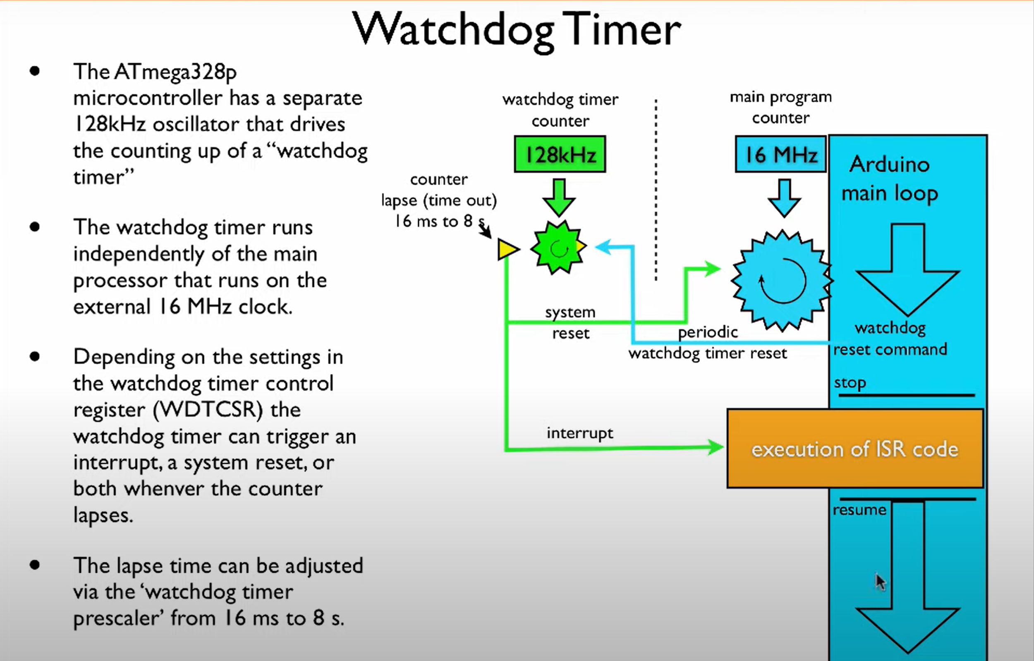

Slide 113
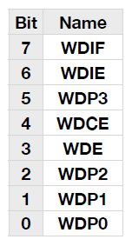
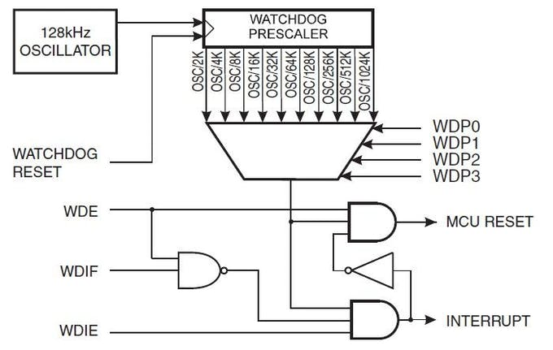
The Register
Youʼll now need to configure your watchdog timer through one of the registers known as WDTCSR.
45

Slide 114
Watchdog Time Setting Table for different Arduino controllers
Threshold value | Constant name | Supported on
15 ms | WDTO_15MS | ATMega 8, 168, 328, 1280, 2560
30 ms | WDTO_30MS | ATMega 8, 168, 328, 1280, 2560
60 ms | WDTO_60MS | ATMega 8, 168, 328, 1280, 2560
120 ms | WDTO_120MS | ATMega 8, 168, 328, 1280, 2560
250 ms | WDTO_250MS | ATMega 8, 168, 328, 1280, 2560
500 ms | WDTO_500MS | ATMega 8, 168, 328, 1280, 2560
1 s | WDTO_1S | ATMega 8, 168, 328, 1280, 2560
2 s | WDTO_2S | ATMega 8, 168, 328, 1280, 2560
4 s | WDTO_4S | ATMega 168, 328, 1280, 2560
8 s | WDTO_8S | ATMega 168, 328, 1280, 2560

Slide 115
#include <avr/wdt.h>
void setup(){
//watchdog timer with 2 Seconds time out
wdt_enable(WDTO_2S);
}
void loop(){
//do stuff here
wdt_reset();
}

Slide 116
Table 1. Watchdog Timer Configuration
WDTON⁽¹⁾ | WDE | WDIE | Mode | Action on Time-out
1 | 0 | 0 | Stopped | None
1 | 0 | 1 | Interrupt mode | Interrupt
1 | 1 | 0 | System Reset mode | Reset
1 | 1 | 1 | Interrupt and System Reset mode | Interrupt, then go to System Reset mode
0 | x | x | System Reset mode | Reset
https://onlinedocs.microchip.com/pr/GUID-0EC909F9-8FB7-46B2-BF4B-05290662B5C3-en-US-12.1.1/index.html?GUID-0FE5D226-2F6B-4AAB-BA12-69A6E55F6E2B

Slide 117
Configuration
WDIF - Sets an interrupt flag but you wont need to
worry about this. It is automatically flagged high and low by the system.
WDIE - Enables Interrupts. This will give you the chance to include one last dying wish (or a few lines of code...) before the board is reset. This is a great way of performing interrupts on a regular interval should the watchdog be configured to not reset on time-out.
46

Slide 118
Configuration
WDCE - This is a safety to enable a configuration mode that will last 4 clock cycles. Set this bit and WDE high before attempting any changes to the watchdog register. There isnʼt really any logic behind this, you just have to set WDCE and WDE to ʻ1ʼ to enter a sort of ʻsetup modeʼ in the watchdog timer.
WDE - Enables system reset on time-out. Whenever the Watchdog timer times out the micocontroller will be reset. Set this to ʻ1ʼ to activate.
47

Slide 119
Configuration
WDP0/WDP1/WDP2/WDP3 - These four bits determine how long the timer will count for before resetting. The exact time is set by setting combinations of the 4 bits in such a pattern.
Table 2. Watchdog Timer Prescale Select
WDP[3] | WDP[2] | WDP[1] | WDP[0] | Number of WDT Oscillator (Cycles) | Oscillator
0 | 0 | 0 | 0 | 2K (2048) | 16 ms
0 | 0 | 0 | 1 | 4K (4096) | 32 ms
0 | 0 | 1 | 0 | 8K (8192) | 64 ms
0 | 0 | 1 | 1 | 16K (16384) | 0.125s
0 | 1 | 0 | 0 | 32K (32768) | 0.25s
0 | 1 | 0 | 1 | 64K (65536) | 0.5s
0 | 1 | 1 | 0 | 128K (131072) | 1.0s
0 | 1 | 1 | 1 | 256K (262144) | 2.0s
1 | 0 | 0 | 0 | 512K (524288) | 4.0s
1 | 0 | 0 | 1 | 1024K (1048576) | 8.0s
48

Slide 120
Example
#include <avr/wdt.h>
void loop()
{
void setup()
{
watchdogSetup(); Serial.begin(9600); Serial.println("Starting up...");
}
void watchdogSetup(void)
{
cli(); // disable all interrupts wdt_reset();// reset the WDT timer
}
ISR(WDT_vect) // Watchdog timer interrupt.
{
Serial.println("watchdogisr ");
// Include your code here - be careful not to
use functions they may cause the interrupt
to hang and
// Enter Watchdog Configuration mode: _{// prevent a reset.}
WDTCSR |= B00011000;
// Set Watchdog settings:
WDTCSR = B01001110; //1 sec WDE
enabled sei();
}
}
https://www.teachmemicro.com/arduino-watchdog-timer/
49

Slide 121
Power Saving (Sleep)-Code
#include <avr/sleep.h>
#include <avr/wdt.h>
int led = 13; //variable for pin that the LED is on
int count = 0; //variable to control how
many times LED blinks before sleep
void setup() { Serial.begin(9600); Serial.println("Start"); watchdogSetup();
sleep_enable(); //enable the sleep
capability
set_sleep_mode(SLEEP_MODE_PWR_D OWN); //set the type of sleep mode. pinMode(led, OUTPUT); //set up the LED pin to output
}
void watchdogSetup(void)
{
cli(); // disable all interrupts wdt_reset();// reset the WDT timer
// Enter Watchdog Configuration mode: WDTCSR |= B00011000;
// Set Watchdog settings:
WDTCSR = B01100001; //8 sec
sei();
}
50

Slide 122
Code
void loop() {
if(count < 2) { //For first two loops blink the LED
digitalWrite(led, HIGH); // turn the
LED on (HIGH is the voltage level)
delay(900); // wait digitalWrite(led, LOW); // turn the
LED off by making the voltage LOW delay(900); // wait
count++; //increment count
}
else {
sleep_cpu(); //enter sleep mode. Next code that will be executed is the ISR when interrupt wakes Arduino from sleep
count = 0; //Set the count back to zero
watchdogSetup();
sleep_enable(); //enable the sleep capability
set_sleep_mode(SLEEP_MODE_PWR_D
OWN); //set the type of sleep mode.
}
}
ISR(WDT_vect) // Watchdog timer interrupt.
{
Serial.println("interrupt"); sleep_disable(); //
}
51

Slide 123
Bibliography
ATmega328/P microcontroller
Embedded Systems Slides by Jonathan Valvano, Design with microprocessors Slides by Radu
Dănescu
52

Slide 124
Distance Measurement and Localization

Slide 125
How to measure the distance to an
object?
RF
Sound Light
‹#›

Slide 126
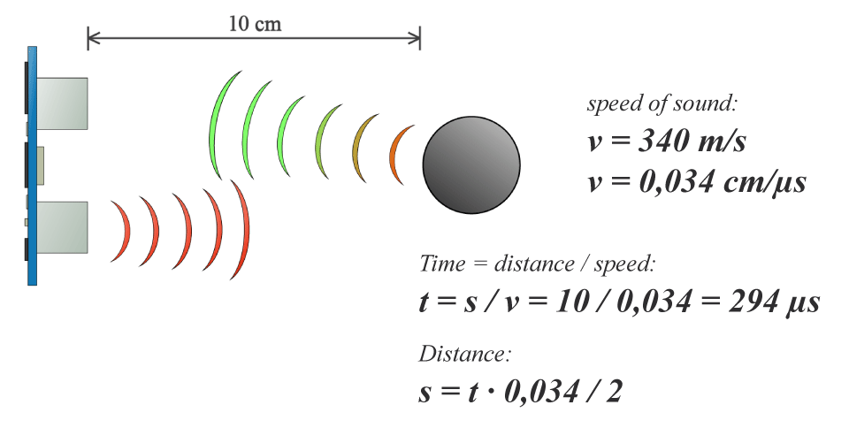
Sound
https://5.imimg.com/data5/FC/MH/DX/SELLER-590122/hc-sr04.pdf
‹#›

Slide 127
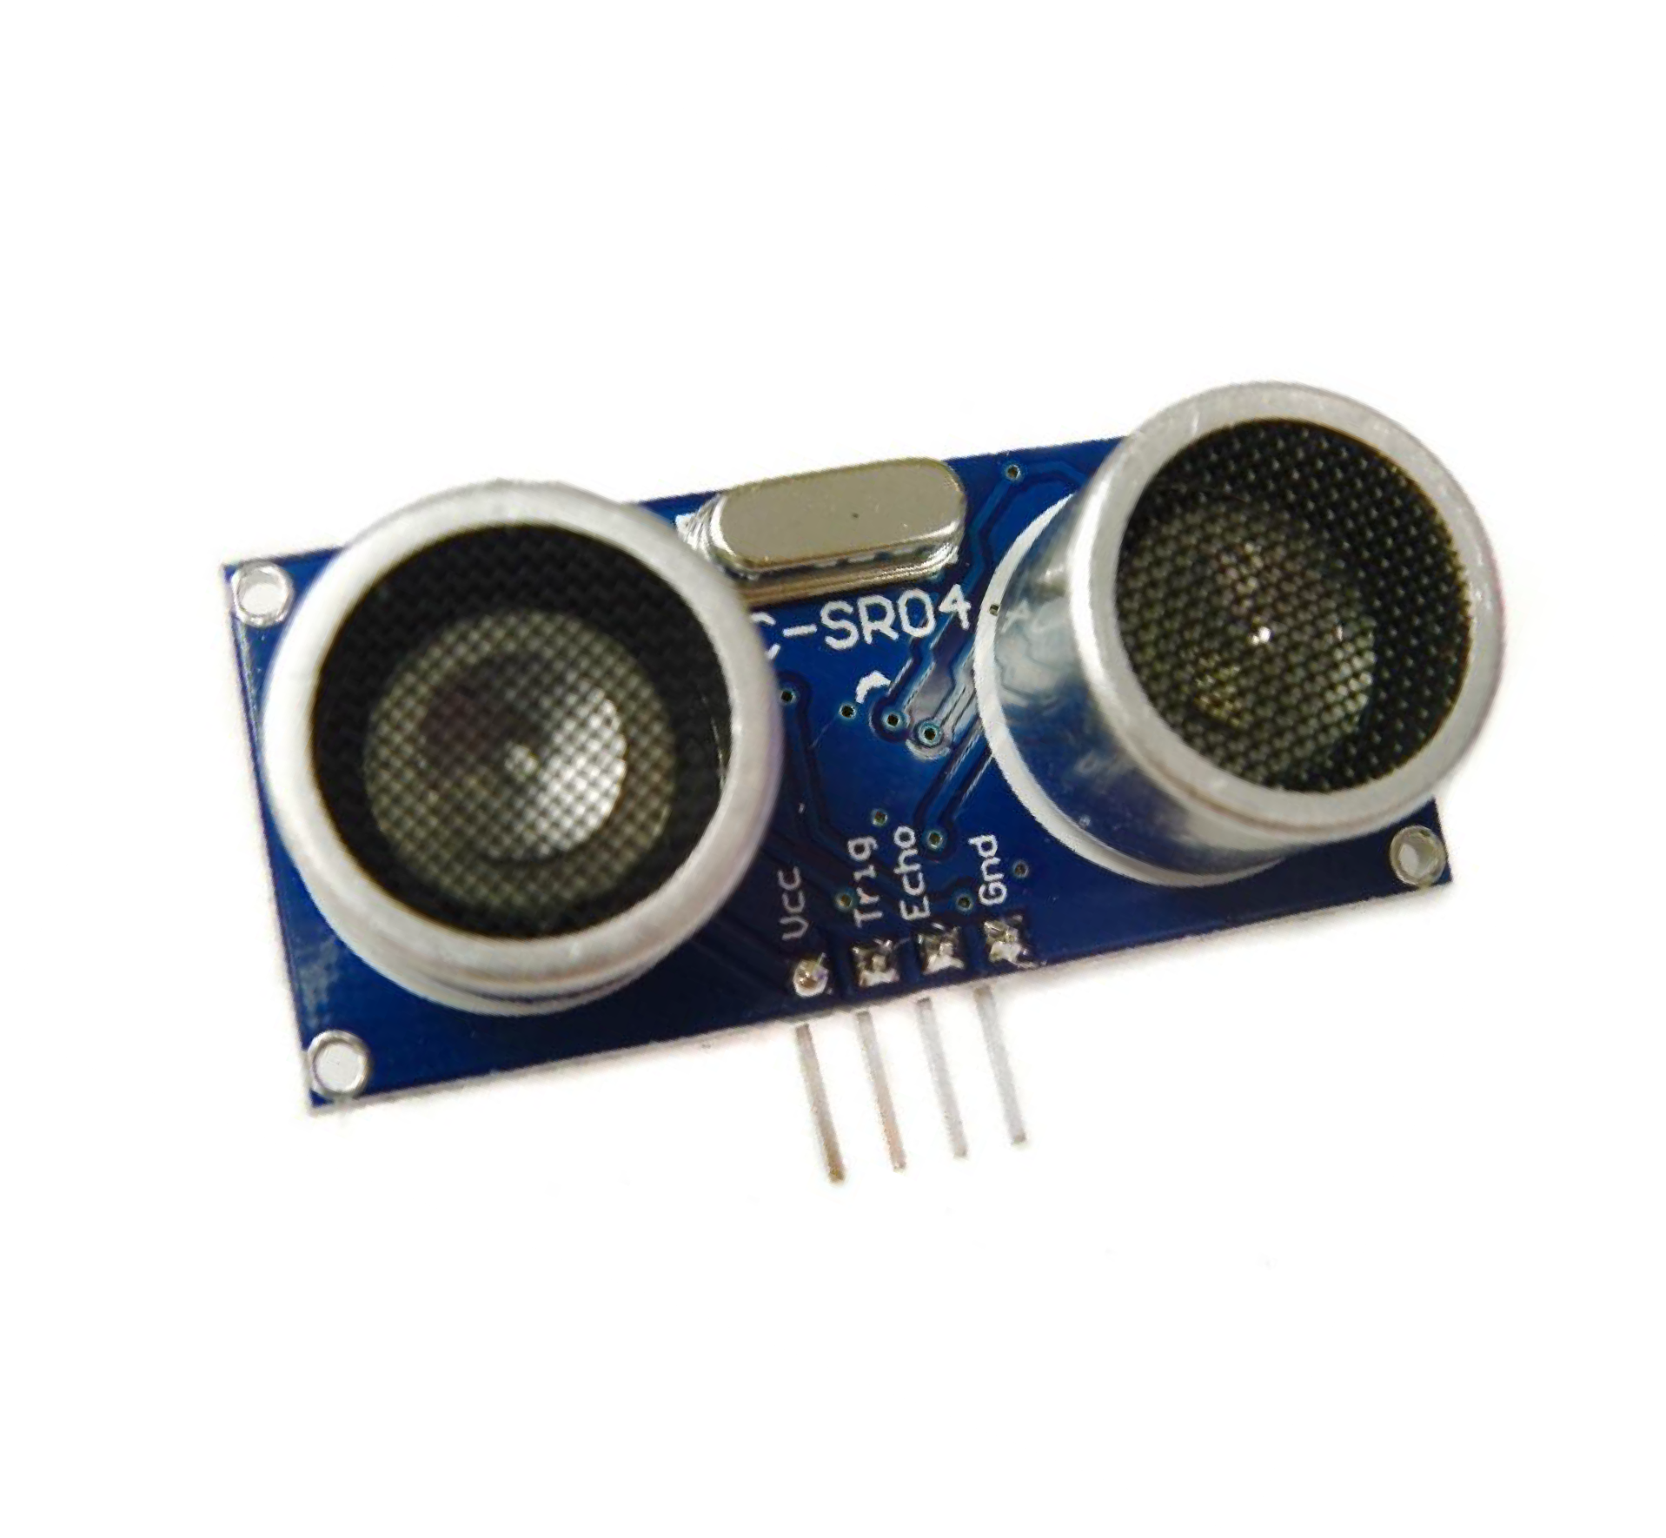

Ultrasonic Sensor
‹#›

Slide 128


Slide 129

How Ultrasonic Sensor works…

Slide 130

Operation
‹#›

Slide 131
#define echoPin 2 // attach pin D2 Arduino to pin Echo of HC-SR04
#define trigPin 3 //attach pin D3 Arduino to pin Trig of HC-SR04
// defines variables
long duration; // variable for the duration of sound wave travel
int distance; // variable for the distance measurement
void setup() {
pinMode(trigPin, OUTPUT); // Sets the trigPin as an OUTPUT
pinMode(echoPin, INPUT); // Sets the echoPin as an INPUT
Serial.begin(9600); // // Serial Communication is starting with 9600 of baudrate speed
Serial.println("Ultrasonic Sensor HC-SR04 Test"); // print some text in Serial Monitor
Serial.println("with Arduino UNO R3");
}
void loop() {
// Clears the trigPin condition
digitalWrite(trigPin, LOW);
delayMicroseconds(2);
// Sets the trigPin HIGH (ACTIVE) for 10 microseconds
digitalWrite(trigPin, HIGH);
delayMicroseconds(10);
digitalWrite(trigPin, LOW);
// Reads the echoPin, returns the sound wave travel time in microseconds
duration = pulseIn(echoPin, HIGH);
// Calculating the distance
distance = duration * 0.034 / 2; // Speed of sound wave divided by 2 (go and back)
// Displays the distance on the Serial Monitor
Serial.print("Distance: ");
Serial.print(distance);
Serial.println(" cm");
}

Slide 132


5 Volt Sensor
We need to convert the 5 volt to 3.3
‹#›

Slide 133

https://thepihut.com/blogs/raspberry-pi-tutorials/hc-sr04-ultrasonic-range-sensor-on-the-raspberry-pi
‹#›

Slide 134
Code
#Libraries
import RPi.GPIO as GPIO
import time
#GPIO Mode (BOARD / BCM)
GPIO.setmode(GPIO.BCM)
#set GPIO Pins GPIO_TRIGGER = 4
GPIO_ECHO = 18
#set GPIO direction (IN / OUT)
GPIO.setup(GPIO_TRIGGER,
GPIO.OUT) GPIO.setup(GPIO_ECHO, GPIO.IN)
‹#›

Slide 135
def distance():
# set Trigger to HIGH
GPIO.output(GPIO_TRIGGER, False)
#ensure that the pin is low for some time time.sleep(0.2) GPIO.output(GPIO_TRIGGER, True)
# set Trigger after 0.01ms to LOW time.sleep(0.00001) GPIO.output(GPIO_TRIGGER, False) StartTime = time.time()
StopTime = time.time()
# save StartTime
while GPIO.input(GPIO_ECHO) == 0:
StartTime = time.time()
# save time of arrival
while GPIO.input(GPIO_ECHO) == 1: StopTime = time.time()
# time difference between start and arrival
TimeElapsed = StopTime - StartTime
# multiply with the sonic speed (34300 cm/s)
# and divide by 2, because there and back distance = (TimeElapsed * 34300) / 2
return distance
9

Slide 136
Code-Cont
if name == ' main ': try:
while True:
dist = distance()
print ("Measured Distance = %.1f cm" % dist) time.sleep(1)
# Reset by pressing CTRL + C
except KeyboardInterrupt:
print("Measurement stopped by User")
GPIO.cleanup()

Slide 137


Slide 138
Deteriming the location of an Object
P1=(x1,y1)
We want to know the location of node U (e.g., a robot)
We have three fixed points: P1, P2, and P3. They are called anchors.
r1
U=(xu,yu)
r2
P2=(x2,y2)
r3
P3=(x3,y3)
If we know the distanc to three different fixed points We can deterime the location of a node u (xu,yu)

Slide 139


Trilateration.. How GPS works!
Indoor Localization
As GPS satellites broadcast their location and time, trilateration measure distances to pinpoint their exact position on Earth.

Slide 140


Slide 141
Trilateration
Assuming distances to three points with known location are exactly given
Solve system of equations (Pythagoras!)
(x_{i},y_{i}) : coordinates of anchor point i, r_{i} distance to anchor i
(x_{u}, y_{u}) : unknown coordinates of node
(x − x ) + (y − y )
2 2
= r
2
for i = 1,2,3
i u i
u
i
Subtracting eq. 3 from 1 & 2:
(x − x ) − (x − x ) + (y − y
) − (y − y ) = r − r
2
2
2
2 2
2
1 u 3
u
1
u
3
u 1 3
(x − x ) − (x
− x ) + (y
y )
− (y − y ) = r
2
2
2
2
2
r
2
2 u 3
u
2
u
3
u 2
3
2(x − x )x − 2(y − y )y = (r − r ) − (
2 −
Rearranging terms gives a linear equation in (x_{u}, y_{u})!
x − x )− (y − y )
2 2
2 2 2
2
3
1 u
3
1 u
1 3
1 3 1
3
= (r − r ) − (
x − x )− (y − y )
(x x )x − 2(y − y )y
2 2
2 2
2
2
3
2
u
2
3
2
3
2
1³3

Slide 142
Trilateration as matrix equation
Rewriting as a matrix equation:
⎤
⎥
⎣ ² ³ ² ³ ² ³ ⎦
⎡(x − x ) ( y − y )⎤⎡ x ⎤ ⎡
2 2 2 2 2 2
(r − r ) − (x − x ) − ( y − y )
2⎢
3 1 3 1
⎥⎢
u
⎥ = ⎢
1 3
1
3
1
3
(x − x )
( y − y )
y
(r ² − r ² ) − (x ² − x ² ) − ( y ² − y ² )
⎣ ³
² ⎦⎣ ^{u} ⎦
2 3
Example:
= (8,2),
(x₁, y₁) = (2,1), (x₂, y₂) = (5,4), (x₃, y₃)
r₁ = 10^{0.5} , r₂ = 2, r₃ = 3
_{2⎡}6
¹ ⎤^{⎡ x}_{u} ⎤ ₌ ⎡⁶⁴⎤
⎢₃
⎢₂₂⎥
⎣
− 2^{⎥⎢ y ⎥}
⎣ ⎦
⎦⎣ ^{u} ⎦
(x_{u},y_{u}) = (5,2)

Slide 143
Trilateration with distance errors
What if only distance estimation r ⁰ = r + ε
available?
Use multiple anchors
i i
i
⎡
2 ₎
⎤
⎥
⎥
⎡ (x − x ) ( y − y ) ⎤
(r ² − r ² ) − (x ² − x ² ) − ( y ² − y
1 n 1 n 1

⎢
n 1 n 1
⎥⎡ ^{x}_{u} ⎤
⎢
n
2⎢

⎥⎢ _{y} ⎥ ⁼ ⎢
⎣(x_{n} − x_{n−1} )
( y_{n} − y_{n−1} )⎦⎣
^{u} ⎦
2
⎥
⎢(r ² − r ² ) − (x ² − x ² ) − ( y
² − y )
⎣ ^{n−1}
n
n−1
n
n−1
^{n} ⎦
Use (x_{u}, y_{u}) that minimize mean square error, i.e, ^{Ax − b} ₂

Slide 144
Minimize mean square error
Look at square of the of Euclidean norm expression
(note that
2
2
_{= V} ^{T}_{V}for all vectors v)
V
Ax − b ² = Ax ² − 2( Ax)^{T} b + b ² 2 2 2
Look at derivative with respect to x, set it equal to
0:
2 Ax A − 2( A)^{T} b = 0
2
( A)^{T} Ax = ( A)^{T} b
Solve the equations to find x

Slide 145
Example
Now assume that the distances were measure with error
r1=5, r2=1, r3=4
If we solve the equations we will get 5.2, 4.8
Error in the distance (5-5.2)
(5.2 − 5)² + (4.8 − 2)² = 2.8

Slide 146
Example-cont
Add new nodes (x4,y4)=(3,1), r4=2
(x5,y5)=(7,5), r5=3
(x6,y6)=(2,8), r6=7
(x7,y7)=(4,6), r7=4
⎡ 2 5
⎢−1 2
⎢− 4 4
⎤
⎥
⎥
A = ⎢
⎥
⎢ 1 5 ⎥
⎢− 3 1 ⎥
⎢₂
⎣
⎡ 56 ⎤
− 2⎥
⎦
solve :
( A)^{T} Ax = ( A)^{T} b
⎢ ₋ ₄ ⎥
⎢ ⎥
_{b =} ⎢−16⎥
(x,y)=(5.5,2.7)
⎢30
⎥
⎢− 29⎥
⎢ ⎥
⎢_{⎣17} ⎥⎦
(5.5 − 5)² + (2.7 − 2)²
= 0.86
18

