Slide 1
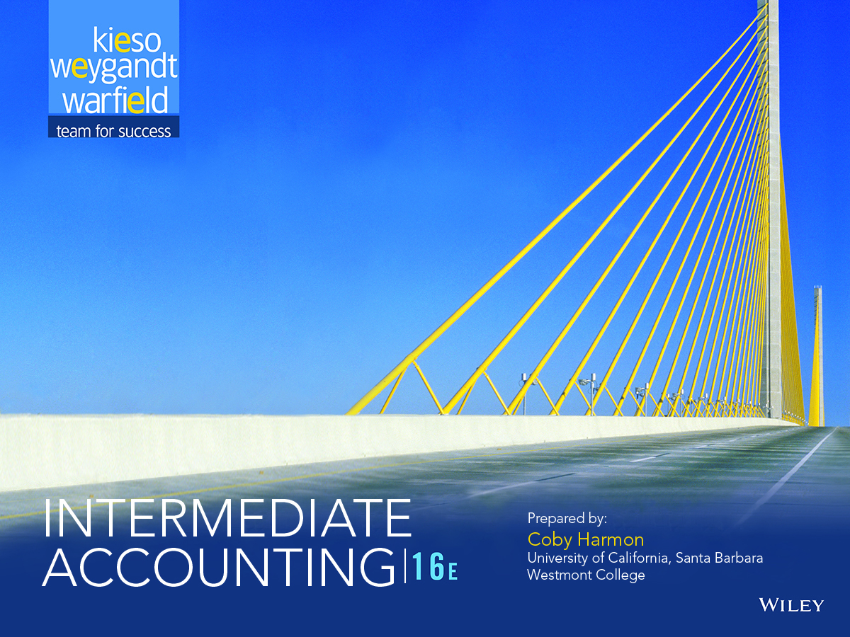

Slide 2
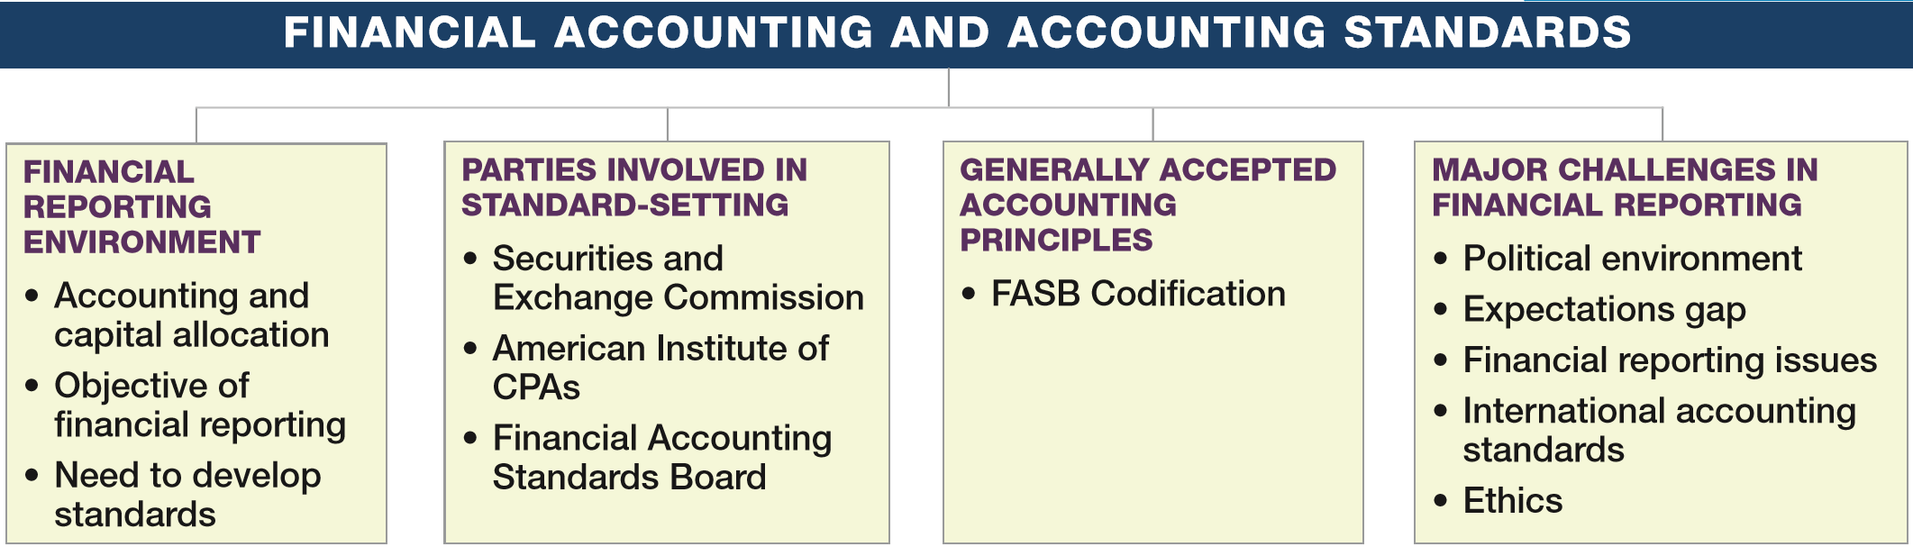
PREVIEW OF CHAPTER 1
Intermediate Accounting
16th Edition
Kieso ● Weygandt ● Warfield

Slide 3
LEARNING OBJECTIVES
1
Financial Accounting and Accounting Standards
After studying this chapter, you should be able to:
Understand the financial reporting environment.
Identify the major policy-setting bodies and their role in the standard-setting process.
Explain the meaning of generally accepted accounting principles (GAAP) and the role of the Codification for GAAP.
Describe major challenges in the financial reporting environment.
LO 1

Slide 4
FINANCIAL REPORTING ENVIRONMENT
Essential characteristics of accounting are:
the identification, measurement, and communication of financial information about
economic entities to
interested parties.
LO 1

Slide 5
FINANCIAL REPORTING ENVIRONMENT
Economic Entity
Financial Statements
Additional Information
Financial Information
Accounting?
Identifies
and
Measures
and
Communicates
Balance Sheet
Income Statement
Statement of Cash Flows
Statement of Owners’ or Stockholders’ Equity
Note Disclosures
President’s letter
Prospectuses
Reports filed with governmental agencies
News releases
Forecasts
Environmental impact statements
Etc.
GAAP
LO 1

Slide 6
FINANCIAL REPORTING ENVIRONMENT
Question
What is the purpose of information presented in notes to the financial statements?
a. To provide disclosure required by generally accepted accounting principles.
b. To correct improper presentation in the financial statements.
c. To provide recognition of amounts not included in the totals of the financial statements.
d. To present management’s responses to auditor comments.
LO 1

Slide 7
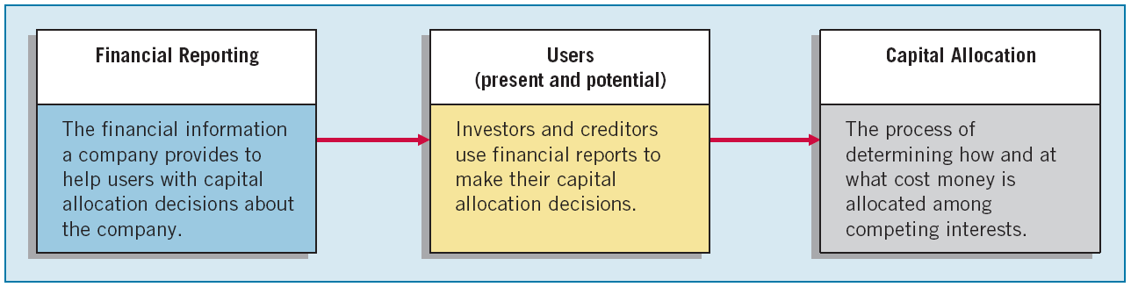
FINANCIAL REPORTING ENVIRONMENT
Accounting and Capital Allocation
Resources are limited. Efficient use of resources often determines whether a business thrives.
ILLUSTRATION 1-1
Capital Allocation Process
LO 1

Slide 8
Accounting and Capital Allocation
Question
An effective process of capital allocation is critical to a healthy economy, which
a. promotes productivity.
b. encourages innovation.
c. provides an efficient and liquid market for buying and selling securities.
d. All of the above.
LO 1

Slide 9
WHAT DO THE NUMBERS MEAN? IT’S THE ACCOUNTING
“It’s the accounting.” That’s what many investors seem to be saying these days. Even the slightest hint of any accounting irregularity at a company leads to a subsequent pounding of the company’s stock price. For example, the Wall Street Journal has run the following headlines related to accounting and its effects on the economy:
Stocks take a beating as accounting woes spread beyond Enron.
Quarterly reports from IBM and Goldman Sachs sent stocks tumbling.
VeriFone ﬁnds accounting issues; stock price cut in half.
Bank of America admits hiding debt.
Facebook, Zynga, Groupon: IPO drops due to accounting, not valuation.
It now has become clear that investors must trust the accounting numbers, or they will abandon the market and put their resources elsewhere. With investor uncertainty, the cost of capital increases for companies who need additional resources. In short, relevant and reliable ﬁnancial information is necessary for markets to be efﬁcient.
LO 1

Slide 10
FINANCIAL REPORTING ENVIRONMENT
Objectives of Financial Reporting
Provide financial information about the reporting entity that is useful to
present and potential equity investors,
lenders, and
other creditors
in making decisions in their capacity as capital providers.
LO 1

Slide 11
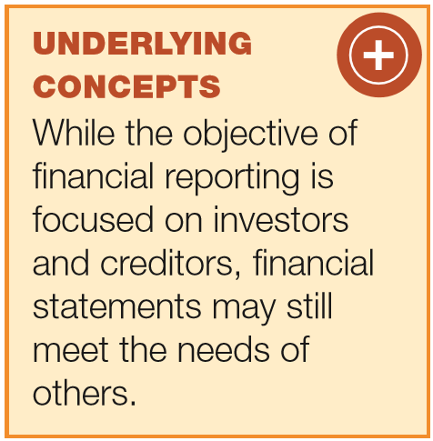
Objective of Financial Accounting
General-Purpose Financial Statements
Provide financial reporting information to a wide variety of users.
Provide the most useful information possible at the least cost.
Equity Investors and Creditors
Investors are the primary user group.
LO 1

Slide 12
Objective of Financial Accounting
Entity Perspective
Companies viewed as separate and distinct from their owners.
Decision-Usefulness
Investors are interested in assessing the company’s
ability to generate net cash inflows and
management’s ability to protect and enhance the capital providers’ investments.
LO 1

Slide 13
WHAT DO THE NUMBERS MEAN? DON’T FORGET STEWARDSHIP
In addition to providing decision-useful information about future cash flows, management also is accountable to investors for the custody and safekeeping of the company’s economic resources and for their efficient and profitable use. For example, the management of The Hershey Company has the responsibility for protecting its economic resources from unfavorable effects of economic factors, such as price changes, and technological and social changes. Because Hershey’s performance in discharging its responsibilities (referred to as its stewardship responsibilities) usually affects its ability to generate net cash inflows, financial reporting may also provide decision-useful information to assess management performance in this role.
Source: Chapter 1, “The Objective of General Purpose Financial Reporting,” and Chapter 3, “Qualitative Characteristics of Useful Financial Information,” Statement of Financial Accounting Concepts No. 8 (Norwalk, Conn.: FASB, September 2010), paras. OB4–OB10.
LO 1

Slide 14
The Need To Develop Standards
Various users need financial information
Financial Statements
Balance Sheet
Income Statement
Statement of Stockholders’ Equity
Statement of Cash Flows
Note Disclosure
The accounting profession has attempted to develop a set of standards that are generally accepted and universally practiced.
Generally Accepted Accounting Principles (GAAP)
LO 1

Slide 15
LEARNING OBJECTIVES
1
Financial Accounting and Accounting Standards
After studying this chapter, you should be able to:
Understand the financial reporting environment.
Identify the major policy-setting bodies and their role in the standard-setting process.
Explain the meaning of generally accepted accounting principles (GAAP) and the role of the Codification for GAAP.
Describe major challenges in the financial reporting environment.
LO 2

Slide 16
PARTIES INVOLVED IN STANDARD SETTING
Three organizations:
Securities and Exchange Commission (SEC).
American Institute of Certified Public Accountants (AICPA).
Financial Accounting Standards Board (FASB).
LO 2

Slide 17

Parties Involved In Standard Setting
Securities and Exchange Commission (SEC)
Established by federal government.
Accounting and reporting for public companies.
Securities Act of 1933
Securities Act of 1934
http://www.sec.gov/
Encouraged private standard-setting body.
SEC requires public companies to adhere to GAAP.
SEC Oversight.
Enforcement Authority.
LO 2

Slide 18

Parties Involved In Standard Setting
American Institute of CPAs (AICPA)
National professional organization
Established the following:
http://www.aicpa.org/
Committee on Accounting Procedures
Accounting Principles Board
1939 to 1959
Issued 51 Accounting Research Bulletins (ARBs)
Problem-by-problem approach failed
1959 to 1973
Issued 31 Accounting Principle Board Opinions (APBOs)
Wheat Committee recommendations adopted in 1973
LO 2

Slide 19
Parties Involved In Standard Setting
Financial Accounting Standards Board (FASB)
Wheat Committee’s recommendations resulted in creation of FASB.
Financial Accounting Foundation
Selects members of the FASB.
Funds their activities.
Exercises general oversight.
Financial Accounting Standards Board
Mission to establish and improve standards of financial accounting and reporting.
Financial Accounting Standards Advisory Council
Consult on major policy issues.
LO 2

Slide 20

Financial Accounting Standards Board
Missions is to establish and improve standards of financial accounting and reporting. Differences between FASB and APB include:
Smaller Membership.
Full-time, Remunerated Membership.
Greater Autonomy.
Increased Independence.
Broader Representation.
http://www.fasb.org/
LO 2

Slide 21
Financial Accounting Standards Board
Question
The first step taken in the establishment of a typical FASB statement is
a. The board conducts research and analysis and a discussion memorandum is issued.
b. A public hearing on the proposed standard is held.
c. The board evaluates the research and public response and issues an exposure draft.
d. Topics are identified and placed on the board’s agenda.
LO 2

Slide 22
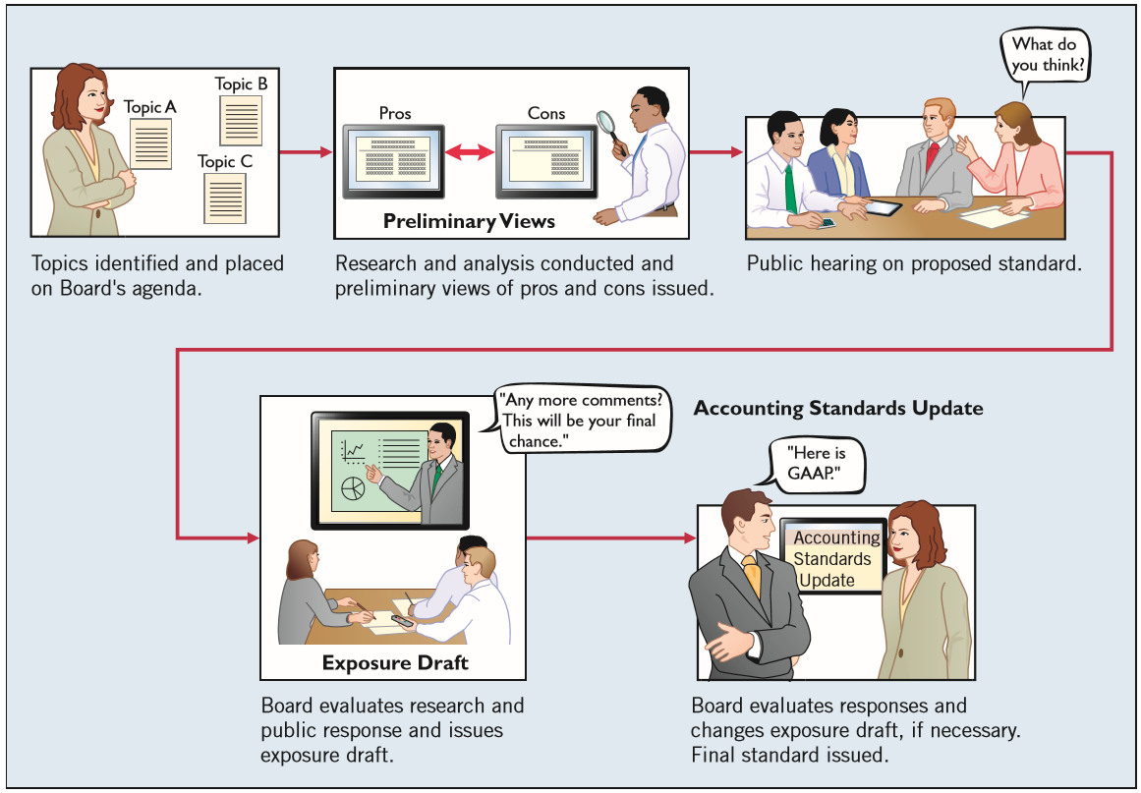
Financial Accounting Standards Board
ILLUSTRATION 1-3
The Due Process System of the FASB
LO 2

Slide 23
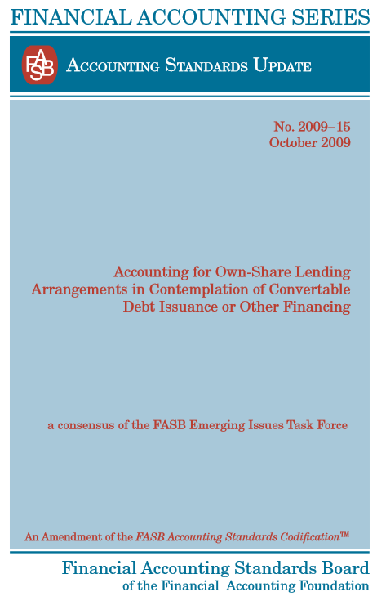
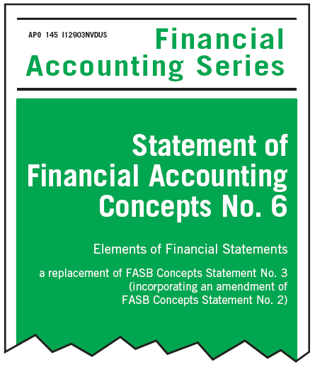
Financial Accounting Standards Board
Types of Pronouncements
Accounting Standards Updates.
Financial Accounting Concepts.
LO 2

Slide 24
LEARNING OBJECTIVES
1
Financial Accounting and Accounting Standards
After studying this chapter, you should be able to:
Understand the financial reporting environment.
Identify the major policy-setting bodies and their role in the standard-setting process.
Explain the meaning of generally accepted accounting principles (GAAP) and the role of the Codification for GAAP.
Describe major challenges in the financial reporting environment.
LO 3

Slide 25
GENERALLY ACCEPTED ACCOUNTING PRINCIPLES
Principles that have substantial authoritative support.
Major sources of GAAP:
FASB Standards, Interpretations, and Staff Positions.
APB Opinions.
AICPA Accounting Research Bulletins.
LO 3

Slide 26
WHAT DO THE NUMBERS MEAN? YOU HAVE TO STEP BACK
Should the accounting profession have principles-based standards or rules-based standards? Critics of the profession today say that over the past three decades, standard-setters have moved away from broad accounting principles aimed at ensuring that companies’ ﬁnancial statements are fairly presented. Instead, these critics say, standard-setters have moved toward drafting voluminous rules that, if technically followed in “check-box” fashion, may shield auditors and companies from legal liability. That has resulted in companies creating complex capital structures that comply with GAAP but hide billions of dollars of debt and other obligations. To add fuel to the ﬁ re, the chief accountant of the enforcement division of the SEC noted, “One can violate SEC laws and still comply with GAAP.”
In short, what he is saying is that it is not enough just to check the boxes. This point was reinforced by the chief accountant of the SEC, who remarked that judgments should result in “accounting that reﬂ ects the substance of the transaction, as well as being in accordance with the literature.” That is, you have to exercise judgment in applying GAAP to achieve high-quality reporting.
Sources: Adapted from S. Liesman, “SEC Accounting Cop’s Warning: Playing by the Rules May Not Head Off Fraud Issues,” Wall Street Journal (February 12, 2002), p. C7.
LO 3

Slide 27
Generally Accepted Accounting Principles
FASB Codification
Goal in developing the Codification is to provide in one place all the authoritative literature related to a particular topic.
Creates one level of GAAP, which is considered authoritative.
All other accounting literature is considered non-authoritative.
FASB has developed the Financial Accounting Standards Board Codification Research System (CRS). The FASB’s primary goal in developing the Codification is to provide in one place all the authoritative literature related to a particular topic.
LO 3

Slide 28
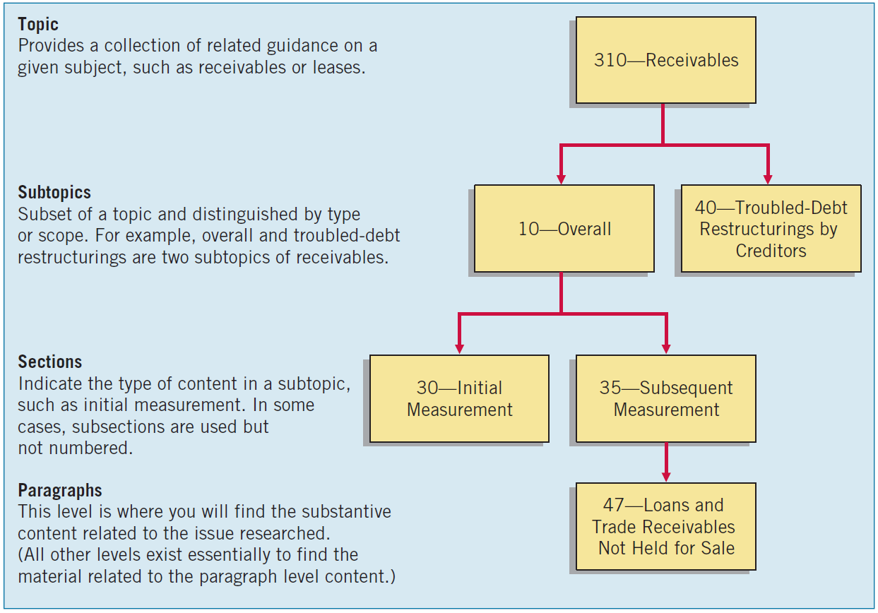
Generally Accepted Accounting Principles
ILLUSTRATION 1-4
FASB Codification Framework
LO 3

Slide 29
LEARNING OBJECTIVES
1
Financial Accounting and Accounting Standards
After studying this chapter, you should be able to:
Understand the financial reporting environment.
Identify the major policy-setting bodies and their role in the standard-setting process.
Explain the meaning of generally accepted accounting principles (GAAP) and the role of the Codification for GAAP.
Describe major challenges in the financial reporting environment.
LO 4

Slide 30
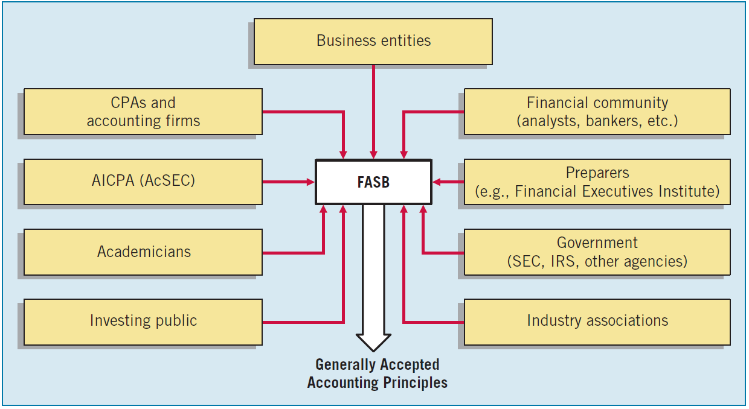
MAJOR CHALLENGES IN FINANCIAL REPORTING
GAAP in a Political Environment
GAAP is as much a product of political action as it is of careful logic or empirical findings.
ILLUSTRATION 1-5
User Groups that Influence the Formulation of Accounting Standards
LO 4

Slide 31
EVOLVING ISSUES FAIR VALUE, FAIR CONSEQUENCES
No recent accounting issue better illustrates the economic consequences of accounting than the current debate over the use of fair value accounting for ﬁnancial assets. Both the FASB and the International Accounting Standards Board (IASB) have standards requiring the use of fair value accounting for ﬁnancial assets, such as investments and other ﬁnancial instruments. Fair value provides the most relevant and reliable information for investors about these assets and liabilities. However, in the wake of the recent credit crisis, some countries, their central banks, and bank regulators want to suspend fair value accounting, based on concerns that use of fair value accounting, which calls for recording signiﬁcant losses on poorly performing loans and investments, could scare investors and depositors and lead to a “run on the bank.” For example, in 2009, Congress ordered the FASB to change its accounting rules so as to reduce the losses banks reported, as the values of their securities had crumbled. These changes were generally supported by banks. But these changes produced a strong reaction from some investors, with one investor group complaining that the changes would “effectively gut the transparent application of fair value measurement.” The group also says suspending fair value accounting would delay the recovery of the banking system. Such political pressure on accounting standard-setters is not conﬁned to the United States. For example, French President Nicolas Sarkozy urged his European Union counterparts to
continued
LO 4

Slide 32
EVOLVING ISSUES FAIR VALUE, FAIR CONSEQUENCES
back changes to accounting rules and give banks and insurers some breathing space amid the market turmoil. And more recently, international ﬁnance ministers are urging the FASB and IASB to accelerate their work on accounting standards, including the fair value guidance for ﬁnancial instruments. Most recently, IASB chair Hans Hoogervorst indicated that work remains to be done in the fair value debate and that “the dichotomy between historical cost and fair value is not as stark as one would expect.” Mr. Hoogervorst noted that while historical cost is to some extent based on fair value, it needs a degree of current measurement to maintain its relevance. It is not free from subjective updating requirements, and it is not necessarily stable. Moreover, historical cost is also vulnerable to abuse. In sum, all the vulnerabilities that are often attributed to fair value accounting can be equally pertinent to historical cost. It is unclear whether these political pressures will have an effect on fair value accounting, but there is no question that the issue has stirred signiﬁ cant worldwide political debate. In short, the numbers have consequences.
Sources: Adapted from Ben Hall and Nikki Tait, “Sarkozy Seeks EU Accounting Change,” The Financial Times Limited (September 30, 2008); Floyd Norris, “Banks Are Set to Receive More Leeway on Asset Values,” The New York Times (March 31, 2009); E. Orenstein, “G20 Finance Ministers Urge FASB, IASB Converge Key Standards by Mid-2013 at the Latest,” FEI Financial Reporting Blog (April 2012); and Speech at the Paris IFRS Conference, http://www.ifrs.org/Alerts/ Conference/Documents/2015/Hans-Hoogervorst-speech-ParisJune-2015.pdf (June 2015).
LO 4

Slide 33
Major Challenges In Financial Reporting
Expectation GAAP
What the public thinks accountants should do vs. what accountants think they can do.
Difficult to close in light of accounting scandals.
Sarbanes-Oxley Act.
Public Company Accounting Oversight Board (PCAOB).
LO 4

Slide 34
Major Challenges In Financial Reporting
Financial Reporting Challenges
Nonfinancial measurements.
Forward-looking information.
Soft assets.
Timeliness.
Understandability.
LO 4

Slide 35
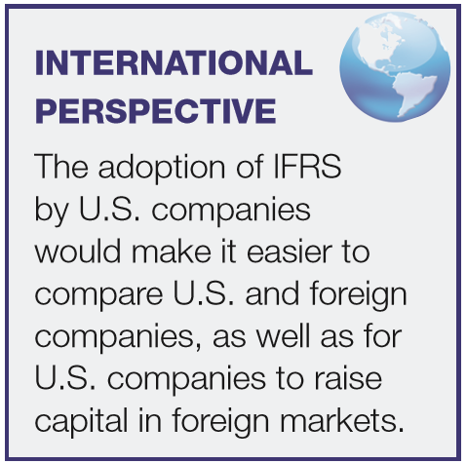
Major Challenges In Financial Reporting
International Accounting Standards
Two sets of standards accepted for international use:
U.S. GAAP, issued by the FASB.
International Financial Reporting Standards (IFRS), issued by the IASB.
LO 4

Slide 36
WHAT DO THE NUMBERS MEAN? CAN YOU DO THAT?
One of the more difﬁcult issues related to convergence and international accounting standards is that countries have different cultures and customs. For example, the former chair of the IASB explained it this way regarding Europe:
“In the U.K. everything is permitted unless it is prohibited. In Germany, it is the other way around; everything is prohibited unless it is permitted. In the Netherlands, everything is prohibited even if it is permitted. And in France, everything is permitted even if it is prohibited. Add in countries like Japan, the United States and China, it becomes very difﬁcult to meet the needs of each of these countries.”
With this diversity of thinking around the world, it understandable why accounting convergence has been so elusive.
Source: Sir D. Tweedie, “Remarks at the Robert P. Maxon Lectureship,” George Washington University (April 7, 2010).
LO 4

Slide 37
Major Challenges In Financial Reporting
Ethics in the Environment of Financial Accounting
In accounting, we frequently encounter ethical dilemmas.
GAAP does not always provide an answer.
Doing the right thing is not always easy or obvious.
LO 4

Slide 38
RELEVANT FACTS
Similarities
Generally accepted accounting principles (GAAP) for U.S. companies are developed by the Financial Accounting Standards Board (FASB). The FASB is a private organization. The Securities and Exchange Commission (SEC) exercises oversight over the actions of the FASB. The IASB is also a private organization. Oversight over the actions of the IASB is regulated by IOSCO.
Both the IASB and the FASB have essentially the same governance structure, that is, a Foundation that provides oversight, a Board, an Advisory Council, and an Interpretations Committee. In addition, a general body that involves the public interest is part of the governance structure.
The FASB relies on the SEC for regulation and enforcement of its standards. The IASB relies primarily on IOSCO for regulation and enforcement of its standards.
LO 5 Compare the procedures related to financial accounting and accounting standards under GAAP and IFRS.

Slide 39
RELEVANT FACTS
Similarities
Both the IASB and the FASB are working together to find common grounds for convergence. A good example is the recent issuance of a new standard on revenue recognition that both organizations support. Also, the Boards are working together on other substantial projects, such as the accounting for leases.
Differences
GAAP is more detailed or rules-based. IFRS tends to simpler and more flexible in its accounting and disclosure requirements. The difference in approach has resulted in a debate about the merits of principles-based versus rules-based standards.
LO 5

Slide 40
RELEVANT FACTS
Differences
Differences between GAAP and IFRS should not be surprising because standard-setters have developed standards in response to different user needs. In some countries, the primary users of financial statements are private investors. In others, the primary users are tax authorities or central government planners. In the United States, investors and creditors have driven accounting-standard formulation.
LO 5

Slide 41
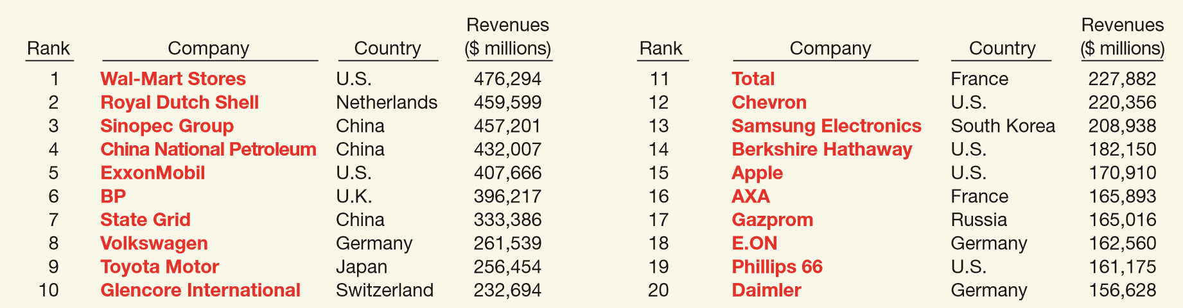
ABOUT THE NUMBERS
World markets are becoming increasingly intertwined. International consumers drive Japanese cars, wear Italian shoes and Scottish woolens, drink Brazilian coffee and Indian tea, eat Swiss chocolate bars, sit on Danish furniture, watch U.S. movies, and use Arabian oil. The tremendous variety and volume of both exported and imported goods indicates the extensive involvement in international trade—for many companies, the world is their market. To provide some indication of the extent of globalization of economic activity, Illustration IFRS1-1 provides a listing of the top 20 global companies in terms of sales.
ILLUSTRATION IFRS 1-1
Global Companies
LO 5

Slide 42
International Standard-Setting Organizations:
International Accounting Standards Board (IASB)
Issues International Financial Reporting Standards (IFRS).
Standards used on most foreign exchanges.
Standards used by foreign companies listing on U.S. securities exchanges.
IFRS used in over 115 countries.
LO 5

Slide 43

International Organization of Securities Commissions (IOSCO)
Does not set accounting standards.
Dedicated to ensuring that global markets can operate in an efficient and effective basis.
http://www.iosco.org/
LO 5

Slide 44
IFRS SELF-TEST QUESTIONS
The major key players on the international side are the:
IASB and FASB.
SEC and FASB.
IOSCO and the SEC.
IASB and IOSCO.
LO 5

Slide 45

International Accounting Standards Board (IASB)
Composed of four organizations—
International Accounting Standards Committee Foundation (IASCF).
International Accounting Standards Board (IASB).
Standards Advisory Council.
International Financial Reporting Interpretations Committee (IFRIC).
http://www.iasb.org
LO 5

Slide 46
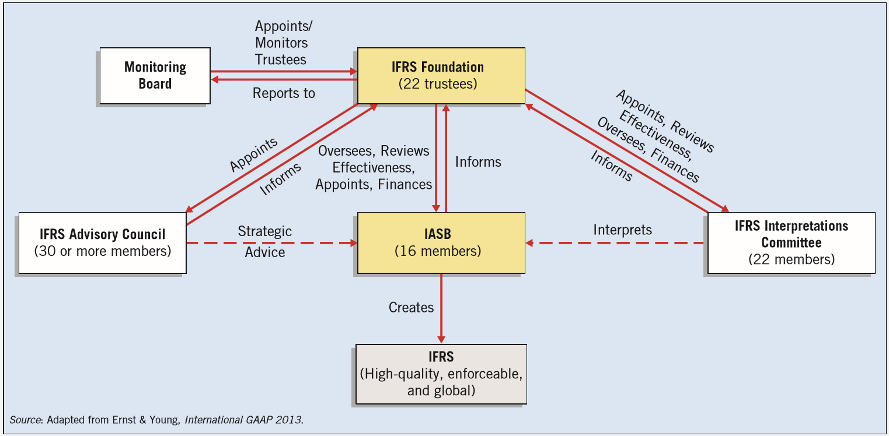
ILLUSTRATION IFRS 1-2
International Standard-Setting Structure
LO 5

Slide 47
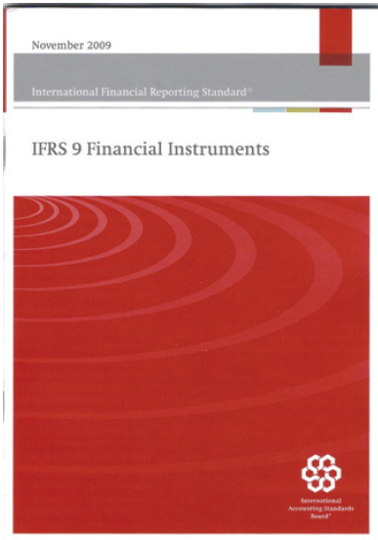
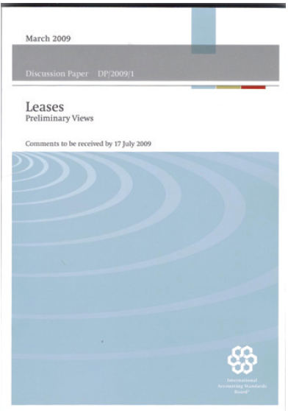
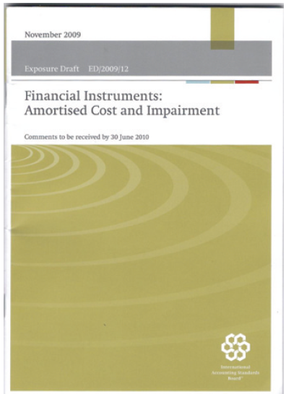
Types of Pronouncements
International Financial Reporting Standards.
Framework For Financial Reporting.
International Financial Reporting Interpretations.
LO 5

Slide 48
Hierarchy of IFRS
Companies first look to:
International Financial Reporting Standards;
International Accounting Standards; and
Interpretations originated by the International Financial Reporting Interpretations Committee (IFRIC) or the former Standing Interpretations Committee (SIC).
LO 5

Slide 49
IFRS SELF-TEST QUESTIONS
IFRS is comprised of:
International Financial Reporting Standards and FASB financial reporting standards.
International Financial Reporting Standards, International Accounting Standards, and international accounting interpretations.
International Accounting Standards and international accounting interpretations.
FASB financial reporting standards and International Accounting Standards.
LO 5

Slide 50
International Accounting Convergence
The SEC appears committed to move to IFRS, assuming that certain conditions are met.
The FASB and the IASB have been working diligently to (1) make their existing financial reporting standards fully compatible as soon as is practicable, and (2) coordinate their future work programs to ensure that once achieved, compatibility is maintained.
LO 5

Slide 51
IFRS SELF-TEST QUESTIONS
Which of the following statements is true?
The IASB has the same number of members as the FASB.
The IASB structure has both advisory and interpretation functions, but no trustees.
The IASB has been in existence longer than the FASB.
The IASB structure is quite similar to the FASB’s, except the IASB has a larger number of board members.
LO 5

Slide 52
ON THE HORIZON
Both the IASB and the FASB are hard at work developing standards that will lead to the elimination of major differences in the way certain transactions are accounted for and reported. In fact, beginning in 2010, the IASB (and the FASB on its joint projects with the IASB) started its policy of phasing in adoption of new major standards over several years. The major reason for this policy is to provide companies time to translate and implement international standards into practice. Much has happened in a very short period of time in the international accounting environment. While adoption of IFRS in the United States is an unlikely avenue to achieve a single set of high-quality accounting standards, there continues to be strong support for the Boards to continue their work to narrow the differences between GAAP and IFRS.
LO 5

Slide 53
IFRS SELF-TEST QUESTIONS
IFRS stands for:
International Federation of Reporting Services.
Independent Financial Reporting Standards.
International Financial Reporting Standards.
Integrated Financial Reporting Services.
LO 5

Slide 54
COPYRIGHT
“Copyright © 2016 John Wiley & Sons, Inc. All rights reserved. Reproduction or translation of this work beyond that permitted in Section 117 of the 1976 United States Copyright Act without the express written permission of the copyright owner is unlawful. Request for further information should be addressed to the Permissions Department, John Wiley & Sons, Inc. The purchaser may make back-up copies for his/her own use only and not for distribution or resale. The Publisher assumes no responsibility for errors, omissions, or damages, caused by the use of these programs or from the use of the information contained herein.”

