Slide 1
Epidemiology-an introduction
Lecture 1

Slide 2
Epidemiology
EPI: UPON, AMONG
DEMOS: PEOPLE
LOGOS: WORD, REASON, DOCTRINE

Slide 3
What is epidemiology?
Epidemiology is the study of how often diseases occur in different groups of people and why.
In medicine
Why has this person got this disease?
What is the best way of treating them?
In epidemiology
What kind of people get this disaese? Why do they get it when others don’t?
How can we find out what is generally the best way of treating people with this disease???

Slide 4
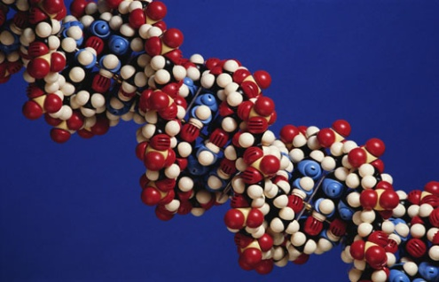
Individual
Molecular
Society
Family

Slide 5
Differences between basic, clinical and public health science
Basic
Clinical
Public Health
What/who is studied
Cells, tissues, animals in labs
Ill patients who seek care or tx
Populations or communities
Research goals
Understand disease mechanisms, effects of toxic substances
Improve diagnosis and treatment of disease
Prevent disease, promote health

Slide 6
In the lab…
Mostly experimental
Variables controlled by the investigator
Highly equipment intensive
All (or most) variables known
Valid results (usually)
Replication relatively easy
Results sometimes uncertain for humans
Little need for statistical manipulation of data

Slide 7
In the community…
Mostly observational
Variables controlled by “nature”
Highly labor intensive
Some variables unknown
Validity of data often questionable
Replication difficult/impossible
Meaning of results for humans clear
Statistical control often very important

Slide 8
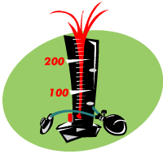
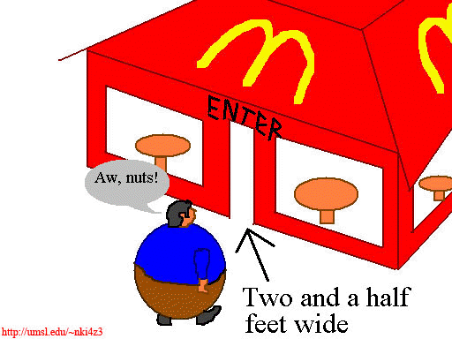
A physiologist may study blood pressure, the epidemiologist will probably study hypertension
The nutritionist studies adult weight, the epidemiologist studies obesity

Slide 9
What is epidemiology?
Epidemiology is based on 2 main assumptions
1. Human disease does not occur at random.
2. Human disease has causal and preventive factors that can be identified through systematic investigation of different populations or subgroups of individuals within a population in different places or at different times.

Slide 10
Definitions
The study of the distribution and determinants of disease frequency in man. (MacMahon and Pugh, 1970)

Slide 11
EPIDEMIOLOGY
FREQUENCY PREVALENCE INCIDENCE
DISTRIBUTION WHO? WHERE? WHEN?
DETERMINANTS WHY?? CAUSES OF DISEASE
HOW MANY?
WHERE?
WHAT NOW?
WHY?
HOW?

Slide 12
Frequency
Amount of disease- risk, incidence rate and prevalence.
These measurements give an idea about the burden of disease in a population

Slide 13
“When we measure,
we know better”
- Center for Disease Control (CDC), Atlanta, Georgia,USA

Slide 14
“Not everything that can be counted counts, and not everything that counts can be counted”
Albert Einstein
هناك شك انها ليست لآلبيرت، اما لِ وليام بروس كاميرون حسب بعض الاثباتات
محمد مصلح 2019-9-9

Slide 15

Distribution
By time
Studying time trends for certain diseases.
Three basic types of time trend are described-
Epidemic: a temporary increase in the incidence of a disease in a population.
Periodic: referes to the pattern of more or less regular changes in incidence (e.g whooping cough tends to peak every 3 years or so.
Secular trends: secular or long –term trends, refer to non-periodic changes in disease statistics over a number of years.

Slide 16

Distribution
By person
Characteristics of person which affect the likelihood of occurrence of
particular Diseases include age, sex, ethnicity, occupation,
socio-economic status, marital status
Disease rates can be calculated for subsets of the population , therefore helping to identify priorities for preventive action.

Slide 17
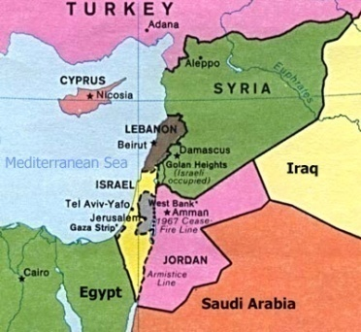
Distribution
By place
International, regional, and small area comparisons of disease distribution may be made.
Standardization is required to allow for important differences in population structure!

Slide 18
Epidemiology
ILLNESS CENTERED
- Cardiovascular epidemiology
- Cancer epidemiology
- Respiratory disease epidemiology
- Infectious disease epidemiology
DETERMINANT CENTERED
- Nutritional epidemiology
- Occupational epidemiology
- Behavioural epidemiology

Slide 19
Epidemiology
CLINICAL EPIDEMIOLOGY
Study of disease outcome
Clinical trials
Notes:
‹#›

Slide 20
History of epidemiology
Epidemiology is as old as medicine itself-
Hippocrates first suggested in the fifth century B.C. that
environmental factors influence disease occurence.
William Farr- a physician-set up a system for routine compilation of the numbers and causes of deaths in England.
- compared mortality patterns of
married and single persons.
workers in different occupations

Slide 21
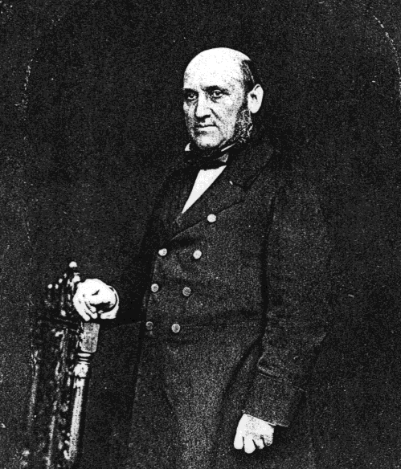
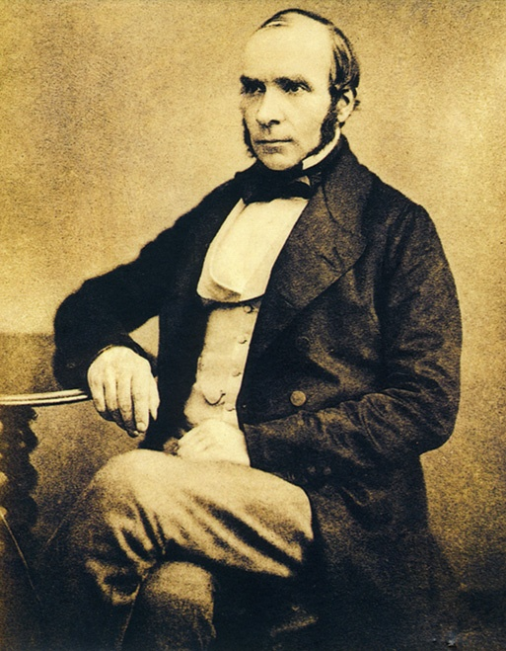
The Founding Father of Modern Epidemiology
?
William Farr
1807-1883
John Snow
1813-1858

Slide 22
Farr was the official “Compiler of Statistics” in the UK General Register Office and is known as the “Father of Vital Statistics”
He was aware of deficiencies in the birth and death registries, but was determined to make the best use of the available data while fully considering the possible implications of the deficiencies; worked to promote accuracy and completeness

Slide 23
Farr used solid quantitative methods (not merely impressions) to study how disease and mortality were influenced by characteristics such as social position, occupation, and physical environment
Was first to produce estimates of annual rates of death from specific causes by analyzing England’s birth and death registries
Among the first to estimate death rates from suicide in different population groups

Slide 24
History of epidemiology
Cholera epidemic- John Snow -1854
Death rates from cholera, 1853-1854, according to water company supplying subdistrict of London
Water company | Population in 1851 | Cholera deaths | Deaths per 100,000 living
Southwake Both companies Lambeth | 167,654 301,149 14,632 | 192 182 0 | 114 60 0

Slide 25
History of epidemiology
Cholera epidemic- John Snow -1854
Death rates from cholera in London, 1853-1854, according to water company supplying actual house
Water company | Number of houses | Cholera deaths | Deaths per 100,000 houses
Southwake Lambeth | 40,046 26,107 | 1263 98 | 315 37

Slide 26
History of epidemiology
JOHN SNOW (1813-1858)
Snow the first investigator to draw together all 3 components of the definition of
Epidemiology!!
Frequency of cholera
2. Distribution of cholera
3. A cause or determinant of the outbreak
Diseases can be prevented without complete knowledge of specific causal factors!
(the bacteria Vibrio cholerae was discovered in 1883 by Robert Koch)

Slide 27
Epidemiologic transition
Epidemiologic transition
Past
Present
Chronic diseases
Cancer, CVD,diabetes
Deficiency diseases
Infectious diseases
long latent period,
multiple causes
Short latent period,single cause
Notes:
‹#›

Slide 28
Noncommunicable diseases
Global mortality
Chronic obstructive pulmonary disease
4.2%
Communicable diseases
41%
Non communicable diseases
58.8%
Diabetes1.1%
Cancer
13.4%
CVD
30.9%
World Health Report 1999
Notes:
‹#›

Slide 29
What are the objectives of epidemiology?
1. To determine the extent/frequency of disease (states of health) and/or behaviors in a community.
2. To identify the etiology or the cause/s of a disease and the factors that impact upon a person’s risk for a disease.
3. To study the natural history and prognosis of disease.

Slide 30
What are the objectives of epidemiology?
4. To evaluate new preventive and therapeutic measures and new modes of health care delivery.
5. To provide the foundation for developing public policy and regulatory decisions relating to public health problems.

Slide 31
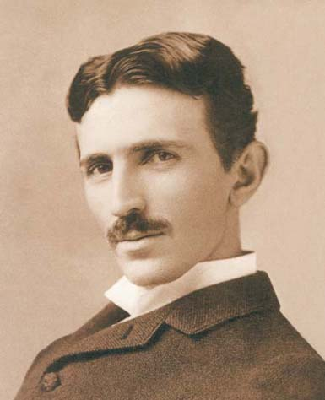
“Science is but a perversion of itself unless it has as its ultimate goal the betterment of humanity”
- Nikola Tesla, Inventor, 1856-1943
“The Father of Physics"
"The man who invented the 20th century“
"the patron saint of modern electricity"

Slide 32
“A MAJOR CHALLENGE FOR EPIDEMIOLOGY today is to become an effective instrument in the SHAPING AND EVALUATION OF HEALTH POLICIES AND PRACTICES… Epidemiologists must OBTAIN AND ANALYSE THE INFORMATION NEEDED and PRESENT IT to health planners IN SUCH A WAY THAT THIS INFORMATION CAN BE USED in policy, planning and evaluation.
Michel Thuriaux, Epidemiology and Statistics Unit, WHO Regional Office for Europe, 1992

Slide 33
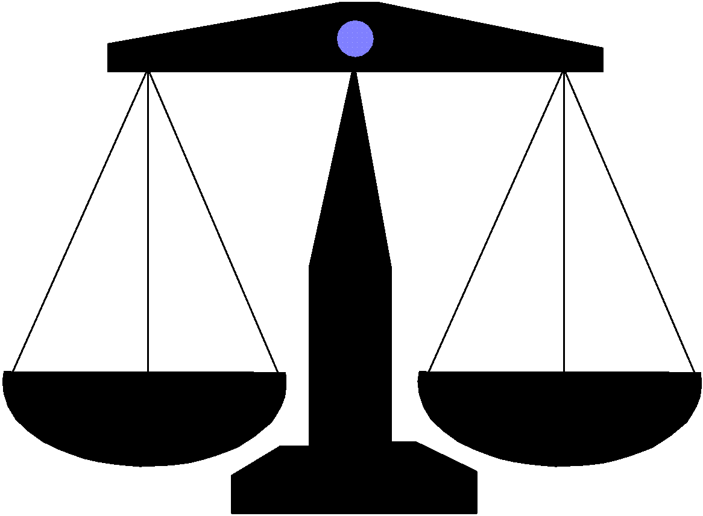
However, as epidemiologist/public health practitioners we most often need to act/intervene under conditions of uncertainty based on the available evidence

Slide 34
CAUSATION
Uses of Epidemiology
Epidemiology is a good tool to study association between disease and different factors.
A cause in epidemiology –is a factor –when its intensity or fequency increases the incidence of disease increases (the probability of disease increases)
A cause does not have to be necessary or sufficient. ..........
e.g if you smoke have a higher probability of developing lung cancer. (interaction between smoking and genetic polymorphism)
Most causes act in interactive ways

Slide 35
Causation
unless we define a disease according to exposure.
HIV- AIDS
Virus-measles
Lead- lead poisoning

Slide 36
Examples from the literature
SMOKING AND LUNG CANCER
AIDS

Slide 37
EPIDEMIOLOGY
FREQUENCY PREVALENCE INCIDENCE
DISTRIBUTION WHO? WHERE? WHEN?
DETERMINANTS CAUSES OF DISEASE
RISK FACTOR
DISEASE
STUDY DESIGN
CHANCE?-statistical testing
BIAS AND CONFOUNDING?
IS IT A CAUSE??

