Slide 1

Name : Mohammed Imad Assi
Student Id : 1200975
Course name : Fundamentals of nursing ”LAB”
Subject name : Gastroenteritis
Doctor’s name : Maram jaghama

Slide 2
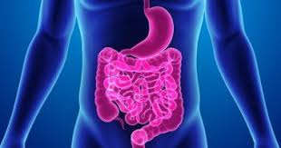
Contents:
1_Defintion of Gastroenteritis
2_Signs and symptoms
3_Causes
4_Diagnosi
5_Medical Management
6_Pharmacologic Management
7__Care plan as a nurse
8_References

Slide 3
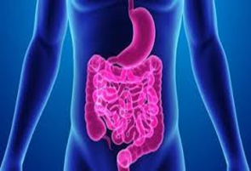
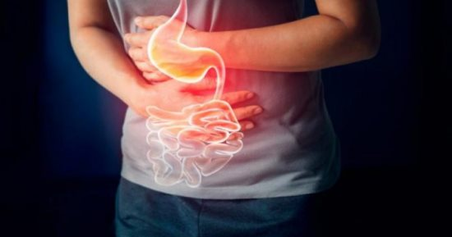
Definition
Gastroenteritis refers to inflammation that affects the digestive system consisting of the mouth, esophagus, stomach and intestine, and in which food is digested. Gastroenteritis is sometimes referred to as stomach flu, although it may not be related to influenza.

Slide 4
Signs and symptoms
Diarrhea. Frequent, watery stools are more consistent with viral gastroenteritis, while stools with blood or mucous are indicative of a bacterial
pathogen.
Vomiting. When symptoms of vomiting predominate, one should consider other diseases such as gastroesophageal reflux disease (GERD), diabetic ketoacidosis, pyloric stenosis, acute abdomen, or urinary tract infection.
Dysuria. Determine if there is an increase or decrease in the frequency of urination as measured by the number of wet diapers, time since last urination, color and concentration of urine, and presence of dysuria.
Abdominal pain. In general, pain that precedes vomiting and diarrhea is more likely to be due to abdominal pathology other than gastroenteritis.
Infection. Determine the presence of fever, chills, myalgias, rash, rhinorrhea, sore throat, cough, known immunocompromised status.

Slide 5
Causes
Infectious agents. The infectious organisms may be salmonella, Escherichia coli, dysentery bacilli, and various viruses, most notably rotaviruses.
Contaminated food. Many diarrheal disturbances in children are caused by contaminated food or human or animal fecal waste through the oral-fecal route.
Unsanitary water and environment. This condition is prevalent in areas lacking adequate clean water and sanitary facilities.
Antibiotic therapy. Diarrhea may also be caused by antibiotic therapy.

Slide 6
Diagnosis
Risk for infection related to inadequate secondary defenses or insufficient knowledge to avoid exposure to pathogens.
Impaired skin integrity related to constant presence of diarrheal stools.
Deficient fluid volume related to diarrheal stools.
Imbalanced nutrition: less than body requirements related to malabsorption of nutrients.
Hyperthermia related to dehydration.

Slide 7
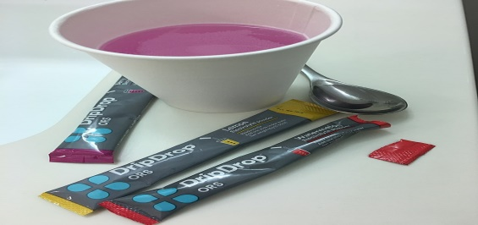


Medical Management
    1_Oral rehydration solution.
    2_IV rehydration.
    3_Diet.

Slide 8

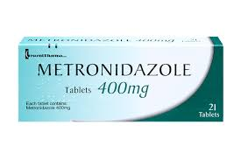

Pharmacologic Management
1. Vaccines.
2. Metronidazole.
3. Antiemetics.

Slide 9
Care plan as a nurse
Risk for Diarrhea:
Rationales | Nursing Intervention
Eating contaminated foods or drinking contaminated water may predispose the client to intestinal infection. | Ask the client about a recent history of: -Drinking contaminated water. -Eating food inadequately cooked. -Ingestion of unpasteurized dairy products.
Defecation pattern will promote immediate treatment. | Evaluate pattern of defecation.
These assessment findings are commonly connected with diarrhea. If gastroenteritis involves the large intestine, the colon is not able to absorb water and the client’s stool is very watery. | Assess for abdominal pain, abdominal cramping, hyperactive bowel sounds, frequency, urgency, and loose stools.

Slide 10
Risk for Fluid Volume Deficit:
Rationale | Nursing Interventions
A loss of interstitial fluid causes the loss of skin turgor. Assessment of the skin turgor in adults is less accurate since their skin normally loses its elasticity. Therefore the skin turgor assessed over the sternum in the forehead is best. Several longitudinal furrows and coating may be noted along the tongue. | Assess the client’s skin turgor and mucous membranes for signs of dehydration.
Vomiting is associated with fluid loss. | Assess the volume and frequency of vomiting.
Gastroenteritis is associated with an increased frequency of very loose or watery bowel movements. The inflammation in the large intestine limits the colon’s ability to absorb water, leading to fluid volume deficit. | Assess the consistency and number of bowel movements.

Slide 11
Risk of Imbalanced Nutrition:
Less Than Body Requirements
Rationales | Nursing Intervention
This will accurately monitor the response to therapy. | Measure client weight.
These data will help in initiating nursing actions and subsequent treatment. | Monitor and record the number of vomiting, amount and frequency.
To determine the amount of food that is consumed. | Monitor the client’s food intake.
This will stimulate the appetite of the client. | Provide a diverse diet according to his needs.

Slide 12
Video of Gastroenteritis
https://www.youtube.com/watch?v=yuZesDQcsU0

Slide 13
References
1_NursesLabs
https://nurseslabs.com/gastroenteritis/
2_Cleveland Clinic Abu Dhabi
https://www.clevelandclinicabudhabi.ae/ar/health-hub/health-library/pages/gastroenteritis.aspx
3_Mayo Clinic
https://www.mayoclinic.org/search/search-results?q=gastroenteritis

