Slide 1

FUNDAMENTAL OF NURSING
Name :asame mazen sweity
Topic:meningitis
University ID: 1200996

Slide 2
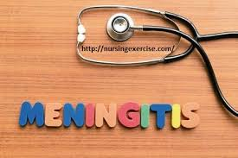
In this presentation I will talk about :
_What is meningitis
_Types of Meningitis
_Symptoms
_Causes of meningitis
_Diagnosing meningitis
_treatment
_Prevention of meningitis
_nursing care plan

Slide 3
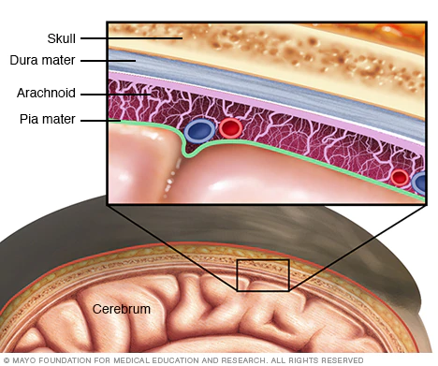
Meningitis
Meningitis is an infection and inflammation of the fluid and the three membranes (strands) that protect the brain and spinal cord. The strong outer membrane is called the dura mater, and the inner thin layer is called the pia mater.، As for the middle class, it is arachnid.
It can infect the body due to a bacterial or viral or fungal infection

Slide 4
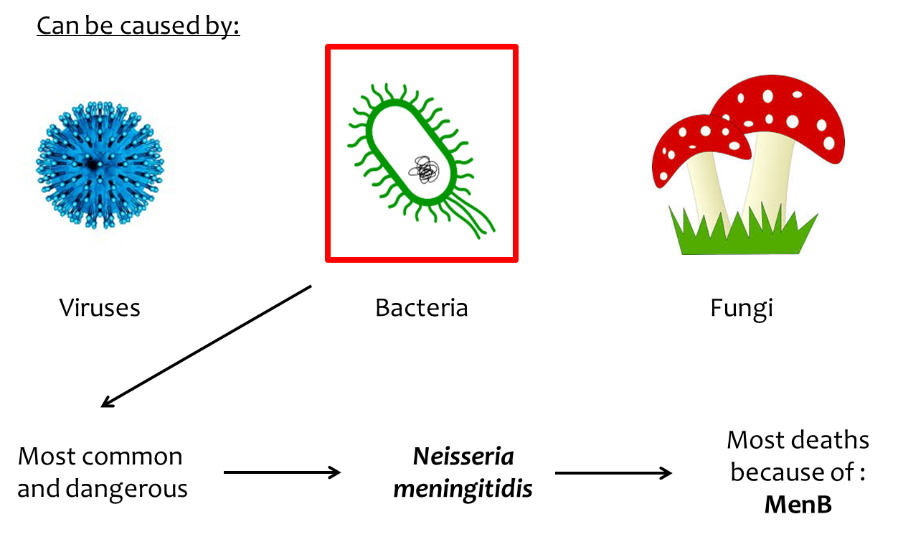
Types of Meningitis
Bacterial meningitis: it starts when bacteria get into your bloodstream from your sinuses, ears, or throat. The bacteria travel through your bloodstream to your brain.
.
Viral meningitis: It has flu-like symptoms, and viruses that cause gastritis are considered to be the cause of viral meningitis.
Fungal meningitis: It is often caused by cryptococcus fungi, or other types of fungi. The fungi are usually inhaled and then transmitted to the bloodstream via the central nervous system.

Slide 5
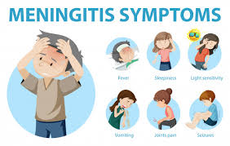
Symptoms
1_Sudden high fever
2_Neck stiffness
3_A severe headache that looks different from a normal headache
4_Headache with nausea or vomiting
5_Confusion or difficulty concentrating
6_Seizures
7_Drowsiness or difficulty waking up
8_Sensitivity to light
9_Loss of appetite and thirst
10_Rashes (sometimes, such as meningococcal meningitis)

Slide 6
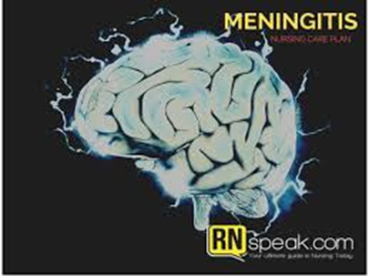
Causes of meningitis
Meningitis almost always results from a bacterial or viral or fungal infection that begins somewhere else in your body, like your ears, sinuses, or throat.
Less common causes of meningitis include:
Autoimmune disorders
Cancer medications
Syphilis
Tuberculosis

Slide 7
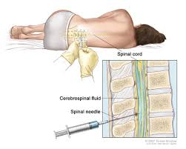
Diagnosing meningitis
A blood sample is placed in a special dish to check that it contains microbes, especially bacteria. The sample may also be placed on a slide and stained (with a Gram stain), and then examined under a microscope for the presence of bacteria.
CT or MRI on the head, X-ray examination or CT scan of the chest or sinuses for swelling or inflammation.
Obtaining cerebrospinal fluid in meningitis, usually cerebrospinal fluid shows low sugar (glucose) along with an increase in the number of white blood cells and increased protein.

Slide 8
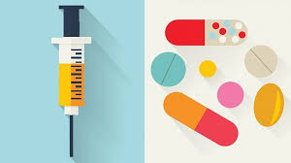
Meningitis treatment
Acute bacterial meningitis is treated with intravenous antibiotics and sometimes corticosteroids.
The type or combination of antibiotics depends on the type of bacteria causing the infection.
As for viral meningitis, it can be treated with bed rest,Plenty of fluids,Over-the-counter pain medications to help reduce fever and relieve body pain.
If the cause of meningitis is not clear, a doctor may begin treatment with antivirals and antibiotics when the cause is known.

Slide 9
prevention of meningitis
Careful hand washing helps prevent the spread of germs.
Don't share drinks, foods, eating utensils, lip balms, or toothbrushes with anyone else.
Maintain your immune system by getting enough rest, exercising regularly, and eating healthy food with plenty of fresh fruits, vegetables.
When you need to cough or sneeze, be sure to cover your mouth and nose.
Pregnant women should be careful with foods. Avoid listeria, for example by cooking meat, including hot dogs and sirloin, to 165 F (74 C.

Slide 10
Nursing care plan
Rationale | Nursing Interventions
A history of aseptic viral meningitis usually begins with an onset of fever up to 104°F. As hyperthermia progresses, HR and BP increase also. | Assess the child’s vital signs closely.
Shivering can happen from rapid reduction of temperature which can result to rebound effect and increase the temperature instead lower the temperature. | Gradually decrease temperature
Decreases temperature by liberating heat by conduction and convection. | Perform tepid sponge
Prevents dehydration; Avoid fluid overload because of the risk of cerebral edema. | Maintain adequate fluid intake as tolerated.
Antibiotics are given to treat the underlying causes of inflammation and thus prevent the occurrence of seizure activity. | Administer antibiotics as indicated..
risk for Hyperthermia:
related to Infection,
Abnormal temperature regulation

Slide 11
risk for Acute Pain:
related to Increased intracranial pressure,
Meningeal irritation
Rationale | Nursing Interventions
Darkening the room may decrease photophobia. | Maintain a quiet environment and keep child’s room darkened.
Stimulation can increase intracranial pressure, hence intensifying the pain. | Prevent stimulation and restrict visitors.
Promotes comfort and reduce irritation and agitation.. | Turn the client often and position the client carefully.
Prevent joint stiffness and neck pain. | Assist ROM exercises.
Antibiotic and corticosteroid therapy are used to reduce the inflammation and therefore decrease pain. | Administer antibiotic and corticosteroid as prescribed.

Slide 12
Rationale | Nursing Interventions
Provides limited stimulation to infant/child during acute stage of disease. | Stay with infant/child and sit near and speak in a low voice.
Decreases intracranial pressure by allowing blood flow from brain by gravity or any obstruction of jugular drainage. | Position with head elevated up to 30 degrees and maintain head alignment with sandbag.
Allows for understanding of increased ICP and life-threatening nature of such a complication. | Explain causes of increased ICP and importance of preventing any further increases in ICP.
Promotes knowledge about possible manifestations of the disease and causes. | Inform parents of changes in condition, reasons for physical and mental changes and effects of the disease
Allows for ongoing care and responsibility in preventing change in neurologic status.. | Inform parents of risk for complications and need for monitoring for increased ICP; review signs and symptoms of increased ICP.
Risk for Injury:
related to Internal factor of altered neurologic regulatory function

Slide 13
References
https://www.mayoclinic.org/ar/diseases-conditions/meningitis/multimedia/meningitis/img-200087274
https://www.webmd.com/children/meningitis-directory
https://www.mayoclinic.org/ar/diseases-conditions/meningioma/multimedia/meninges/img-20008665
https://www.webmd.com/children/qa/what-are-the-different-types-of-meningitis
https://www.webmd.com/children/understanding-meningitis-basics#2-4
https://www.webmd.com/children/video/video-treat-meningitis
https://www.mayoclinic.org/ar/diseases-conditions/meningitis/symptoms-causes/syc-20350508
https://www.webmd.com/children/understanding-meningitis-detection-treatment
https://www.mayoclinic.org/ar/diseases-conditions/meningitis/multimedia/vid-20078248

