Slide 1
Liver Disease & Gallstones
BOOK: CHAPTER 25

Slide 2
The liver is one of the largest organs in the body
Influences nutritional status through the synthesis of bile salts and metabolism of protein, carbohydrate, fat, and vitamins
The first stop for nutrient-rich blood from the intestines and protects the body through modification of toxic substances (the liver detoxifies drugs and alcohol and processes excess nitrogen so that it can be safely excreted as urea)
An indication of the importance of the liver is its ability to regenerate itself: Even if up to 70% of a healthy liver is removed, it will regenerate to its original size

Slide 3
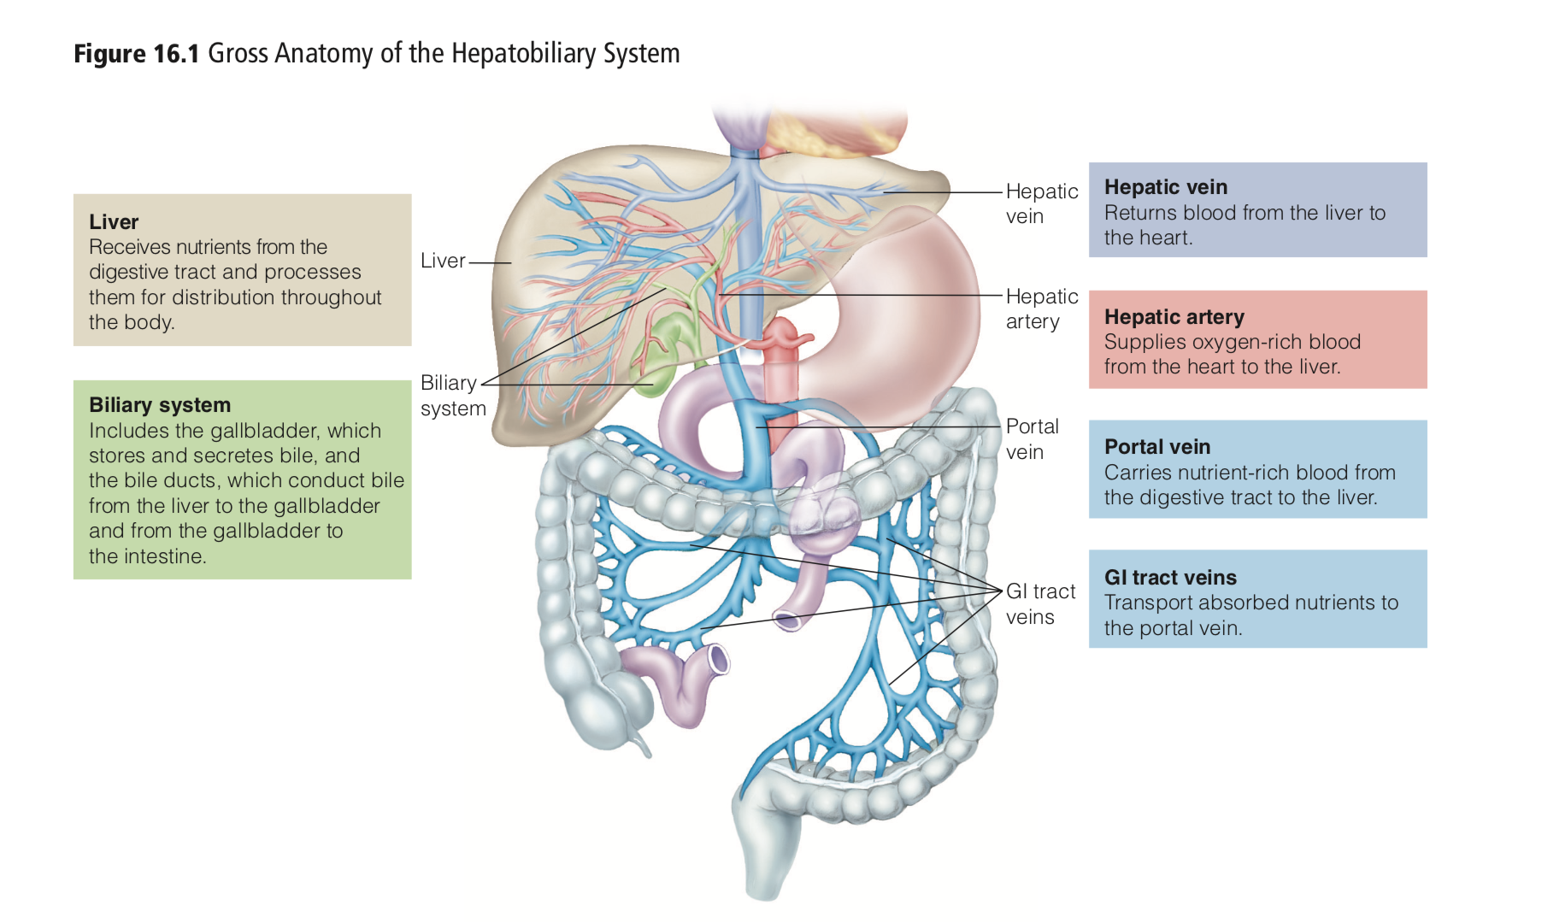

Slide 4
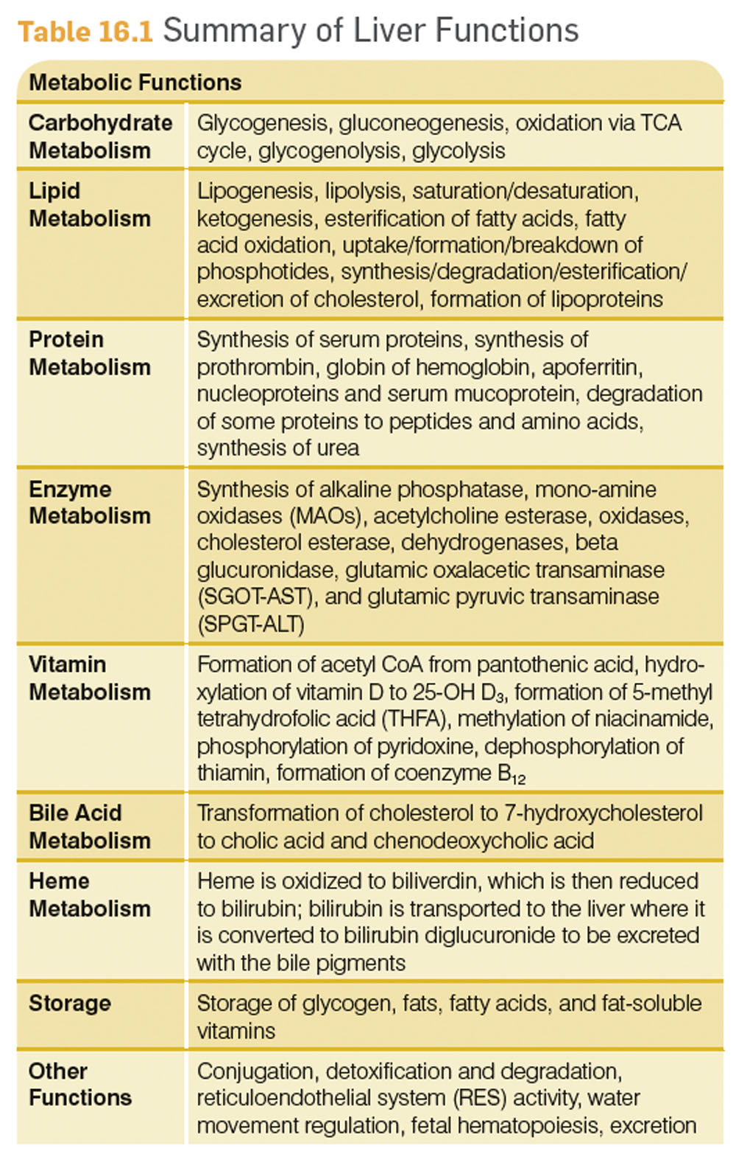

Slide 5
Fatty Liver
One of the most common disorders affecting the liver.
Fatty Liver: Accumulation of fat in liver tissue.
The liver will package excess triglycerides into very-low-density lipoproteins (VLDL) and export it to the bloodstream
Fatty liver represents an imbalance between the amount of fat produced in the liver or picked up from the blood and the amount the liver uses or exports to the blood via VLDL

Slide 6
HIGHLIGHT 7- ALCOHOL
After alcohol is swallowed, it is absorbed primarily from the small intestine into the veins that collect blood from the stomach and bowels and from the portal vein, which leads to the liver. From there it is carried to the liver, where it is exposed to enzymes and metabolized.

Slide 7
Fatty liver may be caused by defects in metabolism, excessive alcohol ingestion
Unlike foods, which require time for digestion, alcohol needs no digestion and is quickly absorbed across the walls of an empty stomach, reaching the brain within a few minutes.
The stomach begins to break down alcohol with its alcohol dehydrogenase enzyme. Women produce less of this stomach enzyme than men; consequently, more alcohol reaches the intes- tine for absorption into the bloodstream
In the small intestine, alcohol is rapidly absorbed. From this point on, alcohol receives priority treatment: it gets absorbed and metabolized before most nutrients→ Alcohol is toxic and cannot be stored

Slide 8
Liver cells are the only cells that can make enough of the alcohol dehydrogenase enzyme to oxidize alcohol at an appreciable rate
liver cells use fatty acids for fuel, and package excess fatty acids into triglycerides → ship them out to other tissues. When alcohol is present, however, the liver cells metabolize alcohol first and let the fatty acids accumulate, sometimes in huge stockpiles.
Alcohol metabolism can also permanently change liver cell structure, impairing the liver’s ability to metabolize fats

Slide 9
The amount of alcohol dehydrogenase enzyme present in the liver varies with individuals, depending on the genes they have inherited and on how recently they have eaten
Fasting→ decrease amount of protein (alcohol- processing enzymes)→ decreased rate of alcohol breakdown and more rapid absorption

Slide 10
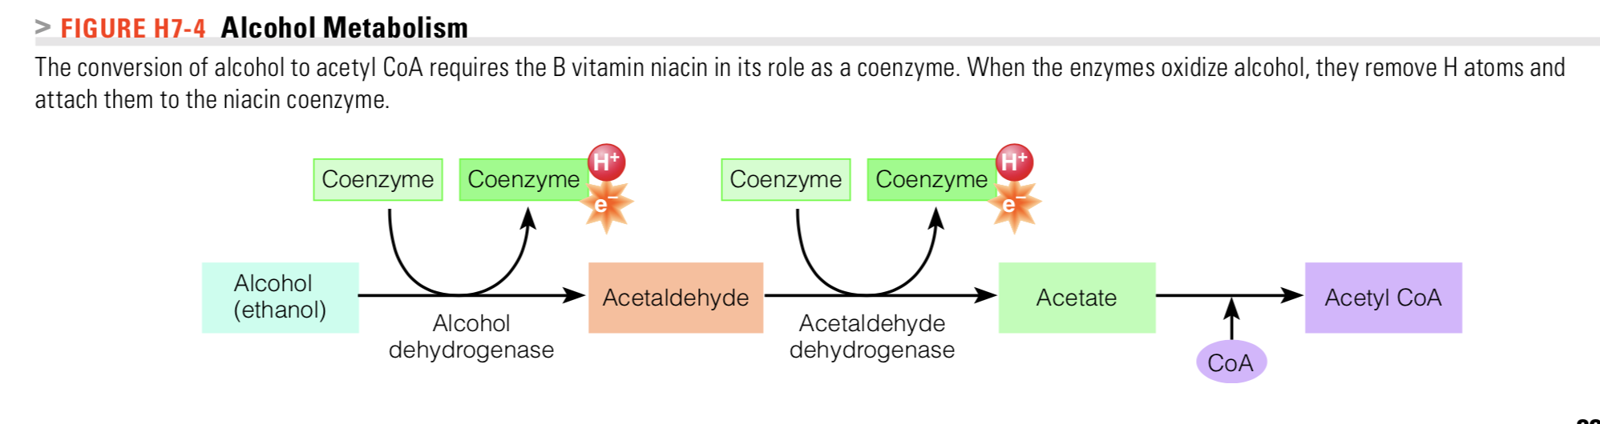
acetaldehyde, a highly reactive and toxic byproduct that may contribute to tissue damage
The B vitamin niacin, in its role as a coenzyme, helpfully picks up these hydrogens and electrons and escorts them to the electron transport chain.

Slide 11
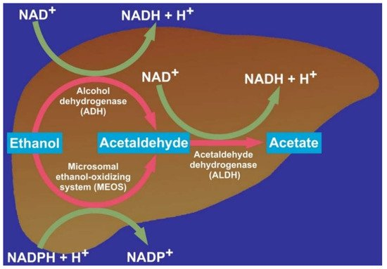
Teschke R. Alcoholic Liver Disease: Alcohol Metabolism, Cascade of Molecular Mechanisms, Cellular Targets, and Clinical Aspects. Biomedicines. 2018; 6(4):106. https://doi.org/10.3390/biomedicines6040106

Slide 12
NAD+ requiring pathway
Ethanol oxidation results in a significant increase in the hepatic NADH/NAD⁺ ratio in both the cytosol and mitochondria
Generation of ROS and oxidative stress in the tissues- tissue damage
“The rate of ethanol and acetaldehyde oxidation by ADH and ALDH is determined by the rate with which the NADH generated can pass through the mitochondrial electron transport system. Because the mitochondrial electron transport system requires oxygen and generates ATP, the rate of NADH oxidation depends both on the cell’s oxygen supply and on its demand for ATP. If either of these two factors is limited, electron transport activity is reduced”
As a result, Ethanol and acetaldehyde MAY be inefficiently metabolized
electrons passing through the mitochondrial electron transport chain are “diverted” into forming harmful ROS
Zakhari S. Overview: how is alcohol metabolized by the body?. Alcohol Res Health. 2006;29(4):245-254.

Slide 13
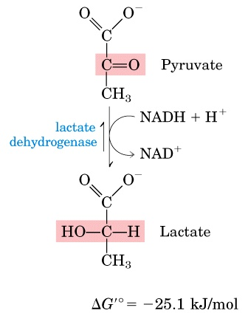
During alcohol metabolism, other metabolic processes requiring NAD+ including glycolysis, the TCA cycle, and the electron transport chain, falter.
Accumulation of H+→ acidity
Promotes the making of lactate from pyruvate. The conversion of pyruvate to lactate uses some of the excess hydrogens, but a lactate build-up
INCREASES acidity and interferes with the excretion of another acid, uric acid, causing inflammation of the joints.

Slide 14
Alcohol alters both amino acid and protein metabolism. Synthesis of proteins important in the immune system slows down, weakening the body’s defenses against infections
alcohol down regulates translational efficiency which is predominantly mediated by a reduction in peptide-chain initiation
protein deficiency becomes apparent, both from a diminished synthesis of proteins and from a poor diet.
drinker’s liver deaminates the amino acids and uses the carbon fragments primarily to make fat or ketone bodies.

Slide 15
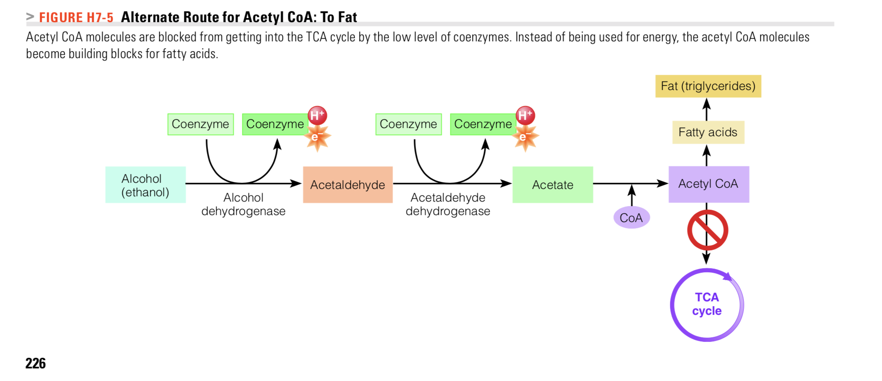
TCA and ETC slow down, pyruvate and acetyl coA build up
Excess acetyl CoA → fatty acid synthesis → fat clogs the liver →Liver cells become less efficient
Consequences:
Reduced activation of vitamin D
Reduced production and and release of bile
The fatty liver has difficulty making glucose from protein. Without gluconeogenesis, blood glucose can plummet, leading to irreversible damage to the central nervous system. The lack of glucose together with the overabundance of acetyl CoA sets the stage for ketosis. The body uses excess acetyl CoA to make ketone bodies; their acidity pushes the acid-base balance further toward acid and suppresses CNS

Slide 16
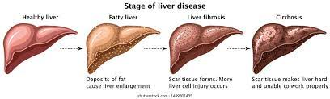
Fat accumulation can be seen in the liver after a single night of heavy drinking.
Fatty liver is reversible with abstinence from alcohol. If fatty liver lasts long enough, however, the liver cells will die and form fibrous scar tissue. This second stage of liver deterioration is called fibrosis
Advanced stage, cirrhosis, damage is the least reversible.

Slide 17
The liver will always choose to metabolize alcohol→ this affects its handling of drugs as well as nutrients.
MEOS (microsomal ethanol-oxidizing system): the liver’s enzyme system that metabolizes both alcohol and several other types of drugs
Handles about one-fifth of the total alcohol a person consumes
High alcohol intake stimulates synthesis of enzymes in the MEOS
Alcohol competes with—and wins out over—Metabolism of other drugs requiring MEOS→ Delayed drug metabolism→ dosage build up or once a heavy drinker stops drinking and alcohol is no longer competing with other drugs, the enhanced MEOS metabolizes drugs much faster this dosage must be altered
→ Many drug labels provide warnings to avoid alcohol while taking the drug

Slide 18
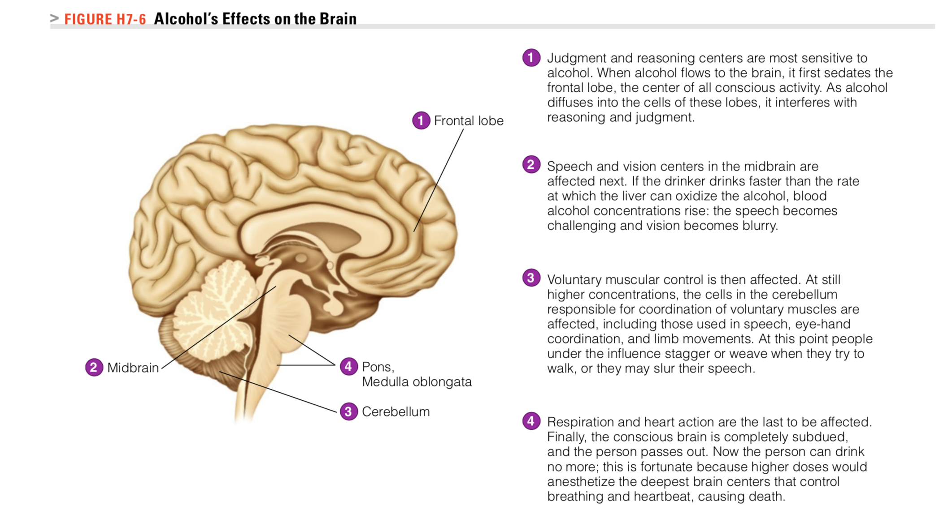
Acts as a sedative

Slide 19
Alcohol’s Damage
Dehydration
Frequent Urination
Alcohol depresses production of antidiuretic hormone (ADH), a hormone produced by the pituitary gland that retains water
Thirst→ more drinking. Water will relieve dehydration
Water loss is accompanied by the loss of important minerals
Malnutrition
Moderate drinkers usually consume alcohol as added energy—on top of their normal food intake
Alcohol can contribute to body fat and weight gain
Alcohol’s contribution to body fat is most evident in the abdominal obesity
Alcohol in heavy doses, though, is not efficiently metabolized, generating more heat than fat. Heavy drinkers usually consume alcohol as substituted energy—instead of their normal food intake. Diet quality declines as alcohol consumption increases
Heavy drinkers usually suffer from malnutrition

Slide 20
Alcohol is rich in energy (7 kcalories per gram), but as with pure sugar or fat, the kcalories are empty of nutrients.
The more alcohol people drink, the less likely that they will eat enough food to obtain adequate nutrients.
Chronic alcohol abuse displaces nutrients from the diet and interfere with the body’s metabolism of nutrients
Effects B vitamin folate. The liver loses its ability to retain folate, and the kidneys increase their excretion of it
Alcohol also interferes with the action of folate in converting the amino acid homocysteine to methionine.
Excess of homocysteine→ linked to heart disease
Inadequate supply of methionine, which slows the production of new cells, especially the rapidly dividing cells of the intestine and the blood (RBC)

Slide 21
Alcohol abuse: The most common cause of thiamin deficiency in the United States is alcoholism.
the cluster of thiamin-deficiency symptoms commonly seen in chronic alcoholism has its own name—Wernicke-Korsakoff syndrome:
paralysis of the eye muscles, poor muscle coordination, impaired memory, and damaged nerves; it and other alcohol-related memory problems may respond to thiamin supplements.
Alcohol causes stomach cells to oversecrete both gastric acid and histamine, an immune system agent that produces inflammation.
stimulation gastric acid secretion, irritating the linings of the stomach and esophagus and making them vulnerable to ulcer formation.
Intestinal cells fail to absorb B vitamins, notably, thiamin, folate, and vitamin B12. Liver cells lose efficiency in activating vitamin D.

