Slide 1
Birzeit University
Course: Fundamentals of Nursing (Laboratory)
Name:(Sabreen Maali).
Topic: (Osteoporosis).
Number :(1200805).
Reference:)Mayo clinic( .
https://www.mayoclinic.org/ar.

Slide 2
Research processes and objectives:
This research includes everything related to osteoporosis, including:
Definition of disease.(تعريف المرض)
Signs and symptoms.(العلامات والاعراض)
The causes of disease.(اسباب المرض)
Disease risks. (مخاطر المرض)
Disease treatment. (علاج المرض)
Care plan as a nurse.(خطةكممرض)

Slide 3
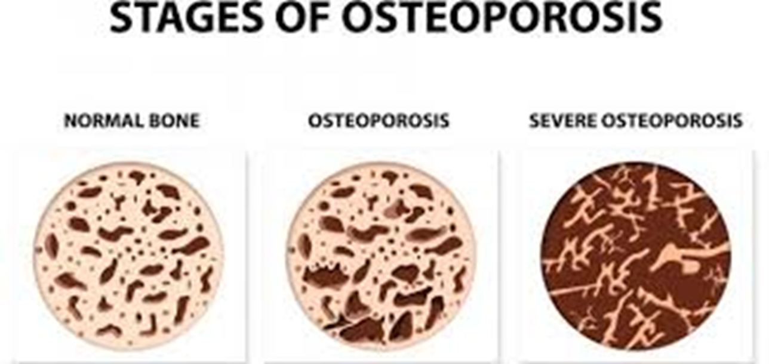
Definition of the disease.
-Osteoporosis is one of the common diseases in Palestine.
It is a rheumatic disease caused by low bone density in the skeleton .As the bones lose their hardness, And become fragile and more likely to break. Fractures associated with osteoporosis most commonly occur in the hip, wrist and spine.

Slide 4
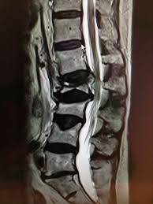
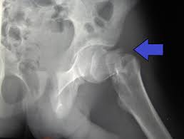
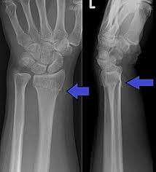
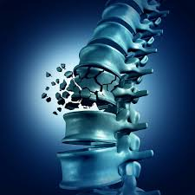
Broken hip
Fracture of the spine
Broken wrist

Slide 5
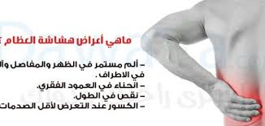
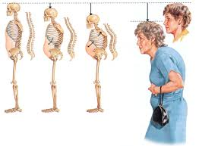
Signs and symptoms:
Back pain as a result of fracturing or eroding the bony vertebrae
Short stature over time
Posture bend
Ease of bone fractures

Slide 6
Causes and risks:
This disease occurs due to several reasons, including:
1Loss of bone tissue.
.2As a result of hormonal changes: the incidence of osteoporosis in females is greater than that of males with age, due to the lack of estrogen hormone in females with age.
3. Lack of calcium or vitamin (D).
4.Lack of protein: collagen, which increases bone density.
5.Getting old.
6.Dysfunction of the thyroid gland and its neighbors.
7.Family history.
8. Also, one of the causes of osteoporosis is taking medicines to combat diseases such as: cancer (chemotherapy).
9. Excessive alcohol use.

Slide 7
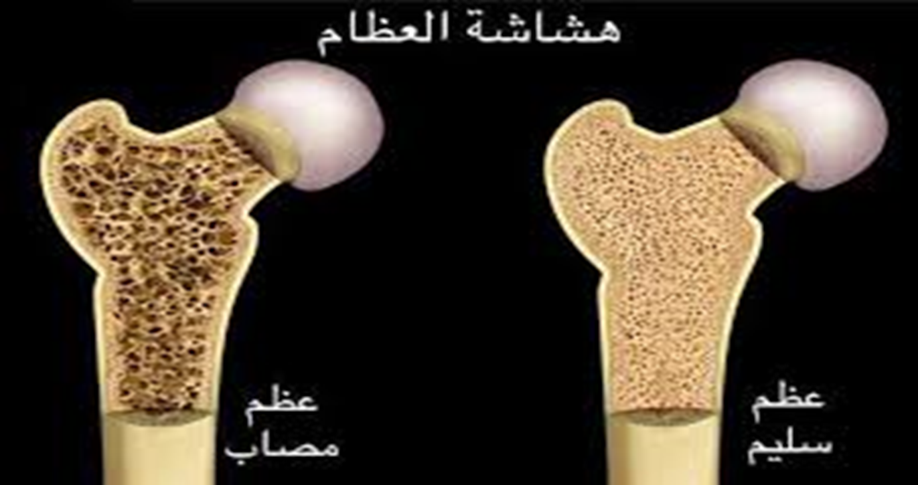
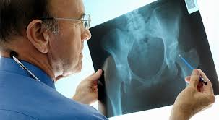
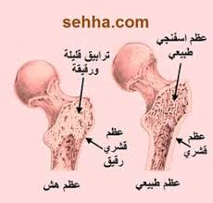

Slide 8
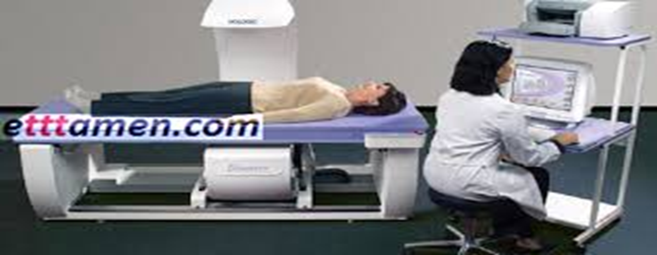
Diagnose the disease
Bone density can be measured with a machine that uses low levels of X-rays to determine the level of minerals in your bones. During this painless test, you will be asked to lie on a table while a scanner passes over your body.

Slide 9
Osteoporosis treatment:
-Treatment for osteoporosis depends on how low the bone density is.
-Where it can be treated with medicines and medical drugs such as: bone-building drugs, as well as pain relievers.
-In some difficult cases, doctors may resort to surgery.
-And also to raise the level of calcium in the body and vitamin D is also necessary in the treatment.

Slide 10


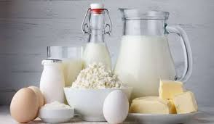
Disease prevention:
-Doctors advise to prevent osteoporosis: Exercise regularly.
-Eat foods that contain vitamin D, such as: liver, fish, and others.
-And foods rich in calcium .Calcium-rich food sources include dairy products, leafy greens, and more.

Slide 11

Care plan as nurse
Osteoporosis is a chronic and very painful disease, so sufferers of this disease need prevention from a psychological point of view before physical. This is part of our role as nurses to relieve their pain and help them heal and restore health.

Slide 12
Risks | Nursing interventions | Rational
(1):Impaired Physical Mobility | -Assess the patient’s functional ability for mobility and note changes. -Provide range of motion exercises every shift. -Reposition patient every 2 hours and prn. | -Identifies problems and helps to establish a plan of care. -Helps to prevent joint contractures and muscle atrophy. -Turning at regular intervals prevents skin breakdown from pressure injury.
(2):Risk for Poisoning | -Evaluate the patient’s entire collection of medications, including over-the-counter drugs, vitamin and mineral supplements, herbal remedies, and dietary regimen. -Provide instructions for use of medications, quantity, frequency, number of doses and times, and under what conditions they are to be taken. | -Provides information as to what drugs and substances are being utilized concurrently. -Facilitates understanding of medication regimen and provides reference material once the patient is discharged.
(3):Bone fragmentation (4):Inflammation of the bone - | -Helping clients move around to avoid falling and causing bone fractures. | -Protecting patients from injuries and falls helps prevent fractures and further deterioration of the bone condition

Slide 13

