Slide 1
Digital Electronics and Computer Organization Lab
ENCS 2110
Experiment No. 7 - Constructing Memory Circuits Using Flip−Flops

Slide 2
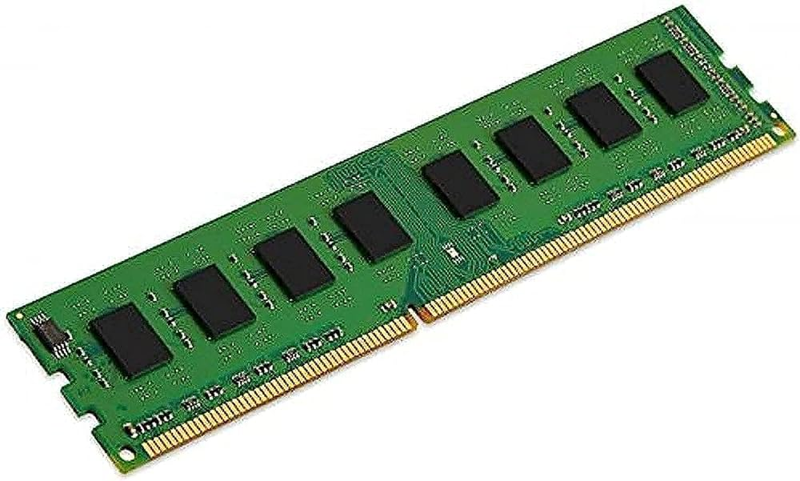
Memory Types
1) Random Access Memory (RAM) is like a temporary workspace for your computer.
It's a type of memory that allows your computer to store and quickly access data that it needs to run programs and perform tasks.
Think of it as a desk where you can place things you're actively working on. The more RAM your computer has, the more tasks it can handle simultaneously and the faster it can switch between them.
However, keep in mind that RAM is temporary storage,
and once you turn off your computer, the data in RAM is
cleared.

Slide 3
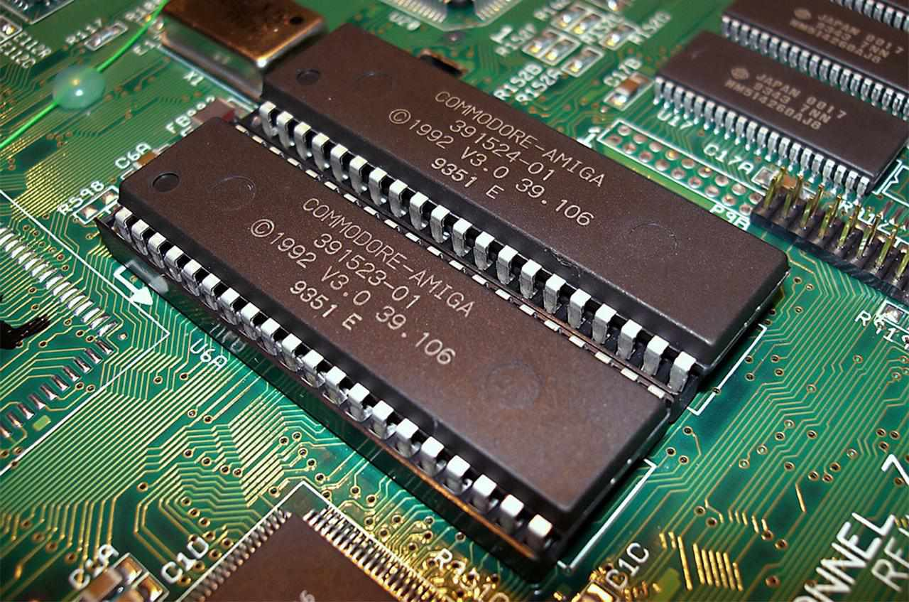
Memory Types
2) Read-Only Memory (ROM) is like a pre-written book for your computer.
It's a type of memory that stores information permanently, and unlike RAM, you can't easily change or write new data to it.
It contains essential instructions and data that your computer needs to start up and perform basic functions, like a set of rules the computer always follows. Even when you turn off your computer, the information in ROM remains intact.
It's called "read-only" because, in general,
you can only read from it, not write to it
like you can with RAM.

Slide 4
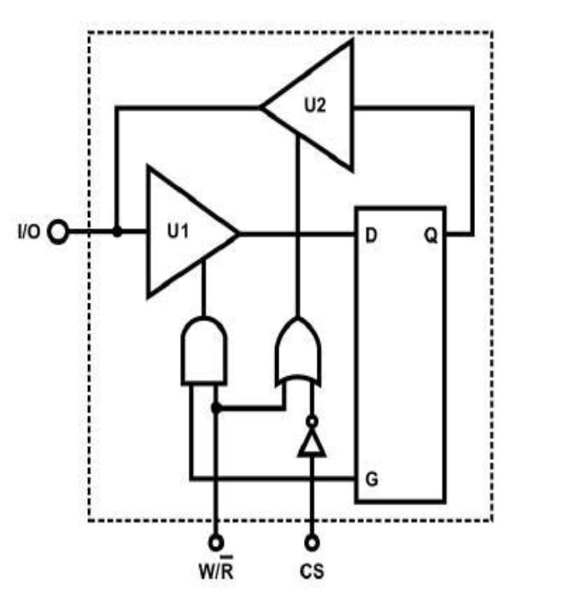
CONSTRUCTING RANDOM ACCESS MEMORY (RAM) WITH D FLIP-FLOP
The following figure shows one bit memory made of D flip flop.
When CS=0, tri-state gates U1 and U2 do not operate, so data input is
not possible, the flip- flop output Q is not sent to the I/O terminal.
The memory is not chosen/disabled
When CS=1, W/R controls the D flip-flop. When W/R' =1, U1 opens but U2 does not, I/O will accept data input. If W/R'=0, the exact opposite will happen and I/O
act as the data output.

Slide 5
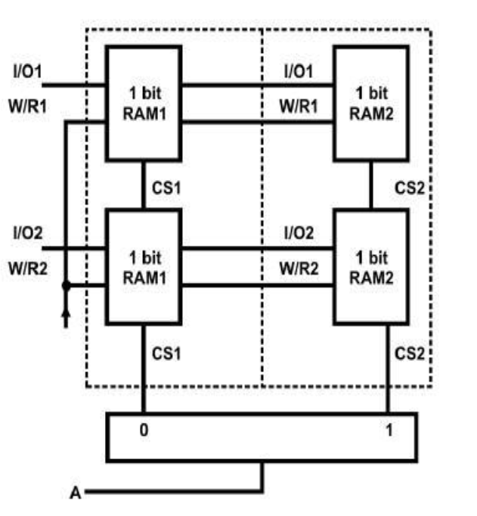
CONSTRUCTING RANDOM ACCESS MEMORY (RAM) WITH D FLIP-FLOP
Building 4-bit memory using 4 D flip flops.
It has 2 cells, each cell with 2 bits.
When CS1=1, RAM1 I/O1 and I/O2 are selected. Address line A is
used to select between RAM1 and RAM2. Since there is only one
address line, we can only select from 2 RAMs. each CS can only
select a 2-bit RAM, so the total capacity is 2×2.

Slide 6
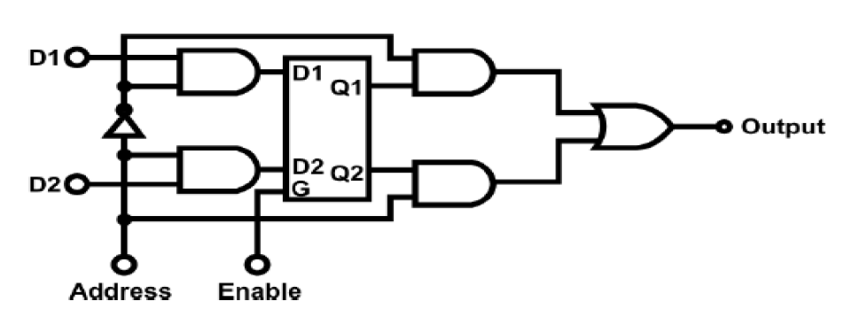
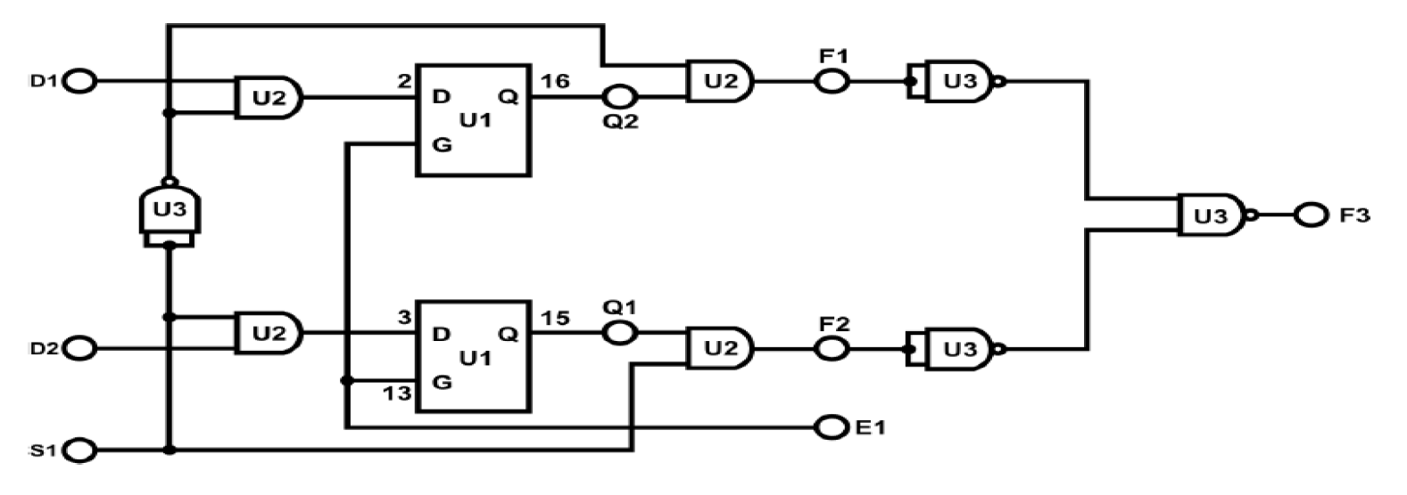
Implementation of the two-bit memory

Slide 7
Memory structure
Each memory cell must have an address
In each cell, it can be divided into a number of bits, famous types are: 1 byte (8 bits) 2 bytes (16 bit) for each cell
How can we know the number of cells in the memory?
How can we calculate the memory entire size?
Address
1bit
1bit
1bit
1bit
Cell 1
Cell 2
Cell 3
.
.
.
.
.
Cell n-1

Slide 8
Memory in read mode
In read mode, memory needs the following:
Data Bus
Address Bus
Memory Controller
Read Enable Signal
Enable signal
Data Output Buffer
Address
1bit
1bit
1bit
1bit
Cell 1
Cell 2
Cell 3
.
.
.
.
.
Cell n-1

Slide 9
Memory in read mode
Data Bus: The data bus is the pathway through which data is transferred between the memory and other components of the computer, such as the CPU. In read mode, the data bus is used to transmit the data from the memory to the requesting component.
Address
1bit
1bit
1bit
1bit
Cell 1
Cell 2
Cell 3
.
.
.
.
Cell n-1
Data bus

Slide 10
Memory in read mode
Address Bus: The address bus is responsible for carrying the memory address to locate the specific data that needs to be read. The size of the address bus determines the maximum addressable memory space.
Address
1bit
1bit
1bit
1bit
Cell 1
Cell 2
Cell 3
.
.
.
.
Cell n-1
Data bus
Address bus

Slide 11
Memory in read mode
Memory Controller: The memory controller manages the communication between the CPU and the memory. It sends signals to the memory modules to read data from specific addresses and ensures that the data is properly transferred to the requesting component.
Address
1bit
1bit
1bit
1bit
Cell 1
Cell 2
Cell 3
.
.
.
.
Cell n-1
Data bus
Address bus
Chip Select

Slide 12
Memory in read mode
Read Enable Signal: This signal indicates that the memory is in read mode and ready to provide data. It is often controlled by the memory controller.
Address
1bit
1bit
1bit
1bit
Cell 1
Cell 2
Cell 3
.
.
.
.
Cell n-1
Data bus
Address bus
Chip Select
Read Signal

Slide 13
Memory in read mode
Enable Signal: When the memory is enabled, then it works as usual, while if it s disabled it does not work at all.
Address
1bit
1bit
1bit
1bit
Cell 1
Cell 2
Cell 3
.
.
.
.
.
Cell n-1
Address bus
Chip Select
Read Signal

Slide 14
Memory in write mode
In write mode, memory needs the following:
Data Bus
Address Bus
Memory Controller
Write Enable Signal
Enable signal
Data Output Buffer
Address
1bit
1bit
1bit
1bit
Cell 1
Cell 2
Cell 3
.
.
.
.
.
Cell n-1

Slide 15
Memory in write mode
Data Bus: The data bus is still important in write mode, as it is used to transmit the data from the component (usually the CPU) to the memory for storage.
Address
1bit
1bit
1bit
1bit
Cell 1
Cell 2
Cell 3
.
.
.
.
.
Cell n-1
Data bus

Slide 16
Memory in write mode
Address Bus: The address bus is necessary to specify the location in the memory where the data should be written. The size of the address bus determines the maximum addressable memory space.
Address
1bit
1bit
1bit
1bit
Cell 1
Cell 2
Cell 3
.
.
.
.
.
Cell n-1
Data bus
Address bus

Slide 17
Memory in write mode
Memory Controller: The memory controller manages the communication between the CPU and the memory. It sends signals to the memory modules to write data to specific addresses and ensures that the data is properly stored.
Address
1bit
1bit
1bit
1bit
Cell 1
Cell 2
Cell 3
.
.
.
.
.
Cell n-1
Data bus
Address bus
Chip Select

Slide 18
Memory in write mode
Write Enable Signal: This signal indicates that the memory is in write mode and ready to accept data. It is controlled by the memory controller and is used to enable the memory cells for writing.
Address
1bit
1bit
1bit
1bit
Cell 1
Cell 2
Cell 3
.
.
.
.
.
Cell n-1
Data bus
Address bus
Chip Select
Write Signal

Slide 19
Memory in write mode
Enable Signal: When the memory is enabled, then it works as usual, while if it s disabled it does not work at all
Address
1bit
1bit
1bit
1bit
Cell 1
Cell 2
Cell 3
.
.
.
.
.
Cell n-1
Data bus
Address bus
Chip Select
Write Signal

Slide 20
What does Random mean in RAM?
Imagine you have a bookshelf where each shelf is like a slot in RAM, and each book on a shelf is like a piece of data. Now, in a regular bookshelf (not a "random access" one), if you want the book on the fifth shelf, you have to start from the first shelf and go through them one by one until you reach the fifth. This takes time.
In a "random access" bookshelf (like RAM), you can instantly jump to the fifth shelf without going through the others. This ability to directly access any shelf is what makes it "random access“ which is much faster.
Address 0
Address 128
Address 200
1bit
1bit
1bit
1bit
Cell 1
Cell 2
Cell 3
.
.
.
.
.
Cell n-1

Slide 21
What does Random mean in RAM?
In Random Access Memory (RAM), the concept of "random access" means that any memory cell can be accessed directly, irrespective of its physical location which means that addresses 0, 128 and 200 have the same access time. This is different from sequential access, where you'd have to go through data in order, like reading through a book.
Address 0
Address 128
Address 200
1bit
1bit
1bit
1bit
Cell 1
Cell 2
Cell 3
.
.
.
.
.
Cell n-1

Slide 22
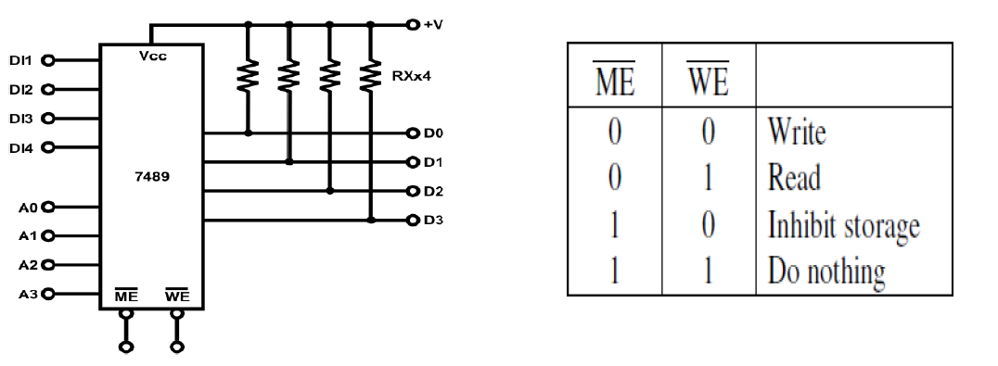
64-BIT RANDOM ACCESS MEMORY (RAM) CIRCUIT
7489 IC is a RAM which was made to have 64 bit memory size.
Each cell has 4 bits.
The IC has 16 cells.
How to calculate total size?
How many address bits should it have?
How many data bits should it have?

Slide 23
64-BIT RANDOM ACCESS MEMORY (RAM) CIRCUIT
7489 IC is a RAM which was made to have 64 bit memory size.
Each cell has 4 bits.
The IC has 16 cells.
How to calculate total size?
Total size = 4 bits/cell X 16 cell = 64 bits.
How many address bits should it have?
How many data bits should it have?

Slide 24
64-BIT RANDOM ACCESS MEMORY (RAM) CIRCUIT
7489 IC is a RAM which was made to have 64 bit memory size.
Each cell has 4 bits.
The IC has 16 cells.
How to calculate total size?
Total size = 4 bits/cell X 16 cell = 64 bits
How many address bits should it have?
4 (log number of cells)
How many data bits should it have?

Slide 25
64-BIT RANDOM ACCESS MEMORY (RAM) CIRCUIT
7489 IC is a RAM which was made to have 64 bit memory size.
Each cell has 4 bits.
The IC has 16 cells.
How to calculate total size?
Total size = 4 bits/cell X 16 cell = 64 bits
How many address bits should it have?
4 (log number of cells)
How many data bits should it have?
4 (cell size of bits)

Slide 26
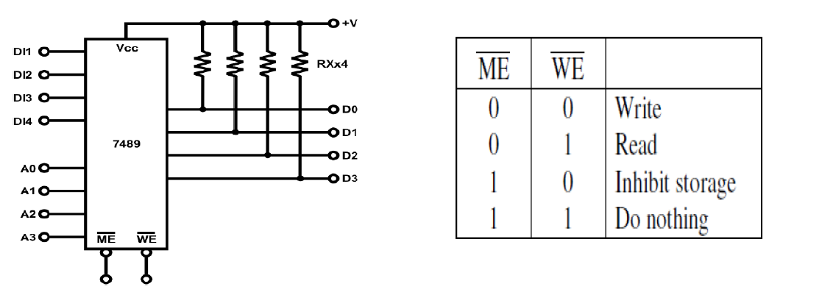
7489 IC modes

Slide 27
Questions
If we want to build a 128 bit Ram using 7489 IC how many Ics do we need?
If we want to build a 256 bit Ram using 7489 IC how many Ics do we need?
How can we control the multiple ICs?

Slide 29
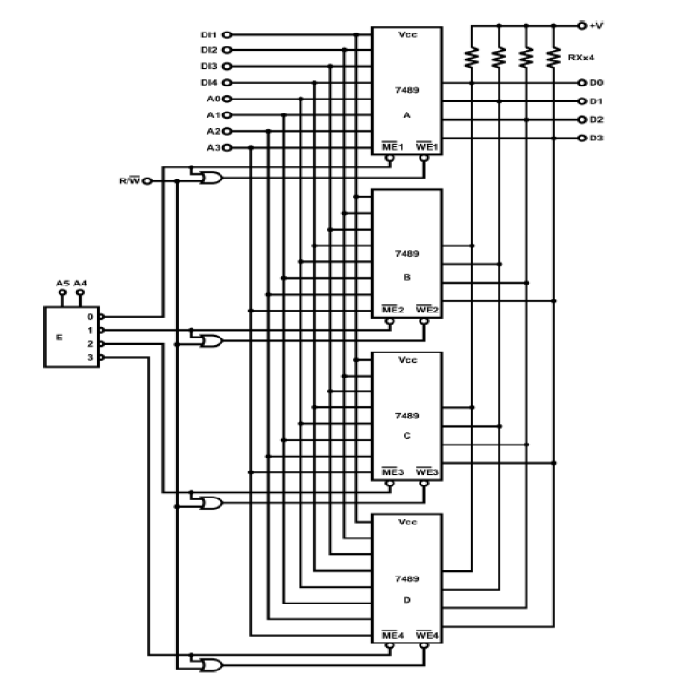
Building 256 bit RAM from IC

Slide 30
Why did we need 6 address bits here while before 4 bits were enough?

Slide 31
Why did we need 6 address bits here while before 4 bits were enough?
We have 16 cells * 4 = 64 cell
Log64 = 6 bits

Slide 32
Question:
Save the number 5
At the address 200

Slide 33
Question:
Save the number 5
At the address 200
Data:
5 -> 0101
Address:
Memory 1 --> 0-63
Memory 2 --> 64-127
Memory 3 --> 128-191
Memory 4 --> 192-255
so, 200 is in the 4th memory
Quarter 4 has 16 cell, each has 4 bits -->
Cell 1 → 192-195
Cell 2 → 196-199
Cell 3 → 200-203
so, 200 is in the 4th memory at the 3rd cell
A5A4 = 11 → 4th Memory
A3A2A1A0 = 0010 → 3rd Cell

Slide 34
Experiment No. 11 - Arithmetic Elements

Slide 35
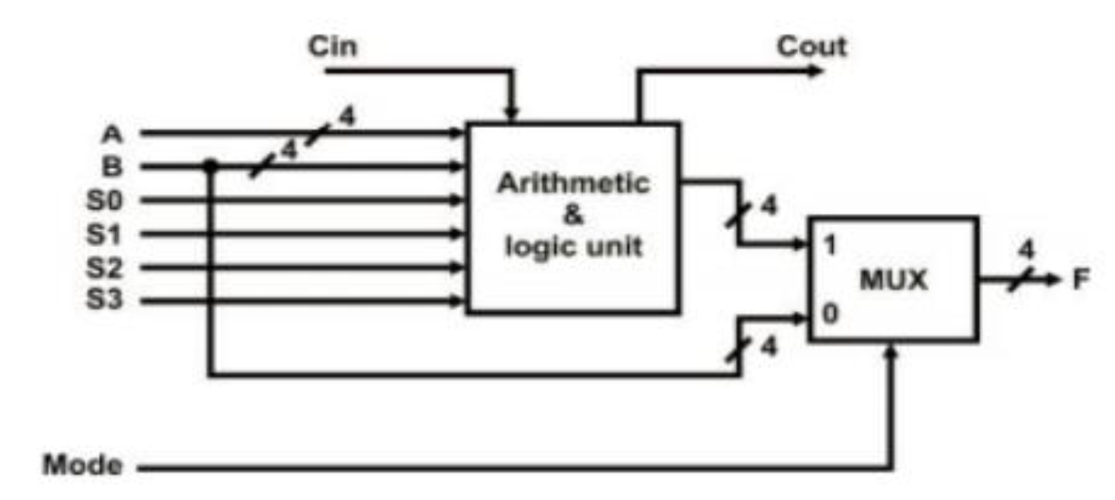
ALU
It consists of two major parts: the arithmetic unit and the logic unit. The output, either arithmetic or logic which is selected by the selection switches

Slide 36
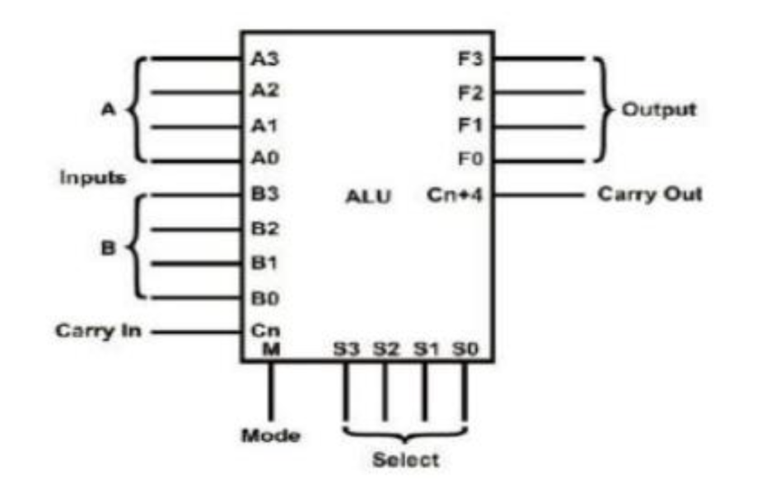
Pin assignments
How many inputs do you see?
How many outputs do you see?
How many control bits do you see?

Slide 37
Pin assignments
The circuit has two 4-bit inputs A and B, as well as a “carry-in” (Cn) input.
There is a mode control input (M). M=1 → Arithmetic , M=0 → Logic
There are 4 function-select lines S0, S1, S2, S3 forming logic or arithmetic operations.
The mode control input (M) and function-select lines (S0~S3) determines which function it will perform.
It has a 4-bit output (F3~F0); a “carry-out” or “Cn+4” output.
The biggest advantage of the design is its ability to perform arithmetic functions such as addition, subtraction. multiplication; and logic functions such as AND, XOR functions.

Slide 38
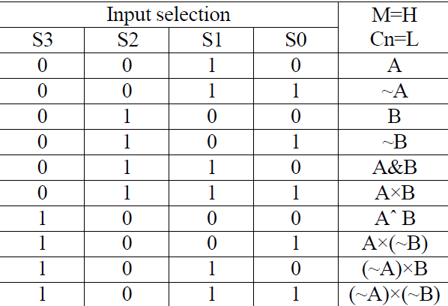
Selection line
When M=1:
S3S2S1S0=0000 → Addition
S3S2S1S0=0001 → Subtraction
.
.
.
.
Note: Watch out for the value of Cn if you want to take previous carry into consideration
Note: Watch out for Cn+4 if you want to take output carry into consideration

Slide 39
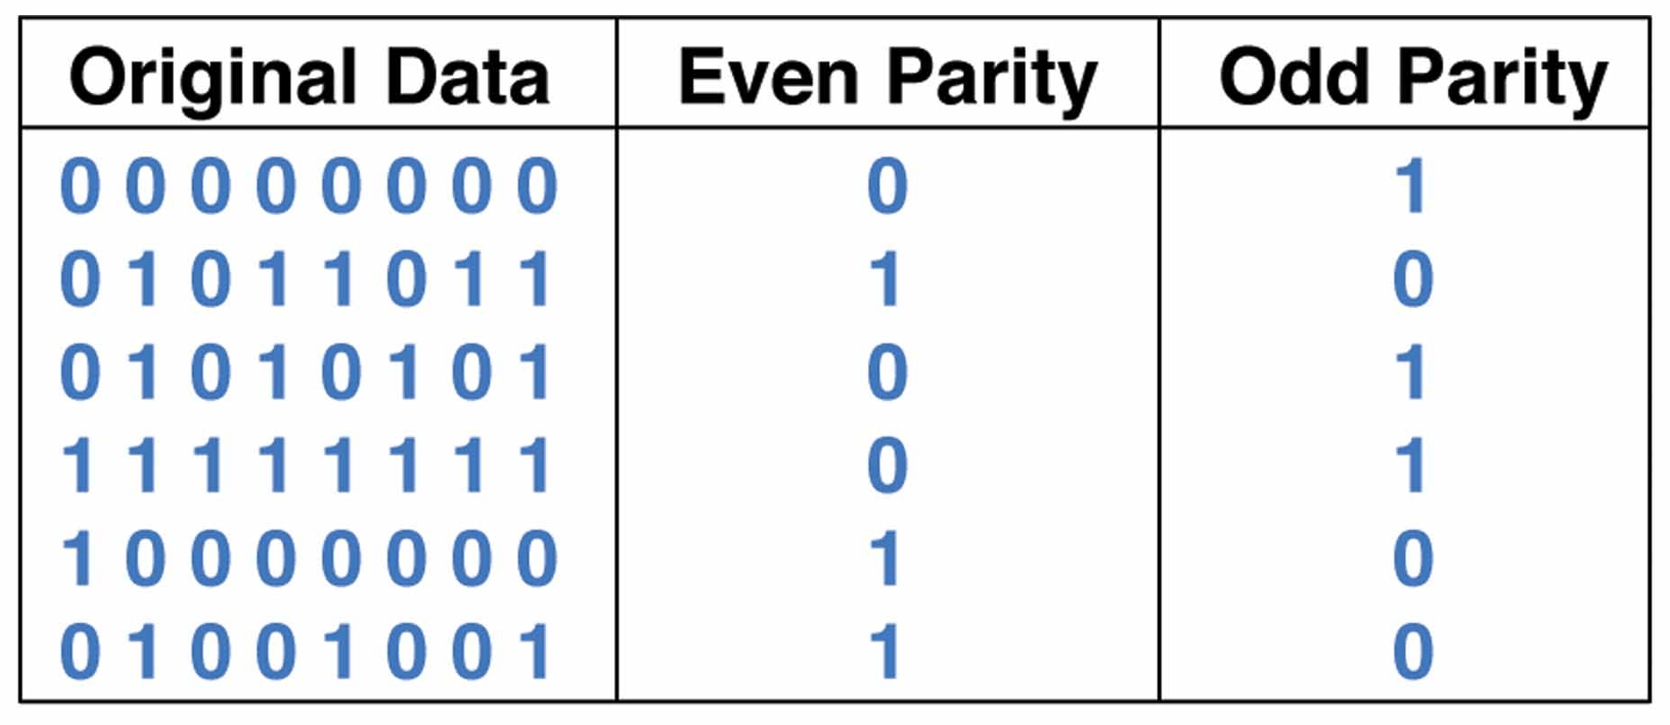
Even/Odd parity

Slide 40
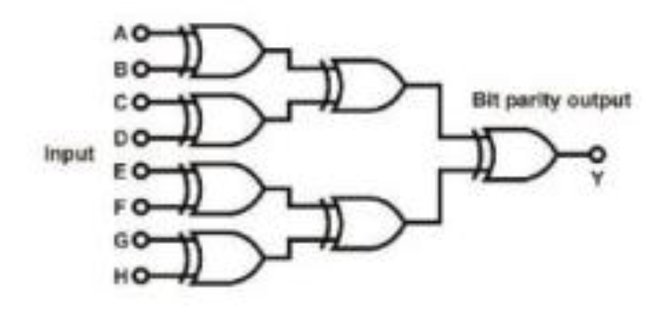
Even bit parity generator

Slide 41
