Slide 1
Inflammation, Inflammatory Response & Fever

Slide 2
Inflammation
An innate, automatic response to cell injury that:
  Neutralizes harmful agents
  Removes damaged and dead tissue
  Generates new tissue
  Promotes healing

Slide 3
Introduction
Inflammation is the body's response to injury and is characterized by the elaboration of chemical mediators and movement of fluid and leukocytes from the vascular compartment into the extravascular tissue space.

Slide 4
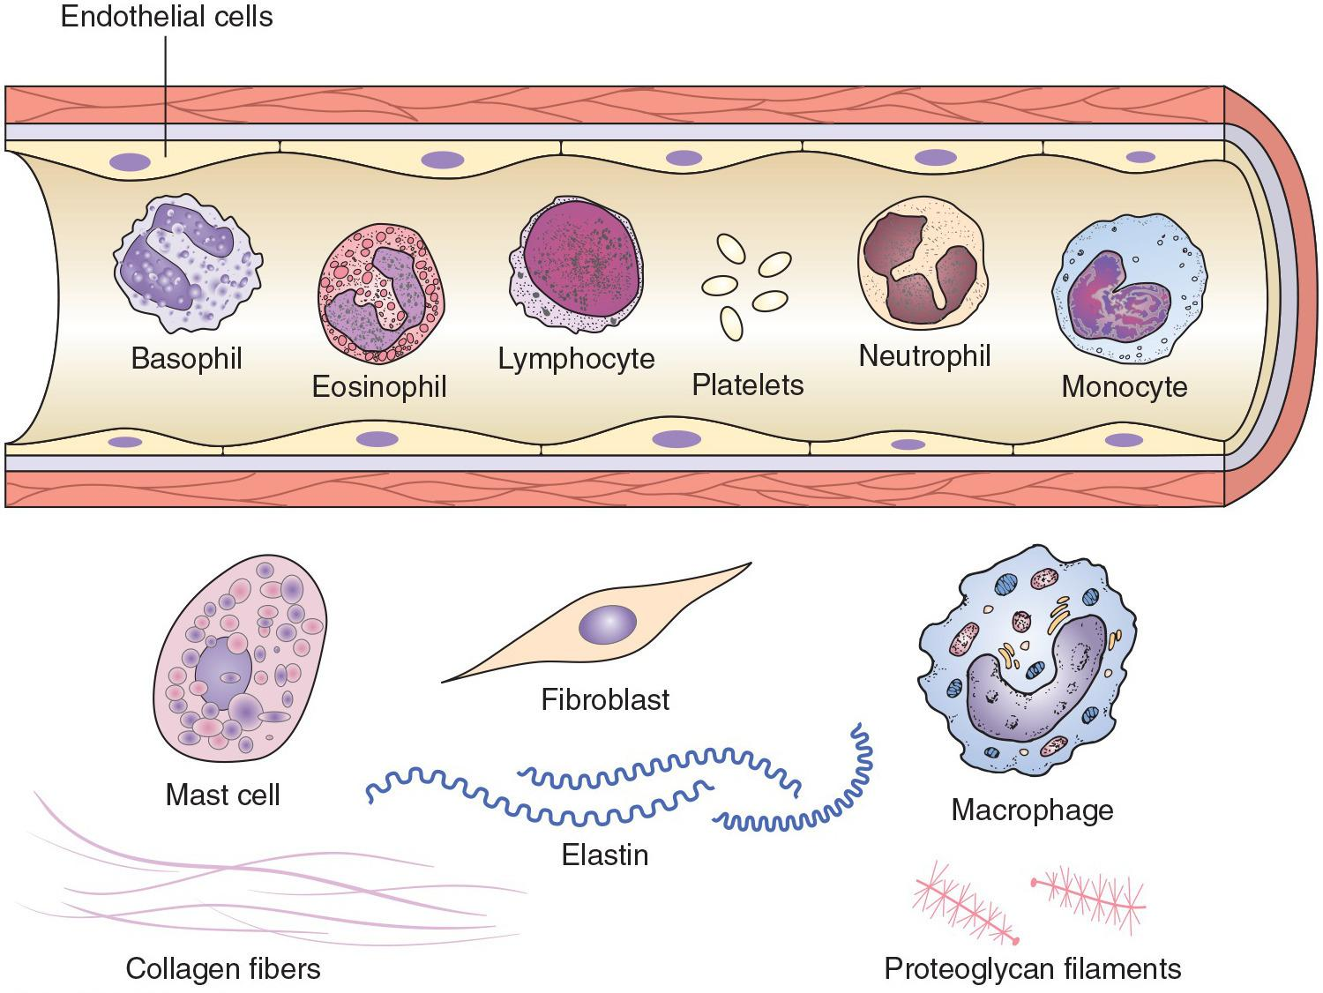
Inflammation

Slide 5
Question?
Which leukocytes participate in the acute inflammatory response?
  Eosinophils
  Monocytes
  Neutrophils
  All of the above
  A and C

Slide 6
Answer
D. All of the above
Rationale: Granulocytes and monocytes play a role in the acute phase of the immune response. Eosinophils and neutrophils are granulocytes, so all of the leukocytes listed participate.

Slide 7
Question?
Which causes the redness (erythema) associated with the inflammatory process?
  Prostaglandins
  Leukotrienes
  Arachidonic acid
  All of the above
  A and B

Slide 8
Answer
E. A and B
Rationale: Prostaglandins and leukotrienes cause vasodilation, which brings more blood to the injured/affected area. The symptoms caused by this vasodilation are redness/erythema and warmth.

Slide 9
Inflammation
There are two types of inflammation:
Acute inflammation, which is of short duration and characterized by the exudation of fluid and plasma proteins, and
Chronic inflammation, which is associated with angiogenesis, tissue necrosis, and fibrosis (scarring).

Slide 10
Who are involved?
Many cells and tissue components contribute to the inflammatory response, including the endothelial cells that form capillaries and line blood vessels, circulating platelets and white blood cells, cells in connective tissue, and components of the extracellular matrix.

Slide 11
Signs
The classic signs of an acute inflammatory response are redness, swelling, local heat, pain, and loss of function.
These manifestations can be attributed to the immediate vascular changes that occur (vasodilation and increased capillary permeability), the influx of inflammatory cells such as neutrophils, and, in some cases, the widespread effects of inflammatory mediators, which produce fever and other systemic signs and symptoms.

Slide 12
Inflammation
Chemical mediators are integral to initiation, amplification, and termination of inflammatory processes. The plasma is the source of mediators derived from three major protein cascades that are activated during inflammation.
These protein cascades include the kallikrein-kininogen system, the coagulation system, and the complement system.
Cell-derived mediators, including histamine, bradykinin, the arachididonic metabolites, platelet activating factor (PAF), and many others are released from cells at the site of inflammation.

Slide 13
Acute Inflammation—Vascular Stage
Vasodilation:
  Increasing blood flow to the injured area.
  Mediators include histamine and nitric oxide.
  Redness and warmth result.
Capillaries become more permeable.
  Allowing exudate to escape into the tissues
  Mediators include histamine, bradykinin, and leukotrienes.
  Swelling, pain, and impaired function result.

Slide 14
Acute Inflammation—Cellular Stage
White blood cells enter the injured tissue:
  Destroying infective organisms
  Removing damaged cells
  Releasing more inflammatory mediators to control further inflammation and healing

Slide 15
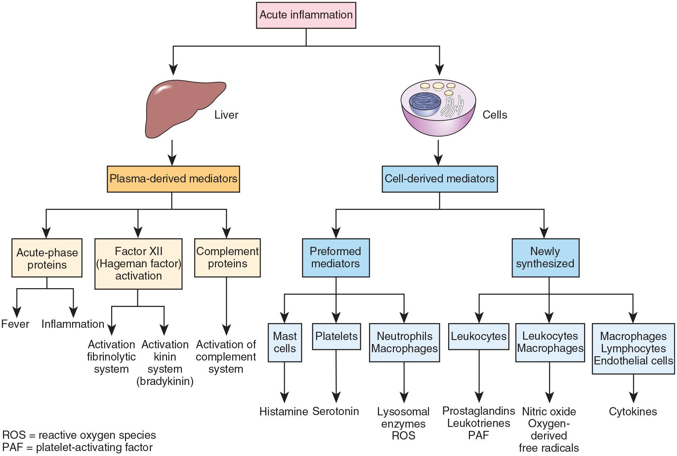
Inflammatory Mediators

Slide 16
Exudate
Acute inflammation may involve the production of exudates containing serous fluid (serous exudate), red blood cells (hemorrhagic exudate), fibrinogen (fibrinous exudate), or tissue debris and white blood cell breakdown products (purulent exudate).

Slide 17
Acute Inflammation
The outcome of acute inflammation generally results in one of three processes: resolution, progression to chronic inflammation, or substantial scarring and fibrosis.

Slide 18
Chronic Inflammation
Chronic inflammation involves infiltration with macrophages, lymphocytes, and fibroblasts, leading to persistent inflammation, fibroblast proliferation, and scar formation.

Slide 19
Question?
True or false?
If you get a paper cut, epithelial tissue will be replaced with connective tissue.

Slide 20
Answer
False
Rationale: The surface epithelial cells of the skin are most likely to be damaged in this instance. Surface epithelial tissue has the ability to regenerate, replacing the damaged tissue with the same type (epithelial).

Slide 21
Chronic Inflammation
Among the conditions associated with chronic inflammation and inappropriate activation of the immune system are low-grade inflammation associated with atherosclerosis and type 2 diabetes mellitus; autoimmune disorders; and susceptibility to cancer due to deoxyribonucleic acid damage, increased tissue proliferation, and creation of an environment rich in cytokines and growth factors that favor tumor cell development and growth.

Slide 22
Chronic Inflammation
The systemic manifestations of inflammation include the effects of the acute -phase response, such as fever and lethargy; increased erythrocyte sedimentation rate (ESR), levels of C-reactive protein (CRP), other acute-phase proteins, and white blood cells; and enlargement of the lymph nodes that drain the affected area.
In severe bacterial infections (sepsis), large quantities of microorganisms in the blood result in the production and release of enormous quantities of inflammatory cytokines and development of what is referred to as the systemic inflammatory response syndrome.

Slide 23
S & S
Fever, an elevation in body temperature, is one of the most prominent manifestations of the acute-phase response, especially if inflammation is caused by infection.
It is produced in response to pyrogens that act by prompting the release of prostaglandin E2 or fever-producing cytokines, which in turn resets the hypothalamic thermoregulatory center.

Slide 24
S & S
There actions that occur during fever consist of four stages:
A prodromal period with nonspecific complaints, such as mild headache and fatigue;
A chill, during which the temperature rises;
A flush, during which the skin becomes warm and flushed; and
A defervescence stage, which is marked by the initiation of sweating.

Slide 25
S & S
The approach to fever in children varies depending on the age of the child.
Infants and young children have decreased immunologic function and are more commonly infected with virulent organisms.

Slide 26
S & S
The elderly tend to have a lower base line temperature, so that serious infections may go unrecognized because of the perceived lack of a significant fever.

Slide 27
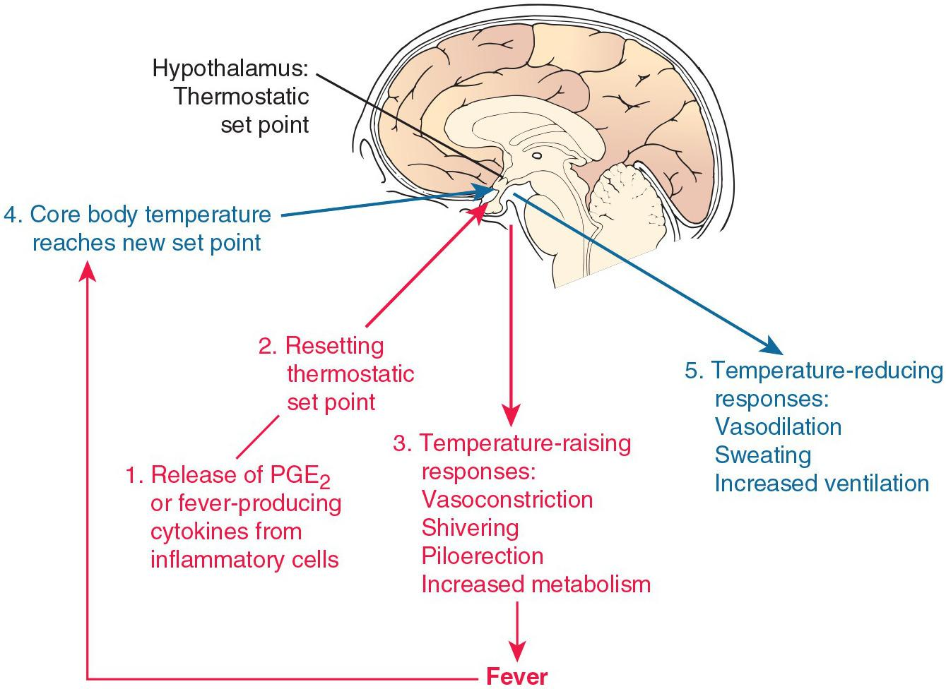
Fever Mechanisms

Slide 28
Question?
True or false?
Body temperature is controlled through negative feedback loops.

Slide 29
Answer
True
Rationale: When the body senses a change out of the norm, it activates mechanisms that oppose that change (vasodilation and sweating with increased temperatures; vasoconstriction and shivering with decreased temperatures). This is known as negative feedback. Positive feedback, on the other hand, senses a change but activates a mechanism that exaggerates the change.

Slide 30
Scenario
Mr. X says he has “chills and fever.”
His daughter wants you to explain how he could have both at the same time and from the same disease.
Question:
Should she be keeping him warmer or helping him cool off?

