Slide 1
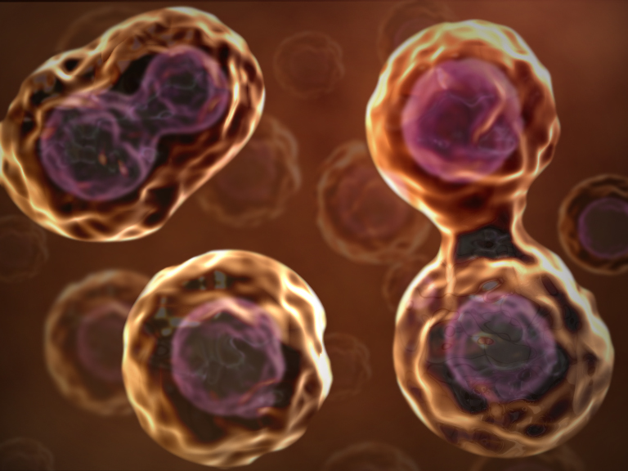
CELL DIVISION

Slide 2
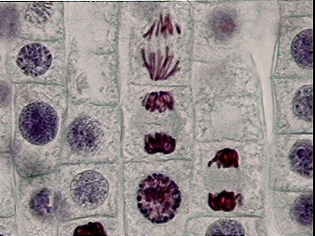
Mitosis
occurs in somatic cells,
producing genetically identical daughter cells (diploid)
each cell has virtually the same DNA sequences.

Slide 3
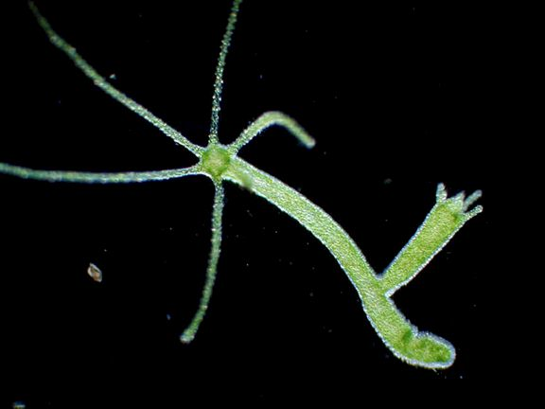
Mitosis
In unicellular organisms: responsible for the production of a new entire organism.
In a multicellular organism, mitosis functions in growth, the replacement and renewal of cells

Slide 4
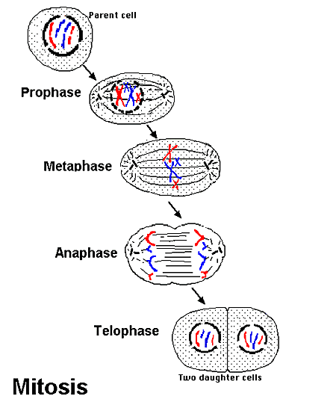
Mitosis
The mitosis phase is also divided into different continuous subphases:
Interphase
Prophase
Metaphase
Anaphase
Telophase

Slide 5
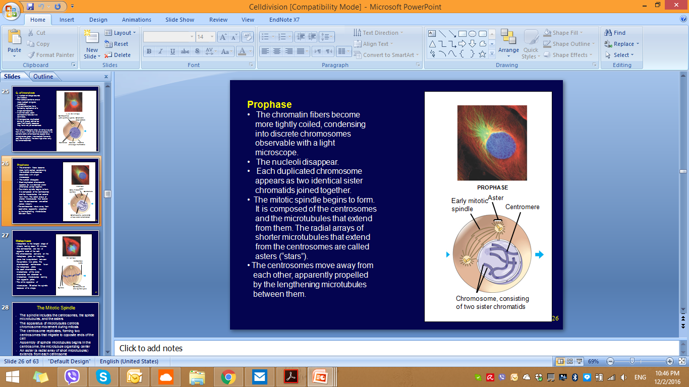
Prophase
- Coiling of the chromatin to form thick, short chromosomes that are visible under the light microscope
-2 chromatids joined by a centromere
- Centrioles move to the opposite sides of the nucleus
- Nucleolus disappears and Nuclear membrane disintegrate

Slide 6
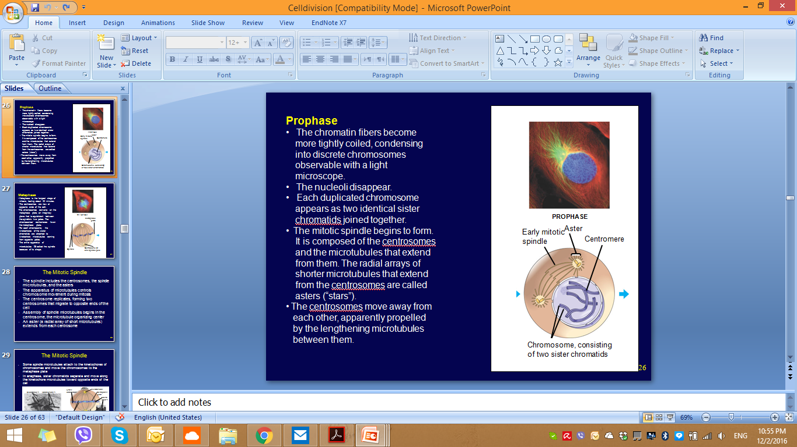
Prometaphase
The mitotic spindle begins to form.
- microtubules extend from the centrosomes to attach to kinetochore (center of each chromatid in a specialized protein structure).
- The centrosomes move away from
each other

Slide 7
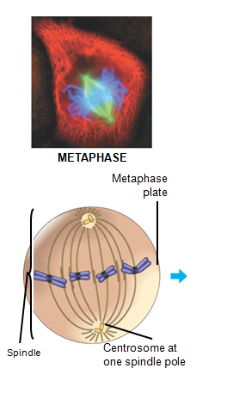
Metaphase
The spindle is completely formed
Chromosomes meet in the middle at the metaphase plate in the cell (equator of cell )

Slide 8
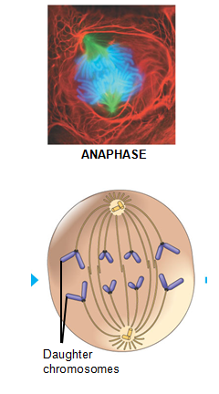
Anaphase
Chromosomes get pulled apart by spindle fibres to the opposite poles of the cell
- The cell elongates.

Slide 9
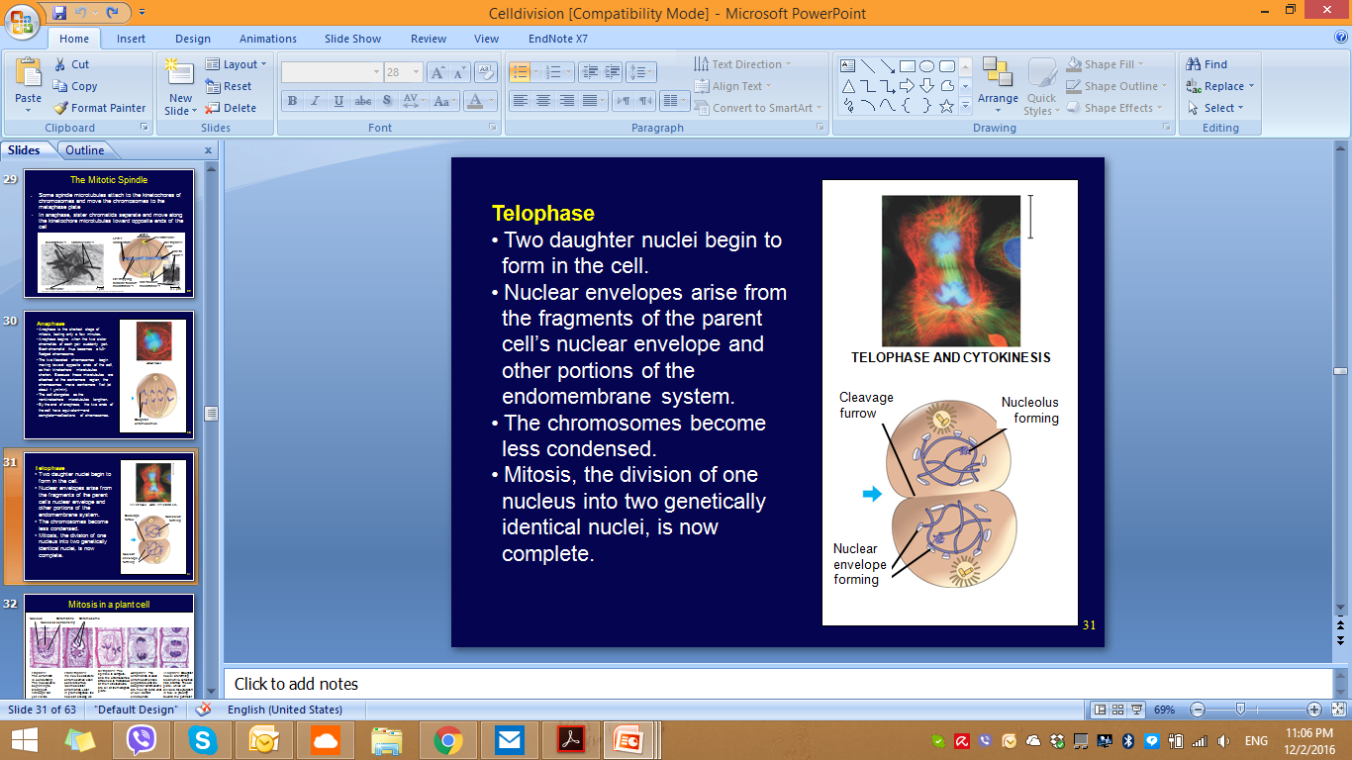
Telophase
Chromosomes uncoil
Centrioles replicate
Nuclear membrane forms
Cell divides

Slide 10
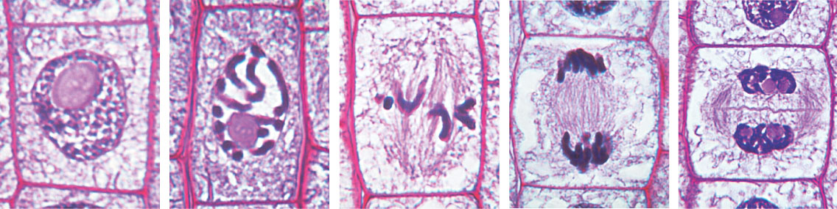
Mitosis in a plant cell
Nucleus
Chromatin
condensing
Chromosome
Nucleolus
1
Prophase.
The chromatin
is condensing.
The nucleolus is
beginning to
disappear.
Although not
yet visible
in the micrograph,
the mitotic spindle is
staring to from.
2
Prometaphase.
We now see discrete
chromosomes; each
consists of two
identical sister
chromatids. Later
in prometaphase, the
nuclear envelop will
fragment.
3
Metaphase. The
spindle is complete,
and the chromosomes,
attached to microtubules
at their kinetochores,
are all at the metaphase
plate.
5
Telophase. Daughter
nuclei are forming.
Meanwhile, cytokinesis
has started: The cell
plate, which will
divided the cytoplasm
in two, is growing
toward the perimeter
of the parent cell.
4
Anaphase. The
chromatids of each
chromosome have
separated, and the
daughter chromosomes
are moving to the ends
of cell as their
kinetochore
microtubles shorten.

Slide 11
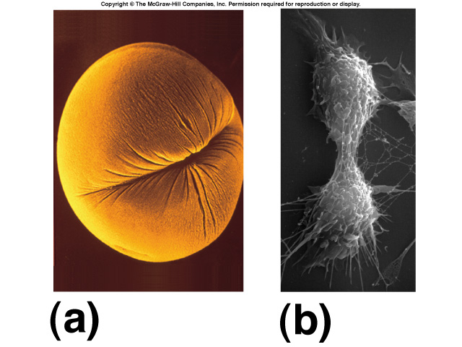
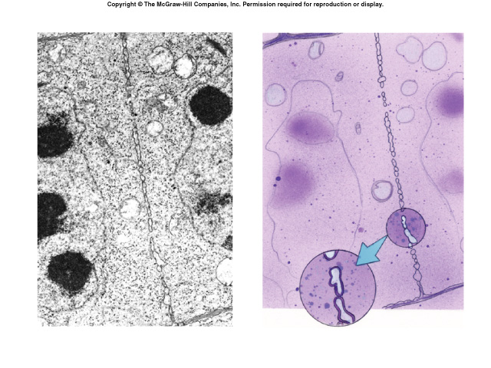
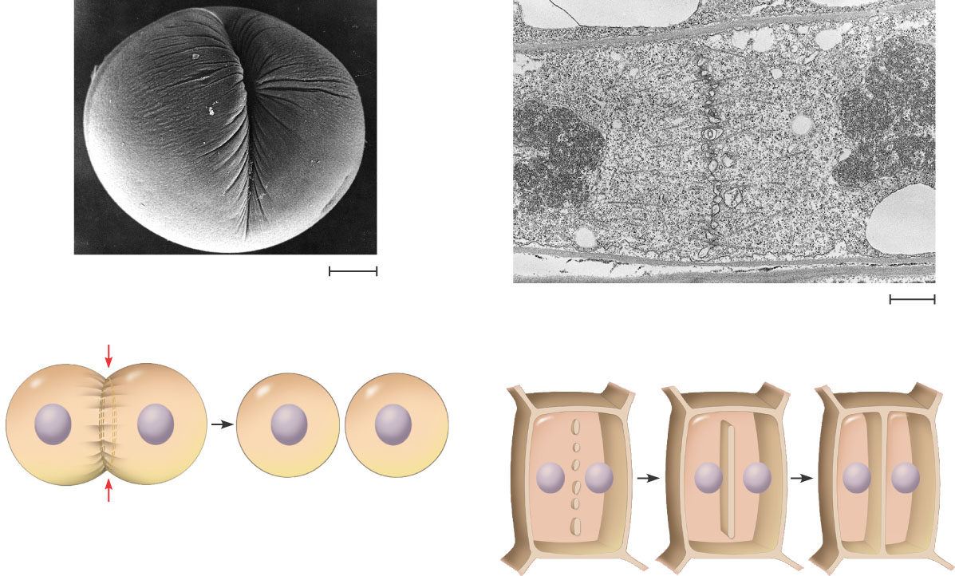
Cytokinesis
Division of cytoplasm, cell
Animal cells
cleavage furrow
Plant cells
- Cell plate formation

Slide 12
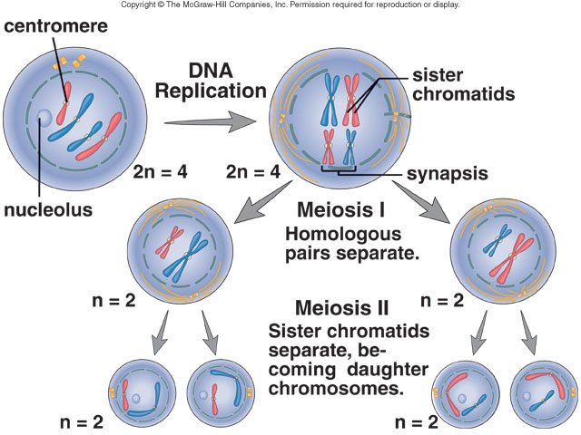
Meiosis
cell division by which germ cells (eggs and sperm) are produced.
One parent cell produces four daughter cells.
Daughter cells have half the number of chromosomes found in the original parent cell
In sexual reproduction, gametes fuse together forming a zygote

Slide 13
Differences in Mitosis & Meiosis
Mitosis
  Asexual
  Cell divides once
  Two daughter cells
  Genetic information is identical
Meiosis
  Sexual
  Cell divides twice
  Four haploid daughter cells
  Genetic information is different

Slide 14
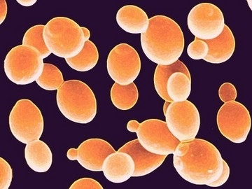
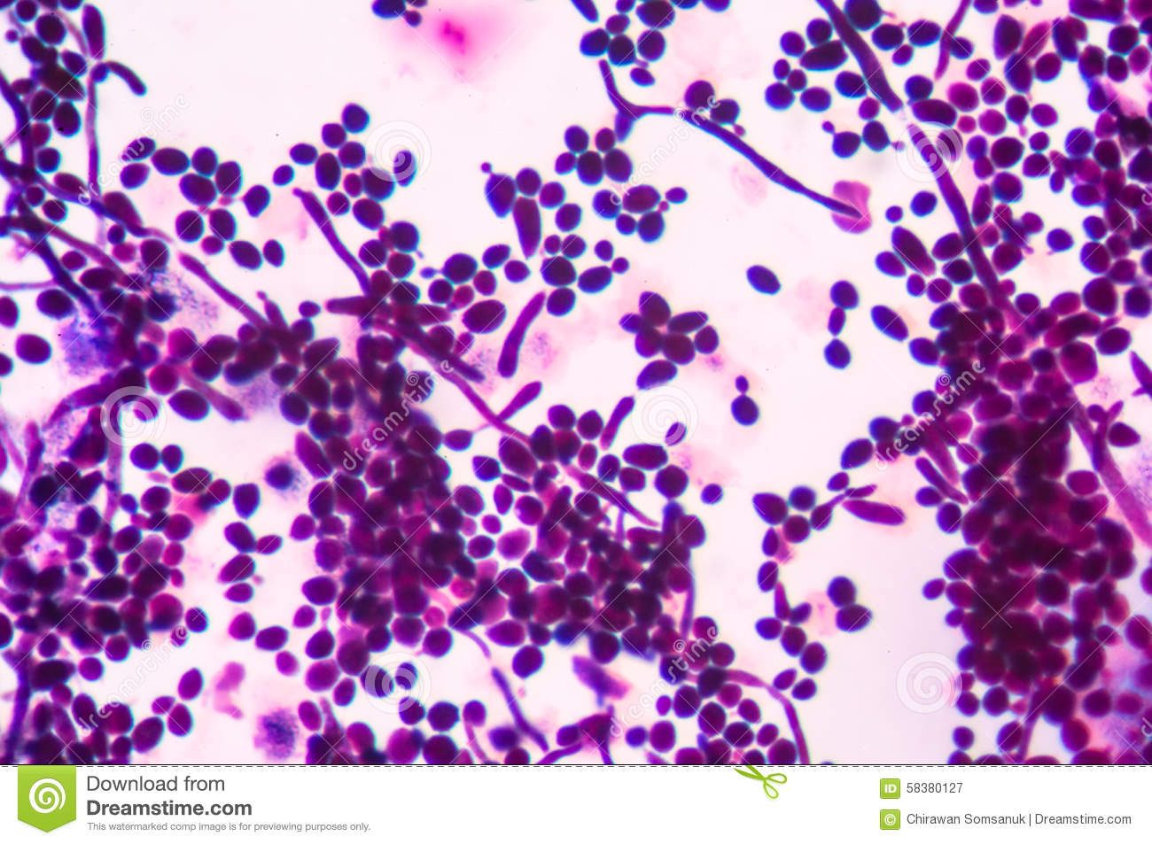
Budding in yeast

Slide 15
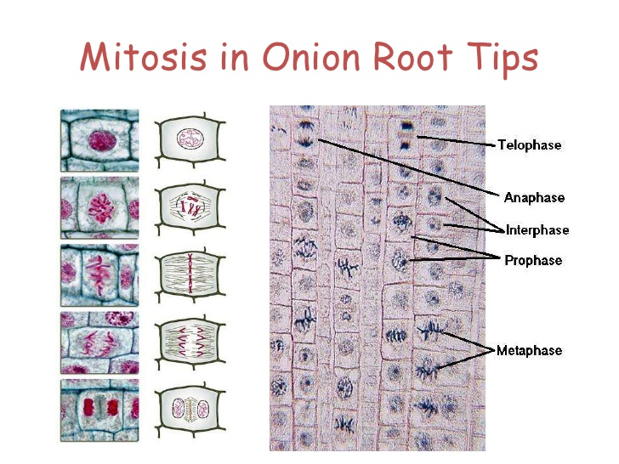

Slide 16
