Slide 1


Slide 2
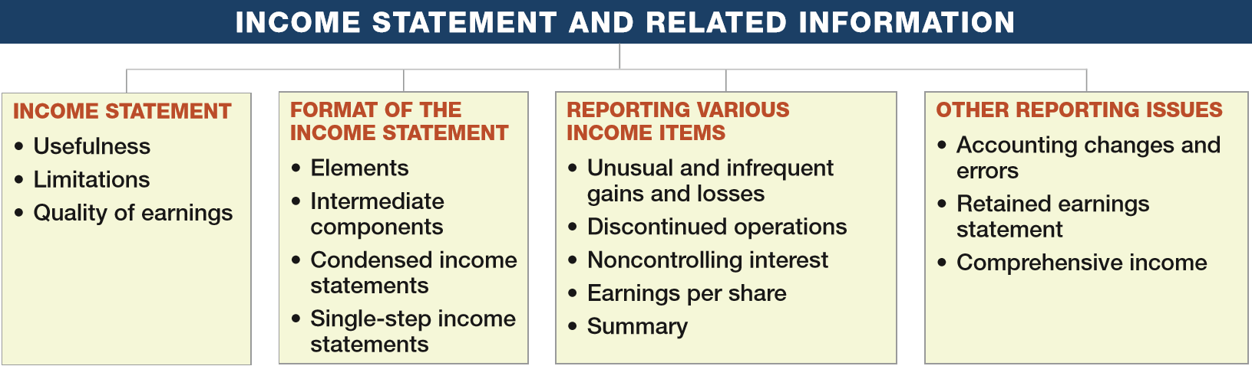
PREVIEW OF CHAPTER 4
Intermediate Accounting
16th Edition
Kieso ● Weygandt ● Warfield

Slide 3
LEARNING OBJECTIVES
4
Income Statement and Related Information
After studying this chapter, you should be able to:
Understand the uses and limitations of an income statement.
Describe the content of the income statement.
Prepare an income statement.
Explain how to report various income items.
Understand the reporting of accounting changes and errors.
Prepare a retained earnings statement.
Explain how to report other comprehensive income.
LO 1

Slide 4
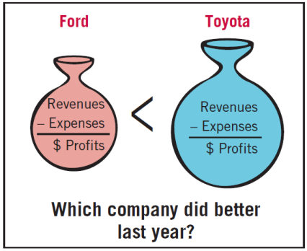

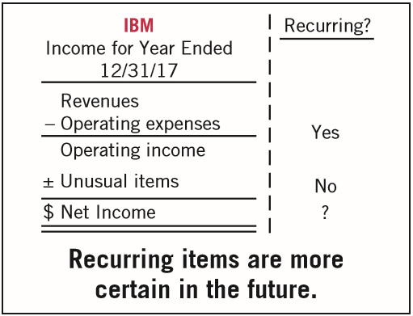
INCOME STATEMENT
Usefulness
Evaluate past performance.
Predicting future performance.
Help assess the risk or uncertainty of achieving future cash flows.
LO 1

Slide 5

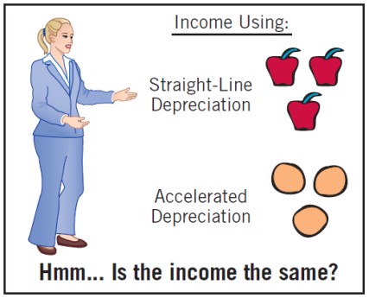
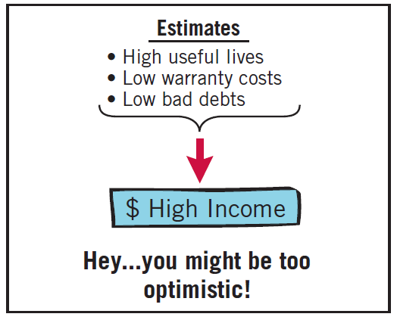
INCOME STATEMENT
Limitations
Companies omit items that cannot be measured reliably.
Income is affected by the accounting methods employed.
Income measurement involves judgment.
LO 1

Slide 6
INCOME STATEMENT
Quality of Earnings
Companies have incentives to manage income to meet or beat Wall Street expectations, so that
  market price of stock increases and
  value of stock options increase.
Quality of earnings is reduced if earnings management results in information that is less useful for predicting future earnings and cash flows.
LO 1

Slide 7
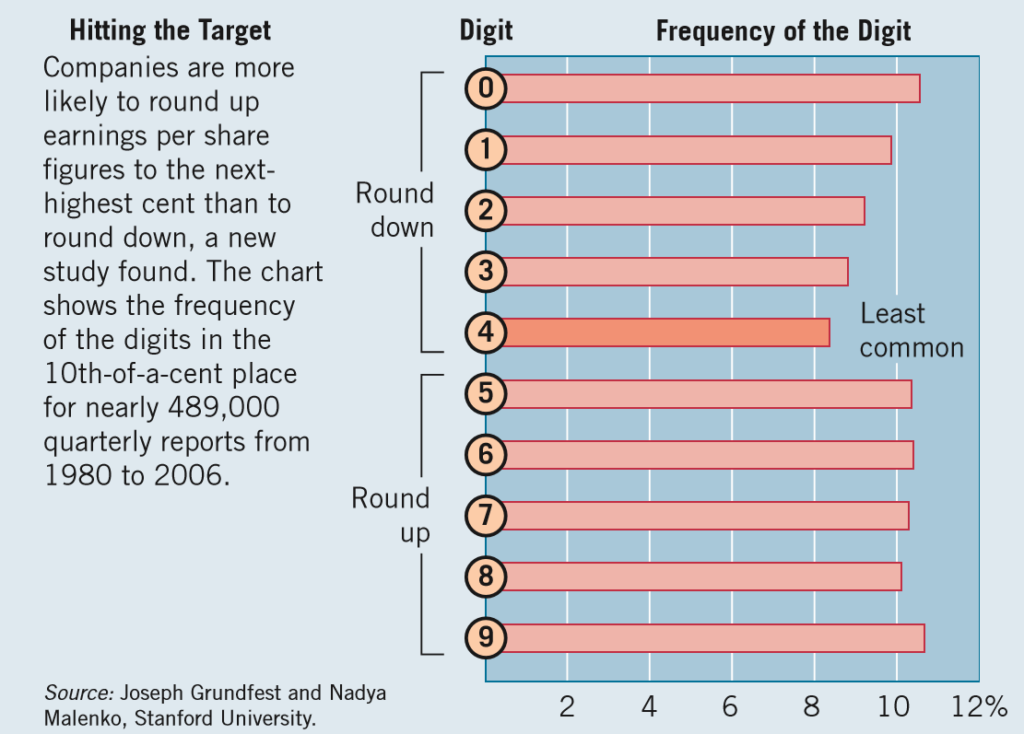
WHAT DO THE NUMBERS MEAN? FOUR: THE LONELIEST NUMBER
WHAT’S YOUR PRINCIPLE
Managing earnings up or down adversely affects the quality of earnings. Why do companies engage in such practices? Some recent research concludes that many companies tweak quarterly earnings to meet investor expectations. How do they do it? Research
ﬁndings indicate that companies tend to nudge their earnings numbers up by a 10th of a cent or two. That lets them round results up to the highest cent, as illustrated in the following chart. What the research shows is that the number
continued
LO 1

Slide 8
WHAT DO THE NUMBERS MEAN? FOUR: THE LONELIEST NUMBER
WHAT’S YOUR PRINCIPLE
“4” appeared less often in the 10th’s place than any other digit and signiﬁcantly less often than would be expected by chance. This effect is called “quadrophobia.” For the typical company in the study, an increase of $31,000 in quarterly net income would boost earnings per share by a 10th of a cent. A more recent analysis of quarterly results for more than 2,600 companies found that rounding up remains more common than rounding down. Another recent study reinforces the concerns about earnings management. Based on a survey of 169 public-company chief ﬁnancial ofﬁcers (and with in-depth interviews of 12), the study concludes that high-quality earnings are sustainable when backed by actual cash ﬂows and “avoiding unreliable long-term estimates.” However, about 20 percent of ﬁrms manage earnings to misrepresent their economic performance. And when they do manage earnings, it could move EPS by an average of 10 percent. Is such earnings management a problem for investors? It is if they cannot determine the impact on earnings quality. Indeed, the surveyed CFOs “believe that it is difﬁcult for outside observers to unravel earnings management, especially when such earnings are managed using
(continued)
LO 1

Slide 9
WHAT DO THE NUMBERS MEAN? FOUR: THE LONELIEST NUMBER
WHAT’S YOUR PRINCIPLE
survey authors say the CFOs “advocate paying close attention to the key managers running the ﬁrm, the lack of correlation between earnings and cash ﬂows, signiﬁcant deviations between ﬁrm and peer experience, and unusual behavior in accruals.”
Sources: S. Thurm, “For Some Firms, a Case of ‘Quadrophobia’,” Wall Street Journal (February 14, 2010); and H. Greenberg, “CFOs Concede Earnings Are ‘Managed’,” www.cnbc.com (July 19, 2012). (The study referred to is by I. Dichev, J. Graham, C. Harvey, and S. Rajgopal, “Earnings Quality: Evidence from the Field,” Emory University Working Paper (July 2012).)
LO 1

Slide 10
LEARNING OBJECTIVES
4
Income Statement and Related Information
After studying this chapter, you should be able to:
Understand the uses and limitations of an income statement.
Describe the content of the income statement.
Prepare an income statement.
Explain how to report various income items.
Understand the reporting of accounting changes and errors.
Prepare a retained earnings statement.
Explain how to report other comprehensive income.
LO 2

Slide 11
FORMAT OF THE INCOME STATEMENT
Elements of the Income Statement
Revenues – Inflows or other enhancements of assets or settlements of its liabilities that constitute the entity’s ongoing major or central operations.
Examples of Revenue Accounts
  Sales
  Fee
  Interest
  Dividend
  Rent
LO 2

Slide 12
FORMAT OF THE INCOME STATEMENT
Elements of the Income Statement
Expenses – Outflows or other using-up of assets or incurrences of liabilities that constitute the entity’s ongoing major or central operations.
Examples of Expense Accounts
  Cost of goods sold
  Depreciation
  Interest
  Rent
  Salaries and wages
  Taxes
LO 2

Slide 13
FORMAT OF THE INCOME STATEMENT
Elements of the Income Statement
Gains – Increases in equity (net assets) from peripheral or incidental transactions.
Losses - Decreases in equity (net assets) from peripheral or incidental transactions.
Gains and losses can result from
  sale of investments or plant assets,
  settlement of liabilities,
  write-offs of assets.
LO 2

Slide 14
LEARNING OBJECTIVES
4
Income Statement and Related Information
After studying this chapter, you should be able to:
Understand the uses and limitations of an income statement.
Describe the content of the income statement.
Prepare an income statement.
Explain how to report various income items.
Understand the reporting of accounting changes and errors.
Prepare a retained earnings statement.
Explain how to report other comprehensive income.
LO 3

Slide 15
FORMAT OF THE INCOME STATEMENT
Intermediate Components
  Format referred to as multiple-step income statement.
  Separates operating transactions from nonoperating transactions.
  Matches costs and expenses with related revenues.
  Highlights certain components of income that analysts use assessing financial performance.
LO 3

Slide 16
Intermediate Components
Common for companies to present some or all of the following sections and totals within the income statement.
  Operating section
  Nonoperating section
  Income tax
  Discontinued operations
  Noncontrolling interest
  Earnings per share
LO 3

Slide 17
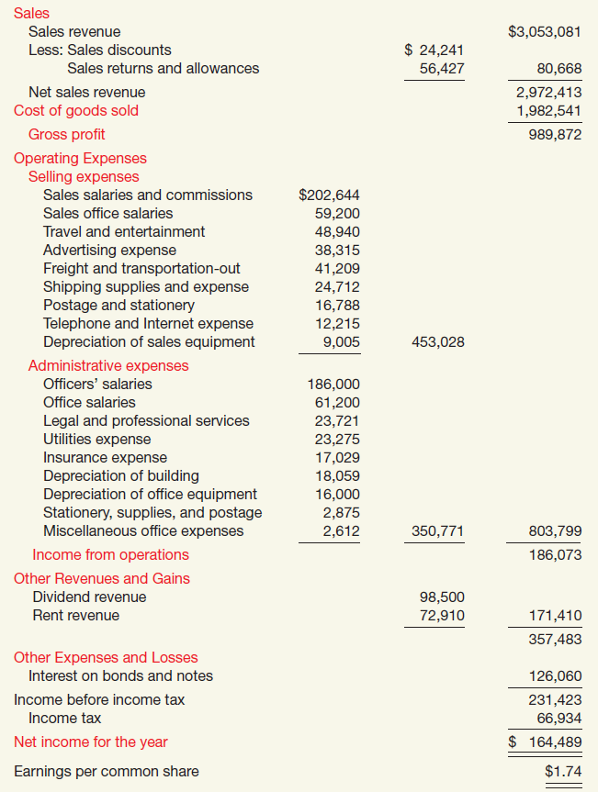
Multiple-Step
CABRERA COMPANY
Income Statement
For The Year Ended December 31, 2017
1. Operating Section
2. Nonoperating Section
3. Income tax
ILLUSTRATION 4-2

Slide 18
WHAT DO THE NUMBERS MEAN? TOP LINE OR BOTTOM LINE?
WHAT’S YOUR PRINCIPLE
The importance of the components of income, as well as the bottom line, is illustrated in the recent case of Chipotle. Its stock had climbed fourfold in ﬁve years and for good reason. The company had been reporting surprisingly high bottom-line income and investors were clamoring to buy. However, in a recent month, that pattern was broken—that is, Chipotle posted solid earnings, but investors sold. The reason? Analysts attribute the sell-off to Chipotle missing its target for revenues. The stock fell 21 percent, from $404 to $317, in a day. And Chipotle was not alone. Six in 10 large companies reported results in that same quarter that missed revenue targets. In response to the bad revenue news, Priceline.com fell $117 to $562 after reporting revenue that was lower than analysts had expected. The story has been the same for dozens of companies across industries, from Coach, a luxury goods retailer, to Boston Scientiﬁc, which sells medical devices, to glass-container maker Owens-Illinois. The recent focus on the top line, revenue, arises because market expectations for revenues do not seem to jive with the companies’ optimistic proﬁt picture. And while companies might report a surprise in earnings,
(continued)
LO 3

Slide 19
WHAT DO THE NUMBERS MEAN? TOP LINE OR BOTTOM LINE?
WHAT’S YOUR PRINCIPLE
analysts will be focusing on revenues. Companies have been able to cut costs to compensate—laying off workers, squeezing remaining staff, and using technology to run more efﬁciently—but there’s a limit to how much you can squeeze your workers and use technology to produce more. U.S. companies are just about as lean as any time in history. As one analyst noted (in this economic environment), “you won’t be able to grow earnings much faster than revenue. . . . Analysts will have to revise down their earnings.” So watch the top line, as well as the bottom line.
Source: Associated Press, “Why Some Stocks Are Sinking Despite Big Profits,” The New York Times (August 12, 2012)
LO 3

Slide 20
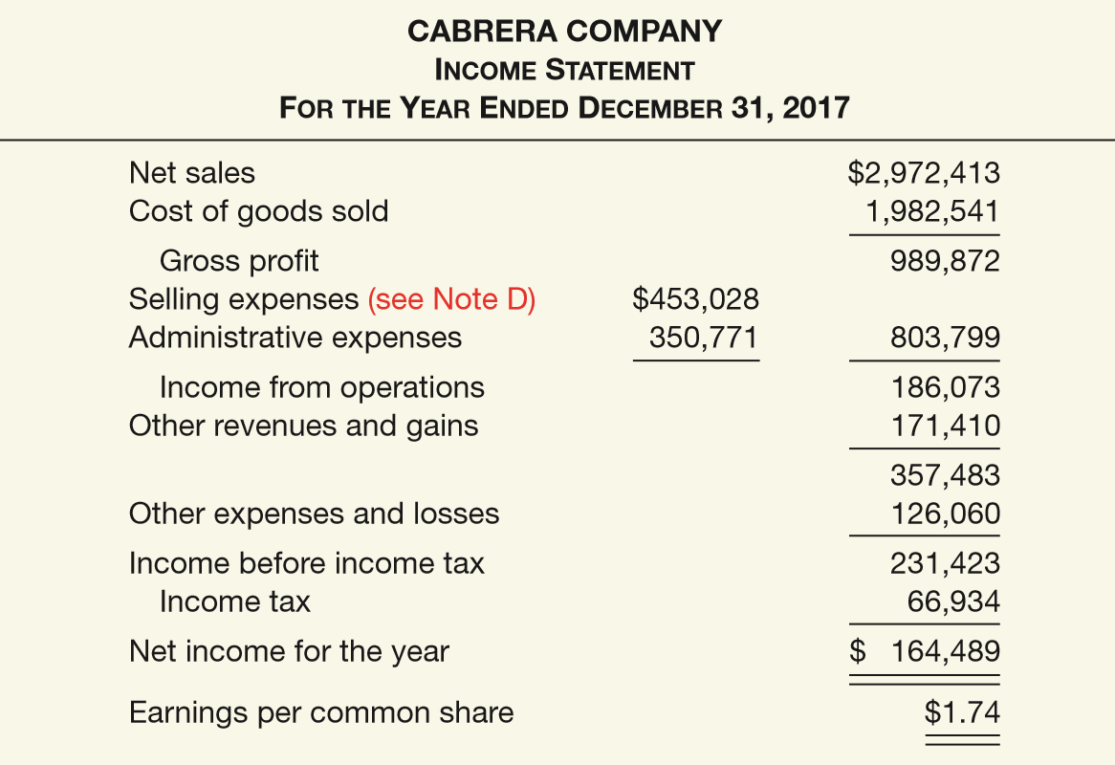
Condensed Income Statements
ILLUSTRATION 4-3
Condensed Income Statement

Slide 21
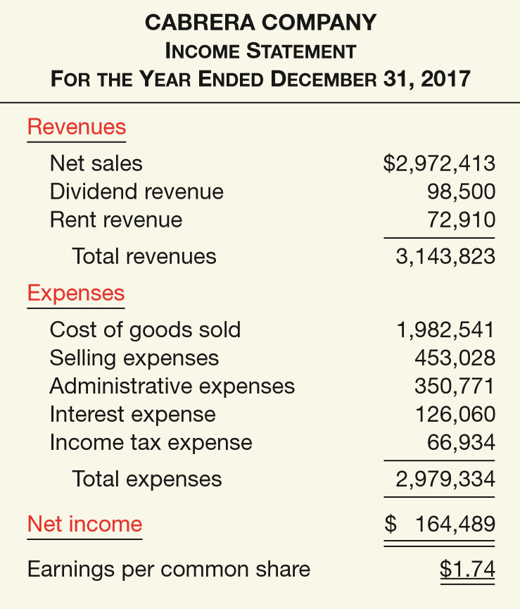
FORMAT OF THE INCOME STATEMENT
Single-Step Income Statements
Revenues
Expenses
Net Income
Single- Step
No implication that one type of revenue or expense item has priority over another.
ILLUSTRATION 4-5
Single-Step Income Statement
LO 3

Slide 22
FORMAT OF THE INCOME STATEMENT
Illustration (E4-5): Prepare a income statement from the data below using the multiple-step form.
LO 3

Slide 23
FORMAT OF THE INCOME STATEMENT
Question
A separation of operating and non operating activities of a company exists in
  both a multiple-step and single-step income statement.
  a multiple-step but not a single-step income statement.
  a single-step but not a multiple-step income statement.
  neither a single-step nor a multiple-step income statement.
LO 3

Slide 24
LEARNING OBJECTIVES
4
Income Statement and Related Information
After studying this chapter, you should be able to:
Understand the uses and limitations of an income statement.
Describe the content of the income statement.
Prepare an income statement.
Explain how to report various income items.
Understand the reporting of accounting changes and errors.
Prepare a retained earnings statement.
Explain how to report other comprehensive income.
LO 4

Slide 25
REPORTING VARIOUS INCOME ITEMS
Companies are required to report unusual and infrequent items as part of net income so users can better determine the long-run earning power of the company.
These income items fall into four general categories:
Unusual gains and losses
Discontinued operations
Noncontrolling interest
Earnings per share
Modified all inclusive concept
LO 4

Slide 26
REPORTING VARIOUS INCOME ITEMS
Unusual and Infrequent Gains and Losses
Unusual. High degree of abnormality and of a type clearly unrelated to, or only incidentally related to, the ordinary and typical activities of the company, taking into account the environment in which it operates.
Infrequency of occurrence. Type of transaction that is not reasonably expected to recur in the foreseeable future, taking into account the environment in which the company operates.
LO 4

Slide 27
Unusual and Infrequent Gains and Losses
Common types of unusual or infrequent gains and losses:
Losses on write-down (impairment) of receivables; inventories; property, plant, and equipment; goodwill or other intangible assets.
Restructuring charges.
Gains and losses from sale or abandonment of property, plant and equipment.
Effects of a strike.
Gains and losses on extinguishment (redemption) of debt obligations.
Gains and losses related to casualties such as fires, floods, and earthquakes.
Gains or losses on sale of investment securities.
LO 4

Slide 28
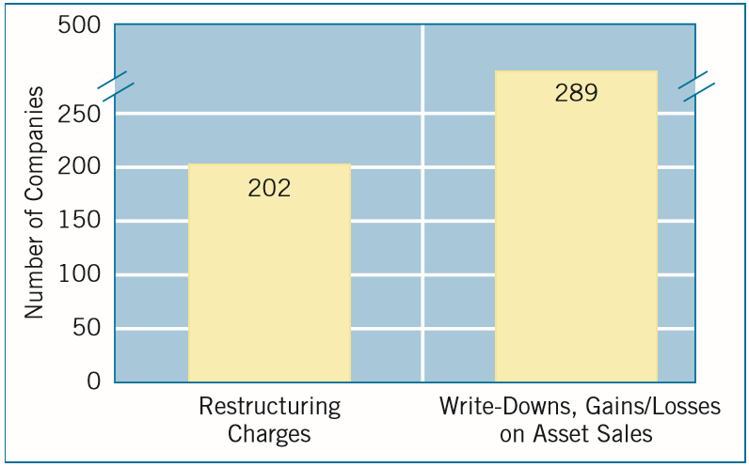
Unusual and Infrequent Gains and Losses
ILLUSTRATION 4-6
Number of Irregular Items Reported in a Recent Year by 500 Large Companies
LO 4

Slide 29
REPORTING VARIOUS INCOME ITEMS
Discontinued Operations
Occurs when two things happen:
  A company eliminates the results of operations of a component of the business.
  The elimination of a component that represents a strategic shift, having a major effect on the company’s operations and financial results.
  Amounts are reported “net of tax.”
LO 4

Slide 30
Discontinued Operations
Illustration: KC Products Inc., a highly diversified company, decides to discontinue its electronics division. During the current year, the electronics division lost $300,000 (net of tax). KC Products sold the division at the end of the year at a loss of $500,000 (net of tax). Show how the discontinued operations would be reported on the income statement for KC Products.
Income from continuing operations $20,000,000
Discontinued operations:
Loss from operations, net of tax 300,000
Loss on disposal, net of tax 500,000
Total loss on discontinued operations 800,000
Net income $19,200,000
ILLUSTRATION 4-7
Income Statement Presentation of Discontinued Operations
LO 4

Slide 31
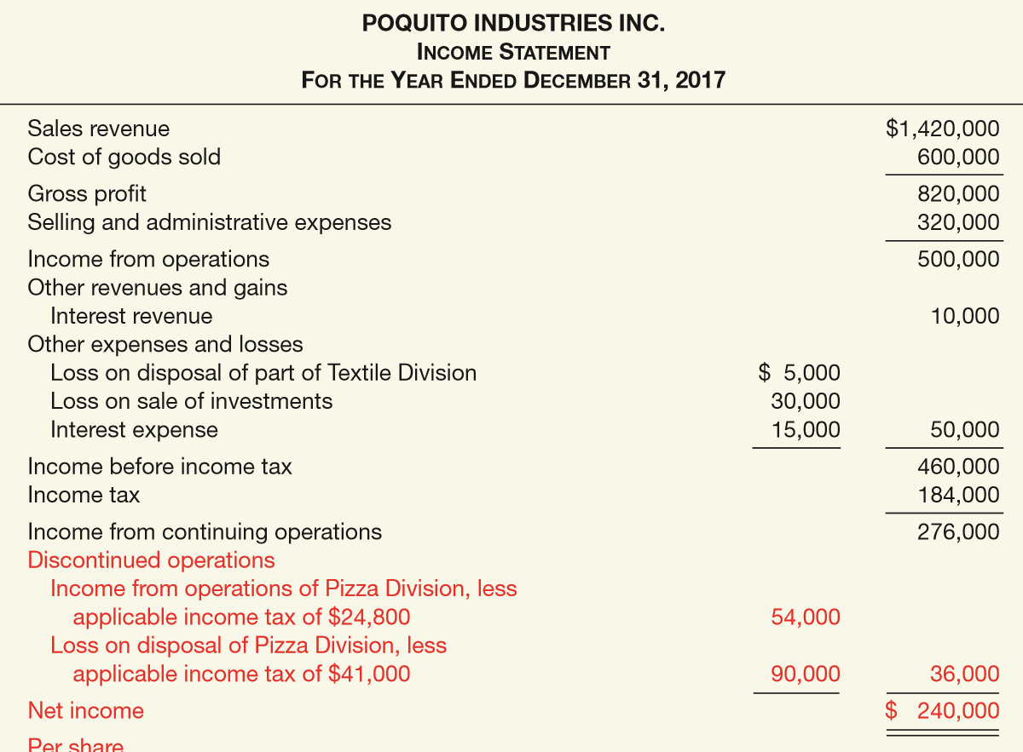

Discontinued Operations
ILLUSTRATION 4-8
Income Statement
Discontinued Operations are reported after “Income from continuing operations.”
Without a discontinued operations this line would be “net income.”

Slide 32
Discontinued Operations
Intraperiod Tax Allocation
The allocation of tax within a period.
Helps users understand the impact of income taxes on the various components of net income.
Intraperiod tax allocation is used for:
(1) Income from continuing operations,
(2) discontinued operations.
LO 4

Slide 33
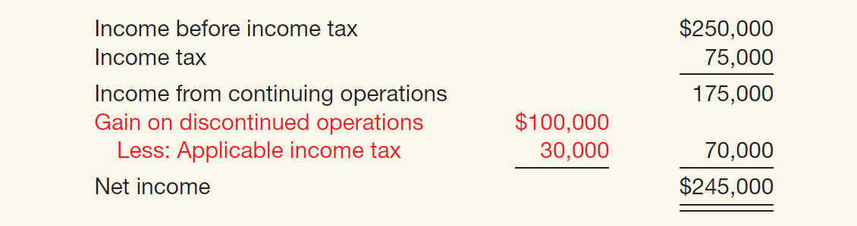
Discontinued Operations
Discontinued Operations (Gain)
Illustration: Schindler Co. has income before income tax of $250,000. It has a gain of $100,000 from a discontinued operation. Assuming a 30 percent income tax rate, Schindler presents the following information on the income statement.
ILLUSTRATION 4-9
Intraperiod Tax Allocation, Discontinued Operations Gain
LO 4

Slide 34
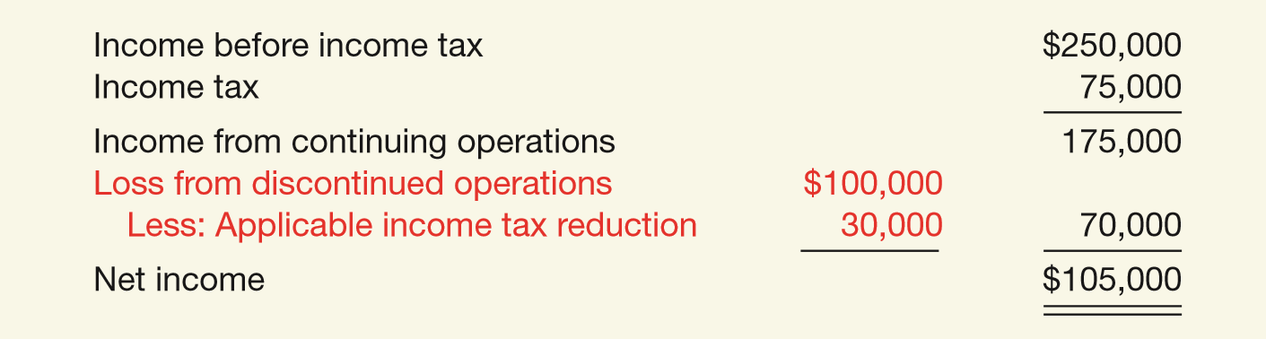
Discontinued Operations
Discontinued Operations (Loss)
Illustration: Schindler Co. has income before income tax of $250,000. It suffers a loss from discontinued operations of $100,000. Assuming a 30 percent tax rate, Schindler presents the income tax on the income statement as shown
ILLUSTRATION 4-10
Intraperiod Tax Allocation, Discontinued Operations Loss
LO 4

Slide 35
REPORTING VARIOUS INCOME ITEMS
Noncontrolling Interest
When a company owns substantial interests (generally greater than 50%) in another company, GAAP generally require that the financial statements of both companies be consolidated together into one set of financials.
Noncontrolling interest is the portion of equity (net assets) interest in a subsidiary not attributable to the parent company.
LO 4

Slide 36
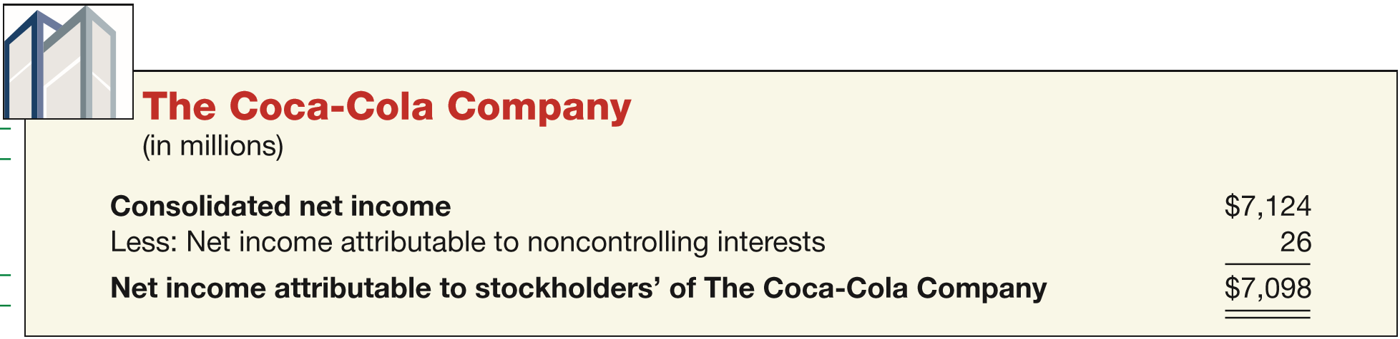
Noncontrolling Interest
Illustration: Assume that Coca-Cola acquires 70 percent of the outstanding stock of Koch Company. Because Coca-Cola owns more than 50 percent of Koch, it consolidates Koch’s financial results with its own. GAAP requires that net income be allocated to the controlling and noncontrolling interest.
ILLUSTRATION 4-12
Presentation of Noncontrolling Interest
The noncontrolling interest amounts are not an expense or dividend, but are allocations of net income (loss) to the noncontrolling interest.
LO 4

Slide 37
REPORTING VARIOUS INCOME ITEMS
Earnings per Share
  Net Income - Preferred Dividends
Weighted Average of Common Shares Outstanding
A significant business indicator.
Measures the dollars earned by each share of common stock.
Must be disclosed on the income statement.
LO 4

Slide 38
Earnings per Share
Illustration: Lancer, Inc. reports net income of $350,000. It declares and pays preferred dividends of $50,000 for the year. The weighted-average number of common shares outstanding during the year is 100,000 shares. Lancer computes earnings per share as follows:
  Net Income - Preferred Dividends
Weighted Average of Common Shares Outstanding
$350,000
- $50,000
=
$3.00 per share
100,000
LO 4

Slide 39
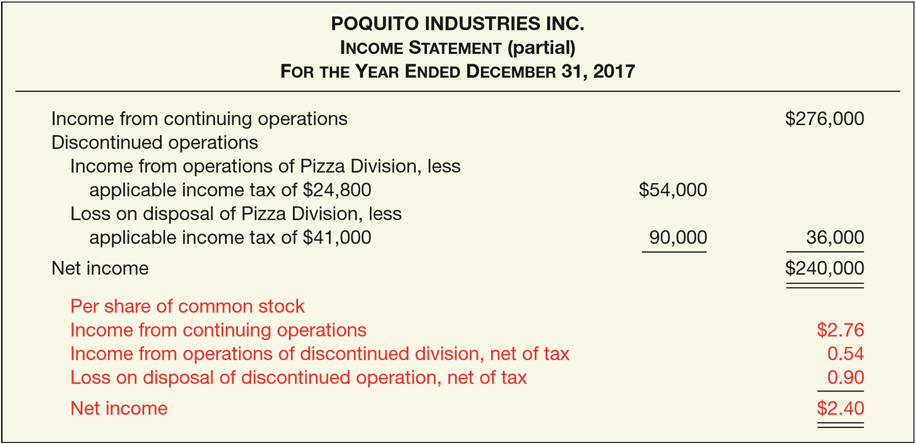
Earnings per Share
ILLUSTRATION 4-14
Income Statement
LO 4

Slide 40
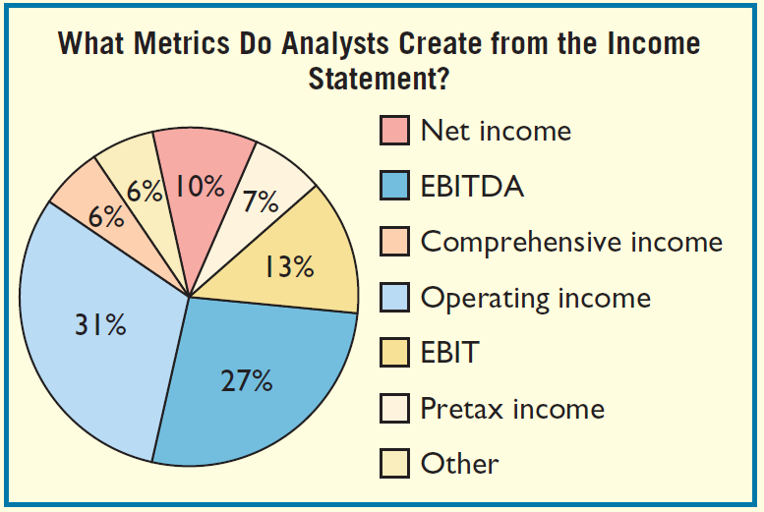
WHAT DO THE NUMBERS MEAN? DIFFERENT INCOME CONCEPTS
WHAT’S YOUR PRINCIPLE
As mentioned in the opening story, the FASB and the IASB have collaborated on a joint project related to presentation of ﬁnancial statements. In 2008, these two groups issued an exposure draft that presented examples of what these new ﬁnancial statements might look like. The Boards also conducted ﬁeld tests on two groups: preparers and users. Preparers were asked to recast their ﬁnancial statements and then comment on the results. Users examined the
recast statements and commented on their usefulness. One part of the ﬁeld test asked analysts to indicate which primary performance metric they use or create from a company’s income statement. They were provided with the following options: (a) Net income; (b) Pretax income; (c) Income before interest and taxes
(continued)
LO 4

Slide 41
WHAT DO THE NUMBERS MEAN? DIFFERENT INCOME CONCEPTS
WHAT’S YOUR PRINCIPLE
(EBIT); (d) Income before interest, taxes, depreciation, and amortization (EBITDA); (e) Operating income; (f) Comprehensive income; and (g) Other. The adjacent chart highlights their responses. As indicated, Operating income (31%) and EBITDA (27%) were identiﬁed as the two primary performance metrics that respondents use or create from a company’s income statement. A majority of the respondents identiﬁed a primary performance metric that
uses net income as its foundation (pretax income would be in this group). Clearly, users and preparers look at more than just the bottom-line income number, which supports the common practice of providing subtotals within the income statement.
Source: “FASB-IASB Report on Analyst Field Test Results,” Financial Statement Presentation Informational Board Meeting (September 21, 2009).
LO 4

Slide 42
LEARNING OBJECTIVES
4
Income Statement and Related Information
After studying this chapter, you should be able to:
Understand the uses and limitations of an income statement.
Describe the content of the income statement.
Prepare an income statement.
Explain how to report various income items.
Understand the reporting of accounting changes and errors.
Prepare a retained earnings statement.
Explain how to report other comprehensive income.
LO 5

Slide 43
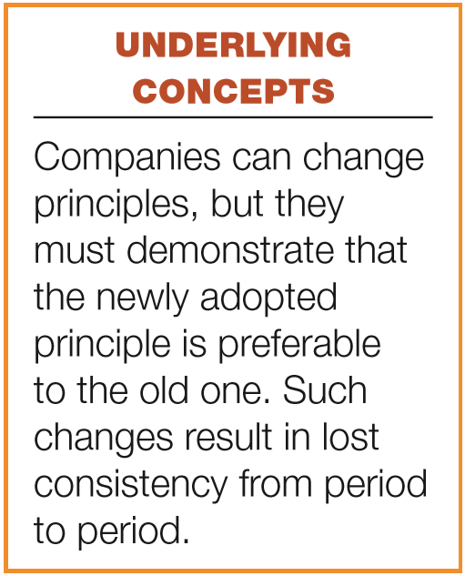
OTHER REPORTING ISSUES
Accounting Changes and Errors
Changes in Accounting Principle
  Retrospective adjustment.
  Cumulative effect adjustment to beginning
  retained earnings.
  Approach preserves comparability across years.
  Examples include:
    change from FIFO to average cost.
    change from the percentage-of-completion to the completed-contract method.
LO 5

Slide 44
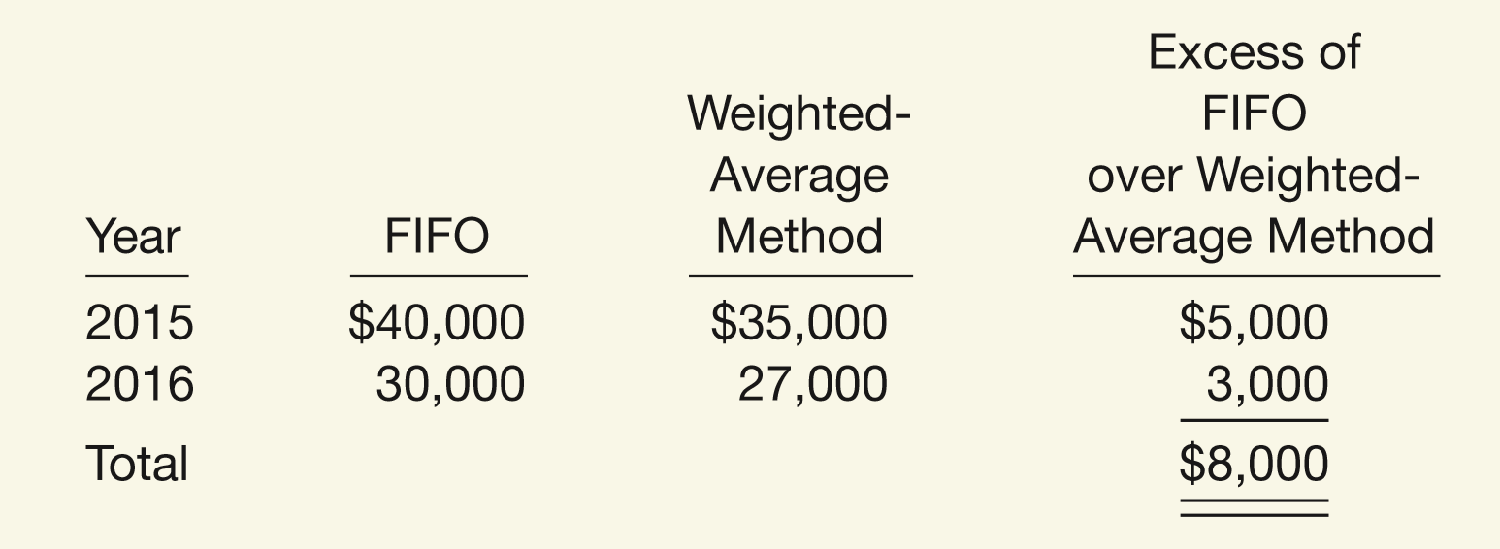
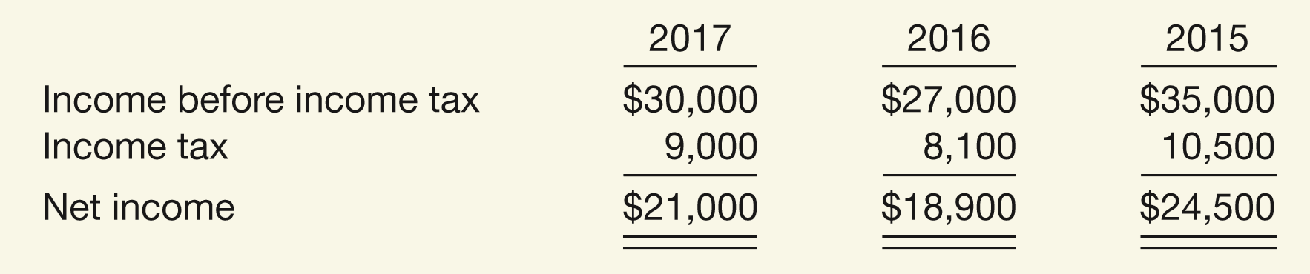
Accounting Changes
Change in Accounting Principle: Gaubert Inc. decided in March 2017 to change from FIFO to weighted-average inventory pricing. Gaubert’s income before taxes, using the new weighted-average method in 2017, is $30,000.
ILLUSTRATION 4-16
Calculation of a Change in
Accounting Principle
Pretax Income Data
ILLUSTRATION 4-17
Income Statement Presentation of a Change in Accounting Principle (Based on 30% tax rate)

Slide 45
Accounting Changes
Change in Accounting Estimates
  Accounted for in the period of change or the period of and the future periods if the change affects both.
  Not handled retrospectively.
  Not considered errors.
  Examples include:
    Useful lives and salvage values of depreciable assets.
    Allowance for uncollectible receivables.
    Inventory obsolescence.
LO 5

Slide 46
Change in Accounting Estimate
Illustration: Arcadia HS, purchased equipment for $510,000 which was estimated to have a useful life of 10 years with a salvage value of $10,000 at the end of that time. Depreciation has been recorded for 7 years on a straight-line basis. In 2017 (year 8), it is determined that the total estimated life should be 15 years with a salvage value of $5,000 at the end of that time.
Questions:
  What is the journal entry to correct the prior years’ depreciation?
  Calculate the depreciation expense for 2017.
No Entry
LO 5

Slide 47
Change in Accounting Estimate
After 7 years
Equipment cost $510,000
Salvage value - 10,000
Depreciable base 500,000
Useful life (original) 10 years
Annual depreciation $ 50,000
First, establish NBV at date of change in estimate.
x 7 years = $350,000
Balance Sheet (Dec. 31, 2016)
Fixed Assets:
Equipment
$510,000
Accumulated depreciation
350,000
Net book value (NBV)
$160,000
LO 5

Slide 48
Change in Accounting Estimate
After 7 years
Net book value $160,000
Salvage value (new) 5,000
Depreciable base 155,000
Useful life remaining 8 years
Annual depreciation $ 19,375
Depreciation Expense calculation for 2017.
Journal entry for 2017
Depreciation Expense 19,375
Accumulated Depreciation 19,375
LO 5

Slide 49
Accounting Errors
Corrections of Errors
  Result from:
    mathematical mistakes.
    mistakes in application of accounting principles.
    oversight or misuse of facts.
  Corrections treated as prior period adjustments.
  Adjustment to the beginning balance of retained earnings.
LO 5

Slide 50
Accounting Errors
Illustration: In 2018, Hillsboro Co. determined that it incorrectly overstated its accounts receivable and sales revenue by $100,000 in 2017. In 2018, Hillboro makes the following entry to correct for this error (ignore income taxes).
Retained Earnings 100,000
Accounts Receivable 100,000
LO 5

Slide 51
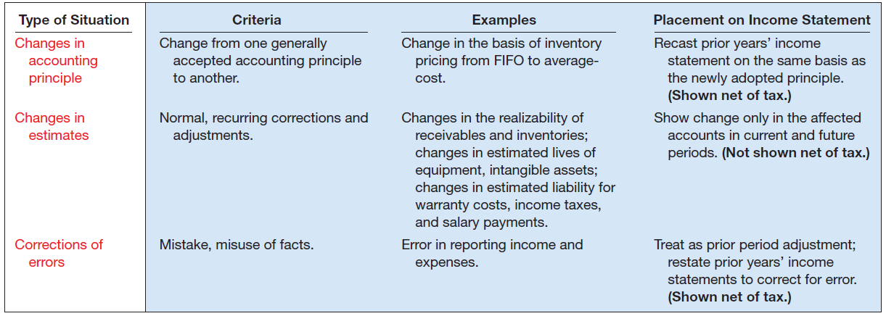
Accounting Changes and Errors
Summary
ILLUSTRATION 4-18
Summary of Accounting Changes and Errors
LO 5

Slide 52
LEARNING OBJECTIVES
4
Income Statement and Related Information
After studying this chapter, you should be able to:
Understand the uses and limitations of an income statement.
Describe the content of the income statement.
Prepare an income statement.
Explain how to report various income items.
Understand the reporting of accounting changes and errors.
Prepare a retained earnings statement.
Explain how to report other comprehensive income.
LO 6

Slide 53
OTHER REPORTING ISSUES
Retained Earnings Statement
Increase
Decrease
Net income
Change in accounting principle
Prior period adjustments
Net loss
Dividends
Change in accounting principles
Prior period adjustments
LO 6

Slide 54
Retained Earnings Statement
Before issuing the report for the year ended December 31, 2017, you discover a $50,000 error (net of tax) that caused 2016 inventory to be overstated (overstated inventory caused COGS to be lower and thus net income to be higher in 2016). Would this discovery have any impact on the reporting of the Statement of Retained Earnings for 2017?
LO 6

Slide 55
Retained Earnings Statement
LO 6

Slide 56
Retained Earnings Statement
Restrictions on Retained Earnings
Disclosed
  In notes to the financial statements.
  As Appropriated Retained Earnings.
LO 6

Slide 57
LEARNING OBJECTIVES
4
Income Statement and Related Information
After studying this chapter, you should be able to:
Understand the uses and limitations of an income statement.
Describe the content of the income statement.
Prepare an income statement.
Explain how to report various income items.
Understand the reporting of accounting changes and errors.
Prepare a retained earnings statement.
Explain how to report other comprehensive income.
LO 7

Slide 58
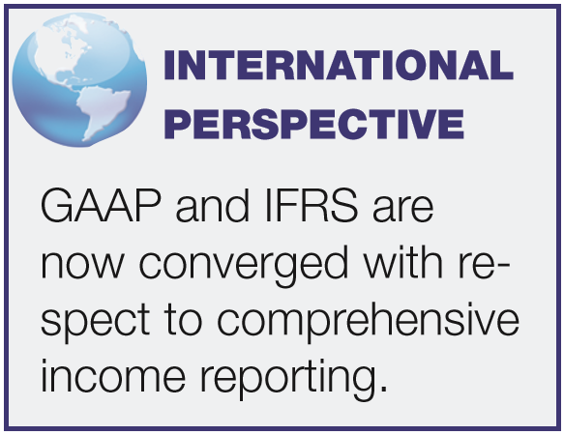
OTHER REPORTING ISSUES
Comprehensive Income
All changes in equity during a period except those resulting from investments by owners and distributions to owners.
Includes:
  all revenues and gains, expenses and losses reported in net income, and
  all gains and losses that bypass
  net income but affect stockholders’
  equity.
LO 7

Slide 59
Comprehensive Income
Net Income
Other Comprehensive Income
+
Unrealized gains and losses on available-for-sale securities.
Translation gains and losses on foreign currency.
Plus others
Reported in Stockholders’ Equity
LO 7

Slide 60
Comprehensive Income
Question
Gains and losses that bypass net income but affect stockholders' equity are referred to as
  comprehensive income.
  other comprehensive income.
  prior period income.
  unusual gains and losses.
LO 7

Slide 61
Comprehensive Income
Companies must display the components of other comprehensive income in one of two ways:
  A single continuous statement (one statement approach) or
  two separate, but consecutive statements of net income and other comprehensive income (two statement approach).
LO 7

Slide 62
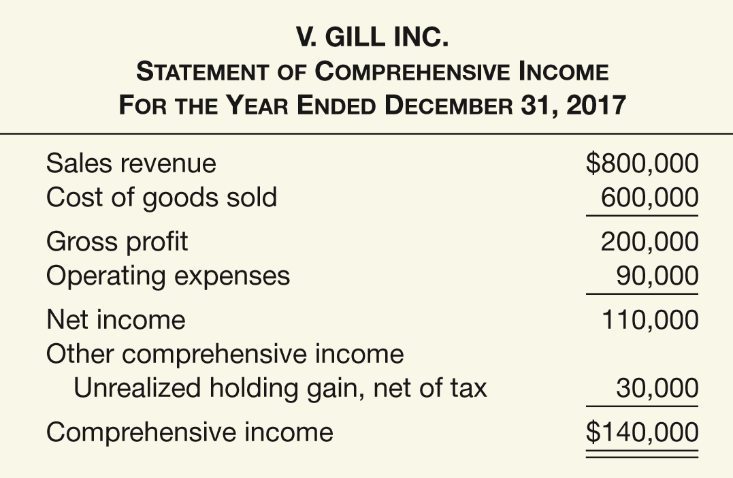
Comprehensive Income
One Statement Approach
Advantage – does not require the creation of a new financial statement.
Disadvantage - net income buried as a subtotal on the statement.
ILLUSTRATION 4-20
One Statement Format: Comprehensive Income
LO 7

Slide 63
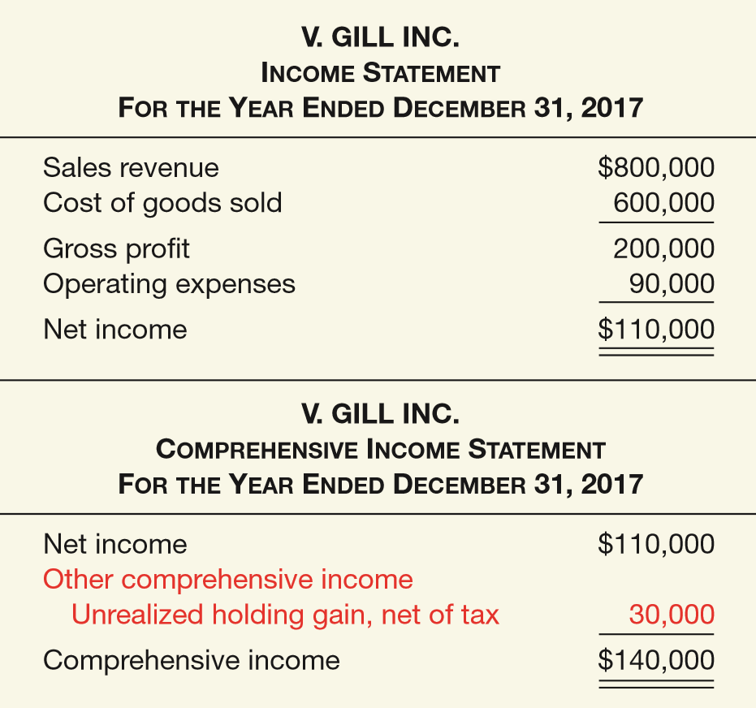
Comprehensive Income
Two Statement Approach
ILLUSTRATION 4-19
ILLUSTRATION 4-21
Two Statement Format: Comprehensive Income

Slide 64
Comprehensive Income
Statement of Stockholders’ Equity
  Reports the changes in each stockholders’ equity account and total equity for the period.
  Following items are disclosed in the statement:
    Contributions (issuances of shares) and distributions (dividends) to owners.
    Reconciliation of the carrying amount of each component of stockholders’ equity from the beginning to the end of the period.
LO 7

Slide 65
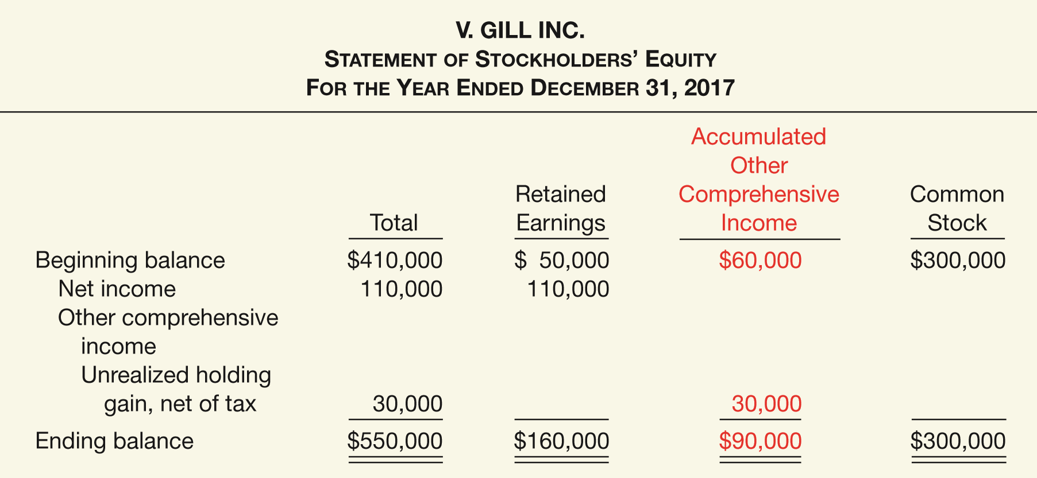
Statement of Stockholders’ Equity
ILLUSTRATION 4-22
Presentation of Comprehensive Income
in Stockholders’ Equity Statement
LO 7

Slide 66
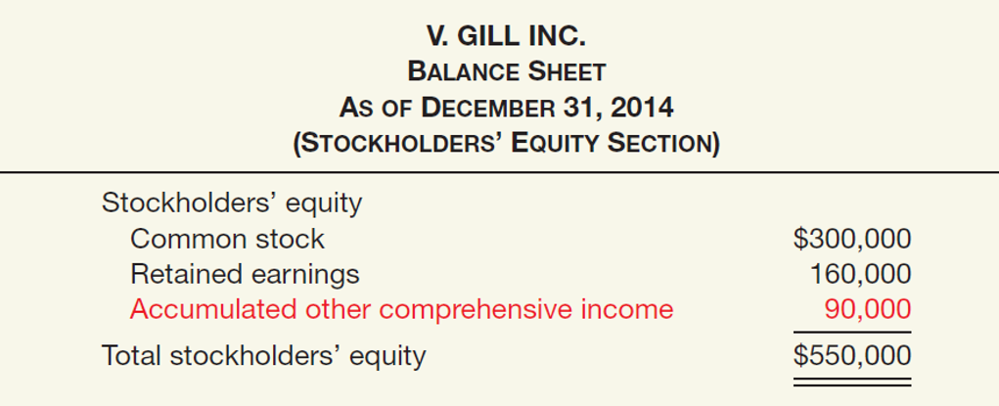
Statement of Stockholders’ Equity
Balance Sheet Presentation
ILLUSTRATION 4-23
Presentation of Accumulated Other Comprehensive Income in the Balance Sheet
LO 7

Slide 67
EVOLVING ISSUE INCOME REPORTING
WHAT’S YOUR PRINCIPLE
As indicated in the chapter, information reported in the income statement is important to meeting the objective of ﬁnancial reporting. However, there is debate over income reporting practices, be it the controversy over pro forma reporting or whether to report comprehensive income in a one statement or a two statement format. In response to these debates and to differences between income reporting under U.S. GAAP and IFRS, standard-setters are working on a project to improve the usefulness of the income statement. Work to date has resulted in two core principles for ﬁnancial statement presentation (for the income statement, balance sheet, and the statement of cash ﬂows) based on the objective of ﬁnancial reporting:
1. Disaggregate information so that it is useful in predicting an entity’s future cash ﬂows. Disaggregation means separating resources by the activity in which they are used and by their economic characteristics.
(continued)

Slide 68
EVOLVING ISSUE INCOME REPORTING
WHAT’S YOUR PRINCIPLE
2. Portray a cohesive ﬁnancial picture of a company’s activities. A cohesive ﬁnancial picture means that the relationship between items across ﬁnancial statements is clear and that a company’s ﬁnancial statements complement each other as much as possible.
Cohesiveness could be addressed by using the same classiﬁcations across the balance sheet, income statement, and statement of cash ﬂows. The proposed model classiﬁes activities as business or ﬁnancing, although some have suggested that each statement be segregated into operating, investing, and ﬁnancing activities. The statement presentation project is currently inactive on the Boards’ joint agenda (see www.fasb.org and click on Inactive Joint FASB/IASB Projects under the Projects tab), but it is expected to restart once the projects on ﬁnancial instruments, revenue recognition, and leases are completed.

Slide 69
RELEVANT FACTS - Similarities
  Both GAAP and IFRS require companies to indicate the amount of net income attributable to noncontrolling interest.
  With the recent FASB Accounting Standards Update, under both IFRS and GAAP, unusual and infrequent income items are reported in Income before income taxes (i.e., not an extraordinary item treatment).
  Both GAAP and IFRS follow the same presentation guidelines for discontinued operations, but IFRS defines a discontinued operation more narrowly. Both standard-setters have indicated a willingness to develop a similar definition to be used in the joint project on financial statement presentation.
LO 8 Compare the accounting for income reporting under GAAP and IFRS.

Slide 70
RELEVANT FACTS - Similarities
  Both GAAP and IFRS have items that are recognized in equity as part of comprehensive income but do not affect net income. Both GAAP and IFRS allow a one statement or two statement approach to preparing the statement of comprehensive income.
RELEVANT FACTS - Differences
  Presentation of the income statement under GAAP follows either a single-step or multiple-step format. IFRS does not mention a single-step or multiple-step approach.
  Under IFRS, companies must classify expenses by either nature or function. GAAP does not have that requirement, but the SEC requires a functional presentation.
LO 8

Slide 71
RELEVANT FACTS - Differences
  IFRS identifies certain minimum items that should be presented on the income statement. GAAP has no minimum information requirements. However, the SEC rules have more rigorous presentation requirements.
  IFRS does not define key measures like income from operations. SEC regulations define many key measures and provide requirements and limitations on companies reporting non-GAAP/ IFRS information.
  Under IFRS, revaluation of property, plant, and equipment, and intangible assets is permitted, with gains reported as other comprehensive income. The effect of this difference is that application of IFRS results in more transactions affecting equity but not net income.
LO 8

Slide 72
ON THE HORIZON
The IASB and FASB are working on a project that would rework the structure of financial statements. One stage of this project will address the issue of how to classify various items in the income statement. A main goal of this new approach is to provide information that better represents how businesses are run. The FASB and IASB have issued a proposal to require comprehensive income be reported in a combined statement of comprehensive income. This approach draws attention away from just one number—net income.
LO 8

Slide 73
IFRS SELF-TEST QUESTION
Which of the following is not reported in an income statement under IFRS?
  Discontinued operations.
  Extraordinary items.
  Cost of goods sold.
  Income tax.
LO 8

Slide 74
IFRS SELF-TEST QUESTION
Which of the following statements is correct regarding income reporting under IFRS?
  IFRS does not permit revaluation of property, plant, and equipment, and intangible assets.
  IFRS provides the same options for reporting comprehensive income as GAAP.
  Companies must classify expenses either by nature or function.
  IFRS provides a definition for all items presented in the income statement.
LO 8

Slide 75
IFRS SELF-TEST QUESTION
Which of the following is not an acceptable way of displaying the components of other comprehensive income under IFRS?
  Within the statement of retained earnings.
  Second income statement.
  Combined statement of comprehensive income.
  All of the above are acceptable.
LO 8

Slide 76
COPYRIGHT
“Copyright © 2016 John Wiley & Sons, Inc. All rights reserved. Reproduction or translation of this work beyond that permitted in Section 117 of the 1976 United States Copyright Act without the express written permission of the copyright owner is unlawful. Request for further information should be addressed to the Permissions Department, John Wiley & Sons, Inc. The purchaser may make back-up copies for his/her own use only and not for distribution or resale. The Publisher assumes no responsibility for errors, omissions, or damages, caused by the use of these programs or from the use of the information contained herein.”

