Slide 1
MNT FOR diabetes

Slide 2
MNT Goals:
Improve blood glucose levels
Slow the progression of diabetic complications
Introduce meal planning strategies
Notes:
The nutrition therapy should accommodate for a person’s dietary preferences and lifestyle
Dietary intakes must be modified to accommodate growth, lifestyle changes, aging, and any complications that develop

Slide 3
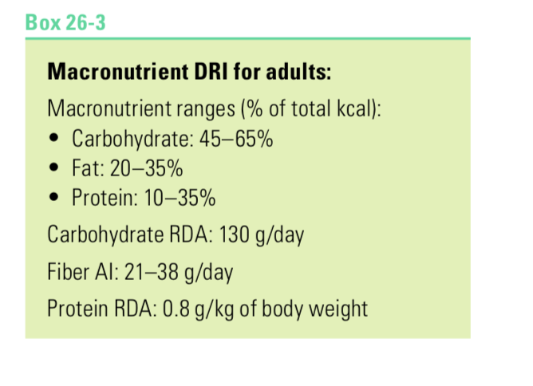
mnt
Macronutrient intakes- same as for adults
Can be personalized for food preferences and metabolic factors (for example, insulin sensitivity, blood lipid levels, and kidney function).
Day-to-day consistency in carbohydrate intake is associated with better glycemic control

Slide 4
Evidence suggests that there is not an ideal percentage of calories from CHO, protein, and fat for all people with diabetes...macronutrient distribution should be based on individual assessment of current eating patterns, preferences and metabolic goals
2014 Nutrition Guidelines, American Diabetes Association

Slide 5
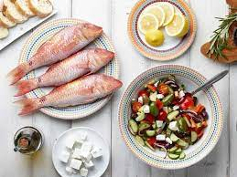
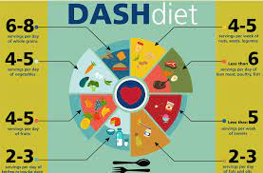
A variety of eating patterns are acceptable for the management of DM such as
  Mediterranean diet
  Vegetarian/vegan › Low fat
  Low CHO
  DASH
What is important is the patients personal preferences, metabolic goals & ability & willingness to make changes
Franz (2016). Diabetes Nutrition Therapy: Effectiveness, Macronutrients, Eating Patterns & Weight Management. AJMS. 351:4, 374-379.

Slide 6
Educate on CHO counting using insulin- to-CHO ratios
Based on patients abilities, preferences & management goals
Strong evidence for the effectiveness of decreasing HgA1C and increasing quality of life
Academy of Nutrition & Dietetics’ Evidence Analysis Library (2015): http://www.andeal.org

Slide 7
MNT/Carbohydrates
The amount of carbohydrate consumed has the greatest influence on blood glucose levels after meal
  the more grams of CHO intake, the greater the glycemic response
For optimal health, the carbohydrate sources should be vegetables, fruits, whole grains, legumes, and milk products, Whole grains
foods made with refined grains and added sugars should be limited
Important to know what foods contain carbohydrates: starchy vegetables, whole grains, fruit, milk and milk products, vegetables, and sugar.

Slide 8
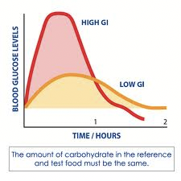
mnt
Glycemic index
A food’s glycemic effect is influenced by the type of carbohydrate in a food, the food’s fiber content, the preparation method, the other foods included in a meal, and individual tolerances
The significance of a food’s glycemic effect is a controversial topic when considering diabetic patients- conflicting evidence on effectiveness of this strategy
HOWEVER, a high-fiber, minimally processed foods—which typically have lower glycemic effects ->frequently recommended for persons with diabetes

Slide 9
mnt
Sugars
Advise against excessive intake of nutritive sweeteners and educate about better CHO sources
Because moderate consumption of sucrose has not been shown to adversely affect glycemic control, sugar recommendations for people with diabetes are similar to those for the general population, which suggest minimizing foods and beverages that contain added sugars
Not necessary to avoid the naturally occurring fructose in fruits and vegetables→ fructose has a lower glycemic response than sucrose and starch
Sugar alcohols (such as sorbitol and maltitol) have lower glycemic effects than glucose or sucrose

Slide 10

mnt
Sucrose
Fructose
Honey
Corn syrup
Molasses
Fruit juice
Dextrose
Maltose
Mannitol
Sorbitol
Xylitol
Hydrogenated starch hydrosylates
There is no significant advantage or disadvantage to using these instead of sucrose
Searchable database for glycemic index: http://www.glycemicindex.com/foodSearch.php

Slide 11
mnt
NON nutritive sweeteners
Artificial sweeteners such as (aspartame, saccharin, and sucralose) contain no digestible carbohydrate and can be safely used in place of sugar.
Research on non-nutritive sweeteners reports no effect on changes in glycemic response.
Can reduce overall calorie and carbohydrate intake

Slide 12
mnt
Fiber
Recommendations for whole grain and fiber intakes are similar to those for the general population
Fiber-rich foods such as whole-grain cereals, legumes, fruits, and veg- etables in their diet
Fiber AI: 21–38 g/day or 14 g per 1000 kcal

Slide 13
mnt
Dietary Fat
A Mediterranean-style dietary pattern that emphasizes monounsaturated fats may benefit both glycemic control and cardiovascular disease (CVD) risk
MUFA’s are found in olive, canola, peanut, sunflower and safflower oils
Avocados, peanut butter and most nuts
Increased intakes of omega-3 fatty acids from fatty fish or plant sources
Saturated fat < 10 percent of total calories
Trans fat intake should be as low as possible

Slide 14
MNT
Protein
Protein recommendations for people with diabetes are similar to those for the general population
high protein intakes are sometimes discouraged because they may be detrimental to kidney function in patients with nephropathy
Recommendations: 15-20% of total calories

Slide 15
MNT
Alcohol use in Diabetes
Women limit their average daily intakes of alcohol to 1 drink
Men limit intake to 2 drinks per day
Individuals using insulin or medications that promote insulin secretion should consume food when they ingest alcoholic beverages to avoid hypoglycemia (alcohol can cause hypoglycemia by interfering with glucose production in the liver)
Alcohol abstention is recommended in: pregnancy, history of alcohol abuse, and other conflicting conditions

Slide 16
MNT
Micronutrients
Micronutrient recommendations for people with diabetes are the same as for the general population. Vitamin and mineral supplementation is not recommended unless nutrient deficiencies develop
Sodium Rec’d
Encourage Individualized Reduction in Sodium Intake
The recommendation for the general population to reduce sodium to less than 2,300 mg per day is also appropriate for adults with diabetes
Academy of Nutrition & Dietetics’ Evidence Analysis Library (2015): http://www.andeal.org

Slide 17
Physical Activity
Accumulating 150 minutes or more of physical activity/wk
Moderate-intensity aerobic exercise spread over at 3 d/ wk with no more than 2 consecutive days without exercise
Resistance training at least 2x/week
Reduce sedentary time
Academy of Nutrition & Dietetics’ Evidence Analysis Library (2015): http://www.andeal.org

Slide 18
Meal-Planning Strategies Carbohydrate Counting
Steps
A dietitian has an interview to assess a patient’s usual food intake and calculates nutrient and energy needs
the patient is given a daily carbohydrate allowance, divided into a pattern of meals and snacks according to individual preferences
The carbohydrate allowance can be expressed in grams or as the number of CHO portions allowed per meal
Frequent monitoring of blood glucose levels can help to determine whether additional carbohydrate restriction would be helpful
The patients must meet CHO goals/allowances but has freedom to choose CHO choices BUT the patient should be encouraged to make healthy food choices
Notes:
approach to quantify carbohydrate intake. The objective of using such a meal planning approach is to “match” mealtime insulin to carbohydrates consumed.

Slide 19
Meal-Planning Strategies
Example
patients A consumes 2000 calories daily
carbohydrate allowance 50 % of calories
How many calories, grams and portions of CHO should patient A consume per day?
Design a meal pattern

Slide 20
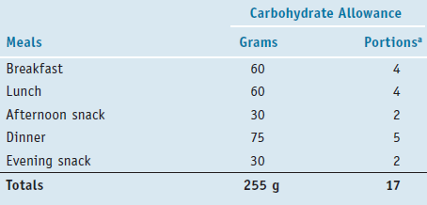
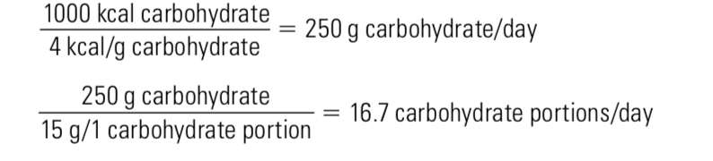
Meal-Planning Strategies
2000 kcal * 50% = 1000 kcal of CHO

Slide 21
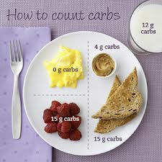

Meal-Planning Strategies
The amount of food containing 15 g carbohydrate counts as one carbohydrate choice.

Slide 22
Meal-Planning Strategies
The distribution of carbohydrates among meals and snacks is based on both individual preferences and metabolic needs.
  WITH conventional insulin therapy , patients must maintain a consistent carbohydrate intake from day to day to match their particular insulin prescription,
  With intensive therapy patients can alter insulin dosage-> CHO variation more flexible

Slide 23
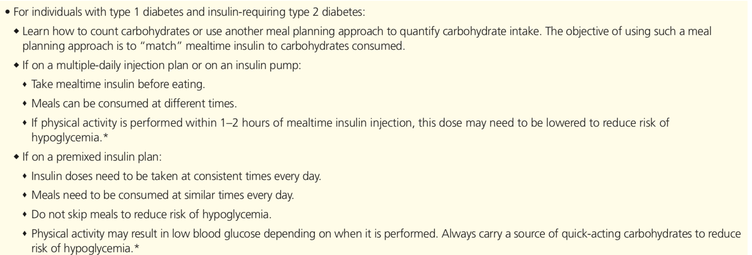
INTENSIVE INSULIN THERAPY
CONVENTIONAL INSULIN THERAPY

Slide 24
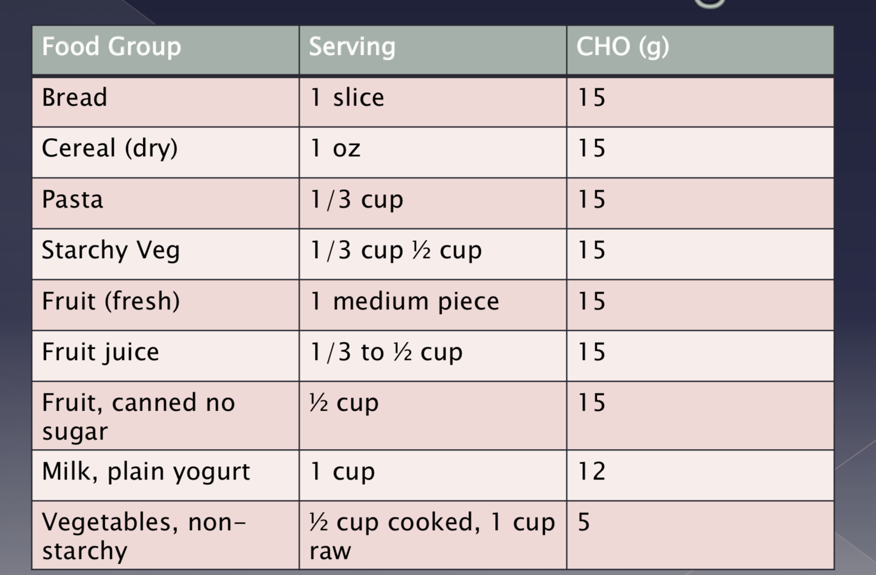
Meal-Planning Strategies
Success with carbohydrate counting requires knowledge about
the food sources of carbohydrates and an understanding of portion control.

Slide 25
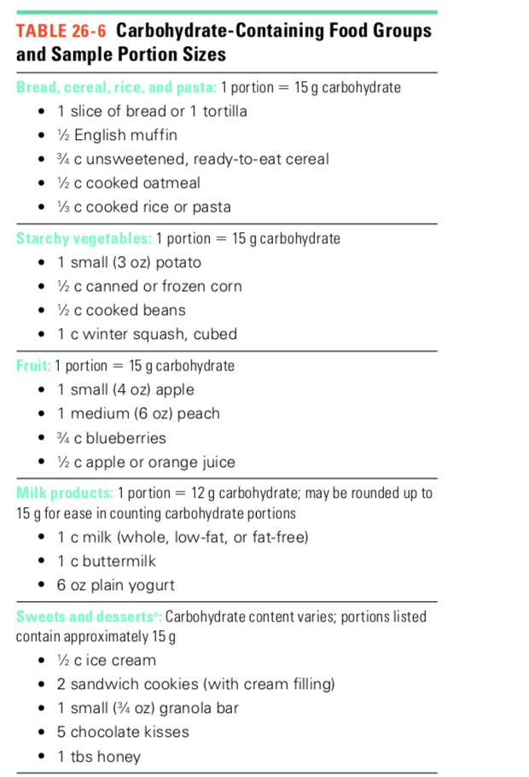
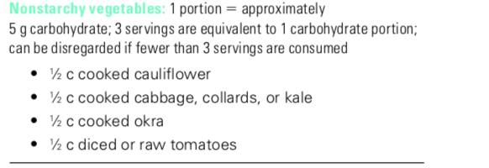

Slide 26
Meal-Planning Strategies
In the exchange system, foods with a similar amount of carbohydrate per serving size are grouped together. The foods within each list can be “exchanged” for one another during meal planning, and you end up with about the same amount of carbohydrate
The Exchange Lists for Meal Planning is a helpful meal-building tool. You have the flexibility to mix and match your carbohydrate food choices

Slide 27
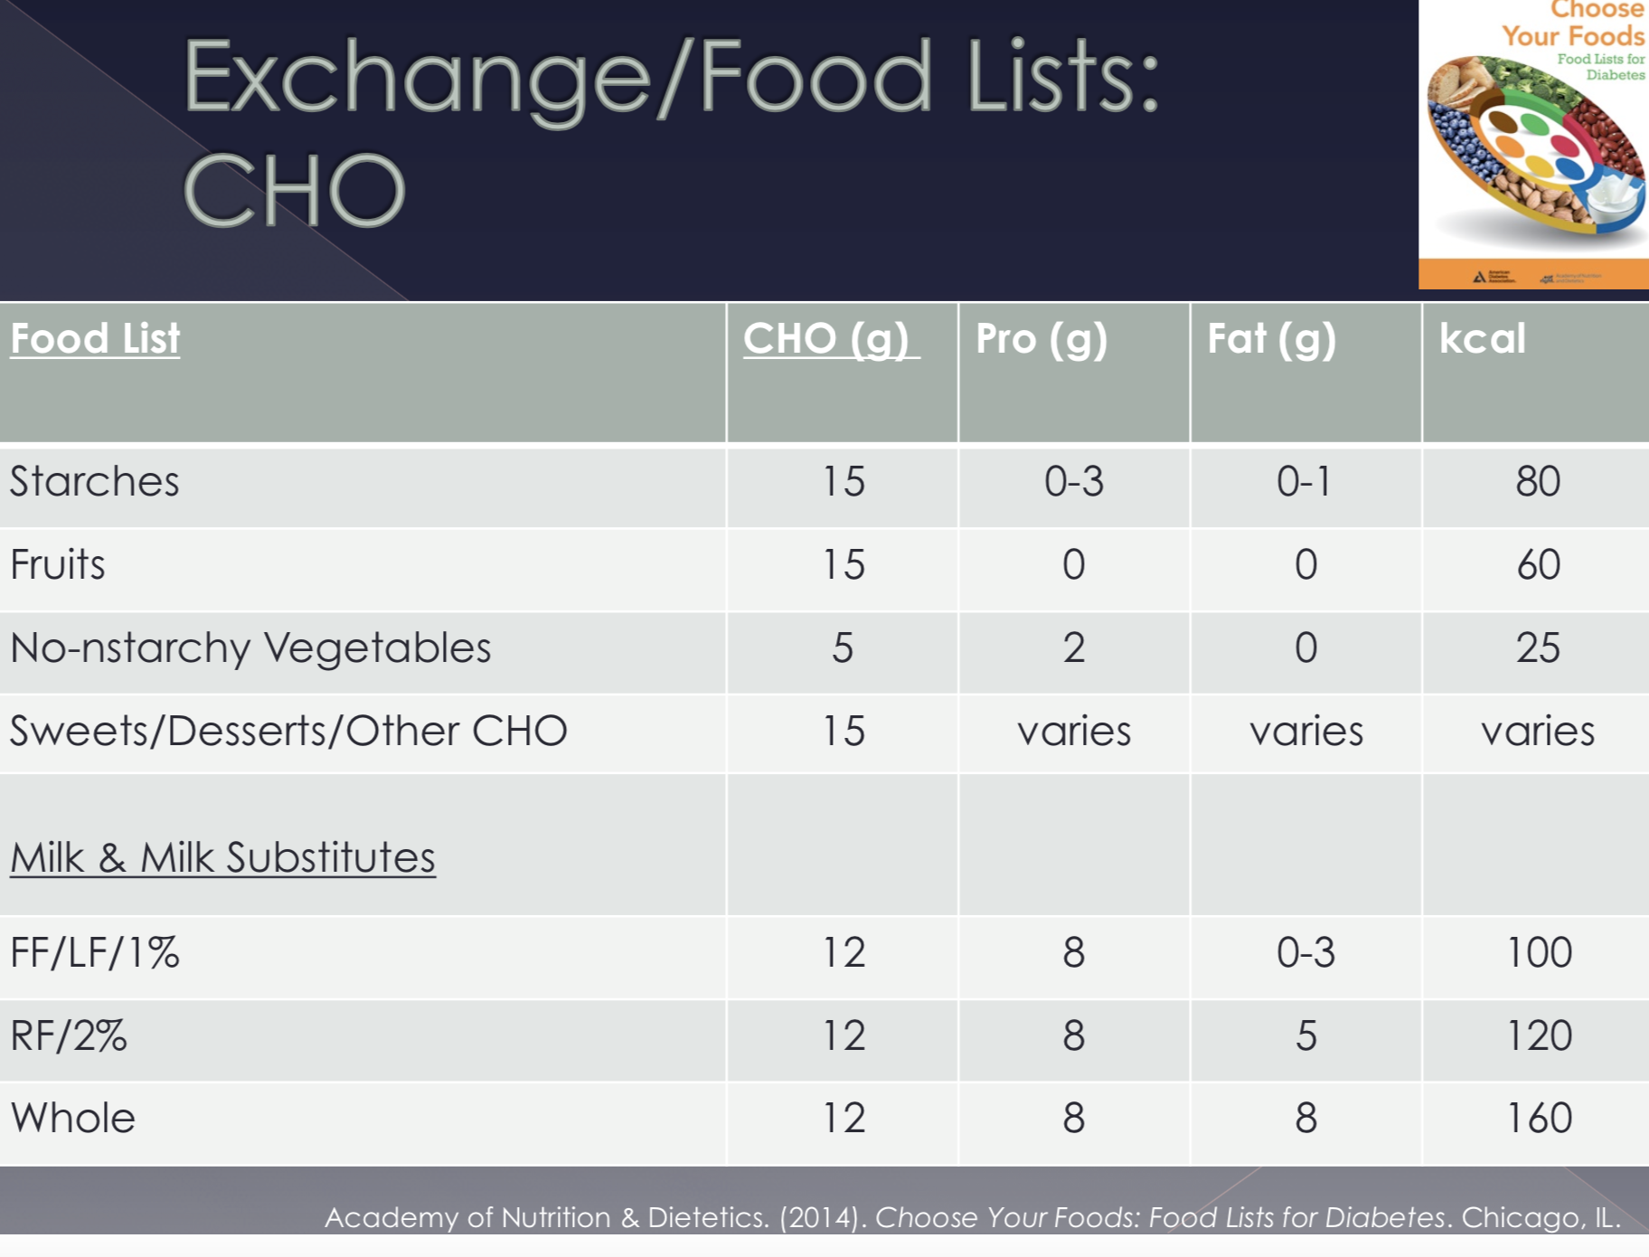

Slide 28
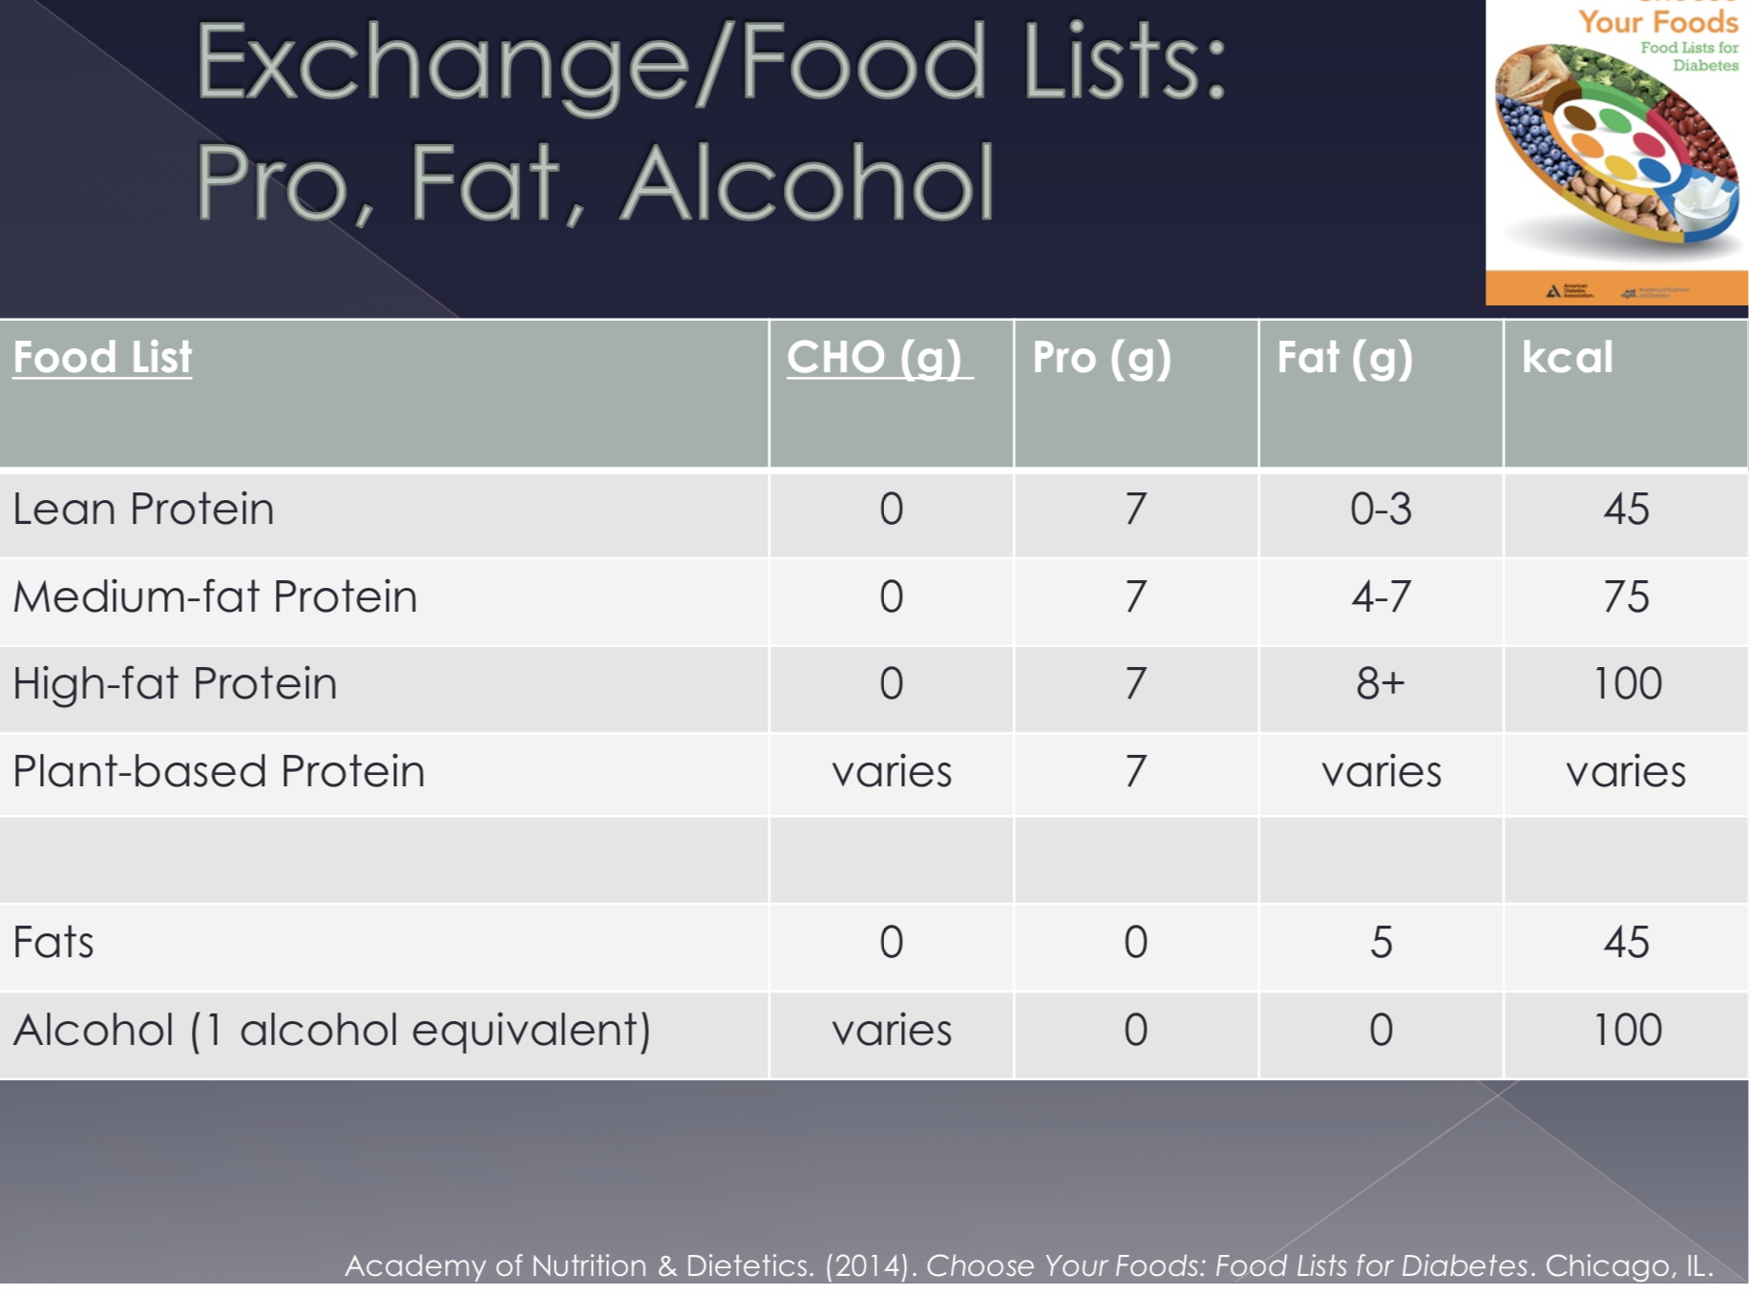

Slide 29
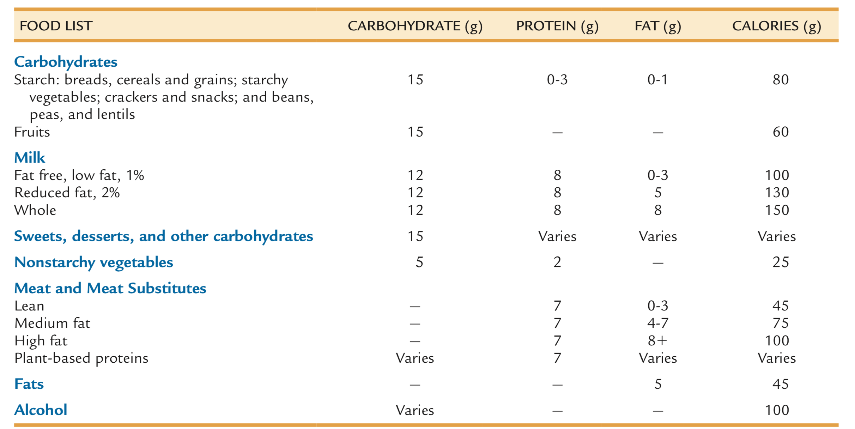
https://nutritrac.elseviermultimedia.us/Personalprofile/webroot/pdf/cyf_1265037248.pdf

Slide 30
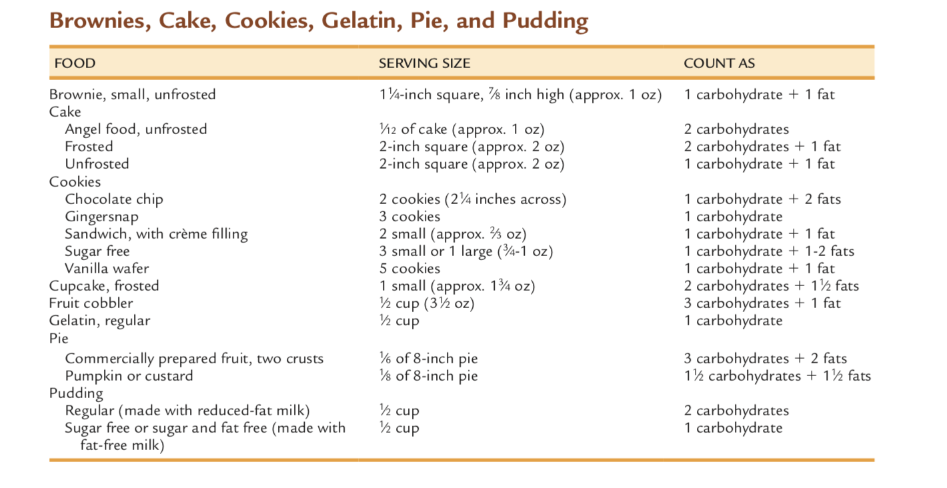
https://nutritrac.elseviermultimedia.us/Personalprofile/webroot/pdf/cyf_1265037248.pdf

Slide 31
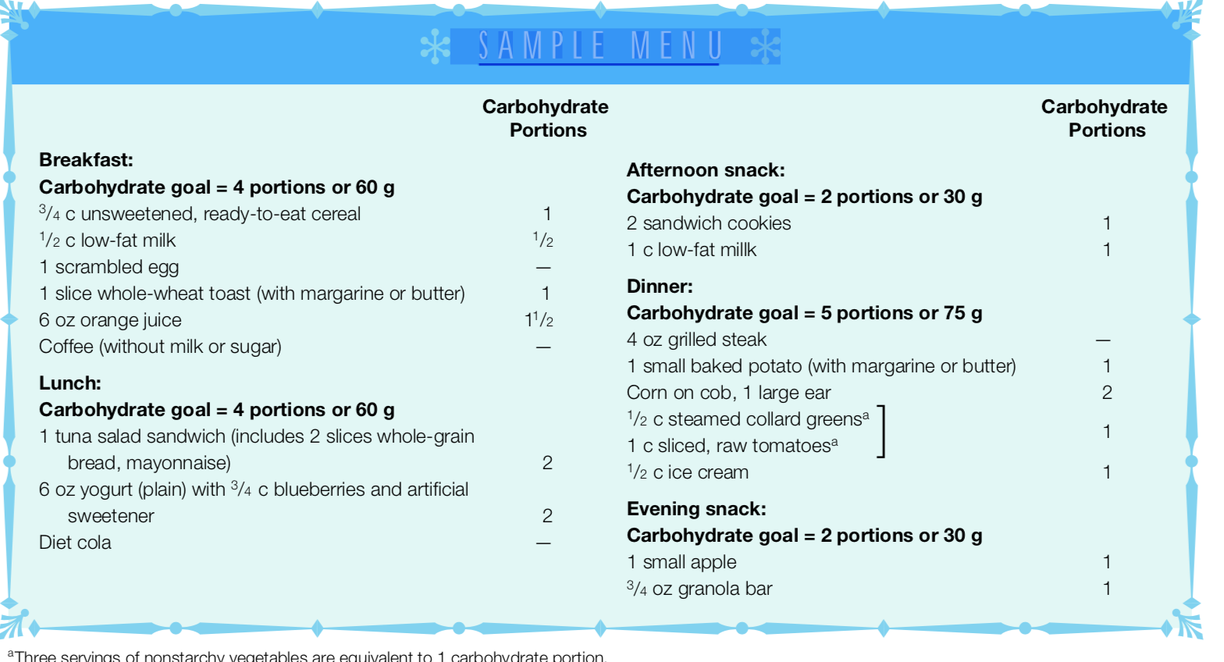
Once patients Learn basic carbohydrate-counting method, individuals can select whatever foods they wish as long as they do not exceed their carbohydrate goals

Slide 32
Food Exchange list handout
https://dtc.ucsf.edu/pdfs/FoodLists.pdf

Slide 33
antidiabetic Drugs
Treatment of type 2 diabetes often requires the use of oral medications and injectable drugs other than insulin
Medications + dietary adjustments and physical activity

Slide 34
Antidiabetic Drugs
How do they work?
Stimulate insulin secretion
Suppress glucagon secretion
Decrease insulin resistance
Reduce glucose production in the liver
Improve glucose utilization in tissues
Delay stomach emptying
Delay carbohydrate absorption

Slide 35
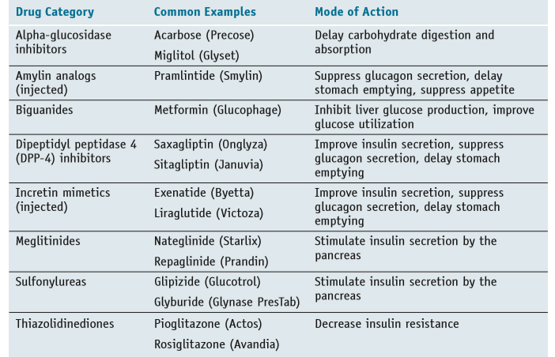

Slide 36
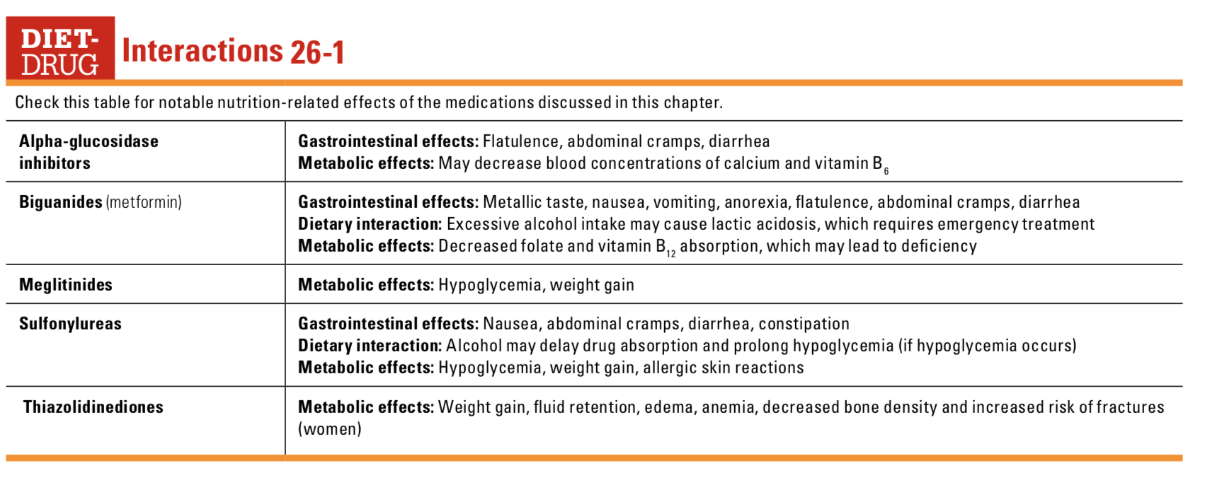

Slide 37
Insulin Therapy
Under normal conditions
  The pancreas secretes insulin in low amounts between meals and during the night (called basal insulin)
  High insulin secretion when meals are ingested
Ideally, the insulin treatment should reproduce the natural pattern of insulin secretion as closely as possible

Slide 38
Insulin therapy
The forms of insulin that are commercially available differ by their onset of action, timing of peak activity, and duration of effects
Rapid Acting (lispro, aspart, glulisine, and inhaled insulin)
Short Acting (regular)
Intermediate Acting
Long Acting

Slide 39
The rapid- and short-acting insulins are typically used at mealtimes
Intermediate- and long-acting insulins provide basal insulin for the periods between meals and during the night
Usually mixtures of insulin are used
The different forms of insulin are made by chemically modifying insulin’s amino acid sequence or by combining insulin with buffers or peptides that alter insulin’s concentration, solubility, or duration of activity in the body

Slide 40
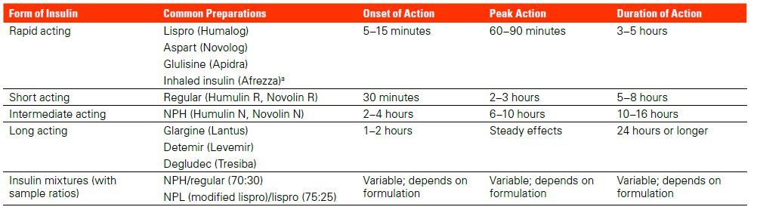

Slide 41
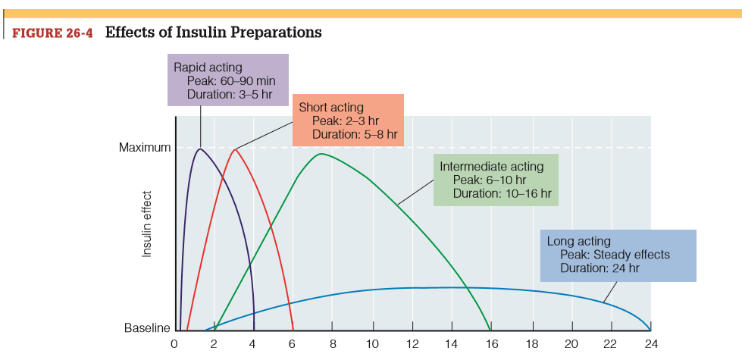

Slide 42

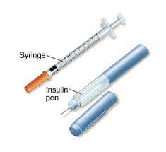
Insulin Delivery
Administered by subcutaneous injection
Either self-administered or provided by caregivers
Disposable syringes
Insulin pens
  Disposable or reusable
Insulin Pumps (delivers a continuous low (basal) dose and when a person eats, delivers a higher dose
Afrezza, a quick acting inhaled insulin, can be an alternative to injectable pre-meal insulin. It is inhaled immediately before a meal

Slide 43
Type 1 diabetes
Best managed with intensive insulin therapy, which involves either three or four daily injections of several types of insulin
Or Insulin pump
Type 2 Diabetes
Initial treatment of type 2 diabetes usually involves nutrition therapy, physical activity, and oral antidiabetic medications,
Most persons use insulin in combination with one or more antidiabetic drugs
Many patients need only one or two daily injections
Varies on patient if they would best benefit from rapid, long acting insulin or a combo

Slide 44
Hypoglycemia is the most common complication of insulin treatment
Hypoglycemia can be corrected with the immediate intake of glucose or a glucose-containing food. Usually, 15 to 20 grams of carbohydrate
Can relieve hypoglycemia in about 15 minutes
Monitoring of blood glucose
15 grams of CHO
Glucose tablets: 4 tablets
Table sugar: 4 tsp
Honey: 1 tbs
Jelly beans: 15 small
Orange juice: 1/2 c

Slide 45
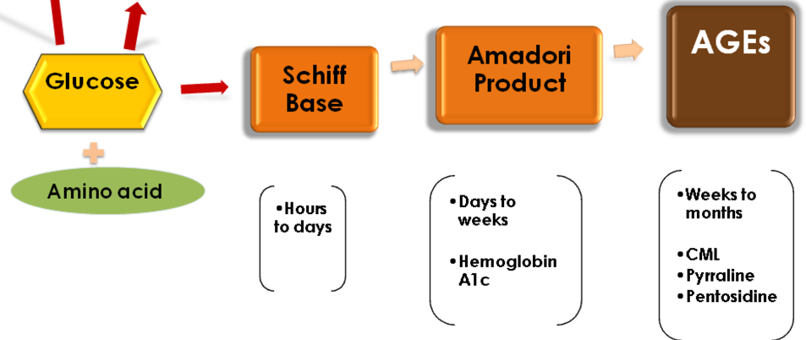
Chromic complications with Diabetes
Advanced glycation end products
The elevated levels of glucose starts forming covalent adducts with plasma proteins through a non-enzymatic process known as glycation
Advanced glycation is one of the major pathways involved in the development and progression of different diabetic complications
Modified from: Luevano-Contreras, C. and Chapman-Novakofski, K. (2010). Dietary Advanced Glycation End Products and Aging. Nutrients, 2(12), pp.1247-1265.

Slide 46
Macrovascular Complication
Atherosclerosis
Type 2 diabetes is frequently accompanied by hypertension (recommended weight loss, a goal of <=140/80 mm Hg, and DASH Diet), abnormal blood lipids (Fat quality, fiber, Mediterranean diet), and obesity.
Peripheral vascular disease
Impaired blood circulation in the limbs increases the risk of claudication and contributes to the development of foot ulcers (can lead to gangrene)

Slide 47
Diabetic Foot
Hyperglycemia related neuropathy can damage the sensation in feet. Hyperglycemia can also affect circulation (Impaired blood flow around the body, especially to the feet)
Problems include injury healing, cramps and pain in legs or feet. Untreated, they could lead to foot ulcers, infections and amputations.

Slide 48
Microvascular Complication/ Retinopathy
Weakened capillaries of the retina leak fluid, lipids, or blood, causing local edema or hemorrhaging.
New blood vessels eventually form, but they are fragile and bleed easily, releasing blood and proteins that obscure vision.
Up to 80% of diabetes patients develop retinopathy 15 to 20 years after diabetes onset. Diabetes retinopathy is estimated to be the leading cause of new cases in blindness in adults

Slide 49
Microvascular Complication/ Nephropathy
Damage to the kidneys’ specialized capillaries prevents adequate blood filtration, resulting in microalbuminuria
As the damage progresses:
Urine production decreases
Nitrogenous wastes accumulate in the blood
Dialysis may be required

Slide 50
Insulin-cho calculations
Example
Your carbohydrate : insulin ratio is
1 unit : 15 grams of carbohydrate. (CARB INTAKE)
Example:
4 svgs bread = 60 g
1 svg milk = 12 g
Total: 72 g carbs
Insulin needed = Total carbs eaten/carb ratio
72g / 15 g = 4.8 units

Slide 51
Assume blood glucose goal range is 150 mg/dL
correction dose of 1 unit of insulin decreases blood glucose by 50 mg/dl. (BLOOD GLUCOSE)
Example:
Current blood glucose: 290 mg/dL
Correction dose to provide:
290 mg/dL – 150 mg/dL = 140 mg/dL
140/50 = 2.8 units

Slide 52
Total insulin needed
Total carbs eaten/carb ratio
72g / 15 g = 4.8 units
Correction dose
290 mg/dL – 150 mg/dL = 140 mg/dL
140/50 = 2.8 units
Total insulin = 4.8 + 2.8 = 7.6 units

Slide 53
Practice
Assuming an insulin to CHO ratio of 1:15
BG range goal is 70-130 mg/dl.
A patient just had lunch, a turkey sandwich , 3/4 cup of blueberries and a diet coke
The patient BG was measured at 210 mg/dL just before lunch
How much insulin should the patient be taking to cover the meal and correct BG levels?

Slide 54
Assuming an insulin to CHO ratio of 1:15 how much insulin should patient B take before consuming breakfast ? What type of insulin do you think would be appropriate
1 cup orange juice
½ cup cooked oatmeal with milk ( using 1 cup whole milk)
1 apple
6 oz yogurt

Slide 55
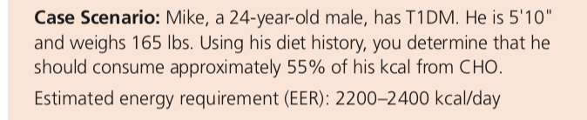
Calculate the grams of CHO
Number of CHO choices
Divide the CHO choices among meals and snacks so that Mike will know the amount of rapid-acting insulin
he should use at each meal ( Assume his insulin to CHO ratio of 1:10 )

