Slide 1
Assessment of stuttering And Cluttering
Chapter 11
Aseel Mushasha

Slide 2
Overview of assessment:
History of the client
Assessment of stuttering ( procedures, analysis )
Orofacial examination
Speech and language assessment
Hearing assessment
Determining the diagnosis
Providing information (reports)

Slide 3
Defining stuttering
Stuttering can develop for no apparent reason.
Stuttering is more common among boys than girls.
Stuttering is more common among highly sensitive children.
Some people are genetically predisposed to stutter.
The onset of stuttering usually occurs before the age of 6.
Most children experience a period of disfluent speech between the ages of 2 and 5; some outgrow it whereas others do not.
Stuttering is variable. A person may be completely fluent in one situation and extremely disfluent in another.
Some disfluency types are more indicative of a fluency disorder than others.
Stuttering causes personal grief, fear, and frustration.

Slide 4
Stuttering and normal disfluency
The disfluency types that are most typically associated with a stuttering disorder are :
1. part-word repetitions
2. monosyllabic whole-word repetitions
3. sound prolongations, silent pauses (blocks), and broken words.
In contrast, the disfluency types that are more frequently associated with normal disfluency are :
interjections, revisions, multisyllabic whole-word repetitions, and phrase repetitions.

Slide 5
Types | examples
Part-word repetitions | “What t-t-t-time is it?”
Whole-word repetitions | “What-what-what are you doing?”
Phrase repetitions | “I want to-I want to-I want to do it.”
Sound/syllable prolongations | “Llllllet me do it.”
Silent prolongations | A struggling attempt to say a word when there is no sound.
Sound/syllable interjections | “um . . . um I had a problem this morning.”
Whole-word interjections | “I had a well problem this morning.”
Phrase interjections | “I had a you know problem this morning.”

Slide 6
types | examples
Silent Pauses A silent duration within speech considered abnormal | “I was going to the [pause] store.”
Broken Words A silent pause within words | “It was won [pause] derful.”
Incomplete Phrases Grammatically incomplete utterances | “I don’t know how to . . . Let us go, guys.”
Revisions Changed words, ideas | “I thought I will write a letter, card.”

Slide 7
Speech sampling:
The most important procedure for any evaluation of stuttering is a speech sample
Obtain samples from a variety of speaking situations, including:
oral reading
dialogue
monologue.
Also obtain samples when speaking to different audiences, including:
family members
Friends
Peers
superiors.

Slide 8
Collect speech samples from:
• The clinic or testing site
• Outside the assessment area but still in proximity to it
• Home
• Classroom
• Playground
• Work environment
• Other places the client spends time and interacts with others
NOTE: If it is not feasible to collect samples from different settings, ask the client or a parent to provide recorded samples for analysis. Because stuttering is variable, it is important to ask how typical the samples are

Slide 9
Cont.
You can use these following material to assess disfluency disorders:
Pictures, Narratives, Reading Passages.
After obtaining thorough and representative samples of the client’s speech, the analysis phase of the assessment can begin. Specifically, determine:
The total number of disfluencies
Frequencies of different types of disfluencies
Disfluency indexes
The duration of individual instances of disfluency
Speech rate
Types and frequencies of secondary behaviors

Slide 10
Disfluency indexes:
It refers to the percentage of disfluent speech present in a speech sample.
It should be determined in several different environments (the therapy room, outside, at home, at work, etc.)
It should be within different modes of speech (reading, spontaneous speech, etc.), and across more than one assessment session.
Use the different forms in the book to determine the disfluency indexes.

Slide 11
Example:
The Total Disfluency Index reflects all disfluencies produced by the client.
For example, consider a 500-word sample with the following number of disfluencies: 75 repetitions, 50 pauses, 25 sound prolongations (150 total disfluencies).
To calculate the Total Disfluency Index:
1. Count the total number of words in the speech sample (500 in this example).
2. Count the total number of disfluencies (150).
3. Divide the total disfluencies by the total words. In this example: 150 / 500 = 0.30.
4. Change to a percentage: 0.30= 30% Total Disfluency Index.

Slide 12
Cont.
Separate indexes can also be determined for individual disfluency types. For example, to calculate a Total Repetitions Index (using the previous example data):
1. Count the total number of words in the speech sample (500 in this example).
2. Count the number of specified disfluencies (75 repetitions in this example).
3. Divide the total specified disfluency (repetitions) by the total words. In this example: 75 / 500 = 0.15.
4. Change to a percentage: 0.15 =15% Total Repetitions Index.
Indexes for any disfluency type can be calculated using the same method.
Also, Time each disfluency with a stopwatch. Pauses or prolongations are most commonly measured, but the duration of repetitions can also be timed. For example, 10 disfluencies resulting in a total of 42 seconds yields an average duration of 4.2 seconds.

Slide 13
Cont.
A third type of disfluency index reflects the percentage of each disfluency type based on the Total Disfluency Index.
For this calculation, base the computation on the total number of disfluencies. Using the same example:
1. Count the total number of disfluencies in the speech sample (150 in this example).
2. Count the number of specified disfluencies (75 repetitions).
3. Divide the total specified disfluency (repetitions) by the total disfluencies. In this example: 75/150 =0.50.
4. Change to a percentage: 0.50 = 50% of all disfluencies present were repetitions.

Slide 14
Accessory behaviors (secondary behaviors)
People who stutter often develop accessory behaviors, also called secondary behaviors in response to, or in anticipation of stuttering.
They are present only during disfluent speech, and the speaker may or may not be aware of these behaviors.
Although such behaviors are common, not all people who stutter exhibit them.
These behaviors may include:
• Associated motor behaviors
• Physiologic responses
• Avoidance
• Expectancy

Slide 15
Associated motor behaviors
Associated motor behaviors are extraneous body movements.
These visible displays of tension usually involve parts of the oral facial mechanism and may include behaviors such as eye blinking wrinkling the forehead, frowning, distorting the mouth, moving the head, and quivering the nostrils.
Sometimes they include movements of body parts that are not normally associated with speech, such as movements of the arms, hands, legs, feet.
During the assessment, note all unusual movements the client exhibits.

Slide 16
Physiologic responses
A client may also exhibit abnormal physiological behaviors associated with stuttering.
These may affect respiratory, phonatory, articulatory, and prosodic aspects of speech production.

Slide 17
Avoidance
Avoidance is a learned response to unpleasant stimuli
many people who stutter learn to avoid certain sounds, words, or speaking situations that are especially difficult for them.
stuttering clients occasionally circumlocute or talk around a subject to avoid disfluencies.
Specifically, some stutterers tend to avoid difficult:
Sounds, Words, Topics, People (e.g., employer, teacher, strangers), Situations (e.g., ordering in a restaurant, talking on the telephone), Communicative events (e.g., public speaking, speaking with members of the opposite sex)

Slide 18
Cont.
During the assessment, pay particular attention to avoidance behaviors. (Ask probing questions during the interview and observe the client’s speech during the speech sample).
Avoidance behaviors can be described as primary or secondary.
Primary avoidances refer to the client’s attempts to alter verbal output.
Secondary avoidances are acts of reducing or ceasing verbal output. Examples of primary and secondary avoidances are provided next.

Slide 19
Cont.
Primary Avoidances
1. Starters: using words, sounds, gestures, or rituals to initiate speech.
2. Postponements: silences (e.g., pretending to think), ritualistic acts (e.g., lip licking), or verbal stalling.
3. Retrials: repeating a fluent utterance to “hurdle” a feared word or phrase.
4. Circumlocutions: sound, word, or phrase substitutions.
5. Antiexpectancies: altering the communicative text by speaking with an accent, imitating someone else’s voice, overemphasizing articulation, speaking rhythmically, whispering, or singing.
secondary Avoidances
1. Reducing verbal output or not talking at all.
2. Relying on others to communicate for them.

Slide 20
Expectancy
Expectancy, also known as anticipation,
is the expectation of a disfluency before it occurs.
Expectancies can occur for sounds, words, people, or specific situations.
Some clients respond to expectancy by “pushing forward” into the disfluency.
Others respond with avoidance behaviors. Obtain information about expectancy by observing and listening during speech tasks and interviews. Ask the client to report when he or she experiences expectancy.

Slide 21
Assessing feelings And Attitudes
Stuttering is a debilitating handicap that can cause feelings of great pain, anguish, and frustration.
Many forms are used to assess feeling and attitudes of people who stutter ( helpful from in the book )
examples: S-Scale, The Modified S-Scale, Adolescent Communication Questionnaire

Slide 22
Criteria for diagnosing stuttering
1. The client has a Total Disfluency Index of 10% or greater.
2. The client’s disfluency indexes for repetitions, prolongations, and interlexical pauses are 3% or greater.
3. The duration of disfluencies is 1 second or longer.
4. The most prevalent disfluency types are part-word repetitions, monosyllabic whole- word repetitions, sound prolongations, silent pauses, or broken words.
5. Secondary accessory behaviors are present.
6. The client’s (or parent’s) degree of concern is significant.

Slide 23
Note:
Making a diagnosis is sometimes more complicated when the client is a young child.
Most clinicians agree that normally developing children experience a period of non-fluent speech. This typically occurs during the preschool years, between the ages of 2 and 5.
Unfortunately there are no sure indicators that a child will naturally outgrow stuttering behavior. Professionals have varying opinions about diagnosing a fluency disorder and recommending therapy for children who stutter.

Slide 24
In general:
stuttering disorder requiring intervention is more likely if:
The child is male.
Stuttering has continued for 6 months or longer.
Onset of stuttering occurred before the child’s third birthday.
The child demonstrates associated motor behaviors.
Other speech or language disorders are present.
The child or child’s family have strong fears or concerns about stuttering.

Slide 25
Note:
When assessing a non-fluent child, it is also important to consider his or her language, articulation, and oral-motor skills.
In some cases, an apparent “stuttering disorder” may actually be a secondary behavior of another communicative disorder.
Speech-language pathologists rely on experience, knowledge of stuttering, and professional judgment to make diagnoses and recommendations.
Commercial assessment instruments are also available to assist in the assessment process. These include
Behavior Assessment Battery (BAB) for School-Age Children Who Stutter
Stuttering Prediction Instrument for Young Children
Stuttering Severity Instrument (SSI-4)
Test of Childhood Stuttering (TOCS)

Slide 26
Stimulability:
Stimulability of fluency refers to a client’s responsiveness to techniques that improve fluency.
Clinicians typically elicit fluent speech by using the same techniques that are used in treatment. Several of these techniques are described in Table 11-1.

Slide 27
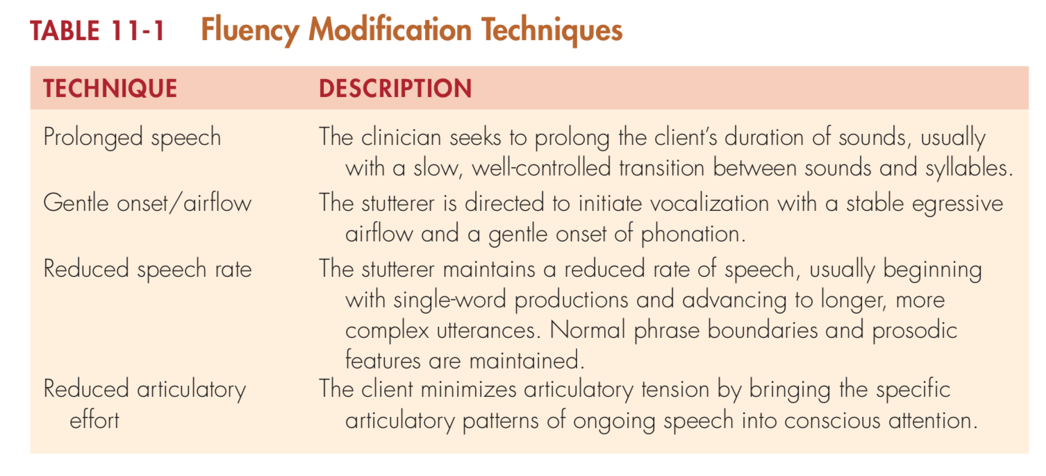

Slide 28
Cluttering:
Cluttering is a fluency disorder that often coexists with stuttering, but can also be present on its own.
The characteristics of cluttering include:
Rapid speech rate, which negatively affects other aspects of communication
Excessive disfluencies
Coexisting disorders of language and/or articulation
Monotone voice
Indistinct “mumbling” speech; sound distortions and omissions are common.
Errors present in connected speech are less pronounced or not present during single-word articulation tests or during more slowly produced speech segments.

Slide 29
Cont.
7. Spoonerisms, in which sounds are transposed in a word, phrase, or sentence—for example, hit the books may be produced as bit the hooks, or many people think so may become many thinkle peep so.
8. Lack of awareness of the speech disorder, at least initially. Clients who clutter are sometimes genuinely surprised when the disorder is diagnosed or when other people do not understand them.
9. Short attention span, restlessness, and hyperactivity
10. Poor handwriting
11. Poor thought organization and expression
12. Lack of rhythm or musical ability

Slide 30
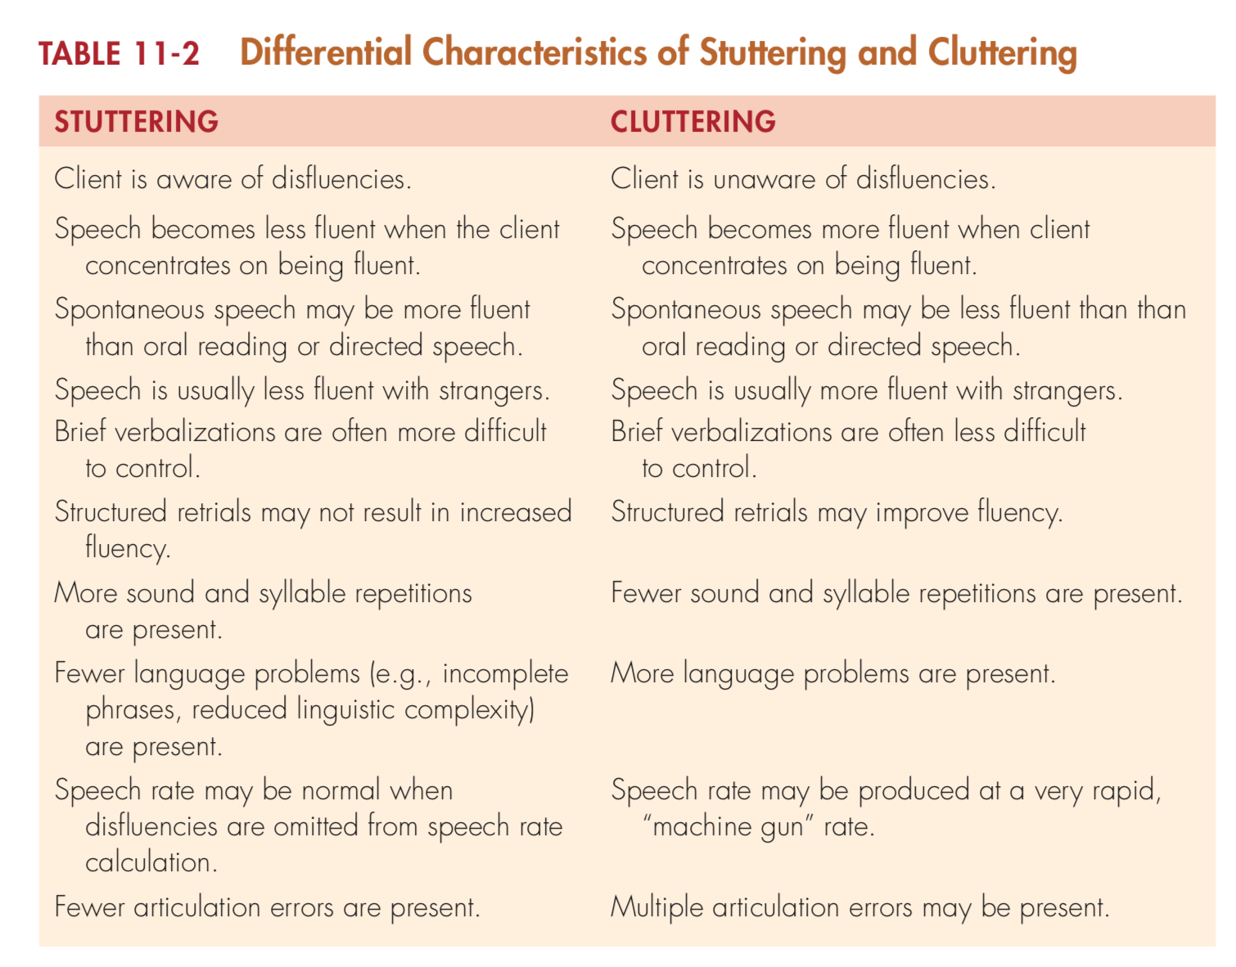

Slide 31
Stimulability:
Once the cluttering behaviors are identified, it is important to see if the client can improve his or her speech.
Two of the five techniques for eliciting improved fluency in Table 11-1 are also useful for cluttering, specifically prolonged speech and reduced speech rate.
These are useful because excessive speech rate is a primary problem with a cluttering pattern.
Even though the cluttering client usually exhibits errors of articulation, language and voice, stimulation of all these deficits may not need to be the primary focus of stimulability assessment.
In many cases, reducing the speech rate to a slower, more manageable speed reduces or eliminates the effects of these secondary characteristics.

