Slide 1
Fluid Mechanics I Chapter 3 Integral Relations for a Control Volume
Dr. Afif Akel Hasan
Mechanical & Mechatronics Engineering

Slide 2
Outline
System and control volume
Basic equations
Volume flow rate
Reynold transport relation
Mass conservation ( continuity)
Energy conservation
Linear momentum equation
Angular momentum equation
Applications

Slide 3
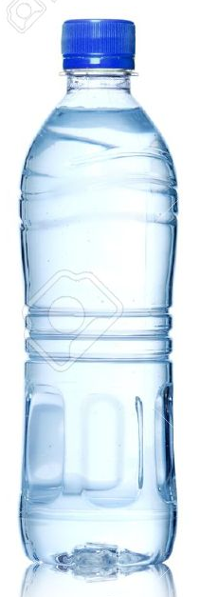
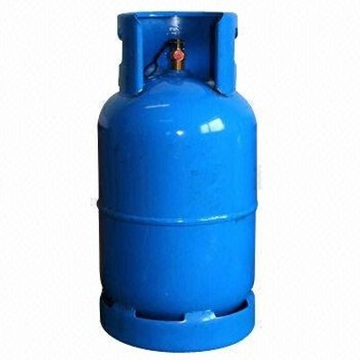
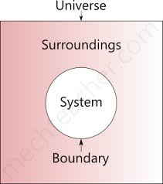

System
A system is defined as an arbitrary quantity of mass of fixed identity ( definite mass of material )
System may change position and thermal condition , but must always entail the same matter .
System is distinguished from other matter which called surroundings ,by its boundaries ,the boundary of system form a closed surface .
m_{system} = constant or (dm /at ) = 0

Slide 4
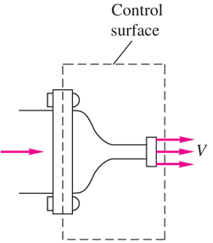

Control Volume
Control volume : a definite volume is designated in a space.
Boundary of this volume is known as control surface.
A mount and identity of matter in the control volume may change with time but the shape of the C.V is fixed.
Energy and mass may flow across the control volume
e.g : flow through section of a nozzle

Slide 5
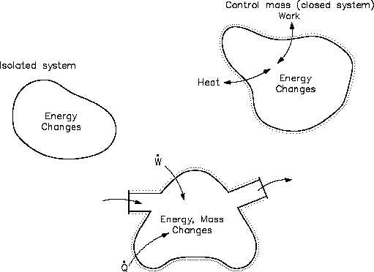
System and Control Volume

Slide 6
Basic equation for a system
Mass conservation (dm /dt ) = 0
Newton’s 2ad law : linear –momentum equation
F = ma = m ( dV/dt ) = d ( mV ) /dt =dP/dt
ie. Net force on system accelerates the system
A vector law : F_{x} = ma_{x} , F_{y} = ma_{y} , F_{z} = ma_{z}
Angular momentum : if surrounding exerts a net moment a bout the center of mass M results in rotation effect .
M = (dH/dt ) when H = (rxV ) dm
H is a vector quantity M_{x} = (dH_{x}/dt )
For rigid body about x –axis M_{x} = I_{x} [d(ω_{x})/dt ];
ω angular velocity a bout x- axis
I_{x} = mass moment of inertia about x-axis

Slide 7
Basic equation for a system
Energy conservation ( 1st law of thermodynamics )
dQ-dW = dE Q : heat transfer
E : total energy of system
E = U + mV² /2 + mgz
W : work
Equation of state
Relates properties at given state P= F (V,T )
e.g Ideal gas P = RT/V, ρ = P/ (TR)

Slide 8
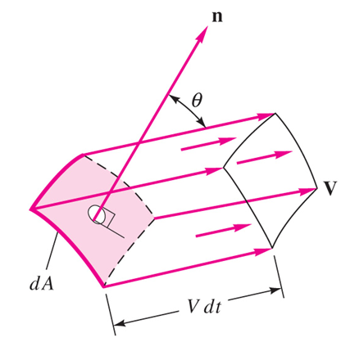
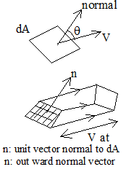
Volume & mass flow
Consider the fluid passing through surface S. what is the volume flow rate Q and the mass flow rate m through this surface ?
Let fluid at V pass through dA at angle θ off the normal , then amount of fluid swept during dt
dѴ = v dt dA cos θ
d Ѵ = v cos θ dt dA
d Ѵ = (v.n) dt dA
(d Ѵ /dt ) = (v.n) dA
V_{n} = velocity component normal to dA
Mass flow rate = ρQ

Slide 9

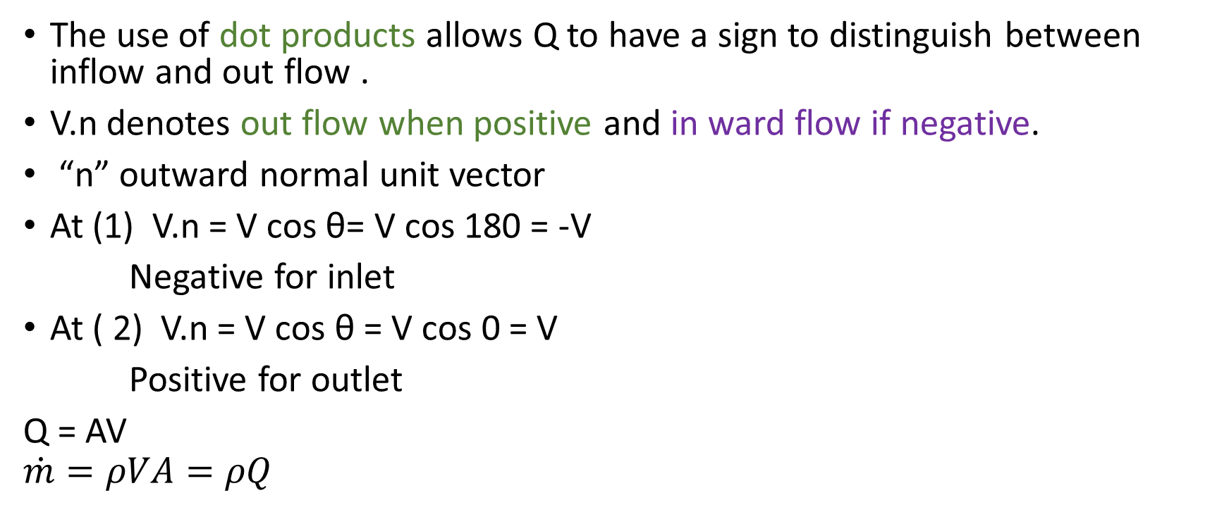
Volume & mass flow
The use of dot products allows Q to have a sign to distinguish between inflow and out flow .
V.n denotes out flow when positive and in ward flow if negative.
“n” outward normal unit vector
At (1) V.n = V cos θ= V cos 180 = -V
Negative for inlet
At ( 2) V.n = V cos θ = V cos 0 = V
Positive for outlet
Q = AV
$$\dot{m}=ρVA=ρQ$$

Slide 10

Example 3.1 P.139
$\dot{m}=ρVA=ρQ$
Q=VA
ρ= 800Kg/m³
V = 5 m/s
A = 2 m²
m. = ρ VA = 800*5*2= 8000Kg/s

Slide 11
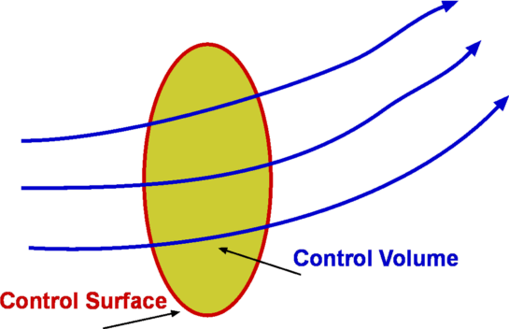
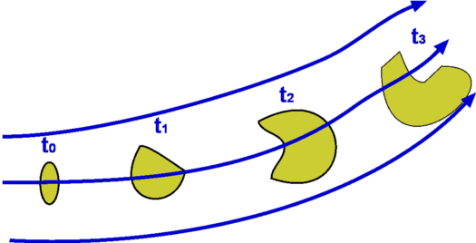
Reynolds transport theorem
In fluid mechanics, it is often more convenient to work with control volumes as it is difficult to identify and follow a system of fluid particles.
Thus, there is a need to relate the system equations and corresponding control volume equations.
The link between the two is given by the Reynolds transport theorem. The theorem is named after Osborne Reynolds (1842–1912).

Slide 12
Reynolds Transport Equation
RTE relates the control volume to the system. To convert system analysis to control volume analysis , we use the Reynold transport theorem , which can be applied to all basic laws .
It can be shown for any arbitrary property B of the fluid , which has intensive value β (β = (dB /dm ) or specific properties ( per unit mass ), the relation between B change in the system to its variation in the control volume as follows ;
For fixed CV
RTE indicates that time rate of change Β within a system is equal to the time rate of change of property Β within the control volume plus the net rate of flux of Β across the control surface of C.V

Slide 13
RTE
For control volume moving at constant velocity
if the constant volume is moving uniformly at velocity V_{s} an observer fixed to the control volume will see a relative velocity V_{r} of fluid crossing the control volume , where
V_{r} = V – V_{s}

Slide 14
Flux terms
Flux term
CS have value only where mass cross the CS other locations is zero
Mass flow / flux in two locations either inflow or into CV or outflow out of the CV
But v.n is positive at outlet and negative for inlet, hence

Slide 15
Flux terms
net rate flux term can be approximated by summation as follows

Slide 16
Steady flow
for steady flow the first Right term is of RTE vanishes
There is no change with time within the CV

Slide 17
Example 3.1 p. 139.
A fixed control volume has three one-dimensional boundary sections, as shown in Fig. E3.1. The flow within the control volume is steady. The flow properties at each section are tabulated below.
Find the rate of change of energy of the system which occupies the control volume at this instant.
The flow within is steady, so that d(ρe)/dt =0 and the volume integral vanishes.
=(300 J/kg)(800 kg/m3)(2 m2)(5 m/s) - 100(800)(3)(8)+ 150(800)(2)(17)=240000J/s

Slide 18
Conservation of mass
Starting with RTE for a fixed control volume
Let Β equal mass of the system , then β = B/m = m/m=1.0
Substitute in RTE
However and since mass of the system is fixed

Slide 19
Conservation of mass
Rewrite integral as ∑
For steady flow (d( )/dt ) = 0 then
This assumes “ average velocity ” for area “A” and also uniform density at cross section

Slide 20
EXAMPLE 3.2
The balloon in Fig. E3.2 is being filled through section 1, where the area is A1, velocity is V1, and fluid density is ρ₁. The average density within the balloon is ρ_{b}(t). Find an expression for the rate of change of system mass within the balloon at this instant.
But (dm/dt) sys = 0

Slide 21
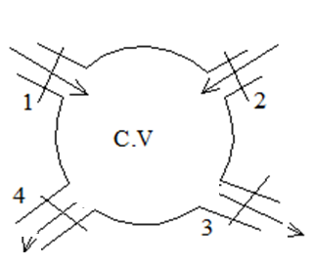
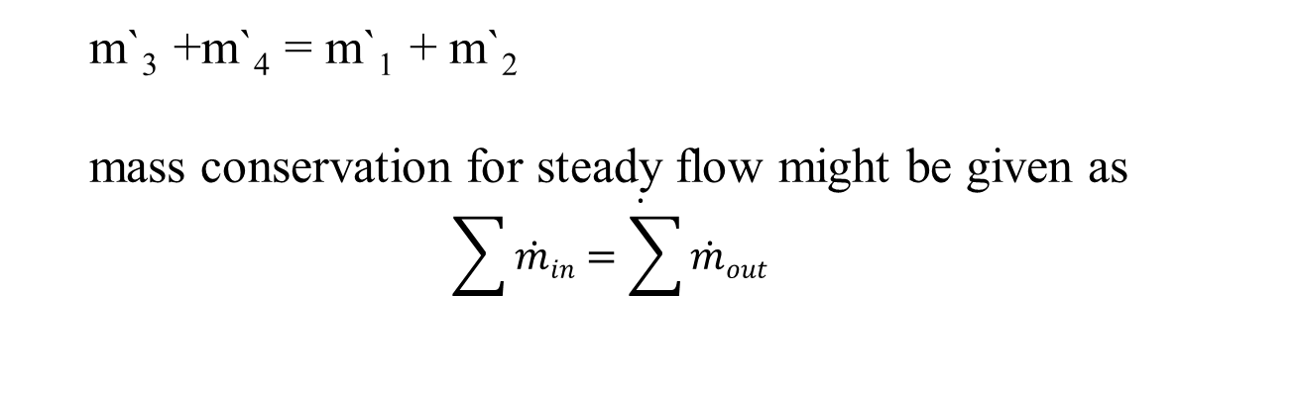
Example
Applying the steady flow mass conservation for C.V in figure
ρ₃A₃V₃ +ρ₄A₄V₄ = ρ₁A₁V₁ + ρ₂A₂V₂
but ρ A V = m` the mass flow rate
m`₃ +m`₄ = m`₁ + m`₂
mass conservation for steady flow might be given as
$$\sum{\dot{\dot{m}in=\sum{\dot{m}out}}}$$

Slide 22
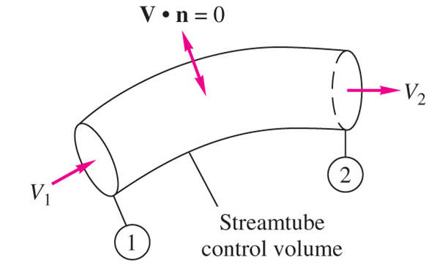
EXAMPLE 3.3
Write the conservation-of-mass relation for steady flow through a streamtube (flow everywhere parallel to the walls) with a single one-dimensional exit 1 and inlet 2 (Fig. E3.3).
For steady flow Eq. (3.24) applies with the single inlet and exit
in a streamtube in steady flow, the mass flow is constant across every section of the tube. If the density is constant,

Slide 23
Average velocity
Average velocity : for incompressible flow average velocity is defined as
For the laminar-flow approximation, m=1/2 and V _{av} = 0.53U₀
For turbulent flow, m = 1/7 and V _{av} = 0.82U₀

Slide 24
EXAMPLE 3.6
The tank in Fig. E3.6 is being filled with water by two one-dimensional inlets. Air is trapped at the top of the tank. The water height is h. (a) Find an expression for the change in water height dh/dt. (b) Compute dh/dt if D1 = 1 in, D2 = 3 in, V1 = 3 ft/s, V2 = 2 ft/s, and At = 2 ft2, assuming water at 20°C.
The flow within is unsteady, and Eq. (3.22) applies with no outlets and two inlets:
Now if A_{t} is the tank cross-sectional area, the unsteady term can be evaluated as follows

Slide 25
EXAMPLE 3.6
The ρ_{a} term vanishes because it is the rate of change of air mass and is zero because the air is trapped at the top

Slide 26
The Linear Momentum Equation
linear momentum mV.
Therefore our dummy variable is B = mV and β= dB/dm= V,
Application of the Reynolds transport theorem gives the linear-momentum relation for a deformable control volume
∑F = d ( mV ) /dt =dP/dt

Slide 27
The Linear Momentum Equation
The term ∑F is the vector sum of all forces acting on the control volume considered as free body
it includes : surface forces on all fluids and solids cut by the control surface ; plus all body forces ( gravity ) acting on mass of C.V
The equation is a vector form , might write it in 3 axis coordinate system for example
for a fixed control volume V_{r} = V

Slide 28
The Linear Momentum Equation
for steady flow (d( )/dt ) = 0
example y- component

Slide 29

One-Dimensional Momentum Flux
the surface integral in Eq. (3.37) is called the momentum-flux term. If we denote momentum by M, then
Because of the dot product, the result will be negative for inlet momentum flux and positive for outlet flux.
If the cross section is one-dimensional, V and are uniform over the area and the integrated result is
Thus if the control volume has only one dimensional inlets and outlets, Eq. reduces to
For steady flow

Slide 30
Forces on CV
force of two types
Body force on gravity ( weight )
Surface force including
a) surface tension ( neglect)
b) shear stress forces τ _{w} .
c) pressure force normal to the control volume .
pressure force : normal inward to surface , let n normal outward unit area vector .
pressure of control volume P as absolute pressure, outside pressure as Pa
the pressure force taken in consideration outside pressure ( P – Pa) then

Slide 31
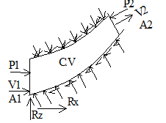

Forces on CV
resultant of all shear forces τ_{w} and pressure forces on the wall are replaced with R_{x} and R_{y} .
For steady flow
$\sum{F=\sum_{out}{\dot{m}V−\sum_{in}{\dot{m}V}}}$

Slide 32
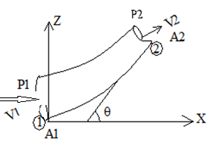

Example elbow
Evaluate forces coming on to the reducing elbow shown for steady flow .
V.n is scalar
- at inlet → V_{I} ←n
+ at outlet → V_{e} →n
∑F_{x} = V_{x1} ( -V₁ A₁ )ρ + V_{x2} ( V₂ A₂ )ρ
V_{x1} =V₁ , V_{x2} = V₂ cos θ
∑F_{x} = V₁ (- V₁ A₁ )ρ + V₂ cos θ ( V₂ A₂ )ρ $\sum{Fx=\sum_{out}{\dot{m}Vx−\sum_{in}{\dot{m}Vx}}}$
∑F_{x} = - $m$ V₁ + $m$V₂ cos θ
P₁ A₁ – p₂ A₂ cos θ +R_{x} = ρQ(V₂ cos θ − V₁ )
→ R_{x} = ρQ(V₂ cos θ − V₁ ) - P₁ A₁ – P₂ A₂ cos θ

Slide 33
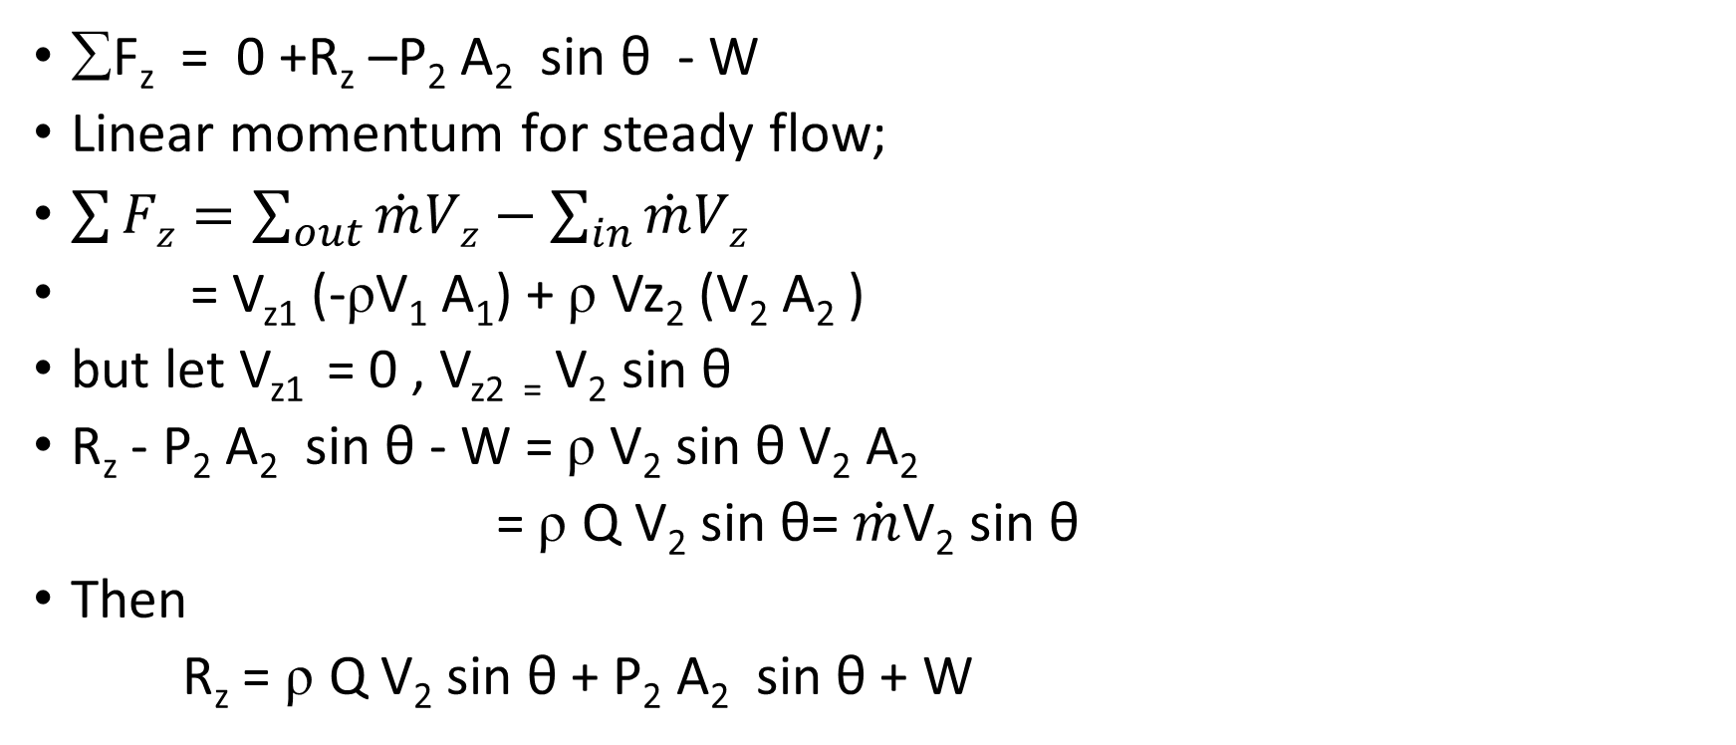
Example elbow
∑F_{z} = 0 +R_{z} –P₂ A₂ sin θ - W
Linear momentum for steady flow;
$\sum{Fz=\sum_{out}{\dot{m}Vz−\sum_{in}{\dot{m}Vz}}}$
= V_{z1} (-ρV₁ A₁) + ρ Vz₂ (V₂ A₂ )
but let V_{z1} = 0 , V_{z2 =} V₂ sin θ
R_{z} - P₂ A₂ sin θ - W = ρ V₂ sin θ V₂ A₂
= ρ Q V₂ sin θ= $\dot{m}$V₂ sin θ
Then
R_{z} = ρ Q V₂ sin θ + P₂ A₂ sin θ + W

Slide 34
EXAMPLE 3.8
A fixed control volume of a streamtube in steady flow has a uniform inlet flow (ρ1, A1, V1) and a uniform exit flow (ρ 2, A2, V2), as shown in Fig. 3.8. Find an expression for the net force on the control volume
from conservation of mass

Slide 35
EXAMPLE 3.9
As shown in Fig. 3.9a, a fixed vane turns a water jet of area A through an angle θ without changing its velocity magnitude. The flow is steady, pressure is P_{a} everywhere, and friction on the vane is negligible.
(a) Find the components F_{x} and F_{y} of the applied vane force.
(b) Find expressions for the force magnitude F and the angle between F and the horizontal; plot them versus θ.

Slide 36
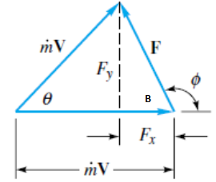
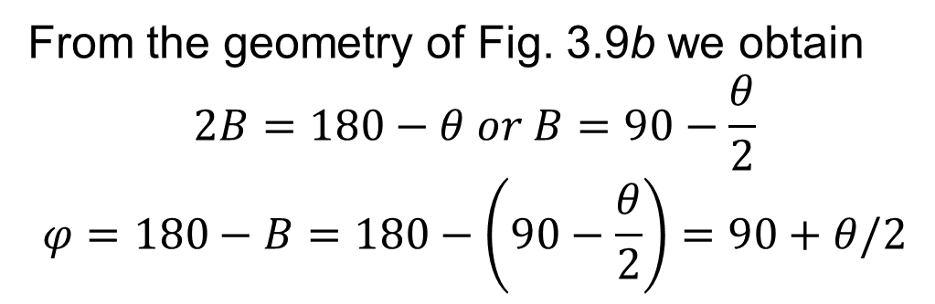
EXAMPLE 3.9
The pressure force is zero in the uniform atmosphere.
We neglect the weight of fluid and the vane weight within the control volume.
But the magnitudes V1=V2= V, and conservation of mass for the streamtube requires m˙ ₁ = m˙₂ = m˙ = ρAV.
From the geometry of Fig. 3.9b we obtain
$$2B=180−θ or B=90−\frac{θ}{2}$$
$$φ=180−B=180−\left(90−\frac{θ}{2}\right)=90+θ/2$$

Slide 37
EXAMPLE 3.9
Maximum force occurs at θ= 180°, that is, when the jet is turned around and thrown back in the opposite direction with its momentum completely reversed.
This force is 2m˙V and acts to the left; that is, φ=180°.

Slide 38
EXAMPLE 3.10
A water jet of velocity V_{j} impinges normal to a flat plate which moves to the right at velocity V _{c} as shown in Fig. 3.10a. Find the force required to keep the plate moving at constant velocity.
if the jet density is 1000 kg/m³, the jet area is 3 cm², and Vj and Vc are 20 and 15 m/s.

Slide 39
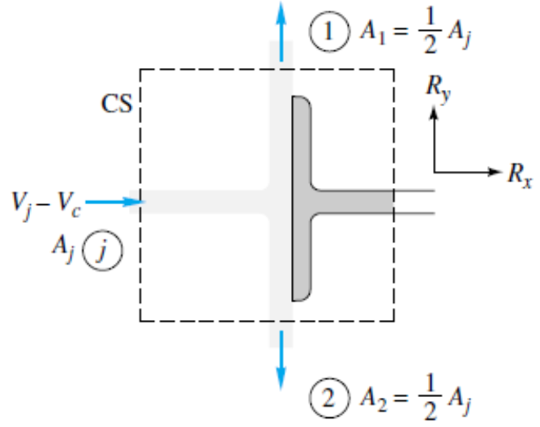
EXAMPLE 3.10
There are two outlets and one inlet
water is incompressible ρ1= ρ 2= ρ j, and we are given that A1 = A2= =(1/2) Aj.
from the symmetry of the jet deflection, we conclude that V1 = V2
Pressure force is zero since it is atmospheric.

Slide 40
Example sluice gate
The sluice gate in Fig. can control and measure flow in open channels. At sections 1 and 2, the flow is uniform and the pressure is hydrostatic. The channel width is b into the paper. Neglecting bottom friction, derive an expression for the force F required to hold the gate.
The CV encloses the inlet and exit and the whole gate, as shown. From mass conservation, the velocities are related by

Slide 41
Angular-Momentum
Dummy variable B be the angular-momentum vector H.
integration over the elemental masses dm. If O is the point about which moments are desired, the angular momentum about O is given by
where r is the position vector from 0 to the elemental mass dm and V is the velocity of that element. The amount of angular momentum per unit mass is thus seen to be

Slide 42
Angular-Momentum
The Reynolds transport theorem
from the angular momentum theorem this must equal the sum of all the moments about point O applied to the control volume
the total moment equals the summation of moments of all applied forces about point O.

Slide 43

Angular-Momentum
Flux term
For steady flow time derivative term is zero, it simplifies to;
$\sum{Mo=\sum{\left(rxV\right)out\dot{mout}−\sum{\left(rxV\right)in\dot{m}in}}}$

Slide 44
EXAMPLE 3.13
As shown in Fig. E3.13a, a pipe bend is supported at point A and connected to a flow system by flexible couplings at sections 1 and 2. The fluid is incompressible, and ambient pressure Pa is zero. (a) Find an expression for the torque T which must be resisted by the support at A, in terms of the flow properties at sections 1 and 2 and the distances h1 and h2. (b) Compute this torque if D1= D2= 3 in, P1= 100 lbf/in2 gage, P2 =80 lbf/in2 gage, V1= 40 ft/s, h1= 2 in, h2= 10 in, and ρ=1.94 slugs/ft3.

Slide 45
EXAMPLE 3.1
For the angular momentum terms r x V, r should be taken from point A to sections 1 and 2.
Note that the gage pressure forces P1A1 and P2A2 both have moments about A.
Cross products are associated either with r₁ sinθ ₁= h1 or
r ₂ sinθ ₂= h2, the perpendicular distances from point A to the pipe axes at 1 and 2.
Remember that m˙ _{in} =m˙ _{out} from the steady-flow continuity relation

Slide 46
The Energy Equation
The dummy variable B becomes energy E, and the energy per unit mass is β=dE/dm=e.
Recall that positive Q denotes heat added to the system and positive W denotes work done by the system.
The pressure work equals the pressure force on a small surface element dA times the normal velocity component into the control volume

Slide 47
The Energy Equation
One-Dimensional Energy-Flux Terms

Slide 48
The Steady-Flow Energy Equation
For steady flow with one inlet and one outlet, both assumed one-dimensional, Eq. reduces to a relation used in many engineering analyses. Let section 1 be the inlet and section 2 the outlet. Then
But, from continuity, m˙ 1=m˙ 2= m˙ , divide by mass flow rate and rearrange as follows ( per unit mass)
Rewrite enthalpy of term of pressure and density then divide by specific weight to get;

Slide 49
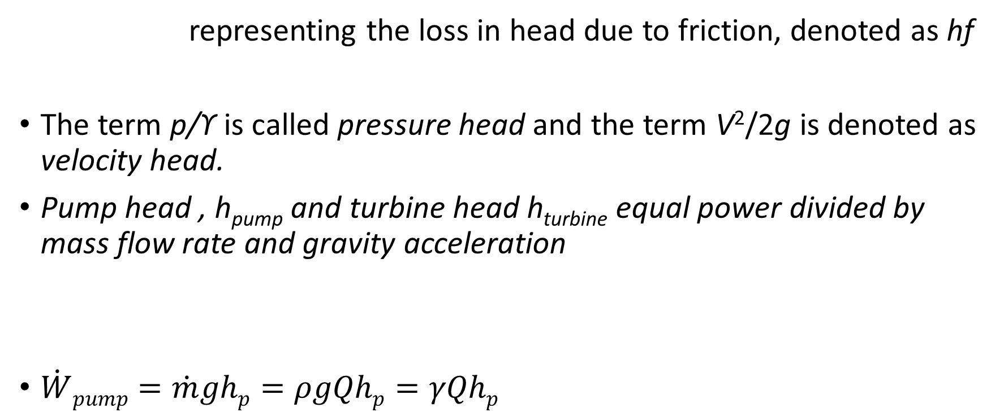
Friction loss
representing the loss in head due to friction, denoted as hf
The term p/ϒ is called pressure head and the term V²/2g is denoted as velocity head.
Pump head , h_{pump} and turbine head h_{turbine} equal power divided by mass flow rate and gravity acceleration
$\dot{W}pump=\dot{m}ghp=ρgQhp=γQhp$

Slide 50
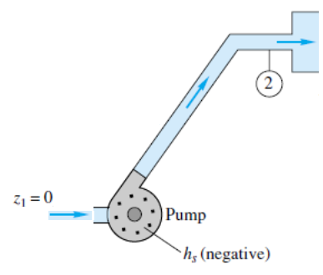
EXAMPLE 3.17
Gasoline at 20°C is pumped through a smooth 12-cm-diameter pipe 10 km long, at a flow rate of 75 m3/h (330 gal/min). The inlet is fed by a pump at an absolute pressure of 24 atm. The exit is at standard atmospheric pressure and is 150 m higher. Estimate the frictional head loss hf, and compare it to the velocity head of the flow V2/(2g).
For gasoline at 20°C, ρ=680 kg/m3, or ϒ =(680)(9.81) 6670 N/m3. There is no shaft work.

Slide 51
Kinetic-Energy Correction Factor
Often the flow entering or leaving a port is not strictly one- dimensional and to account for this a correction factor α is introduced and evaluated as;
The term is the kinetic-energy correction factor, having a value of about 2.0 for fully developed laminar pipe flow and from 1.04 to 1.11 for turbulent pipe flow

Slide 52
EXAMPLE 3.19
A hydroelectric power plant (Fig. E3.19) takes in 30 m³/s of water through its turbine and discharges it to the atmosphere at V₂=2m/s. The head loss in the turbine and penstock system is hf=20 m. Assuming turbulent flow, α= 1.06, estimate the power in MW extracted by the turbine.
let 1 at reservoir free surface, 2 is at the turbine outlet
Given V1 = 0, P1= Patm, and z1= 100 m.
Assuming steady-flow

Slide 53
EXAMPLE 3.20
The pump in Fig. E3.20 delivers water (62.4 lbf/ft3) at 3 ft3/s to a machine at section 2, which is 20 ft higher than the reservoir surface. The losses between 1 and 2 are given by hf= KV₂ ² /(2g), and K= 7.5. Find the horsepower required for the pump if it is 80 percent efficient.
If the reservoir is large, the flow is steady, with V1= 0. We can compute V2 from

Slide 54
EXAMPLE 3.20
Assuming α= 1.07

Slide 55
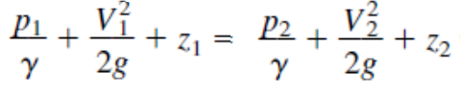
Frictionless Flow: The Bernoulli Equation
Energy equation per unit mass
Bernoulli equation for steady frictionless incompressible flow along a
streamline

Slide 56
Bernoulli Equation
If we compare the Bernoulli equation with the energy equation we see that the Bernoulli equation contains even more restrictions.
The complete list of assumptions for B.eq is as follows;
1. Steady flow—a common assumption applicable to many flows.
2. Incompressible flow—acceptable if the flow Mach number is less than 0.3.
3. Frictionless flow—very restrictive, solid walls introduce friction effects.
4. Flow along a single streamline—different streamlines may have different
“Bernoulli constants” w0= p/ρ+ V²/2 +gz, depending upon flow conditions.
5. No shaft work between 1 and 2—no pumps or turbines on the streamline.
6. No heat transfer between 1 and 2—either added or removed.

Slide 57
Hydraulic and Energy Grade Lines
The hydraulic grade line (HGL) shows the height corresponding to elevation and pressure head z + p/ϒ=HGL,
The energy grade line (EGL) shows the height of the total Bernoulli constant h0 =z+ p/ϒ+ V²/(2g)=EGL.
EGL = HGL + V²/(2g)

Slide 58
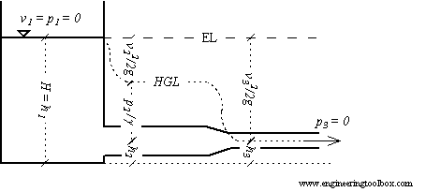
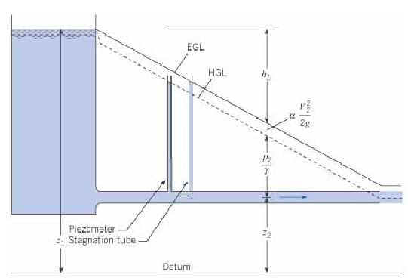
The Total Head
states that the sum of
pressure head - p / γ
velocity head - v² / 2 g
elevation head - h

Slide 59
EXAMPLE 3.21
Find a relation between nozzle discharge velocity V2and tank free-surface height h as in Fig. E3.21. Assume steady frictionless flow
But since sections 1 and 2 are both exposed to atmospheric pressure p1= p2 = pa, the pressure terms cancel,

Slide 60
Siphon
P3.169 Once it has been started by sufficient suction, the siphon in Fig. P3.169 will run continuously as long as reservoir fluid is available. Using Bernoulli’s equation with no losses, show:
(a) that the exit velocity V2 depends only upon gravity and the distance H and (b) that the lowest (vacuum) pressure occurs at point 3 and depends on the distance L , H.

Slide 61
EXAMPLE 3.23
A constriction in a pipe will cause the velocity to rise and the pressure to fall at section 2 in the throat. The pressure difference is a measure of the flow rate through the pipe. The smoothly necked-down system is called a venturi tube. Find an expression for the mass flux in the tube as a function of the pressure change.
If the tube is horizontal, z1= z2 and we can solve for V2
discharge coefficient cd

Slide 62
EXAMPLE 3.24
A 10-cm fire hose with a 3-cm nozzle discharges 1.5 m3/min to the atmosphere. Assuming frictionless flow, find the force FB exerted by the flange bolts to hold the nozzle on the hose.
B.Eq
given p2= pa= 0 gage pressure

Slide 63
EXAMPLE 3.24
control-volume force balance
The steady-flow momentum relation

Slide 64
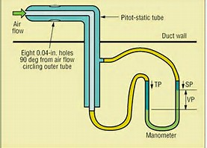
Pressure terms
Static Pressure
It is static relative to the moving fluid and can be measured through a flat opening in parallel to the flow.
Dynamic Pressure
The term 1/2 ρ v² is called the dynamic pressure.
Hydrostatic Pressure
The term γ h is called the hydrostatic pressure. It represent the pressure due to change in elevation.
Stagnation Pressure
the stagnation point where the velocity in the flow is zero

Slide 65
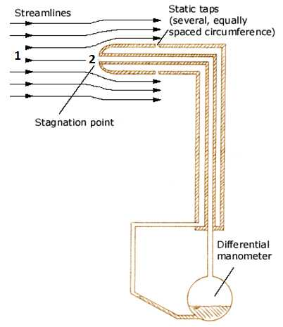


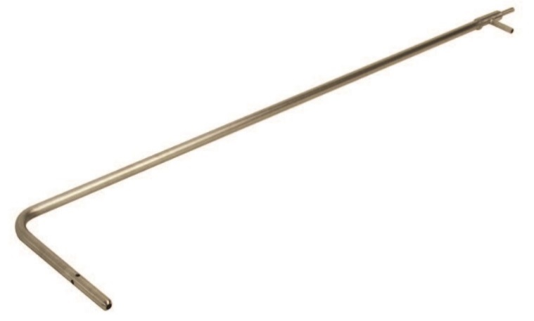


Pitot –tube theory
If z₁ = z₂ and point 2 is a stagnation point, i.e., v₂ = 0, the above equation reduces to

Slide 66
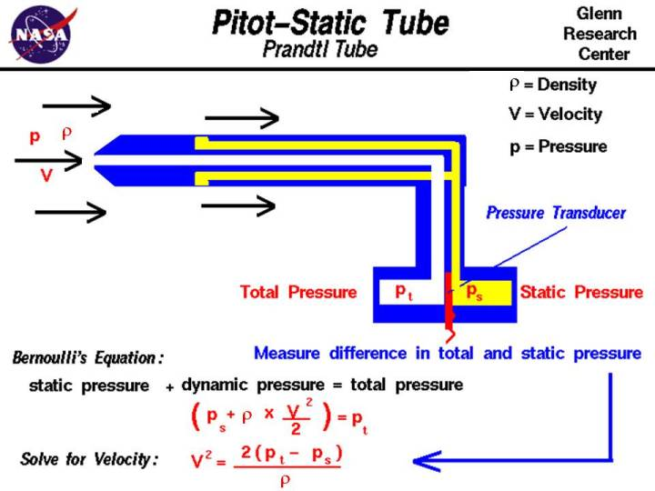

Slide 67
End of chapter 3 Integral relations of control volume

