Slide 1
Chapter 18
Acid-Base Equilibria
Copyright ©The McGraw-Hill Companies, Inc. Permission required for reproduction or display.
Notes:
‹#›

Slide 2
Acid-Base Equilibria
18.1 Acids and Bases in Water
18.2 Autoionization of Water and the pH Scale
18.3 Proton Transfer and the Brønsted-Lowry Acid-Base Definition
18.4 Solving Problems Involving Weak-Acid Equilibria
18.5 Weak Bases and Their Relation to Weak Acids
18.6 Molecular Properties and Acid Strength
18.7 Acid-Base Properties of Salt Solutions
18.8 Electron-Pair Donation and the Lewis Acid-Base Definition
Notes:
‹#›

Slide 3
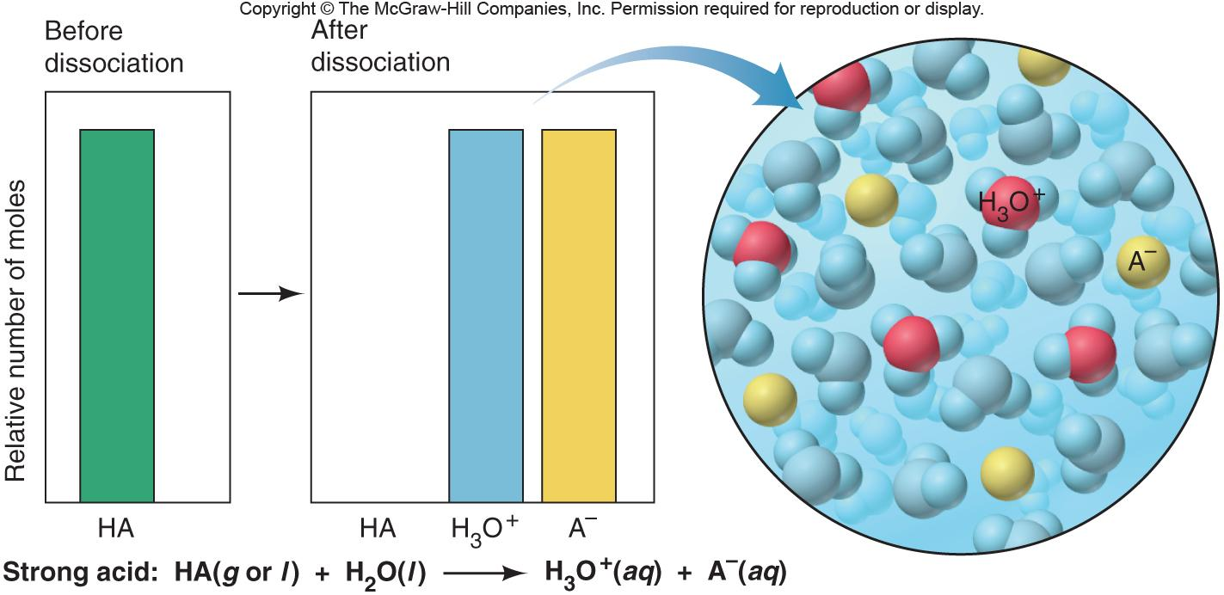
Figure 18.2
The extent of dissociation for strong acids.
Notes:
‹#›

Slide 4
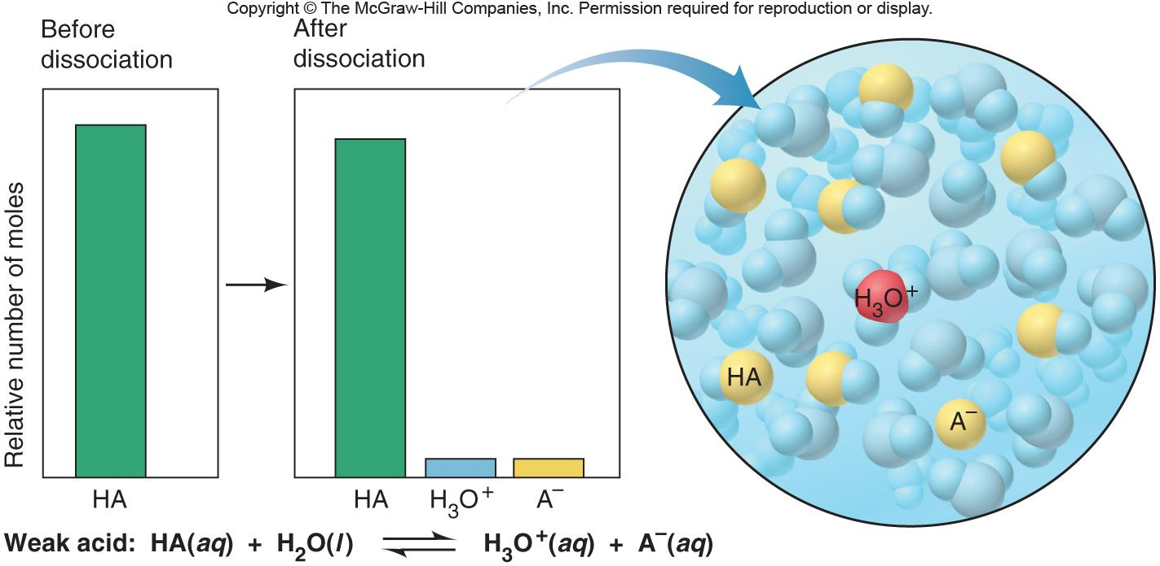
Figure 18.3
The extent of dissociation for weak acids.
Notes:
‹#›

Slide 5

Strong acids dissociate completely into ions in water.
HA(g or l) + H₂O(l) H₃O⁺(aq) + A⁻(aq)
K_{c} >> 1
Weak acids dissociate very slightly into ions in water.
HA(aq) + H₂O(l) H₃O⁺(aq) + A⁻(aq)
K_{c} << 1
The Acid-Dissociation Constant
[H₃O⁺][A⁻]
stronger acid higher [H₃O⁺]
K_{c} =
[H₂O][HA]
larger K_{a}
[H₃O⁺][A⁻]
K_{c}[H₂O] = K_{a} =
[HA]
smaller K_{a} lower [H₃O⁺]
weaker acid
Notes:
‹#›

Slide 6
SAMPLE PROBLEM 18.1
Classifying Acid and Base Strength from the Chemical Formula
PROBLEM:
Classify each of the following compounds as a strong acid, weak acid, strong base, or weak base:
(a) H₂SeO₄
(b) (CH₃)₂CHCOOH
(c) KOH
(d) (CH₃)₂CHNH₂
PLAN:
Pay attention to the text definitions of acids and bases. Look at O for acids as well as the -COOH group; watch for amine groups and cations in bases.
SOLUTION:
(a) Strong acid: H₂SeO₄ - the number of O atoms exceeds the number of ionizable protons by 2.
(b) Weak acid: (CH₃)₂CHCOOH is a carboxylic acid having a -COOH group.
(c) Strong base: KOH is a Group 1A(1) hydroxide.
(d) Weak base: (CH₃)₂CHNH₂ has a lone pair of electrons on the N and is an amine.
Notes:
‹#›

Slide 7
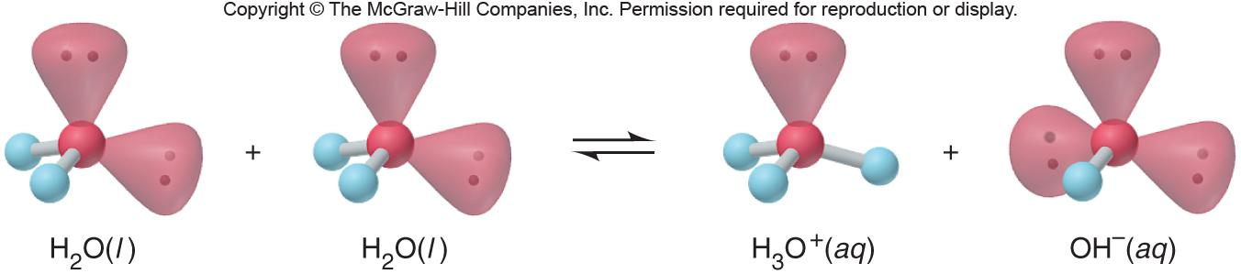
Autoionization of Water and the pH Scale
Notes:
‹#›

Slide 8

H₂O(l) + H₂O(l) H₃O⁺(aq) + OH⁻(aq)
[H₃O⁺][OH⁻]
K_{c} =
[H₂O]²
The Ion-Product Constant for Water
K_{c}[H₂O]² =
K_{w} =
[H₃O⁺][OH⁻]
= 1.0 x 10⁻¹⁴ (at 25ºC)
A change in [H₃O⁺] causes an inverse change in [OH⁻].
In an acidic solution, [H₃O⁺] > [OH⁻]
In a basic solution, [H₃O⁺] < [OH⁻]
In a neutral solution, [H₃O⁺] = [OH⁻]
Notes:
‹#›

Slide 9
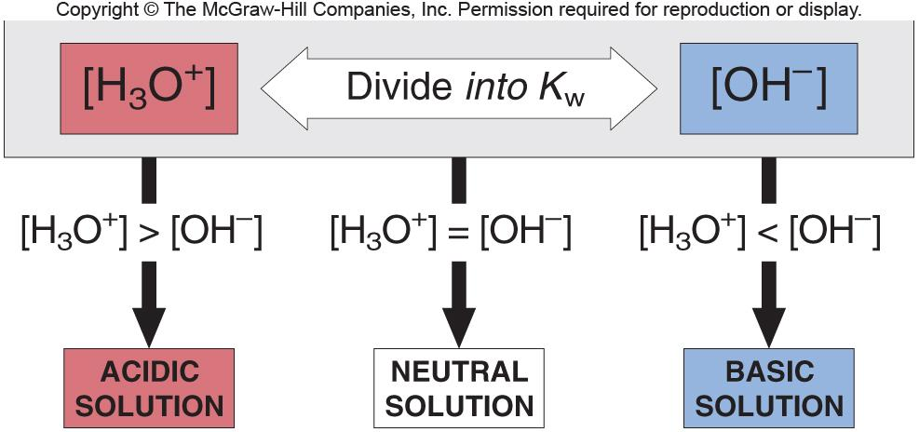
The relationship between [H₃O⁺] and [OH⁻] and the relative acidity of solutions.
Figure 18.4
Notes:
‹#›

Slide 10
SAMPLE PROBLEM 18.2
Calculating [H₃O⁺] or [OH⁻] in Aqueous Solution
PROBLEM:
A research chemist adds a measured amount of HCl gas to pure water at 25ºC and obtains a solution with [H₃O⁺] = 3.0 x 10⁻⁴ M. Calculate [OH⁻]. Is the solution neutral, acidic, or basic?
PLAN:
Use the K_{w} at 25ºC and the [H₃O⁺] to find the corresponding [OH⁻].
SOLUTION:
K_{w} = 1.0 x 10⁻¹⁴ = [H₃O⁺] [OH⁻] so
K_{w}
1.0 x 10⁻¹⁴
3.3 x 10⁻¹¹M
[OH⁻] = = =
[H₃O⁺]
3.0 x 10⁻⁴
[H₃O⁺] is > [OH⁻] and the solution is acidic.
Notes:
‹#›

Slide 11
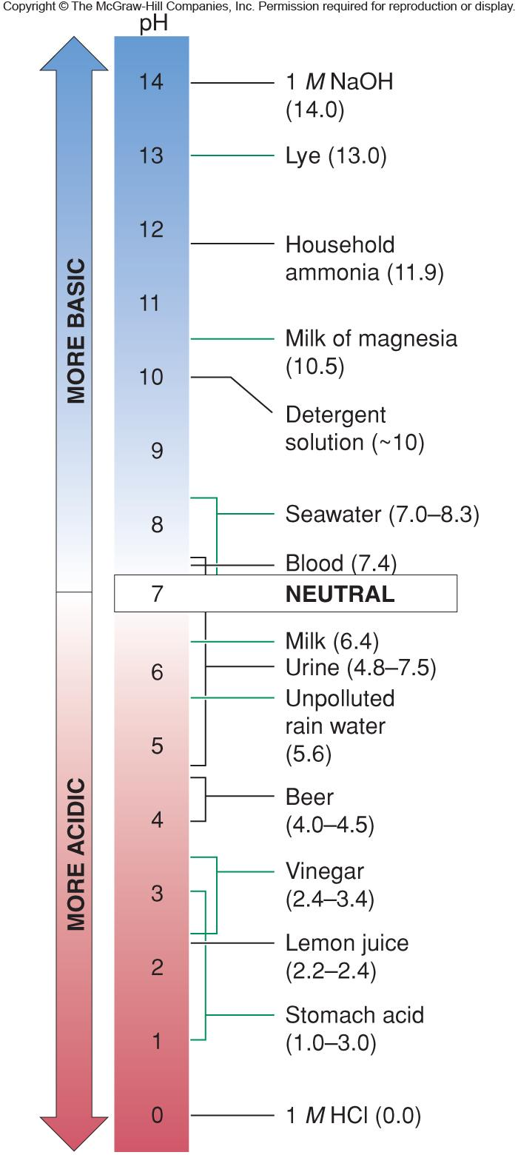
Figure 18.5
The pH values of some familiar aqueous solutions.
pH = -log [H₃O⁺]
Notes:
‹#›

Slide 12
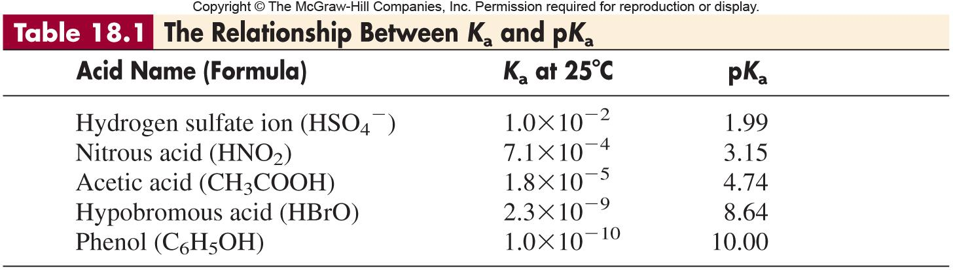
Notes:
‹#›

Slide 13
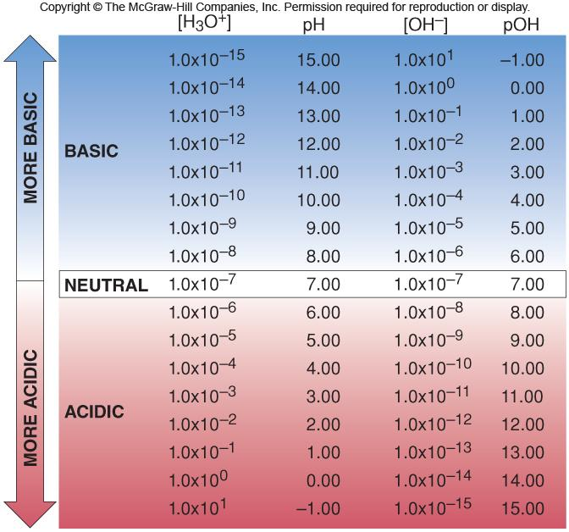
Figure 18.6
The relations among [H₃O⁺], pH, [OH⁻], and pOH.
Notes:
‹#›

Slide 14
SAMPLE PROBLEM 18.3
Calculating [H₃O⁺], pH, [OH⁻], and pOH
PROBLEM:
In an art restoration project, a conservator prepares copper-plate etching solutions by diluting concentrated HNO₃ to 2.0 M, 0.30 M, and 0.0063 M HNO₃. Calculate [H₃O⁺], pH, [OH⁻], and pOH of the three solutions at 25ºC.
PLAN:
HNO₃ is a strong acid so [H₃O⁺] = [HNO₃]. Use K_{w} to find the [OH⁻] and then convert to pH and pOH.
Notes:
‹#›

Slide 15
SAMPLE PROBLEM 18.3
Calculating [H₃O⁺], pH, [OH⁻], and pOH
continued
SOLUTION:
For 2.0 M HNO₃ [H₃O⁺] = 2.0 M -log [H₃O⁺] = -0.30 = pH
K_{w}
1.0 x 10⁻¹⁴
[OH⁻] = = = 5.0 x 10⁻¹⁵ M pOH = 14.30
[H₃O⁺]
2.0
For 0.30 M HNO₃ [H₃O⁺] = 0.30 M -log [H₃O⁺] = 0.52 = pH
K_{w}
1.0 x 10⁻¹⁴
[OH⁻] = = = 3.3 x 10⁻¹⁴ M pOH = 13.48
[H₃O⁺]
0.30
For 0.0063 M HNO₃ [H₃O⁺] = 0.0063 M -log [H₃O⁺] = 2.20 = pH
K_{w}
1.0 x 10⁻¹⁴
[OH⁻] = = = 1.6 x 10⁻¹² M pOH = 11.80
[H₃O⁺]
6.3 x 10⁻³
Notes:
‹#›

Slide 16
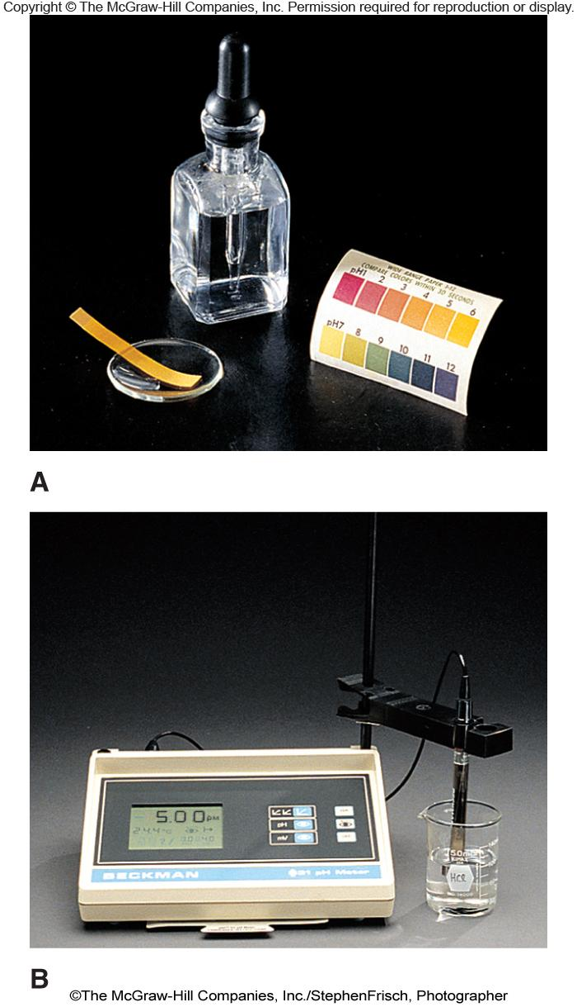
Figure 18.7
Methods for measuring the pH of an aqueous solution.
pH (indicator) paper
pH meter
Notes:
‹#›

Slide 17
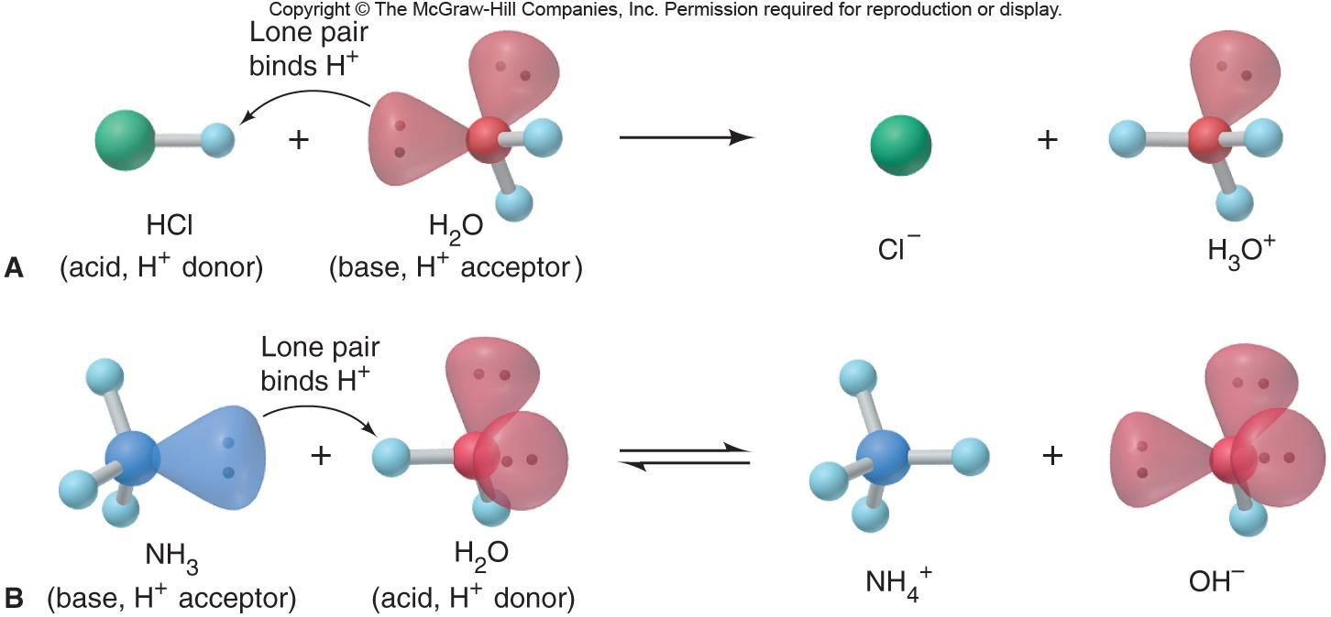
Figure 18.8
Proton transfer as the essential feature of a Brønsted-Lowry acid-base reaction.
Notes:
‹#›

Slide 18
Brønsted-Lowry Acid-Base Definition
An acid is a proton donor, any species which donates an H⁺.
A base is a proton acceptor, any species which accepts an H⁺.
An acid-base reaction can now be viewed from the standpoint of the reactants and the products.
An acid reactant will produce a base product and the two will constitute an acid-base conjugate pair.
Notes:
‹#›

Slide 19
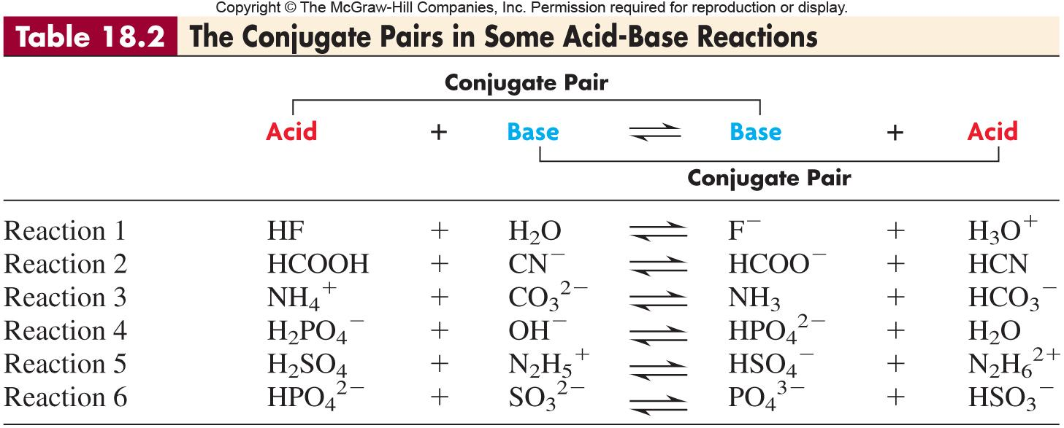
Notes:
‹#›

Slide 20
SAMPLE PROBLEM 18.4
Identifying Conjugate Acid-Base Pairs
PROBLEM:
The following reactions are important environmental processes. Identify the conjugate acid-base pairs.
(a) H₂PO₄⁻(aq) + CO₃²⁻(aq) HPO₄²⁻(aq) + HCO₃⁻(aq)
(b) H₂O(l) + SO₃²⁻(aq) OH⁻(aq) + HSO₃⁻(aq)
PLAN:
Identify proton donors (acids) and proton acceptors (bases).
conjugate pair₁
conjugate pair₂
SOLUTION:
(a) H₂PO₄⁻(aq) + CO₃²⁻(aq) HPO₄²⁻(aq) + HCO₃⁻(aq)
proton donor
proton acceptor
proton acceptor
proton donor
conjugate pair₁
conjugate pair₂
(b) H₂O(l) + SO₃²⁻(aq) OH⁻(aq) + HSO₃⁻(aq)
proton donor
proton acceptor
proton acceptor
proton donor
Notes:
‹#›

Slide 21
SAMPLE PROBLEM 18.5
Predicting the Net Direction of an Acid-Base Reaction
PROBLEM:
Predict the net direction and whether K_{c} is greater or less than 1 for the following reaction (assume equal initial concentrations of all species):
H₂PO₄⁻(aq) + NH₃(aq) NH₄⁺(aq) + HPO₄²⁻(aq)
PLAN:
Identify the conjugate acid-base pairs and then consult Figure 18.9 to determine the relative strength of each. The stronger the species, the greater will be the concentration of its conjugate.
SOLUTION:
(a) H₂PO₄⁻(aq) + NH₃(aq) HPO₄²⁻(aq) + NH₄⁺(aq)
stronger acid
stronger base
weaker base
weaker acid
Net direction is to the right with K_{c} > 1.
Notes:
‹#›

Slide 22
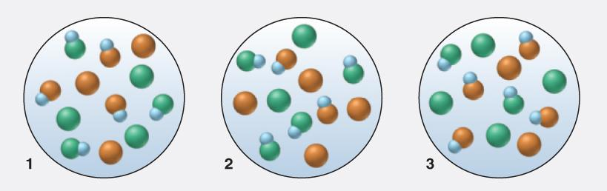
SAMPLE PROBLEM 18.6
Using Molecular Scenes to Predict the Net Direction of an Acid-Base Reaction
PROBLEM:
Given that a 0.10 M solution of HX (blue and green) has a pH of 2.88 and a 0.10 M solution of HY (blue and orange) has a pH of 3.52, which scene best represents the equilibrium mixture after equimolar solutions of HX and Y⁻ (orange) are mixed?
PLAN:
Determine the relative strengths of HX and HY from their pH. A stronger acid and base will produce a weaker base and acid, respectively.
SOLUTION:
HX is a stronger acid (lower pH) than HY; Y⁻ is a stronger base than X⁻. The HX + Y⁻ reaction will have a K_{c} > 1. The equilibrium mixture will have more HY than HX and more X⁻ than Y⁻. Therefore, scene 3 best represents an equilibrium mixture.
Notes:
‹#›

Slide 23
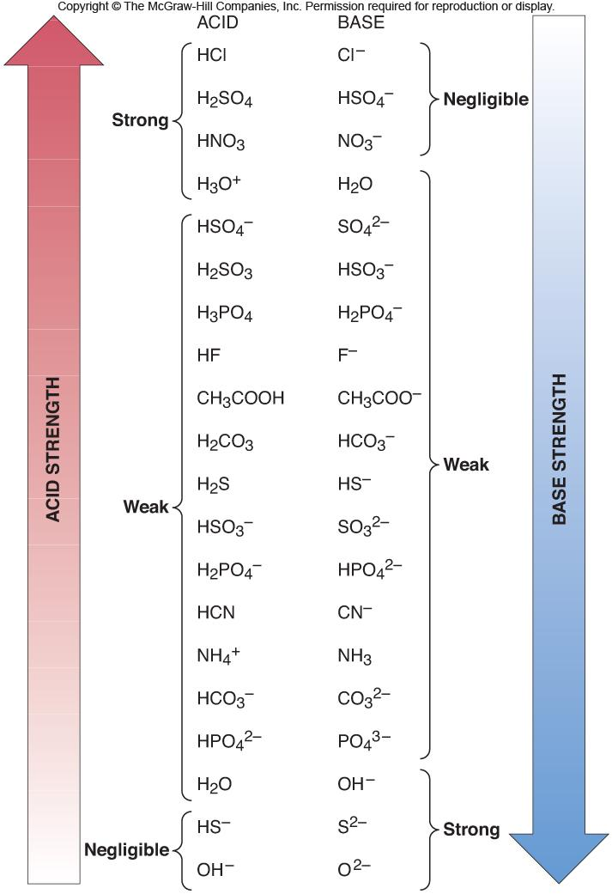
Figure 18.9
Strengths of conjugate acid-base pairs.
Notes:
‹#›

Slide 24

SAMPLE PROBLEM 18.7
Finding K_{a} of a Weak Acid from the Solution pH
PROBLEM:
Phenylacetic acid (C₆H₅CH₂COOH, simplified here as HPAc) builds up in the blood of persons with phenylketonuria, an inherited disorder that, if untreated, causes mental retardation and death. A study of the acid shows that the pH of 0.12 M HPAc is 2.62. What is the K_{a} of phenylacetic acid?
PLAN:
Write out the dissociation equation. Use pH and solution concentration to find the K_{a}.
Assumptions:
With a pH of 2.62, the [H₃O⁺]_{HPAc} >> [H₃O⁺]_{water}.
[PAc⁻] ≈ [H₃O⁺]; since HPAc is weak, [HPAc]_{initial} ≈ [HPAc]_{initial} - [HPAc]_{dissociation}
SOLUTION:
HPAc(aq) + H₂O(l) H₃O⁺(aq) + PAc⁻(aq)
K_{a} =
[H₃O⁺][PAc⁻]
[HPAc]
Notes:
‹#›

Slide 25
SAMPLE PROBLEM 18.7
Finding K_{a} of a Weak Acid from the Solution pH
continued
Concentration (M)
HPAc(aq) + H₂O(l) H₃O⁺(aq) + PAc⁻(aq)
Initial
0.12
-
1 x 10⁻⁷
0
Change
-x
-
+x
+x
Equilibrium
0.12 - x
-
x + (<1 x 10⁻⁷)
x
[H₃O⁺] = 10^{-pH} = 2.4 x 10⁻³ M which is >> 10⁻⁷ (the [H₃O⁺] from water)
x ≈ 2.4 x 10⁻³ M ≈ [H₃O⁺] ≈ [PAc⁻]
[HPAc]_{equilibrium} = 0.12 - x ≈ 0.12 M
(2.4x10⁻³) (2.4x10⁻³)
So K_{a} =
= 4.8 x 10⁻⁵
0.12
1x10⁻⁷ M
Be sure to check for % error.
[H₃O⁺]_{from water};
x100
= 4 x 10⁻³ %
2.4x10⁻³ M
[HPAc]_{diss};
2.4x10⁻³ M
x100
= 2.0 %
0.12 M
Notes:
‹#›

Slide 26
SAMPLE PROBLEM 18.8
Determining Concentrations from K_{a} and Initial [HA]
PROBLEM:
Propanoic acid (CH₃CH₂COOH, which we simplify as HPr) is a carboxylic acid whose salts are used to retard mold growth in foods. What is the [H₃O⁺] of 0.10 M HPr (K_{a} = 1.3 x 10⁻⁵)?
PLAN:
Write out the dissociation equation and expression; make whatever assumptions about concentration that are necessary; substitute.
Assumptions:
For HPr(aq) + H₂O(l) H₃O⁺(aq) + Pr ⁻(aq)
x = [HPr]_{diss} = [H₃O⁺]_{from HPr}= [Pr⁻]
K_{a} =
[H₃O⁺][Pr ⁻]
SOLUTION:
[HPr]
Concentration (M)
HPr(aq) + H₂O(l) H₃O⁺(aq) + Pr⁻(aq)
Initial
0.10
-
0
0
Change
-x
-
+x
+x
Equilibrium
0.10 - x
-
x
x
Since K_{a} is small, we will assume that x << 0.10
Notes:
‹#›

Slide 27
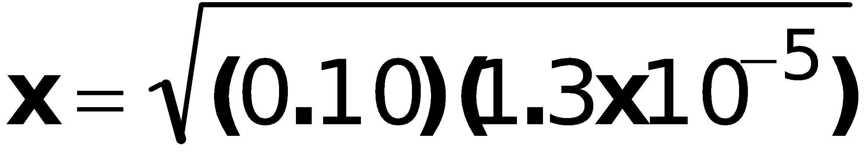
SAMPLE PROBLEM 18.8
Determining Concentrations from K_{a} and Initial [HA]
continued
[H₃O⁺][Pr ⁻]
(x)(x)
1.3 x 10⁻⁵ =
=
[HPr]
0.10
= 1.1 x 10⁻³ M = [H₃O⁺]
1.1 x 10⁻³M
Check: [HPr]_{diss} = x 100 = 1.1%
0.10 M
Notes:
‹#›

Slide 28
[HA]_{dissociated}
Percent HA dissociation =
x 100
[HA]_{initial}
Polyprotic acids
acids with more than one ionizable proton
H₃PO₄(aq) + H₂O(l) H₂PO₄⁻(aq) + H₃O⁺(aq)
[H₃O⁺][H₂PO₄⁻]
K_{a1} =
= 7.2 x 10⁻³
[H₃PO₄]
H₂PO₄⁻(aq) + H₂O(l) HPO₄²⁻(aq) + H₃O⁺(aq)
[H₃O⁺][HPO₄²⁻]
K_{a2} =
= 6.3 x 10⁻⁸
[H₂PO₄⁻]
[H₃O⁺][PO₄³⁻]
HPO₄²⁻(aq) + H₂O(l) PO₄³⁻(aq) + H₃O⁺(aq)
K_{a3} =
= 4.2 x 10⁻¹³
[HPO₄²⁻]
K_{a1} > K_{a2} > K_{a3}
Notes:
‹#›

Slide 29
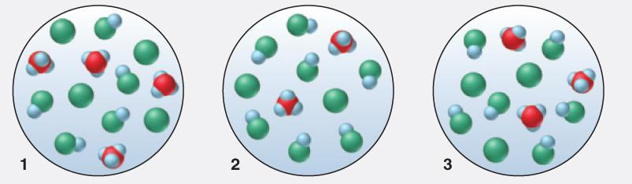
SAMPLE PROBLEM 18.9
Using Molecular Scenes to Determine the Extent of HA Dissociation
PROBLEM:
A 0.15 M solution of acid HA (blue and green) is 33% dissociated. Which scene represents a sample of that solution after it is diluted with water?
PLAN:
Calculate percent dissociation for each scene. Percent dissociation increases as an acid is diluted.
SOLUTION:
Solution 1: 4/(5 + 4) x 100 = 44%
Solution 2: 2/(7 + 2) x 100 = 22%
Solution 3: 3/(6 + 3) x 100 = 33%
Therefore, scene 1 is the diluted solution.
Notes:
‹#›

Slide 30
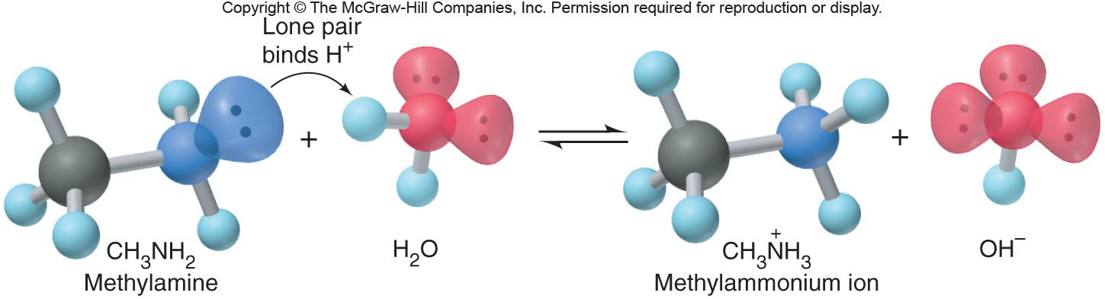
Figure 18.10
Abstraction of a proton from water by methylamine.
Notes:
‹#›

Slide 31
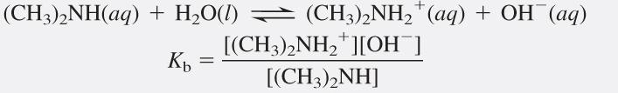
SAMPLE PROBLEM 18.10
Determining pH from K_{b} and Initial [B]
PROBLEM:
Dimethylamine, (CH₃)₂NH, a key intermediate in detergent manufacture, has a K_{b} of 5.9 x 10⁻⁴. What is the pH of 1.5 M (CH₃)₂NH?
PLAN:
Perform this calculation as you did for acids. Keep in mind that you are working with K_{b} and a base.
Assumptions:
K_{b} >> K_{w} so [OH⁻]_{from water} is neglible
[(CH₃)₂NH₂⁺] = [OH⁻] = x ; [(CH₃)₂NH₂⁺] - x ≈ [(CH₃)₂NH]_{initial}
Notes:
‹#›

Slide 32
SAMPLE PROBLEM 18. 10
Determining pH from K_{b} and Initial [B]
continued
SOLUTION:
Concentration (M)
(CH₃)₂NH(aq) + H₂O(l) (CH₃)₂NH₂⁺(aq) + OH⁻(aq)
Initial
1.5
-
0
0
Change
- x
-
+ x
+ x
Equilibrium
1.5 - x
-
x
x
[(CH₃)₂NH₂⁺][OH⁻]
x²
K_{b} = 5.9 x 10⁻⁴ =
5.9 x 10⁻⁴ =
x = 3.0 x 10⁻² M = [OH⁻]
[(CH₃)₂NH]
1.5
Check assumption:
3.0 x 10⁻² M
x 100 = 2%
1.5 M
K_{w}
1.0 x 10⁻¹⁴ M
[H₃O⁺] = = = 3.3 x 10⁻¹³ M
[OH⁻]
3.0 x 10⁻²M
pH = -log 3.3 x 10⁻¹³ = 12.48
Notes:
‹#›

Slide 33
SAMPLE PROBLEM 18.11
Determining the pH of a Solution of A⁻
PROBLEM:
Sodium acetate (CH₃COONa, or NaAc for this problem) has applications in photographic development and textile dyeing. What is the pH of 0.25 M NaAc? K_{a} of acetic acid (HAc) is 1.8 x 10⁻⁵.
PLAN:
Sodium salts are soluble in water so [Ac⁻] = 0.25 M.
Write the association equation for acetic acid; use the K_{a} to find the K_{b}.
SOLUTION:
Concentration
Ac⁻(aq) + H₂O(l) HAc(aq) + OH⁻(aq)
Initial
0.25
-
0
0
Change
-x
-
+x
+x
Equilibrium
0.25 - x
-
x
x
[HAc][OH⁻]
K_{w}
1.0 x 10⁻¹⁴
K_{b} =
=
K_{b} =
= 5.6 x 10⁻¹⁰ M
[Ac⁻]
K_{a}
1.8 x 10⁻⁵
Notes:
‹#›

Slide 34
SAMPLE PROBLEM 18.11
Determining the pH of a Solution of A⁻
continued
[Ac⁻] = 0.25 M - x ≈ 0.25 M
[HAc][OH⁻]
K_{b} =
x²
[Ac⁻]
5.6 x 10⁻¹⁰ =
0.25 M
x = 1.2 x 10⁻⁵ M = [OH⁻]
1.2 x 10⁻⁵ M
Check assumption:
x 100 = 4.8 x 10⁻³ %
0.25 M
K_{w}
1.0 x 10⁻¹⁴
[H₃O⁺] =
=
= 8.3 x 10⁻¹⁰ M
[OH⁻]
1.2 x 10⁻⁵
pH = -log (8.3 x 10⁻¹⁰) pH = 9.08
Notes:
‹#›

Slide 35
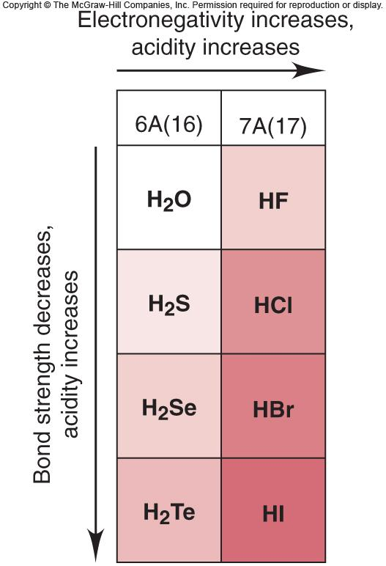
Figure 18.11
The effect of atomic and molecular properties on
nonmetal hydride acidity.
Notes:
‹#›

Slide 36
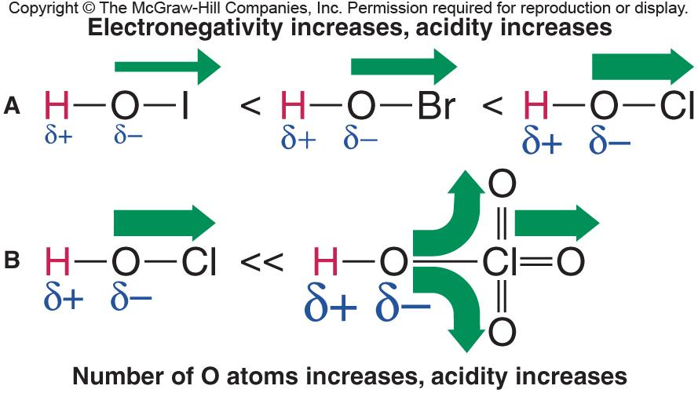
Figure 18.12
The relative strengths of oxoacids.
Notes:
‹#›

Slide 37
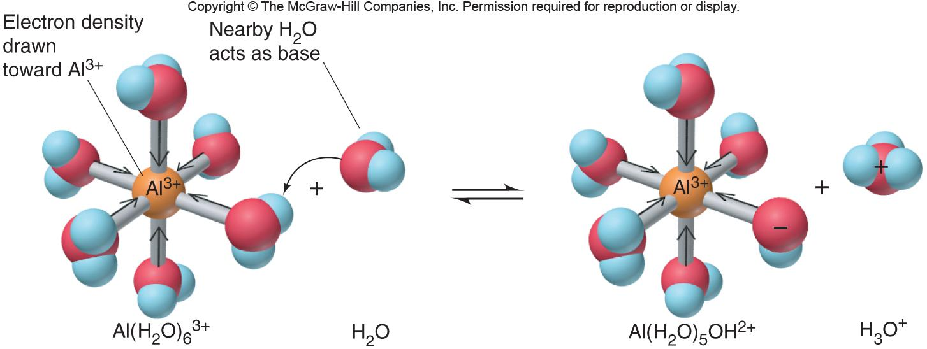
Figure 18.13
The acidic behavior of the hydrated Al³⁺ ion.
Notes:
‹#›

Slide 38
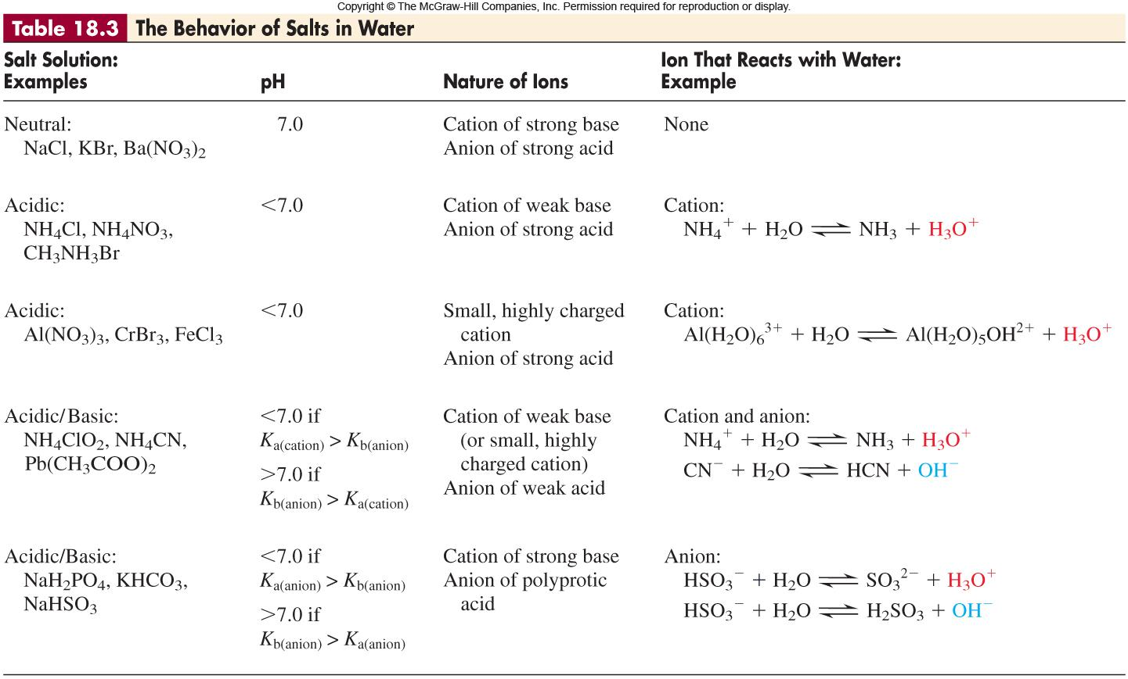
Notes:
‹#›

Slide 39
SAMPLE PROBLEM 18.13
Predicting the Relative Acidity of a Salt Solution from K_{a} and K_{b} of the Ions
PROBLEM:
Determine whether an aqueous solution of zinc formate, Zn(HCOO)₂, is acidic, basic, or neutral.
PLAN:
Both Zn²⁺ and HCOO⁻ come from weak conjugates. In order to find the relative acidity, write out the dissociation reactions and use the information in Appendix C.
SOLUTION:
Zn(H₂O)₆²⁺(aq) + H₂O(l) Zn(H₂O)₅OH⁺(aq) + H₃O⁺(aq)
HCOO⁻(aq) + H₂O(l) HCOOH(aq) + OH⁻(aq)
K_{a} Zn(H₂O)₆²⁺ = 1 x 10⁻⁹
K_{w}
1.0 x 10⁻¹⁴
K_{a} HCOO⁻ = 1.8 x 10⁻⁴ ; K_{b} = = = 5.6 x 10⁻¹¹
K_{a}
1.8 x 10⁻⁴
K_{a} for Zn(H₂O)₆²⁺ >>> K_{b} HCOO⁻, therefore, the solution is acidic.
Notes:
‹#›

Slide 40
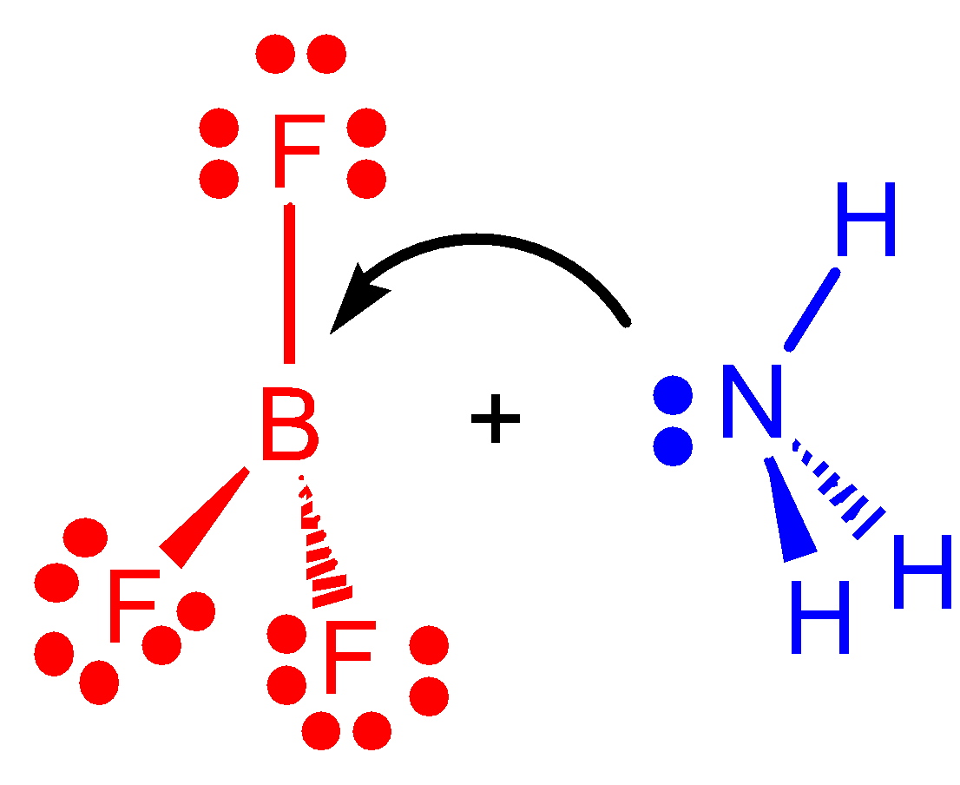
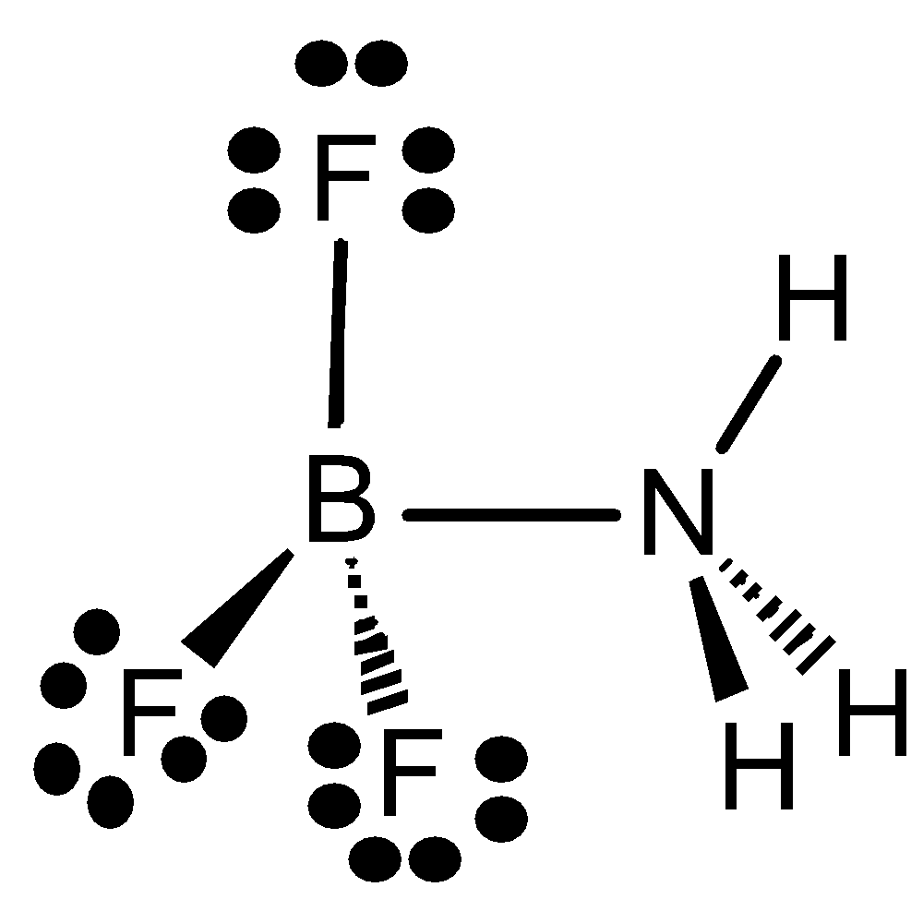

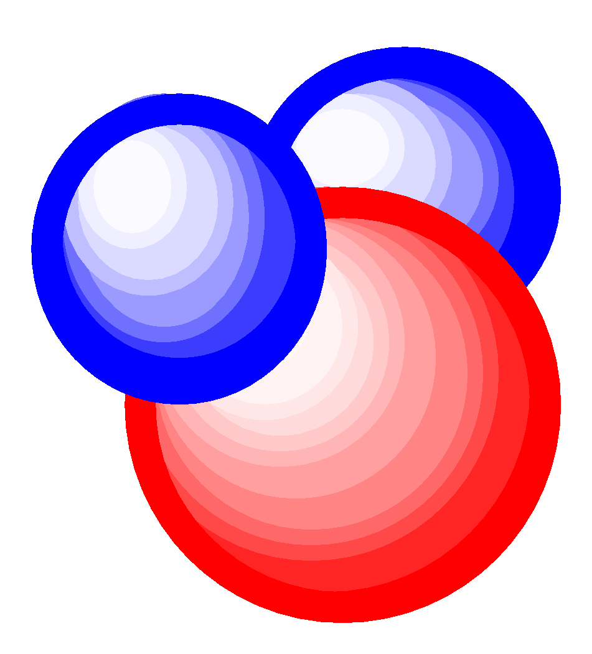
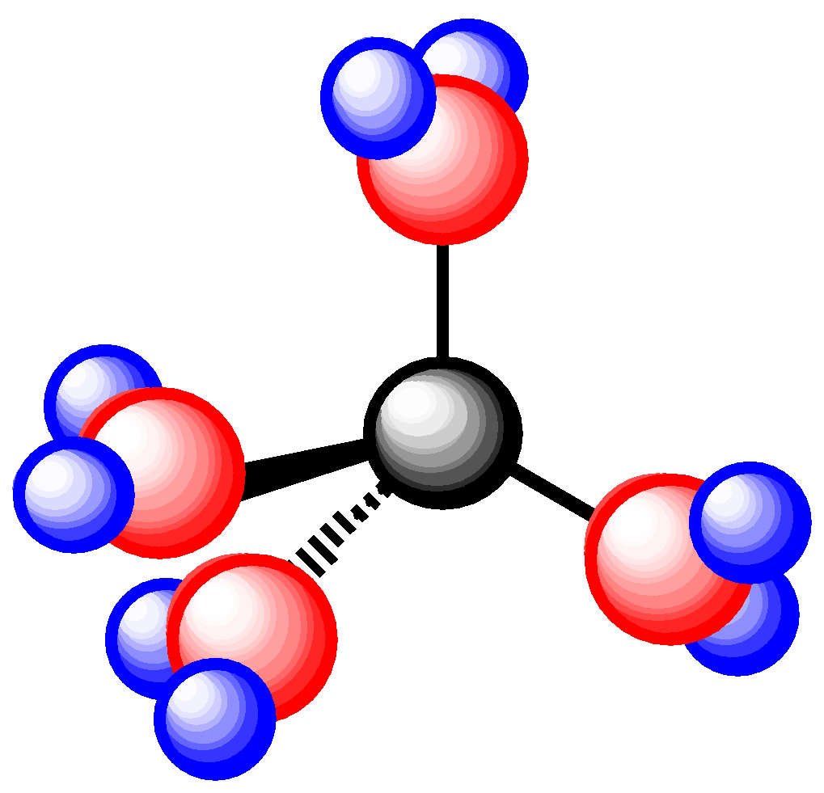

pg. 622
Molecules as Lewis Acids
An acid is an electron-pair acceptor.
A base is an electron-pair donor.
acid
base
adduct
M(H₂O)₄²⁺(aq)
M²⁺
H₂O(l)
adduct
Notes:
‹#›

Slide 41
SAMPLE PROBLEM 18.14
Identifying Lewis Acids and Bases
PROBLEM:
Identify the Lewis acids and Lewis bases in the following reactions:
(a) H⁺ + OH⁻ H₂O
(b) Cl⁻ + BCl₃ BCl₄⁻
(c) K⁺ + 6H₂O K(H₂O)₆⁺
PLAN:
Look for electron pair acceptors (acids) and donors (bases).
SOLUTION:
acceptor
(a) H⁺ + OH⁻ H₂O
donor
acceptor
(b) Cl⁻ + BCl₃ BCl₄⁻
acceptor
donor
(c) K⁺ + 6H₂O K(H₂O)₆⁺
donor
Notes:
‹#›

