Slide 1


Algorithm
Computer Science Department Comp 131

Slide 2

Algorithm & Pseudocode
An algorithm is a procedure or formula for solving a problem.
Pseudocode is a kind of structured English for describing algorithms. It allows the designer to focus on the logic of the algorithm without being distracted by details of language syntax.

Slide 3
Example
Let's say that you have a friend arriving at the airport, and your friend needs to get from the airport to your house. Here are three different algorithms that you might give your friend for getting to your home:

Slide 4

Example Cont.
The taxi algorithm:
Go to the taxi stand.
Get in a taxi.
Give the driver my address.

Slide 5
Example Cont.
The call-me algorithm:
When your plane arrives, call my cell phone.
Meet me outside baggage claim.

Slide 6
Example Cont.
The bus algorithm:
Outside baggage claim, catch bus number 70.
Transfer to bus 14 on Rukab Street.
Get off on Jerusalem street.
Walk two blocks north to my house.

Slide 7

Common Action Keywords
Input: READ , OBTAIN, GET
Output: PRINT, DISPLAY, SHOW
Compute: COMPUTE, CALCULATE
Initialize:
Add one:
SET INCREMENT

Slide 8

Types of Algorithm operations
Sequential
Conditional
Iterative

Slide 9
Sequential
Computation operations
Example:
Set the value of “variable” to “value” or “arithmetic expression”
Variable
Named storage location that can hold a data value

Slide 10

Sequential
Input operations
To receive data values from the user. Example
Get a value for r, the radius of the circle
Output operations
To send results to the screen for display. Example
Print the value of Area

Slide 11
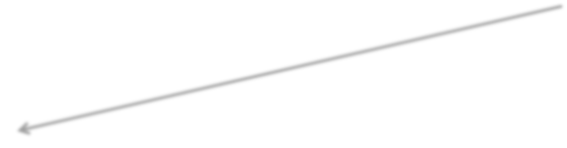
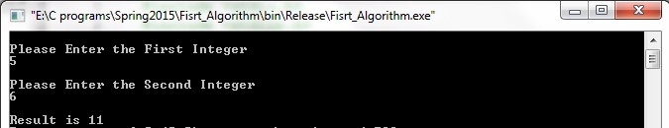
Sequential
Write an algorithm to find and print the sum of two integers ?
Ask user to enter first integer
Read the integer and save as integer_1
Ask user to enter the second integer
Read second integer and save as integer_2
Add integer_1 to integer_2 and save result as sum
Print sum to screen
1
2
3
4
6

Slide 12
Sequential
Write an algorithm to find and print the area of rectangle.
Ask user to enter the height of rectangle.
Read height and save as rectangle_height.
Ask user to enter the width of rectangle.
Read width and save as rectangle_width.
Multiply rectangle_heigh by rectangle_width and save the result as area.
Display area.

Slide 13

Sequential
Write an algorithm to reverse any two digits number.
Ask user to enter two digits number.
Read number and save as num.
Divide num by ten and save result as tens.
Divide num by ten and save remainder as rem.
Multiply rem by ten and save the result as rev.
Add tens to rev.
Print rev.
Suppose num=12
tens=num /10 =12/10→tens=1 rem=num%10=12%10→rem=2 rev=rem*10=2*10→rev=20 rev=rev+tens=20+1→rev=21

Slide 14
Conditional
IF
Case

Slide 15

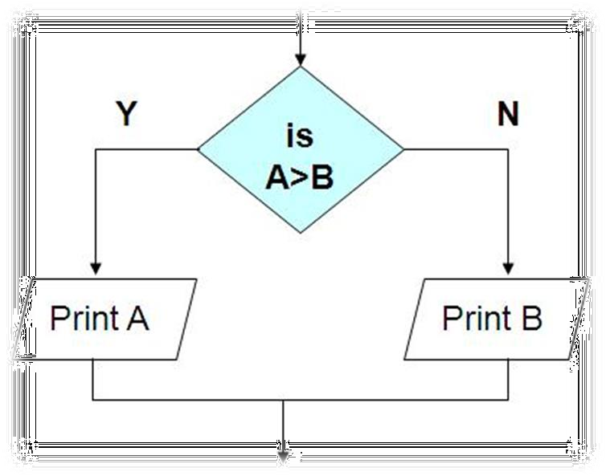
Conditional
Ask questions and choose alternative actions based on the answers.
Example
if A is greater than B then print A
else
print B
end if

Slide 16
Conditional
ELSE keyword is optional
IF condition THEN
Sequence
END IF
IF condition THEN
Sequence 1
ELSE IF condition THEN Sequence 2
ELSE IF condition THEN Sequence 3
ELSE
Sequence 4 END IF

Slide 17
Conditional
Logical Operators :
Relational Operators :
AND
OR
Greater than
Greater than or equal
Less than
Less than or equal
Equal
Not Equal

Slide 18

Conditional
Write an algorithm to print passed or failed based on the student grade.
Ask user to enter student grade.
Read grade and save as student_grade.
If student_grade greater than or equal sixty then print “passed”
else
print “failed” end if

Slide 19
Conditional
Write an algorithm to find and print the maximum element of a set of 3 integers.
Ask user to enter the first integer.
Read number and save as
first_integer.
Ask user to enter the second integer.
Read number and save as second_integer.
Ask user to enter third integer.
Read number and save as
third_integer.
Let max equal to the first_integer.
If max less than second_integer then set max to second_integer
end if
If max less than third_integer then set max to third_integer
end if
Print “the maximum integer is” max

Slide 20
Conditional
Write an algorithm to find and print the smallest of three given numbers (assume all numbers are different).
Ask user to enter first number
Read number and save as num1
Ask user to enter second number
Read number and save as num2
Ask user to enter third number
Read number and save as num3
If num1 smaller than num2 and num1 smaller than num3 then print num1 is the smallest
else If num2 smaller than num1 and num2 smaller than num3 then
print num2 is the smallest
else
print num3 is the smallest
end if
Rules for logical And operations
T | T | T
T | F | F
F | T | F
F | F | F

Slide 21

Conditional
Write an algorithm to read a number x and display its sign.
Ask user to enter a number
Read number and save as X
If x is greater than zero then print x “is positive”
else if x is equal zero then
print x “is zero” else
print x “is negative” end if

Slide 22

Conditional
Write an algorithm that will input student average. If the average is greater than or equal to 60 and less than or equal to 70, the algorithm should display “Passed”. If it is greater than 70 and less than or equal to 80, print “Good”. If it is greater than 80 and less than 90, print “Very good”. If it is greater than 90 , print “Excellent”. If it is less than 60 the prints “Fail”.

Slide 23

Conditional
Ask user to enter student average
Read average and save as ag
If ag is greater than or equal to sixty and ag is less than or equal to seventy then
print “Pass”
else if ag is greater than seventy and ag is less than or equal to eighty then print “Good”
else if ag is greater than eighty and ag is less than ninety then
print “Very good”
else if ag is greater than ninety then print “Excellent”
else
print “Fail” end if
Rules for logical OR operations
T | T | T
T | F | T
F | T | T
F | F | F

Slide 24
Iterative
Perform “looping” behavior; repeating actions until a continuation condition becomes false
(1)
WHILE condition
sequence END WHILE (2)
REPEAT
sequence UNTILE condition
(3)
FOR iteration bounds
sequence END FOR

Slide 25
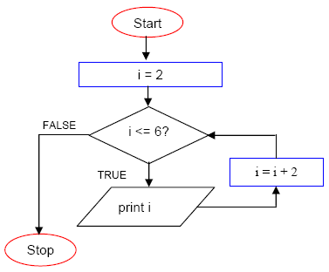
Iterative
Set i equal to two
While i less than or equal six
print i
add two to i end while
Output: 2 4 6

Slide 26
Iterative
Write an algorithm to calculate the average of a set of 10 students.
Solution 1 Solution 2

Slide 27
Iterative
Write an algorithm to calculate the average of a set of 10 students.
Solution 1 Solution 2
1. Set counter to zero
Set counter to one
Set total to zero
While counter is less than or equal ten
Set total to zero
While counter is less than ten Ask user to enter grade Read grade and save as gd Add the gd into the total increment counter
end while
Set the average to the total divided by 10
Print “the average is ” average
Ask user to enter grade Read grade and save as gd Add the gd into the total increment counter
end while
4. Set the average to the total divided by
counter
5. Print “the average is ” average

Slide 28
Iterative
Write an algorithm that will count the number of student pass in a class and the amount failed. The pass mark is more than or equal to 65. Suppose the number of students are 30 . The algorithm should output the amount fail and passed.

Slide 29
Iterative
Set counter to zero
Set numberOfStudents to thirty
Set passCounter to zero
Set failureCounter to zero
While counter less than numberOfStudents
Ask user to enter student average
Read average and save as ag
if ag greater than or equal sixty five then
increment passCounter
else
increment failureCounter
end if
increment counter
end while
Message
Value
6. Print “pass counter =“ passCounter
“and failure counter =“ failureCounte

Slide 30
Extra Exercises
Write an algorithm that takes n integers and decides and prints the number of integers divisible by 3 and the number of integers not divisible by 3.
Write an algorithm that will accept the values of the sides of a square and display its area where the formula is : area = side*side

Slide 31

Extra Exercises
Solutions:
Extra Exercises _1.txt
Extra Exercises _2.txt

Slide 32

Extra Exercises
Write an algorithm to calculate the sum of a set of values (we don’t know their count). When 0 is entered this means that algorithm should stop receiving data, and print the sum
Write an algorithm to calculate the sum of a set of values (we don’t know their count). When the sum exceeds 25 this means that algorithm should stop receiving data, and print the number of values were entered.
Abdallah Karakra

