Slide 1
Exp #7
Fragments
SLIDES BY: Tarek Zidan and Mohamad Balawi

Slide 2
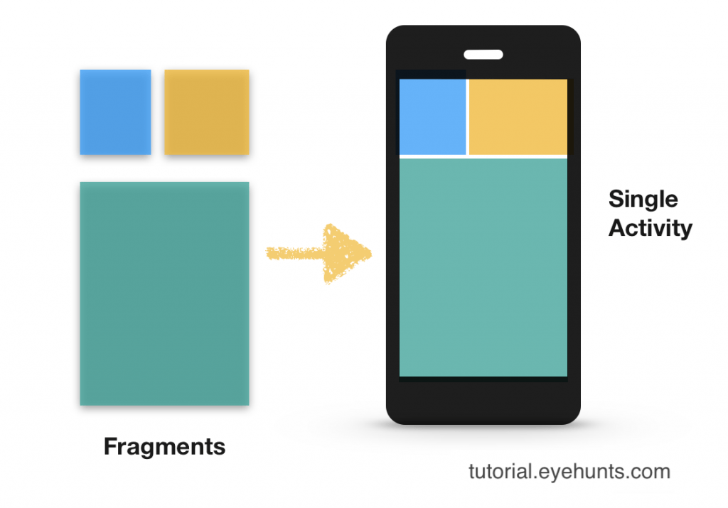
What is a fragment?
A fragment represents a modular portion of the user interface within an activity. A fragment has its own lifecycle, receives its own input events, and you can add or remove fragments while the containing activity is running.

Slide 3
Fragment vs Activity (1)
Fragement
Activity
Represents a portion of an Activity's UI.
Highly reusable, can be used in multiple activities.
Can interact with the user through its hosting Activity.
Can be nested within other Fragments or Activities.
Introduced in Android 3.0 (API level 11)
Has its own lifecycle independent of Activity lifecycle.
Represents a single screen with UI.
Less reusable, standalone.
Directly interacts with the user.
Cannot be nested within other Activities.
Available since Android 1.0.
Has its own lifecycle.

Slide 4
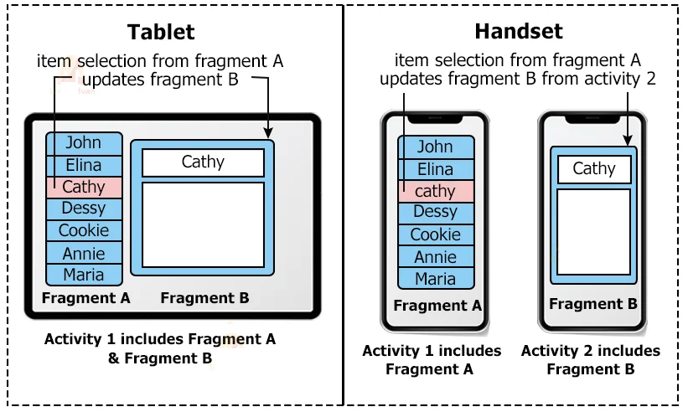
Fragment vs Activity (2)

Slide 5
Ways to add fragments
There are two general ways to add fragments to an activity:
Declare it statically in the activity layout file.
  Attach the fragment inside the activity through XML using tag.
Add it programmatically using the fragment manager.
  Every activity has its own Fragment Manager, it maintains references to all fragments inside the activity.

Slide 6
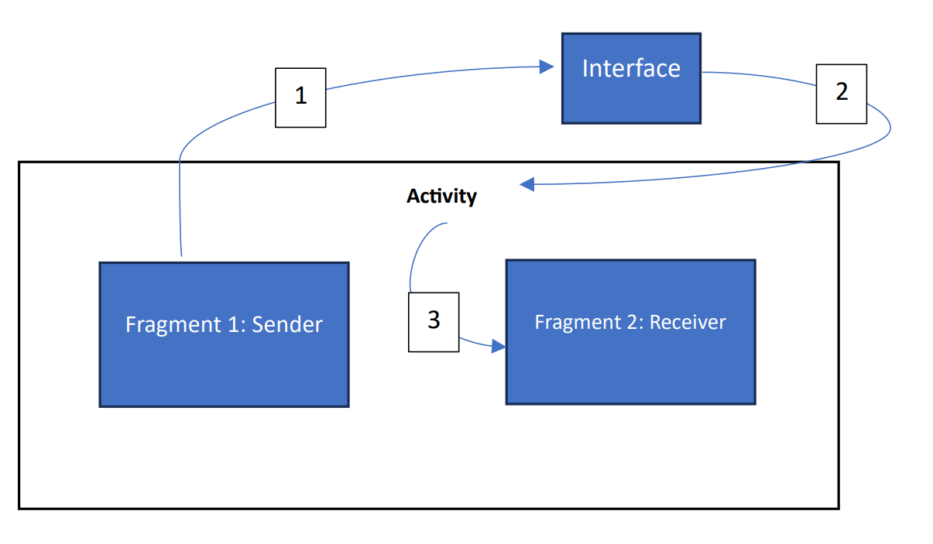
Communication between Fragments (1)
Fragments are sub-UI, they live inside an activity, and to communicate with each other, they use the activity that they live in as a middle-man via interfaces.

Slide 7
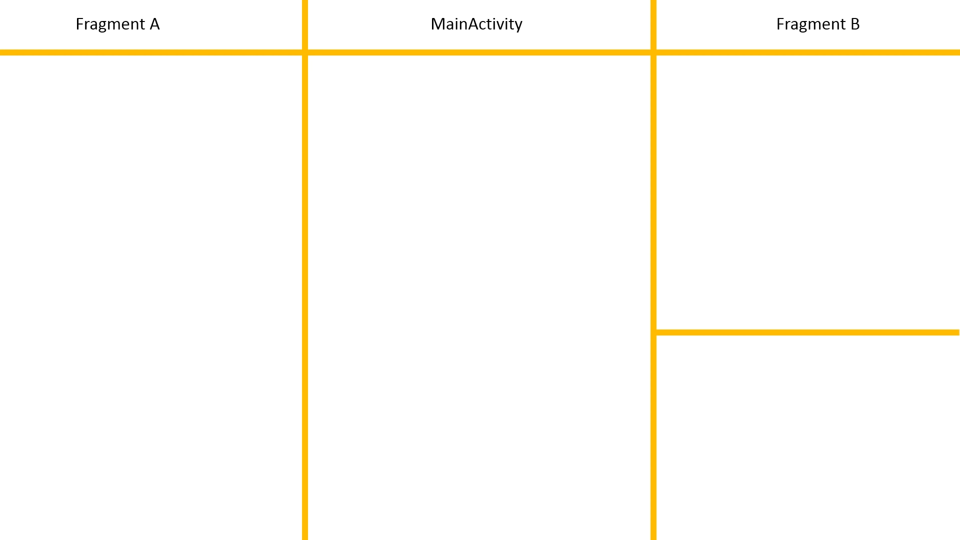
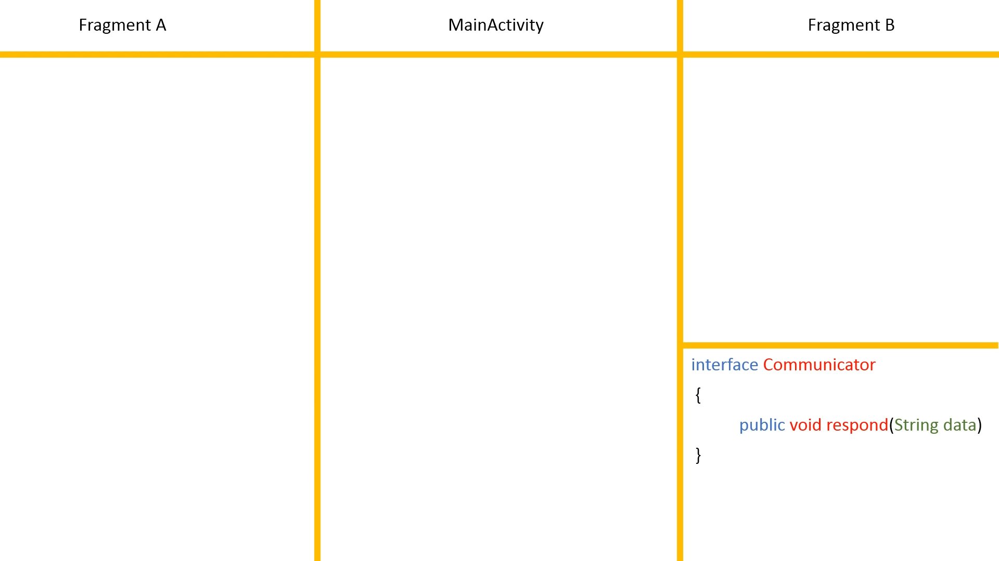
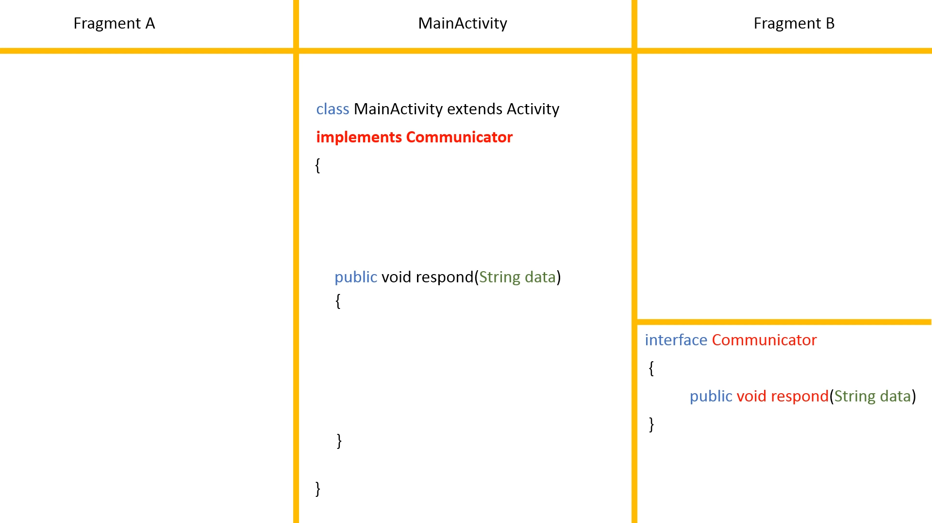
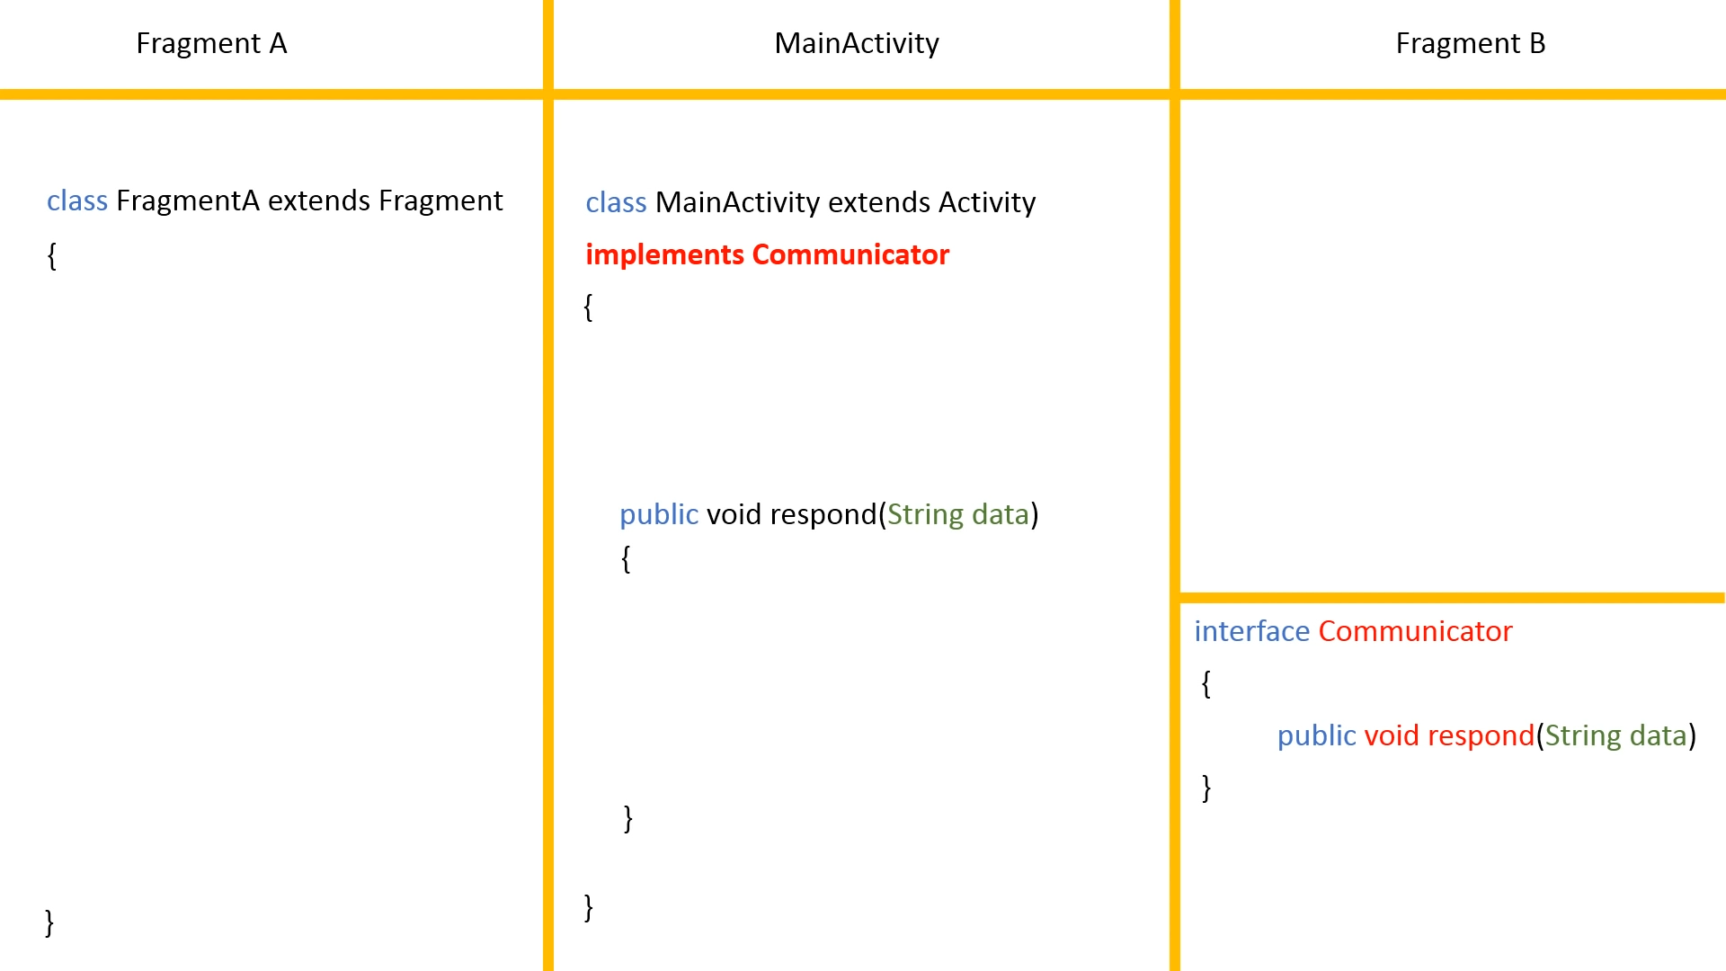
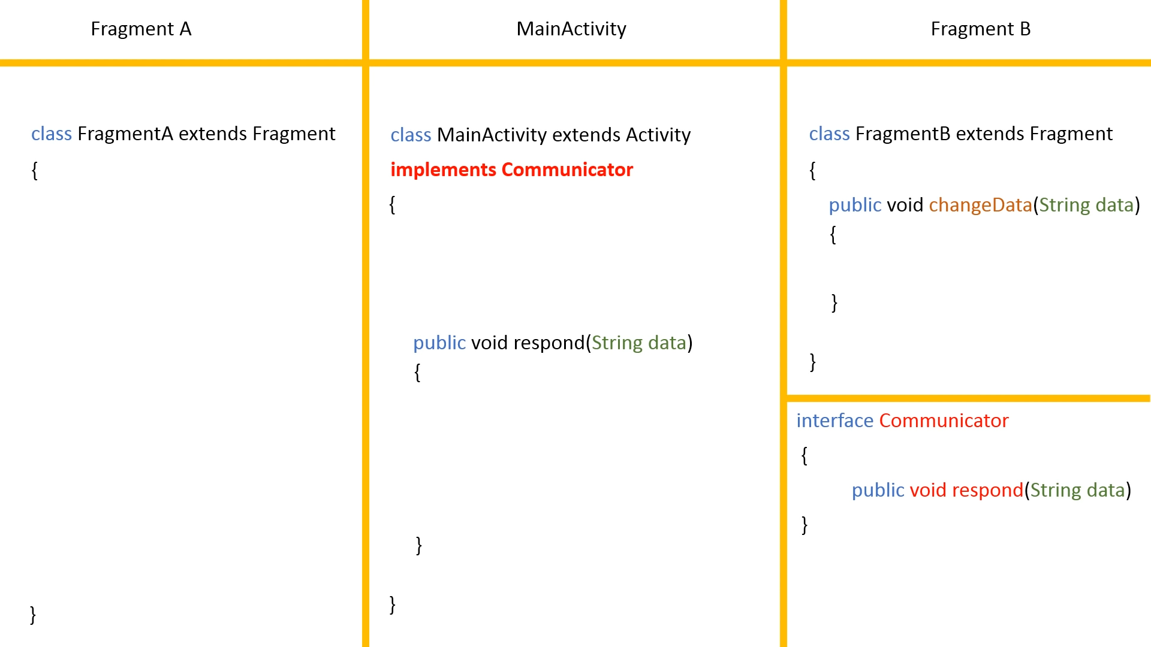
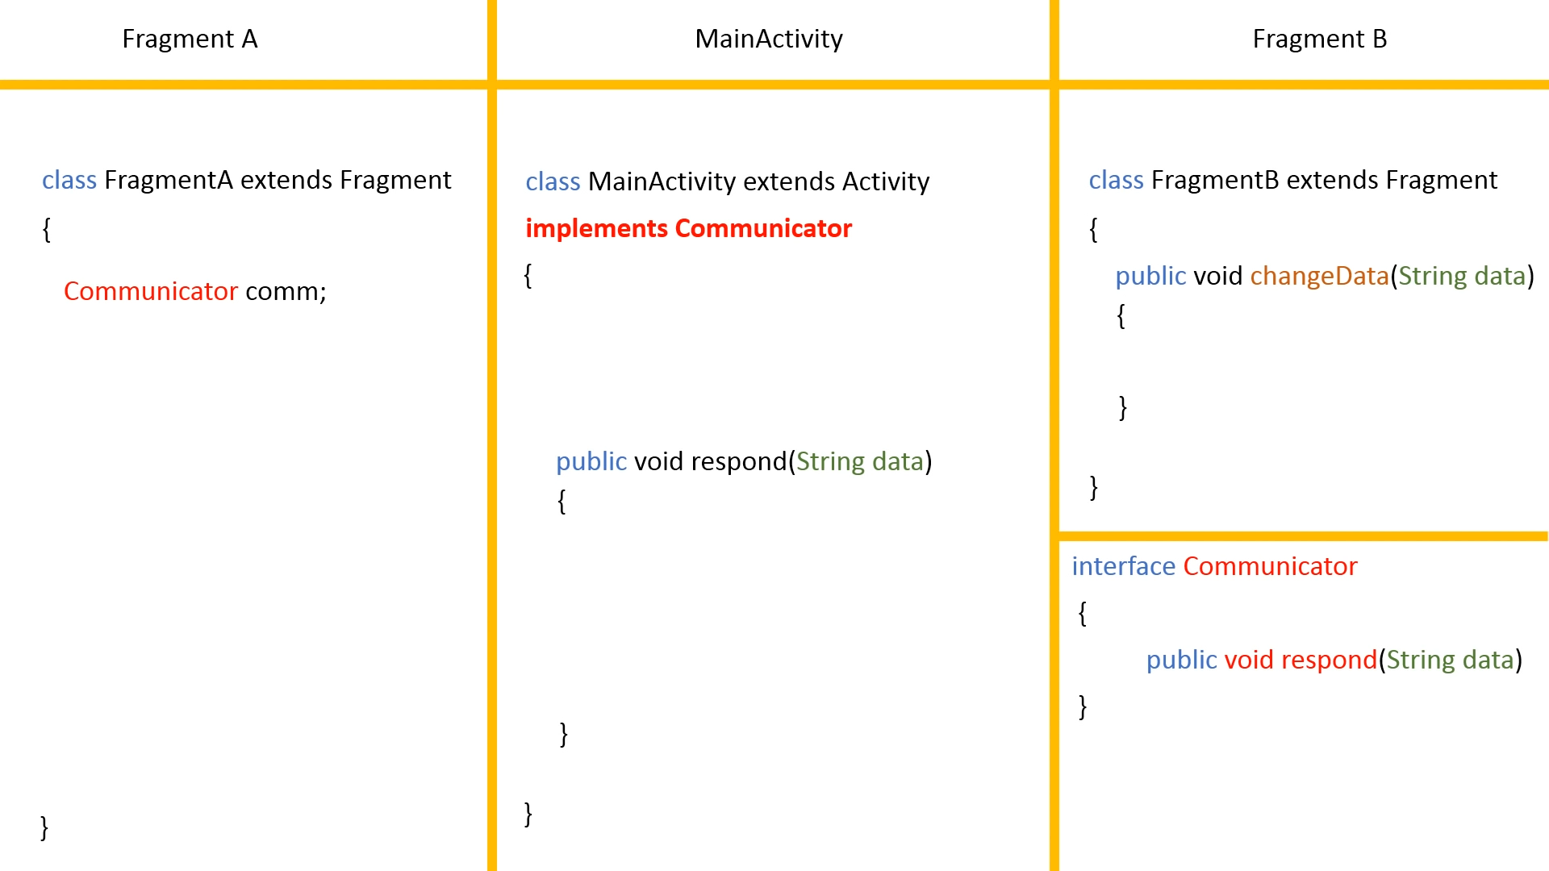
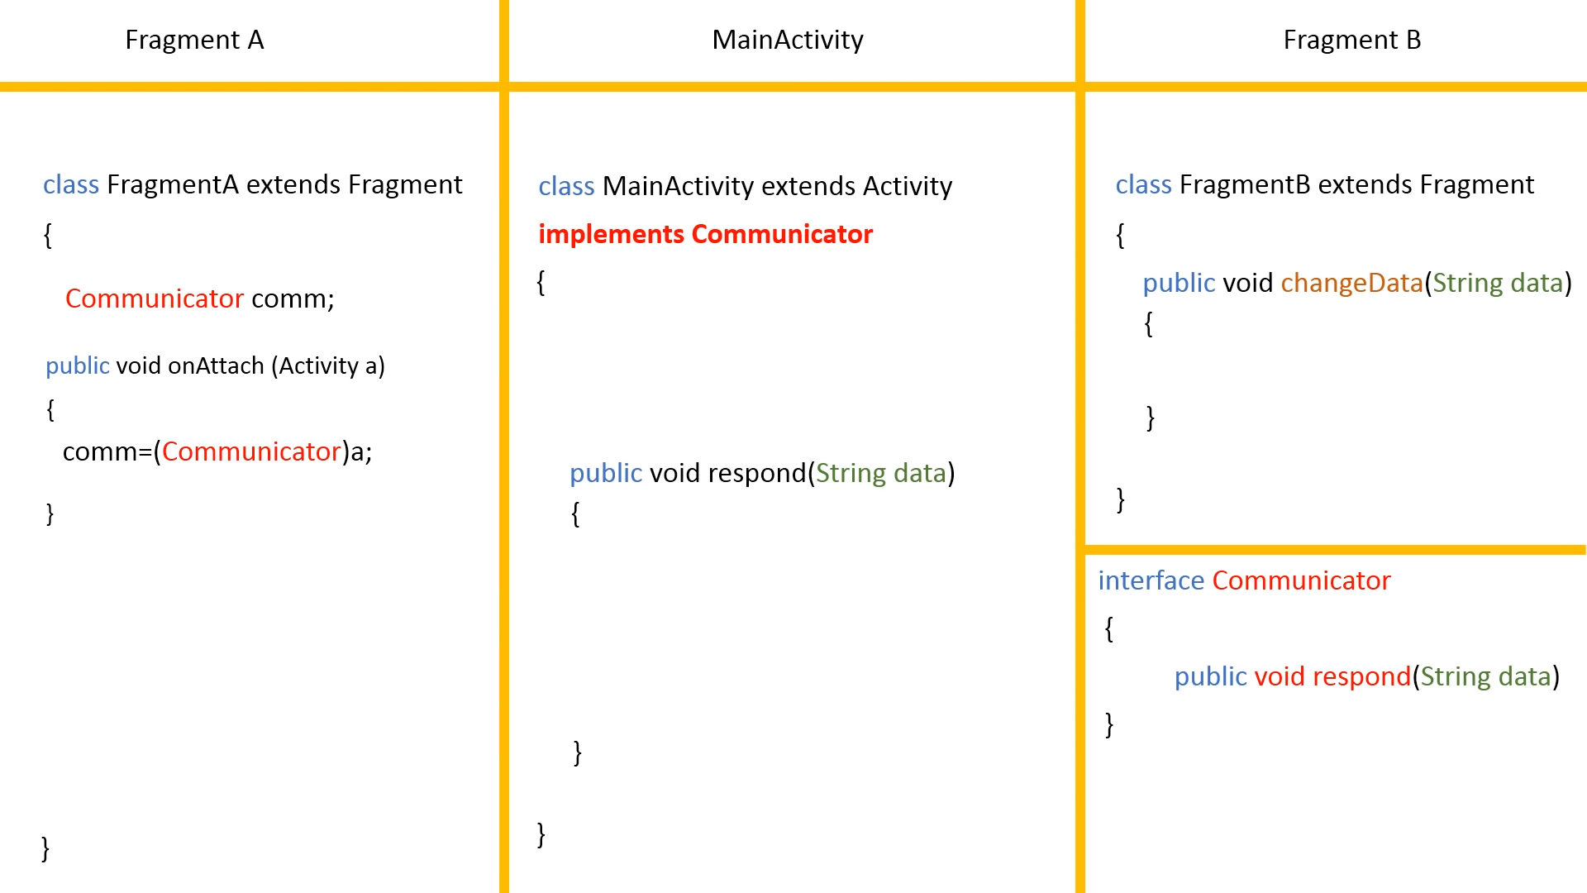
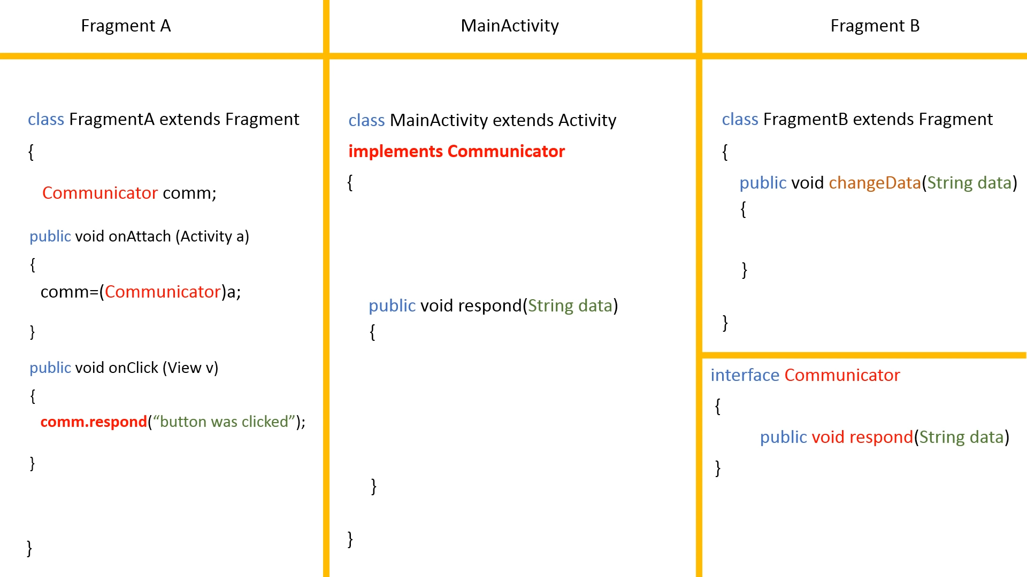
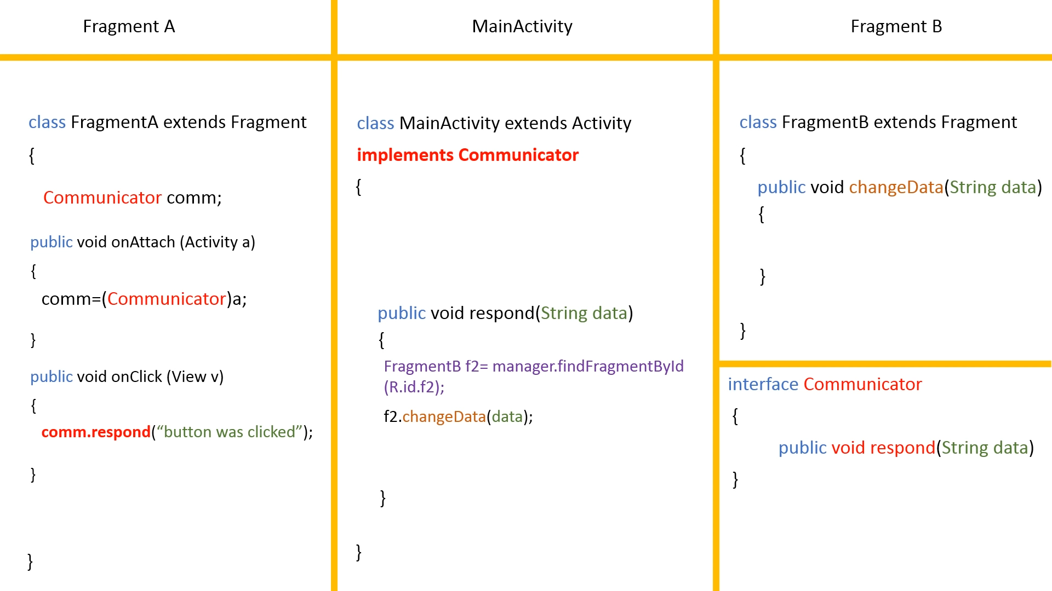

Slide 8
onActivityCreated is deprecated
@Override
public void onActivityCreated(@Nullable Bundle savedInstanceState) {
super.onActivityCreated(savedInstanceState);
...
}
As of Android API level 28 (Android 9.0, Pie), the onActivityCreated() method in Fragment has been deprecated. Instead, you can use onViewCreated() along with onActivityCreated() logic as an alternative approach.
@Override
public void onViewCreated(@NonNull View view, @Nullable Bundle savedInstanceState) {
super.onViewCreated(view, savedInstanceState);
...
}

Slide 9
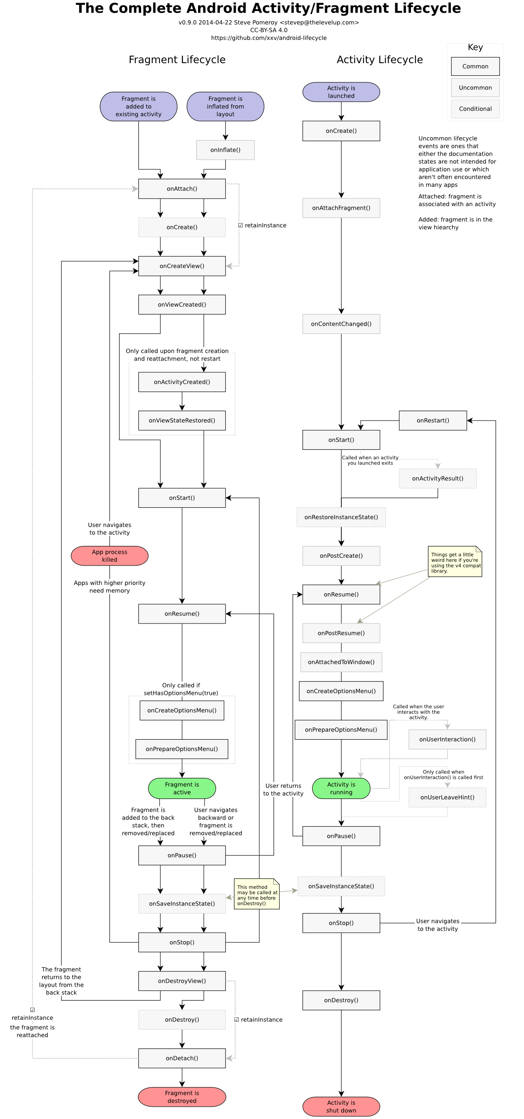
Fragment life-cycle

Slide 10
Fragment Transactions
We have full control over fragments when we interact with them programmatically, this includes the following possible transactions:
Add Adds a fragment to an activity.
Remove Destroys a fragment’s view and state.
Detach Destroys a fragment’s view, but keep its state.
Attach Re-attaches a detached fragment (adds its view).
Replace Replaces a fragment, equivalent to remove then add.

Slide 11
First application

Slide 12
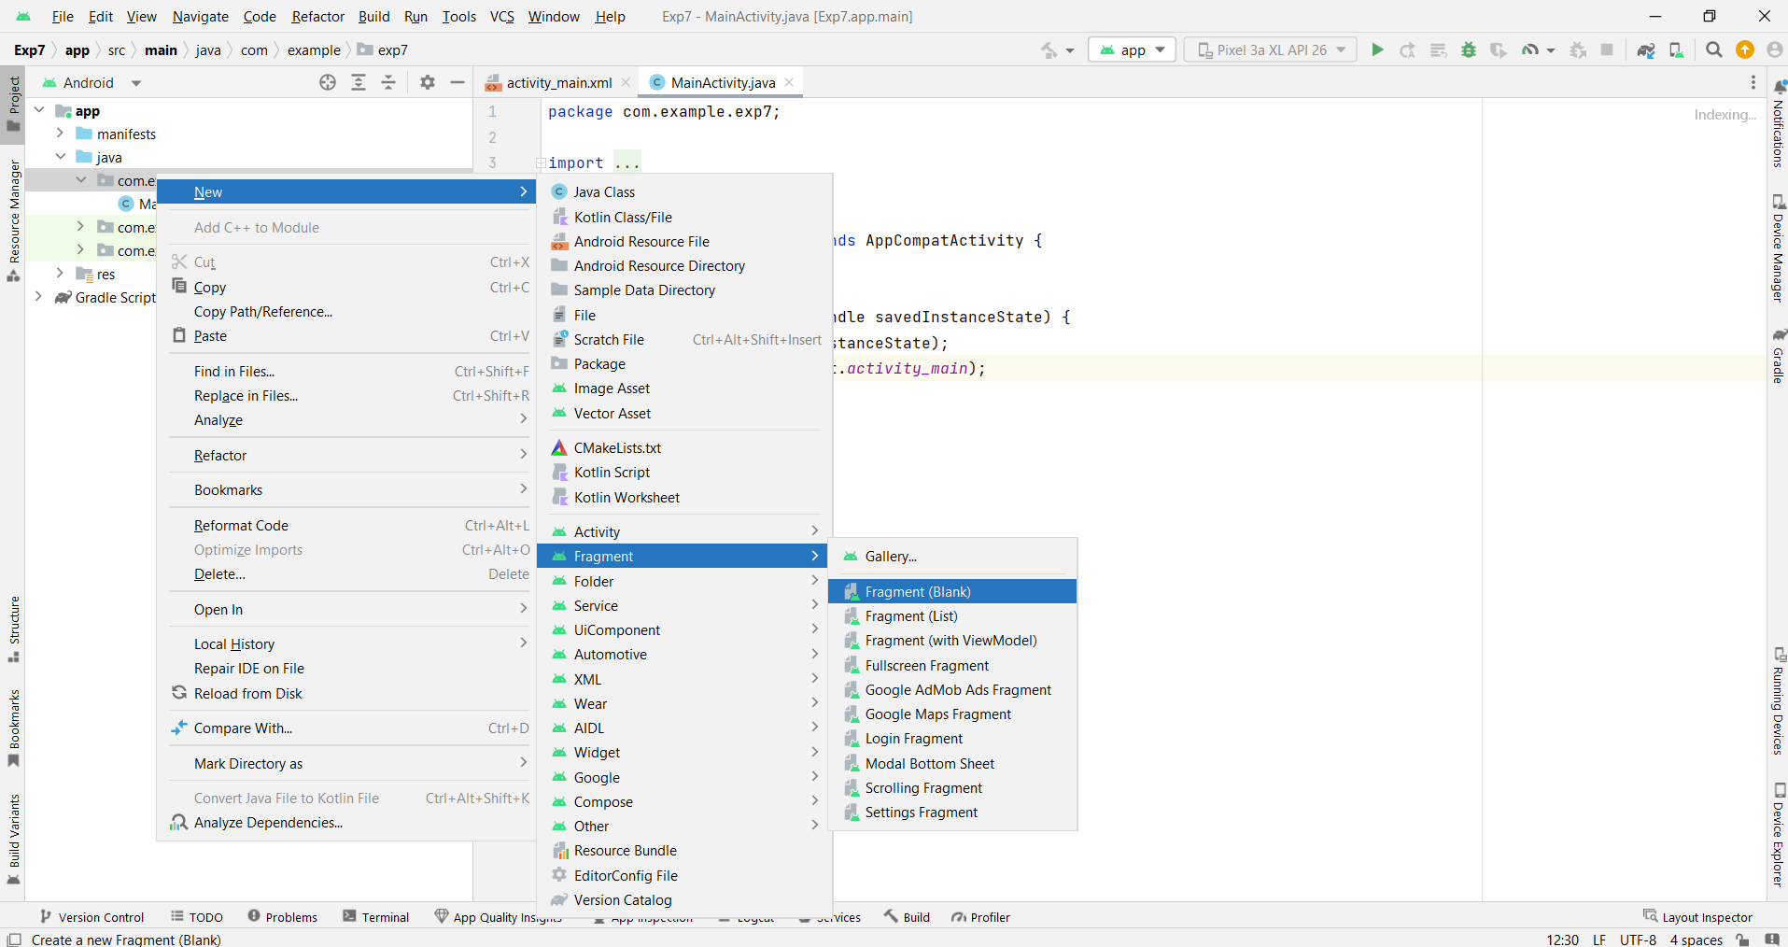
How to add a fragment

Slide 13
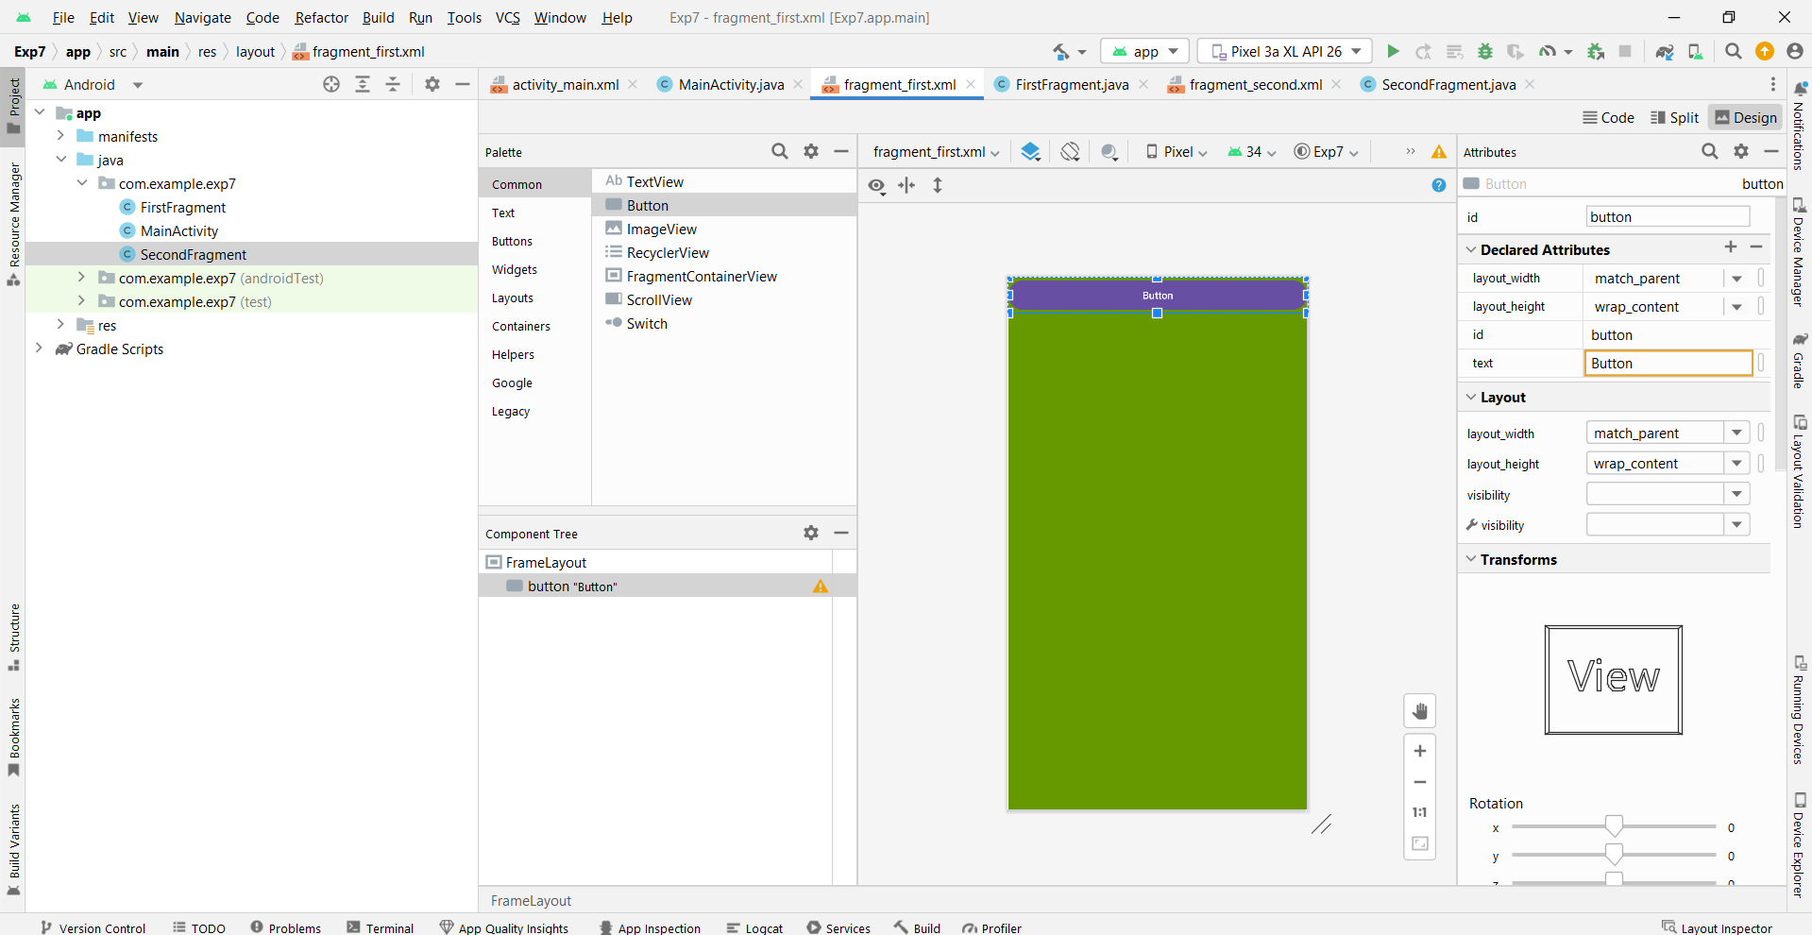
Fragment one

Slide 14
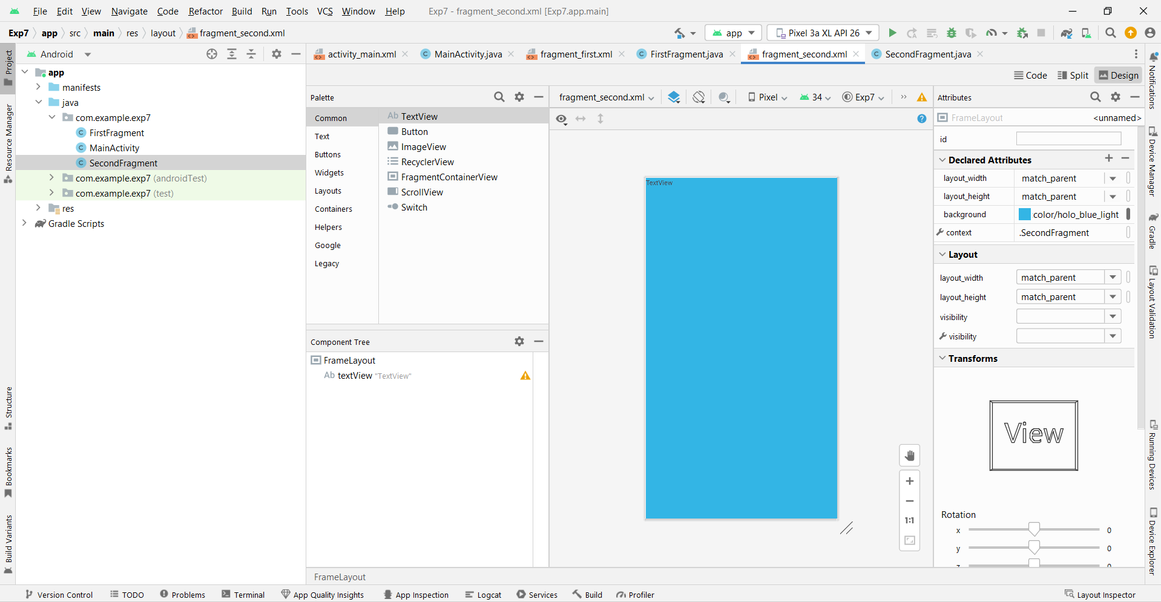
Fragment two

Slide 15
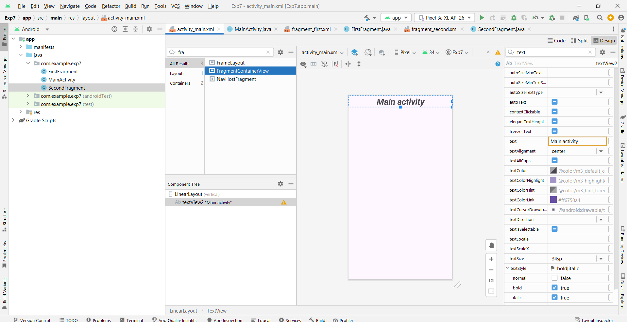
Add fragments to main activity

Slide 16
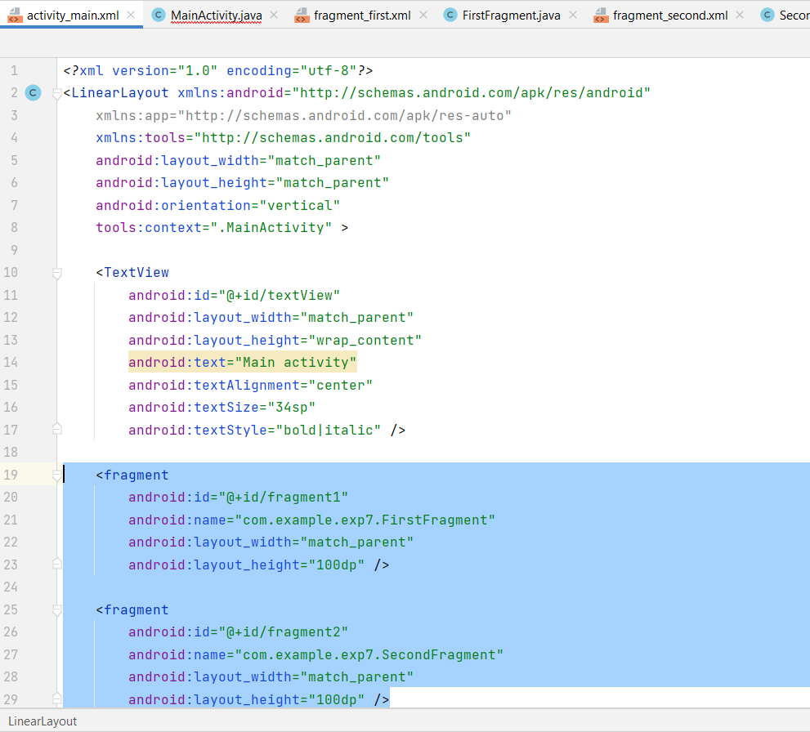
Add fragments to main activity
If you can't find the ‘Fragment’ component in your pallet, just copy and paste this code into your main activity xml file.
<fragment
android:id="@+id/fragment1"
android:name="com.example.exp7.FirstFragment"
android:layout_width="match_parent"
android:layout_height="100dp" />
<fragment
android:id="@+id/fragment2"
android:name="com.example.exp7.SecondFragment"
android:layout_width="match_parent"
android:layout_height="100dp" />

Slide 17
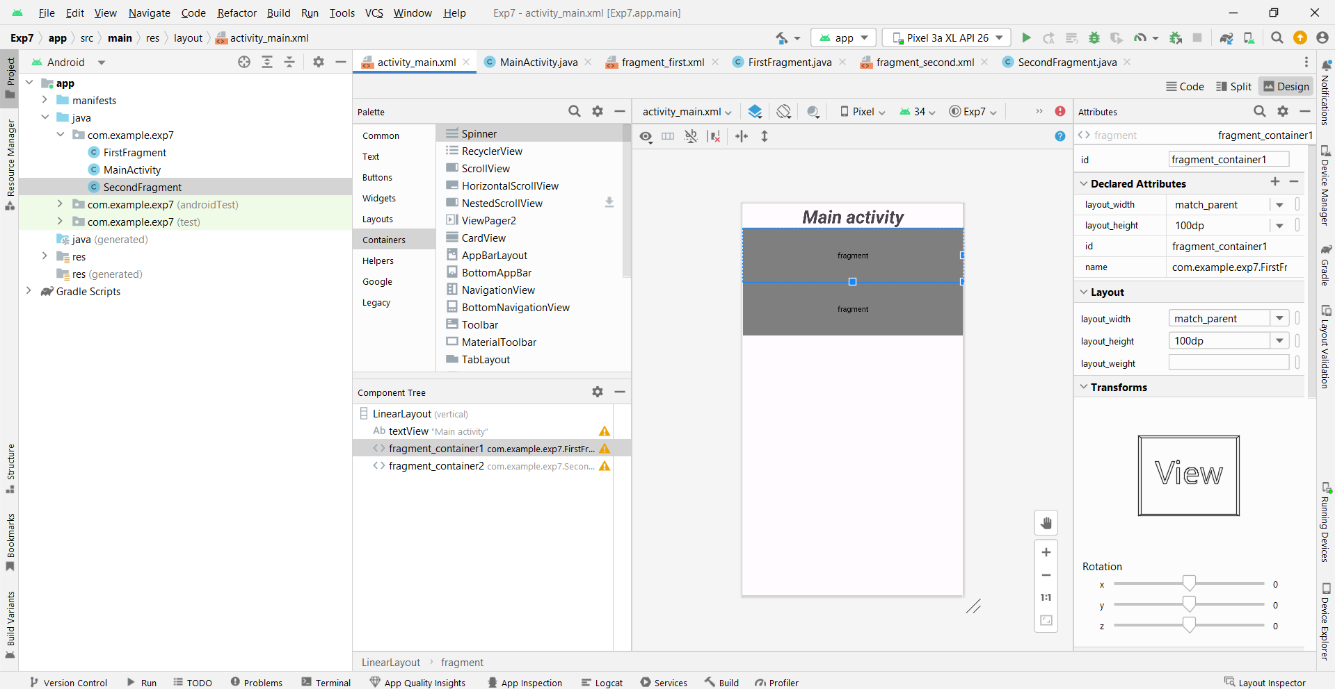
Please note that the fragments will only appear at runtime

Slide 18
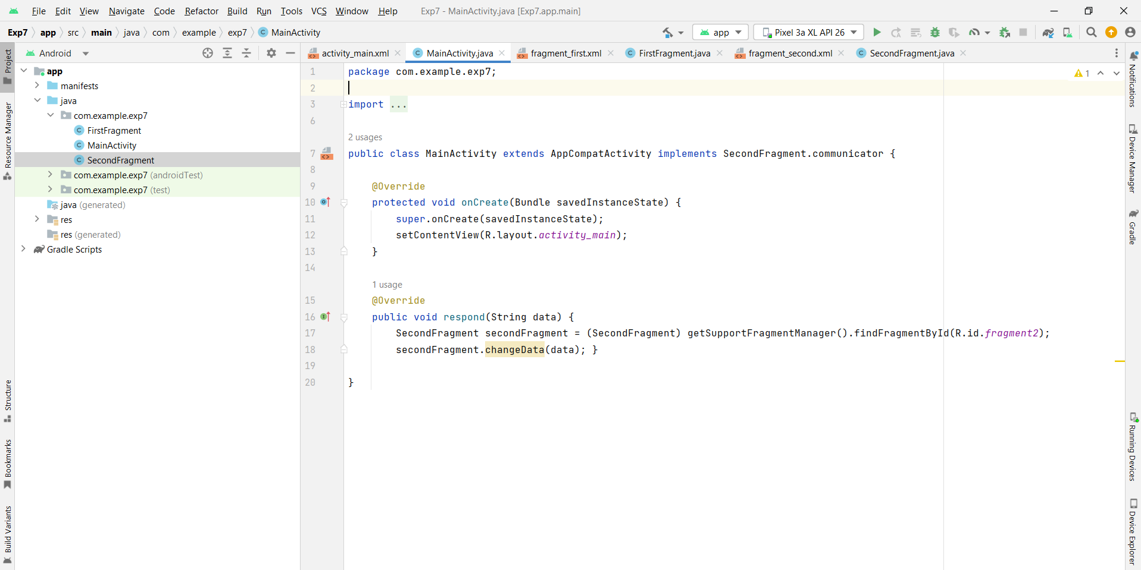
Main Activity

Slide 19
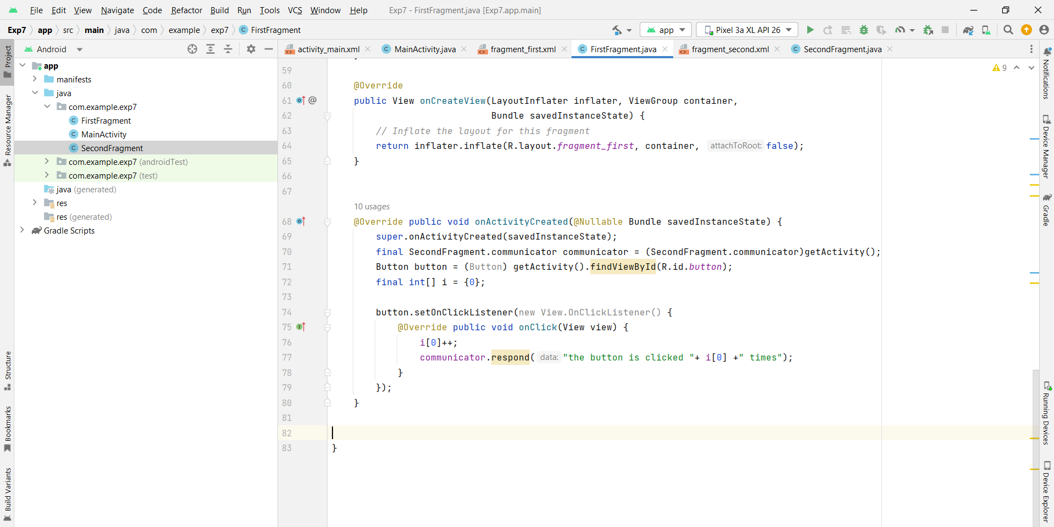
First fragment (leave all initial code above as it is)

Slide 20
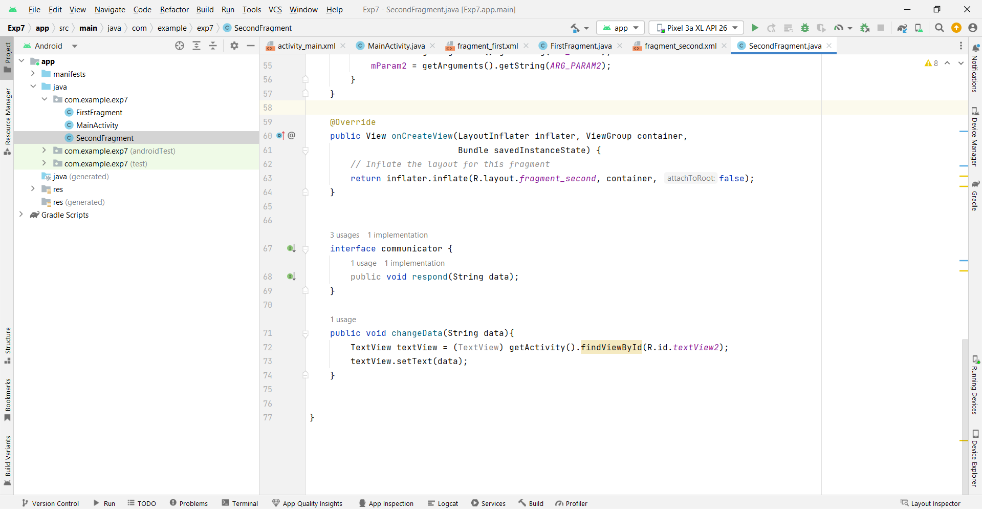
Second fragment (leave all initial code above as it is)

Slide 21
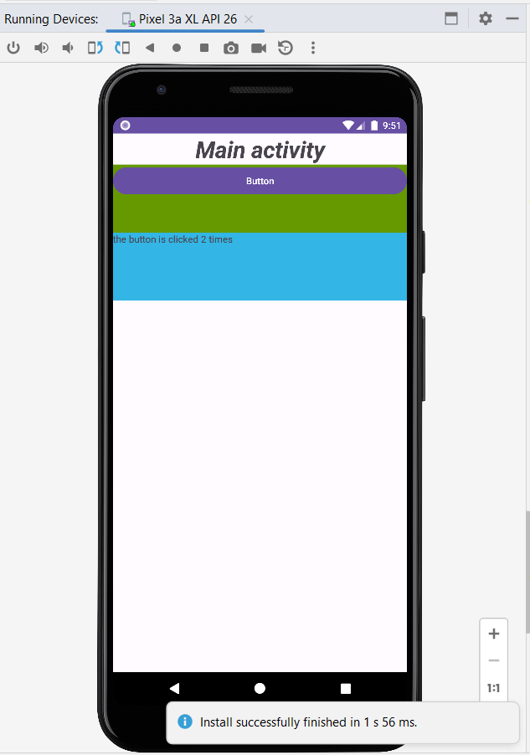
Result

Slide 22
Second application

Slide 23
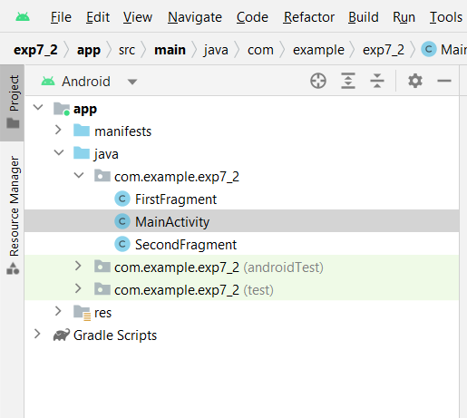
Create two fragments, and change background colors, but do not add them to the XML as earlier, here they are going to be added at run time (dynamically).

Slide 24
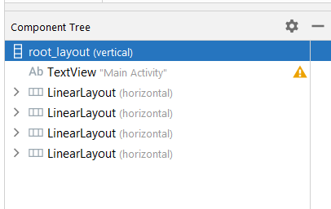
Note: name the base layout ‘root_layout’

Slide 25
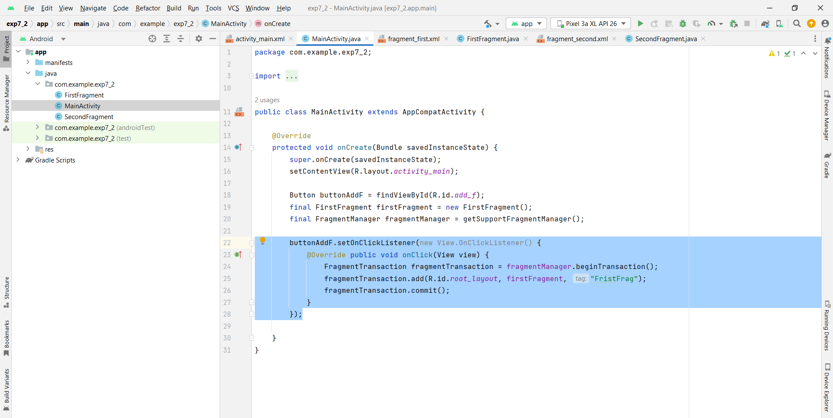
Main

Slide 26
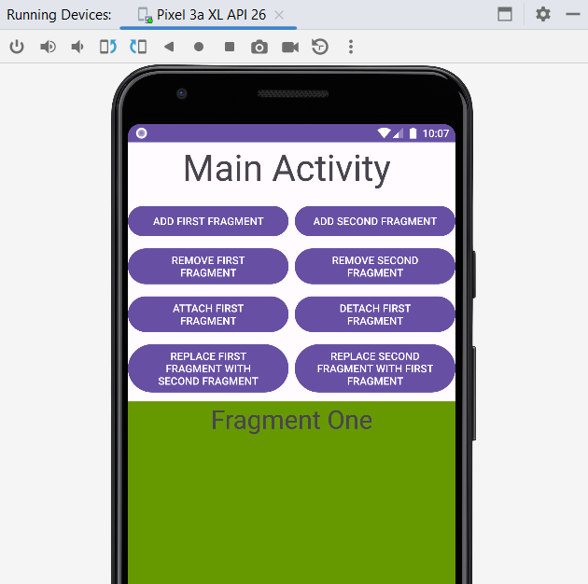
Result

Slide 27
Task:
As you have seen, the only implemented button was the one that adds fragment 1.
Your task is to continue the Java code to implement all other buttons so that they all function properly.

