Slide 1
Voice Disorders
Mutasem Khalaf, MA., C, CCC-SLP
Clinical Supervisor, Speech-Language Pathologist
Department of Audiology and Speech Therapy, Faculty of Pharmacy, Nursing and Health Professions, Birzeit University(BZU)

Slide 2
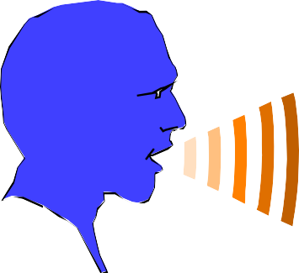
Phonation
Sound is produced by the vibration of the vocal folds
Vocal folds lie within the laryngeal cavity/larynx
Larynx is the superior continuation of the respiratory passage

Slide 3
NORMAL VOICE
Respiratory System
Laryngeal System
Supralaryngeal.
Vocal folds
Vocal tract
lungs
ribs
abdomen
power
Voice source
Filter

Slide 4
Functions of the larynx
Airway protection
  prevents foreign substances from entering the lungs
  expels the substances trying to enter the lungs (laryngeal reflex activity - cough/spastic closure)
helps on thoracic fixation
phonation (larynx = sound generator)

Slide 5
LARYNGEAL ELEMENTS:
  1 bone
  9 cartilages (3 paired)
  Intrinsic and extrinsic laryngeal muscles
VOICE
  Pitch- Fo
  Loudness- Amplitude
  Quality (harsh, breathy, hypernasal, hyponasal)

Slide 6
Larynx
Lies superior in the respiratory passage way opposite approximately the fifth or sixth cervical vertebral body

Slide 7
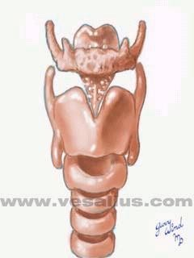
Hyiod
Epiglottis
Thyroid
Cricoid

Slide 8
Cartilages of the larynx are held together by membranes and ligaments
Vocal folds lie within the laryngeal cavity

Slide 9
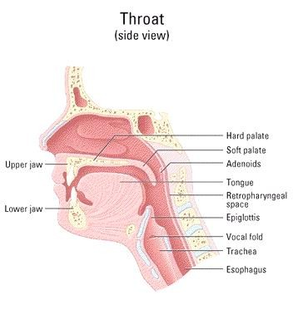

Slide 10
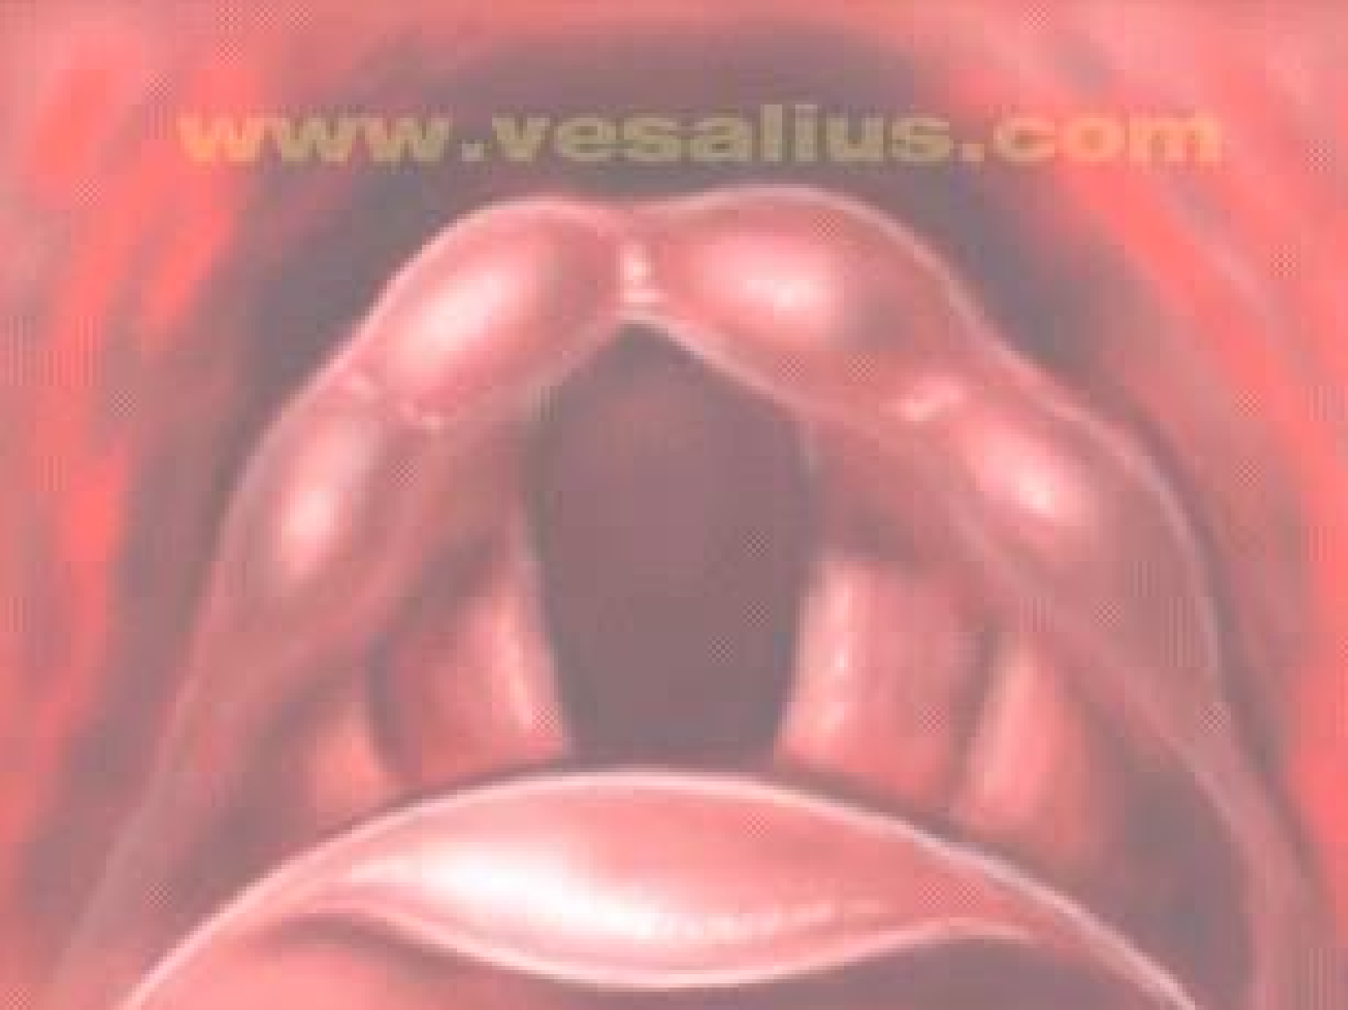
Arytnoids
Glottis
Vocal Folds
Epiglottis

Slide 11
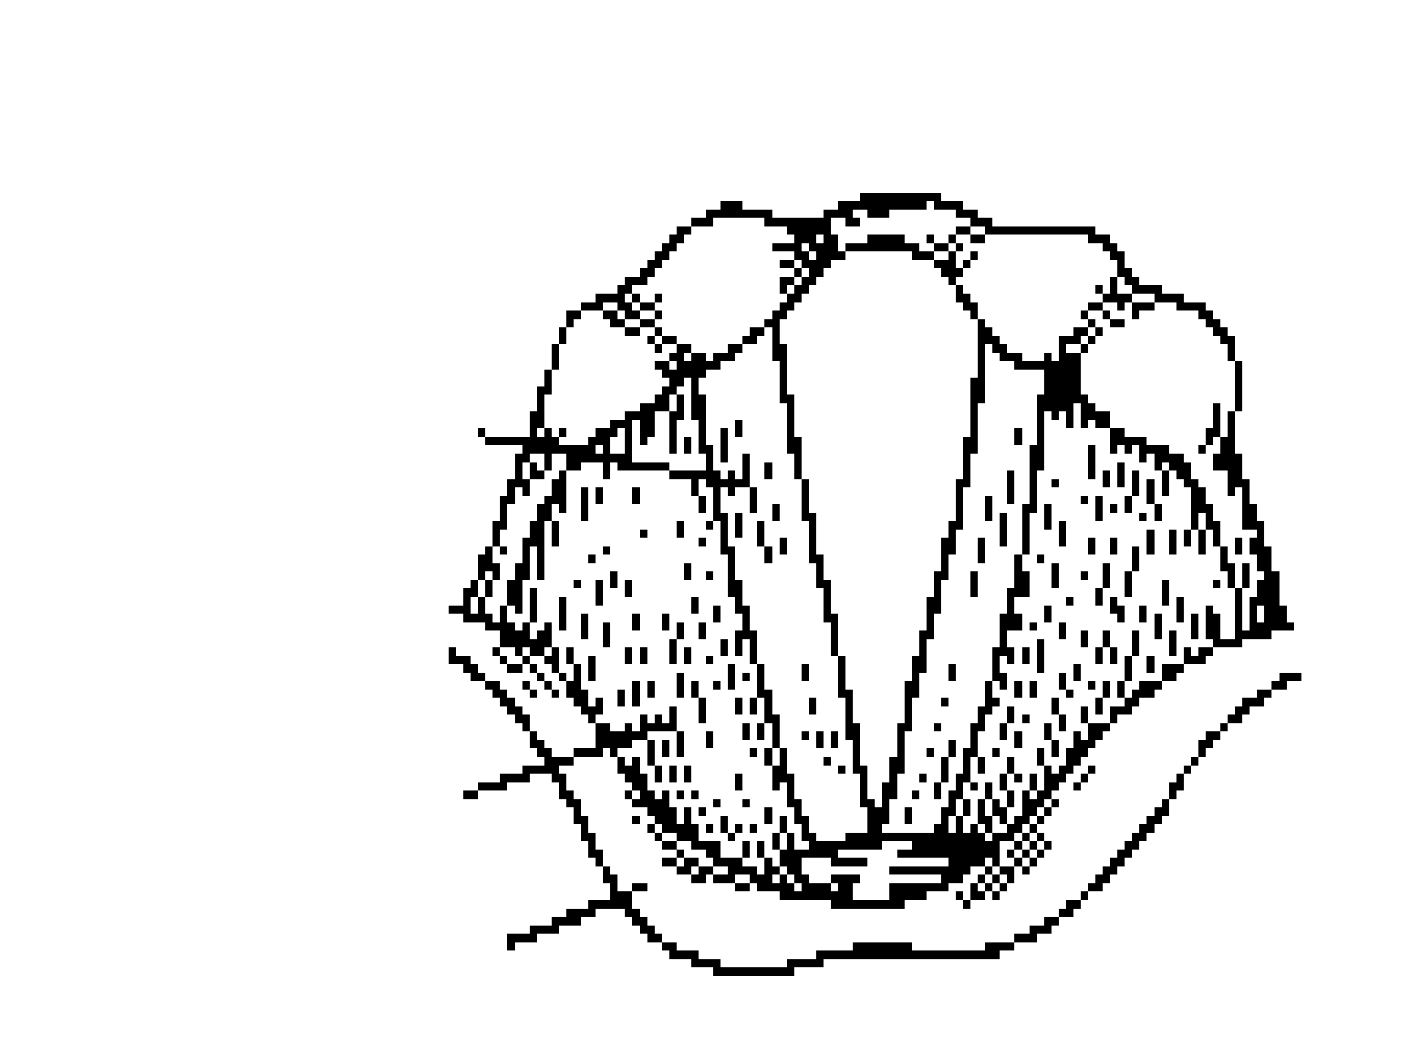
Vocal Fold
Venticular Folds
Epiglottis

Slide 12
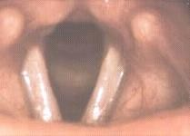
Posterior Pharyngeal Wall
Arytenoid
Trachea
Vocal Fold
Venticular Fold
Epiglottis
Endoscopic View

Slide 13
Laryngeal Cavities
Supraglottal cavity: from the VF to the aryepiglottic folds.
It can function as a resonator of the sound produced by the VF
Subglottal cavity: from the VF to the 1st tracheal ring. It’s here that pressure increases until it is sufficient to start VF vibration
Ventricles: lateral space between false and true VF. Resonance

Slide 14
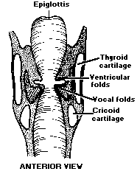
Supraglottal
Ventricles
Subglottal

Slide 15
Hyoid Bone
The only laryngeal bone (U-shaped)
The union between the tongue and the laryngeal structure
The only bone in the body that is not attached to another bone
Part of the laryngeal system attachment for superior and inferior extrinsic laryngeal muscles

Slide 16
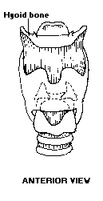

Slide 17
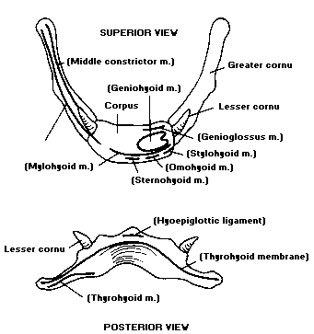

Slide 18
Laryngeal Cartilages
Thyroid (1)
Cricoid (1)
Arytenoids (2)
Corniculated (2)
Cunneiforms (2)
Epiglottis (1)
Total = 9 (3 paired)

Slide 19
1. Thyroid Cartilage
unpaired
hyaline cartilage
superior cornu attaches indirectly to the major cornu of the hyoid bone
inferior cornu attaches posteriorly to the cricoid cartilage

Slide 20
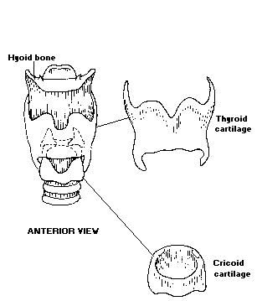
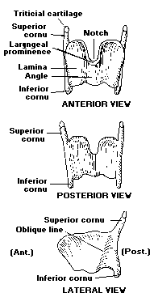

Slide 21
2. Cricoid Cartilage
unpaired
hyaline cartilage
sits on top of the trachea
shaped like a signet ring
anterior arch (anulus)
posterior lamina (signet)
4 articular facet: 2 with thyroid to allow a rocking motion; 2 with arytenoids

Slide 22
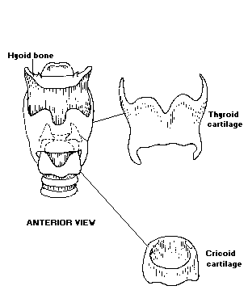

Slide 23
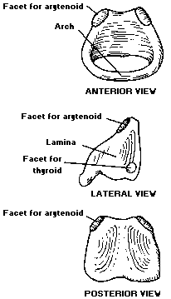

Slide 24
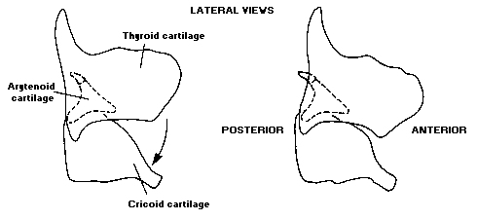

Slide 25
3. Arytenoid Cartilages
paired
hyaline + elastic
sit on top of the superior surface of the signet portion of the cricoid cartilage
pyramid shaped: apex and base
lateral projection = Muscular process (insertion of the cricoarytenoid muscle)
anterior projection = Vocal process (posterior attach VF)

Slide 26
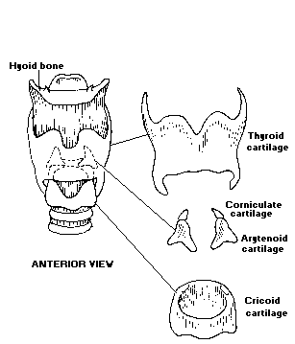

Slide 27
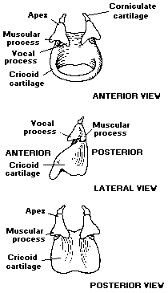
Arytenoid Cartilages

Slide 28
Movements of Arytenoid Cartilages
rocking: forward and backward
gliding
no rotational movement

Slide 29
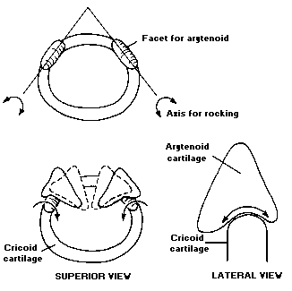
Rocking

Slide 30
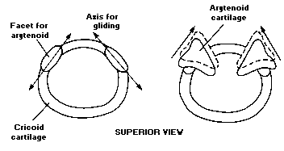
Gliding

Slide 31
4. Corniculated Cartilages
paired
elastic cartilages
sit on top of the apex of the arytenoid cartilages
pyramid shaped
function ?? Part of the arytenoids

Slide 32
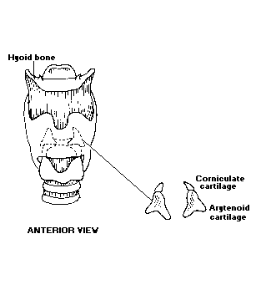
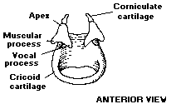

Slide 33
5. Cuneiform Cartilages
paired small cartilages (nod-shaped)
elastic cartilages
embedded in the mucous membrane
biological f.: supportive framework for a corniculated fold tissue running from corniculate to the epiglottis cartilage = aryepiglottic fold
nonbiological f.: no role even for phonation

Slide 34
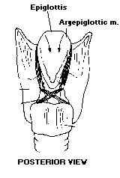

Slide 35
6. Epiglottis
Non-paired cartilage (leaf-shaped)
elastic cartilage
petiole attach. to the inside of the thyroid
anterior surface attach. to the hyoid bone by ligaments
biological f.: closes off airway directing the food toward esophagus during swallowing
nonbiological f.: tongue position move epiglottis but no real function for phonation or articulation

Slide 36
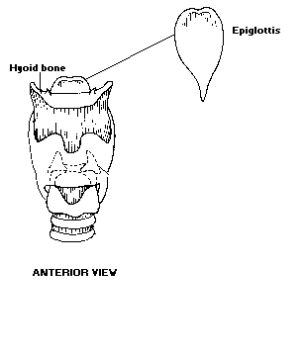
petiole

Slide 37
Extrinsic Laryngeal Muscles
8
one attach. to the laryngeal structure
second attach. to outside of the larynx:
  mandible
  mastoid or styloid process
  thorax

Slide 38
Extrinsic Laryngeal Muscles
4 are suprahyoid:
  Digastric: ant. + post. Belly
  Geniohyoid
  Mylohyoid
  Stylohyoid
4 are infrahyoid:
  Thyrohyoid
  Sternohyoid
  Omohyoid
  Sternothyroid

Slide 39
1. Digastric
Suprahyoid muscle
2 muscle sections; anterior + posterior belly
Origin: Mandible or mastoid process
Insertion: intermediate tendon connected with the hyoid bone
Function:
Anterior belly: pulls the hyoid bone forward and elevates larynx
Posterior belly: Pulls the hyoid up and posteriorly and elevates (larynx)

Slide 40
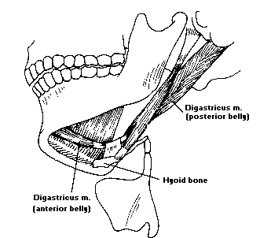

Slide 41
2. Geniohyoid
Suprahyoid muscle
paired cylindrical muscle, lies on the surface of the mylohyoid
Origin: mandibular symphasis of mandible
Insertion: anterior surface of the hyoid body
Function: pulls the hyoid bone forward and upward (larynx)

Slide 42
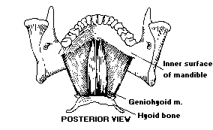

Slide 43
3. Mylohyoid
Suprahyoid muscle
unpaired
thin muscle forming the floor of the mouth
Origin: inner surface of the mandible
Insertion: fibers cross to the midline raphe which extends to the hyoid body
Function: pulls the hyoid bone forward and upward (larynx)

Slide 44
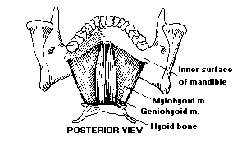

Slide 45
4. Stylohyoid
Suprahyoid muscle
Paired
long slender muscle located on the surface of the posterior belly of the digastric
Origin: styloid process of the temporal bone
Insertion: body of the hyoid
Function: pulls the hyoid bone posteriorly and upward (larynx)

Slide 46
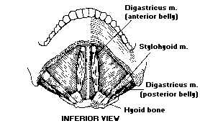

Slide 47
Suprahyoid Muscles
Form a sling supporting the hyoid, and
Secondarily, the larynx

Slide 48
Suprahyoid Muscles (Cont.)
Anterior part:
Digastric anterior
Geniohyoid
Mylohyoid
  pulls the hyoid up + forward (larynx)
  front vowels /i, e/
  consonants w/ high front tongue position (/sh/, /s/)
Posterior part:
Digastric posterior
Stylohyoid
– pulls the hyoid up + backward (larynx)

Slide 49
5. Thyrohyoid
Infrahyoid paired muscle
Thin muscle lying deep to the omohyoid
Origin: oblique line of the thyroid lamina
Insertion: greater horn (cornu) of the hyoid bone
Function: decrease distance between thyroid and hyoid

Slide 50
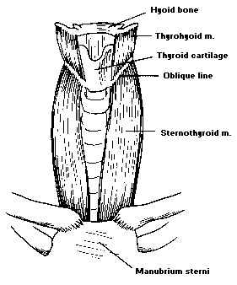

Slide 51
6. Sternothyroid
Infrahyoid paired muscle
Long thin muscle on anterior side of the neck
Origin: Manubrium and costal cartilage of the first rib
Insertion: oblique line of the thyroid
Function: pulls down the thyroid

Slide 53
7. Sternohyoid
Infrahyoid paired muscle
Thin muscle lying on anterior side of the neck
Origin: Manubrium and end of the clavicle
Insertion: hyoid body
Function: pulls down the hyoid bone

Slide 54
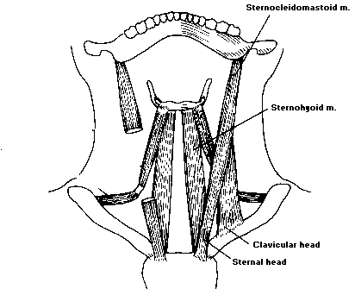

Slide 55
8. Omohyoid
Infrahyoid paired muscle
Long narrow 2-part muscle on anterior and lateral surface of the neck: inferior + superior bellies
Origin: Inf. belly: surface of the scapula
Sup. belly: intermediate tendon connected with the hyoid
Insertion: Inf. belly: intermediate tendon
Sup. belly: great horn of the hyoid
Function: both pull down the thyroid

Slide 56
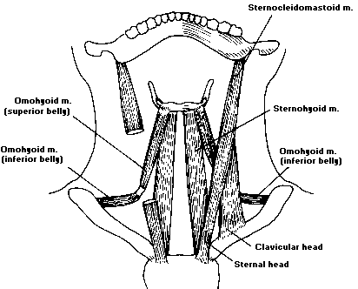

Slide 57
Intrinsic Laryngeal Muscles
5
Both attachments (origin & insertion) to the laryngeal structures
(i.e., laryngeal cartilages)
Interarytenoid muscles / Arytenoideus
  Transverse
  Oblique
Lateral cricoarytenoid

Slide 58
Intrinsic Laryngeal Muscles (Cont.)
Posterior cricoarytenoid
Cricothyroid
Thyroarytenoid
  Thyrovocalis
  Thyromuscularis
Functions: 1. shape of the glottis
2. Vibration of the VF

Slide 59
1. Interarytenoids
Unpaired muscle with fibers oriented in 2 directions
Transverse arytenoid
Origin: Lateral margin of one arytenoid and courses to the lateral margin of the other arytenoid
Insertion: Arytenoid of the opposite side
Function: Adducts arytenoids, i.e. closing the glottis
Oblique arytenoid
Origin: Base of one arytenoid and courses to the apex of the other arytenoid
Insertion: Arytenoid of the opposite side
Function: Adducts arytenoids, i.e., closing the glottis

Slide 60
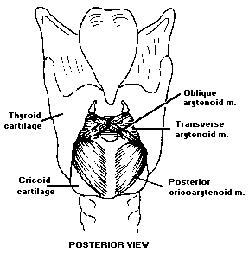

Slide 61
2. Lateral Cricoarytenoid
A fan-shaped muscle lying along the upper surface of the cricoid cartilage
Origin: Upper border of the cricoid
Insertion: Anterior surface of the muscular process of the arytenoid
Function: Adducts the vocal processes of the arytenoids, i.e. closing the membranous glottis

Slide 62
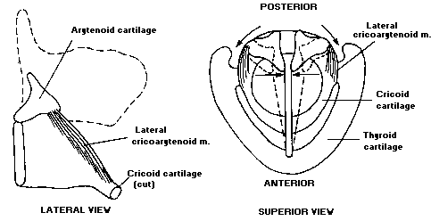

Slide 63
3. Posterior Cricoarytenoid
A fan-shaped m. located on the posterior surface of the cricoid
Origin: On the posterior lamina of the cricoid
Insertion: Posterior surface of the muscular process of the arytenoid
Function: Abducts the arytenoids, i.e., opening the glottis

Slide 64
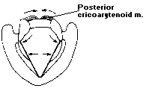

Slide 65
4. Cricothyroid
A fan-shaped m. located between cricoid and thyroid ; consisting of fibers oriented in2 directions: pars oblique and pars recta
Origin: Arch of cricoid
Insertion: Inferior margin of the thyroid
Function: decrease the distance between thyroid and cricoid, i.e. increase the distance between the thyroid and arytenoid, (increase the length of the VF, decrease mass & increase the tension). Therefore increasing the vocal pitch

Slide 66
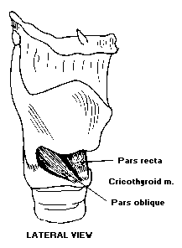

Slide 67
5. Thyroarytenoid
A bundle of fibers making up the true VF.
It can be divided into 2 muscle groups:
Thyrovocalis muscle (medially and more active)
Thyromuscularis muscle (laterally and less active)
Origin: Anteriorly, from the posterior surface of the thyroid
Insertion: Along the lateral base of an arytenoids from the vocal process to the muscle process
Function: decrease the distance between thyroid and arytenoids, (decrease the length of the VF, increase mass and decrease tension). Therefore, decreasing the vocal pitch

Slide 68
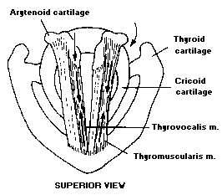

Slide 69
Motions
Adduction
Intraarytenoids (transverse + oblique) Lateral cricoarytenoid (LCA)
Abduction
Posterior Cricoarytenoid (PCA)
Raising pitch
Cricothyroid
Lowering pitch
Thyroarytenoid

Slide 70
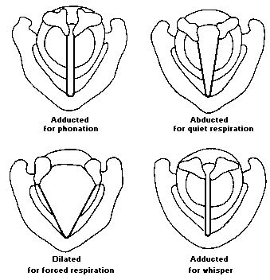

Slide 71
1. Adduction of the arytenoids
1.1 Intrarytenoids (Transverse + Oblique) O : approximate the arytenoids
T: Bind the arytenoids together, causing them to slide toward the midline>>> squeezing the vocal process
1.2. Lateral cricoarytenoid (LCA) Medial compression

Slide 72
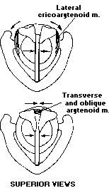

Slide 73
2. Abduction of the Arytenoids
2.1. Posterior Cricoarytenoid (PCA) Pulls the muscular process of the arytenoids posteriorly, rocking the arytenoids back to their axis (active during physical exercise to permit greater air in and out)

Slide 74
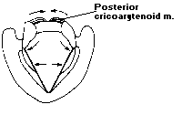

Slide 75
3. Increasing Pitch
3.1. Cricothyroid
Decreases the distance between the cricoid and the thyroid carilages, thus elongating the vocal process and places it under increased tension
More tense>>>increased pitch

Slide 76
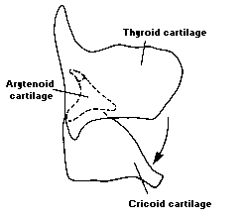

Slide 77
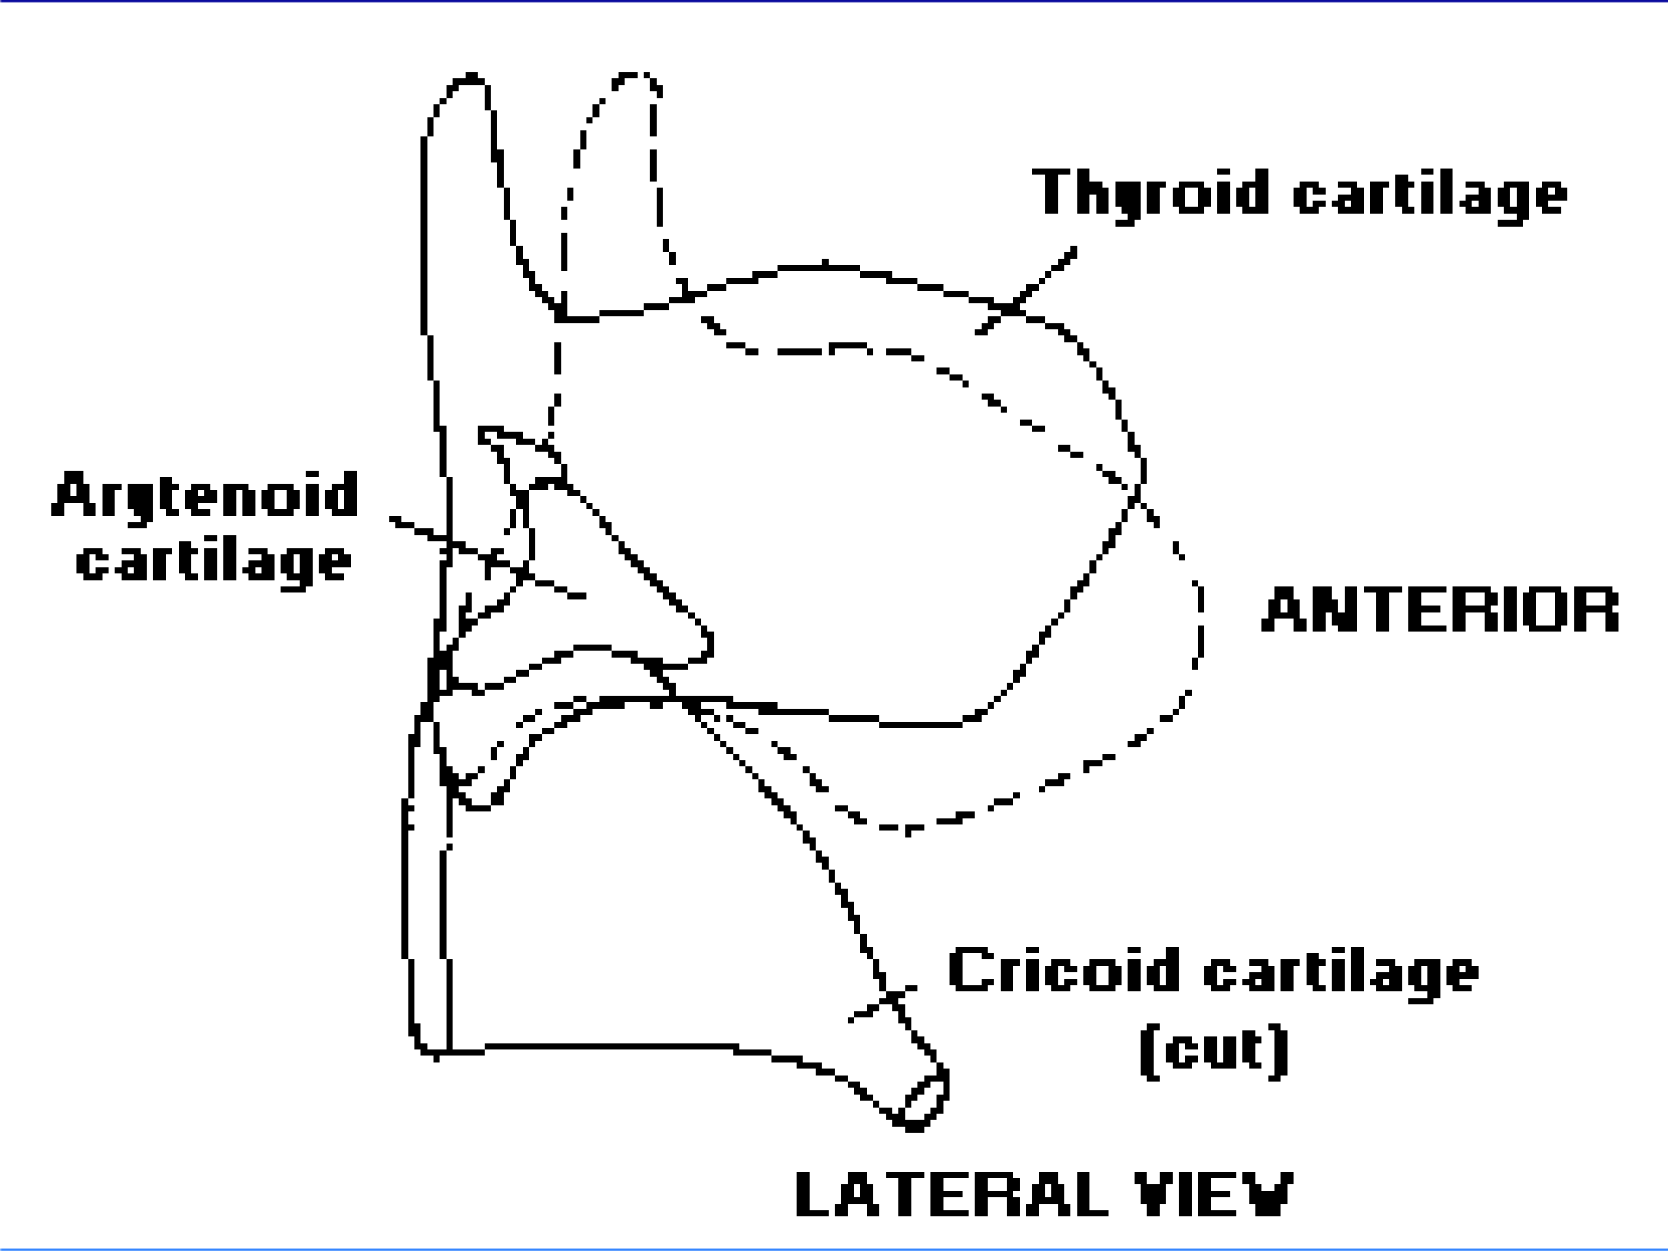

Slide 78
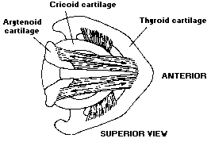

Slide 79
4. Decreasing pitch
4.1 Thyroarytenoid
Tilts the thyroid backward to relax the vocal process and at the same time pulls the muscular process forward to assist in medial compression

Slide 80
