Slide 1

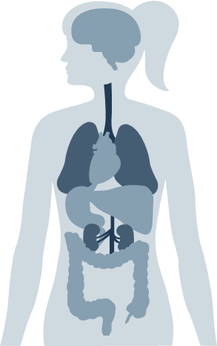
anorexia
Fundamentals Of Nursing Lab 1
Ward Tawfeq (1200883)

Slide 2


Table of Contents
01
02
03
04
05
The Disease
Signs and symptoms
Diagnosis
Causes
Treatment
06 : Care plan

Slide 3


Introduction
Anorexia Nervosa is an eating disorder characterized by refusal to maintain weight within the limits of the normal minimum. With characteristic is to lose weight on purpose.

Slide 4

About the Disease
01
Anorexia nervosa — often simply called anorexia is an eating disorder characterized by an abnormally low body weight , an intense fear of gaining weight , People with anorexia place a high value on controlling their weight and shape.
To prevent weight gain or to continue losing weight, people with anorexia usually severely restrict the amount of food they eat. They may control calorie intake by vomiting after eating or by misusing laxatives,diuretics or enemas. They may also try to lose weight by exercising excessively. No matter how much weight is lost, the person continues to fear weight gain

Slide 5
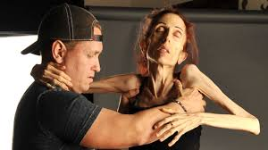
Signs and symptoms of Anorexia can be physical and also emotional or behavioral. These include:
Extreme weight loss
Thin appearance
Abnormal blood counts
Fatigue
Insomnia
Dizziness or fainting
Hair loss
No menstruation
Dry or yellowish skin
Intolerance of cold

Slide 6
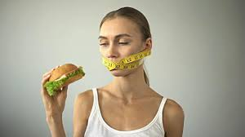
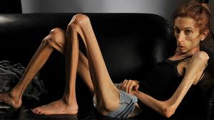
Irregular heart rhythms
Low blood pressure
Dehydration
Skipping meals/refusing to eat
Self-induced vomiting
Restricting food intake by dieting or fasting
Covering up in layers of clothing
Social withdrawal
Complaining about being fat or having parts of the body that are fat

Slide 7

Causes
Biological & Genetic Factors
- May be caused by an imbalance in certain brain chemicals that control digestion, appetite, and hunger.
- Genetic tendency towards perfectionism.
- Genetic factors may affect a person’s susceptibility to eating disorders.
Psychological Factors
- Depression and anxiety.
- Difficulties in handling stress.
- Extreme drive for perfectionism.
- Negative self image.
- Having eating problems since childhood or infancy.

Slide 8


Diagnosis
If your doctor suspects that you have anorexia nervosa, he or she will typically do several tests and exams to help pinpoint a diagnosis

Slide 9
Diagnosis
Physical exam
Psychological evaluation
Lab tests.
This may include measuring your height and weight; checking your vital signs, such as heart rate, blood pressure and temperature; checking your skin and nails for problems; listening to your heart and lungs; and examining your abdomen.
These may include a complete blood count (CBC) and more-specialized blood tests to check electrolytes and protein as well as functioning of your liver, kidney and thyroid. A urinalysis also may be done.
A doctor or mental health professional will likely ask about your thoughts, feelings and eating habits. You may also be asked to complete psychological self-assessment questionnaires

Slide 10
Treatment
Treatment for anorexia is generally done using a team approach, which includes doctors, mental health professionals and dietitians, all with experience in eating disorders. Ongoing therapy and nutrition education are highly important to continued recovery.

Slide 11


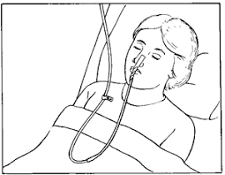
Treatment
anorexia
Medical care
Because of the host of complications anorexia causes, you may need frequent monitoring of vital signs, hydration level and electrolytes, as well as related physical conditions. In severe cases, people with anorexia may initially require feeding through a tube that's placed in their nose and goes to the stomach (nasogastric tube).
Care is usually coordinated by a primary care doctor or a mental health professional, with other professionals involved.

Slide 12


Medications
No medications are approved to treat anorexia because none has been found to work very well. However, antidepressants or other psychiatric medications can help treat other mental health disorders you may also have, such as depression or anxiety.
Treatment challenges in anorexia
One of the biggest challenges in treating anorexia is that people may not want treatment. Barriers to treatment may include:
Thinking you don't need treatment
Fearing weight gain
Not seeing anorexia as an illness but rather a lifestyle choice
People with anorexia can recover.

Slide 13
Treatment
Restoring a healthy weight
The first goal of treatment is getting back to a healthy weight. You can't recover from anorexia without returning to a healthy weight and learning proper nutrition. Those involved in this process may include:
Your primary care doctor, who can provide medical care and supervise your calorie needs and weight gain
A psychologist or other mental health professional, who can work with you to develop behavioral strategies to help you return to a healthy weight
A dietitian, who can offer guidance getting back to regular patterns of eating, including providing specific meal plans and calorie requirements that help you meet your weight goals
Your family, who will likely be involved in helping you maintain normal eating habits

Slide 14


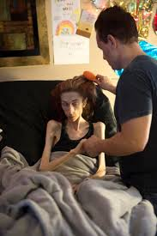
Care Plan for
Anorexia
Nervosa
Patients
Imbalanced Nutrition: Less Than Body Requirement
Nursing Intervention: Watching the patient during
meals and for a specific amount of time after meals.
Rationale: To make sure they are following the meal plan given to them by the physician.

Slide 15


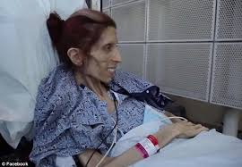
Care Plan for
Anorexia
Nervosa
Patients
Risk for Deficient Fluid Volume
Nursing Intervention: Monitor and record vital signs,
Rationale: These can all indicate a lack in fluid volume,
such as dehydration. Orthostatic hypotension can also
occur, therefore it is best to constantly monitor.

Slide 16
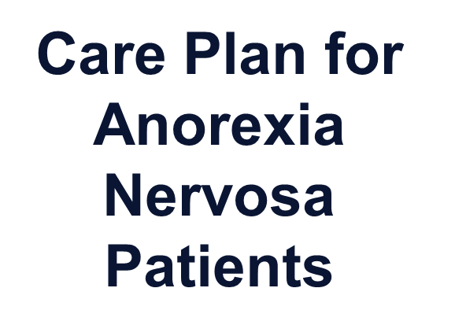

Risk for Impaired Skin Integrity
Nursing Interventions: Observe for reddened, blanched, excoriated areas.
Rationale
Indicators of increased risk of breakdown, requiring more intensive treatment.
Nursing Interventions: Massage skin gently, especially over bony prominences.
Rationale: Improves circulation to the skin, enhances skin tone.

Slide 17


References
1_https://nurseslabs.com/7-eating-disorders-anorexia-bulimia-nervosa-nursing-care-plans/6/
2_https://www.mayoclinic.org/diseases-conditions/anorexia-nervosa/symptoms-causes/syc-20353591
References

Slide 18
Thanks do you have any question

