Slide 1
IRON

Slide 2
Intro
Iron deficiency is the most common nutritional deficiency
Both iron deficiency and iron overload ( absorbing too much iron) have serious consequences and effect human health

Slide 3
Iron Roles in the Body
Iron has two ionic states
ferrous iron (Fe++)→ In the reduced state, iron has lost two electrons a charge of +2
ferric iron (Fe+++)→ the oxidized form
By switching between the two states, iron serves as a cofactor for enzymes that perform oxidation-reduction reactions in the body
Enzymes involved in making amino acids, collagen, hormones, and neurotransmitters all require iron

Slide 4
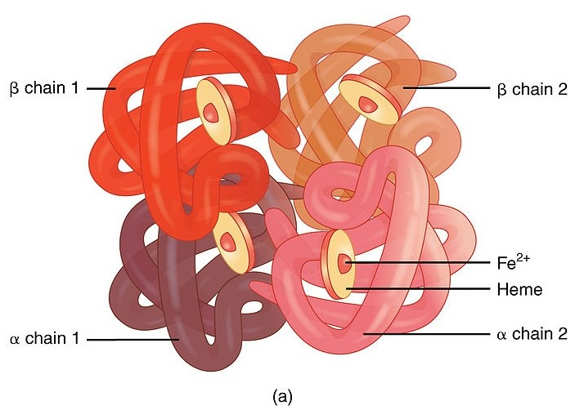
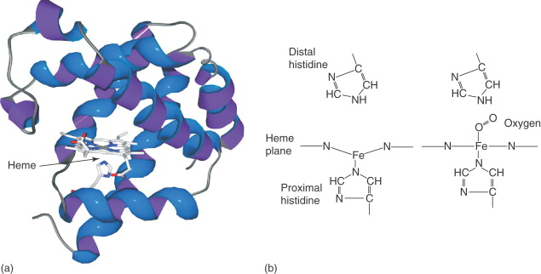
Iron Roles in the body
Hemoglobin
Iron is part of two important proteins: Hemoglobin in the red blood cells and Myoglobin in the muscle cells. In both, iron helps accept, carry, and then release oxygen.
Involved in the electron transport chain ( process of making ATP for cells)
Myoglobin
https://www.differencebetween.com/difference-between-iron-and-vs-hemoglobin/
https://www.sciencedirect.com/topics/nursing-and-health-professions/myoglobin

Slide 5
60% of the iron in our body is in RBC→ mainly in Hemoglobin
25% is in the storage form--> in the liver
The remainder: myoglobin in muscles (8%) and in enzymes (5%).
small amount circulation bound to the plasma transport protein, transferrin.

Slide 6
Iron absorption
More iron is absorbed when stores are empty and less is absorbed when stores are full.
Special proteins help the body absorb iron from food
The iron-storage protein ferritin captures iron from food and stores it in the cells of the small intestine.
Iron transport protein called transferrin.

Slide 7
Iron from dietary sources
Iron occurs in two forms in foods:
Heme iron: found only in foods derived from the flesh of animals, such as meats, poultry, and fish
Nonheme iron, which is found in both plant-derived and animal-derived foods
The iron is released from the heme protein with the help of acid in the stomach and is absorbed into the enterocyte cells of the SI ( usually this iron that is attached to the heme complex is in the ferrous form (Fe++) so it is absorbed well!

Slide 8
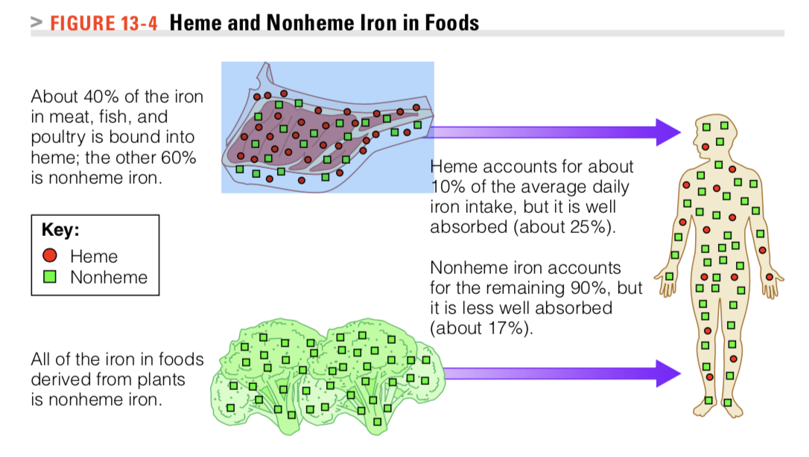
Meat, fish, and poultry contain the well-absorbed Heme iron and MFP factor a peptide that promotes the absorption of non-Heme iron from other foods eaten at the same meal.
IRON FROM ANIMAL SOURCES IS IN THE HEME AND NON HEME FORM
PLANTS-> NON-HEME IRON

Slide 9
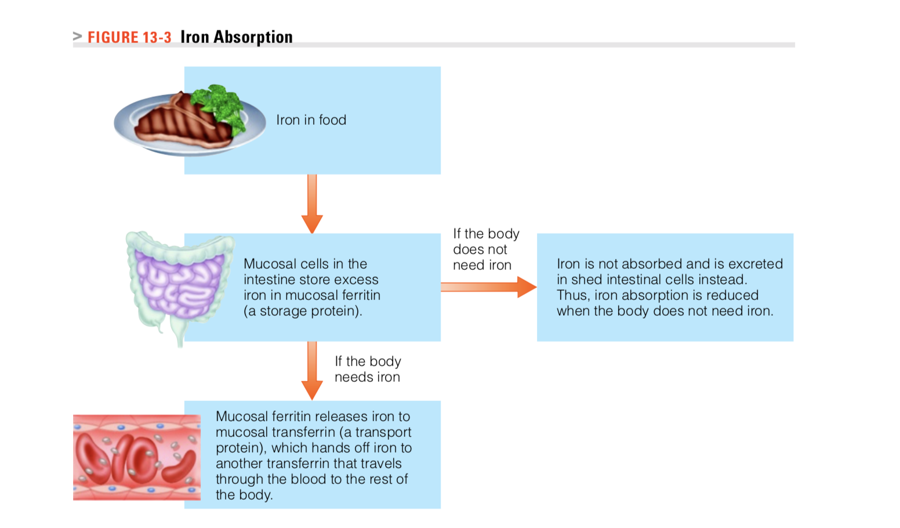

Slide 10
Iron absorption/ Dietary enhancers, inhibitors that affect iron Absorption
Inhibitors
Phytates in legumes, whole grains, and rice
vegetable proteins in soybeans, other legumes, and nuts
the calcium in milk
polyphenols (such as tannic acid) in tea, coffee, grain products, oregano
Enhancers
Vitamin C (ascorbic acid) enhances nonheme iron absorption from foods eaten at the same meal by capturing the iron and keeping it in the reduced Fe+2 form ready for absorption
Some acids (such as citric acid) and sugars (such as fructose) also enhance nonheme iron absorption.
MFP factor
Most of these factors exert a strong influence individually, but when combined with the others components of the meal, their influence decreases

Slide 11
Ferritin: storage protein of iron is present in the SI cells ( enterocytes) and in the liver.. Extra iron is stored as ferritin in the spleen and bone marrow
The blood transport protein Transferrin delivers iron to the bone marrow and other tissues. The bone marrow uses large quantities of iron to make new red blood cells
Most of the ferritin is in our body cells, liver, enterocytes etc. only very little is in our blood. Serum ferritin are measurements done to assess iron status ( blood tests)

Slide 12
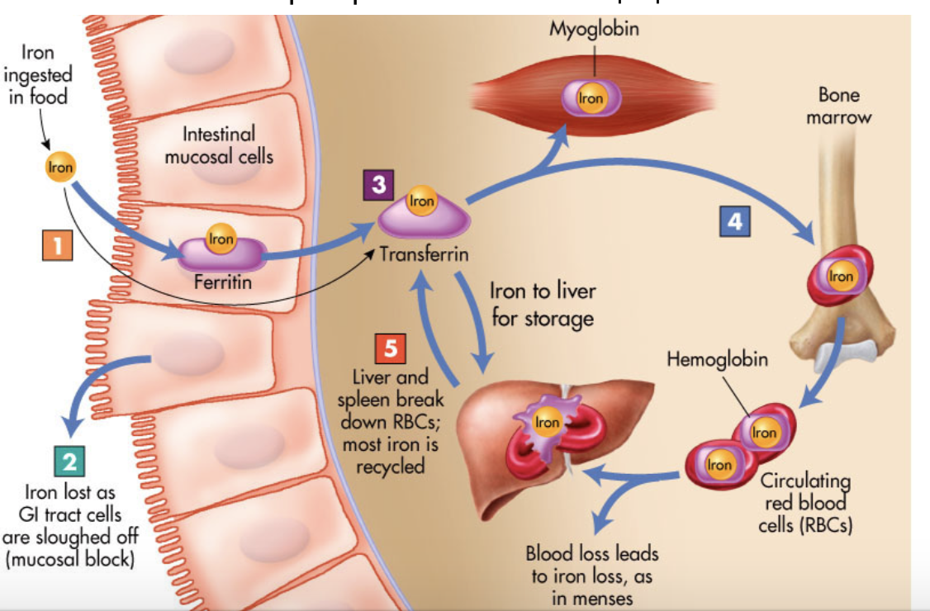
Ferritin: Storage protein→ stores Iron as the ferric form
Transferrin: transport protein

Slide 13
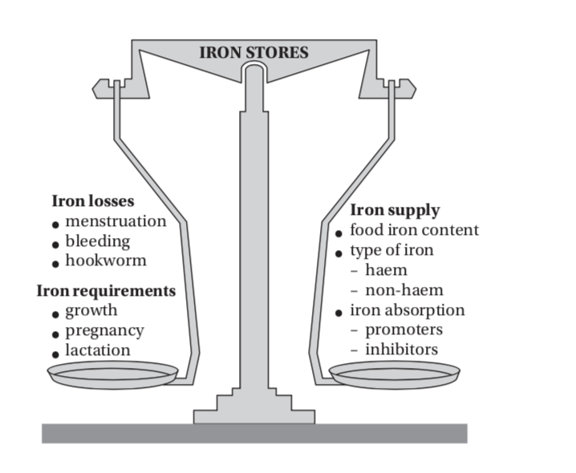
Iron balance
Iron supply is influenced by the amount and type of iron in food and the combination of various inhibitors and promoters of iron bioavailability
Critical times where deficiencies may develop:
In infancy
Pre-adolescent growth spurt
Women during reproductive life (particularly during pregnancy)
In these times, the iron requirements may exceed the iron supply, making iron deficiency more common during these periods.

Slide 14
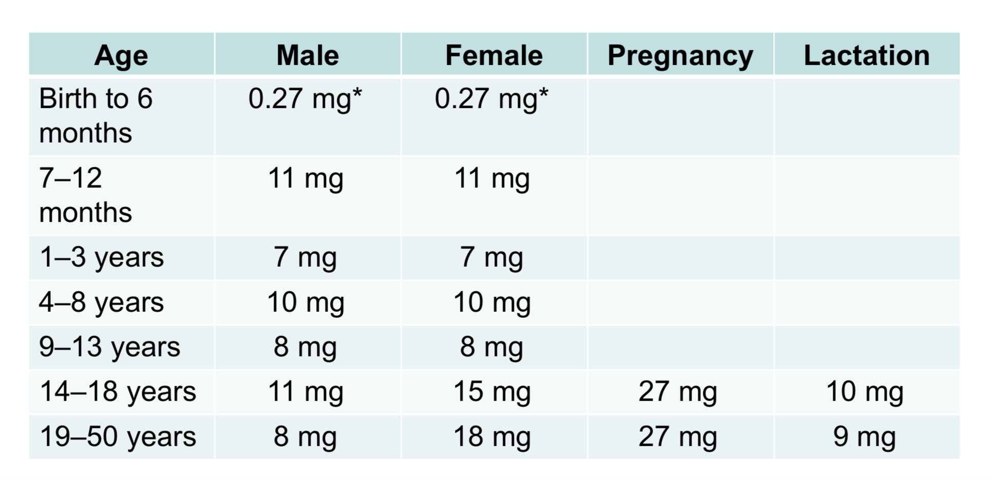
RDAs for Iron AI= Adequate intake
UL=45 mg/day for adults
Vegetarians = RDA * 1.8
Vegetarians women= 18 * 1.8= 32 mg/day

Slide 15
Iron Deficiency
Worldwide, iron deficiency is the most common nutrient de- ficiency, with iron-deficiency anemia affecting 1.5 to 2.0 billion people— mostly preschool children and pregnant women
Pregnancy demands additional iron to support the added blood volume, growth of the fetus, and blood loss during childbirth.
Rapid growth of adolescence ( male and female)
menstrual losses of females also demand extra iron that a typical teen diet may not provide
Bleeding from any site incurs iron losses.

Slide 16
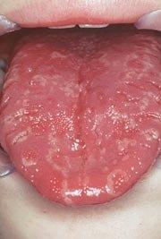
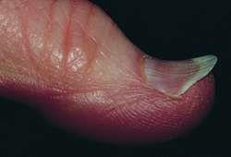
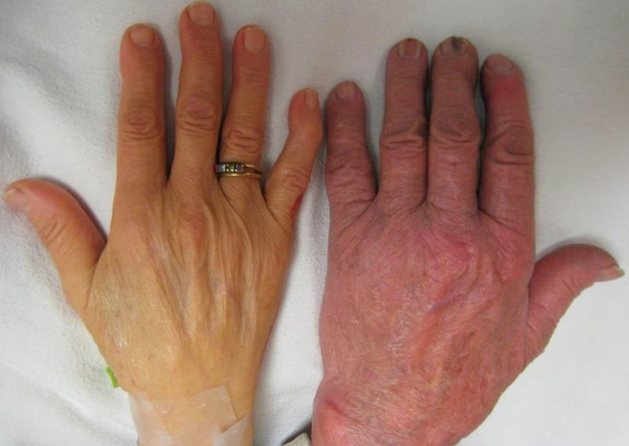
Iron Deficiency Anemia
Signs and symptoms
Pale skin Koilonychia (spoon nails) Glossitis
Inside of the inner eyelids is pink
Fatigue, inadequate muscle function, anorexia, growth abnormalities, pica
Notes:
PICA : craving and chewing substances that have no nutritional value — such as ice, clay, soil or paper

Slide 17
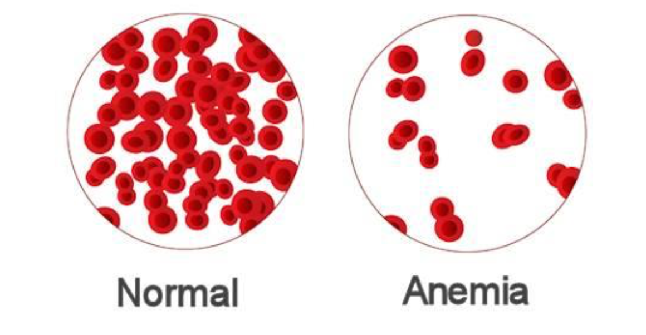
In Iron deficiency anemia hemoglobin synthesis decreases, resulting in red blood cells that are pale (hypochromic) and small (microcytic), a

