Slide 1
Interfacing Circuits- DC and AC Bridges
Measurement of resistance
  Voltage dividers
  Wheatstone Bridge
  Temperature compensation for strain gauges
AC bridges
  Measurement of capacitance
  Measurement of impedance

Slide 2

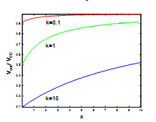

Voltage divider
Assumptions
  Interested in measuring the fractional change in resistance x of the sensor: RS=R0(1+x)
    R0 is the sensor resistance in the absence of a stimuli
  Load resistor expressed as RL=R0k for convenience
The output voltage of the circuit is
Questions
What if we reverse RS and RL?
How can we recover RS from Vout?

Slide 3
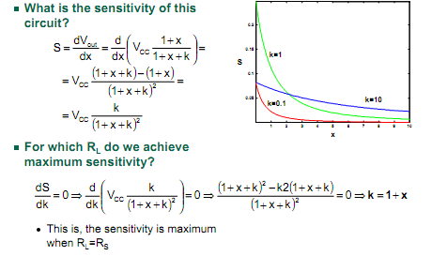
Voltage Divider

Slide 4
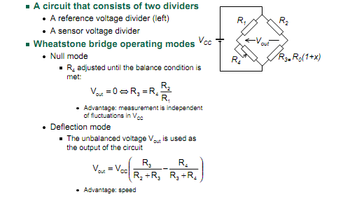
Wheatstone bridge

Slide 5
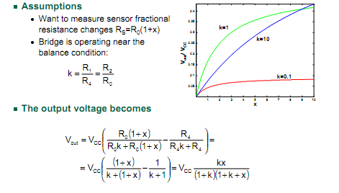
Wheatstone bridge

Slide 6
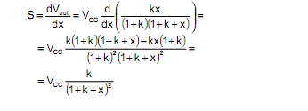
What is the sensitivity of the Wheatstone bridge?
The sensitivity of the Wheatstone bridge is the same as that of a
voltage divider
  You can think of the Wheatstone bridge as a DC offset removal circuit
So what are the advantages, if any, of the Wheatstone bridge?

Slide 7
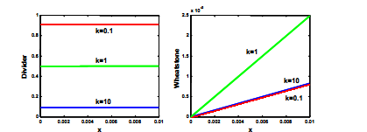
Voltage divider vs. Wheatstone for small x
The figures below show the output of both circuits for small fractional resistance changes
  The voltage divider has a large DC offset compared to the voltage swing, which makes the curves look “flat” (zero sensitivity)
    Imagine measuring the height of a person standing on top of a tall building by running a large tape measure from the street
The sensitivity of both circuits is the same!
  However, the Wheatstone bridge sensitivity can be boosted with a gain stage
    Assuming that our DAQ hardware dynamic range is 0-5VDC, 0<x<0.01 and k=1, estimate the maximum gain that could be applied to each circuit

Slide 8
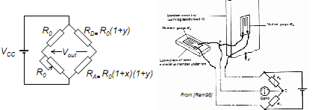
Compensation in a Wheatstone bridge
Strain gauges are quite sensitive to temperature
  A Wheatstone bridge and a dummy strain gauge may be used to compensate for this effect
    The “active” gauge RA is subject to temperature (x) and strain (y) stimuli
    The dummy gauge RD, placed near the “active” gauge, is only subject to temperature
  The gauges are arranged according to the figures below
  The effect of (1+y) on the right divider cancels out

Slide 9
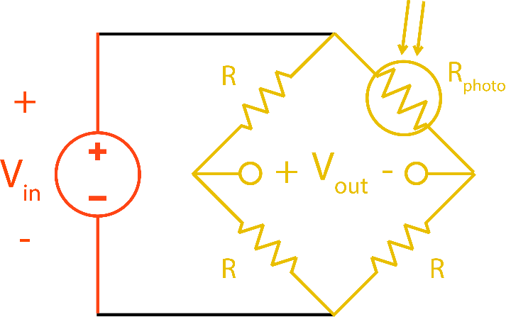
Exercise
Let's say you had a photocell with the following specifications:
Rlight=500 Ω
Rdark=10 kΩ
Which of the following would be suitable choices for R, given that you would like the swing of Vout to include both positive and negative voltages?

Slide 10
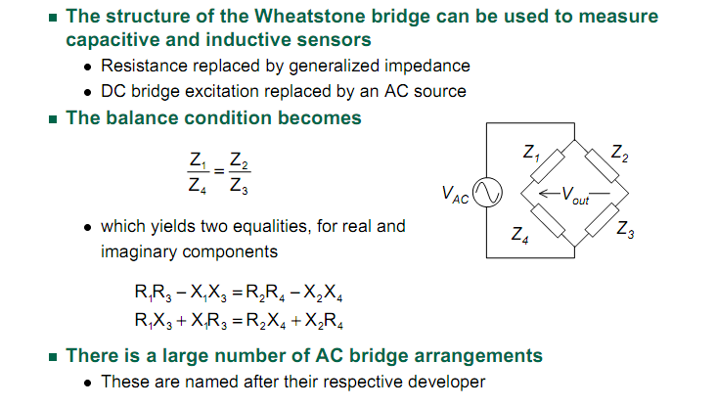
AC bridges

Slide 11
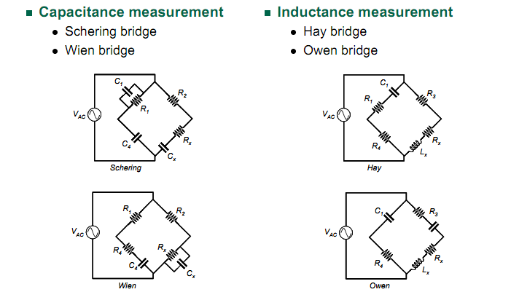
AC Bridges

