Slide 1
Chapter 10
Analysis of Insurance Contracts

Slide 2
Agenda
Basic parts of an insurance contract
Definition of “Insured”
Endorsements and Riders
Deductibles
Coinsurance
Other-insurance provisions

Slide 3
Basic Parts of an Insurance Contract
Declarations are statements that provide information about the particular property or activity to be insured
Can usually be found on the first page of the policy
In property insurance, it contains name of the insured, location of property, period of protection, amount of insurance, premium and deductible information
Insurance contracts typically contain a page or section of definitions
For example, the insured is referred to as “you”
Notes:
Transparency Master 1.2

Slide 4
Basic Parts of an Insurance Contract
The insuring agreement summarizes the major promises of the insurer (the heart of an insurance contract)
The two basic forms of an insuring agreement in property insurance are:
Named perils coverage, where only those perils specifically named in the policy are covered
Open-perils, or special coverage, where all losses are covered except those losses specifically excluded
Notes:
The insurer agrees to do certain things, such as paying losses from covered perils, providing certain services (such as loss prevention services) or agreeing to defend the insured in a liability lawsuit.
If the peril is not named, it is not covered (E.g in a homeowners policy, personal property is covered for fire, windstorm, and certain other named perils, only losses caused by these perils are covered. Flood damage is not covered because flood is not a listed peril.
For example, only fire is excluded. Or life insurance only suicide is excluded.
- An open-perils generally is preferable to the first type, because the protection is broader with fewer gaps in coverage.

Slide 5
Basic Parts of an Insurance Contract
Insurance contracts contain three major types of exclusions
Excluded perils, e.g., flood, intentional act
Excluded losses, e.g., a professional liability loss is excluded in the homeowners policy
Excluded property, e.g., pets are not covered as personal property in the homeowners policy
Notes:
An example of excluded loss: failure of an insured to protect the property from further damage after a loss occurs is excluded.

Slide 6
Why are Exclusions Necessary?
Some perils are not commercially insurable
e.g., catastrophic losses due to war
Extraordinary hazards are present
e.g., using the automobile for a taxi
Coverage is provided by other contracts
e.g., use of auto excluded on homeowners policy
Notes:
Transparency Master 1.2
A health insurance contract may exclude losses within the direct control of the insured, such as an intentional, self-inflicted injury.
The chance of an accident is much higher.
Duplication of indemnification by two different insurance contracts.

Slide 7
Why are Exclusions Necessary?
Moral hazard problems
e.g., coverage of money limited to $200 in homeowners policy
Attitudinal hazard problems
e.g., individuals are forced to bear losses that result from their own carelessness
Coverage not needed by typical insureds
e.g., homeowners policy does not cover aircraft
Notes:
Moral hazard for fraudulent approaches to gain insurance
Attitudinal hazard: inappropriate management of home appliances.
Share of losses wouldn’t be fair.

Slide 8
Basic Parts of an Insurance Contract
Conditions are provisions in the policy that qualify or place limitations on the insurer’s promise to perform
If policy conditions are not met, the insurer can refuse to pay the claim
Insurance policies contain a variety of miscellaneous provisions
e.g., cancellation, subrogation, grace period, misstatement of age
Notes:
Common conditions: Notifying the insurer if a loss occurs, protecting the property after a loss, preparing an inventory of damaged personal.
Grace period: فترة السماح

Slide 9
Definition of “Insured”
An insurance contract must identify the persons or parties who are insured under the policy
The named insured is the person or persons named in the declarations section of the policy
The first named insured has certain additional rights and responsibilities that do not apply to other named insureds
A policy may cover other parties even though they are not specifically named
Additional insureds may be added using an endorsement
Notes:
Full names of the insureds.
Additional rights might include the right to a premium refund
For example: a homeowners policy covers resident relatives of the named insured or any person under age 21 who is in the care of the insured, or car drivers above 24.
Additional insureds like under 24 drivers.

Slide 10
Endorsements and Riders
In property and liability insurance, an endorsement is a written provision that adds to, deletes from, or modifies the provisions in the original contract
e.g., an earthquake endorsement to a homeowners policy
In life and health insurance, a rider is a provision that amends or changes the original policy
e.g., a waiver-of-premium rider on a life insurance policy
Notes:
- waiver: تنازل عن قسط

Slide 11
Deductibles
A deductible is a provision by which a specified amount is subtracted from the total loss payment that otherwise would be payable
The purpose of a deductible is to:
Eliminate small claims that are expensive to handle and process
Reduce premiums paid by the insured
Reduce moral hazard and attitudinal (morale) hazard

Slide 12
Deductibles in Property insurance
With a straight deductible, the insured must pay a certain number of dollars of loss before the insurer is required to make a payment
e.g., an auto insurance deductible
An aggregate deductible means that all losses that occur during a specified time period, usually a year, are accumulated to satisfy the deductible amount
Notes:
Collision of 10,000$ and 1,000$ deductible: Indemnification 9,000$
For aggregate: Only accumulated losses above deductibles will be paid

Slide 13
Deductibles in Health Insurance
A calendar-year deductible is a type of aggregate deductible that is found in basic medical expense and major medical insurance contracts
An elimination (waiting) period is a stated period of time at the beginning of a loss during which no insurance benefits are paid
e.g., disability income contracts that replace part of a disabled worker’s earnings typically have elimination periods of 30, 60, or 90 days, or longer periods.

Slide 14
Coinsurance
A coinsurance clause in a property insurance contract encourages the insured to insure the property to a stated percentage of its insurable value
If the coinsurance requirement is not met at the time of the loss, the insured must share in the loss as a coinsurer

Slide 15
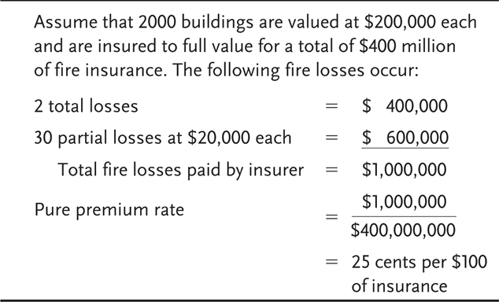
Exhibit 10.1 Insurance to Full Value

Slide 16
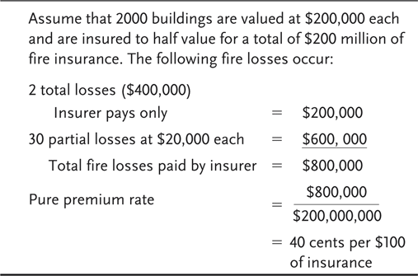
Exhibit 10.2 Insurance to Half Value

Slide 17
Coinsurance in Health Insurance
Health insurance policies frequently contain a coinsurance clause
The clause requires the insured to pay a specified percentage of covered medical expenses in excess of the deductible
The purposes of coinsurance in health insurance are to reduce premiums and prevent overutilization of policy benefits

Slide 18
Other-insurance Provisions
The purpose of other-insurance provisions is to prevent profiting from insurance and violation of the principle of indemnity
Under a pro rata liability provision, each insurer’s share of the loss is based on the proportion that its insurance bears to the total amount of insurance on the property
Under contribution by equal shares, each insurer shares equally in the loss until the share paid by each insurer equals the lowest limit of liability under any policy, or until the full amount of the loss is paid

Slide 19

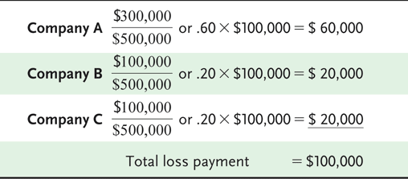
Exhibit 10.3 Pro Rata Liability Example
Notes:
- Each insurance company indemnifies with its share of the 500,000$.

Slide 20
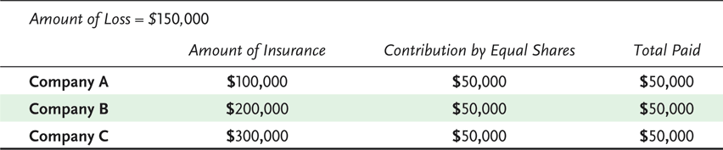
Exhibit 10.4 Contribution by Equal Shares (Example 1)

Slide 21
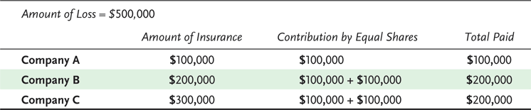
Exhibit 10.5 Contribution by Equal Shares (Example 2)
Notes:
500,000$ loss

Slide 22
Other-insurance Provisions
Under a primary and excess insurance provision, the primary insurer pays first, and the excess insurer pays only after the policy limits under the primary policy are exhausted
The coordination of benefits provision in group health insurance is designed to prevent overinsurance and the duplication of benefits if one person is covered under more than one group health insurance plan
Notes:
Primary and excess (Like car and health insurances)
Coordination of benefits like health insurance of both parents.

