Slide 1
Audit responsibilities and objectives
Chapter 6

Slide 2
Chapter 6 Learning Objectives
6-1 Explain the objective of conducting an audit of financial statements
and an audit of internal controls.
6-2 Distinguish management’s responsibility for the financial statements
from the auditor’s responsibility for verifying those statements.
6-3 Explain the auditor’s responsibility for discovering material
misstatements due to fraud or error.
6-4 Describe the need to maintain professional skepticism when
conducting an audit.
.

Slide 3
Chapter 6 Learning Objectives (cont.)
6-5 Describe the key elements of an effective professional judgment
process.
6-6 Identify the benefits of a cycle approach to segmenting the audit.
6-7 Describe why the auditor obtains assurance by auditing transactions
and ending balances, including presentation and disclosure.
6-8 Distinguish among the management assertions about financial
information.

Slide 4
Chapter 6 Learning Objectives (cont.)
6-9 Link transaction-related audit objectives to management assertions
for classes of transactions.
6-10 Link balance-related and presentation and disclosure-related audit
objectives to management assertions.
6-11 Explain the relationship between audit objectives and the
accumulation of audit evidence.

Slide 5
OBJECTIVE 6-1
Explain the objective of conducting an audit of financial statements and an audit of internal controls.

Slide 6
Objective to conducting an audit of financial statements
The preface to the clarified AICPA auditing standards:
The primary focus is on issuing an opinion on the financial statements.
The steps to develop audit objectives are listed in Figure 6-1.

Slide 8
OBJECTIVE 6-2
Distinguish management’s responsibility for the financial statements from the auditor’s responsibility for verifying those statements.

Slide 9
Management’s Responsibilities
Financial statements and internal controls.
Sarbanes-Oxley increases management’s
responsibility for the financial statements.
CEO and CFO must certify quarterly and annual
financial statements submitted to the SEC.
Many public companies include a statement regarding management responsibility in relation to the CPA firm. An example of such a statement is included in Figure 6-2.

Slide 11
OBJECTIVE 6-3
Explain the auditor’s responsibility
for discovering material misstatements due to fraud or error.

Slide 12
Auditor’s responsibilities
AICPA auditing standards state:

Slide 13
Auditor’s responsibilities (cont.)
Errors versus Fraud:
An error is an unintentional misstatement of the financial statements, whereas fraud is intentional.
For fraud, there is a distinction between misappropriation of assets, usually committed by employees, and fraudulent financial reporting, usually committed by management.
Auditor’s Responsibilities for Detecting Material Errors:
Auditors spend a great portion of their time planning and performing audits to detect unintentional errors made by management and employees.
Notes:
Errors can occur in the financial statements because of miscalculations, omissions, misunderstandings, misapplication of standards, and so on. Fraud is intentional. Misappropriation of assets means that someone is using (or stealing) company assets for personal gain. Fraudulent financial reporting means that management is manipulating the financial statements to make them look better than what is actually happening with the company.

Slide 14
Auditor’s responsibilities (cont.)
Auditor’s Responsibilities for Detecting Material Fraud:
Auditing standards make no distinction between the auditor’s responsibilities for detecting errors versus fraud.
However, the standards do recognize that fraud is more difficult to detect because those who are committing the fraud attempt to conceal the fraud.
Fraudulent Financial Reporting versus Misappropriation of Assets: Both are harmful to financial statement users. Fraudulent financial statements present users with incorrect financial information that is used for decision making. Misappropriation of assets is harmful to creditors, stockholders, and others because the assets have been taken from their rightful owners, the company.

Slide 15
Auditor’s Responsibilities for Discovering Illegal Acts
Type
Responsibility
Direct-Effect
Same as for
errors and
fraud
Indirect-Effect
No Assurance
Notes:
Regarding indirect-effect illegal acts, auditing standards state that the auditor lacks legal expertise and the frequent indirect relationship between illegal acts and the financial statements makes it impractical for auditors to assume responsibility for discovering those illegal acts.

Slide 16
Auditor’s responsibilities (cont.)
Audit Procedures When Noncompliance Is Identified or Suspected: The auditor should obtain an understanding of the situation and discuss the matter with management at a level above those involved.
Auditors should obtain sufficient evidence regarding material amounts that are directly affected by laws and regulations.
Laws such as those relating to taxes and pensions usually have a direct effect on the amounts or disclosures in the financial statements, and therefore require the auditor’s attention.
Reporting Identified or Suspected Noncompliance: Unless the matter is inconsequential, the auditor should communicate with those charged with governance of matters of noncompliance.

Slide 17
OBJECTIVE 6-4
Describe the need to maintain professional skepticism when conducting an audit.

Slide 18
Professional skepticism
Aspects of Professional Skepticism: Two primary components: A questioning mindset and a critical assessment of audit evidence.
Elements of Professional Skepticism:
  Questioning mindset—“trust but verify”—a disposition to inquiry with some sense of doubt.
  Suspension of judgment—withholding judgment until appropriate evidence is obtained.
  Search for knowledge—a desire to investigate beyond the obvious, with a desire to corroborate.
  Interpersonal understanding—recognition that people’s motivations and perceptions can lead them to provide biased or misleading information.
  Autonomy—the self-direction, moral independence, and conviction to decide for oneself, rather than accepting the claims of others.
  Self-esteem—the self-confidence to resist persuasion and to challenge assumptions or conclusions.
Notes:
Professional skepticism is a mindset of questioning everything—not taking anything at face value—verify what the client presents.

Slide 19
OBJECTIVE 6-5
Describe the key elements of an effective professional judgment process.

Slide 20
Professional judgment
Professional judgment is part of professional skepticism.
Elements of the Judgment Process:
Identify and define the issue.
Gather the facts and information and identify the relevant literature.
Perform the analysis and identify potential alternatives.
Make the decision.
Review and complete the documentation and rationale for the conclusion.
These five key elements are illustrated in Figure 6-3.
Notes:
Professional judgment improves with experience. This is one of the reasons that the standards stress that assistants should be properly supervised. The professional judgment of a more experienced auditor (i.e., a supervisor) will be more advanced than the first or second year auditor being supervised.

Slide 22
Professional judgment (cont.)
Some potential judgment tendencies, traps, and biases to keep in mind:

Slide 23
OBJECTIVE 6-6
Identify the benefits of a cycle approach
to segmenting the audit.

Slide 24
Financial statement cycles
  A common form of segmenting is called the cycle approach, which divides classes of transactions and account balances that are closely related into segments.
  The cycles used in this text are listed below and detailed in Figure 6-4.
  Sales and collection cycle
  Acquisition and payment cycle
  Payroll and personnel cycle
  Inventory and warehousing cycle
  Capital acquisition and repayment cycle
  A trial balance is illustrated in Figure 6-5, with accounts categorized by cycle.
  Cycles applied to the trial balance are illustrated in Table 6-2.
Notes:
An audit of financial statements is a huge job. Segmenting makes the execution of the audit objectives more manageable, while ensuring that all important functions and account balances are audited.

Slide 28
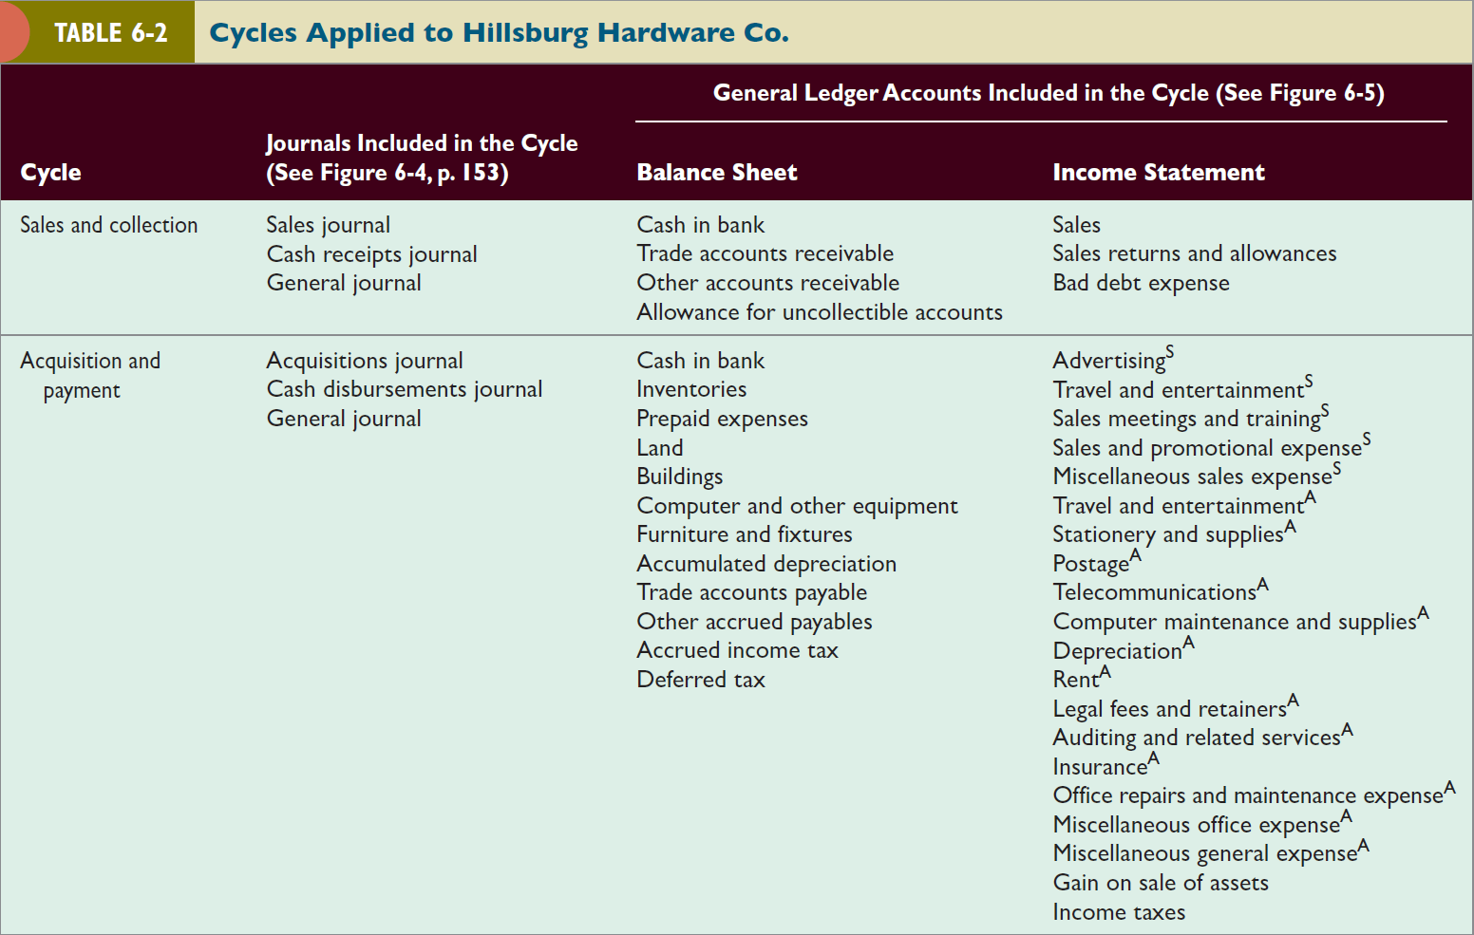

Slide 29

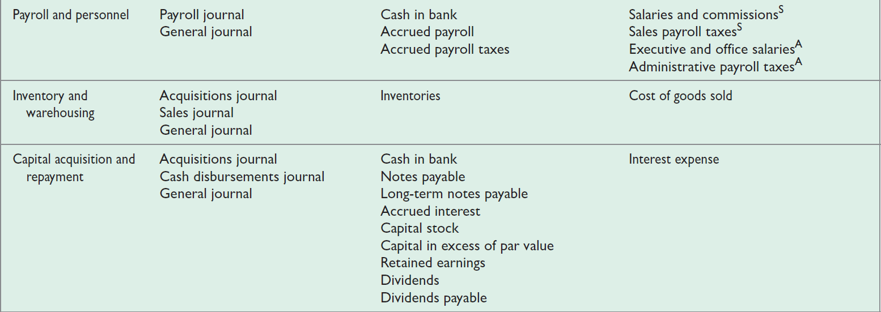

Slide 30
Financial statement cycles (cont.)
Relationships among cycles are illustrated in Figure 6-6 below.

Slide 31
OBJECTIVE 6-7
Describe why the auditor obtains assurance by auditing transactions and ending balances, including presentation and disclosure.

Slide 32
Setting audit objectives
  The most efficient way to conduct audits is to obtain some combination of assurance for each class of transactions and for the ending balances in the related accounts.
  Audit objectives for each class of transactions include:
  Transaction-related audit objectives
  Balance-related audit objectives
  Presentation and disclosure-related audit objectives.
  Figure 6-7 presents an illustration of balances and transactions affecting the balances for Accounts Receivable.

Slide 33
Notes:
This illustration applies to the Sales and Collection cycle.

Slide 34
OBJECTIVE 6-8
Distinguish among the management assertions about financial information.

Slide 35
Management assertions
  Management assertions are implied or expressed representations by management about classes of transactions and the related accounts and disclosures in the financial statements.
  Assertions by management are directly related to the financial reporting framework (U.S. GAAP or IFRS) that forms the criteria that management uses to record and disclose accounting information in financial statements.
  Management assertions lead to the audit objectives. Therefore, auditors must have a thorough understanding of management assertions to perform quality audits.

Slide 36
Management assertions (cont.)
The PCAOB standards describe five categories of management assertions:
Existence or occurrence
Completeness
Valuation or allocation
Rights and obligations
Presentation and disclosure
AICPA and IAASB standards describe three categories of assertions:
Assertions about classes of transactions and events
Assertions about account balances
Assertions about presentation and disclosure
Table 6-3 maps the PCAOB standards with the AICPA and IAASB standards.

Slide 37
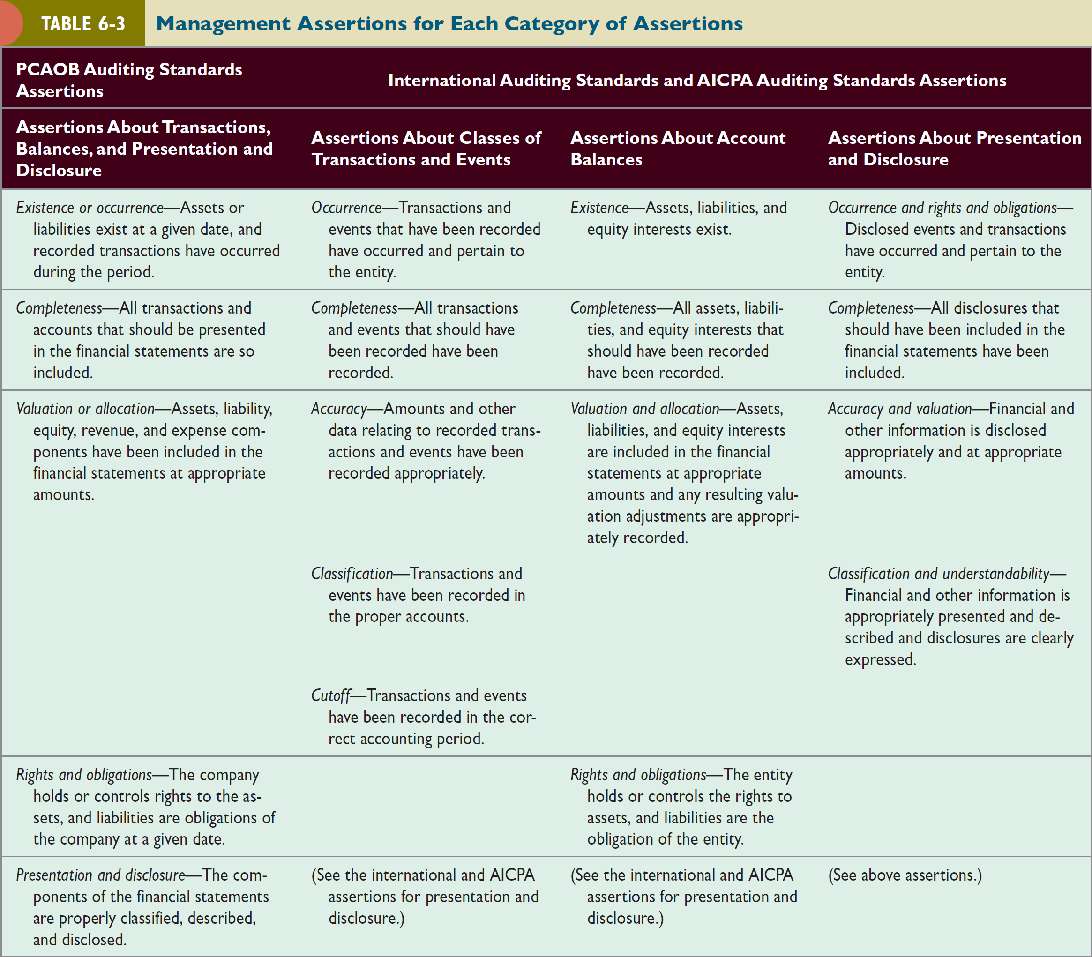

Slide 38
OBJECTIVE 6-9
Link transaction-related audit objectives
to management assertions for
classes of transactions.

Slide 39
Transaction-related audit objectives
  General Transaction-Related Audit Objectives:
  Occurrence—Recorded transactions exist.
  Completeness—Existing transactions are recorded.
  Accuracy—Recorded transactions are stated at the correct amounts.
  Posting and Summarization—Recorded transactions are properly included in the master files and are correctly summarized.
  Classification—Transactions included in the client’s journals are properly classified.
  Timing—Transactions are recorded on the correct dates.

Slide 40
Transaction-related audit objectives (cont.)
Specific Transaction-Related Audit Objectives—The specific transaction-related objectives are tailored to the specific class of transactions being audited.
Relationship Among Management Assertions and Transaction-Related Audit Objectives—For each management assertion, there are general transaction-related audit objectives as well as specific transaction-related audit objectives.
Table 6-4 illustrates these relationships using sales transactions.

Slide 42
OBJECTIVE 6-10
Link balance-related and presentation and disclosure-related audit objectives to management assertions.

Slide 43
Balance-related and presentation and disclosure-related audit objectives
  General Balance-Related Audit Objectives:
  Existence—Amounts included exist.
  Completeness—Existing amounts are included.
  Accuracy—Amounts included are stated at the correct amounts.
  Classification—Amounts included in the client’s listing are properly classified.
  Cutoff—Transactions near the balance sheet date are recorded in the proper period.
  Detail Tie-In—Details in the account balance agree with related master file amounts, foot to the total in the account balance, and agree with the total.
  Realizable Value—Assets are included at the amounts estimated to be realized.
  Rights and Obligations—Assets are owned or controlled by the entity, and liabilities are obligations of the entity.

Slide 44
Balance-related and presentation and disclosure-related audit objectives (cont.)
Specific Balance-Related Audit Objectives—The same as for transaction-related audit objectives, each balance-related audit objective should be tailored to the account balance being audited.
Relationship Among Management Assertions and Balance-Related Audit Objectives—These relationships for Inventory are illustrated in Table 6-5.
Presentation and Disclosure-Related Audit Objectives—These relationships for Notes Payable are illustrated in Table 6-6.

Slide 47
OBJECTIVE 6-11
Explain the relationship between audit objectives and the accumulation of audit evidence.

Slide 48
How audit objectives are met
Figure 6-8 illustrates four phases of the audit.
Phase I: Plan and Design an Audit Approach.
The main objective of an audit is to accumulate enough evidence to provide an opinion on the financial statements. Two overriding considerations affect how an auditor approaches the audit:
  Sufficient appropriate evidence must be accumulated to meet the auditor’s professional responsibility.
  The cost of accumulating the evidence should be minimized.
The audit plan should result in an effective audit at a reasonable cost.

Slide 49
How audit objectives are met (cont.)
Phase I: Plan and Design and Audit Approach (cont.).
Risk assessment procedures include the following:
Obtain an understanding of the entity and its environment.
Understand internal control and assess control risk.
Assess risk of material misstatement.
Phase II: Perform Tests of Controls and Substantive Tests of Transactions.
Tests of controls allow the auditor to evaluate the effectiveness of internal controls and determine whether the controls can be relied upon to reduce planned control risks.
Substantive tests of transactions allow the auditor to evaluate the client’s recording of transactions.

Slide 50
How audit objectives are met (cont.)
Phase III: Perform Substantive Analytical Procedures and Tests of Details of Balances.
Analytical procedures consist of evaluations of plausible relationships among financial and nonfinancial data.
Tests of details of balances are specific procedures intended to test for monetary misstatements in the financial statements.
Phase IV: Complete the Audit and Issue and Audit Report.
After all procedures have been completed, the auditor will reach an overall conclusion as to whether the financial statements are fairly presented.
After the conclusion, the auditor must issue an audit report that will accompany the client’s financial statements.

Slide 52
