Slide 1
AMINO ACIDS

Slide 2
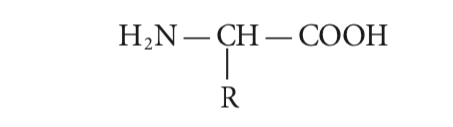
Structure
Central carbon (C)
At least one amino group (—NH )
At least one carboxy (acid) group (—COOH), and a side chain (R group)
Characteristics of the side chains of the amino acids that make up a poly- peptide bestow on a protein its structure and influence its functional role in the body.

Slide 3
Grouping AA
Side chains of the amino acids → Structural similarities
Presence or absence of a net charge is another → Zwitterions have no net electrical charge because their side chains are not charged, and the one positive and one negative charge from the amino and carboxy groups, respectively, in their base structure cancel each other out.
Polarity→ Polarity depends on the side chain or R group of the amino acid.
Essentiality

Slide 4
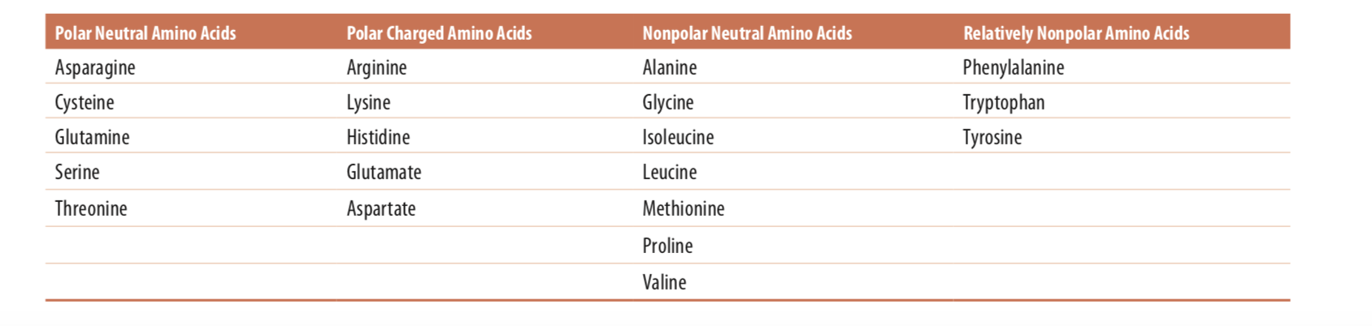
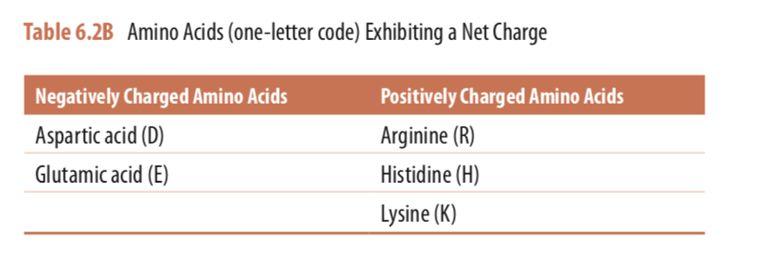

Slide 5
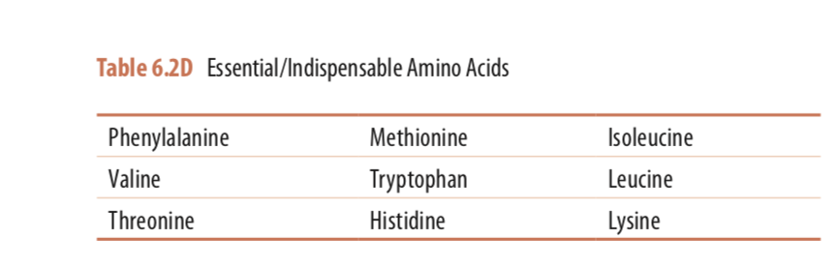

Slide 6
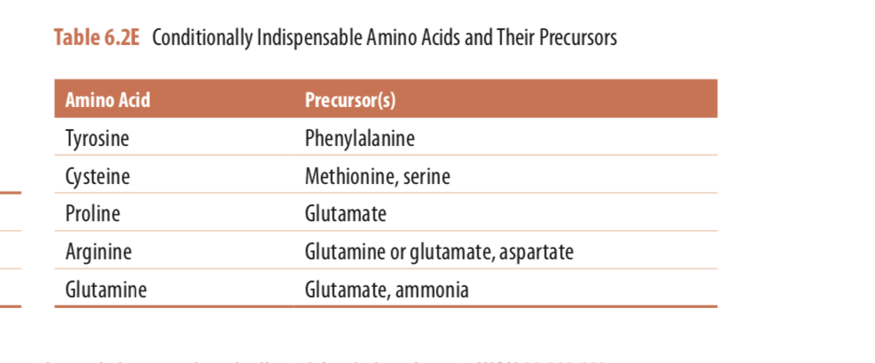
A dispensable amino acid may become indispensable if there are rate limitations to its synthesis such as may occur if precursor availability is limited. Similarly, if an organ does not function properly then amino acid metabolism may not proceed normally. For example, neonates born prematurely often have immature organ function. Immature liver function or liver disease (cirrhosis) impairs both phenylalanine and methionine metabolism, which occurs primarily in the liver.
Arginine : conditionally essential amino acid→ Can be synthesized de novo in the body but production is insufficient to meet the body’s needs during early development nor during periods of infection or inflammation

Slide 7
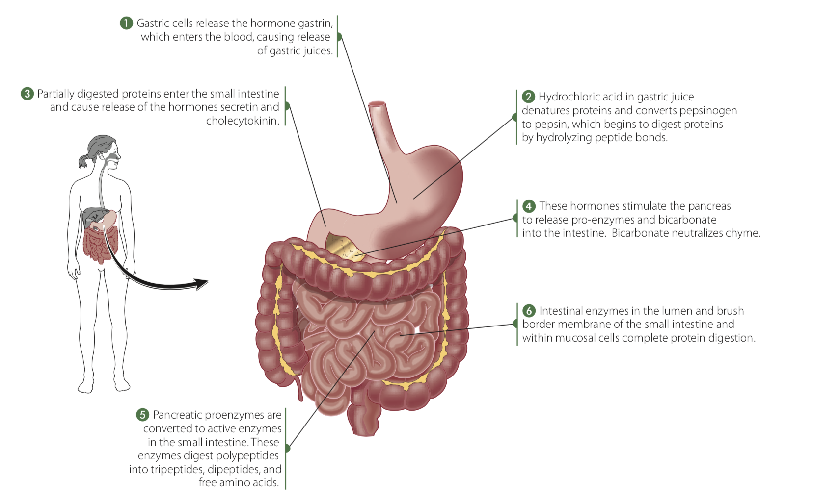
Entry of dietary protein into the stomach stimulates the gastric mucosa to secrete the hormone gastrin→ stimulates the secretion of hydrochloric acid by the parietal cells and pepsinogen by the chief cells of the gastric glands

Slide 8
The liver is the primary site for the uptake of most amino acids following ingestion of a protein-containing meal
In animals, amino acids undergo oxidative degradation in three different metabolic circumstances:
During the normal synthesis and degradation of cellular proteins→ protein turnover→ Some amino acids that are released from protein breakdown and are not needed for new protein synthesis undergo oxidative degradation.
When a diet is rich in protein and the ingested amino acids exceed the body’s needs for protein synthesis, the surplus is catabolized; amino acids cannot be stored.
During starvation or in uncontrolled diabetes mellitus, when carbohydrates are either unavailable or not properly utilized, cellular proteins are used as fuel.

Slide 9
In Oxidative Degradation
Amino acids lose their amino groups to form Alpha- keto acids
The alpha keto acids oxidize to CO2 and H2O or provide three- and four-carbon units that can be converted by gluconeogenesis into glucose, the fuel for brain, skeletal muscle, and other tissues
Every amino acid contains an amino group→the pathways for amino acid degradation include a key step in which the amino group is separated from the carbon skeleton and shunted into the pathways of amino group metabolism

Slide 10
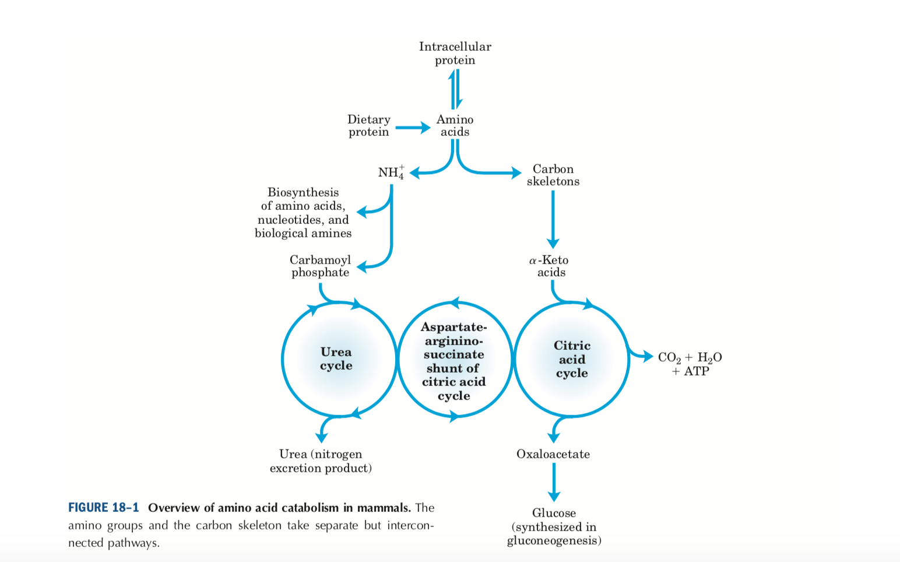

Slide 11
Fates of Amino Groups
Most amino acids are metabolized in the liver→ Some of the ammonia generated recycled and used in a variety of biosynthetic pathways; the excess is either excreted directly or converted to urea or uric acid for excretion
The first step in the catabolism of most L-amino acids, once they have reached the liver, is removal of the amino groups, promoted by enzymes called amino- transferases or transaminases.

Slide 12
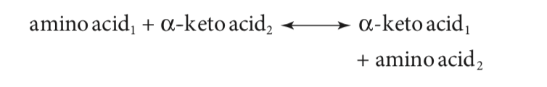
Transamination of Amino Acids
Transamination reactions involve the transfer of an amino group from one amino acid to a-keto acid
The carbon skeleton/a-keto acid that gains the amino group becomes an amino acid, and the amino acid that loses its amino group becomes an a-keto acid
Important for the synthesis of many of the body’s dispensable amino acids.

Slide 13
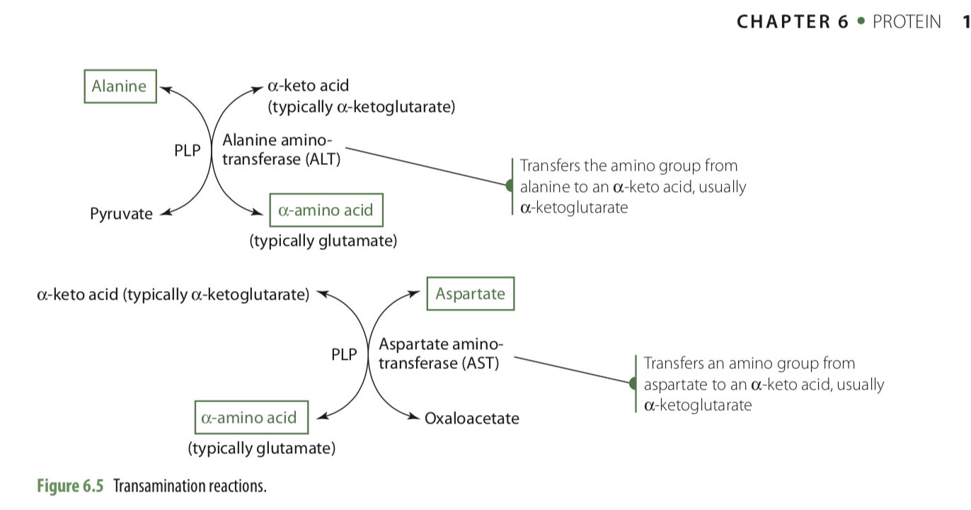
Transamination reactions are catalyzed by enzymes called aminotransferases/transaminases
These enzymes typically require vitamin B6 in its coenzyme form, pyridoxalphosphate (PLP).

Slide 14
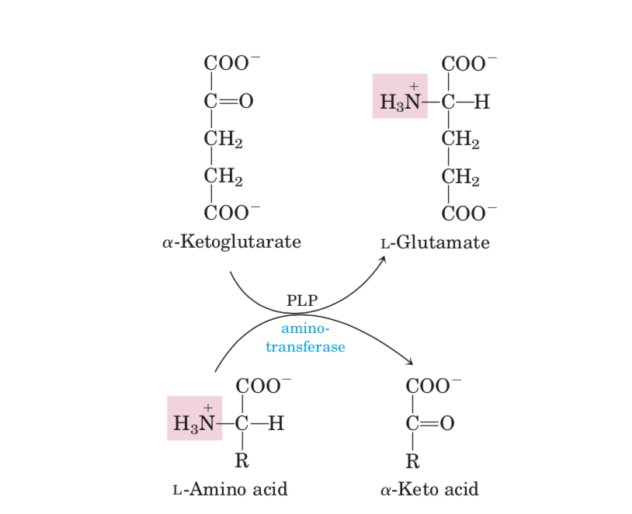

Slide 15
(ALT and AST) are among the body’s most active and involve three key amino acids and a-keto acids—alanine and its a-keto acid pyruvate, glutamate and its a-keto acid a-ketoglutarate, and aspartate and its a-keto acid oxaloacetate—
Glutamate and a-ketoglutarate readily transfer and/or accept amino groups→ Play central role in amino acid metabolism.
Aminotransferases are found in varying concentrations in different tissues.→ example (AST is found in higher concentrations in the heart than in the liver, muscle, and other tissues. In contrast, ALT is found in higher concentrations in the liver than the heart)
with injury or disease to an organ, serum enzyme concentrations of aminotransferases rise→ serve as an indicator of organ damage

Slide 16
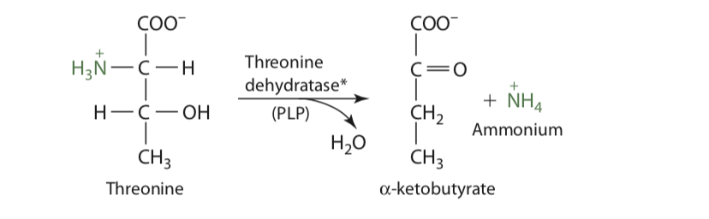
Deamination of Amino Acids
Involve only the removal of an amino group from an amino acid, with no transfer of the amino group to another compound
The amino group is released as ammonia, but at the body’s physiological pH, ammonia is typically converted (in a reversible reaction) to the ammonium ion
Produce an a-keto acid and ammonia or an ammonium ion
Vitamin B6 as PLP is required by the enzyme.

Slide 17
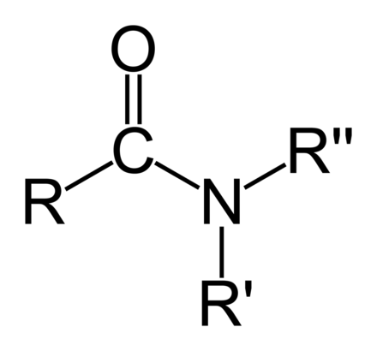
Disposal of Ammonia
Major sources of ammonia and/or ammonium ions in the body include:
Formation in the body from chemical reactions such as deamination
Generation by the deamidation of the amide groups from glutamine and asparagine
Ingestion and absorption from foods (e.g., cheeses, processed meats)
Generation by the bacterial lysis of urea and amino acids in the GI tract and subsequent absorption into the body.
Amide

Slide 18
Three enzymes—glutamate dehydrogenase, glutamine synthetase, and carbamoyl phosphate synthetase I (as part of the urea cycle)—assist in the removal of the ammonia/ammonium ions from body cells
Found in high concentrations in the liver but are also found in the kidneys

Slide 19
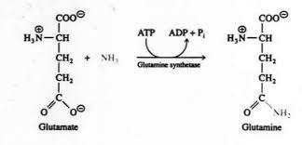
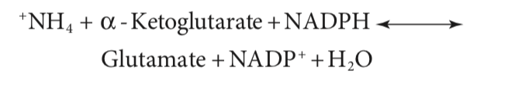

Glutamate dehydrogenase readily uses an ammonia or ammonium ion (NH4+ ) and a-ketoglutarate to synthesize the amino acid glutamate
Glutamate dehydrogenase
Glutamine synthetase

Slide 20
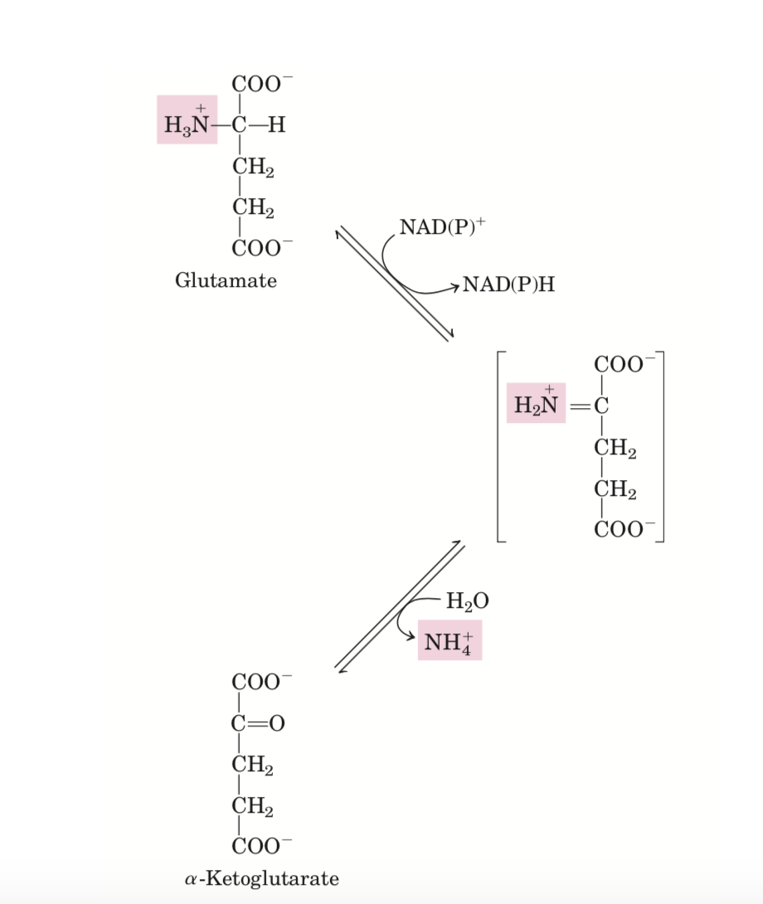
Reaction catalyzed by glutamate dehydrogenase. The glutamate dehydrogenase of mammalian liver has the unusual capacity to use either NAD+ or NADP+ as cofactor.

Slide 21
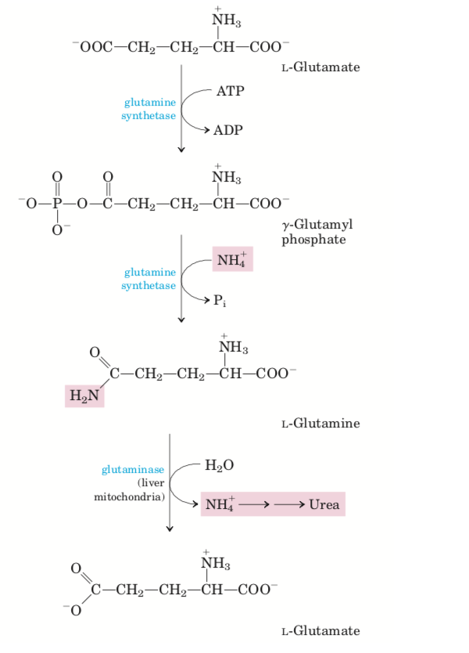

Slide 22
Liver’s perivenous cells synthesize glutamate and glutamine from ammonia or ammonium ions, the periportal hepatocytes are active in ureagenesis
Periportal cells are responsible for almost all amino acid catabolism, so ammonia and ammonium ions generated during amino acid degradative reactions can also be immediately used for urea synthesis.

Slide 23
Glucose-Alanine cycle
Transporting amino groups to the liver in a nontoxic form,
In muscle and certain other tissues that degrade amino acids for fuel, amino groups are collected in the form of glutamate by transamination
Glutamate can be converted to glutamine for transport to the liver, or it can transfer its amino group to pyruvate ( a product of muscle glycolysis) by the action of alanine aminotransferase
The alanine formed passes into the blood and travels to the liver. In the cytosol of hepatocytes, alanine aminotransferase transfers the amino group from alanine to alpha- ketoglutarate, forming pyruvate and glutamate.

Slide 24
Glutamine Transports Ammonia in the Bloodstream
Ammonia is quite toxic to animal tissues
In most animals much of the free ammonia is converted to a nontoxic compound before export from the extrahepatic tissues into the blood and transport to the liver or kidneys.
For this transport function, glutamate, critical to intra- cellular amino group metabolism, is supplanted by L-glutamine. The free ammonia produced in tissues is combined with glutamate to yield glutamine by the action of glutamine synthetase.

Slide 25
The Urea Cycle
Ammonia (NH3) (or an ammonium ion) combines with CO (which can also be present as HCO3-) to form carbamoyl phosphate in a reaction catalyzed by mitochondrial carbamoyl phosphate synthetase I
Carbamoyl phosphate reacts with ornithine in the mitochondria to form citrulline
Aspartate reacts with citrulline once it has been trans- ported into the cytosol to form argininosuccinate → rate-limiting step of the cycle. ATP (two high-energy bonds) and Mg+2 required
Argininosuccinate is cleaved by argininosuccinase in the cytosol to form fumarate and arginine
Urea is formed and ornithine is re-formed from the cleavage of arginine

Slide 26
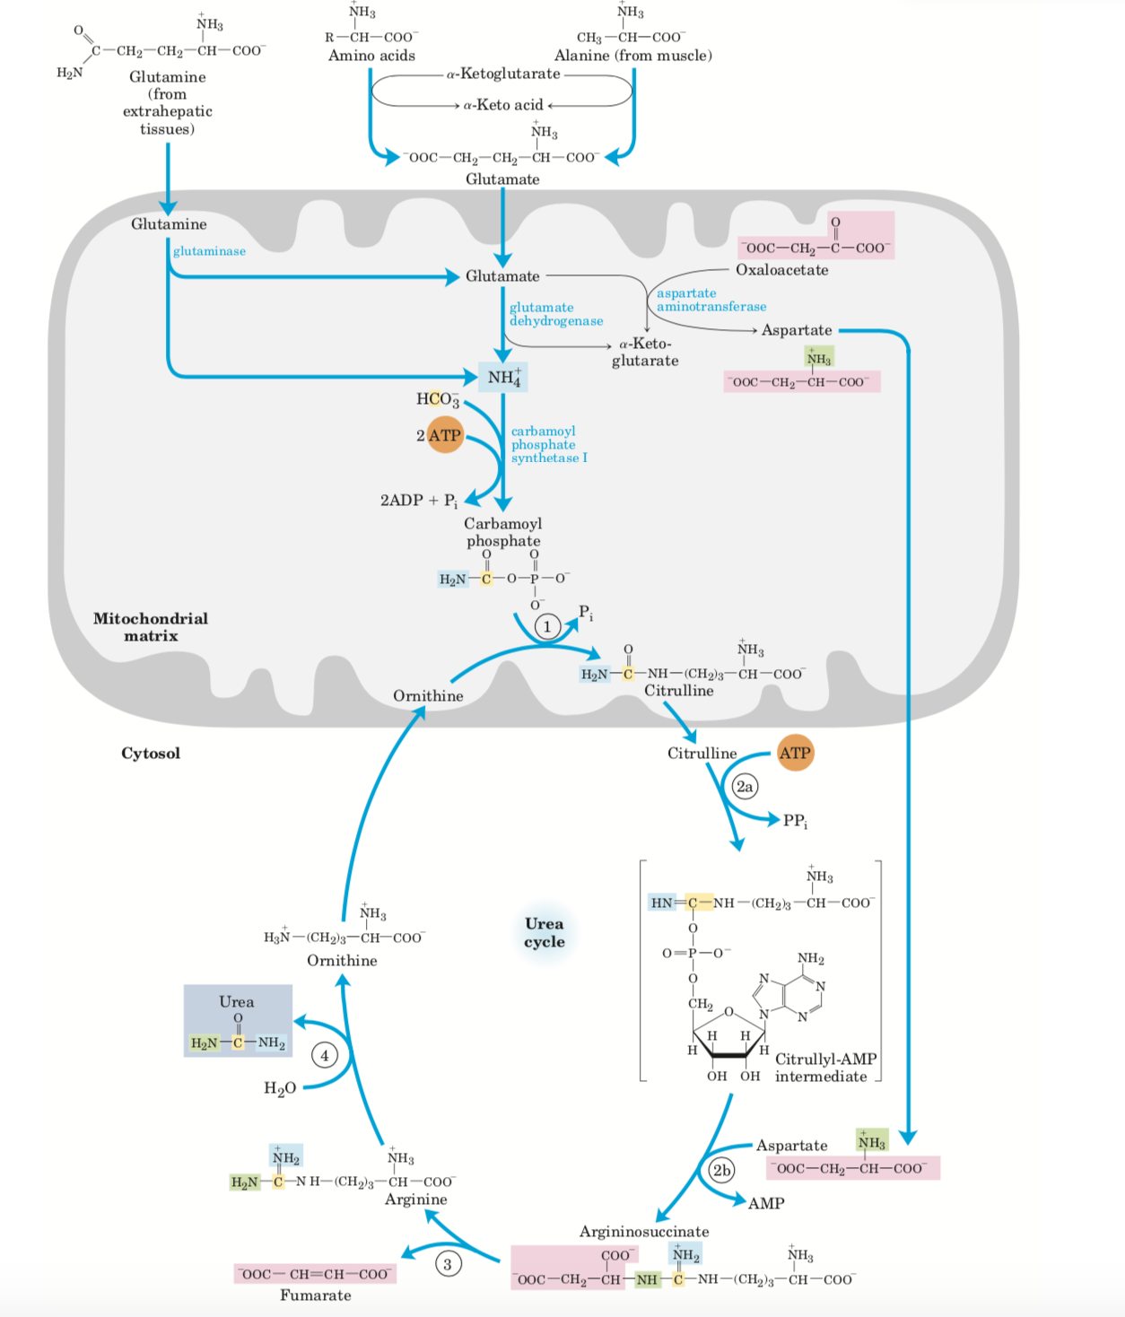

Slide 27
