Slide 1

Principles of causation and Interpretation of results part 2

Slide 2
Causation
RISK FACTOR
DISEASE
Observational study
Results that show an association
Is the association due to chance?
Is the association due to Bias?
Is the association due to confounding?
Is the association a cause-effect relationship?

Slide 3
Causality
There is an Association between a risk factor and a certain disease!!
Is it a true cause and effect relationship?
Hill’s Criteria for causality-
Strength Consistency Biologic plausibility
Temporality Dose-response Analogy
Specificity
Notes:
Causality-
There is an association between a dietary factor and a certain disease! Now the question is is it a true cause and effect relationship??
Bradford Hill suggested certain factors that can be considered for determining causality. It is worth notng that hill has not intended to offer a check list of necessary conditions for proving causality but rather as a guildline...
An association is causal if it is strong, if there are consisitent findings from different types of studies, if there is a biologic mechanism behind the association, temporality- exposure have to proceed the outcome, for a relation to be causal there should be a dose –response relationship, and another criteria is analogy- the association had been demonstarted in other species- for example in animals! Specificity is another criteria which means that for a factor to be causal it must lead to a single effect not to multiple effects.

Slide 4
Problems with Hill’s ”criteria”
Strength of association- weak associations can be causal.
Biologic plausibility- pathophysiology of most cancers and other chronic diseases is poorly understood-so lack of a well defined mechanism should not be used as evidence against causality.
Specificity – a dietary factor maybe associated with many diseases and therefore this criteria is irrelevent.
Notes:
Strength of association- in studies relating diet to disease, true associations are not likely to be strong because of low variation in diet between people.
Consistency- abosolute consistency is not realistic because of the complexity of nutrient-nutrient interactions and low variation in diet within populations
Biologic plausibility- pathophysiology of most cancers and other chronic diseases is poorly understood-so lack of a well defined mechanism should not be used as evidence against causality.
Specificity – diet maybe associated with many diseases and therefore this criteria is irrelevent. For example low folate is associated with neural tube defects and with increasing the risk of CVD.

Slide 5

Causality
Dose –response- not all relationships are linear.
Optimal
100%
Marginal
Marginal
Biological Function
Deficiency
Toxicity
Concentration or intake of nutrient
Figure adapted from W. Willett, nutritional epidemiology 2nd ed. 1998
Notes:
As for dose-response relationships- relationship between the dietary factor and disease are likely to be non linear, and therefore the dose response relationship depends on the levels you are comparing and their location on the curve.
For example if 2 points on the ascending part of the curve are compared, it might be concluded that the nutrient was beneficial. If points on the horizontal portion are compared, it might be concluded that the nutrient had no effect. If points on the descending segment were contrasted, it might be reported that the nutrient was harmful.
Therefore the health effects of the nutrient can only be fully appreciated by an examination of the dose-response relationship over a full range of exposures, which may not be possible within any single study.
Also clear dose-response relationships can be the result of bias or confounding.

Slide 6




SCIENCE VOL 296 14 JULY 1995
Notes:
And in the July 1995 issue of Science an article regarding the limitations and diffculties in epidemiology in establishing a causal relationship between diet, lifestyle or environmental factors with disease has been published. In this article famous epidemiologists were asked about the reason for the contraversial findings in epidemiology. ken rothman for example said- we are pushing the edge of what can be done with epidemiology, and norman breslow said that people may think they have been able to control for things that are inherently not controlable.
And sander greenland said the sin comes in believing a causal hypothesis is true because your study came up with a positive answer.

Slide 7
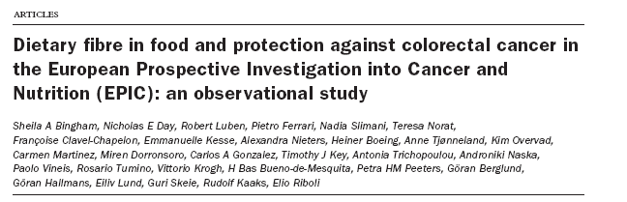
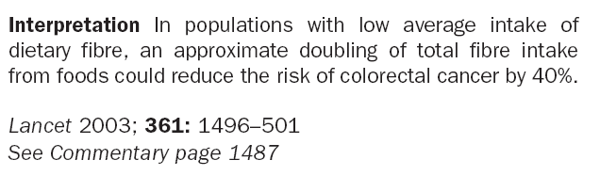
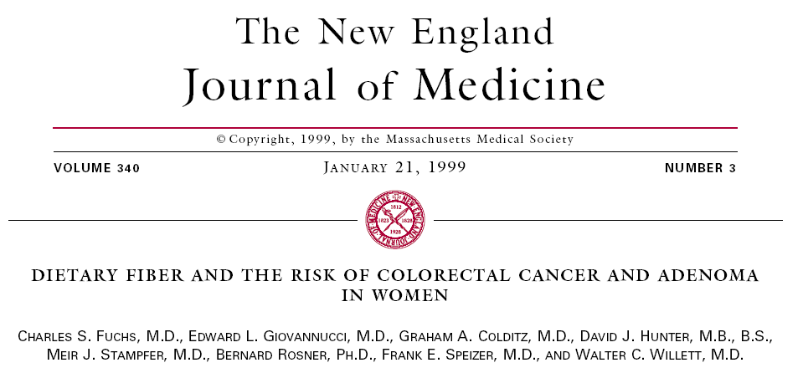
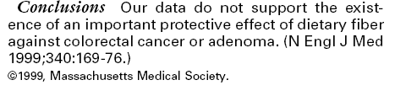
Notes:
however…..There are contraversial findings in epidemiology…… for example does dietary fiber in food protects against colorectal cancer?
Results from 2 large cohorts studies looked at this. The Epic study which is a cohort on 478,021 individuals from 10 European countries. Showed that the intake of fibre reduces the risk of colorectal cancer by 40%.
While another cohort: Nurses’s health study which has dietary data on 77 283 women showed that there was no protective effect of dietary fiber against colorectal cancer.

Slide 8
  [Fat consumption and breast cancer: preliminary results from the E3N-Epic cohort]
  CONCLUSION: There was no detectable association between fatty acids or food items contributing to fat intake and breast cancer risk. These analyses suggest there is a need for longer follow-up time to increase statistical power and confirm these tendencies.
Bull Cancer. 2001 Oct;88(10):954-8
  Premenopausal fat intake and risk of breast cancer
  CONCLUSIONS: Intake of animal fat, mainly from red meat and high-fat dairy foods, during premenopausal years is associated with an increased risk of breast cancer.
J Natl Cancer Inst. 2003 Jul 16;95(14):1079-85.
Notes:
Another example
Does fat consumption increase the risk of breast cancer?
The Epic study reported no detectable association between fat intake and breast cancer, while the large nurse’s health study reported an increased risk.
The literature is full of such contraversial findings….

Slide 9
Vitamin A and lung cancer
Vitamin A: function and forms
Vitamin A functions in the regulation of cell differentiation. Loss of differentiation is a basic feature of malignancy so vitamin A maybe related to cancer incidence.
Vitamin A – diversity of sources
Animal sources - vitamin A pre-formed - retinol
Plant sources - Carotenoids – Beta-carotene retinol
Notes:
Vitamin A and lung cancer-
Vitamin A functions in the regulation of cell differentiation. Loss of differentiation is a basic feature of malignancy so vitamin A maybe related to cancer incidence.
vitamin A comes from 2 sources- animal sources –contain the natural preformed vitamin A , usually referred to as retinol.
And plant sources which don’t have the preformed vitamin A but have a group of carotenoids , some of which can be metabolized to form retinol, the physiologically active form of vitamin A. Beta carotene is the most plentiful carotenoid with potential vitamin A activity.because it can be cleaved after absorption to form 2 molecules of retinol.

Slide 10
Vitamin A and lung cancer
Animal studies
Animal studies showed that Vitamin A inhibited the occurence of induced tumors.
Epidemilogic studies
  Case-control – diet
Cohort –diet
    serum
Notes:
Animal studies showed that vitamin a inhibited the occurence of induced tumers.
The relationship between vitamin a and lung cancer was also evaluated in epidemiologic studies.
In cohort studies both dietary intake and serum levels of pre-formed vitamin A abd beta carotene were studied as the dietary exposure.
In case control studiies only dietary intake was used as a dietary exposure since the levels of the vitamin A can be affected by disease or treatment in cases and so is not a valid estimate.

Slide 11
Vitamin A and lung cancer
Cohort studies of vitamin A intake and lung cancer
RR for High vs. Low intake categories
Total pre-formed carotenoid
Bjelke (1975)- 8278 Norwegian men 0.4
Kvåle 1983- extended follow-up of the same cohort.
0.5
Shekelle et al 1981 NS 0.1
Notes:
Prospective studies on vitamin A intake and lung cancer –
The fisrt study was conducted by Bjelke in 1975 and it was a follow-up study on 8278 norwegian men. The RR for total vitamin intake estimated from the intake of fruits and vegetables was 0.4 for men who took above average levels of vitamin A than those who’s intake of vitamin A was below average, ie there was a 60% decrease in risk.
In an extended follow up of same cohort Kvåle found that the protective effects were attributable to carrots and other vegetables, so this study provided stronger evidence for a beneficial effect of carotenoids than from preformed vitamin A.
The first epidemiologic study in which the independent effects of carotenoids and preformed vitamin A were formally examined was reported by Shekelle et al in 1981, and he found that preformed vitamin A was not related to the incidence of lung cancer, but in a striking contrast vitamin A from carotenoids was strongly associated with lower risk of this disease.
After that more prospective studies were done and most of them found an inverse relationship between vitamin A carotenoids and the risk of lung cancer. It is worth noting that stronger inverse relationships were observed for fruits and vegetables intake , suggesting that factors in those foods, other than or in addition to beta carotene might be protective against lung cancer.

Slide 12
Vitamin A and lung cancer
Case-control studies of vitamin A intake and lung cancer
RR for high vs. Low intake categories
Total preformed carotenoid
MacLennan et al 1977
0.6-0.7
Zigler et al 1984
1.1 1.3 0.8
Le Marchand et al 1989 Men 0.6 1.1 0.5
Women 0.4 1.0 0.4
Notes:
Around 20 case control studies were done to study the relationship between the intake of vitamin A and lung cancer all studies had consistent findings. Preformed vitamin A had no relationship with with the incidence of lung cancer while carotenoids sources of vitamin A were protective against lung cancer. And in this table we see few examples of these studies.
However these studies didnot distingish between the various carotenoids including those without potental vitamin A activity.

Slide 13
Vitamin A and lung cancer
Serum beta-carotene and lung cancer
RR for
High vs. Low category
Nomura et al (1985) 0.5
Menkes et al (1986) 0.5
Notes:
As for beta caroten nested case control studies showed consistently that serum beta caroten was inversely associated with lung cancer.

Slide 14
Vitamin A and lung cancer
Causality
Is this relationship CAUSAL?
Hill’s Criteria for causality-
Strength Consistency Biologic plausibility
Temporality Dose-response Analogy
Specificity





Consistency of the association between carotenoid intake and lung cancer as seen in case-control and cohort studies as well as those based on biochemical measurments
Notes:
Now what about causality? Is this relationship causal?
If we go through Hill’s criteria for causality we can say that the relationship between beta carotene and lung cancer was moderately strong, there was Consistency in the association between carotenoid intake and lung cancer as seen in case-control and cohort studies as well as those based on biochemical measurments. The biological plausibility exisits in the fact that Vitamin A functions in the regulation of cell differentiation. Loss of differentiation is a basic feature of malignancy so vitamin A maybe related to cancer incidence. Temporality was demonstated in the cohort studies. And as for analogy animal studies have previously shown that Vitamin A inhibited the occurence of induced tumers. However it is worth mentioning that beta carotene was not extensively studied in animals and the studies showed that alpha carotene seems more promising! As for specificity well there is no specificity since vitamin a has been see to reduce the risk of different types of cancer.
now is the relationship due to confounding?

Slide 15
Vitamin A and lung cancer
Randomized Trials
3 large Randomized Trials
The Alpha-Tocopherol Beta-Carotene Cancer Prevention Study, 1994
- Conducted among smoking men in Finland
STOPPED after 6 Years
Incidence of lung cancer was 18% higher in the treatment group
Notes:
The best way to resolve confounding is by doing a randomized controlled trial.’
Relatively easy to implement- active agent can be formulated in a capsule.
and in fact 3 large randomized controlled trials were conducted.
First the The Alpha-Tocopherol Beta-Carotene Cancer Prevention Study, 1994
And it was conducted among smoking men in finland
an unexpected result happened and the trial was stopped after 6 years because the incidence of lung cancer was 18% higher in the treatment group!

Slide 16
Vitamin A and lung cancer
Randomized Trials
Carotene and Retinol Efficacy Trial, CARET Study, 1996
conducted among men who were at high risk due to smoking or asbestos exposure.
A combination of beta-carotene and preformed vitamin A was compared with placebo
Stopped prematurely
28% increase in the incidence of lung cancer among men receiving the supplements
Notes:
The second study was the Caret study, 1996
conducted among men who were at high risk due to smoking or asbestos exposure.
A combination of beta-carotene and preformed vitamin A was compared with placebo
This trial was also Stopped prematurely- because there was a 28% increase in the incidence of lung cancer among men recieving the suppplements.

Slide 17
Vitamin A and lung cancer
Randomized Trials
The physicians health study, 1996
-Conducted among US physicians who received beta-carotene supplements for 12 years.
No increase or decrease in lung cancer (relative risk= 0.93)
Notes:
The third study was the physicians health study- 1996
Conducted among US physicians who recieved beta-carotene supplements for 12 years.
and in this study there was No increase no decrease in lung cancer (relative risk= 0.93)
These RT collectievely provide strong evidence against the hypothesis that high doses of beta-carotene supplementation can reduce the risk of lung cancer
The lack of any protective effect in the Physician’s Health Study decreases the probability that an important protective effect was missed due to unsufficient follow-up time.
The lack of an adverse (or beneficial) effect of beta-carotene in the 3rd Trial could possibly be related to the higher levels of blood carotenoids at baseline .

Slide 18
Vitamin A and lung cancer
Conclusions
The inverse relationship between intake of vegetables and fruits and the risk of lung cancer, represents one of the best established associations in the field of nutritional epidemiology.
Randomized trials indicate that this is unlikely to be due to a protective effect of beta carotene. It is more likely that other carotenoids or chemically unrelated, but correlated constituents are the active agents.
More specific and detailed analyses of observational data could be of great value-
Dietary measurments-data analysis for individual foods and for known nutrients
-Biochemical measurements measure a wide variety of factors, including other specific carotenoids
Notes:
The inverse relationship between intake of vegetables and fruits and the risk of lung cancer, represents one of the best established associations in the field of nutritional epidemiology.
Randomized trials indicate that this is unlikely to be due to a protective effect of beta carotene. It is more likely that other carotenoids or unrelated constituents are the active agents.
More specific and detailed analyses of obsevational data could be of great value- - dietary measurments-data analysis for individual foods and for known nutrients
-biochemical measurements measure a wide variety of factors, including other specific carotenoids

Slide 19
  Prospective study of fruit and vegetable consumption and risk of lung cancer among men and women
(47 778 men Health Professionals' Follow-up Study
and 77 283 women in the Nurses' Health Study )
J Natl Cancer Inst. 2000 Nov 15;92(22):1812-23
  CONCLUSION: Higher fruit and vegetable intakes were associated with lower risks of lung cancer in women but not in men. It is possible that the inverse association among the women remained confounded by unmeasured smoking characteristics, although fruits and vegetables were protective in both men and women who never smoked.
Notes:
Using data from 2 large cohort studies- (47 778 men Health Professionals' Follow-up Study
and 77 283 women in the Nurses' Health Study )
the relationship between the intake of fruits and vegetables and the risk of lung cancer was evaluated
And the authors concluded that CONCLUSION: Higher fruit and vegetable intakes were associated with lower risks of lung cancer in women but not in men
( It is possible that the inverse association among the women remained confounded by unmeasured smoking characteristics, although fruits and vegetables were protective in both men and women who never smoked.)

Slide 20
  Fruits and vegetables and lung cancer: Findings from the European prospective investigation into cancer and nutrition (EPIC)
Int J Cancer. 2004 Jan 10;108(2):269-276
  Data on 478,021 individuls from 10 European countries.
  CONCLUSION: There was no association between vegetable consumption or vegetable subtypes and lung cancer risk. After adjustment for age, smoking, height, weight and gender, there was a significant inverse association between fruit consumption and lung cancer risk: the hazard ratio for the highest quintile of consumption relative to the lowest being 0.60 (95% Confidence Interval 0.46-0.78), p for trend 0.0099
Notes:
and a recent paper that will be published next month-Data on 478,021 individuls from 10 European countries, participating in the epic study reported that.
There was no association between vegetable consumption or vegetable subtypes and lung cancer risk however there was a significant association with fruit consumption!

