Slide 1
Lecture 8
NUTD 343
Dr. Emilia Rappocciolo

Slide 2
Campylobacter
Curved, S-shaped, or spiral rods that are 0.2 to 0.9 μm wide and 0.5 to 5 μm long. Gram-negative, non-spore-forming rods that may form spherical or coccoid bodies in old cultures or cultures exposed to air for prolonged periods. The organisms are motile, microaerophilic (can be killed by oxygen and susceptible to freezing).
  Susceptible to low pH and are killed at pH 2.3.
  Viable and grow in bile at 37°C and survive better in feces, milk, water, and urine held at 4°C than in material held at 25°C.
  Freezing reduces the number of Campylobacter organisms in contaminated poultry, but even after being frozen to −20°C, small numbers of Campylobacter organisms can be recovered.
  In spite of its fragility, Campylobacter still ranks close to Salmonella in the number of laboratory confirmed cases of foodborne illness.

Slide 3
aNimal reservoirs

Slide 4
disease
Gastrointestinal disease mostly caused by C. jejuni and C. coli.
Patients may be asymptomatic (show no sign of illness) to severely ill. Symptoms and signs: fever, abdominal cramping, and diarrhea (with or without blood) that lasts several days to >1 week. Symptomatic infections are usually self-limiting Other infections and diseases include bacteremia, bursitis, urinary tract infection, meningitis, endocarditis, peritonitis, erythema nodosum, pancreatitis, abortion and neonatal sepsis, reactive arthritis, and Guillain-Barré syndrome (GBS).
Deaths directly attributable to C. jejuni infection are rarely reported
Easily treated with antibiotics. Erythromicin, ciproflaxicin. Little known resistance.

Slide 5
Virulence factors
Attachment: intimate binding of the bacterium with the host cell surface by using many types of adhesins. Following contact, C. jejuni produces at least 14 new proteins. Production corresponds to a rapid increase in uptake and changes in the host cell membrane. Following attachment and internalization, Campylobacter-infected cells release molecules that promote the recruitment of white blood cells to the site of the infection. Induction of host cell death by C. jejuni may enhance the survival and spread of the pathogen.
Flagella and Motility: Motility and flagella are important determinants for the entry process.
Toxins: C. jejuni may produce an enterotoxin similar to cholera toxin. Other Factors

Slide 6
Virulence factors
Campylobacters are microaerobic, and C. jejuni has a higher temperature for optimal growth, 42°C, than other intestinal bacterial pathogens. Understanding the effects of environmental signals on the growth, metabolism, and pathogenicity of Campylobacter strains will have a major impact on the ability to control campylobacters in the environment and food chain. Such pathways include response to iron; oxidative stress; temperature regulation, including cold and heat shock responses; and starvation

Slide 7
Yersinia enterocolitica
11 species and is classified within the family Enterobacteriaceae. Gram-negative, oxidase-negative, rod-shaped, facultative anaerobes that ferment glucose.
The genus includes three well-characterized pathogens of mammals, one pathogen of fish, and several other species whose etiologic role in disease is uncertain. The four known pathogenic species are Y. pestis, the causative agent of bubonic and pneumonic plague (the Black Death); Y. pseudotuberculosis, a rodent pathogen that occasionally causes disease in humans; Yersinia ruckeri, a cause of enteric disease in salmonids and other freshwater fish; and Y. enterocolitica, a versatile intestinal pathogen and the most prevalent Yersinia species among human

Slide 8
Virulence factors
Most environmental strains are nonpathogenic
Pathogenic strains are predominant in pigs.
Both the pathogenic and non pathogenic strains produce enterotoxin. (Yst) toxin production alone is not enough to cause yersiniosis.
Pathogenic strains carry several virulence factors encoded in chromosome. Adhesion, invasion, and colonization in intestinal epithelial cells and lymph nodes.
After colonization, Yst enterotoxin cause fluid secretion in intestine.
The pathogenic strains vary in serological characteristics.

Slide 9
Disease and symptoms
Foods incriminated for yersiniosis are refrigerated foods
A high dose 10⁷ cells is required for the disease
Once ingested, the bacteria binds/adheres to M cells in the terminal ilium and is taken up by M cells
Engulfed bacteria are released and invade epithelial cells
Bacteria can spread to regional lymph nodes, liver, and spleen.
In the intestine, the enterotoxin, promotes fluid secretion resulting in diarrhea.
Young children are more susceptible to foodborne yersiniosis.
Symptoms
  severe abdominal pain at the lower quadrant of the abdomen mimicking appendicitis, diarrhea, nausea, vomiting, and fever.
The disease can be fatal in rare cases

Slide 10
Food association
Many foods can harbor the organism
  raw milk
  processed dairy products
  raw and improperly cooked meats
  fresh vegetables
  improperly chlorinated water
Foods implicated in yersiniosis:
  raw and pasteurized milk, ice cream
  improperly cooked meats
A food can be contaminated from a human carrier or a pet
Cells can grow at refrigerated temperature, a low initial load can reach a high level during extended storage of refrigerated foods

Slide 11
prevention
The strains are psychrotrophs
refrigeration cannot be used to control growth
Good sanitation during handling and processing of food
Proper heat treatment are important to control the occurrence of yersiniosis
Consumption of raw milk or meat cooked at low temperatures should be avoided

Slide 12
vibrio
The genus Vibrio consists of at least 28 species, and 3 that are often associated with V. parahaemolyticus in aquatic environments and seafood are V. vulnificus, V. alginolyticus, and V. cholerae.
V. parahaemolyticus as a foodborne gastroenteritis agent was made first by Fujino in1951. Whereas the incidence of this illness is low in the United States and some European countries, it is high in Japan.
V. cholerae is best known as the cause of human cholera contracted from polluted water, and seven pandemics have been recorded. Prior to 1992, the strains that cause epidemic/pandemic cholera belonged to serovar O group 1. Although generally non pathogenic, non-01 strains are known to cause gastroenteritis, soft-tissue infections, and septicemia in humans.

Slide 13
disease
Extremely virulent, can cause severe watery diarrhoea that if not treated can kill within hours.
Most infected people do not show symptoms, but can shed the bacteria for up to 10 days and infect others.
Transmission closely linked to limited access to sanitation, clean water, and adequate sewage systems.
A vaccine is available. Cholera is an easily treatable disease. The majority of people can be treated successfully through prompt administration of oral rehydration solution (ORS).

Slide 14
Enterohemorrhagic Escherichia coli
E. coli - facultative anaerobic gram-negative bacterium
Present mainly in the GI of humans animals
Most commensal strains are harmless
Many are pathogenic and cause diseases/infections:
  intestinal gastroenteritis
  urinary tract infections
Differentiated by serology/genetic by surface antigens or their encoding genes:
  “O” (somatic), identifies the serogroup (0157, 055, ...)
  “H” (flagella), identifies the serotype (H7,..)
  “K” (capsule) antigens (not used for E.coli diarrheal disease)
Based on O, H antigens, > 700 serotypes of E. coli are identified

Slide 15
Enterohemorrhagic Escherichia coli
Pathogenicity/virulence is based on:
  adhesions (fimbriae, intimin)
  invasions (hemolysins)
  motility (flagella)
  toxins (enterotoxins, Shiga toxins [Stxs], cytotoxins, endotoxins),
  Antiphagocytic (capsules, K antigens, LPS)
genetic characteristics (plasmids, pathogenecity islands)
Dose levels vary- E.coli 0157:H7 as low as 10 cells
Symptoms occur after 24 hrs.
Symptoms: abdominal pain, diarrhoea, nausea, vomiting, fever

Slide 16
Shiga-toxigenic Escherichia coli
Strains in this group (O157:H7) and some others, recognized in (1982) cause:
severe bloody diarrhea (hemorrhagic colitis)
hemorrhagic uremic syndrome (HUS) in humans.
The main characteristics of these pathotypes is
the production of Shiga-toxin (Stx), Stx1 and Stx2 -important virulence factors, responsible for HUS.
Stx binds to receptor in intestinal, kidney cells and leukocytes, blocks protein synthesis, cause cell death.

Slide 17
e. Coli o157:h7
O157:H7 produce Stx(s)
grows rapidly at 30–42ºC but poorly at 44–45 ºC, NG at <10ºC
Strains resistant to pH < 4.5 have been identified
destroyed by pasteurization 64.3ºC in 9.6 s
The cells survive well in food at –20ºC.
Inability to ferment sorbitol within 24 hours
EHEC produce pediatric bloody diarrhea (80%) and hospitalization (34%)
Copious bloody discharge (haemorrhagic colitis), intense inflammation, haemolytic uremic HUS.

Slide 18
e. Coli o157:h7
Survival of enteric E. coli strains in the highly acidic environment of human digestive tract.
E. coli is known to be tolerant to acid
This tolerance contribute to low dose (~102 cells) required for infection
Four of the five primary systems utilize an amino acid dependent amino acid decarboxylase to generate an alkaline product and CO₂ which will raise the pHi from 2.5-4
AR2: glutamate decarboxylase
AR3: arginine-dependent
AR4: lysine dependent- lysine decarboxylase

Slide 19
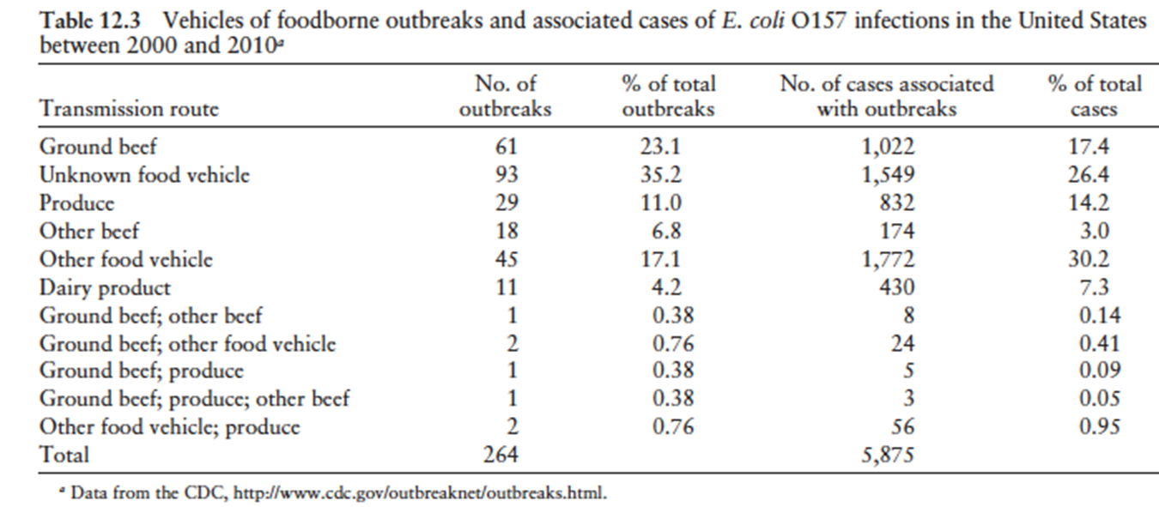
outbreaks

Slide 20
prevention
Proper sanitation
Cook at appropriate temperatures, refrigerate, and prevent cross-contamination
The Food Safety Inspection Service in the US has provided guidelines to control foodborne illness from this pathogen:
  Use only pasteurized milk
  quickly refrigerate or freeze perishable foods
  never thaw a food at room temperature or keep a refrigerated food at room temperature over two hours
  wash hands, utensils, and work areas with hot soapy water after contact with raw meat
  cook meat until the center is gray or brown
  prevent fecal-oral contamination through proper personal hygiene
  decontaminate produce surfaces using liquid (hypochlorite solution, hydrogen peroxide) or gaseous (ozone, chlorine dioxide)

