Slide 1
IDS/IPS Definition and Classification

Slide 2
Contents
Overview of IDS/IPS
Components of an IDS/IPS
IDS/IPS classification
  By scope of protection
  By detection model

Slide 3
Overview of IDS/IPS
Intrusion
  A set of actions aimed at compromising the security goals (confidentiality, integrity, availability of a computing/networking resource)
Intrusion detection
  The process of identifying intrusion activities
Intrusion prevention
  The process of both detecting intrusion activities and managing responsive actions throughout the network.

Slide 4
Overview of IDS/IPS
Intrusion detection system (IDS)
  A system that performs automatically the process of intrusion detection.
Intrusion prevention system (IPS)
  A system that has an ambition to both detect intrusions and manage responsive actions.
  Technically, an IPS contains an IDS and combines it with preventive measures (firewall, antivirus, vulnerability assessment) that are often implemented in hardware.

Slide 5
Overview of IDS/IPS
Some authors consider an IPS a new (fourth) generation IDS – a convergence of firewall and IDS.
IPS use IDS algorithms to monitor and block/allow traffic based on expert analysis.
The ”firewall” part of an IPS can prevent malicious traffic from entering/exiting the network. It can also alert the operator about such activities.

Slide 6
Overview of IDS/IPS
A complete IPS solution usually has the capability of enforcing traditional static firewall rules and operator-defined white -lists and blacklists.
IPS are very resource intensive. In order to operate with high performance, they should be implemented by means of the best hardware and software technologies.
IPS hardware often includes ASICs (Application Specific Integrated Circuits)

Slide 7
Overview of IDS/IPS
Principal differences between IDS and IPS:
  IPS try to block malicious traffic, unlike IDS that just alert personnel to its presence.
  IPS acts to combine single-point security solutions (anti-virus, anti-spam, firewall, IDS, …).

Slide 8
Overview of IDS/IPS
Basic assumptions:
  System activities are observable
  Normal and intrusive activities have distinct evidence – the goal of an IDS/IPS is to detect the difference.

Slide 9
Components of an IDS/IPS
System activities are observable
Incoming traffic/logs
Data pre-processor
Activity data
Detection
model(s)
Normal and intrusive activities have distinct evidence
Detection algorithm
Alerts
Decision
criteria
Action/Report
Alert filter

Slide 10
Components of an IDS/IPS
Data pre-processor
  Collects and formats the data to be analyzed by the detection algorithm.
Detection algorithm
  Based on the detection model, detects the difference between ”normal” and intrusive audit records.
Alert filter
  Based on the decision criteria and the detected intrusive activities, estimates their severity and alerts the operator/manages responsive activities (usually blocking).

Slide 11
Components of an IDS/IPS
Incoming traffic/log data
  Packets – headers contain routing information, content may (and is more and more) also be important for detecting intrusions.
  Logs – a chronological set of records of system activity.

Slide 12
Components of an IDS/IPS
Incoming traffic/log data (cont.)
  Problems related to data
    Inadequate format for intrusion detection
    Information important for intrusion detection is often missing (e.g. in log files).
  Thus we need some data pre-processing
    Adjust data format (relatively easy)
    Resolve for missing data (not so easy)
      Insertion of reconstructed values
      Special distances (for unequal-length data patterns).

Slide 13
Components of an IDS/IPS
Detection algorithm
  Checks the incoming data for presence of anomalous content.
  A major detection problem
    There is no sharp limit between “normal” and “intrusive” – it often depends on the context – hence statistical analysis of the input data may be useful.
    To determine the context, a lot of memory is needed.

Slide 14
Components of an IDS/IPS
Alert filter
  Determines the severity of the detected intrusive activity.
  A major decision problem
    It is difficult to estimate the severity of threat in real time.
    Filtering is normally carried out by means of a set of thresholds (decision criteria). Thresholds should be carefully set in order to maintain a high level of security and a high level of system performance at the same time.

Slide 15
IDS/IPS classification
By scope of protection (or by location)
  Host-based IDS
  Network-based IDS
  Application-based IDS
  Target-based IDS
By detection model
  Misuse detection
  Anomaly detection

Slide 16
IDS classification
Host-based
  Collect data from sources internal to a computer, usually at the operating system level (various logs etc.)
  Monitor user activities.
  Monitor executions of system programs.

Slide 17
IDS classification
Network-based
  Collect network packets. This is usually done by using network devices that are set to the promiscuous mode. (A network device operating in the promiscuous mode captures all network traffic accessible to it, not just that addressed to it.)
  Have sensors deployed at strategic locations
  Inspect network traffic
  Monitor user activities on the network.

Slide 18
IDS classification
Application-based
  Collect data from running applications.
  The data sources include application event logs and other data stores internal to the application.

Slide 19
IDS classification
Target-based (integrity verification)
  Generate their own data (by adding code to the executable, for example).
  Use checksums or cryptographic hash functions to detect alterations to system objects and then compare these alterations to a policy.
  Trace calls to other programs from within the monitored application.

Slide 20
IDS classification
Misuse detection
  Asks the following question about system events: Is this particular activity bad?
  Misuse detection involves gathering information about indicators of intrusion in a database and then determining whether such indicators can be found in incoming data.

Slide 21
IDS classification
Misuse detection (cont.)
  To perform misuse detection, the following is needed:
    A good understanding of what constitutes a misuse behaviour (intrusion patterns, or signatures).
    A reliable record of user activity.
    A reliable technique for analyzing that record of activity (very often – pattern matching).

Slide 22
Misuse Detection
Intrusion patterns (signatures)
Analysis (e.g. pattern matching)
Intrusion
Activities
Signature example: if src_ip = dst_ip then “land attack”

Slide 23
IDS classification
Misuse detection (cont.)
  It is best suited for reliably detecting known misuse patterns (by means of signatures).
  It is not possible to detect previously unknown attacks, or attacks with unknown signature. A single bit of difference may be enough for an IDS to miss the attack.
  However, it is possible to use the existing knowledge (for instance, of outcomes of attacks) to recognize new forms of old attacks.

Slide 24
IDS classification
Misuse detection (cont.)
  Misuse detection has no knowledge about the intention of activity that matches a signature.
  Hence it sometimes generates alerts even if the activities are normal (normal activities often closely resemble the suspicious ones).
  Hence IDS that use signature detection are likely to generate false positives.

Slide 25
IDS classification
Misuse detection (cont.)
  New attacks require new signatures, and the increasing number of vulnerabilities causes that signature databases grow over time.
  Every packet must be compared to each signature for the IDS to detect intrusions. This can become computationally expensive as the amount of bandwidth increases.

Slide 26
IDS classification
Misuse detection (cont.)
  When the amount of bandwidth overwhelms the capabilities of the IDS, it causes the IDS to miss or drop packets.
  In this situation, false negatives are possible.

Slide 27
IDS classification
Anomaly detection
  Anomaly detection involves a process of establishing profiles of normal user behaviour, comparing actual user behaviour to those profiles, and alerting if deviations from the normal behaviour are detected.
  The basis of anomaly detection is the assertion that abnormal behaviour patterns indicate intrusion.

Slide 28
IDS classification
Anomaly detection (cont.)
  Profiles are defined as sets of metrics - measures of particular aspects of user behaviour.
  Each metric is associated with a threshold or a range of values.

Slide 29
IDS classification
Anomaly detection (cont.)
  Anomaly detection depends on an assumption that users exhibit predictable, consistent patterns of system usage.
  The approach also accommodates adaptations to changes in user behaviour over time.

Slide 30
IDS classification
Anomaly detection (cont.)
  The completeness of anomaly detection depends on the selected set of metrics – it should be rich enough to express as much of anomalous behaviour as possible.
  Capable of detecting new attacks.

Slide 31
IDS classification
Anomaly detection (cont.)
  An attacker can replicate a misuse detection system and check which signatures it detects.
  Then he/she can use the attack not detectable by the IDS in question.
  This is not possible to do with an anomaly detection system.

Slide 32
IDS classification
Anomaly detection (cont.)
  However, it is not always the case that abnormal behaviour patterns indicate an intrusion – sometimes, rare sequences represent normal behaviour. This is a major problem in anomaly detection – false positives.
  If anomaly detection IDS thresholds are set too high, we may miss the attacks and have false negatives.

Slide 33
Anomaly Detection
Profiles of normal behaviour
Intrusion
Analysis
Activities

Slide 34
IDS classification
Anomaly detection (cont.)
  Methods of anomaly detection:
    Statistical methods
    Artificial intelligence (cognitive science,…)
    Data mining
    Mathematical abstractions of biological systems (neural nets, immunological system simulation, process homeostasis…)
    Etc.

Slide 35
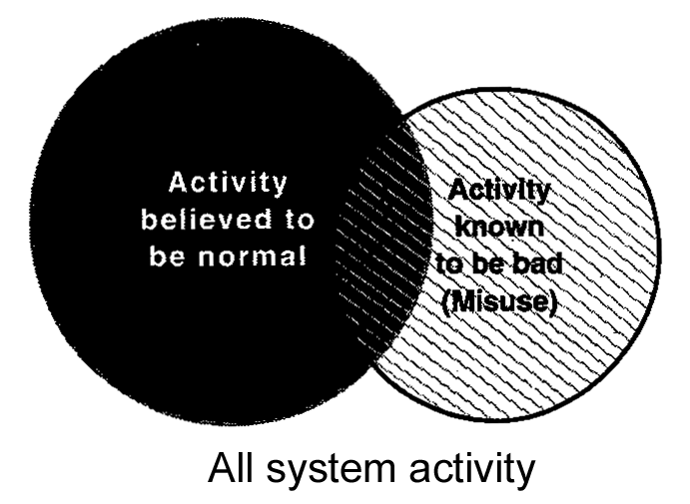
IDS classification
The fundamental debate between proponents of anomaly detection and proponents of misuse detection:
  Overlap of the regions representing "normal," and "misuse “ activities.

Slide 36
IDS classification
The proponents of anomaly detection assert that the intersection between the two regions is minimal.
The proponents of misuse detection assert that the intersection is quite large, to the point that given the difficulties in characterizing "normal” activity, it is pointless to use anomaly detection.

Slide 37
IDS classification
The solution of this problem is probably in combining the two detection models.
Although the IDS/IPS manufacturers do not publish the details of their designs, it is quite probable that they combine misuse detection and anomaly detection approach in their solutions.

