Slide 1
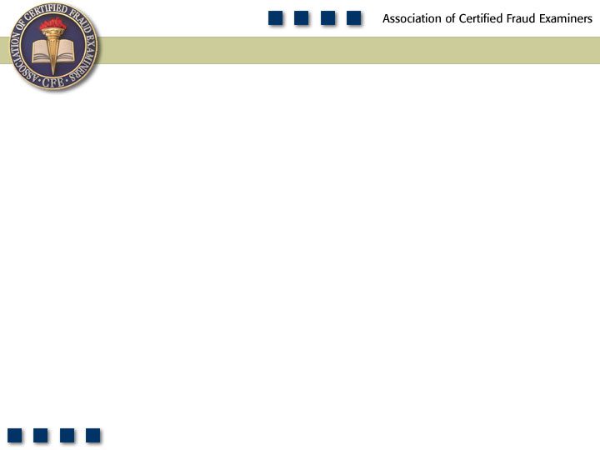
Chapter 6
Payroll Schemes

Slide 2
Learning Objectives
List and understand the three main categories of payroll fraud.
Understand the relative cost and frequency of payroll frauds.
Define a ghost employee.
List and understand the four steps to making a ghost employee scheme work.
Understand how separation of duties in payroll and human resources functions can reduce the threat of payroll fraud.
Be familiar with methods identified in this chapter for preventing and detecting ghost employee schemes.

Slide 3
Learning Objectives
List and understand the four ways that employees can obtain authorization for a falsified timecard in a manual system.
Understand the role that payroll controls play in preventing falsified hours and salary schemes.
Discuss the methods identified in this chapter for preventing and detecting falsified hours and salary schemes.
Understand how employees commit commission schemes.
Identify red flags that are typically associated with commission schemes.
Be familiar with proactive audit tests that can be used to detect various forms of payroll fraud.

Slide 4
Payroll
Schemes
Ghost
Employees
Commission
Schemes
Workers
Compensation
Falsified
Wages

Slide 5
Frequency of Fraudulent Disbursements

Slide 6
Median Loss of Fraudulent Disbursements

Slide 7
Payroll Schemes
Occupational frauds in which a person who works for an organization causes that organization to issue a payment by making a false claim for compensation
  Ghost employee schemes
  Falsified hours and salary schemes
  Commission schemes

Slide 8
Ghost Employees
Someone on the payroll who does not actually work for the victim company
  Fictitious person
  Friend or relative
  Accomplice
  Other

Slide 9
Ghost Employee Schemes
Adding the ghost to the payroll
  Through the personnel department
  Through the hiring department
  Through the payroll department
  Using names similar to real employees
  Failing to remove terminated employees from the payroll

Slide 10
Ghost Employee Schemes
Collecting timekeeping information
  Fake timecards
  Approval of timecards
  Computerized timekeeping systems
  Salaried workers vs. hourly workers

Slide 11
Ghost Employee Schemes
Issuing the ghost’s paycheck
Delivery of the paycheck
  Hand delivered
  Mailed to the employees address
  Direct deposited

Slide 12
Preventing and Detecting Ghost Employee Schemes
Separate the hiring function from the payroll function
Personnel records should be independently maintained from payroll and timekeeping functions
Personnel department should verify any changes to payroll
Background and reference checks should be made in advance of hire

Slide 13
Preventing and Detecting Ghost Employee Schemes
Periodically check the payroll records against personnel records for terminated employees and unauthorized wage or deduction adjustments
Periodically run computer reports for employees
  Without SSNs
  With no deductions - withholding taxes or insurance
  With no physical address or telephone number
Compare payroll expenses to production schedules
Keep signed checks in a secure location
Verify proper distribution and require employee identification

Slide 14
Falsified Hours and Salary
Overpayment of wages is the most common form of misappropriating payroll funds
Increase number of hours or rate of pay
Time clocks
Computer tracking of employee time
Manually prepared timecards

Slide 15
Manually Prepared Timecards
Forging a supervisor’s signature
Collusion with a supervisor
Rubber stamp supervisors
Poor custody procedures

Slide 16
Other Schemes
Time clocks and other automated timekeeping systems
  Employee has someone else clock in for him/her when absent
Rates of pay

Slide 17
Preventing and Detecting Falsified Hours and Salary Schemes
Preparation, authorization, distribution, and reconciliation should be segregated
Transfers of funds from general accounts to payroll accounts should be handled independently
No overtime should be paid unless authorized in advance
Sick leave and vacation time should not be granted without supervisory review and should be monitored for excessive time taken

Slide 18
Preventing and Detecting Falsified Hours and Salary Schemes
A designated official should verify all wage rate changes
Timecards should be taken directly to the payroll department after approval
Time cards should be secured and monitored
Run programs to actively seek out fraudulent payroll activity

Slide 19
Tests for Fraudulent Payroll Activity
Review employees who have significantly more overtime than similar employees
Trend analysis of budgeted vs. actual expenses
Run exception reports for employees who have had disproportionately large increases in wages
Verify payroll taxes equal federal return tax forms
Compare net payroll to payroll checks issued

Slide 20
Commission Schemes
Pay is based on an employee’s output rather than hours worked or a set salary
Falsify the amount of sales made
  Create fraudulent sales orders, customer purchase orders, credit authorizations, packing slips, invoices, etc.
  Ring up a false sale on the cash register
  Overstate legitimate sales
Fraudulently increase the rate of commission

Slide 21
Detecting Commission Schemes
Run periodic reports to show an unusual relationship between sales figures and commission figures
Run reports that compare commissions earned among salespersons
Track uncollected sales generated by each salesperson
Conduct random samples of customers to verify that the customer exists

