Slide 1
Disease frequency measures
Measures used as health indicators

Slide 2
“It is not because countries are poor that they cannot afford good health information; it is because they are poor that they cannot afford to be without it”
- Health Metrics Network, WHO, 2005

Slide 3
Mortality as Indicator of Health Status of a Population
Death is a unique and universal event, and as a final event, clearly defined
Age at death and cause of death provide a picture of health status
In high mortality settings, information on trends of death by causes substantiate the progress of health programs

Slide 4
As survival improves with modernization, and populations age, mortality measures do not give an adequate picture of a population’s health status
Indicators of morbidity such as the prevalence of chronic diseases and disabilities become more important

Slide 5
The concept of using mortality data as a basis for public health action arose in Europe some 500 years ago… Graunt’s analyses of Bills of Mortality in the 1600s…
Sadly, we know more about epidemiology and public health in certain 18th century European populations than we do about the current situation of some/many developing countries

Slide 6
Measures of Mortality
Crude Death Rates
Age-Specific Death Rates
Cause-Specific Death Rates
Life Table Estimates
– Life Expectancy
– Survivorship (by age)
Special Indicators
– Infant and Maternal Mortality Rates
Case Fatality

Slide 7
Crude Death Rate
Total number of deaths in a defined period (usually one year) out of the average population for that time period (per /1000 persons)

Slide 8
Risk of death changes by age, so CDR is affected by population age structure
Aging populations can have rising CDRs even as health conditions are improving
Countries with very young populations will often have lower CDRs, but not necessarily age-specific death rates, than those with older populations
Therefore, mortality comparisons across population groups must always account for differences in age composition

Slide 10
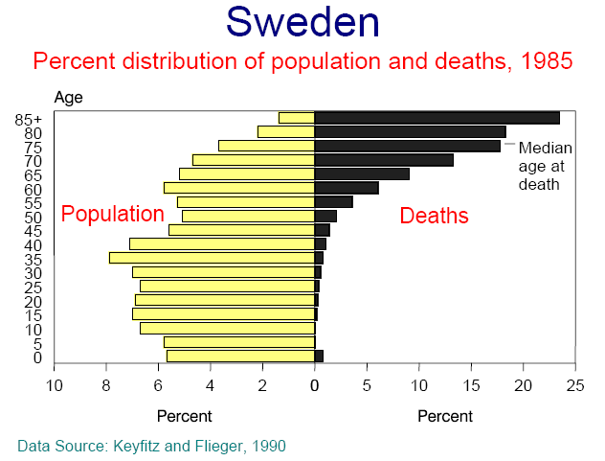

Slide 11
Age-specific Death Rates
Total number of deaths in a specific age-group within a defined period out of the average population for that age-group (per /1000 persons)

Slide 12
Why age-specific death rates?
Can compare mortality at different ages or in the same age group over time
Can compare across population groups with different age compositions
Can be used to calculate life-tables for life-expectancy estimations

Slide 13
Life Expectancy
LE_{age X} = average number of years a person aged x will live, if subject to the mortality rates contained in the life table (i.e. if the age-specific death rates for a given year prevailed for the rest of that person’s life)

Slide 14
“In the long run, we are all dead”
- John Maynard Keynes

Slide 15
Is there an upper limit to life expectancy?
Compression of mortality: An increasing of concentration of deaths at older ages
Compression of morbidity: An increasing of illness and disability in the latter years of life with fewer years of disabled life before death among the elderly
Are health gains matching or exceeding gains in survival?

Slide 16
If there is no compression of mortality and no postponement of morbidity, then increasing life expectancy will result in growing numbers of ill and disabled elderly, creating increasing burdens on the health care system and society

Slide 17
Highest – Japan: 82.6 years
Lowest – Swaziland: 39.6 years*
* 40% below world average!

Slide 18
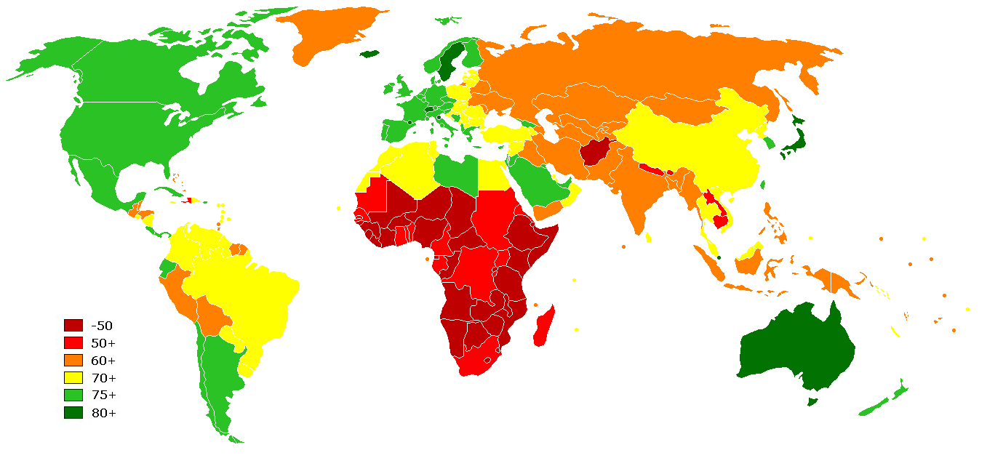

Slide 19
79.1 | Netherlands | 52.9 | Cameroon
47.4 | Nigeria | 80.3 | Canada
73.4 | Palest. Terr. | 72.9 | China
71.7 | Philippines | 72.9 | Colombia
65.5 | Russia | 52.9 | Ethiopia
64.6 | Tajikistan | 76.3 | Georgia
51.8 | Uganda | 59.5 | Ghana
67.9 | Ukraine | 68.6 | India
78.1 | USA | 55.3 | Kenya
65.0 | Uzbekistan | 65.9 | Kyrgyzstan
CIA World Factbook (2008 estimates)

Slide 20
Cause-Specific Death Rates
Number of deaths attributable to a particular cause divided by the population at risk (usually in deaths per 100,000)

Slide 21
Multiple causes of death are an important issue when dealing with cause-specific mortality data
At times, the cause with the greatest public health significance may be lost

Slide 22
Infant Mortality
Number of deaths before one year of age (from a specific cause or all causes) divided by total number of live births (/100,000 live births)

Slide 23
Why IMR?
Good indicator of overall health status (and healthcare) of a population
Major determinant of LE at birth
Sensitive to changes in socio-economic conditions

Slide 24
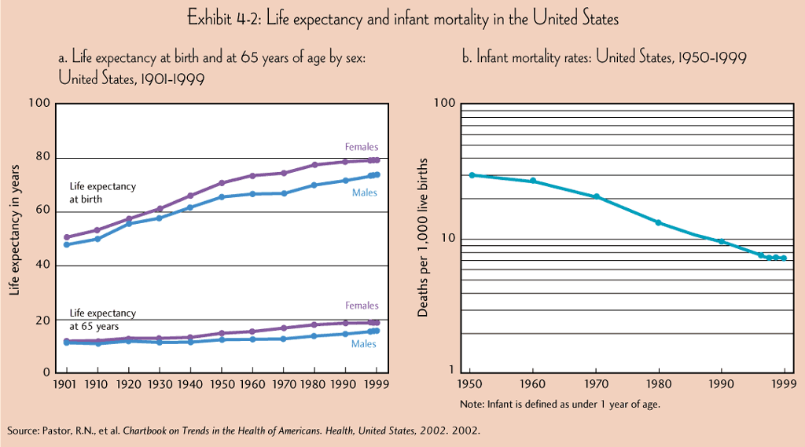

Slide 26
Maternal Mortality
“Death of a woman while pregnant or within 42 days of termination of pregnancy irrespective of the duration and site of pregnancy, from any cause related to or aggravated by the pregnancy or its management, but not from accidental or incidental causes”
- ICD-10

Slide 27
UN Millennium Development Goal #5
Improve Maternal Health
Maternal Mortality Ratio:
The number of recorded (or estimated) maternal deaths divided by the total recorded (or estimated) live births in the same period

Slide 28
The maternal mortality ratio should not be confused with the maternal mortality rate (whose denominator is the number of women of reproductive age), which measures the likelihood of both becoming pregnant and dying during pregnancy or within six weeks after delivery. The maternal mortality ratio (whose denominator is the number of live birth), takes fertility levels (likelihood of becoming pregnant) into consideration.

Slide 29
The Millennium Development Goals Report 2008

Slide 30
Maternal mortality remains unacceptably high across much of the developing world.
In 2005, more than 500,000 women died during pregnancy, childbirth or in the six weeks after delivery.
99% of these deaths occurred in the developing regions, with sub-Saharan Africa and Southern Asia accounting for 86% of them.
In sub-Saharan Africa, a woman’s risk of dying from treatable or preventable complications of pregnancy and childbirth over the course of her lifetime is 1 in 22, compared to 1 in 7,300 in the developed regions.

