Slide 1
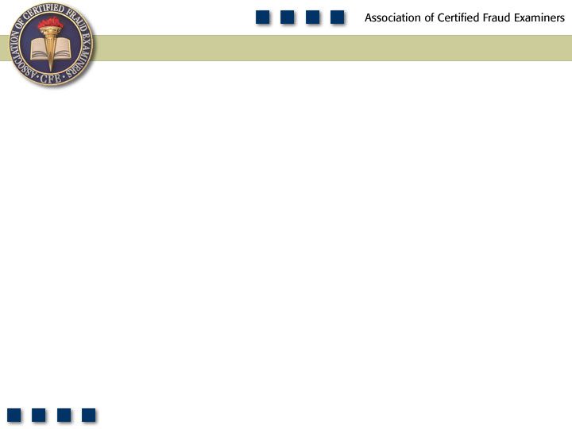
Chapter 5
Check Tampering

Slide 2
Learning Objectives
Define check tampering.
Understand the five principal categories of check tampering.
Detail the means by which employees fraudulently obtain company checks.
Understand how forged signatures are created on blank check stock.
Be familiar with the methods identified in this chapter for preventing and detecting forged maker schemes.
Differentiate between forged maker and forged endorsement schemes.
Detail the methods employees use to intercept outgoing checks before they are delivered to the intended payee.

Slide 3
Learning Objectives
Be able to discuss methods that can be used to prevent and detect the theft and/or alteration of outgoing company checks.
Understand how authorized maker schemes work and why they are especially difficult to prevent.
Understand how check tampering is hidden in a company’s accounting records.
Describe measures companies can take to prevent and detect fraudulent electronic payments.
Be familiar with proactive audit tests that can be used to detect check tampering.

Slide 4
Check Tampering
Forged
Maker
Forged
Endorsement
Altered
Payee
Concealed
Checks
Authorized
Maker

Slide 5
Frequency of Fraudulent Disbursements

Slide 6
Median Loss of Fraudulent Disbursements

Slide 7
Check Tampering Schemes
Perpetrator physically prepares the fraudulent check
Depend on:
  Access to check stock
  Access to bank statements
  Access to cash disbursements journal
  Ability to forge signatures or alter other information on the check

Slide 8
Forged Maker Schemes
An employee misappropriates a check and fraudulently affixes the signature of an authorized maker
Must have:
  Access to a blank check
  Convincing forgery of an authorized signature
  Ability to conceal the crime

Slide 9
Obtaining the Check
Employees having access to company checks
  A/P clerks, office managers, bookkeepers
Employees lacking access to company checks
  Checks poorly guarded
Producing counterfeit checks

Slide 10
Safeguarding the Check Stock
Maintained under lock and key
Access limited to those with check preparation duties
Boxes of blank checks should be sealed with security tape
Periodically check the security of unused checks
Voided check should be promptly destroyed
Checks should be printed on watermark paper with security threads and distinctly marked paper
Out-of-sequence canceled checks and duplicate check numbers should be investigated
Each day the first check of the day should be reconciled to the last check written the previous day

Slide 11
To Whom Is The Check
Made Payable?
Perpetrator
Accomplice
“Cash”
Vendors

Slide 12
Forging the Signature
Free-hand forgery
  May not need to be particularly accurate
Photocopied forgeries
  Photocopies are made of legitimate signatures and affixed to the check
Automatic check-signing mechanisms
  Produce perfect forgeries

Slide 13
Forged Maker Schemes
Concealing the fraud
  Miscode the check
Converting the check
  Fake identification may be needed
  Checks made payable to “cash” require the endorsement of the person converting the check thus leaving a clue as to the identity of the forger

Slide 14
Preventing and Detecting
Forged Maker Schemes
Safeguard blank check stock
Establish rules for custody of checks that have been prepared but not signed
Separate duties of check preparer and check signers
Rotate authorized check signers when possible and keep track of authorized signers
Strictly limit access to signature stamps

Slide 15
Forged Endorsement Schemes
Employee intercepts a company check intended for a third party
Signs the third party’s name on the endorsement line of the check

Slide 16
Intercepting Checks
Before Delivery
Employee involved in delivery of checks
Poor controls of signed checks
Theft of returned checks
Rerouting the delivery of checks
Converting the stolen check

Slide 17
Preventing and Detecting the Theft of Outgoing Company Checks
Separate the functions of cutting checks, check signing, and delivery of checks
Employees should be trained to look for schemes involving check theft
Investigate vendor and customer complaints
Accounting system should identify duplicate payments

Slide 18
Preventing and Detecting the Theft of Outgoing Company Checks
Authority to make changes to vendor records should be restricted
Periodic report listing all changes to vendor records should be generated to determine if there is an unusual number of changes made
Investigate canceled checks with dual endorsements and non-payroll checks signed by an employee
Chart the date of mailing for every outgoing check so that if a check is stolen, you can determine who worked in the mailroom on the date it was stolen

Slide 19
Altered Payee Schemes
Employee intercepts a company check intended for a third party
Payee designation is altered so the check can be converted
Less chance of discovery unless canceled checks are reviewed during reconciliation

Slide 20
Altering Checks Prepared by Others
Inserting a new payee
  A false payee’s name is inserted in place of the true payee’s name
  Accounts payable system is manipulated and the payee’s name is changed
“Tacking on”
  Letters or words are added to the end of the real payee designation

Slide 21
Altering Checks Prepared by the Fraudster
Erasable ink
  Erasing typewriters
  Erasable pens
  Pencils
Blank checks
  Authorized signer signs a check left blank to be filled in by the fraudster

Slide 22
Preventing and Detecting Altered Company Checks
Separation of duties in the check writing process
  Check preparation, signing, and delivery
Separation of duties of the check reconciliation process
  Check preparation and check reconciliation
Check the canceled check against the entry in the books
Consider using carbon copy checks to check against canceled checks for discrepancies

Slide 23
Concealed Check Schemes
Employee prepares a fraudulent check and submits it along with legitimate checks
Check is payable to the employee, an accomplice, a fictitious person, or a fictitious business
Occurs when checks are signed without proper review or reviewer is busy
In many cases, only the signature line is exposed and the payee is concealed

Slide 24
Authorized Maker Schemes
Employee with signatory authority writes a fraudulent check
Overriding controls through intimidation
  High-level managers can make employees afraid to question suspicious transactions
  Can happen when ownership is absent or inattentive
Poor controls
  Failure to closely monitor accounts
  Lack of separation of duties

Slide 25
Preventing and Detecting Check Tampering by Authorized Makers
Difficult to detect because check signer is relied on to serve as a control
Separate the duties of the check writing function
  Check preparer and check signer
  Check signers should not have access to blank checks
Require dual signatures for disbursements over a certain amount
Maintain up-to-date vendor lists and confirm all disbursements to the lists, scrutinizing checks to unknown vendors

Slide 26
Concealing Check Tampering
Forged endorsement schemes and altered payee schemes create a problem for the fraudster because the checks are intended for a legitimate recipient who will complain if a payment isn’t received
An investigation could be triggered and the fraud discovered

Slide 27
Concealing Check Tampering
Fraudster reconciling the bank statement
  Remove fraudulent check
  Doctor the bank statement
  Code check as “void” or don’t include it in the disbursements journal
Re-alteration of checks
  Check is changed back to the rightful payee when returned from the bank
  Re-altered checks will match the names of the legitimate payees listed in the disbursements journal

Slide 28
Concealing Check Tampering
Falsifying the disbursements journal
  Check made payable to the perpetrator but a different person is listed as the payee in the books
  Amount of the check can also be falsified in the disbursements journal
  Existing accounts that are rarely reviewed or are very active are preferred

Slide 29
Concealing Check Tampering
Reissuing intercepted checks
  New checks are issued to replace the ones that the vendor did not receive
  The original invoice is changed in a manner that avoids a duplicate check for new check
  New check is issued and a stop payment is supposed to have been made
Bogus supporting documents
  Fake documentation is needed to support the check
  False payment vouchers, invoices, purchase orders, receiving reports are submitted

Slide 30
Electronic Payment Tampering
Electronic payments
  Alternative to paper checks
  Enable payer to transmit funds electronically over Internet or other medium
  Include ACH payments, online bill payments, and wire transfers

Slide 31
Electronic Payment Tampering
Methods used to manipulate electronic payments include
  Abusing legitimate access to employer’s payment system
  Gaining access through social engineering or password theft
  Exploiting weaknesses in internal control or payment system

Slide 32
Prevention and Detection of Electronic Payment Tampering
Internal controls
  Separation of duties; e.g., segregate duties for creating, approving, and releasing wires
  Segregating bank accounts; e.g., separate accounts for paper and electronic transactions
  Daily account monitoring and reconciliation
  Management and protection of user access and account information

Slide 33
Prevention and Detection of Electronic Payment Tampering
Bank security services
  Set up ACH blocks/ACH filters
  Use positive pay for ACH
  Restrict banking software access to specific banking activities to enhance separation of duties; e.g., viewing bank statements or initiating electronic payments
  Customize banking software to incorporate dual authorization and daily or individual transaction limits
  Use bank’s multi-factor authentication tools; e.g., tokens, digital certificates, and smart cards

