Slide 1
Chapter 5
Matter Waves

Slide 2
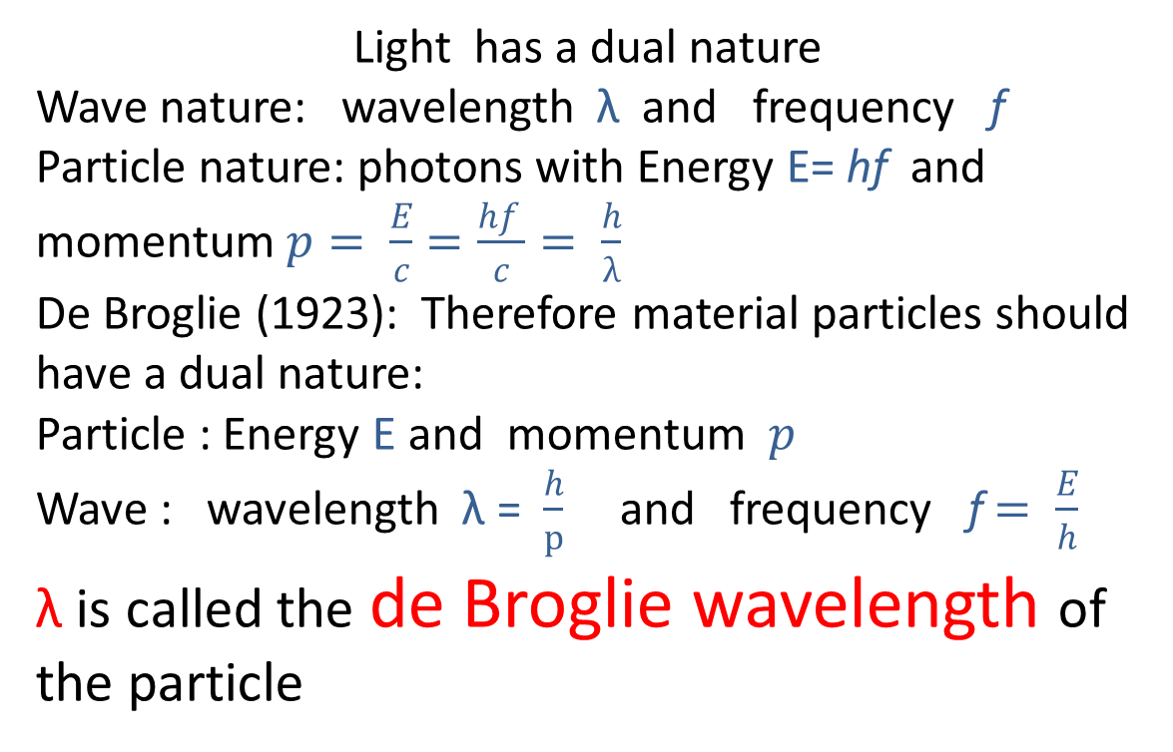
Light has a dual nature
Wave nature: wavelength λ and frequency f
Particle nature: photons with Energy E= hf and momentum $p= \frac{E}{c}=\frac{hf }{c}= \frac{h}{λ}$
De Broglie (1923): Therefore material particles should have a dual nature:
Particle : Energy E and momentum $p$
Wave : wavelength λ = $\frac{h}{p}$ and frequency f$= \frac{E}{h}$
λ is called the de Broglie wavelength of the particle

Slide 3
The de Broglie hypothesis can explain Bohr’s quantization of angular momentum

Slide 4
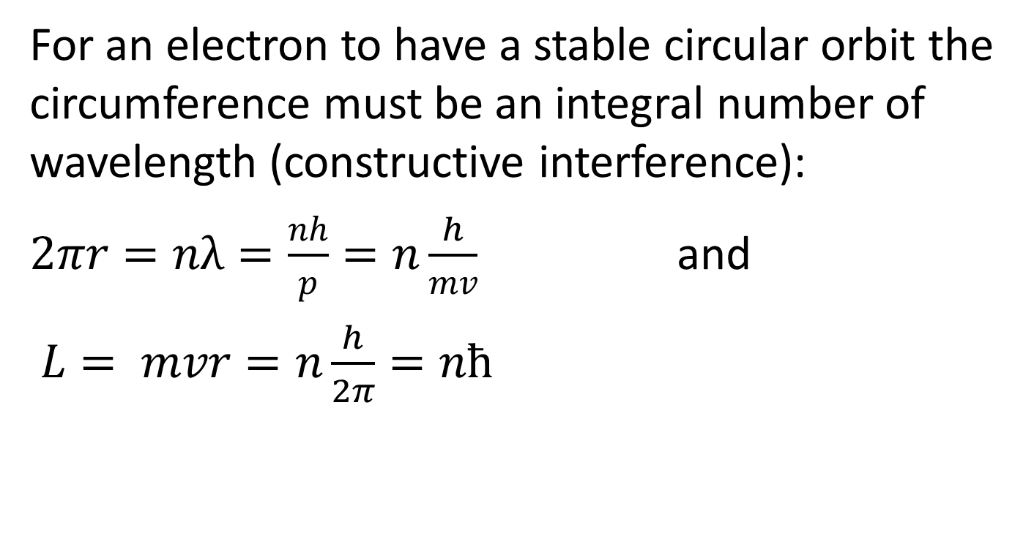
stable circular orbits
For an electron to have a stable circular orbit the circumference must be an integral number of wavelength (constructive interference):
$2πr=nλ=\frac{nh}{p}=n\frac{h}{mv}$ and
$L= mvr=n\frac{h}{2π}=nħ$

Slide 5
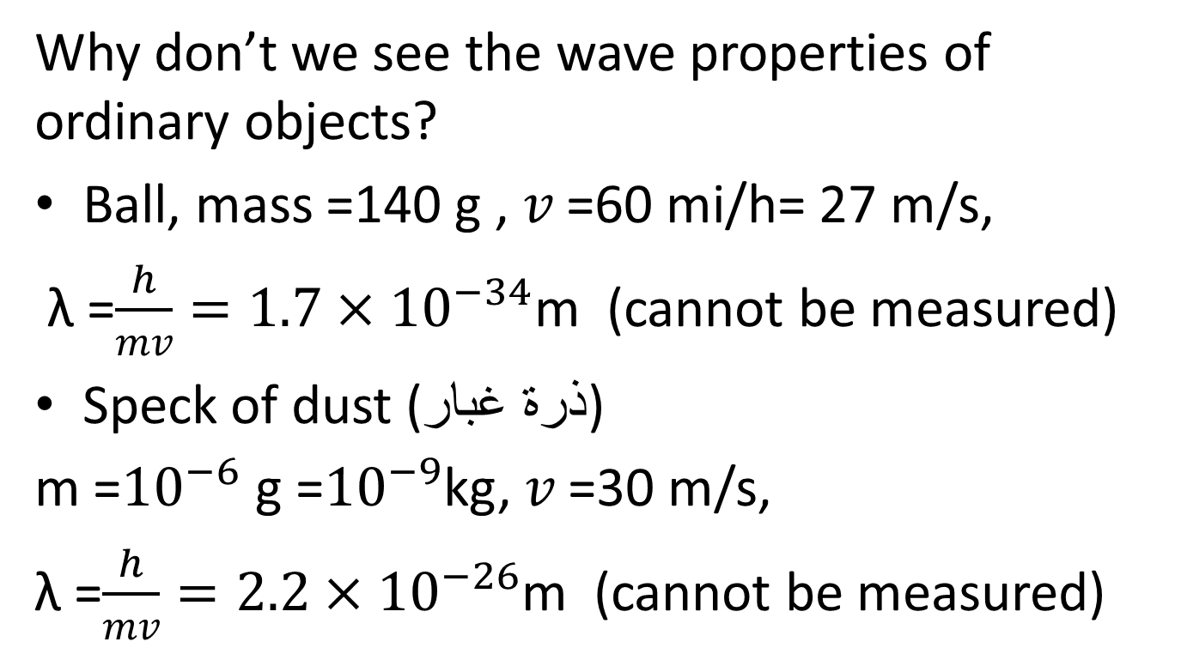
Example 5.1
Why don’t we see the wave properties of ordinary objects?
Ball, mass =140 g , $v$ =60 mi/h= 27 m/s,
λ =$\frac{h}{mv}=1.7×{10}^{−34}$m (cannot be measured)
Speck of dust (ذرة غبار)
m =${10}^{−6}$ g =${10}^{−9}$kg, $v$ =30 m/s,
λ =$\frac{h}{mv}=2.2×{10}^{−26}$m (cannot be measured)

Slide 6
Davisson-Germer Experiment

Slide 7
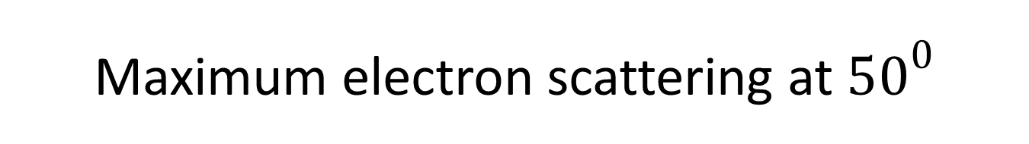
Maximum electron scattering at ${50}^{0}$

Slide 8
Maximum can be easily explained by wave properties
Low-energy electrons (54eV), unlike X-rays, cannot penetrate the crystal: reflection is only from the top layer of atoms.

Slide 9
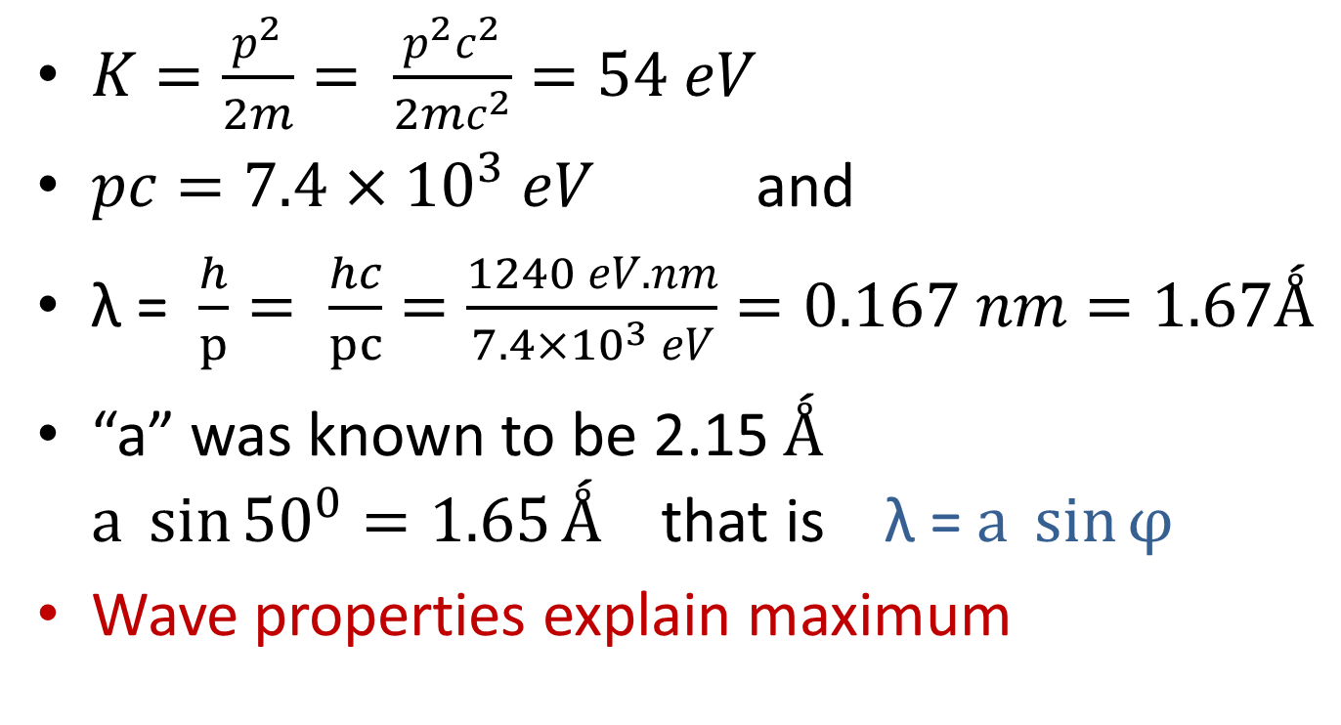
They used 54 eV electrons
$K=\frac{p^{2}}{2m}= \frac{p^{2}c^{2}}{2mc^{2}}=54 eV$
$pc=7.4×{10}^{3} eV$ and
λ = $\frac{h}{p}= \frac{hc}{pc}=\frac{1240 eV.nm}{7.4×{10}^{3} eV}=0.167 nm=1.67Ǻ$
“a” was known to be 2.15 $Ǻ$ $a \sin{{50}^{0}=1.65}Ǻ$ that is λ = $a \sin{φ}$
Wave properties explain maximum

Slide 10
Diffraction on same crystal
(a) with X-rays and (b) with electrons

Slide 11
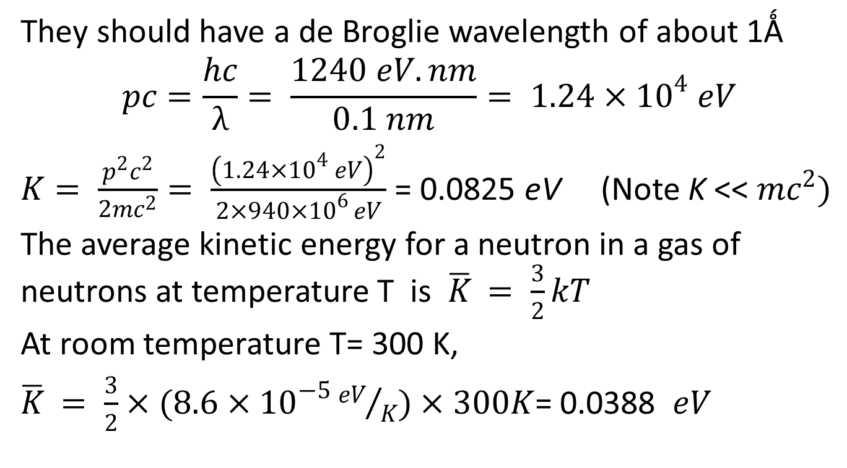
Example 5.3: What kinetic energy (in eV) should neutrons have if they are to be diffracted by crystals?
They should have a de Broglie wavelength of about 1Ǻ
$$pc=\frac{hc}{λ}= \frac{1240 eV.nm}{0.1 nm}= 1.24×{10}^{4} eV$$
$K= \frac{p^{2}c^{2}}{2mc^{2}}= \frac{{\left(1.24×{10}^{4} eV\right)}^{2}}{{2×940×10}^{6 }eV}$= 0.0825 eV (Note K <<$mc^{2})$
The average kinetic energy for a neutron in a gas of neutrons at temperature T is $\overline{K}$ $= \frac{3}{2}kT$
At room temperature T= 300 K,
$\overline{K}$ $= \frac{3}{2}×(8.6×{10}^{−5}{eV}/K)×300K$= 0.0388 $eV$

Slide 12
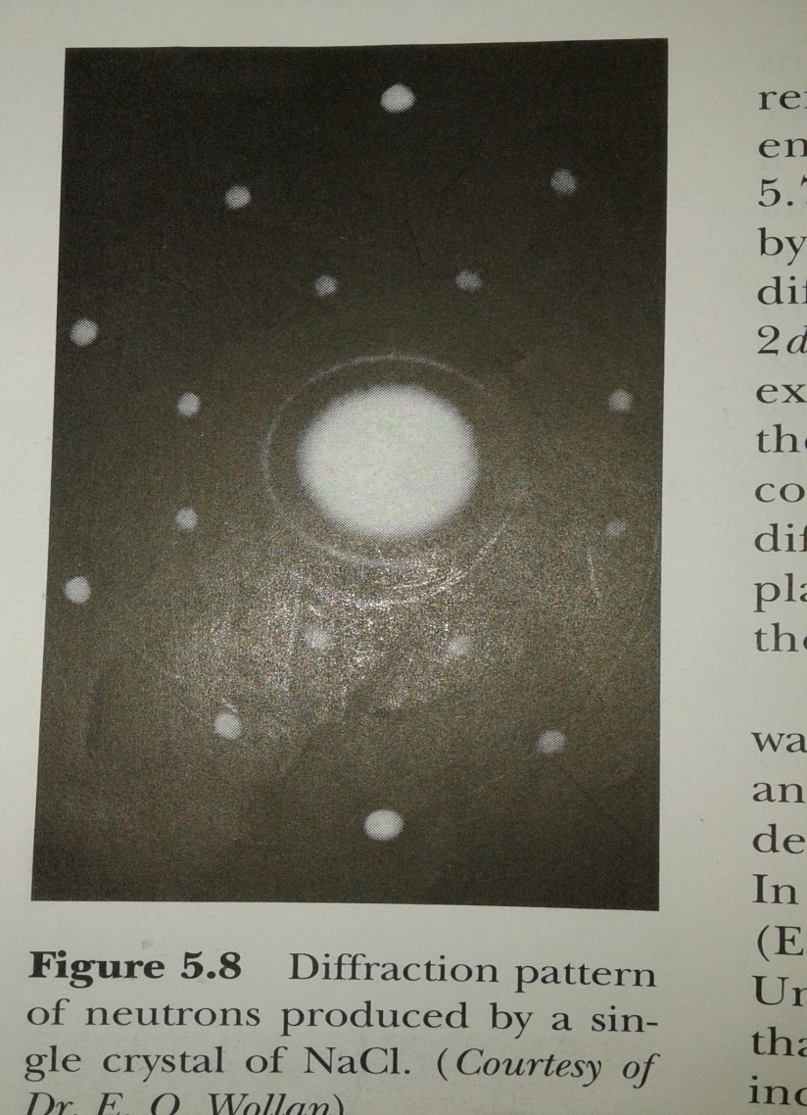
Thermal neutrons
Neutrons at thermal equilibrium with matter at room temperature are called thermal neutrons and are used in diffraction experiments on crystals as in
Fig. 5.8

Slide 13
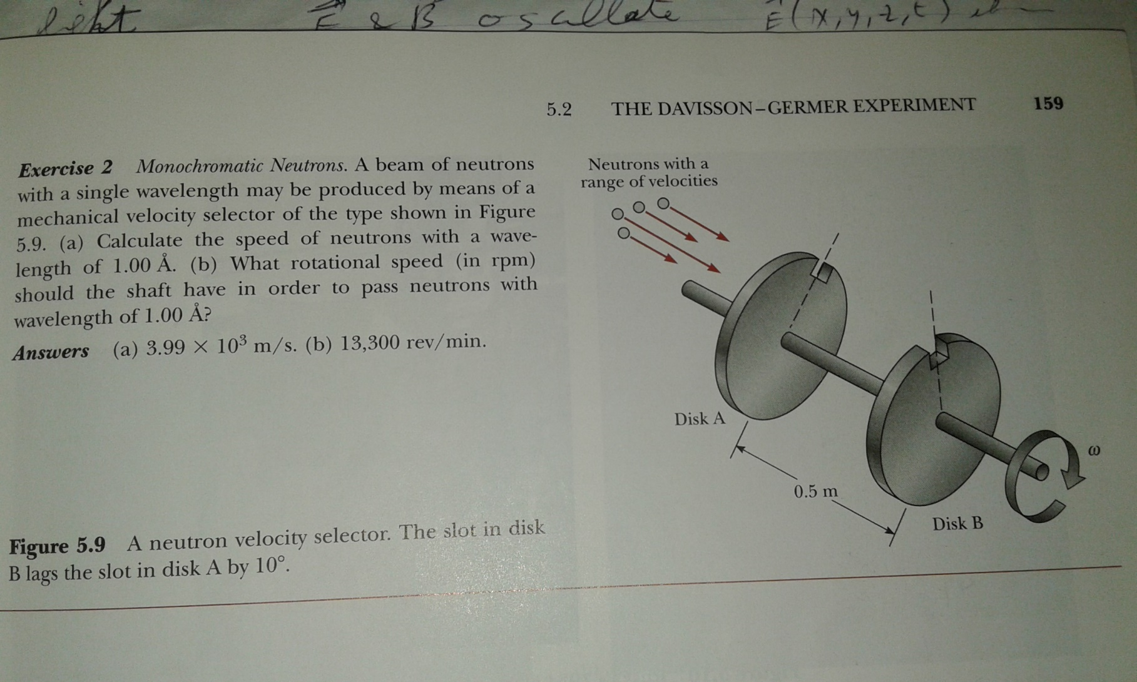
Neutrons have no charge. How can we control neutron speed to get a single wavelength for diffraction experiments? Velocity Selector:

Slide 14
The electron microscope uses electrons instead of light to “see” very small microscopic objects. We cannot see the electrons with our eyes but use detectors and display the results on screens.
Material on electron microscope (pages 159- 163): not required but look at the photos.
Section 5.3: wave groups (pages 164- 173): not required.

