Slide 1
Instruction Level Parallelism

Slide 2
Outline
ILP
Compiler techniques to increase ILP
Loop Unrolling
Static Branch Prediction
Dynamic Branch Prediction
Overcoming Data Hazards with Dynamic Scheduling
(Start) Tomasulo Algorithm
Conclusion

Slide 3
Recall from Pipelining Review
Pipeline CPI = Ideal pipeline CPI + Structural Stalls + Data Hazard Stalls + Control Stalls
Ideal pipeline CPI: measure of the maximum performance attainable by the implementation
Structural hazards: HW cannot support this combination of instructions
Data hazards: Instruction depends on result of prior instruction still in the pipeline
Control hazards: Caused by delay between the fetching of instructions and decisions about changes in control flow (branches and jumps)

Slide 4
Instruction Level Parallelism
Instruction-Level Parallelism (ILP): overlap the execution of instructions to improve performance
2 approaches to exploit ILP:
1) Rely on hardware to help discover and exploit the parallelism dynamically (e.g., Pentium 4, AMD Opteron, IBM Power) , and
2) Rely on software technology to find parallelism, statically at compile-time (e.g., Itanium 2)

Slide 5
Data Dependence and Hazards
Instr_{J} is data dependent (aka true dependence) on Instr_{I:}
Instr_{J} tries to read operand before Instr_{I} writes it
or Instr_{J} is data dependent on Instr_{K} which is dependent on Instr_{I}
If two instructions are data dependent, they cannot execute simultaneously or be completely overlapped
Data dependence in instruction sequence ⇒ data dependence in source code ⇒ effect of original data dependence must be preserved
If data dependence caused a hazard in pipeline, called a Read After Write (RAW) hazard
I: add r1,r2,r3
J: sub r4,r1,r3

Slide 6
ILP and Data Dependencies,Hazards
HW/SW must preserve program order: order instructions would execute in if executed sequentially as determined by original source program
Dependences are a property of programs
Presence of dependence indicates potential for a hazard, but actual hazard and length of any stall is property of the pipeline
Importance of the data dependencies
1) indicates the possibility of a hazard
2) determines order in which results must be calculated
3) sets an upper bound on how much parallelism can possibly be exploited
HW/SW goal: exploit parallelism by preserving program order only where it affects the outcome of the program

Slide 7
Name Dependence #1: Anti-dependence
Name dependence: when 2 instructions use same register or memory location, called a name, but no flow of data between the instructions associated with that name; 2 versions of name dependence
Instr_{J} writes operand before Instr_{I} reads it Called an “anti-dependence” by compiler writers. This results from reuse of the name “r1”
If anti-dependence caused a hazard in the pipeline, called a Write After Read (WAR) hazard
I: sub r4,r1,r3
J: add r1,r2,r3
K: mul r6,r1,r7

Slide 8
Name Dependence #2: Output dependence
Instr_{J} writes operand before Instr_{I} writes it.
Called an “output dependence” by compiler writers This also results from the reuse of name “r1”
If anti-dependence caused a hazard in the pipeline, called a Write After Write (WAW) hazard
Instructions involved in a name dependence can execute simultaneously if name used in instructions is changed so instructions do not conflict
Register renaming resolves name dependence for regs
Either by compiler or by HW
I: sub r1,r4,r3
J: add r1,r2,r3
K: mul r6,r1,r7

Slide 9
Control Dependencies
Every instruction is control dependent on some set of branches, and, in general, these control dependencies must be preserved to preserve program order
if p1 {
S1;
};
if p2 {
S2;
}
S1 is control dependent on p1, and S2 is control dependent on p2 but not on p1.

Slide 10
Control Dependence Ignored
Control dependence need not be preserved
willing to execute instructions that should not have been executed, thereby violating the control dependences, if can do so without affecting correctness of the program
Instead, 2 properties critical to program correctness are
exception behavior and
data flow

Slide 11
Exception Behavior
Preserving exception behavior ⇒ any changes in instruction execution order must not change how exceptions are raised in program (⇒ no new exceptions)
Example: DADDU R2,R3,R4 BEQZ R2,L1 LW R1,0(R2) L1:
(Assume branches not delayed)
Problem with moving LW before BEQZ?

Slide 12
Data Flow
Data flow: actual flow of data values among instructions that produce results and those that consume them
branches make flow dynamic, determine which instruction is supplier of data
Example:
DADDU R1,R2,R3 BEQZ R4,L DSUBU R1,R5,R6 L: … OR R7,R1,R8
OR depends on DADDU or DSUBU? Must preserve data flow on execution

Slide 13
Ideas to Reduce Stalls
Hardware
Software

Slide 14
Dynamic Scheduling

Slide 15
Advantages of Dynamic Scheduling
Dynamic scheduling - hardware rearranges the instruction execution to reduce stalls while maintaining data flow and exception behavior
It handles cases when dependences unknown at compile time
it allows the processor to tolerate unpredictable delays such as cache misses, by executing other code while waiting for the miss to resolve
It allows code that compiled for one pipeline to run efficiently on a different pipeline
It simplifies the compiler
Hardware speculation, a technique with significant performance advantages, builds on dynamic scheduling (next lecture)

Slide 16
HW Schemes: Instruction Parallelism
Key idea: Allow instructions behind stall to proceed DIVD F0,F2,F4 ADDD F10,F0,F8 SUBD F12,F8,F14
Enables out-of-order execution and allows out-of-order completion (e.g., SUBD)
In a dynamically scheduled pipeline, all instructions still pass through issue stage in order (in-order issue)
Will distinguish when an instruction begins execution and when it completes execution; between 2 times, the instruction is in execution
Note: Dynamic execution creates WAR and WAW hazards and makes exceptions harder

Slide 17
Example on WAR and WAW Hazards
Anti-dependence between ADD.D and SUB.D
WAR hazard on F8
Output dependence between ADD.D and MUL.D WAW hazard on F6
DIV.D F0, F2, F4
ADD.D F6, F0, F8
S.D F6, 0(R1)
SUB.D F8, F10, F14
MUL.D F6, F10, F8
WAR and RAW hazards are caused by out-of-order execution, but can be eliminated with register renaming
DIV.D F0, F2, F4
ADD.D F6, F0, F8
S.D F6, 0(R1)
SUB.D T1, F10, F14
MUL.D T2, F10, T1
Use temporary registers T1 and T2 to eliminate name dependences
Register renaming can be done statically by the compiler or dynamically by the pipeline

Slide 18
Dynamic Scheduling: Tomasulo
Fast IBM 360/91 for scientific code
Completed in 1967
Before cache memories
Implemented complex memory system
Pipelined floating point units
FP Adder
FP Multiplier (Divide done in multiplier)
Dynamic scheduling in FP unit (Tomasulo)
The descendants of Tomasulo are found in
Alpha 21264, Pentium 4, AMD Opteron, Power 5, etc

Slide 19
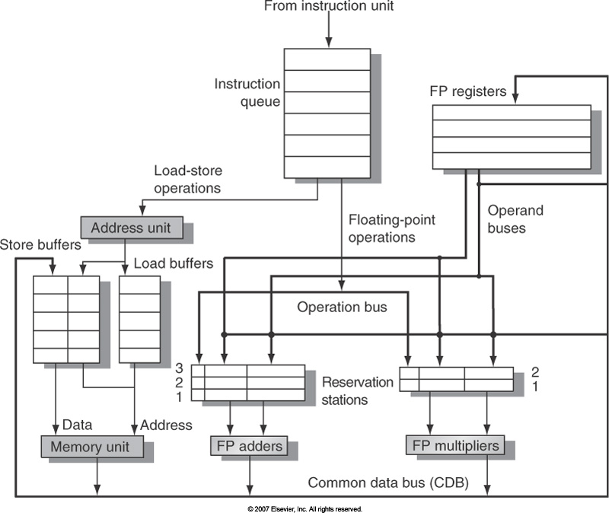
Tomasulo’s
Organization

Slide 20
Tomasulo Algorithm
Buffers & Control distributed with Function Units
FU buffers are called “reservation stations” and have pending operands
Registers in instructions are replaced by values or by pointers to reservation stations, called tags
Reservation stations provide renaming to avoid WAR & WAW hazards
Results are broadcast on the Common Data Bus to all reservation stations, not through registers
Avoids RAW hazards by executing an instruction only when its operands are available
Load and Stores treated as Function Units (FU) with Reservation Stations (RS) as well

Slide 21
Generalized Tomasulo’s Organization
Enhance parallel pipeline architecture
Apply Tomasulo's algorithm to all pipelined units
Not just floating point
Biggest difference: handle loads/stores like other instructions
Use "tags" to identify data values
Both tags and register designators can name data
Reservation Stations (RS) distribute control
Set of Reservation Stations per functional unit
Tag identifies result of instruction in RS
Common Data Bus (CDB) broadcasts all results

Slide 22
Generalized Tomasulo’s Organization
FP adder unit and reservation stations should also be added to this diagram
ISSUE
MULT
RS
EXECUTE
Mult. 1
Mult. 2
Mult. 3
Mult. 4
Load Queue
I-cache
access
Decode
D-Cache 1
D-Cache 2
Load/Store
RS
Address
Unit
Common Data Bus
Regs
ALU
RS
Store Queue
ALU
Integer
WRITE-BACK

Slide 23
Three Stages of Tomasulo’s Algorithm
1. ISSUE
Get next instruction from fetch unit
Check for available reservation station
If not available, stall due to structural hazard
If RS available, issue
Copy ready registers to RS
Copy tags for all non-ready
registers to RS
ISSUE
EXECUTE
Mult. 1
Mult. 2
Mult. 3
Mult. 4
M RS
Address
Unit
LQ
I-cache
access
Decode
D-Cache 1
D-Cache 2
LS RS
Common Data Bus
Regs
SQ
Integer
WRITE-BACK
A RS

Slide 24
Three Stages of Tomasulo’s Algorithm
2. Execute
If input operands available, issue and begin execution
If not, monitor CDB for necessary input operands
If several instructions become ready for the same functional unit in the same clock cycle, one of them is chosen for execution
ISSUE
EXECUTE
Mult. 1
Mult. 2
Mult. 3
Mult. 4
M RS
Address
Unit
LQ
I-cache
access
Decode
D-Cache 1
D-Cache 2
LS RS
Common Data Bus
Regs
SQ
Integer
WRITE-BACK
A RS

Slide 25
Three Stages of Tomasulo’s Algorithm
3. Write Back
If CDB available, write result on CDB
All destinations with matching tags receive data
CDB broadcasts results to all reservation stations
If not, wait for CDB to
become available
ISSUE
EXECUTE
Mult. 1
Mult. 2
Mult. 3
Mult. 4
M RS
Address
Unit
LQ
I-cache
access
Decode
D-Cache 1
D-Cache 2
LS RS
Common Data Bus
Regs
SQ
Integer
WRITE-BACK
A RS

Slide 26
Reservation Station Components
Op: Operation to perform in the unit (e.g., + or –)
Vj, Vk: Value of Source operands
Store buffers has V field, result to be stored
Qj, Qk: Reservation stations producing source registers (value to be written)
Note: Qj,Qk=0 => ready
Store buffers only have Qi for RS producing result
Busy: Indicates reservation station or FU is busy
A Address information for loads or stores. Initially immediate field of instruction then effective address when calculated.
Register result status—Indicates which functional unit will write each register, if one exists. Blank when no pending instructions that will write that register.
Notes:
What you might have thought
1. 4 stages of instruction executino
2.Status of FU: Normal things to keep track of (RAW & structura for busyl):
Fi from instruction format of the mahine (Fi is dest)
Add unit can Add or Sub
Rj, Rk - status of registers (Yes means ready)
Qj,Qk - If a no in Rj, Rk, means waiting for a FU to write result; Qj, Qk means wihch FU waiting for it
3.Status of register result (WAW &WAR)s:
which FU is going to write into registers
Scoreboard on 6600 = size of FU
6.7, 6.8, 6.9, 6.12, 6.13, 6.16, 6.17
FU latencies: Add 2, Mult 10, Div 40 clocks

Slide 27
Dependency Graph For Example Code
1
Example Code
L.D F6, 34 (R2)
1
2
3
4
5
6
L.D F6, 34(R2)
L.D F2, 45(R3)
MUL.D F0, F2, F4
SUB.D F8, F6, F2
DIV.D F10, F0, F6
ADD.D F6, F8, F2
2
L.D F2, 45 (R3)
3
MUL.D F0, F2, F4
4
SUB.D F8, F6, F2
Date Dependence:
(1, 4) (1, 5) (2, 3) (2, 4)
(2, 6) (3, 5) (4, 6)
Output Dependence:
(1, 6)
Anti-dependence:
(5, 6)
5
DIV.D F10, F0, F6
6
ADD.D F6, F8, F2
The same code used is the scoreboard example

Slide 28
Tomasulo Example
Instruction stream
3 Load/Buffers
FU count
down
3 FP Adder R.S.
2 FP Mult R.S.
Clock cycle counter
Assume the following latencies: load is 1 clock cycle, add is 2 clock cycles, multiply is 6 clock cycles, and divide is 12 clock cycles.
Notes:
assume the following latencies: load is 1 clock cycle, add is 2 clock cycles, multiply is 6 clock cycles, and divide is 12 clock cycles.

Slide 29
Tomasulo Example Cycle 1

Slide 30
Tomasulo Example Cycle 2
Note: Can have multiple loads outstanding

Slide 31
Tomasulo Example Cycle 3
Note: registers names are removed (“renamed”) in Reservation Stations; MULT issued
Load1 completing; what is waiting for Load1?

Slide 32
Tomasulo Example Cycle 4
Load2 completing; what is waiting for Load2?

Slide 33
Tomasulo Example Cycle 5
Timer starts down for Add1, Mult1

Slide 34
Tomasulo Example Cycle 6
Issue ADDD here despite name dependency on F6?

Slide 35
Tomasulo Example Cycle 7
Add1 (SUBD) completing; what is waiting for it?

Slide 36
Tomasulo Example Cycle 8

Slide 37
Tomasulo Example Cycle 9

Slide 38
Tomasulo Example Cycle 10
Add2 (ADDD) completing; what is waiting for it?

Slide 39
Tomasulo Example Cycle 11
Write result of ADDD here?
All quick instructions complete in this cycle!

Slide 40
Tomasulo Example Cycle 12

Slide 41
Tomasulo Example Cycle 13

Slide 42
Tomasulo Example Cycle 14

Slide 43
Tomasulo Example Cycle 15
Mult1 (MULTD) completing; what is waiting for it?

Slide 44
Tomasulo Example Cycle 16
Just waiting for Mult2 (DIVD) to complete

Slide 45
Faster than light computation (skip a couple of cycles)

Slide 46
Tomasulo Example Cycle 55

Slide 47
Tomasulo Example Cycle 56
Mult2 (DIVD) is completing; what is waiting for it?

Slide 48
Tomasulo Example Cycle 57
Once again: In-order issue, out-of-order execution and out-of-order completion.

Slide 49
Tomasulo’s scheme offers 2 major advantages
Distribution of the hazard detection logic
distributed reservation stations and the CDB
If multiple instructions waiting on single result, & each instruction has other operand, then instructions can be released simultaneously by broadcast on CDB
If a centralized register file were used, the units would have to read their results from the registers when register buses are available
Elimination of stalls for WAW and WAR hazards

Slide 50
Tomasulo Drawbacks
Complexity
delays of 360/91, MIPS 10000, Alpha 21264, IBM PPC 620 in CA:AQA 2/e, but not in silicon!
Many associative stores (CDB) at high speed
Performance limited by Common Data Bus
Each CDB must go to multiple functional units ⇒high capacitance, high wiring density
Number of functional units that can complete per cycle limited to one!
Multiple CDBs ⇒ more FU logic for parallel assoc stores
Non-precise interrupts!
We will address this later

Slide 51
Tomasulo Loop Example
Loop: LD F0 0 R1
MULTD F4 F0 F2
SD F4 0 R1
SUBI R1 R1 #8
BNEZ R1 Loop
Assume FP Multiply takes 4 execution clock cycles.
Assume first load takes 8 cycles (possibly due to a cache miss), second load takes 4 cycles (cache hit).
Assume R1 = 80 initially.
Assume SUBI only takes one cycle (issue)
Assume branch resolved in issue stage (no EX or CDB write)
Assume branch is predicted taken and no branch misprediction.
No branch delay slot is used in this example.
Stores take 3 cycles (ex, mem) and do not write on CDB
We’ll go over the execution to complete first two loop iterations.

Slide 52
Tomasulo Loop Example Dependency Graph (First three iterations shown)
First
Iteration
Example Code
1
L.D F0, 0 (R1)
1
2
3
4
5
6
7
8
9
L.D F0, 0 (R1)
MUL.D F4, F0, F2
S.D F4, 0(R1)
L.D F0, 0(R1)
MUL.D F4, F0, F2
S.D F4, 0(R1)
L.D F0, 0(R1)
MUL.D F4, F0, F2
S.D F4, 0(R1)
2
MUL.D F4, F0, F2
3
Second
Iteration
S.D F4, 0(R1)
4
L.D F0, 0 (R1)
5
MUL.D F4, F0, F2
6
Third
Iteration
S.D F4, 0 (R1)
Loop maintenance (DADDUI)
and branches (BNE) not shown
7
L.D F0, 0 (R1)
Name dependencies between iteration 3 instructions
and iteration 1 instructions are not shown in graph
8
MUL.D F4, F0, F2
9
S.D F4, 0 (R1)

Slide 53
Loop Example
Iter-
ation
Count
Added Store Buffers
Instruction Loop
Value of Register used for address, iteration control

Slide 54
Loop Example Cycle 1

Slide 55
Loop Example Cycle 2

Slide 56
Loop Example Cycle 3
Implicit renaming sets up data flow graph

Slide 57
Loop Example Cycle 4
Dispatching SUBI Instruction (not in FP queue)

Slide 58
Loop Example Cycle 5
And, BNEZ instruction (not in FP queue)

Slide 59
Loop Example Cycle 6
Notice that F0 never sees Load from location 80

Slide 60
Loop Example Cycle 7
Register file completely detached from computation
First and Second iteration completely overlapped

Slide 61
Loop Example Cycle 8

Slide 62
Loop Example Cycle 9
Load1 completing: who is waiting?
Note: Dispatching SUBI

Slide 63
Loop Example Cycle 10
Load2 completing: who is waiting?
Note: Dispatching BNEZ

Slide 64
Loop Example Cycle 11
Next load in sequence

Slide 65
Loop Example Cycle 12
Why not issue third multiply?

Slide 66
Loop Example Cycle 13
Why not issue third store?

Slide 67
Loop Example Cycle 14
Mult1 completing. Who is waiting?

Slide 68
Loop Example Cycle 15
Mult2 completing. Who is waiting?

Slide 69
Loop Example Cycle 16

Slide 70
Loop Example Cycle 17

Slide 71
Loop Example Cycle 18

Slide 72
Loop Example Cycle 19

Slide 73
Loop Example Cycle 20
Once again: In-order issue, out-of-order execution and out-of-order completion.

Slide 74
Why can Tomasulo overlap iterations of loops?
Register renaming
Multiple iterations use different physical destinations for registers (dynamic loop unrolling).
Reservation stations
Permit instruction issue to advance past integer control flow operations
Also buffer old values of registers - totally avoiding the WAR stall that we saw in the scoreboard.
Other perspective: Tomasulo building data flow dependency graph on the fly.

Slide 75
Explicit Register Renaming
Make use of a physical register file that is larger than number of registers specified by ISA
Keep a translation table:
ISA register => physical register mapping
When register is written, replace table entry with new register from freelist.
Physical register becomes free when not being used by any instructions in progress.
Pipeline can be exactly like “standard” DLX pipeline
IF, ID, EX, etc….
Advantages:
Removes all WAR and WAW hazards
Like Tomasulo, good for allowing full out-of-order completion
Allows data to be fetched from a single register file
Makes speculative execution/precise interrupts easier:
All that needs to be “undone” for precise break point is to undo the table mappings

Slide 76
Explicit Renaming Support Includes:
Rapid access to a table of translations
A physical register file that has more registers than specified by the ISA
Ability to figure out which physical registers are free.
No free registers ⇒ stall on issue
Thus, register renaming doesn’t require reservation stations. However:
Many modern architectures use explicit register renaming + Tomasulo-like reservation stations to control execution.

Slide 77
What about Precise Exceptions/Interrupts?
Both Scoreboard and Tomasulo have:
In-order issue, out-of-order execution, out-of-order completion
Recall: An interrupt or exception is precise if there is a single instruction for which:
All instructions before that have committed their state
No following instructions (including the interrupting instruction) have modified any state.
Need way to resynchronize execution with instruction stream (I.e. with issue-order)
Easiest way is with in-order completion (i.e. reorder buffer)
Other Techniques: Future File, History Buffer

Slide 78
HW support for precise interrupts
Concept of Reorder Buffer (ROB):
Holds instructions in FIFO order, exactly as they were issued
Each ROB entry contains PC, dest reg, result, exception status
When instructions complete, results placed into ROB
Supplies operands to other instruction between execution complete & commit ⇒ more registers like RS
Tag results with ROB buffer number instead of reservation station
Instructions commit ⇒values at head of ROB placed in registers
As a result, easy to undo speculated instructions on mispredicted branches or on exceptions
Reorder
Buffer
FP
Op
Queue
FP Regs
Commit path
Res Stations
Res Stations
FP Adder
FP Adder

Slide 79
Adding Speculation to Tomasulo
Must separate execution from allowing instruction to finish or “commit”
This additional step called instruction commit
When an instruction is no longer speculative, allow it to update the register file or memory
Requires additional set of buffers to hold results of instructions that have finished execution but have not committed
This reorder buffer (ROB) is also used to pass results among instructions that may be speculated

Slide 80
Reorder Buffer (ROB)
In Tomasulo’s algorithm, once an instruction writes its result, any subsequently issued instructions will find result in the register file
With speculation, the register file is not updated until the instruction commits
(we know definitively that the instruction should execute)
Thus, the ROB supplies operands in interval between completion of instruction execution and instruction commit
ROB is a source of operands for instructions, just as reservation stations (RS) provide operands in Tomasulo’s algorithm
ROB extends architectured registers like RS

Slide 81
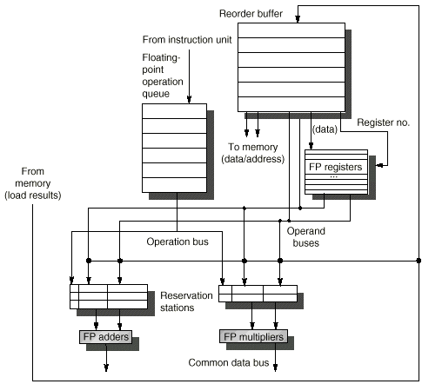
Tomasulos with Speculation

Slide 82
Reorder Buffer Entry
Each entry in the ROB contains four fields:
Instruction type
a branch (has no destination result), a store (has a memory address destination), or a register operation (ALU operation or load, which has register destinations)
Destination
Register number (for loads and ALU operations) or memory address (for stores) where the instruction result should be written
Value
Value of instruction result until the instruction commits
Ready
Indicates that instruction has completed execution, and the value is ready

Slide 83
Recall: 4 Steps of Speculative Tomasulo Algorithm
1. Issue—get instruction from FP Op Queue
If reservation station and reorder buffer slot free, issue instr & send operands & reorder buffer no. for destination (this stage sometimes called “dispatch”)
2. Execution—operate on operands (EX)
When both operands ready then execute; if not ready, watch CDB for result; when both in reservation station, execute; checks RAW (sometimes called “issue”)
3. Write result—finish execution (WB)
Write on Common Data Bus to all awaiting FUs & reorder buffer; mark reservation station available.
4. Commit—update register with reorder result
When instr. at head of reorder buffer & result present, update register with result (or store to memory) and remove instr from reorder buffer. Mispredicted branch flushes reorder buffer (sometimes called “graduation”)

Slide 84
Tomasulo With Reorder buffer:
Done?
FP Op
Queue
ROB7
ROB6
ROB5
ROB4
ROB3
ROB2
ROB1
Newest
Reorder Buffer
Oldest
F0
LD F0,10(R2)
N
Registers
To
Memory
Dest
Dest
from
Memory
Dest
Reservation
Stations
1 10+R2
FP adders
FP multipliers
Notes:
Resolve RAW memory conflict? (address in memory buffers)
Integer unit executes in parallel

Slide 85
Tomasulo With Reorder buffer:
Done?
FP Op
Queue
ROB7
ROB6
ROB5
ROB4
ROB3
ROB2
ROB1
Newest
Reorder Buffer
F10
ADDD F10,F4,F0
N
Oldest
F0
LD F0,10(R2)
N
Registers
To
Memory
Dest
Dest
from
Memory
2 ADDD R(F4),ROB1
Dest
Reservation
Stations
1 10+R2
FP adders
FP multipliers
Notes:
Resolve RAW memory conflict? (address in memory buffers)
Integer unit executes in parallel

Slide 86
Tomasulo With Reorder buffer:
Done?
FP Op
Queue
ROB7
ROB6
ROB5
ROB4
ROB3
ROB2
ROB1
Newest
Reorder Buffer
F2
DIVD F2,F10,F6
N
F10
ADDD F10,F4,F0
N
Oldest
F0
LD F0,10(R2)
N
Registers
To
Memory
Dest
Dest
from
Memory
2 ADDD R(F4),ROB1
3 DIVD ROB2,R(F6)
Dest
Reservation
Stations
1 10+R2
FP adders
FP multipliers
Notes:
Resolve RAW memory conflict? (address in memory buffers)
Integer unit executes in parallel

Slide 87
Tomasulo With Reorder buffer:
Done?
FP Op
Queue
ROB7
ROB6
ROB5
ROB4
ROB3
ROB2
ROB1
Newest
F0
ADDD F0,F4,F6
N
F4
LD F4,0(R3)
N
Reorder Buffer
--
BNE F2,<…>
N
F2
DIVD F2,F10,F6
N
F10
ADDD F10,F4,F0
N
Oldest
F0
LD F0,10(R2)
N
Registers
To
Memory
Dest
Dest
from
Memory
2 ADDD R(F4),ROB1
6 ADDD ROB5, R(F6)
3 DIVD ROB2,R(F6)
Dest
Reservation
Stations
1 10+R2
5 0+R3
FP adders
FP multipliers
Notes:
Resolve RAW memory conflict? (address in memory buffers)
Integer unit executes in parallel

Slide 88
Tomasulo With Reorder buffer:
Done?
FP Op
Queue
--
ROB5
ST 0(R3),F4
N
ROB7
ROB6
ROB5
ROB4
ROB3
ROB2
ROB1
Newest
F0
ADDD F0,F4,F6
N
F4
LD F4,0(R3)
N
Reorder Buffer
--
BNE F2,<…>
N
F2
DIVD F2,F10,F6
N
F10
ADDD F10,F4,F0
N
Oldest
F0
LD F0,10(R2)
N
Registers
To
Memory
Dest
Dest
from
Memory
2 ADDD R(F4),ROB1
6 ADDD ROB5, R(F6)
3 DIVD ROB2,R(F6)
Dest
Reservation
Stations
1 10+R2
5 0+R3
FP adders
FP multipliers
Notes:
Resolve RAW memory conflict? (address in memory buffers)
Integer unit executes in parallel

Slide 89
Tomasulo With Reorder buffer:
Done?
FP Op
Queue
--
M[10]
ST 0(R3),F4
Y
ROB7
ROB6
ROB5
ROB4
ROB3
ROB2
ROB1
Newest
F0
ADDD F0,F4,F6
N
F4
M[10]
LD F4,0(R3)
Y
Reorder Buffer
--
BNE F2,<…>
N
F2
DIVD F2,F10,F6
N
F10
ADDD F10,F4,F0
N
Oldest
F0
LD F0,10(R2)
N
Registers
To
Memory
Dest
Dest
from
Memory
2 ADDD R(F4),ROB1
6 ADDD M[10],R(F6)
3 DIVD ROB2,R(F6)
Dest
Reservation
Stations
1 10+R2
FP adders
FP multipliers
Notes:
Resolve RAW memory conflict? (address in memory buffers)
Integer unit executes in parallel

Slide 90
Tomasulo With Reorder buffer:
Done?
FP Op
Queue
--
M[10]
ST 0(R3),F4
Y
ROB7
ROB6
ROB5
ROB4
ROB3
ROB2
ROB1
Newest
F0
<val2>
ADDD F0,F4,F6
Ex
F4
M[10]
LD F4,0(R3)
Y
Reorder Buffer
--
BNE F2,<…>
N
F2
DIVD F2,F10,F6
N
F10
ADDD F10,F4,F0
N
Oldest
F0
LD F0,10(R2)
N
Registers
To
Memory
Dest
Dest
from
Memory
2 ADDD R(F4),ROB1
3 DIVD ROB2,R(F6)
Dest
Reservation
Stations
1 10+R2
FP adders
FP multipliers
Notes:
Resolve RAW memory conflict? (address in memory buffers)
Integer unit executes in parallel

Slide 91
Tomasulo With Reorder buffer:
Done?
FP Op
Queue
--
M[10]
ST 0(R3),F4
Y
ROB7
ROB6
ROB5
ROB4
ROB3
ROB2
ROB1
Newest
F0
<val2>
ADDD F0,F4,F6
Ex
F4
M[10]
LD F4,0(R3)
Y
Reorder Buffer
--
BNE F2,<…>
N
F2
DIVD F2,F10,F6
N
F10
ADDD F10,F4,F0
N
Oldest
What about memory
hazards???
F0
LD F0,10(R2)
N
Registers
To
Memory
Dest
Dest
from
Memory
2 ADDD R(F4),ROB1
3 DIVD ROB2,R(F6)
Dest
Reservation
Stations
1 10+R2
FP adders
FP multipliers
Notes:
Resolve RAW memory conflict? (address in memory buffers)
Integer unit executes in parallel

Slide 92
Avoiding Memory Hazards
WAW and WAR hazards through memory are eliminated with speculation because actual updating of memory occurs in order, when a store is at head of the ROB, and hence, no earlier loads or stores can still be pending
RAW hazards through memory are maintained by two restrictions:
not allowing a load to initiate the second step of its execution if any active ROB entry occupied by a store has a Destination field that matches the value of the A field of the load, and
maintaining the program order for the computation of an effective address of a load with respect to all earlier stores.
these restrictions ensure that any load that accesses a memory location written to by an earlier store cannot perform the memory access until the store has written the data

Slide 93
Memory Disambiguation: Sorting out RAW Hazards in memory
Question: Given a load that follows a store in program order, are the two related?
(Alternatively: is there a RAW hazard between the store and the load)? Eg: st 0(R2),R5 ld R6,0(R3)
Can we go ahead and start the load early?
Store address could be delayed for a long time by some calculation that leads to R2 (divide?).
We might want to issue/begin execution of both operations in same cycle.
Today: Answer is that we are not allowed to start load until we know that address 0(R2) ≠ 0(R3)
Next : We might guess at whether or not they are dependent (called “dependence speculation”) and use reorder buffer to fix up if we are wrong.

Slide 94
Hardware Support for Memory Disambiguation
Need buffer to keep track of all outstanding stores to memory, in program order.
Keep track of address (when becomes available) and value (when becomes available)
FIFO ordering: will retire stores from this buffer in program order
When issuing a load, record current head of store queue (know which stores are ahead of you).
When have address for load, check store queue:
If any store prior to load is waiting for its address, stall load.
If load address matches earlier store address (associative lookup), then we have a memory-induced RAW hazard:
store value available ⇒ return value
store value not available ⇒ return ROB number of source
Otherwise, send out request to memory
Actual stores commit in order, so no worry about WAR/WAW hazards through memory.

Slide 95
Memory Disambiguation:
Done?
FP Op
Queue
ROB7
ROB6
ROB5
ROB4
ROB3
ROB2
ROB1
Newest
Reorder Buffer
--
LD F4, 10(R3)
N
F2
R[F5]
ST 10(R3), F5
N
F0
LD F0,32(R2)
N
Oldest
--
<val 1>
ST 0(R3), F4
Y
Registers
To
Memory
Dest
Dest
from
Memory
Dest
Reservation
Stations
2 32+R2
4 ROB3
FP adders
FP multipliers
Notes:
Resolve RAW memory conflict? (address in memory buffers)
Integer unit executes in parallel

Slide 96
How much to speculate?
Speculation Pro: uncover events that would otherwise stall the pipeline (cache misses)
Speculation Con: speculate costly if exceptional event occurs when speculation was incorrect
Typical solution: speculation allows only low-cost exceptional events (1st-level cache miss)
When expensive exceptional event occurs, (2nd-level cache miss or TLB miss) processor waits until the instruction causing event is no longer speculative before handling the event
Assuming single branch per cycle: future may speculate across multiple branches!

Slide 97
Loop unrolling

Slide 98
Software Techniques - Example
This code, add a scalar to a vector:
for (i=1000; i>0; i=i–1)
x[i] = x[i] + s;
Assume following latencies for all examples
Ignore delayed branch in these examples
Instruction Instruction Latency stalls between producing result using result in cycles in cycles
FP ALU op Another FP ALU op 4 3
FP ALU op Store double 3 2
Load double FP ALU op 1 1
Load double Store double 1 0
Integer op Integer op 1 0

Slide 99
FP Loop: Where are the Hazards?
First translate into MIPS code:
-To simplify, assume 8 is lowest address
Loop: L.D F0,0(R1) ;F0=vector element
ADD.D F4,F0,F2 ;add scalar from F2
S.D 0(R1),F4 ;store result
DADDUI R1,R1,-8 ;decrement pointer 8B (DW)
BNEZ R1,Loop ;branch R1!=zero

Slide 100
FP Loop Showing Stalls
1 Loop: L.D F0,0(R1) ;F0=vector element
2 stall
3 ADD.D F4,F0,F2 ;add scalar in F2
4 stall
5 stall
6 S.D 0(R1),F4 ;store result
7 DADDUI R1,R1,-8 ;decrement pointer 8B (DW)
8 stall ;assumes can’t forward to branch
9 BNEZ R1,Loop ;branch R1!=zero
Instruction Instruction Latency in producing result using result clock cycles
FP ALU op Another FP ALU op 3
FP ALU op Store double 2
Load double FP ALU op 1
9 clock cycles: Rewrite code to minimize stalls?

Slide 101
Revised FP Loop Minimizing Stalls
1 Loop: L.D F0,0(R1)
2 DADDUI R1,R1,-8
3 ADD.D F4,F0,F2
4 stall
5 stall
6 S.D 8(R1),F4 ;altered offset when move DSUBUI
7 BNEZ R1,Loop
Swap DADDUI and S.D by changing address of S.D
Instruction Instruction Latency in producing result using result clock cycles
FP ALU op Another FP ALU op 3
FP ALU op Store double 2
Load double FP ALU op 1
7 clock cycles, but just 3 for execution (L.D, ADD.D,S.D), 4 for loop overhead; How make faster?
Notes:
3 clocks doing work, 3 overhead (stall, branch, sub)

Slide 102
Unroll Loop Four Times (straightforward way)
1 cycle stall
1 Loop: L.D F0,0(R1)
3 ADD.D F4,F0,F2
6 S.D 0(R1),F4 ;drop DSUBUI & BNEZ
7 L.D F6,-8(R1)
9 ADD.D F8,F6,F2
12 S.D -8(R1),F8 ;drop DSUBUI & BNEZ
13 L.D F10,-16(R1)
15 ADD.D F12,F10,F2
18 S.D -16(R1),F12 ;drop DSUBUI & BNEZ
19 L.D F14,-24(R1)
21 ADD.D F16,F14,F2
24 S.D -24(R1),F16
25 DADDUI R1,R1,#-32 ;alter to 4*8
26 BNEZ R1,LOOP
27 clock cycles, or 6.75 per iteration
(Assumes R1 is multiple of 4)
Rewrite loop to minimize stalls?
2 cycles stall

Slide 103
Unrolled Loop That Minimizes Stalls
1 Loop: L.D F0,0(R1)
2 L.D F6,-8(R1)
3 L.D F10,-16(R1)
4 L.D F14,-24(R1)
5 ADD.D F4,F0,F2
6 ADD.D F8,F6,F2
7 ADD.D F12,F10,F2
8 ADD.D F16,F14,F2
9 S.D 0(R1),F4
10 S.D -8(R1),F8
11 S.D -16(R1),F12
12 DSUBUI R1,R1,#32
13 S.D 8(R1),F16 ; 8-32 = -24
14 BNEZ R1,LOOP
14 clock cycles, or 3.5 per iteration

Slide 104
Unrolled Loop Detail
Do not usually know upper bound of loop
Suppose it is n, and we would like to unroll the loop to make k copies of the body
Instead of a single unrolled loop, we generate a pair of consecutive loops:
1st executes (n mod k) times and has a body that is the original loop
2nd is the unrolled body surrounded by an outer loop that iterates (n/k) times
For large values of n, most of the execution time will be spent in the unrolled loop

Slide 105
5 Loop Unrolling Decisions
Requires understanding how one instruction depends on another and how the instructions can be changed or reordered given the dependences:
Determine loop unrolling useful by finding that loop iterations were independent (except for maintenance code)
Use different registers to avoid unnecessary constraints forced by using same registers for different computations
Eliminate the extra test and branch instructions and adjust the loop termination and iteration code
Determine that loads and stores in unrolled loop can be interchanged by observing that loads and stores from different iterations are independent
Transformation requires analyzing memory addresses and finding that they do not refer to the same address
Schedule the code, preserving any dependences needed to yield the same result as the original code

Slide 106
3 Limits to Loop Unrolling
Decrease in amount of overhead amortized with each extra unrolling
Amdahl’s Law
Growth in code size
For larger loops, concern it increases the instruction cache miss rate
Register pressure: potential shortfall in registers created by aggressive unrolling and scheduling
If not be possible to allocate all live values to registers, may lose some or all of its advantage
Loop unrolling reduces impact of branches on pipeline; another way is branch prediction

Slide 107
Branch Prediction

Slide 108
Branch Prediction
Guess the direction of a branch
Guess its target if necessary
Fetch instructions from there
Execute Speculatively
Without knowing whether we should
Eventually, verify if prediction was correct
If correct, good for us
if not, well, discard and execute down the right path

Slide 109
For Example
while (l)
if (l->data == 0)
l->data++;
l = l->next
loop: beq r1, r0, done
ld r2, 0(r1)
bne r2, r0, noinc
inc: add r2, r2, 1
st r2, 0(r1)
noinc: ld r1, 4(r1)
bra loop
done:

Slide 110
Branch Prediction Steps
Elements of Branch Prediction
Start with branch PC and answer:
Why just PC? Early in the pipeline!
Q1? Branch taken or not?
Q2? Where to?
Q3? Target Instruction
All must be done to be successful
Let’s consider these separately

Slide 111
Static Branch Prediction
Static:
Decisions do not take into account dynamic behavior
Non-adaptive can be another term
Always Taken
Always Not-Taken
Forward NT Backward T
If X then T but if Y then NT but if Z then T
More elaborate schemes are possible
Bottom line
Accuracy is high but not high enough
Say it’s 60%

Slide 112
Static Branch Prediction
Predict branch statically when we compile the program
Simplest scheme is to predict all branches as taken
Untaken branch frequency = 34% of all branch instructions (SPEC programs)
Or predict backward branches as taken and forward branches as not taken
Some processors allow branch prediction hints to be inserted in code
More accurate static scheme predicts branches using profile information collected from earlier runs, and modify prediction based on last run
Integer
Floating Point

Slide 113
Dynamic Branch Prediction
Why? Larger window -> More opportunity for parallelism
Basic Idea:
hardware guesses whether a branch will be taken, and if so where it will go
What makes these work?
Past Branch Behavior STRONG indicator of future branch behavior
Branches tend to exhibit regular behavior

Slide 114
Dynamic Branch Prediction
Why does prediction work?
Underlying algorithm has regularities
Data that is being operated on has regularities
Instruction sequence has redundancies that are artifacts of way that humans/compilers think about problems
Is dynamic branch prediction better than static branch prediction?
Seems to be
There are a small number of important branches in programs which have dynamic behavior

Slide 115
Dynamic Branch Prediction
Performance = ƒ(accuracy, cost of misprediction)
Branch History Table (BHT)
Lower bits of PC address = index to BHT table
Each entry consists of few bits
Says whether or not branch is predicted to be taken
No address check
1-bit BHT is simplest to implement
Record last branch outcome and uses it to predict future
Problem: in a loop, 1-bit BHT will cause two mispredictions
End of loop case, when it exits instead of looping as before
First time through loop on next time through code, when it predicts exit instead of looping

Slide 116
2-bit Predictors
2-bit scheme change prediction only if we get two mispredictions
BHT = 2^{n} entries
Program Counter
10
11
00
01
. . .
11
11
00
00
Upper bits
n bits
Branch
Prediction
T
NT
Strongly
Taken
Weakly
Taken
T
T
NT
Weakly
Not Taken
NT
Strongly
Not Taken
T
NT

Slide 117
BHT Accuracy
Mispredict because either:
Wrong guess for that branch
Got branch history of wrong branch when index the table
4096 entry table:
Integer
Floating Point

Slide 118
Correlating Predictors
Branches from different instructions may be correlated
if (aa < 0) aa = 0;
if (bb < 0) bb = 0;
if (aa != bb) { . . . }
If the first two conditions are true, then the third one will be false
Save history of all recent branch outcomes
Global Branch History Register is a m-bit shift register
Holds most recent m branch outcomes
Approximation to path followed

Slide 119
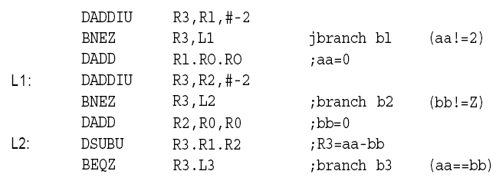
Correlating Predictors
Here is the MIPS code:
Assuming that aa and bb are assigned to registers R1 and R2:
The key observation is that the behavior of branch b3 is correlated with the behavior of branches b1 and b2.
A predictor that uses only the behavior of a single branch to predict the outcome of that branch can never capture this behavior.

Slide 120
Correlated Branch Prediction
Idea: record m most recently executed branches as taken or not taken, and use that pattern to select the proper n-bit branch history table
In general, (m,n) predictor means record last m branches to select between 2^{m} history tables, each with n-bit counters
Thus, old 2-bit BHT is a (0,2) predictor
Global Branch History: m-bit shift register keeping T/NT status of last m branches.
Each entry in table has m n-bit predictors.

Slide 121
Correlating Branches
Branch address
(2,2) predictor
– Behavior of recent branches selects between four predictions of next branch, updating just that prediction
4
2-bits per branch predictor
Prediction
2-bit global branch history

Slide 122
Accuracy of Different Schemes
20%
4096 Entries 2-bit BHT
Unlimited Entries 2-bit BHT
1024 Entries (2,2) BHT
18%
16%
14%
12%
11%
Frequency of Mispredictions
10%
8%
6%
6%
6%
6%
5%
5%
4%
4%
2%
1%
1%
0%
0%
nasa7
matrix300
tomcatv
doducd
spice
fpppp
gcc
expresso
eqntott
li
4,096 entries: 2-bits per entry
Unlimited entries: 2-bits/entry
1,024 entries (2,2)

Slide 123
Tournament Predictors
Multilevel branch predictor
Use n-bit saturating counter to select between predictors
Usual choice between global and local predictors
Ability to select the right predictor for a particular branch

Slide 124
Tournament Predictors
Example of a tournament predictor using 29K bits and used in Alpha 21264, Pentium 4, and Power 5.
Uses 4K 2-bit counters indexed by local branch address to select between:
Global predictor
4K entries indexed by history of last 12 branches (2¹² ⁼ 4K)
Each entry is a standard 2-bit predictor
Local predictor is a 2-level predictor
Local history table: 1024 10-bit entries recording last 10 branch outcomes, indexed by branch address
The pattern of the last 10 occurrences of that particular branch used to index table of 1K entries with 3-bit saturating counters

Slide 125
Example of a Tournament Predictor
Global Branch History Register
Updated on each branch outcome
4K × 2-bit
entries
1K × 10-bit
entries
1K × 3-bit
entries
10
11
00
01
.
.
.
Program Counter
1011100110
0000110000
1010101010
0100000111
.
.
.
101
000
100
011
.
.
.
10 bits
10
10
GBHR = 12 bits
12
2-Level Local Predictor
Global Predictor
4K × 2-bit
entries
Global Prediction
Local Prediction
Program Counter
10
11
00
01
.
.
.
12 bits
12
Select Predictor
Tournament Predictor
Final Prediction

Slide 126
Shift left at every local branch—collecting local history
Only the most significant bit is used→ 0=NT, 1=T
For each NT branch, it is decremented and for each T branch, it is incremented
Keep history of choices between Local or Global Predictor
Shift left
Keeps the history of branch globally

Slide 127
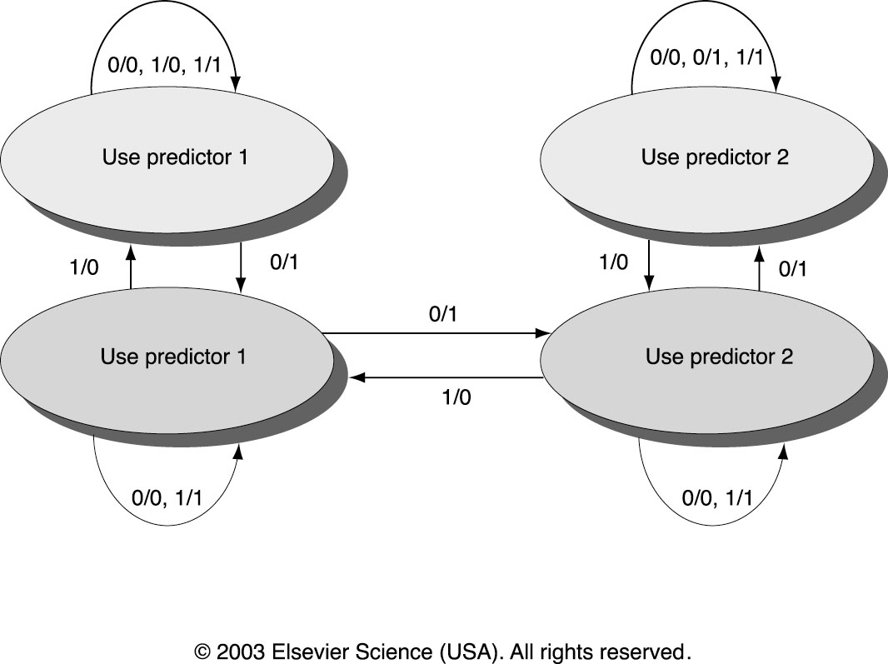
Example of a Tournament Predictor
The value of the saturating counter determines whether to choose the local or global predictor.
How does the choice predictor determine this?
Whenever the local counter is correct and the global counter is incorrect, the choice predictor’s corresponding counter is decremented.
Whenever the local counter is incorrect and the global counter is correct, the choice predictor’s corresponding counter is incremented.
If the counters are both correct, or both incorrect, the choice predictor’s corresponding counter is not changed.

Slide 128
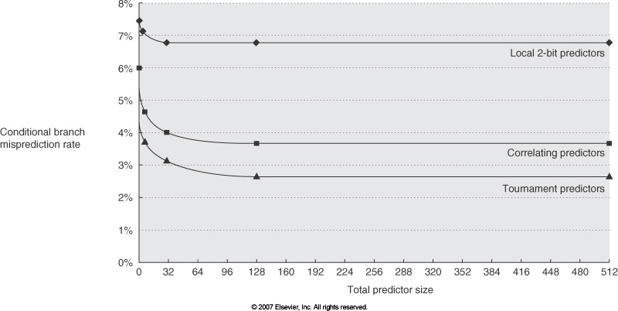
Comparing Predictors
Advantage of tournament predictor is ability to select the right predictor for a particular branch
Particularly crucial for integer benchmarks.
A typical tournament predictor will select the global predictor almost 40% of the time for the SPEC integer benchmarks and less than 15% of the time for the SPEC FP benchmarks

Slide 129
Pentium 4 Misprediction Rate (per 1000 instructions, not per branch)
≈ 6% misprediction rate per branch SPECint (19% of SPECINT instructions are branch)
≈ 2% misprediction rate per branch SPECfp (5% of SPECFP instructions are branch)
SPECint2000
SPECfp2000

Slide 130
Branch Target Buffers (BTB)
Branch target calculation is costly and stalls the instruction fetch.
BTB stores PCs the same way as caches
The PC of a branch is sent to the BTB
When a match is found the corresponding Predicted PC is returned
If the branch was predicted taken, instruction fetch continues at the returned predicted PC

Slide 131
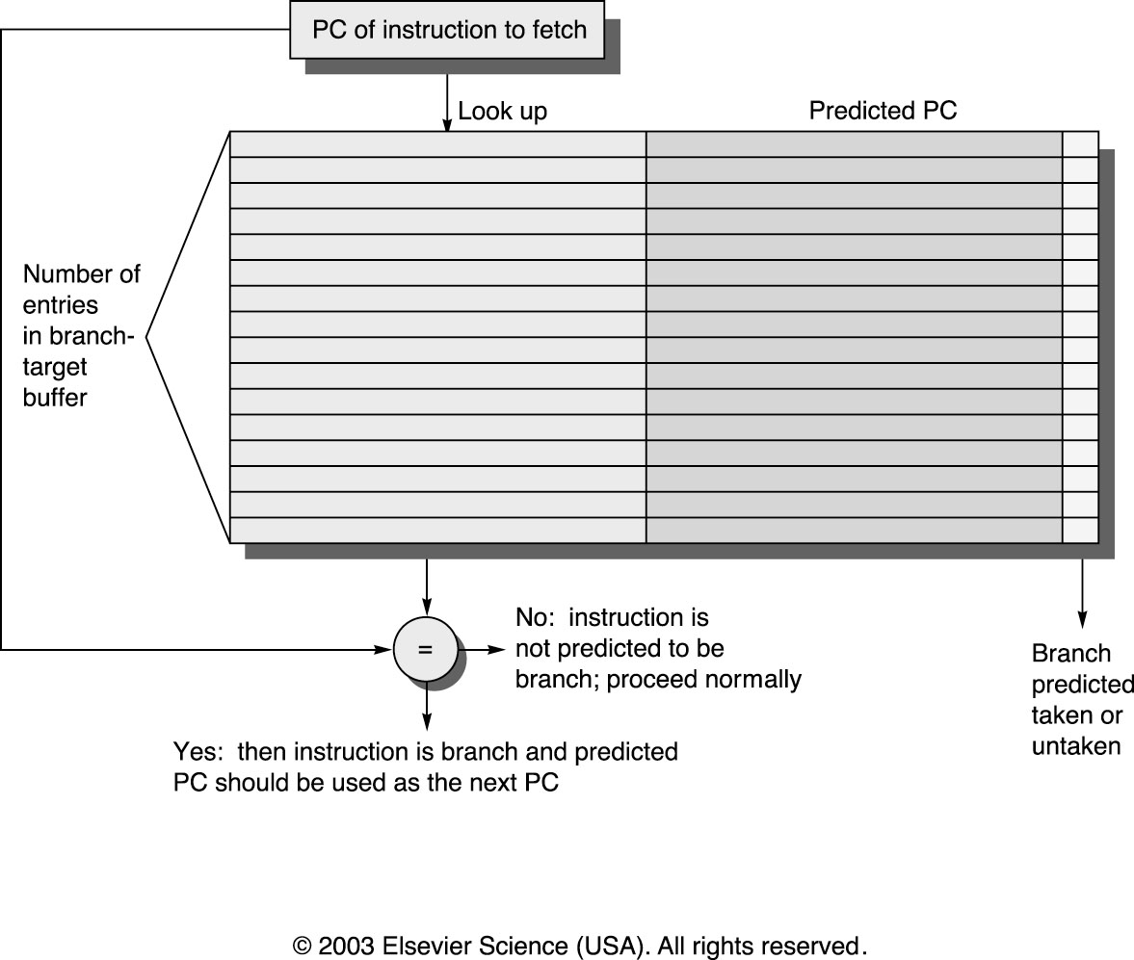
Branch Target Buffers

Slide 132
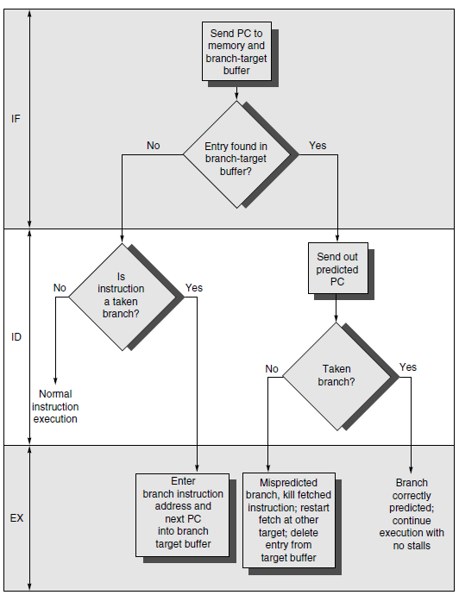
Branch Target Buffers

Slide 133

Branch Target Cache
Similar to BTB, but we also want to get the target instruction!
– Prediction returns not just the target address, but also the instruction stored there
– Allows zero-cycle unconditional branches (branch-folding)
• Send target-instruction to ID rather than branch
• Branch is not even sent into pipe
For conditional branches? Read
Branch Target Cache
Target instructions stored here
Target instruction

Slide 134
Return Address Predictors
Included in many recent processors
– Alpha 21264 => 12 entry RAS (Return Address Stack )
Procedure returns account for ~85% of indirect jumps (jumps whose address varies at run time). It will then return to many different locations—BTB may not predict accurately,
Therefore, small buffer of Return Addresses=cache of the most recent return addresses
• Like a hardware stack, LIFO
– At Procedure Call => Push Return address onto stack
– Procedure Return => Prediction off of top of stack, Pop it
• RAS tends to work quite well since call depths are typically not large

Slide 135
Relationship between precise interrupts and speculation:
Speculation is a form of guessing.
Important for branch prediction:
Need to “take our best shot” at predicting branch direction.
If we issue multiple instructions per cycle, lose lots of potential instructions otherwise:
Consider 4 instructions per cycle
If take single cycle to decide on branch, waste from 4 - 7 instruction slots!
If we speculate and are wrong, need to back up and restart execution to point at which we predicted incorrectly:
This is exactly same as precise exceptions!
Technique for both precise interrupts/exceptions and speculation: in-order completion or commit

Slide 136
Speculation to greater ILP
3 components of HW-based speculation:
Dynamic branch prediction to choose which instructions to execute
Speculation to allow execution of instructions before control dependences are resolved
+ ability to undo effects of incorrectly speculated sequence
Dynamic scheduling to deal with scheduling of different combinations of basic blocks

Slide 137
Getting CPI < 1: Issuing Multiple Instructions/Cycle
Vector Processing: Explicit coding of independent loops as operations on large vectors of numbers
Multimedia instructions being added to many processors
Superscalar: varying no. instructions/cycle (1 to 8), scheduled by compiler or by HW (Tomasulo)
IBM PowerPC, Sun UltraSparc, DEC Alpha, Pentium III/4
(Very) Long Instruction Words (V)LIW: fixed number of instructions (4-16) scheduled by the compiler; put ops into wide templates
Intel Architecture-64 (IA-64) 64-bit address
Renamed: “Explicitly Parallel Instruction Computer (EPIC)”
Anticipated success of multiple instructions lead to Instructions Per Clock cycle (IPC) vs. CPI

Slide 138
Getting CPI < 1: Issuing Multiple Instructions/Cycle
Superscalar MIPS: 2 instructions, 1 FP & 1 anything
– Fetch 64-bits/clock cycle; Int on left, FP on right
– Can only issue 2nd instruction if 1st instruction issues
– More ports for FP registers to do FP load & FP op in a pair
Type Pipe Stages
Int. instruction IF ID EX MEM WB
FP instruction IF ID EX MEM WB
Int. instruction IF ID EX MEM WB
FP instruction IF ID EX MEM WB
Int. instruction IF ID EX MEM WB
FP instruction IF ID EX MEM WB
1 cycle load delay expands to 3 instructions in SS
instruction in right half can’t use it, nor instructions in next slot

Slide 139
Multiple Issue Issues
issue packet: group of instructions from fetch unit that could potentially issue in 1 clock
If instruction causes structural hazard or a data hazard either due to earlier instruction in execution or to earlier instruction in issue packet, then instruction does not issue
0 to N instruction issues per clock cycle, for N-issue
Performing issue checks in 1 cycle could limit clock cycle time:
=> issue stage usually split and pipelined
1st stage decides how many instructions from within this packet can issue, 2nd stage examines hazards among selected instructions and those already been issued
=> higher branch penalties => prediction accuracy important

Slide 140
Multiple Issue Challenges
While Integer/FP split is simple for the HW, get CPI of 0.5 only for programs with:
Exactly 50% FP operations AND No hazards
If more instructions issue at same time, greater difficulty of decode and issue:
Even 2-scalar => examine 2 opcodes, 6 register specifiers, & decide if 1 or 2 instructions can issue
Register file: need 2x reads and 1x writes/cycle
Rename logic: must be able to rename same register multiple times in one cycle! For instance, consider 4-way issue:
add r1, r2, r3 add p11, p4, p7 sub r4, r1, r2 ⇒ sub p22, p11, p4 lw r1, 4(r4) lw p23, 4(p22) add r5, r1, r2 add p12, p23, p4
Imagine doing this transformation in a single cycle!
Result buses: Need to complete multiple instructions/cycle
So, need multiple buses with associated matching logic at every reservation station.
Or, need multiple forwarding paths

Slide 141
Superscalar Dynamic Scheduling
The Tomasulo dynamic scheduling algorithm is extended to issue more than one instruction per cycle.
However the restriction that instructions must issue in program order still holds to avoid violating instruction dependencies (construct correct dependency graph dynamically).
The result of issuing multiple instructions in one cycle should be the same as if they were single-issued, one instruction per cycle.
How to issue two instructions and keep in-order instruction issue for Tomasulo?
Simplest Method: Restrict Type of Instructions Issued Per Cycle
To simplify the issue logic, issue one one integer + one floating-point instruction per cycle (for a 2-way superscalar).
1 Tomasulo control for integer, 1 for floating point.
FP loads/stores might cause a dependency between integer and FP issue:
Replace load reservation stations with a load queue; operands must be read in the order they are fetched (program order).
Replace store reservation stations with a store queue; operands must be written in the order they are fetched.
Load checks addresses in Store Queue to avoid RAW violation
(get load value from store queue if memory address matches)
Store checks addresses in Load Queue to avoid WAR, and checks Store Queue to avoid WAW.

Slide 142
Superscalar Dynamic Scheduling
Three techniques can be used to support multiple instruction issue in Tomasulo
without putting restrictions on the type of instructions issued per cycle:
Issue at a higher clock rate so that issue remains in order.
For example for a 2-Issue supercalar issue at 2X Clock Rate.
Widen the issue logic to handle multiple instruction issue
All possible dependencies between instructions to be issues are detected at once and the result of the multiple issue matches in-order issue
Issue
First
Instruction
Issue
Second
Instruction
One Cycle
2-Issue superscalar
Check
Instruction
Dependencies
Issue
Both
Instructions
0, 1 or 2 instructions issued per cycle
for either method
Why?
One Cycle
For correct dynamic construction of dependency graph:
The result of issuing multiple instructions in one cycle should
be the same as if they were single-issued, one instruction per cycle.

Slide 143
Superscalar Dynamic Scheduling
To avoid increasing the CPU clock cycle time in the last two approaches, multiple instruction issue can be spilt into two pipelined issue stages:
Issue Stage One: Decide how many instructions can issue simultaneously checking dependencies within the group of instructions to be issued + available RSs, ignoring instructions already issued.
Issue Stage Two: Examine dependencies among the selected instructions from the group and the those already issued.
This approach is usually used in dynamically-scheduled wide superscalars that can issue four or more instructions per cycle.
Splitting the issue into two pipelined staged increases the CPU pipeline depth and increases branch penalties
This increases the importance of accurate dynamic branch prediction methods.
Further pipelining of issue stages beyond two stages may be necessary as CPU clock rates are increased.
The dynamic scheduling/issue control logic for superscalars is generally very complex growing at least quadratically with issue width.
e.g 4 wide superscalar -> 4x4 = 16 times complexity of single issue CPU

Slide 144
Superscalar Dynamic Scheduling with Dual-issue
Notes:
Assume that there are separate integer functional units for effective address
calculation, for ALU operations, and for branch condition evaluation.
Create a table as in Figure 3.27 for the first three iterations of this loop for
both machines. Assume that up to two instructions of any type can commit
per clock.
The time of issue, execution, and writing result for a dual-issue version of our pipeline without speculation.
Note that the L.D following the BNE cannot start execution earlier, because it must wait until the branch outcome
is determined. This type of program with data dependent branches that cannot be resolved earlier, shows the strength of
speculation. Separate functional units for address calculation, ALU operations, and branch condition evaluation allow multiple
instructions to execute in the same cycle.

Slide 145
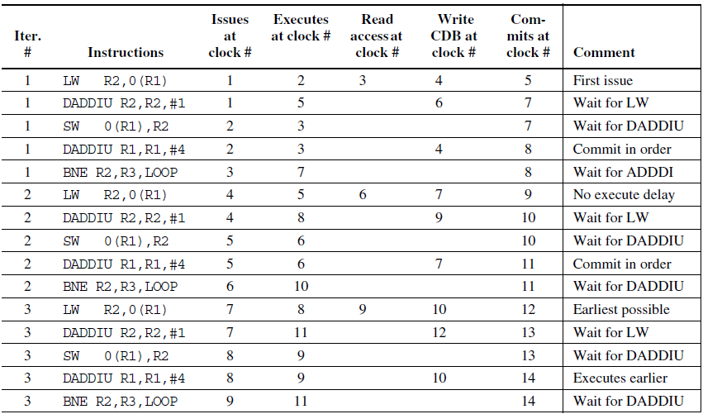
Superscalar Dynamic Scheduling with Dual-issue and speculation
Notes:
The time of issue, execution, and writing result for a dual-issue version of our pipeline with speculation.
Note that the L.D following the BNE can start execution early, because it is speculative.

Slide 146
Limits to ILP
Conflicting studies of amount
Benchmarks (vectorized Fortran FP vs. integer C programs)
Hardware sophistication
Compiler sophistication
How much ILP is available using existing mechanisms with increasing HW budgets?
Do we need to invent new HW/SW mechanisms to keep on processor performance curve?
Intel MMX, SSE (Streaming SIMD Extensions): 64 bit ints
Intel SSE2: 128 bit, including 2 64-bit Fl. Pt. per clock
Motorola AltaVec: 128 bit ints and FPs
Supersparc Multimedia ops, etc.

Slide 147
Limits to ILP
Initial HW Model here; MIPS compilers.
Assumptions for ideal/perfect machine to start:
1. Register renaming – infinite virtual registers => all register WAW & WAR hazards are avoided
2. Branch prediction – perfect; no mispredictions
3. Jump prediction – all jumps perfectly predicted 2 & 3 => machine with perfect speculation & an unbounded buffer of instructions available
4. Memory-address alias analysis – addresses are known & a store can be moved before a load provided addresses not equal
Also: unlimited number of instructions issued/clock cycle; perfect caches; 1 cycle latency for all instructions (FP *,/);

