Slide 1
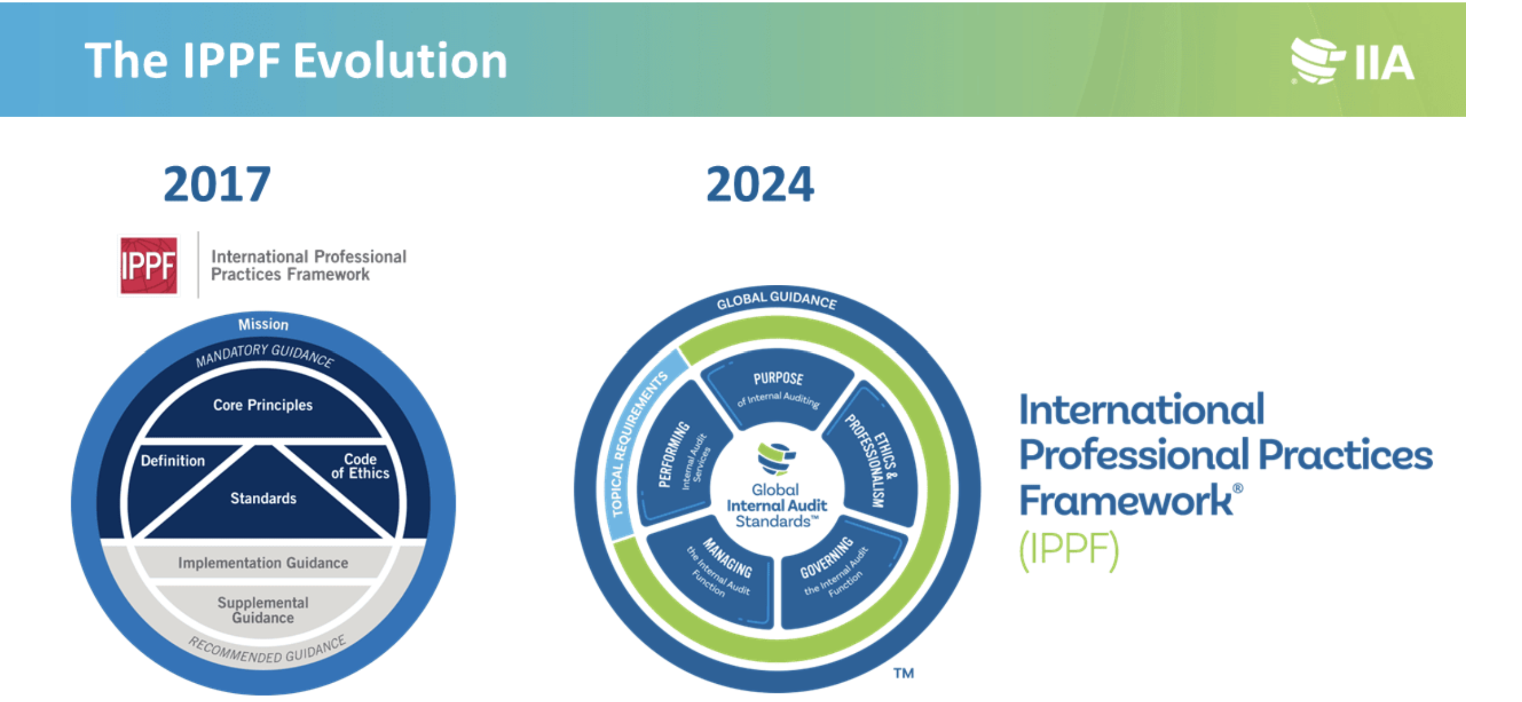

Slide 2
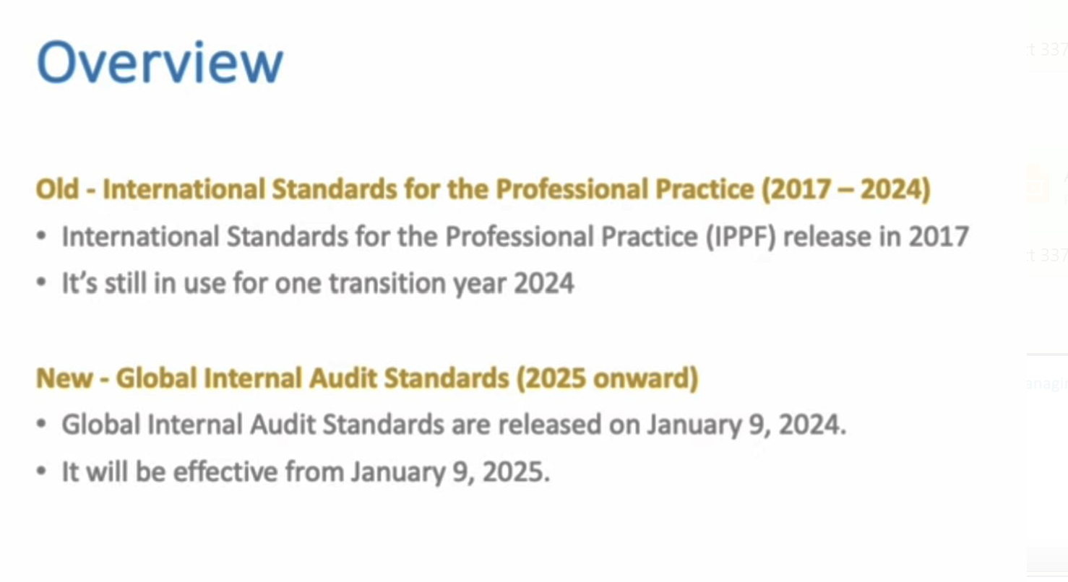

Slide 3
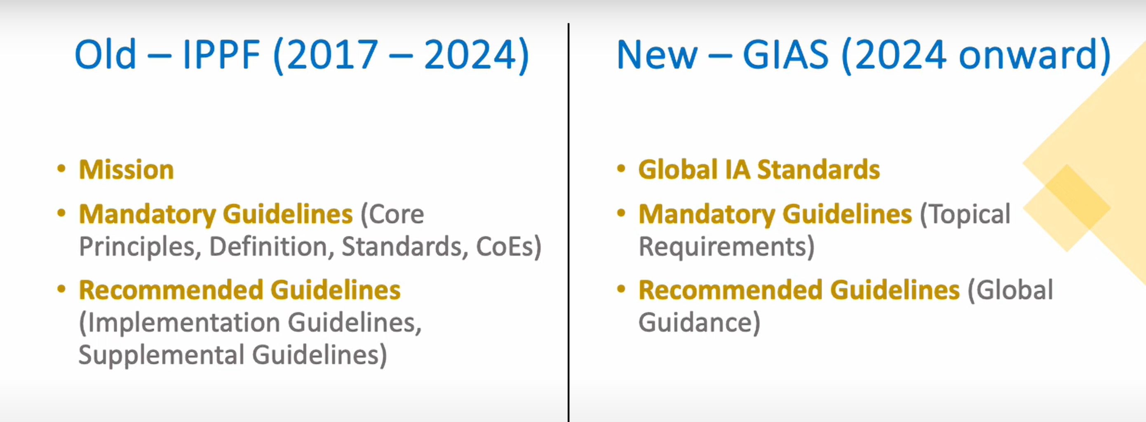
IPPF 2017 vs. IPPF 2024

Slide 4
What Happened To The Content Of The 2017 IPPF?
The 2024 Global Internal Audit Standards incorporate all the mandatory elements of the 2017 IPPF, including the Definition of Internal Auditing, Mission of Internal Audit, Code of Ethics, Core Principles for the Professional Practice of Internal Auditing.
Additionally, the recommended guidance contained in the 2017 Implementation Guides also has been incorporated into the 2024 Standards as considerations for implementation and examples of evidence of conformance. These elements are no longer considered separate elements of the framework.

Slide 5
Key Changes to the IPPF
The International Professional Practices Framework (IPPF) has undergone significant revisions between its 2017 and 2024 editions to enhance the effectiveness and clarity of internal auditing standards. The key changes are as follows:
1. Introduction of the Global Internal Audit Standards
Unified Framework: The 2024 IPPF consolidates previously separate elements—such as the Mission of Internal Audit, Definition of Internal Auditing, Core Principles, Code of Ethics, and Standards—into a single, cohesive document known as the Global Internal Audit Standards.
2. Structural Reorganization
Five Domains: The new Standards are organized into five domains:
  Purpose of Internal Auditing
  Ethics and Professionalism
  Governing the Internal Audit Function
  Managing the Internal Audit Function
  Performing Internal Audit Services
This structure aims to provide a more logical and user-friendly framework for internal auditors.
3. Enhanced Focus on Governance and Management
Clarified Roles: The 2024 Standards delineate the responsibilities of the board and senior management in supporting an effective internal audit function, emphasizing the importance of governance structures and mutual expectations.

Slide 6
Key Changes to the IPPF (continued)
4. Quality Assurance and Improvement Program (QAIP) Enhancements
Certified Reviewers: The updated Standards require that at least one reviewer in an external quality assessment be a Certified Internal Auditor, ensuring a higher level of expertise in evaluations.
5. Integration of Implementation Guidance
Embedded Guidance: Previously separate Implementation Guides are now incorporated within the Standards, providing practical considerations and examples directly alongside the requirements, facilitating easier application.
6. Introduction of Topical Requirements
Specific Risk Areas: The 2024 IPPF introduces Topical Requirements as a mandatory component, addressing specific risk areas such as cybersecurity and sustainability, to enhance the consistency and quality of internal audit services in these domains.
7. Emphasis on Public Interest and Stakeholder Communication
Purpose of Internal Auditing: The new Standards underscore the role of internal auditing in serving the public interest and provide clearer communication to stakeholders and regulators about the profession's value.
These revisions reflect a comprehensive effort to modernize the IPPF, making it more adaptable to current and emerging challenges in the internal audit profession.

Slide 7
IPPF 2024-Overview
To make the Standards clearer and easier to use, the new, wide-ranging structure adds two bold innovations.
First, mandatory elements and implementation guidance now reside under a single roof.
Second, the Standards are organized into five domains that begin with the Purpose of Internal Auditing and end with detailed descriptions of how internal audit services must be delivered.
The new structure reemphasizes that the Standards are based on principles. If one can imagine the five domains of the Standards as a set of building blocks, the governing principle of all principles can be found in the Purpose of Internal Auditing. From there everything else flows.
In addition, each domain — except the purpose statement — has a hierarchical structure: principles at the top, followed by the required standards and implementation practices, and, finally, examples of how conformance can be achieved. Internal auditors can now visualize how the different domains relate to each other and find what they need within the Standards much more easily.

Slide 8
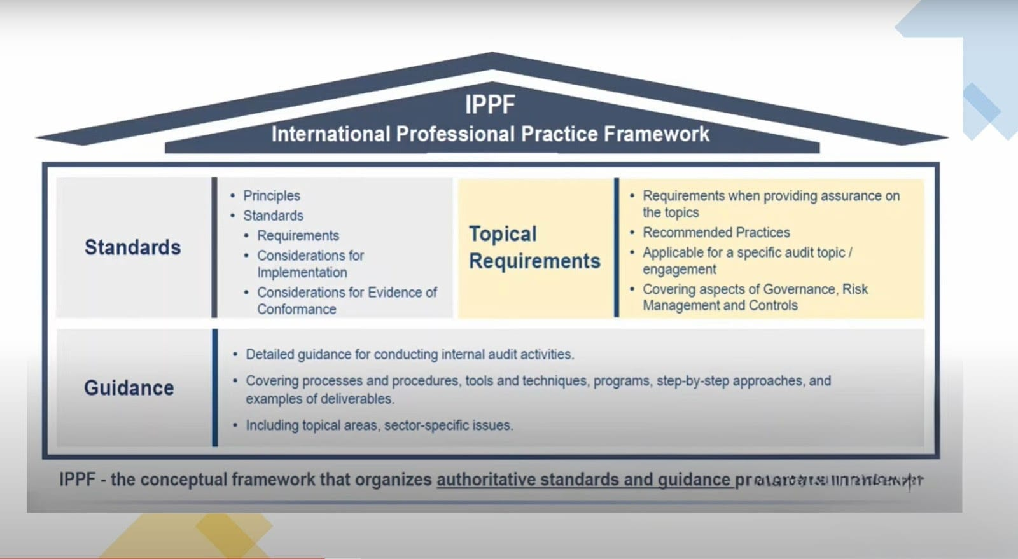

Slide 9
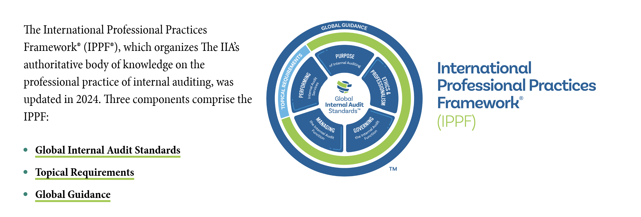
IPPF 2024- Components

Slide 10
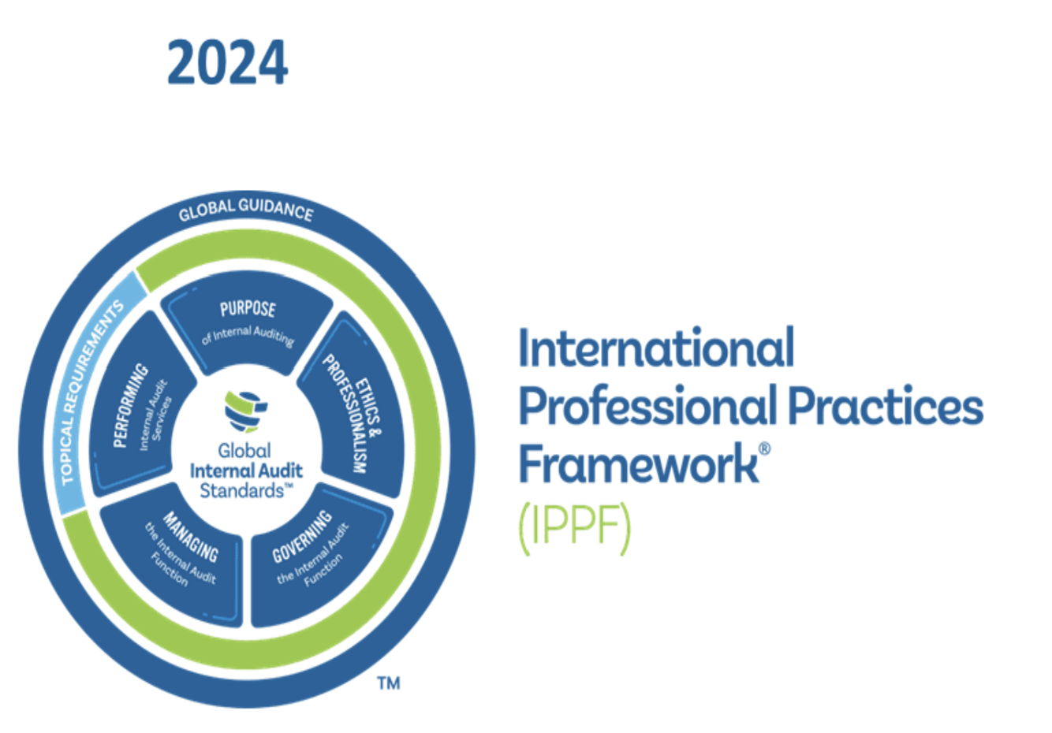
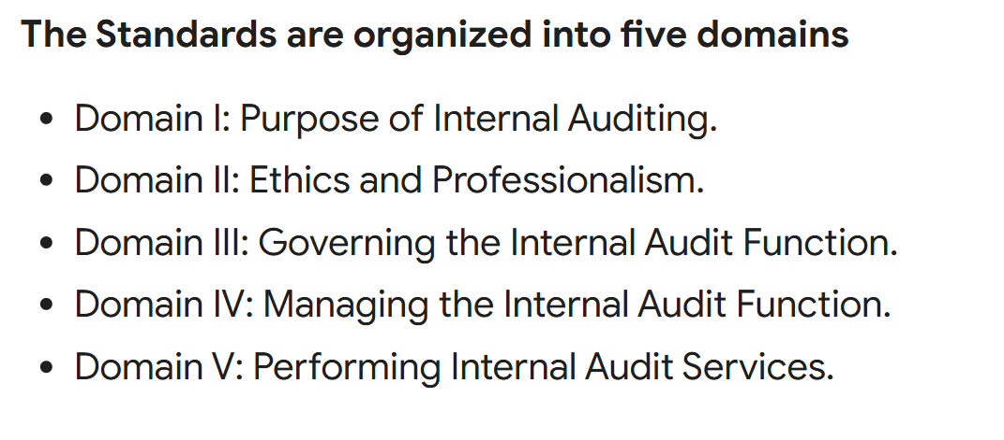
5 Domains of Global IA Standards
The Global Internal Audit Standards are organized into 5 Domains, which consists of 15 Principles and 52 Standards.

Slide 11
Domain I: Purpose of Internal Auditing
The new Standards do much more than simply reorganize existing material. Domain I prominently heralds internal auditing’s value. To that end, the Purpose of Internal Auditing now says:
  “Internal auditing strengthens the organization’s ability to create, protect, and sustain value by providing the board and management with independent, risk-based, and objective assurance, advice, insight, and foresight.”
Internal audit accomplishes this by enhancing the organization’s:
  Ability to successfully achieve its objectives.
  Governance, risk management, and control processes.
  Decision-making and oversight processes.
  Reputation and credibility with its stakeholders.
  Ability to serve the public interest.

Slide 12
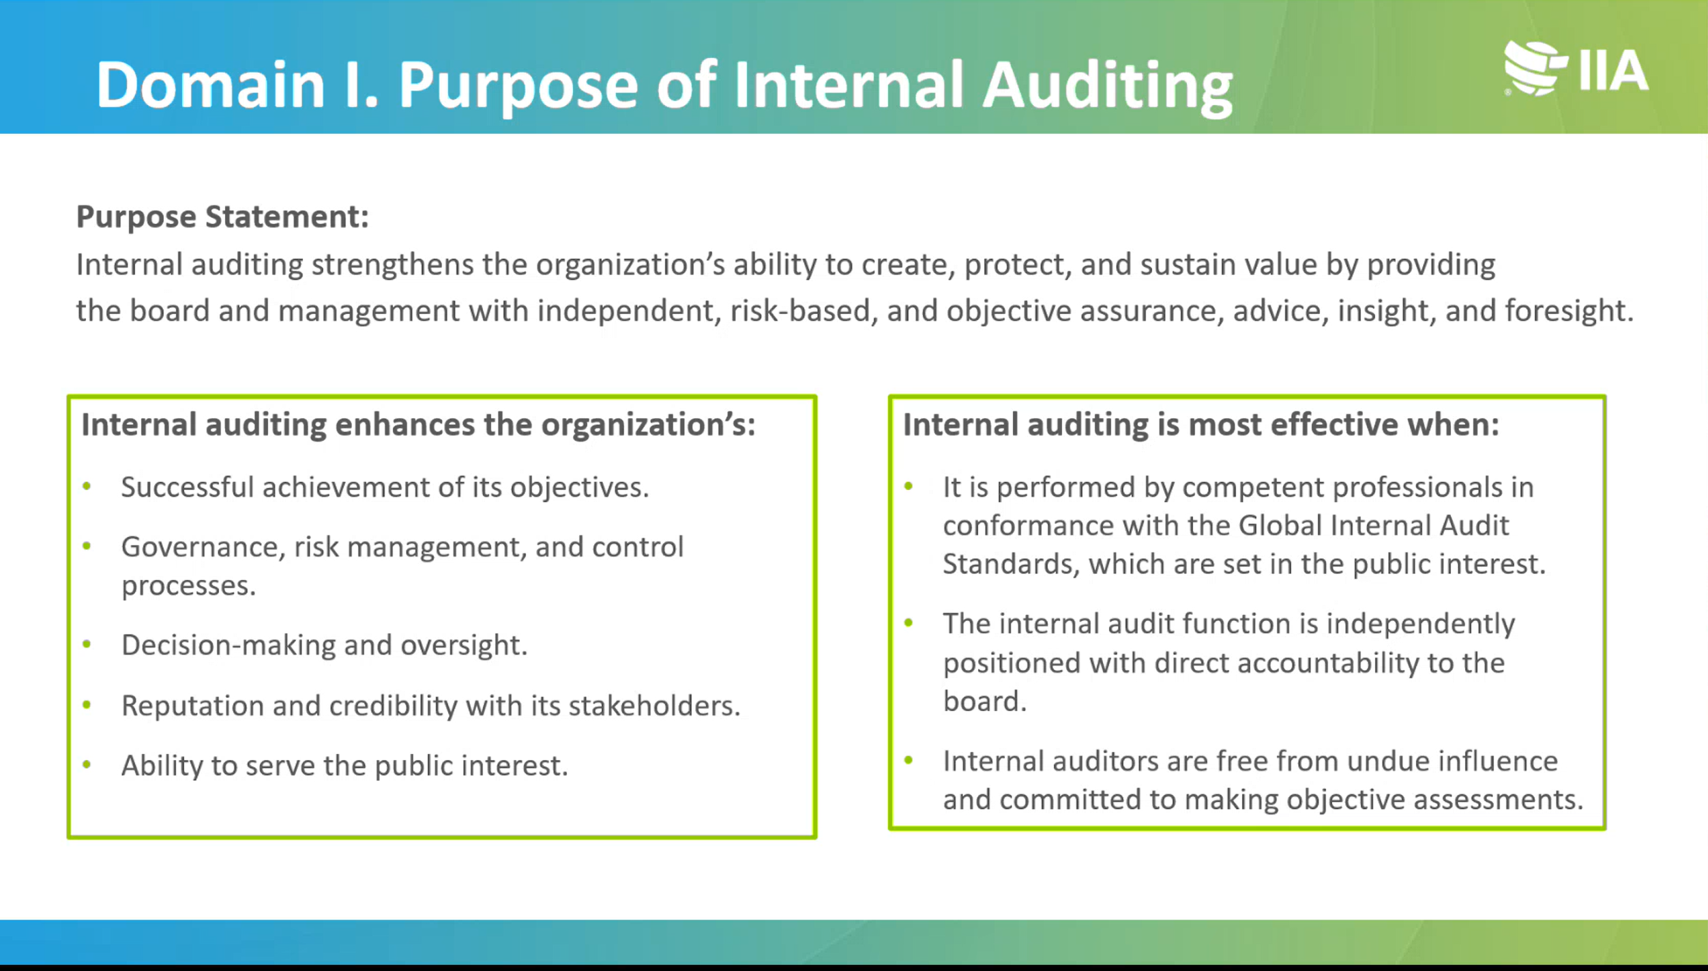

Slide 13
Domain II: Ethics and Professionalism
The second set of principles are contained in Domain II.
This domain encompasses both the existing Code of Ethics, some principles from the 2017 Standards, and what were previously referred to as attribute standards — namely those concerned with objectivity, competency, confidentiality, and due professional care.
The 13 standards in this domain are organized under five principles: demonstrate integrity, maintain objectivity, demonstrate competency, exercise due professional care, and maintain confidentiality.

Slide 14
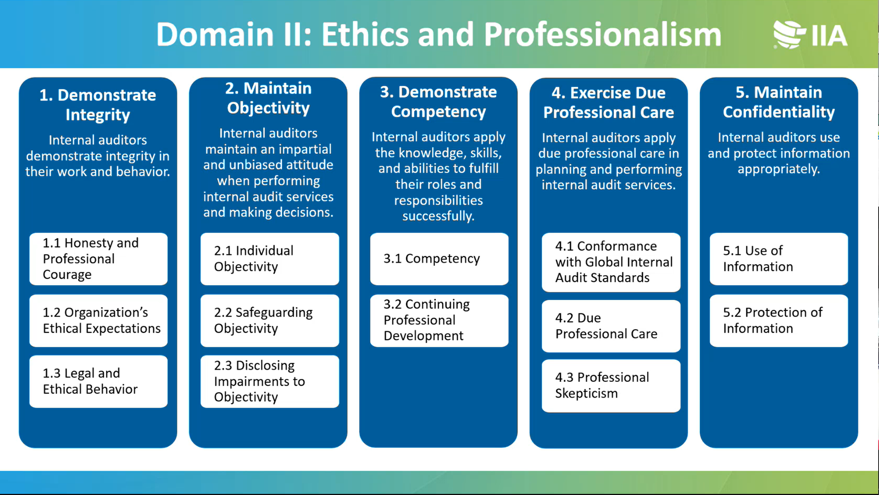

Slide 15
Domain III: Governing the Internal Audit Function
Domain III comprises three core principles: how the board authorizes the internal audit function, the function’s organizational independence, and internal audit oversight (see “Domain III: Strengthening Governance”). In many ways, Domain III has required a particularly careful balancing act. Strictly speaking, CAEs are not responsible for the governance structure of the organizations in which they serve — that is the board’s job.

Slide 16
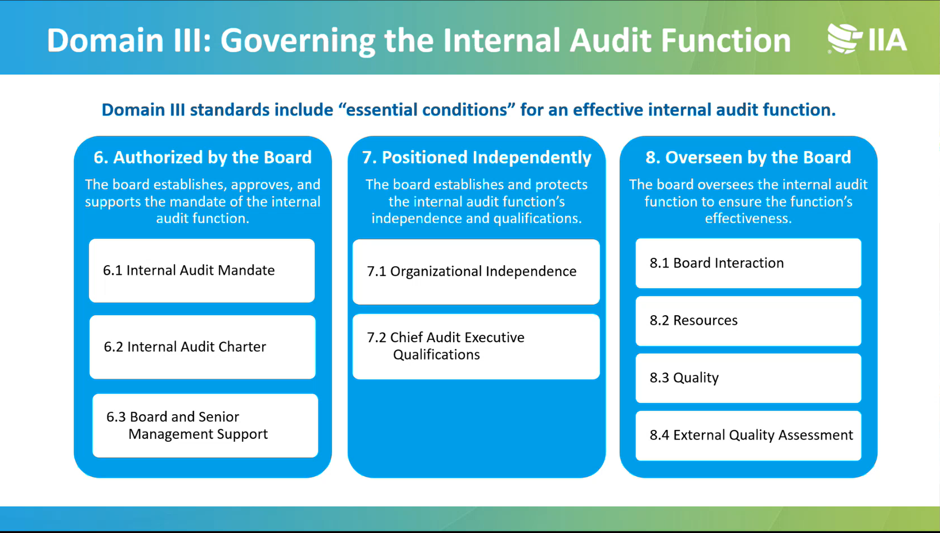

Slide 17
Domain IV: Managing the Internal Audit Function
The first of two domains focusing on internal audit activities, Domain IV, Managing the Internal Audit Function, focuses on the CAE’s responsibilities and has four principles: planning strategically, managing resources, communicating effectively, and enhancing quality. The need to plan strategically is a new requirement to ensure the internal audit function delivers on its purpose to help the organization achieve its objectives.

Slide 18
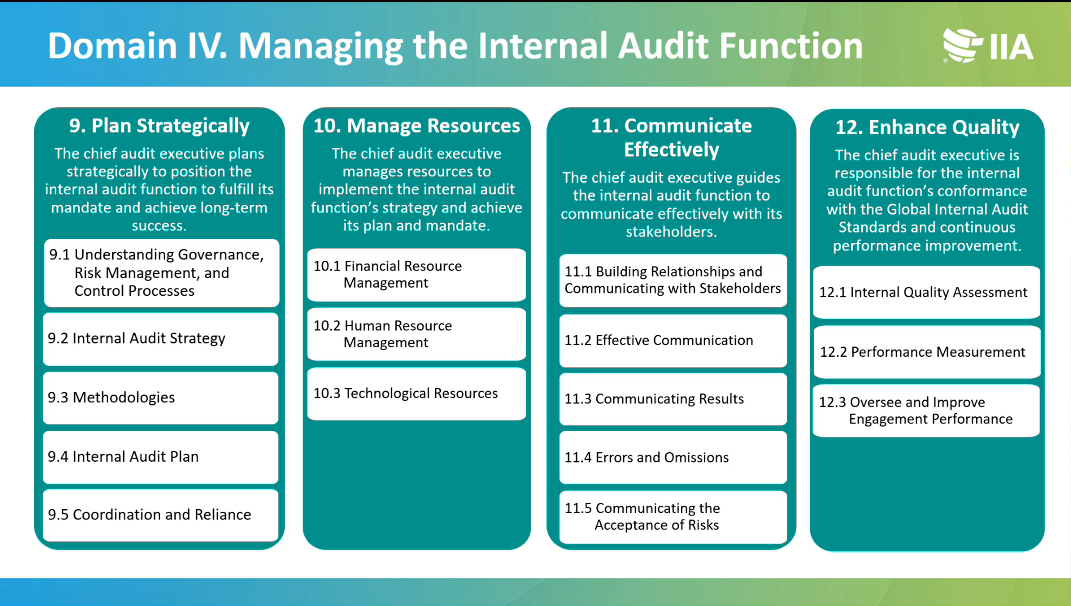

Slide 19
Domain V: Performing Internal Audit Services
Over the past few years, organizations have increasingly tasked CAEs with conducting advisory engagements to rapidly assess fast-moving threats.
The COVID-19 pandemic accelerated this trend, and levels of geopolitical uncertainty mean that such services are in high demand.
The domain ensures practitioners understand they must conform with the Standards when providing assurance audits and advisory engagements.
Unless a standard explicitly says you do not have to follow it during an advisory engagement, then internal auditors should assume they must follow the standard in full.

Slide 20
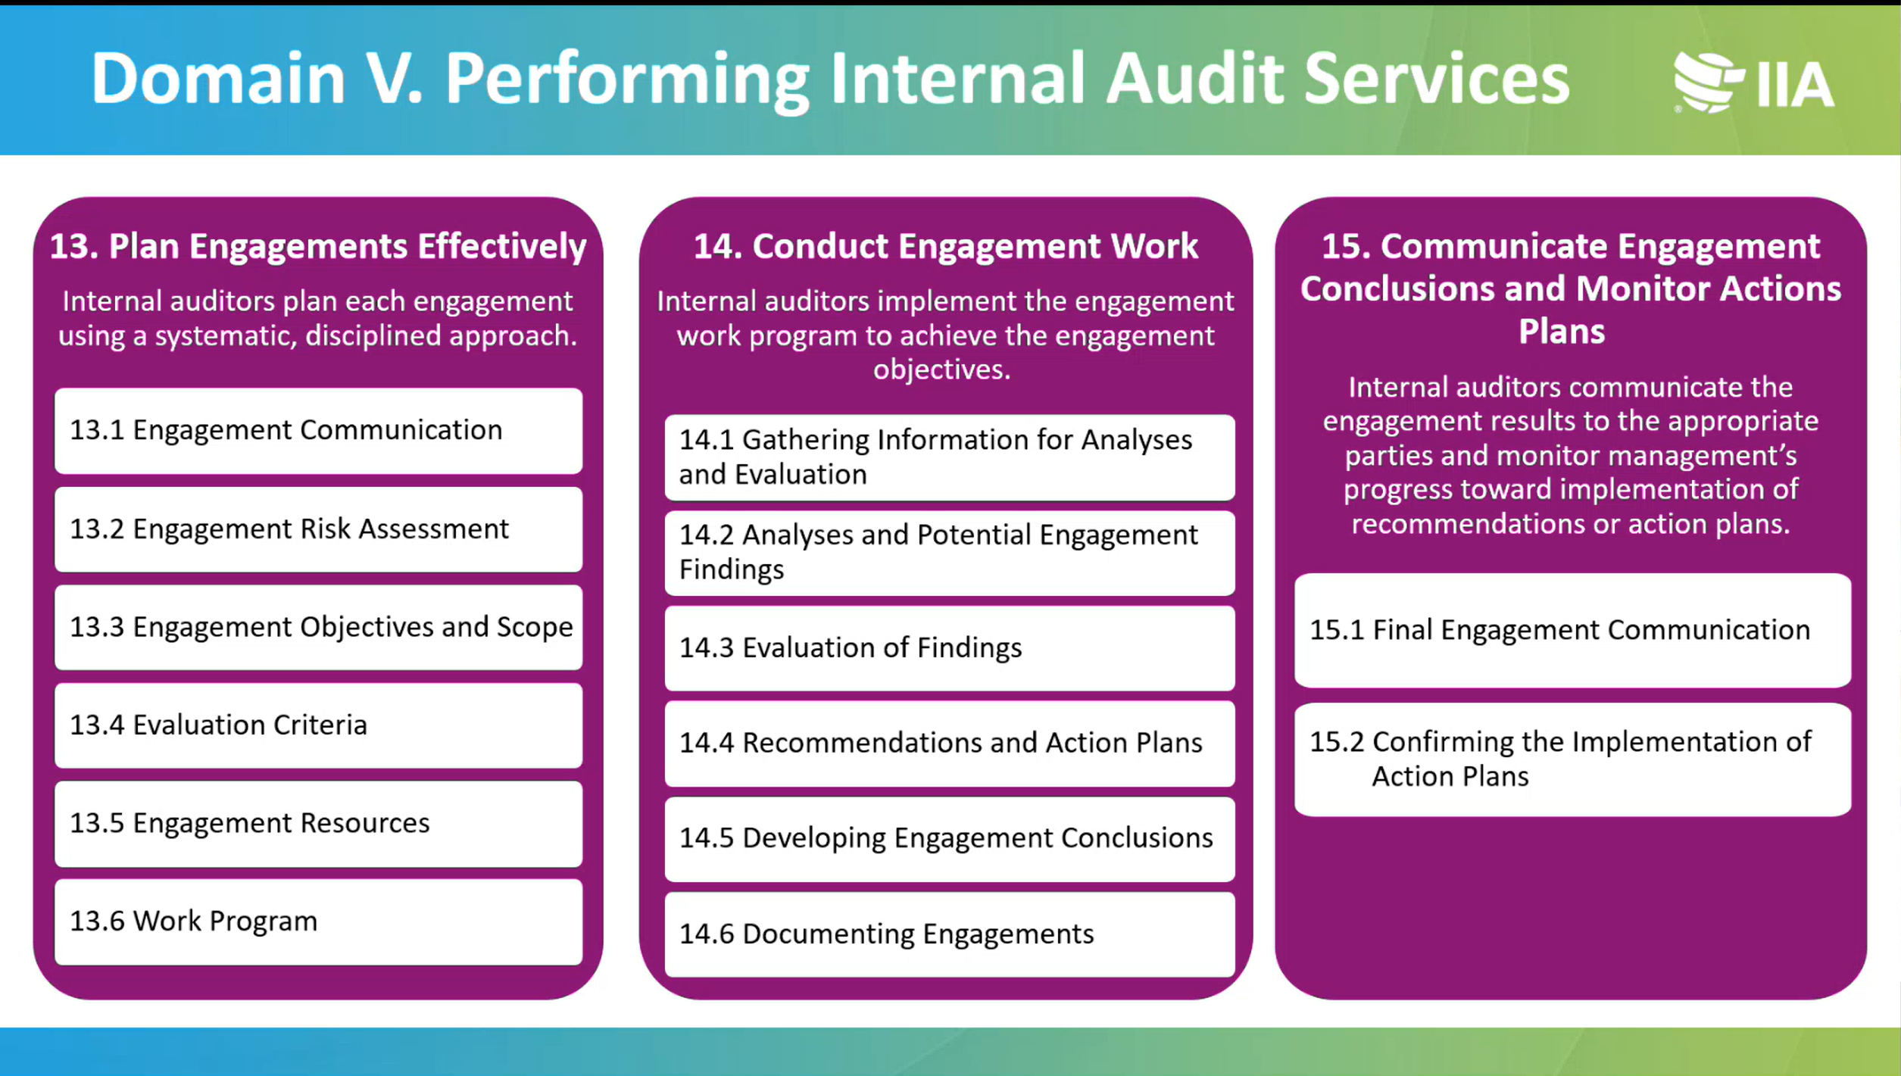

Slide 21
Implementing the Global Internal Audit Standards
The Global Internal Audit StandardsTM, released January 9, 2024, will become effective January 9, 2025.
Internal audit functions should start adopting the Standards now.
The Standards guide the worldwide professional practice of internal auditing and serve as a basis for evaluating and elevating the quality of the internal audit function.
At the heart of the Standards are 15 guiding principles that enable effective internal auditing.
The Standards are set according to a due process followed by the International Internal Audit Standards Board and overseen by the IPPF Oversight Council.

Slide 22
